Slide 1

Bale/Doneen Live
Scientific Update Session
Amy Doneen DNP, ARNP
January 16, 2019
5:30-6:30 pm PST

Slide 2
Outline for tonight –
Statistics: 1. Strokes on the rise
Red Flags: 2. Women increased parity = Increased CV risk
3. BMI above normal = increased CV risk
Disease: 4. CACS and Cancer risk?
Fire: 5. Inflammation – reducing CV risk
Roots: 6. Oral Care reduces CV risk
7. OSA and BP in Blacks
Optimal: 8. Serial Measurements of Galectin-3
Treatment: 9. C0-Q10 and statin myopathy
10. PCSK9 and Inflammation (PET)
11. Statin and Inflammation (PET)
12. DAPT and CVA/TIA

Slide 3



Slide 4
Global, Regional, and Country-Specific
Lifetime Risks of Stroke, 1990 and 2016
The global lifetime risk of stroke is approximately 25% starting at the age of 25 years among both men and women.
There is large geographic variation, with a particularly high lifetime risk of stroke in
East Asia, Central Europe, and Eastern Europe.
The estimated global lifetime risk of stroke from the
age of 25 years onward was 24.9%.
Feigin, V., Nguyen, G., Cercy, K., et al. (2018). Global, regional, and country-specific lifestime risks of stroke, 1990 and 2016. N Engl J Med 379;25, 2429-2437

Slide 5
Global, Regional, and Country-Specific
Lifetime Risks of Stroke, 1990 and 2016
Risk among men was 24.7% (95%, 23.3 to 26.0)
Risk among women was 25.1% (95%, 23.7 to 26.5)
The highest estimated lifetime risks of stroke was in:
East Asia (38.8%)
Central Europe (31.7%)
Eastern Europe (31.6%)
The lowest risk was in eastern sub-Saharan Africa (11.8%).
The mean global lifetime risk of stroke increased by 9% from
22.8% in 1990 to 24.9% in 2016
Feigin, V., Nguyen, G., Cercy, K., et al. (2018). Global, regional, and country-specific lifestime risks of stroke, 1990 and 2016. N Engl J Med 379;25, 2429-2437

Slide 6
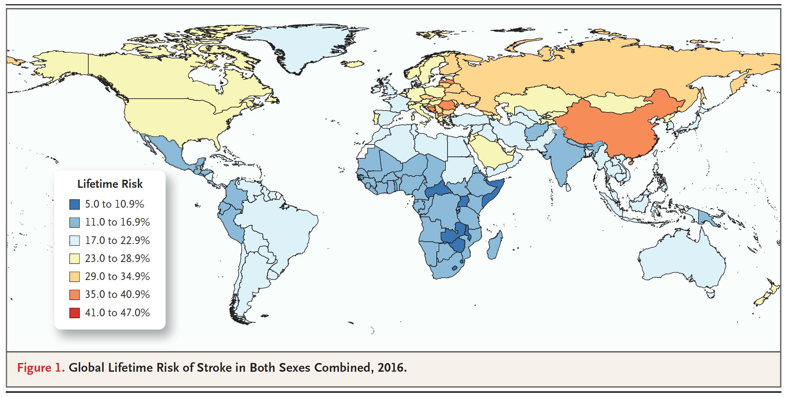
Global, Regional, and Country-Specific
Lifetime Risks of Stroke, 1990 and 2016
There was geographic variation in the lifetime risk of stroke, with the highest risks in East Asia, Central Europe, and Eastern Europe.
Feigin, V., Nguyen, G., Cercy, K., et al. (2018). Global, regional, and country-specific lifestime risks of stroke, 1990 and 2016. N Engl J Med 379;25, 2429-2437

Slide 7
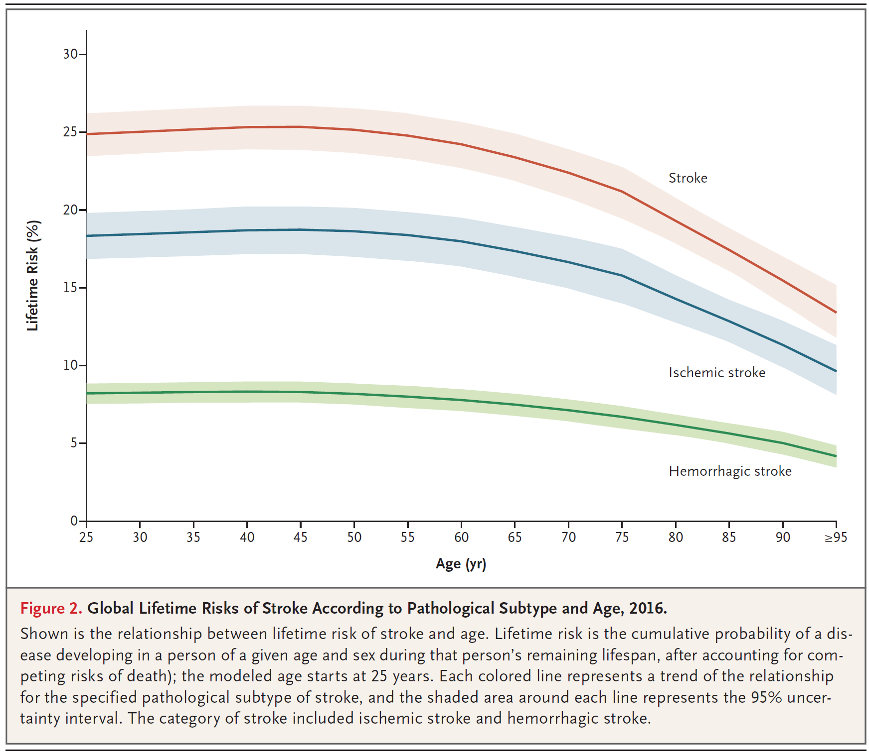
Global, Regional, and Country-Specific
Lifetime Risks of Stroke, 1990 and 2016
The mean global lifetime risk of stroke increased from 22.8% in 1990 to 24.9% in 2016, a relative increase of 8.9%.
Feigin, V., Nguyen, G., Cercy, K., et al. (2018). Global, regional, and country-specific lifestime risks of stroke, 1990 and 2016. N Engl J Med 379;25, 2429-2437

Slide 8
Global, Regional, and Country-Specific
Lifetime Risks of Stroke, 1990 and 2016
BaleDoneen Take-Away:
We are treating a global disease – atherosclerosis.
We have a 25% chance of having a stroke in our lifetime.
Stroke remains the leading cause of disability.
Perhaps could say – We have a 25% chance of becoming disabled.
The most developed countries have the highest risk??
We are talking about ATHEROSCLEROSIS – OUR SPECIALTY!
Remember – we must get patients EDFROG’d globally!
Ischemic stroke are preventable with a precision-based/inflammatory approach to health – ie: The BDM.
Feigin, V., Nguyen, G., Cercy, K., et al. (2018). Global, regional, and country-specific lifestime risks of stroke, 1990 and 2016. N Engl J Med 379;25, 2429-2437

Slide 9


Slide 10


Parity and CV risk

Slide 11
Parity and CV risk
First – a few definitions to clarify:
Gravidity - the number of times a female has been pregnant, regardless of parity.
Parity – the number of pregnancies that have been carried to a viable gestational age.

Slide 12
Parity related to increased risk of maternal CVD compared to nulliparity
Ten cohort studies involving 150,512 incident cases of cardiovascular disease among 3,089,929 participants were included in the meta-analysis.
A significant association between parity and cardiovascular disease risk was observed while comparing parity with nulliparity:
RR 1.14 (95% CI) 1.09–1.18; p=0.002)
Findings suggest that ever parity is related to cardiovascular disease risk and there is an association between the number of pregnancies and the risk of cardiovascular disease.
Wenzhen Li, Ruan, Wenya, Zuzun, Lu, et al. Jan 11, 2019. Parity and risk of maternal cardiovascular disease: A dose-response meta-analysis of cohort studies. European Journal of Preventive Cardiology 0(00)

Slide 13
Parity related to increased risk of maternal CVD compared to nulliparity
Previous data showing parity increased woman’s risk of: hip fracture, increased type 2 DM, Increased CVD and age of parity all increase progression of CVD
1. Ness RB, Schotland HM, Flegal KM, et al. Reproductive history and coronary heart disease risk in women. Epidemiol Rev 1994; 16: 298–314.
2. He J, Gu D, Wu X, et al. Major causes of death among men and women in China. N Engl J Med 2005; 353: 1124–1134.
3. Robbins CL, Hutchings Y, Dietz PM, et al. History of preterm birth and subsequent cardiovascular disease: a systematic review. Am J Obstet Gynecol 2014; 210: 285–297.
4. Rosendaal NTA and Pirkle CM. Age at first birth and risk of later-life cardiovascular disease: a systematic review of the literature, its limitation, and recommendations for future research. BMC Public Health 2017; 17: 627.
5. Sanghavi M and Rutherford JD. Cardiovascular physiology of pregnancy. Circulation 2014; 130: 1003–1008.
6. Fisher C, MacLean M, Morecroft I, et al. Is the pregnancy hormone relaxin also a vasodilator peptide secreted by the heart? Circulation 2002; 106: 292–295.
7. Glisic M, Shahzad S, Tsoli S, et al. Association between progestin-only contraceptive use and cardiometabolic outcomes: a systematic review and meta-analysis. Eur J Prev Cardiol 2018; 25: 1042–1052.
Wenzhen Li, Ruan, Wenya, Zuzun, Lu, et al. Jan 11, 2019. Parity and risk of maternal cardiovascular disease: A dose-response meta-analysis of cohort studies. European Journal of Preventive Cardiology 0(00)

Slide 14
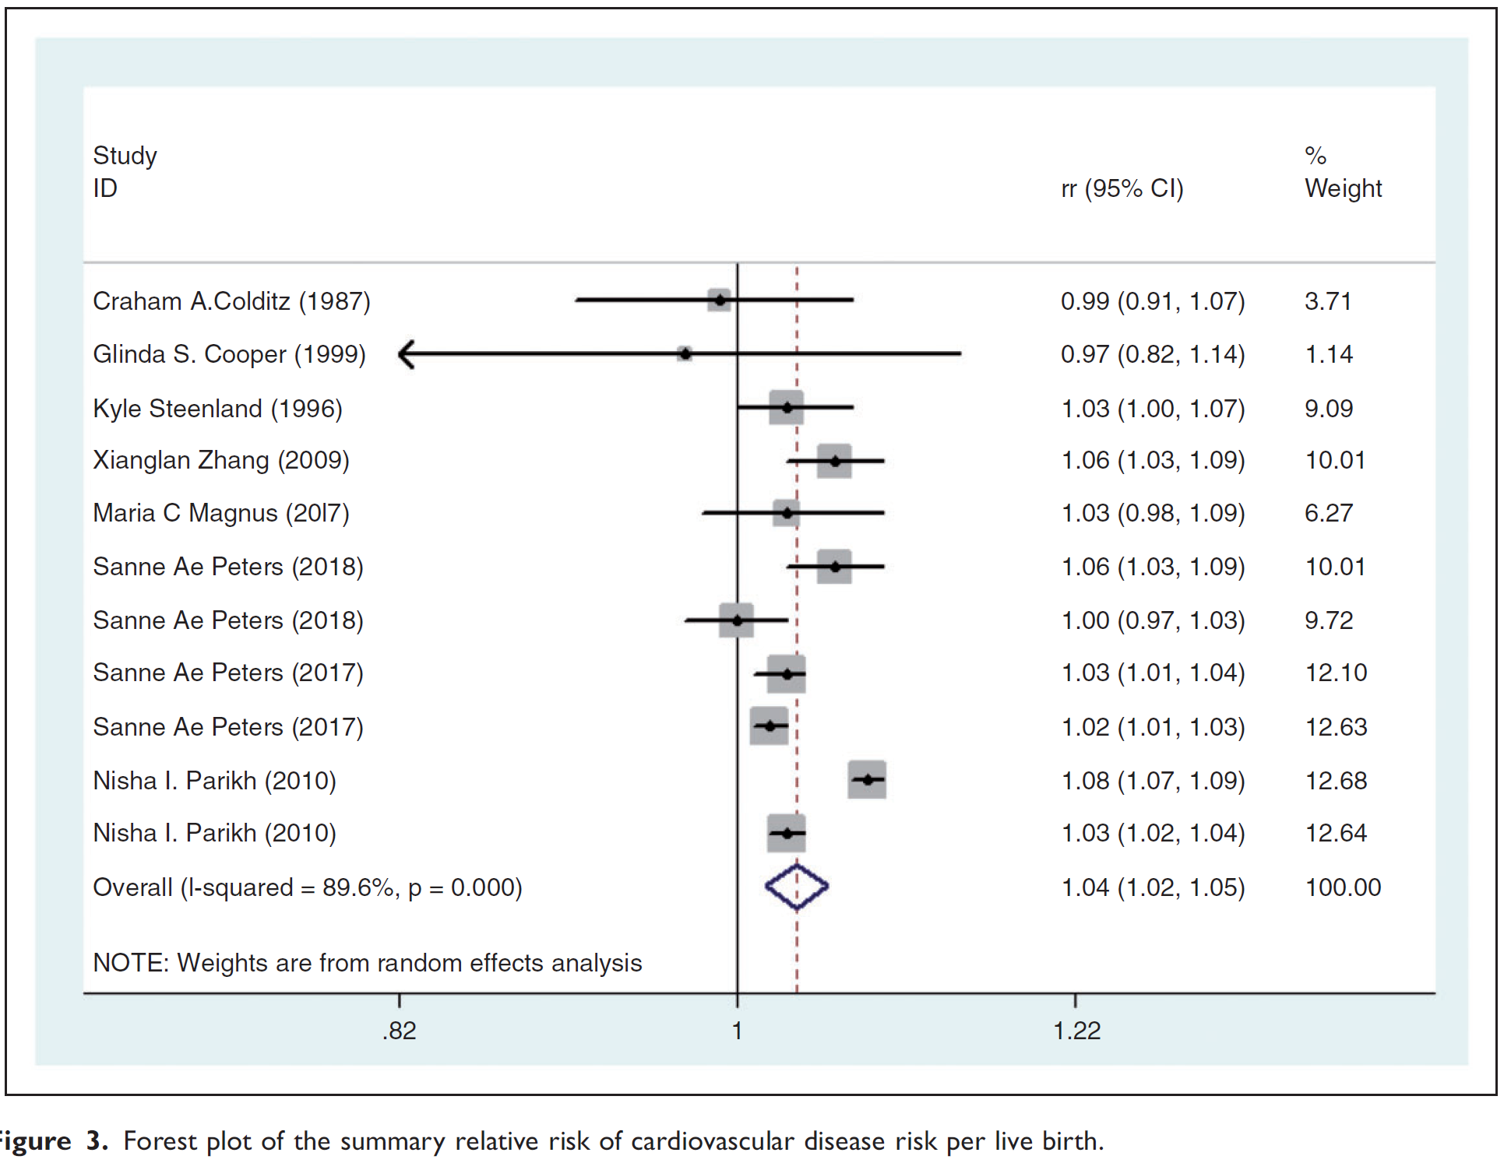
Parity related to increased risk of maternal CVD compared to nulliparity
Wenzhen Li, Ruan, Wenya, Zuzun, Lu, et al. Jan 11, 2019. Parity and risk of maternal cardiovascular disease: A dose-response meta-analysis of cohort studies. European Journal of Preventive Cardiology 0(00)

Slide 15
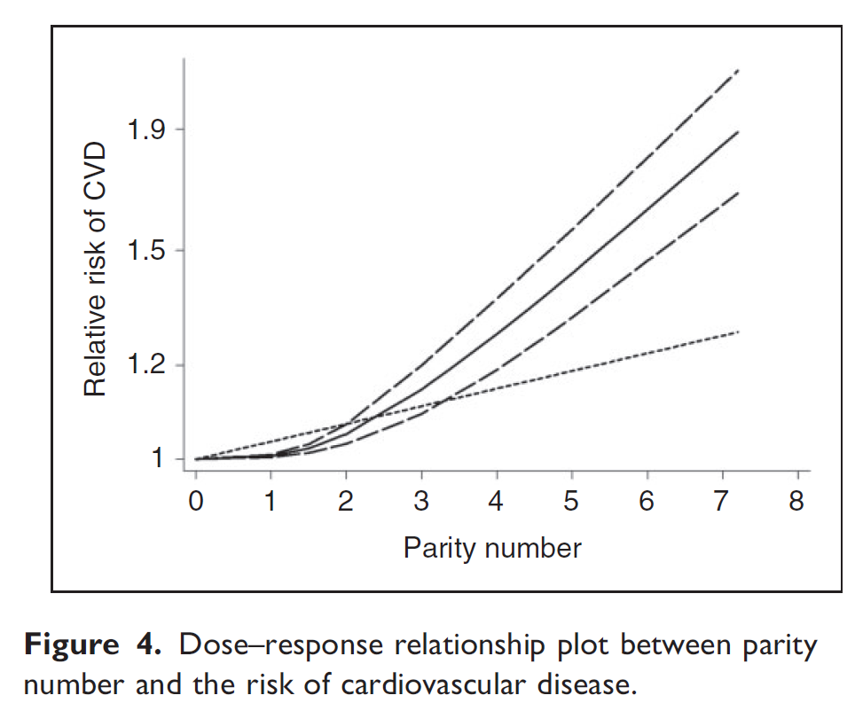
Parity related to increased risk of maternal CVD compared to nulliparity
Wenzhen Li, Ruan, Wenya, Zuzun, Lu, et al. Jan 11, 2019. Parity and risk of maternal cardiovascular disease: A dose-response meta-analysis of cohort studies. European Journal of Preventive Cardiology 0(00)

Slide 16
Parity related to increased risk of maternal CVD compared to nulliparity
There is a J-shaped curve -
Nulliparous women may suffer from infertility, PCOS, ovulation disorders and tubal factors.
Increasing parity > 2 – discuss: repeated exposure to hormone alterations, which may lead to the association between parity number and CVD risk (per live birth). accumulation of physiological changes, such as pancreatic b-cell proliferation and progressive insulin resistance.
In addition, repeated and continuous lifestyle changes may induce excess gestational weight gain and postpartum obesity, which could have an impact on a woman’s health in the future.
The recurrence of pregnancy complications in subsequent pregnancies may exert a cumulative burden on CVD.
Wenzhen Li, Ruan, Wenya, Zuzun, Lu, et al. Jan 11, 2019. Parity and risk of maternal cardiovascular disease: A dose-response meta-analysis of cohort studies. European Journal of Preventive Cardiology 0(00)

Slide 17
Parity related to increased risk of maternal CVD compared to nulliparity
BaleDoneen Take-Away:
This is another red flag – number of pregnancies and live births. Multiple births >2, seems to carry an increased risk compared to nulliparity.
However – we do not know why? Lots of hypothesis.
Women’s bodies go through so many changes in life – puberty, pregnancy, menopause – perhaps the sure fact of being ‘female’ is a red flag ☺
Many clues to CV risk with women and pregnancy – number of pregnancies, miscarriage, GDM, Pre-eclampsia,pre-term birth, infertility, etc…..be aware! Huge opportunity to appreciate the complexity of our lives through our gestational history.
Wenzhen Li, Ruan, Wenya, Zuzun, Lu, et al. Jan 11, 2018. Parity and risk of maternal cardiovascular disease: A dose-response meta-analysis of cohort studies. European Journal of Preventive Cardiology 0(00)

Slide 18
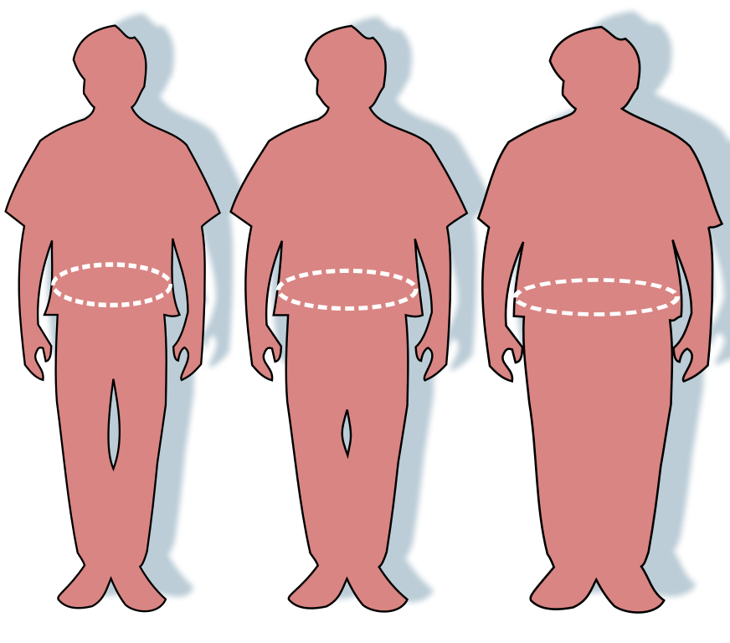
Increased BMI is Risky

Slide 19
Association of Body Mass Index With Lifetime Risk of Cardiovascular Disease and Compression of Morbidity
Population-based study, pooled individual-level data from adults (baseline age, 20-39, 40-59, and 60-79 years) across 10 large US prospective cohorts, with 3.2 million person-years of follow-up from 1964 to 2015.
All participants were free of clinical CVD at baseline with available BMI index and CVD outcomes data.
Data were analyzed from October 2016 to July 2017
Khan, S., Ning, H., Wilkins, J., et al. 2018. Association of body mass index with lifestime risk of cardiovascular disease and compression of morbidity. JAMA Cardiol. 2018;3(4):280-287.

Slide 20
Association of Body Mass Index With Lifetime Risk of Cardiovascular Disease and Compression of Morbidity
Total CVD and CVD subtype, including fatal and nonfatal coronary heart disease, stroke, congestive heart failure, and other CVD deaths.
BMI was calculated as weight in kg divided by height in meters squared
Joint cumulative risks for CVD or non CV death
190 672 in-person examinations included in this study
Mean age 46 years (men) and 58.7 years (women 73.9%)
Khan, S., Ning, H., Wilkins, J., et al. 2018. Association of body mass index with lifestime risk of cardiovascular disease and compression of morbidity. JAMA Cardiol. 2018;3(4):280-287.

Slide 21
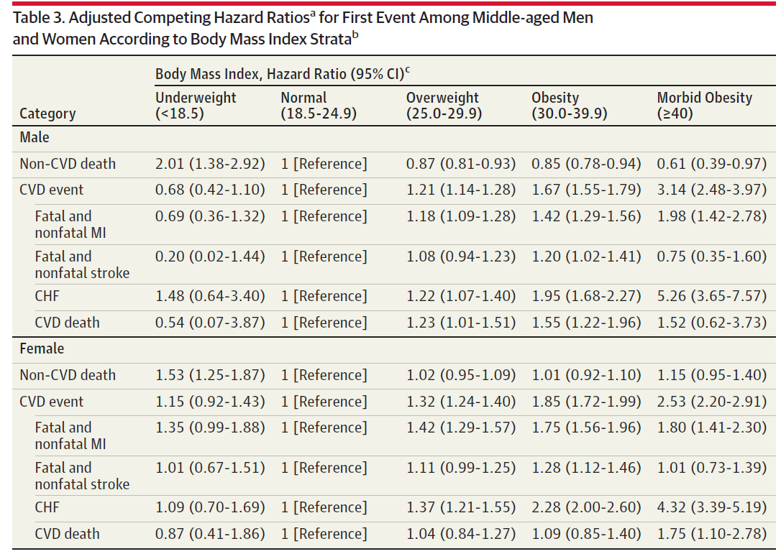
Association of Body Mass Index With Lifetime Risk of Cardiovascular Disease and Compression of Morbidity
Khan, S., Ning, H., Wilkins, J., et al. 2018. Association of body mass index with lifestime risk of cardiovascular disease and compression of morbidity. JAMA Cardiol. 2018;3(4):280-287.

Slide 22
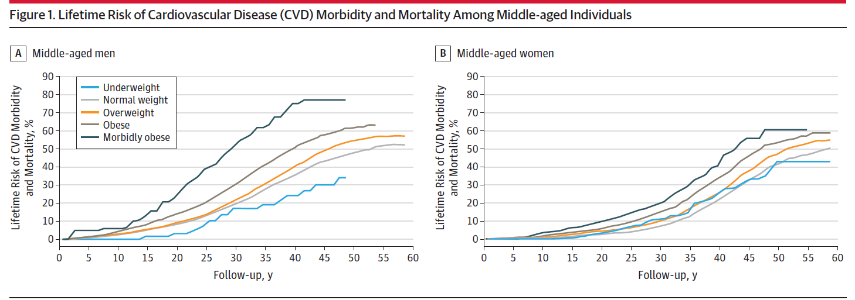
Association of Body Mass Index With Lifetime Risk of Cardiovascular Disease and Compression of Morbidity
Khan, S., Ning, H., Wilkins, J., et al. 2018. Association of body mass index with lifestime risk of cardiovascular disease and compression of morbidity. JAMA Cardiol. 2018;3(4):280-287.

Slide 23
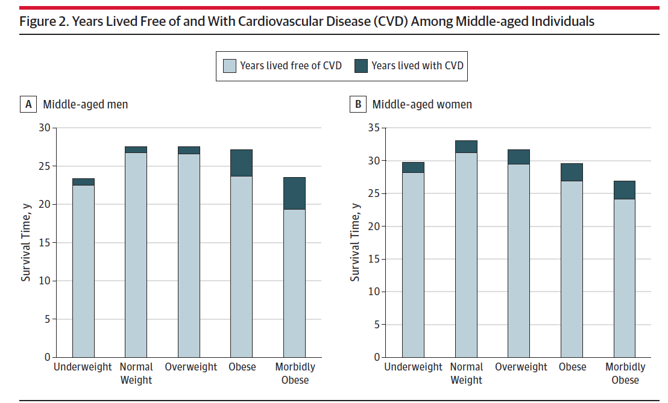
Association of Body Mass Index With Lifetime Risk of Cardiovascular Disease and Compression of Morbidity
Khan, S., Ning, H., Wilkins, J., et al. 2018. Association of body mass index with lifestime risk of cardiovascular disease and compression of morbidity. JAMA Cardiol. 2018;3(4):280-287.

Slide 24
Association of Body Mass Index With Lifetime Risk of Cardiovascular Disease and Compression of Morbidity
BaleDoneen Take-Away:
1. Limitations that BMI at baseline without change in BMI follow-up.
2. BMI does not account for visceral adiposity (data wasn’t available)
3. The way the authors presented the years ‘living with CVD’ is particularly helpful to appreciate the health expenditures related to treating end-stage and microvascular disease.
4. BMI is a very cost effective tool although not perfect – biometrics better.
5. The data surrounding CHF across the tertiles of obesity for both men and women is particularly interesting – huge quality of life and financial burden issue!
6. Also appreciate that the underweight (BMI <18.5) was NOT significant with any of the CV categories with both men and women.
Khan, S., Ning, H., Wilkins, J., et al. 2018. Association of body mass index with lifestime risk of cardiovascular disease and compression of morbidity. JAMA Cardiol. 2018;3(4):280-287.

Slide 25
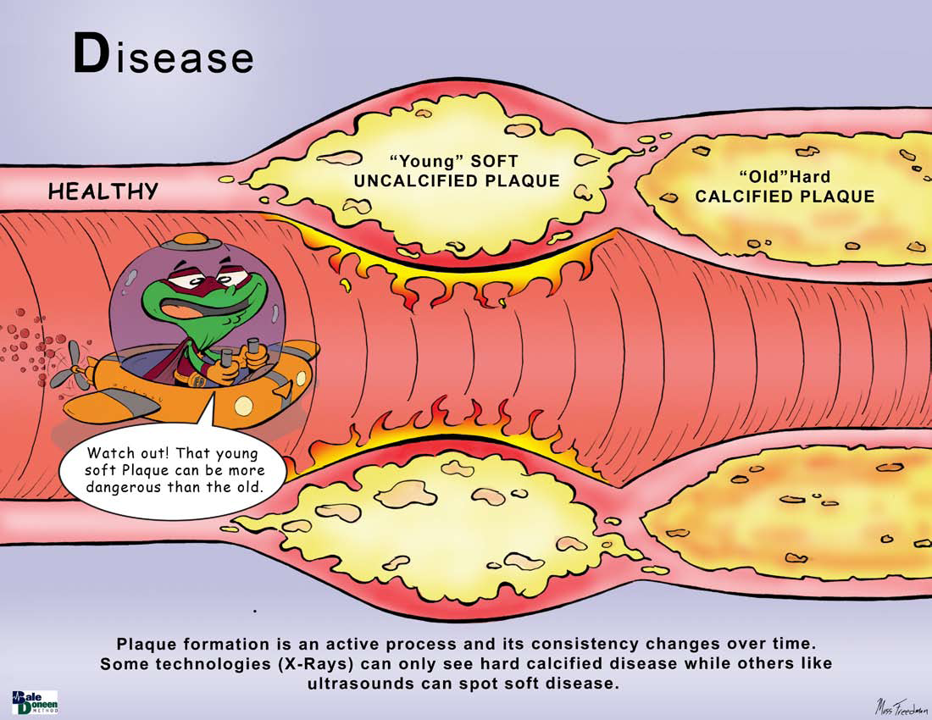

Slide 26
CACS and long-term risk of CV vs cancer mortality: The CAC Consortium.
The CAC Consortium is comprised of 66 636 scans performed in asymptomatic patients without known CVD.
The mean age 54 ± 11 years and 67% men.
Cause of death was ascertained from death certificates.
The association of CAC with cause-specific mortality was calculated using sub-distribution hazard ratio (SHR) models, which account for competing causes of death.
Whelton, S., Rifai, M., Dardari, Z., et al. 12.2018. CAC and competing long-term risk of CVD vs. cancer mortality: The CAC Consortium. European Heart Journal - Cardiovascular Imaging (2018) 0, 1–7.

Slide 27
CACS and long-term risk of CV vs cancer mortality: The CAC Consortium.
There were 3158 deaths over a median 12 ± 4 years follow-up (37% cancer and 32% CVD).
Cancer was the leading cause of death when CAC= 0
CVD overtaking cancer when baseline CAC >300
Whelton, S., Rifai, M., Dardari, Z., et al. 12.2018. CAC and competing long-term risk of CVD vs. cancer mortality: The CAC Consortium. European Heart Journal - Cardiovascular Imaging (2018) 0, 1–7.

Slide 28
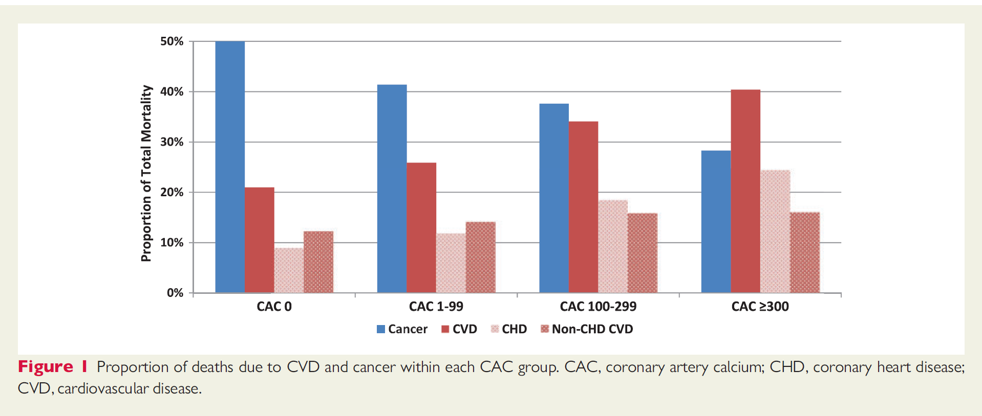
CACS and long-term risk of CV vs cancer mortality: The CAC Consortium.
Whelton, S., Rifai, M., Dardari, Z., et al. 12.2018. CAC and competing long-term risk of CVD vs. cancer mortality: The CAC Consortium. European Heart Journal - Cardiovascular Imaging (2018) 0, 1–7.

Slide 29
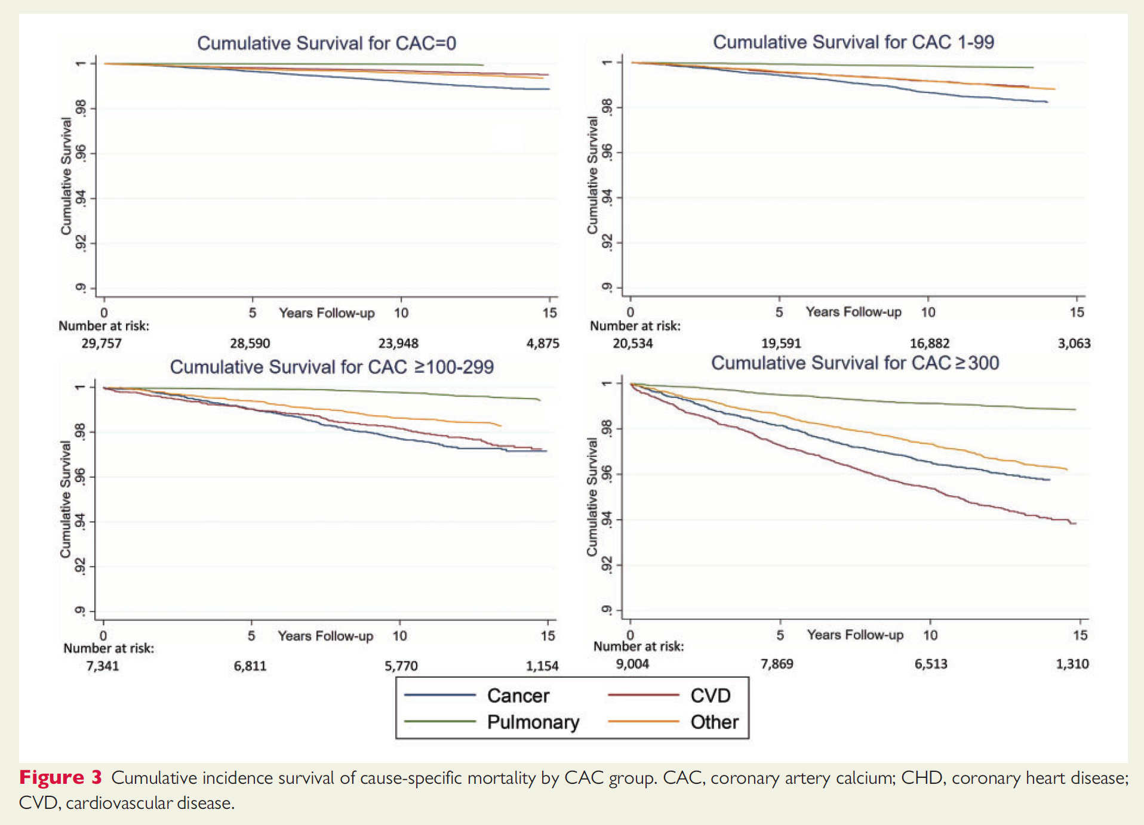
CACS and long-term risk of CV vs cancer mortality: The CAC Consortium.
Whelton, S., Rifai, M., Dardari, Z., et al. 12.2018. CAC and competing long-term risk of CVD vs. cancer mortality: The CAC Consortium. European Heart Journal - Cardiovascular Imaging (2018) 0, 1–7.

Slide 30
CACS and long-term risk of CV vs cancer mortality: The CAC Consortium.
BaleDoneen Take-Away:
1. The concern of CACS missing soft plaque is not the take-away here.
2. This information helps appreciate that increasing CACS may also represent an individuals overall health status.
3. Many of the root causes of arterial inflammation/CVD also have nondominant relationships with diseases of ageing – this is not to be confused with using increasing CACS as a simple marker of ageing but rather perhaps an insight into the impact of a lifelong and systemic fight against inflammation in general.
4. We must appreciate and value the impact of CV prevention on overall health maintenance.
Whelton, S., Rifai, M., Dardari, Z., et al. 12.2018. CAC and competing long-term risk of CVD vs. cancer mortality: The CAC Consortium. European Heart Journal - Cardiovascular Imaging (2018) 0, 1–7.

Slide 31
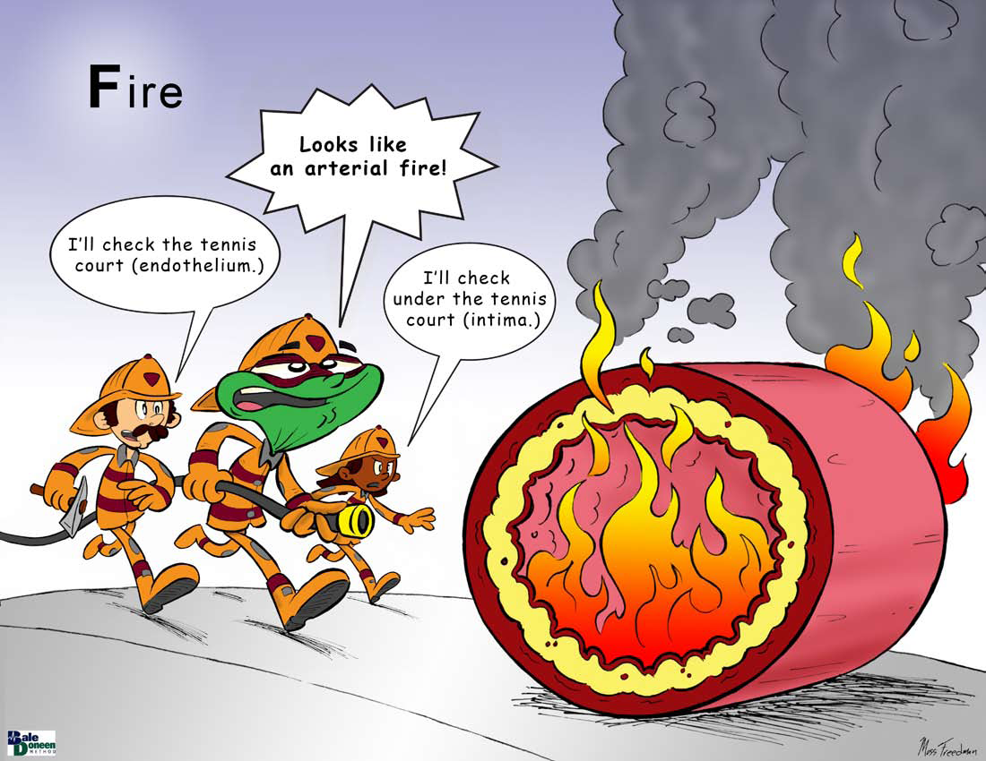

Slide 32
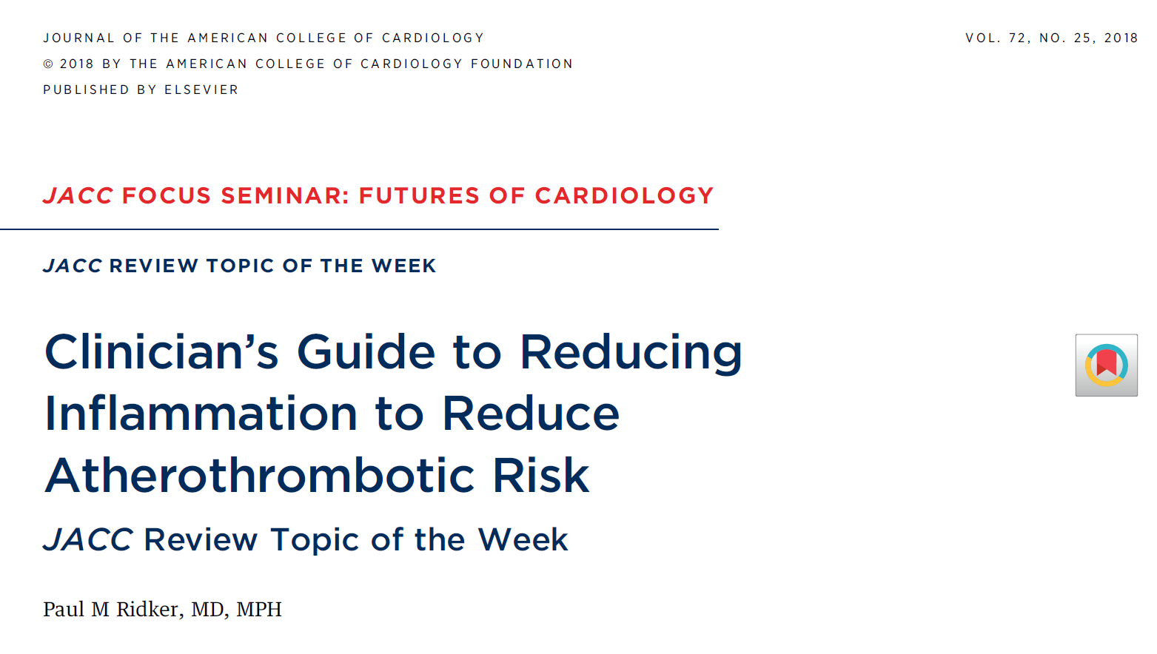

Slide 33
Guide to Reducing Inflammation to Reduce
Atherothrombotic Risk: JACC Review
Life-threatening CV events occur despite control of conventional risk factors. Inflammation, as measured by hsCRP, is assoc with future vascular events in both primary and secondary prevention, independent of usual risk markers.
Statins are powerful lipid-lowering agents with clinically relevant anti-inflammatory effects.
The CANTOS (Canakinumab Anti-inflammatory Thrombosis Outcomes Study) trial showed that reducing inflammation through IL-1b inhibition significantly reduced vascular risk, beyond that achievable with lipid lowering.
Ridker, P. Guide to reducing inflammation to reduce atherothrombotic risk: JACC Review. J Am Coll Cardiol 2018;72:3320–31.

Slide 34
Guide to Reducing Inflammation to Reduce
Atherothrombotic Risk: JACC Review
CANTOS further demonstrated a 31% reduction in cardiovascular mortality and all-cause mortality among patients treated with canakinumab who achieved the largest reductions in hsCRP, as well as efficacy in high-risk patients with chronic kidney disease and diabetes.
This review outlines the clinical implications of CANTOS for patients with “residual inflammatory risk,” the potential benefits and risks associated with anti-inflammatory therapy, and the importance of CANTOS for future drug development.
Ridker, P. Guide to reducing inflammation to reduce atherothrombotic risk: JACC Review. J Am Coll Cardiol 2018;72:3320–31.

Slide 35
Guide to Reducing Inflammation to Reduce
Atherothrombotic Risk: JACC Review
Because of Cantos - It is no longer appropriate to use the term “residual risk” to describe the high rate of recurrent CV events among those who experienced prior myocardial infarction.
Rather, to provide best care, clinicians must now distinguish between patients with “residual cholesterol risk” and those with “residual inflammatory risk”.
Ridker, P. Guide to reducing inflammation to reduce atherothrombotic risk: JACC Review. J Am Coll Cardiol 2018;72:3320–31.

Slide 36
Guide to Reducing Inflammation to Reduce
Atherothrombotic Risk: JACC Review
When LDLC remains >100 mg/dl despite aggressive statin therapy), trial evidence indicates that ezetimibe and PCSK9 inhibitors can further lower vascular event rates by 6% to 15%, respectively yet, the LDLC-lowering effects of PCSK9 inhibition vary widely for individual patients.
Thus, one strategy for clinicians to consider for “residual cholesterol risk” is to give a short course of PCSK9 inhibition and then continue long-term treatment only among those who achieved large additional reductions in LDLC.
Ridker, P. Guide to reducing inflammation to reduce atherothrombotic risk: JACC Review. J Am Coll Cardiol 2018;72:3320–31.

Slide 37
Guide to Reducing Inflammation to Reduce
Atherothrombotic Risk: JACC Review
Current prevention guidelines suggest that use of hsCRP is most appropriate when clinical decisions to initiate statin therapy are uncertain.
This recommendation is based largely on data from the 2008 JUPITER trial in which 20 mg of rosuvastatin daily, compared to placebo, was found to reduce the rate of first myocardial infarction, stroke, or CV death by 47% when administered to patients with LDLC <130mg/dl and hsCRP >2mg/l.
Ridker, P. Guide to reducing inflammation to reduce atherothrombotic risk: JACC Review. J Am Coll Cardiol 2018;72:3320–31.

Slide 38
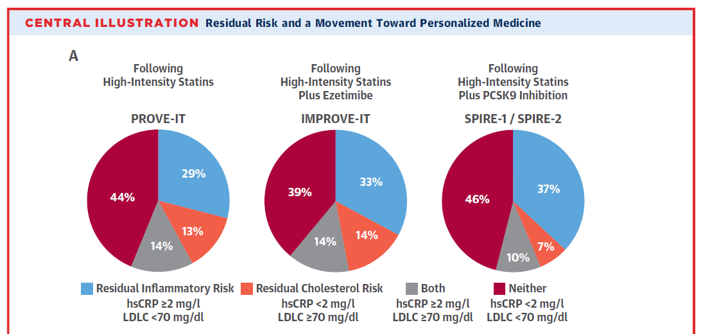
Guide to Reducing Inflammation to Reduce
Atherothrombotic Risk: JACC Review
Ridker, P. Guide to reducing inflammation to reduce atherothrombotic risk: JACC Review. J Am Coll Cardiol 2018;72:3320–31.

Slide 39
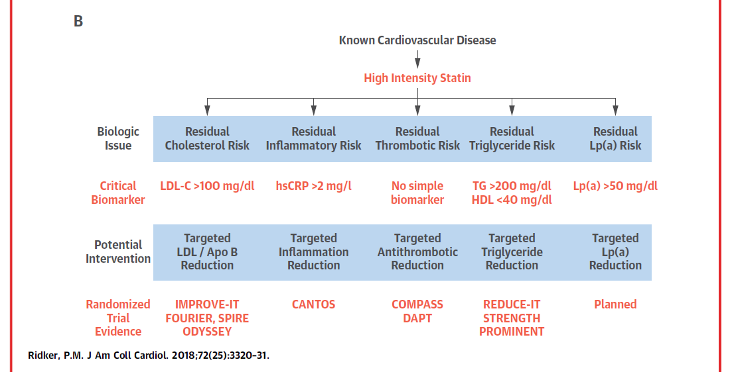
Guide to Reducing Inflammation to Reduce
Atherothrombotic Risk: JACC Review
Ridker, P. Guide to reducing inflammation to reduce atherothrombotic risk: JACC Review. J Am Coll Cardiol 2018;72:3320–31.

Slide 40
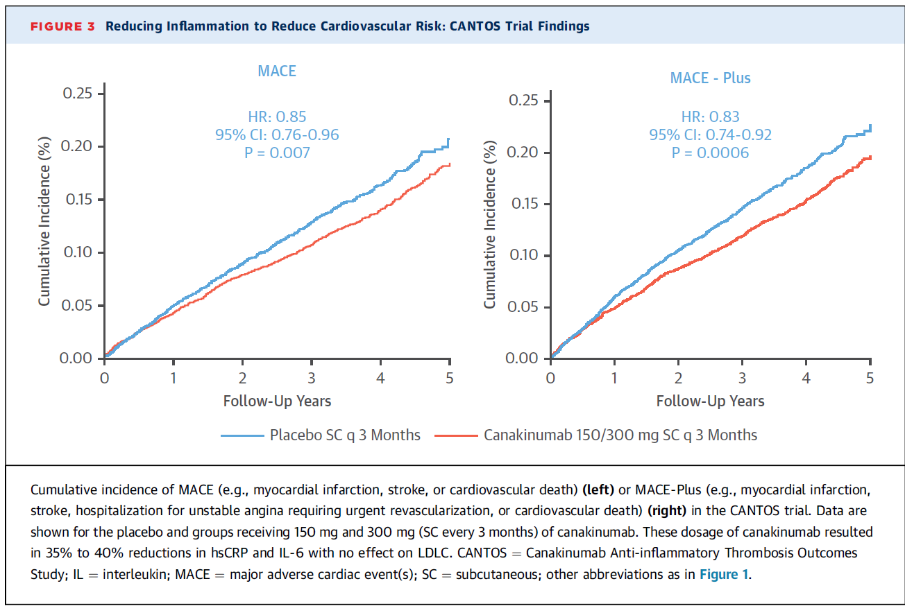
Guide to Reducing Inflammation to Reduce
Atherothrombotic Risk: JACC Review
Ridker, P. Guide to reducing inflammation to reduce atherothrombotic risk: JACC Review. J Am Coll Cardiol 2018;72:3320–31.

Slide 41
Guide to Reducing Inflammation to Reduce
Atherothrombotic Risk: JACC Review
BaleDoneen Take-Away:
Without BDM – everyone seems to be grasping at the the treatment for “residual inflammation’.
How did we do this?
Ridker, P. Guide to reducing inflammation to reduce atherothrombotic risk: JACC Review. J Am Coll Cardiol 2018;72:3320–31.

Slide 42
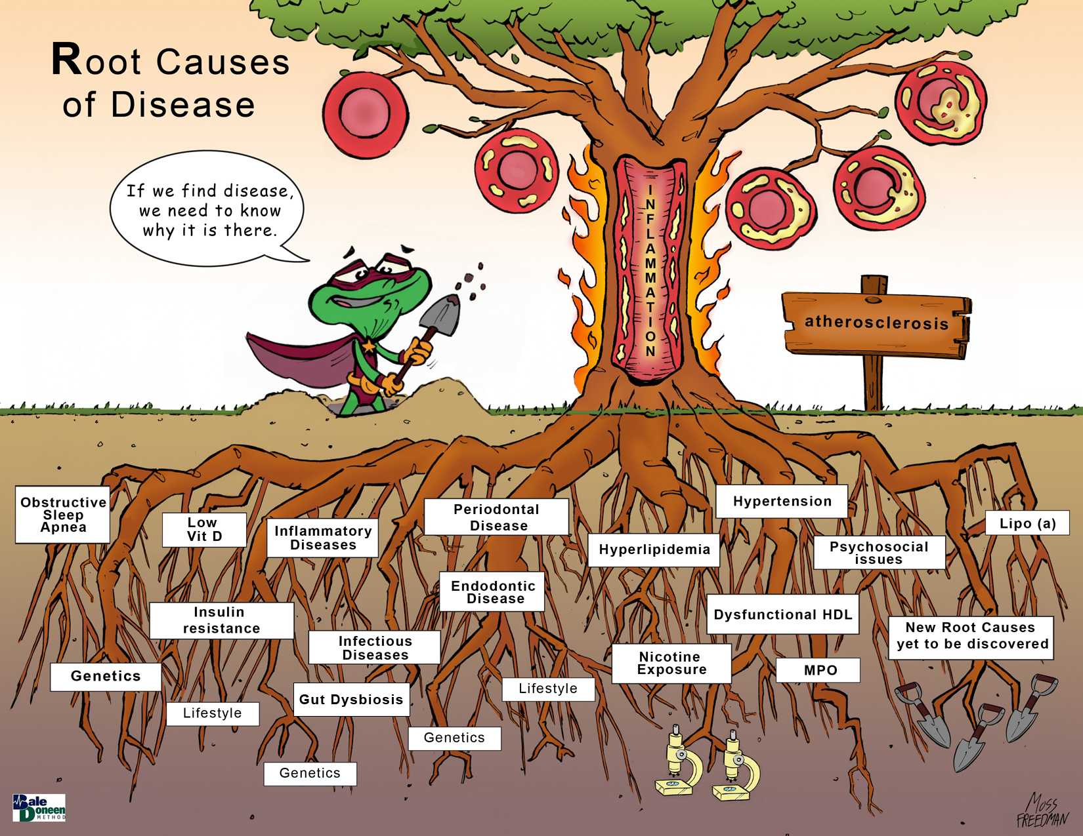
Guide to Reducing Inflammation to Reduce
Atherothrombotic Risk: JACC Review
Residual Risk is found here, under this tree!
Ridker, P. Guide to reducing inflammation to reduce atherothrombotic risk: JACC Review. J Am Coll Cardiol 2018;72:3320–31.

Slide 43
.
Periodontal Disease
reference

Slide 44
Improved oral hygiene care attenuates the cardiovascular risk of oral health disease
Premise of the research:
Periodontal disease causes transient bacteremia, systemic inflammation, and endothelial dysfunction, which are possible mechanisms underlying atherogenesis.
Cotti E, Dessi C, Piras A, Mercuro G. Can a chronic dental infection be considered a cause of cardiovascular disease? A review of the literature. Int J Cardiol. 2011;148:4–10.
Park, S.H., Kim, S.H., Kang, S.H., et al. Nov. 22, 2018. Improved oral hygiene care attenuates the cardiovascular risk of oral health disease: A population-based study from Korea. European Heart Journal, 0, 1-9.
Notes:
those with known CHD or HF eat four or five oily-fish meals per week or take the equivalent in omega-3 supplements; healthy people should consume around two fatty-fish meals per week or the same in supplements
adding just one [omega-3 PUFA] pill a day reduced HF deaths by between 8% and 9%
more studies are needed to explore the effects of various doses of omega-3 PUFAs on the primary and secondary reduction of AF and to determine whether the benefits are caused by antiarrhythmic effects, benefits on autonomic tone, or even anti-inflammatory effects,
There's no harm in taking extra—the only negative of extra is the calories. I don't think anyone thinks now that fish oil is doing any harm."

Slide 45
Improved oral hygiene care attenuates the cardiovascular risk of oral health disease
A population-based study from Korea of 247 696 healthy adults aged 40 years or older who underwent an oral health screening program and had no history of major CV events
Subjects from the National Health Insurance System-National Health Screening Cohort.
After a median follow-up of 9.5 years, 14 893 major cardiovascular events occurred including cardiac death, MI, stroke, and heart failure.
Park, S.H., Kim, S.H., Kang, S.H., et al. Nov. 22, 2018. Improved oral hygiene care attenuates the cardiovascular risk of oral health disease: A population-based study from Korea. European Heart Journal, 0, 1-9.
Notes:
those with known CHD or HF eat four or five oily-fish meals per week or take the equivalent in omega-3 supplements; healthy people should consume around two fatty-fish meals per week or the same in supplements
adding just one [omega-3 PUFA] pill a day reduced HF deaths by between 8% and 9%
more studies are needed to explore the effects of various doses of omega-3 PUFAs on the primary and secondary reduction of AF and to determine whether the benefits are caused by antiarrhythmic effects, benefits on autonomic tone, or even anti-inflammatory effects,
There's no harm in taking extra—the only negative of extra is the calories. I don't think anyone thinks now that fish oil is doing any harm."

Slide 46
Improved oral hygiene care attenuates the cardiovascular risk of oral health disease
Oral hygiene care such as frequent tooth brushing and regular dental visits for professional cleaning reduced the risk of future cardiovascular events in healthy adults.
This study also suggests that improved oral hygiene behavior may modify the association between oral health and cardiovascular diseases.
Park, S.H., Kim, S.H., Kang, S.H., et al. Nov. 22, 2018. Improved oral hygiene care attenuates the cardiovascular risk of oral health disease: A population-based study from Korea. European Heart Journal, 0, 1-9.
Notes:
those with known CHD or HF eat four or five oily-fish meals per week or take the equivalent in omega-3 supplements; healthy people should consume around two fatty-fish meals per week or the same in supplements
adding just one [omega-3 PUFA] pill a day reduced HF deaths by between 8% and 9%
more studies are needed to explore the effects of various doses of omega-3 PUFAs on the primary and secondary reduction of AF and to determine whether the benefits are caused by antiarrhythmic effects, benefits on autonomic tone, or even anti-inflammatory effects,
There's no harm in taking extra—the only negative of extra is the calories. I don't think anyone thinks now that fish oil is doing any harm."

Slide 47
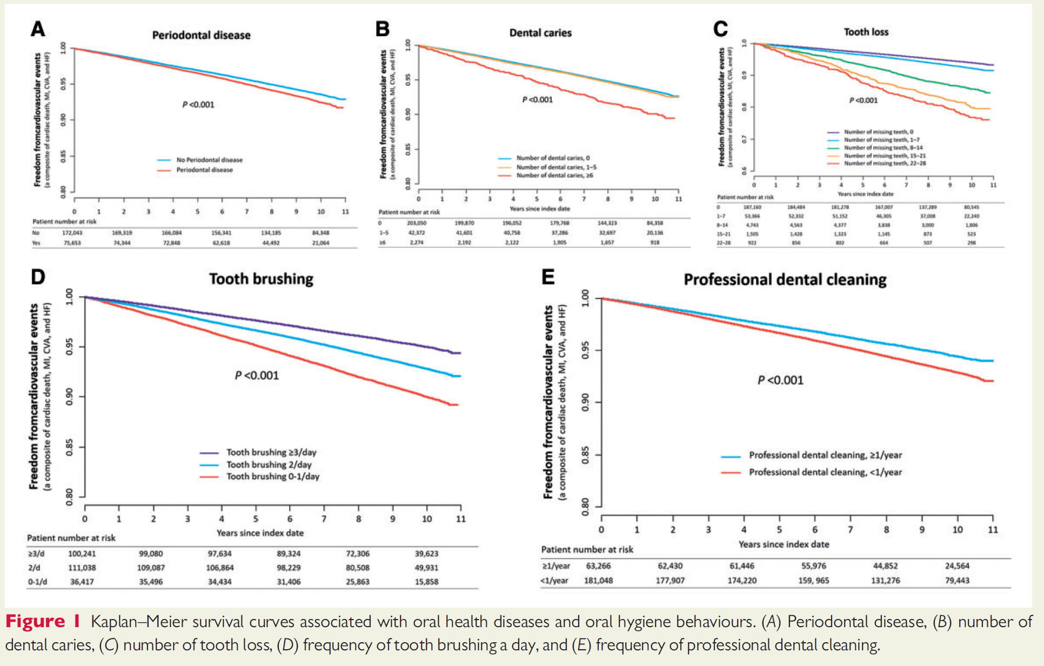
Park, S.H., Kim, S.H., Kang, S.H., et al. Nov. 22, 2018. Improved oral hygiene care attenuates the cardiovascular risk of oral health disease: A population-based study from Korea. European Heart Journal, 0, 1-9.
Notes:
those with known CHD or HF eat four or five oily-fish meals per week or take the equivalent in omega-3 supplements; healthy people should consume around two fatty-fish meals per week or the same in supplements
adding just one [omega-3 PUFA] pill a day reduced HF deaths by between 8% and 9%
more studies are needed to explore the effects of various doses of omega-3 PUFAs on the primary and secondary reduction of AF and to determine whether the benefits are caused by antiarrhythmic effects, benefits on autonomic tone, or even anti-inflammatory effects,
There's no harm in taking extra—the only negative of extra is the calories. I don't think anyone thinks now that fish oil is doing any harm."

Slide 48
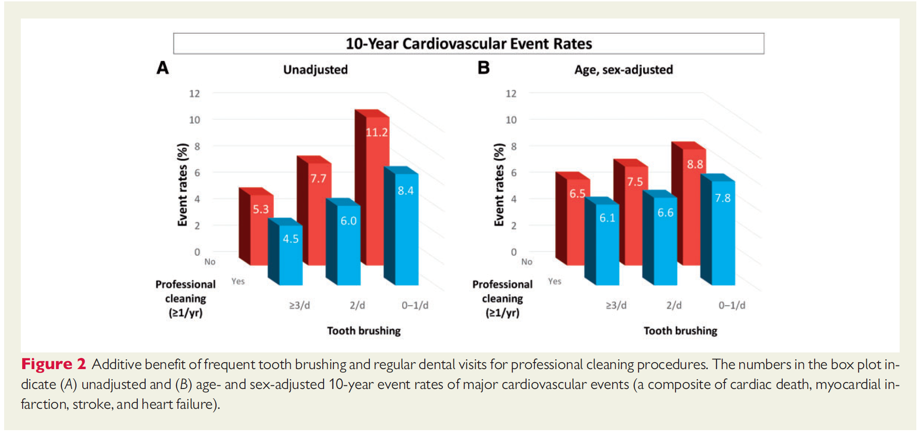
A population-based study from Korea
Park, S.H., Kim, S.H., Kang, S.H., et al. Nov. 22, 2018. Improved oral hygiene care attenuates the cardiovascular risk of oral health disease: A population-based study from Korea. European Heart Journal, 0, 1-9.
Notes:
those with known CHD or HF eat four or five oily-fish meals per week or take the equivalent in omega-3 supplements; healthy people should consume around two fatty-fish meals per week or the same in supplements
adding just one [omega-3 PUFA] pill a day reduced HF deaths by between 8% and 9%
more studies are needed to explore the effects of various doses of omega-3 PUFAs on the primary and secondary reduction of AF and to determine whether the benefits are caused by antiarrhythmic effects, benefits on autonomic tone, or even anti-inflammatory effects,
There's no harm in taking extra—the only negative of extra is the calories. I don't think anyone thinks now that fish oil is doing any harm."

Slide 49
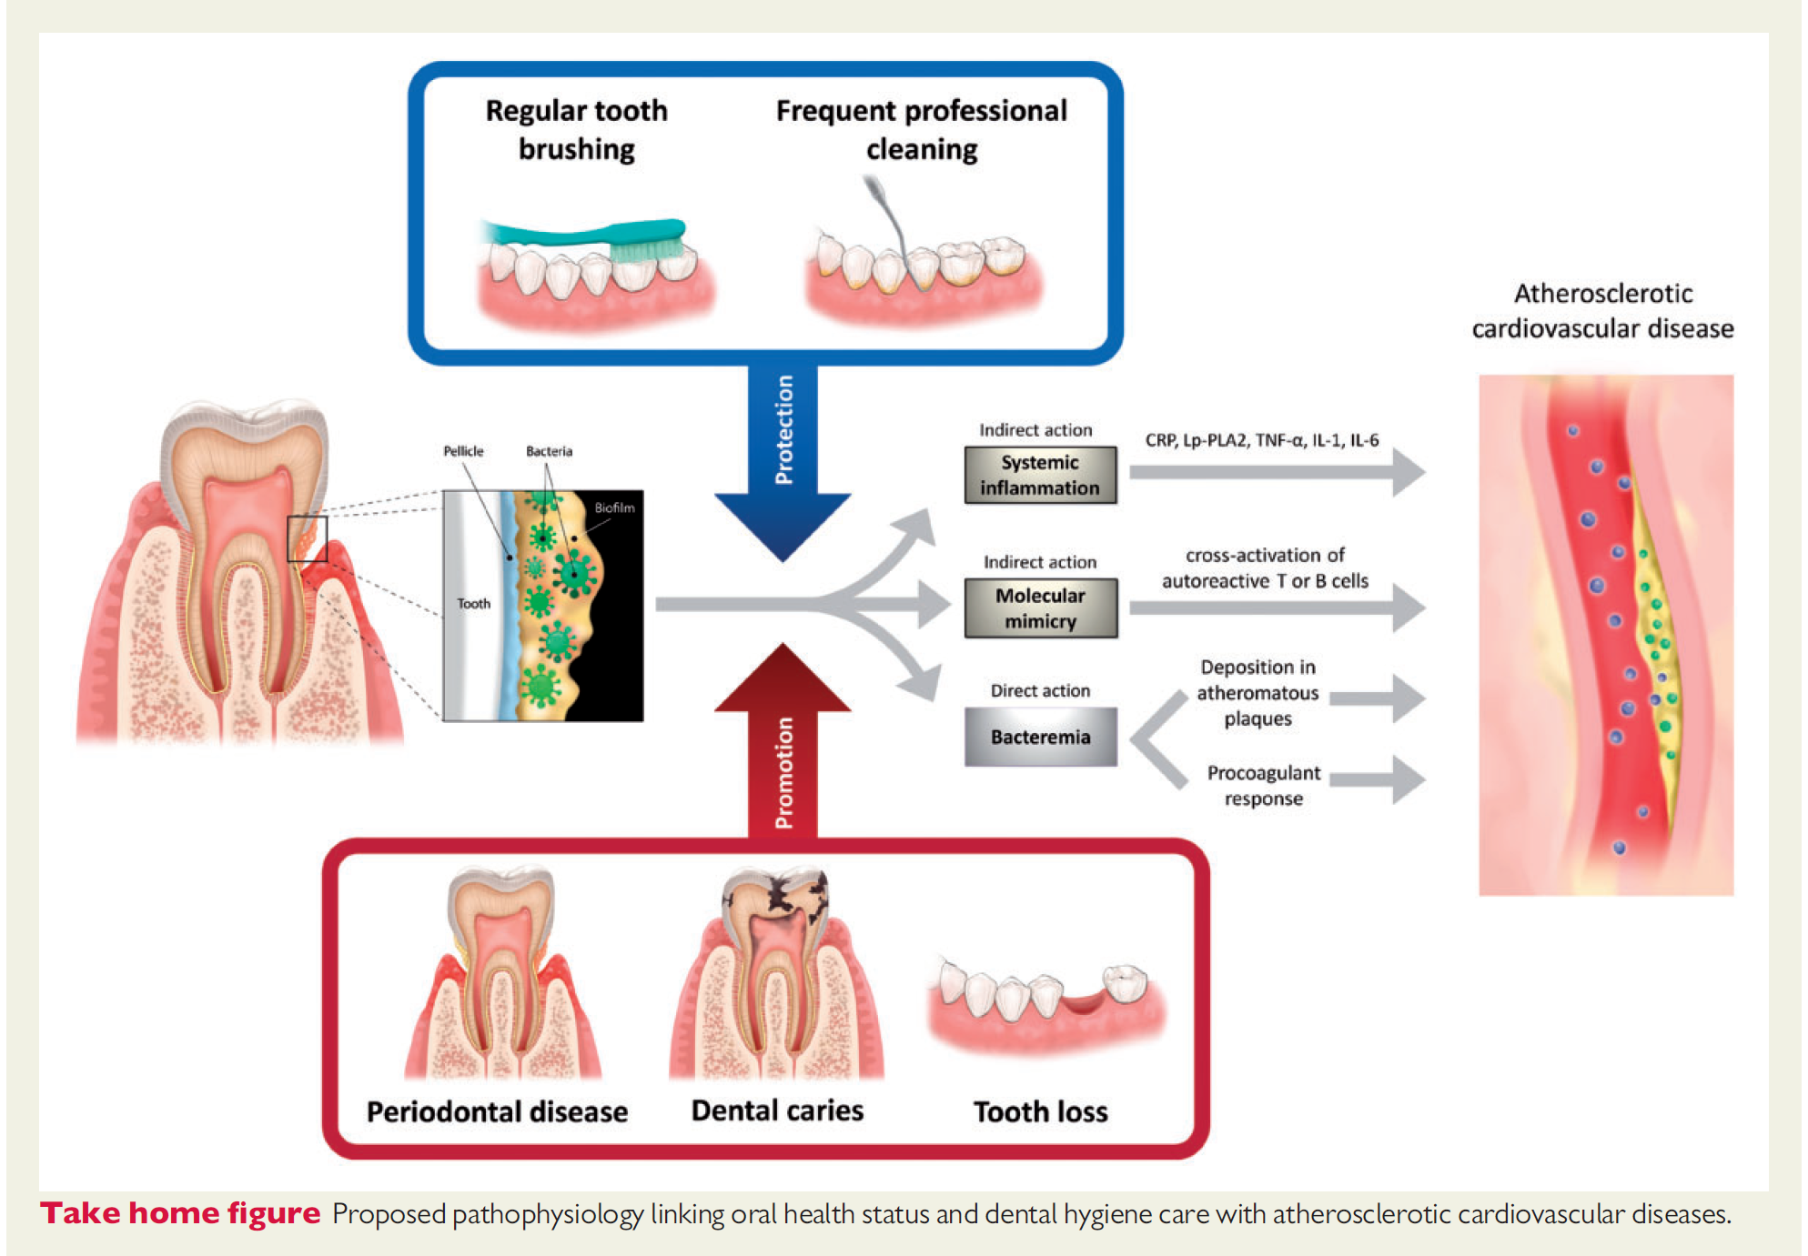
Improved oral hygiene care attenuates the cardiovascular risk of oral health disease
Park, S.H., Kim, S.H., Kang, S.H., et al. Nov. 22, 2018. Improved oral hygiene care attenuates the cardiovascular risk of oral health disease: A population-based study from Korea. European Heart Journal, 0, 1-9.
Notes:
those with known CHD or HF eat four or five oily-fish meals per week or take the equivalent in omega-3 supplements; healthy people should consume around two fatty-fish meals per week or the same in supplements
adding just one [omega-3 PUFA] pill a day reduced HF deaths by between 8% and 9%
more studies are needed to explore the effects of various doses of omega-3 PUFAs on the primary and secondary reduction of AF and to determine whether the benefits are caused by antiarrhythmic effects, benefits on autonomic tone, or even anti-inflammatory effects,
There's no harm in taking extra—the only negative of extra is the calories. I don't think anyone thinks now that fish oil is doing any harm."

Slide 50
Improved oral hygiene care attenuates the cardiovascular risk of oral health disease
Study Findings and Conclusions
Tooth brushing > 3x day was associated with a 19% reduction in CV events compared with tooth brushing < once a day.
Regular professional cleaning once a year or more was shown to reduce CV risk by 14%.
Researchers state that results are in line with previous observational studies:
Periodontal disease causes chronic inflammation.
A reduction in inflammatory markers such as C-reactive protein and interleukins have been reported in association with regular tooth brushing as well as periodontal treatment.
Oral hygiene has been suggested to modify major risk factors such as diabetes and dyslipidemia.
Oral hygiene alters the oral microbiota. Increasing evidence suggests the human microbiota play a role in the pathogenesis of atherosclerotic cardiovascular disease and heart failure.
Park, S.H., Kim, S.H., Kang, S.H., et al. Nov. 22, 2018. Improved oral hygiene care attenuates the cardiovascular risk of oral health disease: A population-based study from Korea. European Heart Journal, 0, 1-9.
Notes:
those with known CHD or HF eat four or five oily-fish meals per week or take the equivalent in omega-3 supplements; healthy people should consume around two fatty-fish meals per week or the same in supplements
adding just one [omega-3 PUFA] pill a day reduced HF deaths by between 8% and 9%
more studies are needed to explore the effects of various doses of omega-3 PUFAs on the primary and secondary reduction of AF and to determine whether the benefits are caused by antiarrhythmic effects, benefits on autonomic tone, or even anti-inflammatory effects,
There's no harm in taking extra—the only negative of extra is the calories. I don't think anyone thinks now that fish oil is doing any harm."

Slide 51
Improved oral hygiene care attenuates the cardiovascular risk of oral health disease
BaleDoneen Take-Away:
Particularly appreciate that this oral hygiene study was published in the European Heart Journal.
The world is ready to hear our message – that oral health experts MUST be part of the conversation to eradicate heart disease as the number one cause of death and stroke as the number one cause of disability!
This is a world-wide issue – we need to keep talking – we have the knowledge, tools and passion.
The fact that the CANTOS trial has brought attention to inflammation as the keystone demands that the medical and dental community recognize the MANY various opportunities to identify and eradicate sources of inflammation.
Park, S.H., Kim, S.H., Kang, S.H., et al. Nov. 22, 2018. Improved oral hygiene care attenuates the cardiovascular risk of oral health disease: A population-based study from Korea. European Heart Journal, 0, 1-9.
Notes:
those with known CHD or HF eat four or five oily-fish meals per week or take the equivalent in omega-3 supplements; healthy people should consume around two fatty-fish meals per week or the same in supplements
adding just one [omega-3 PUFA] pill a day reduced HF deaths by between 8% and 9%
more studies are needed to explore the effects of various doses of omega-3 PUFAs on the primary and secondary reduction of AF and to determine whether the benefits are caused by antiarrhythmic effects, benefits on autonomic tone, or even anti-inflammatory effects,
There's no harm in taking extra—the only negative of extra is the calories. I don't think anyone thinks now that fish oil is doing any harm."

Slide 52
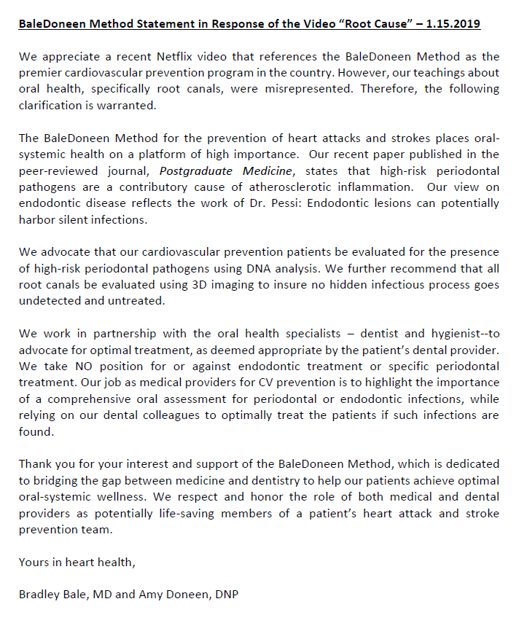
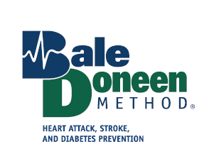


Slide 53
.
Sleep Apnea
reference

Slide 54
Obstructive sleep apnea
& resistant hypertension in Blacks
Between 2012 and 2016, Jackson Heart Sleep Study participants (N=913) underwent an in-home sleep apnea study, clinic BP
Moderate or severe OSA defined as AHI ≥15
Prevalent HTN was defined as SBP ≥130 mm Hg or DBP >80mm Hg, use of antihypertensives, or self-report of a diagnosis of hypertension.
Controlled BP defined as BP <130/80 with use of < 1-2 classes of Rx.
Uncontrolled/Resistant BP defined as BP > 3 classes of Rx
Johnson, D., Thomas, J., Abdalla, M., et al. Association between sleep apnea and blood pressure control in blacks. Circulation. 2018;139:00–00.
Notes:
those with known CHD or HF eat four or five oily-fish meals per week or take the equivalent in omega-3 supplements; healthy people should consume around two fatty-fish meals per week or the same in supplements
adding just one [omega-3 PUFA] pill a day reduced HF deaths by between 8% and 9%
more studies are needed to explore the effects of various doses of omega-3 PUFAs on the primary and secondary reduction of AF and to determine whether the benefits are caused by antiarrhythmic effects, benefits on autonomic tone, or even anti-inflammatory effects,
There's no harm in taking extra—the only negative of extra is the calories. I don't think anyone thinks now that fish oil is doing any harm."

Slide 55
Obstructive sleep apnea
& resistant hypertension in Blacks
The analytic sample with hypertension (N=664) had a mean age of 64.0 + 10.6 years, 69.1% female, 58.6% obese, and 51.3% college educated.
Among the sample, 25.7% had OSA – untreated in 94% of participants.
48% had uncontrolled HTN and 14% had resistant HTN
After adjustment for confounders, participants with moderate or severe OSA had a 2.0 times higher odds of resistant hypertension
(95% CI, 1.14–3.67)
Johnson, D., Thomas, J., Abdalla, M., et al. Association between sleep apnea and blood pressure control in blacks. Circulation. 2018;139:00–00.
Notes:
those with known CHD or HF eat four or five oily-fish meals per week or take the equivalent in omega-3 supplements; healthy people should consume around two fatty-fish meals per week or the same in supplements
adding just one [omega-3 PUFA] pill a day reduced HF deaths by between 8% and 9%
more studies are needed to explore the effects of various doses of omega-3 PUFAs on the primary and secondary reduction of AF and to determine whether the benefits are caused by antiarrhythmic effects, benefits on autonomic tone, or even anti-inflammatory effects,
There's no harm in taking extra—the only negative of extra is the calories. I don't think anyone thinks now that fish oil is doing any harm."

Slide 56
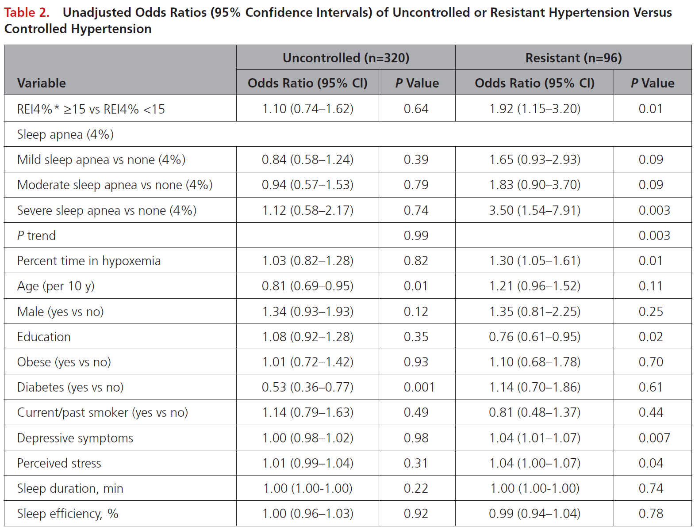
Obstructive sleep apnea
& resistant hypertension in Blacks
Johnson, D., Thomas, J., Abdalla, M., et al. Association between sleep apnea and blood pressure control in blacks. Circulation. 2018;139:00–00.
Notes:
those with known CHD or HF eat four or five oily-fish meals per week or take the equivalent in omega-3 supplements; healthy people should consume around two fatty-fish meals per week or the same in supplements
adding just one [omega-3 PUFA] pill a day reduced HF deaths by between 8% and 9%
more studies are needed to explore the effects of various doses of omega-3 PUFAs on the primary and secondary reduction of AF and to determine whether the benefits are caused by antiarrhythmic effects, benefits on autonomic tone, or even anti-inflammatory effects,
There's no harm in taking extra—the only negative of extra is the calories. I don't think anyone thinks now that fish oil is doing any harm."

Slide 57
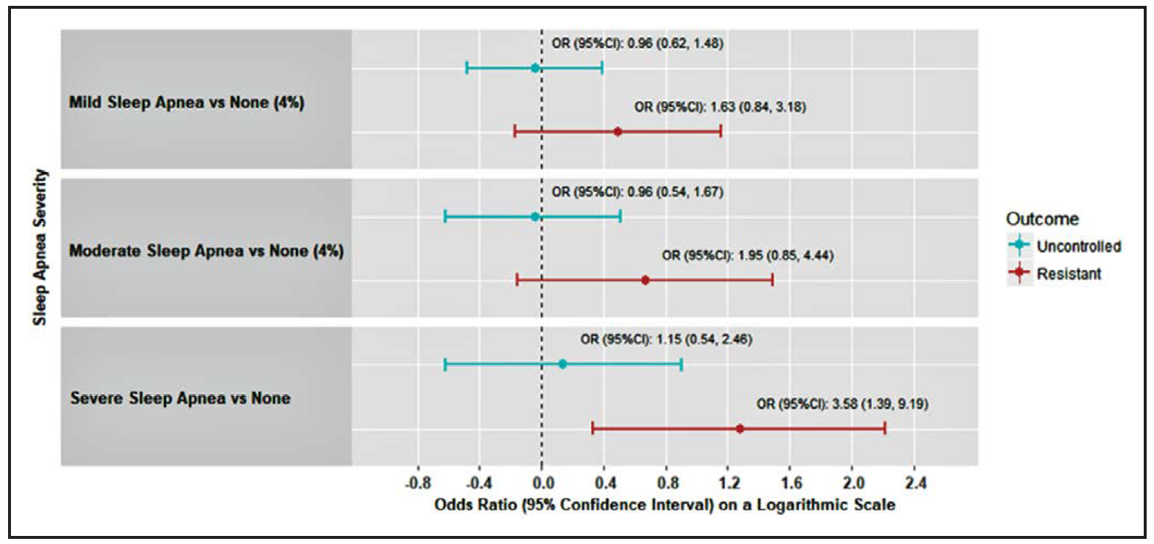
Obstructive sleep apnea
& resistant hypertension in Blacks
Johnson, D., Thomas, J., Abdalla, M., et al. Association between sleep apnea and blood pressure control in blacks. Circulation. 2018;139:00–00.
Notes:
those with known CHD or HF eat four or five oily-fish meals per week or take the equivalent in omega-3 supplements; healthy people should consume around two fatty-fish meals per week or the same in supplements
adding just one [omega-3 PUFA] pill a day reduced HF deaths by between 8% and 9%
more studies are needed to explore the effects of various doses of omega-3 PUFAs on the primary and secondary reduction of AF and to determine whether the benefits are caused by antiarrhythmic effects, benefits on autonomic tone, or even anti-inflammatory effects,
There's no harm in taking extra—the only negative of extra is the calories. I don't think anyone thinks now that fish oil is doing any harm."

Slide 58
Obstructive sleep apnea
& resistant hypertension in Blacks
BaleDoneen Take-Away:
Look carefully for OSA when patient has HTN.
In this demographic - These results suggest that untreated OSA may contribute to hard-to-control BP in blacks. Assessment and treatment of OSA should be considered.
Always ask “why” before adding more medication – what might be missing?
Weight was NOT statistically different between the two groups – don’t let obesity to be the main reason to get a sleep study.
Blacks have unique challenges with BP treatment so….make sure to prioritize sleep evaluation – both apnea and disturbance.
Home sleep studies were utilized – this is optimal.
Johnson, D., Thomas, J., Abdalla, M., et al. Association between sleep apnea and blood pressure control in blacks. Circulation. 2018;139:00–00.
Notes:
those with known CHD or HF eat four or five oily-fish meals per week or take the equivalent in omega-3 supplements; healthy people should consume around two fatty-fish meals per week or the same in supplements
adding just one [omega-3 PUFA] pill a day reduced HF deaths by between 8% and 9%
more studies are needed to explore the effects of various doses of omega-3 PUFAs on the primary and secondary reduction of AF and to determine whether the benefits are caused by antiarrhythmic effects, benefits on autonomic tone, or even anti-inflammatory effects,
There's no harm in taking extra—the only negative of extra is the calories. I don't think anyone thinks now that fish oil is doing any harm."

Slide 59
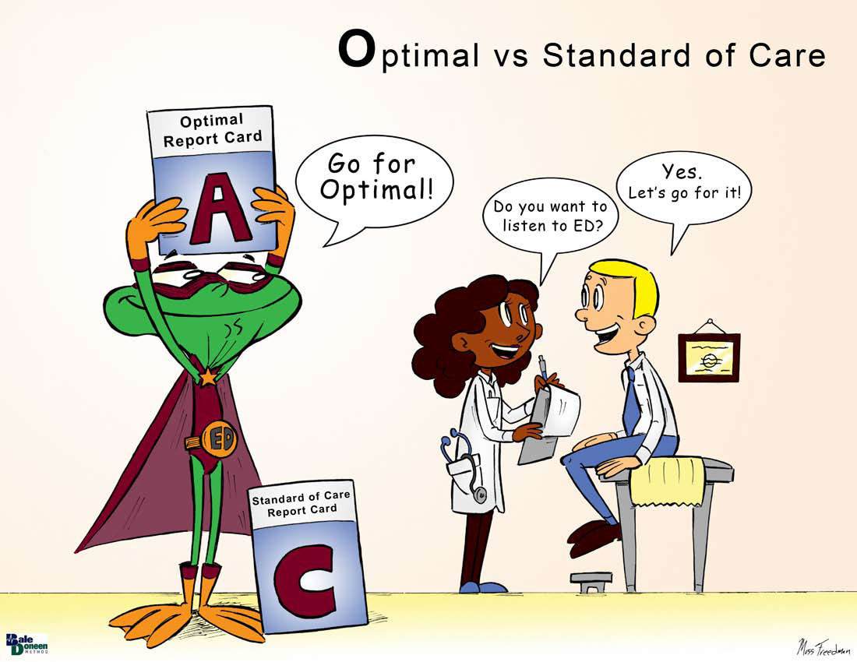

Slide 60

Galectin-3 – how is my heart?

Slide 61
Longitudinal Change in Galectin-3 is predictive of future HF, CVD and Mortality.
Galectin-3 (Gal-3), is an emerging biomarker of heart failure (HF). Expressed by activated macrophages and other cells during myocardial stress, Gal-3 plays an important regulatory role in inflammation and fibrosis.
Gal-3 binding sites are mainly located in myocardial extracellular matrix and cardiac fibroblasts, where it induces fibroblast proliferation, collagen deposition, and cardiac remodeling.
In human studies, higher levels of Gal-3 are associated with all-cause and cardiovascular mortality in patients with heart failure as well as in general population.
In addition, circulating Gal-3 predicts incident HF after acute coronary syndrome in the community.
Ghorbani, A., Bhambhani, V., Christenson, R., et al. Longitudinal change in galectin-3 and incident cardiovascular outcomes. J Am Coll Cardiol 2018;72:3246-54.
Notes:
those with known CHD or HF eat four or five oily-fish meals per week or take the equivalent in omega-3 supplements; healthy people should consume around two fatty-fish meals per week or the same in supplements
adding just one [omega-3 PUFA] pill a day reduced HF deaths by between 8% and 9%
more studies are needed to explore the effects of various doses of omega-3 PUFAs on the primary and secondary reduction of AF and to determine whether the benefits are caused by antiarrhythmic effects, benefits on autonomic tone, or even anti-inflammatory effects,
There's no harm in taking extra—the only negative of extra is the calories. I don't think anyone thinks now that fish oil is doing any harm."

Slide 62
Longitudinal Change in Galectin-3 is predictive of future HF, CVD and Mortality.
Despite relatively low biological variation, plasma Gal-3 levels do change over time, andGal-3 trajectory might be independent of baseline levels.
Systolic blood pressure and urinary excretion of albumin were shown to predict temporal changes in Gal-3 levels.
Prior studies have shown that serial measurements of Gal-3 provide incremental prognostic information in patients with existing HF.
Individuals with persistently elevated plasma Gal-3 concentrations had a significantly higher incidence of HF over an 8-year follow-up, with comparable signals for CV mortality, new-onset atrial fibrillation (AF), and cardiovascular events, suggesting a role for repeated measurements of circulating Gal-3.
Ghorbani, A., Bhambhani, V., Christenson, R., et al. Longitudinal change in galectin-3 and incident cardiovascular outcomes. J Am Coll Cardiol 2018;72:3246-54.
Notes:
those with known CHD or HF eat four or five oily-fish meals per week or take the equivalent in omega-3 supplements; healthy people should consume around two fatty-fish meals per week or the same in supplements
adding just one [omega-3 PUFA] pill a day reduced HF deaths by between 8% and 9%
more studies are needed to explore the effects of various doses of omega-3 PUFAs on the primary and secondary reduction of AF and to determine whether the benefits are caused by antiarrhythmic effects, benefits on autonomic tone, or even anti-inflammatory effects,
There's no harm in taking extra—the only negative of extra is the calories. I don't think anyone thinks now that fish oil is doing any harm."

Slide 63
Longitudinal Change in Galectin-3 is predictive of future HF, CVD and Mortality.
Galectin-3 (Gal-3) has been associated with heart failure (HF) and poor cardiovascular outcomes. However, the effect of longitudinal changes in Gal-3 on clinical outcomes remains unclear.
Aim of this study sought to examine the role of serial Gal-3 measurements in predicting risk of future HF, cardiovascular disease (CVD), and mortality.
A total of 2,477 participants in the Framingham Heart Study Offspring cohort underwent measurement of plasma Gal-3 levels at 2 examinations
(1995 to 1998 & 2005 to 2008).
Linear regression models were used to examine clinical correlates of change in Gal-3. Proportional hazards models were used to relate future clinical outcomes with change in Gal-3. Followed 7.8 years.
Ghorbani, A., Bhambhani, V., Christenson, R., et al. Longitudinal change in galectin-3 and incident cardiovascular outcomes. J Am Coll Cardiol 2018;72:3246-54.
Notes:
those with known CHD or HF eat four or five oily-fish meals per week or take the equivalent in omega-3 supplements; healthy people should consume around two fatty-fish meals per week or the same in supplements
adding just one [omega-3 PUFA] pill a day reduced HF deaths by between 8% and 9%
more studies are needed to explore the effects of various doses of omega-3 PUFAs on the primary and secondary reduction of AF and to determine whether the benefits are caused by antiarrhythmic effects, benefits on autonomic tone, or even anti-inflammatory effects,
There's no harm in taking extra—the only negative of extra is the calories. I don't think anyone thinks now that fish oil is doing any harm."

Slide 64

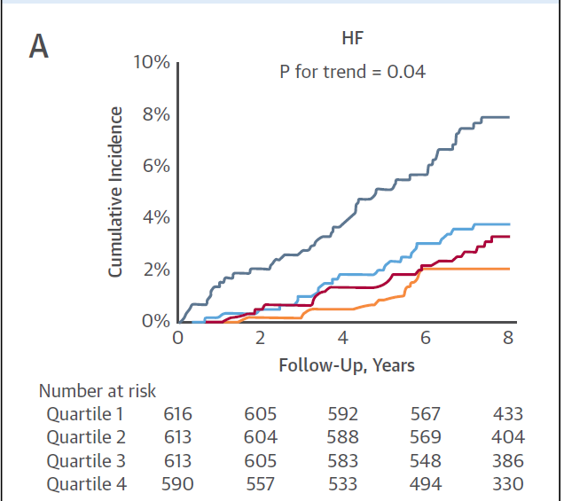

Longitudinal Change in Galectin-3 is predictive of future HF, CVD and Mortality.
Heart Failure
Ghorbani, A., Bhambhani, V., Christenson, R., et al. Longitudinal change in galectin-3 and incident cardiovascular outcomes. J Am Coll Cardiol 2018;72:3246-54.
Notes:
those with known CHD or HF eat four or five oily-fish meals per week or take the equivalent in omega-3 supplements; healthy people should consume around two fatty-fish meals per week or the same in supplements
adding just one [omega-3 PUFA] pill a day reduced HF deaths by between 8% and 9%
more studies are needed to explore the effects of various doses of omega-3 PUFAs on the primary and secondary reduction of AF and to determine whether the benefits are caused by antiarrhythmic effects, benefits on autonomic tone, or even anti-inflammatory effects,
There's no harm in taking extra—the only negative of extra is the calories. I don't think anyone thinks now that fish oil is doing any harm."

Slide 65
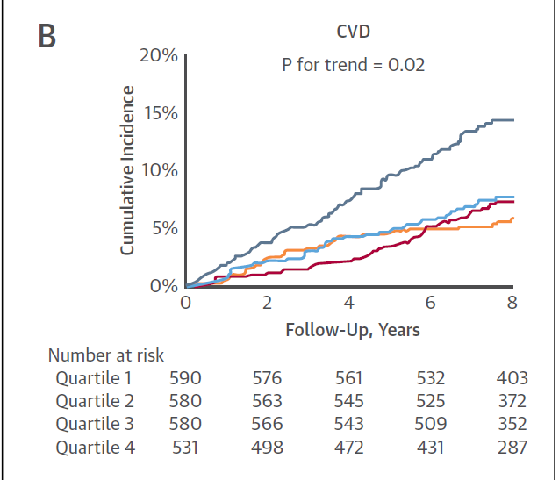
Longitudinal Change in Galectin-3 is predictive of future HF, CVD and Mortality.
CVD
Ghorbani, A., Bhambhani, V., Christenson, R., et al. Longitudinal change in galectin-3 and incident cardiovascular outcomes. J Am Coll Cardiol 2018;72:3246-54.
Notes:
those with known CHD or HF eat four or five oily-fish meals per week or take the equivalent in omega-3 supplements; healthy people should consume around two fatty-fish meals per week or the same in supplements
adding just one [omega-3 PUFA] pill a day reduced HF deaths by between 8% and 9%
more studies are needed to explore the effects of various doses of omega-3 PUFAs on the primary and secondary reduction of AF and to determine whether the benefits are caused by antiarrhythmic effects, benefits on autonomic tone, or even anti-inflammatory effects,
There's no harm in taking extra—the only negative of extra is the calories. I don't think anyone thinks now that fish oil is doing any harm."

Slide 66
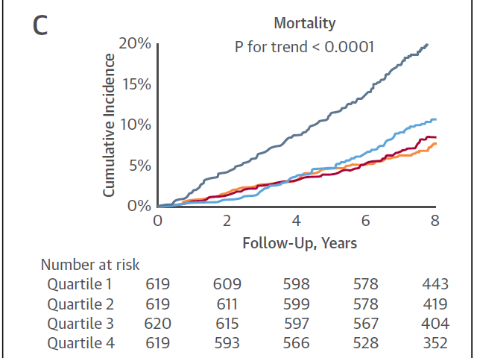
Longitudinal Change in Galectin-3 is predictive of future HF, CVD and Mortality.
Mortality
Ghorbani, A., Bhambhani, V., Christenson, R., et al. Longitudinal change in galectin-3 and incident cardiovascular outcomes. J Am Coll Cardiol 2018;72:3246-54.
Notes:
those with known CHD or HF eat four or five oily-fish meals per week or take the equivalent in omega-3 supplements; healthy people should consume around two fatty-fish meals per week or the same in supplements
adding just one [omega-3 PUFA] pill a day reduced HF deaths by between 8% and 9%
more studies are needed to explore the effects of various doses of omega-3 PUFAs on the primary and secondary reduction of AF and to determine whether the benefits are caused by antiarrhythmic effects, benefits on autonomic tone, or even anti-inflammatory effects,
There's no harm in taking extra—the only negative of extra is the calories. I don't think anyone thinks now that fish oil is doing any harm."

Slide 67
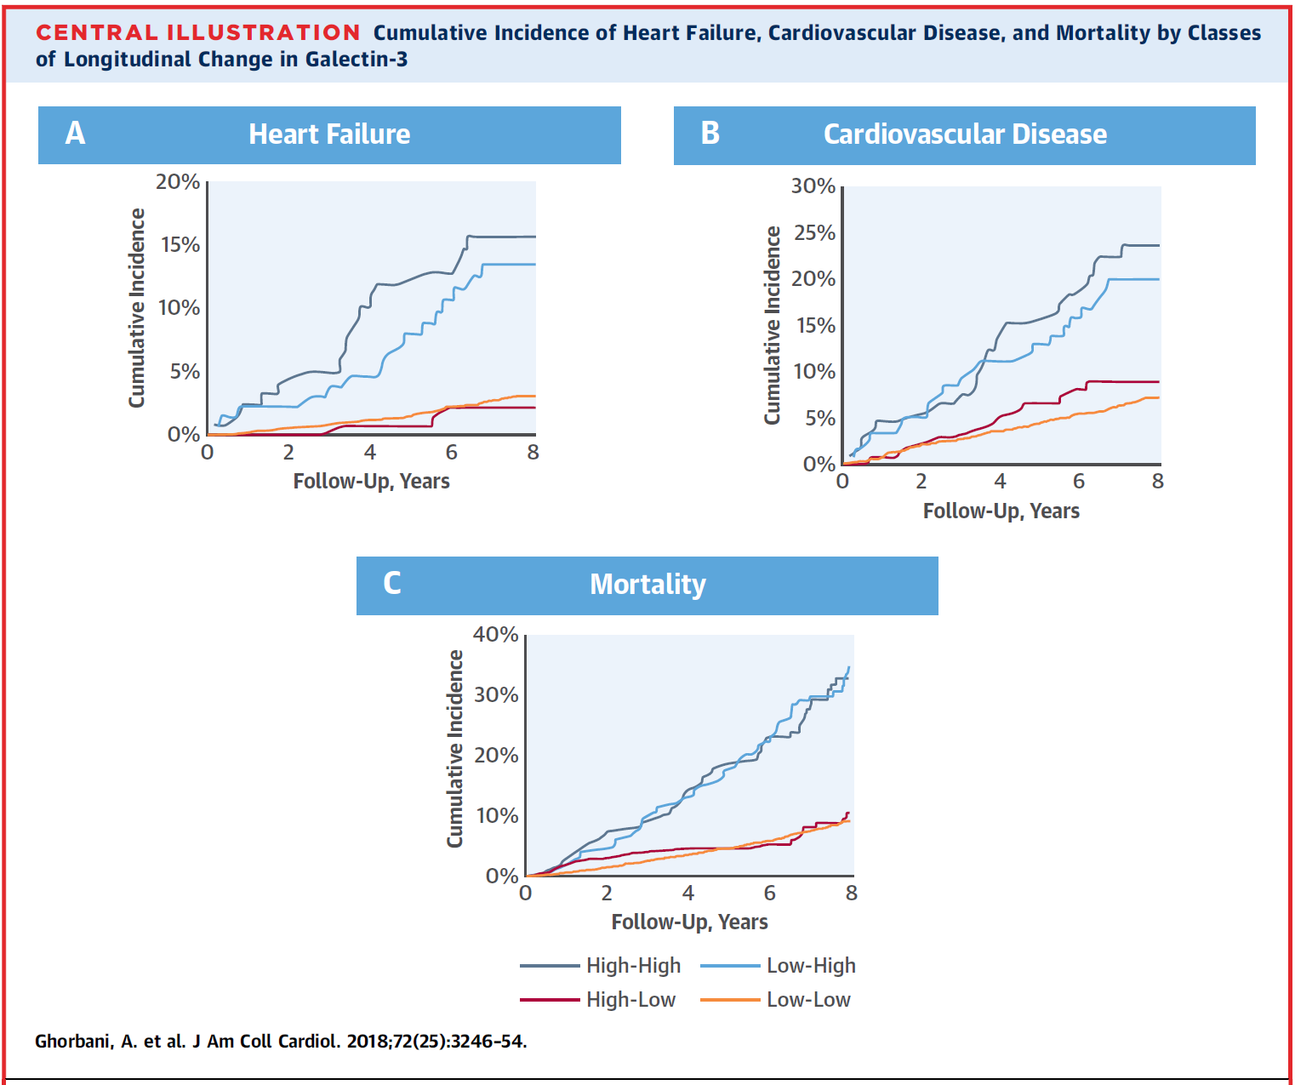
Longitudinal Change in Galectin-3 is predictive of future HF, CVD and Mortality.
Ghorbani, A., Bhambhani, V., Christenson, R., et al. Longitudinal change in galectin-3 and incident cardiovascular outcomes. J Am Coll Cardiol 2018;72:3246-54.
Notes:
those with known CHD or HF eat four or five oily-fish meals per week or take the equivalent in omega-3 supplements; healthy people should consume around two fatty-fish meals per week or the same in supplements
adding just one [omega-3 PUFA] pill a day reduced HF deaths by between 8% and 9%
more studies are needed to explore the effects of various doses of omega-3 PUFAs on the primary and secondary reduction of AF and to determine whether the benefits are caused by antiarrhythmic effects, benefits on autonomic tone, or even anti-inflammatory effects,
There's no harm in taking extra—the only negative of extra is the calories. I don't think anyone thinks now that fish oil is doing any harm."

Slide 68
Longitudinal Change in Galectin-3 is predictive of future HF, CVD and Mortality.
Three main findings:
Traditional CV risk factors, including older age, HTN, DM, and BMI, are associated with rise in Gal-3 over time, the largest increases in Gal-3 occur with intervening events including the development of CKD and HF.
Data demonstrate that longitudinal change in Gal-3 above a single baseline measure is independently associated with the development of future HF, CVD, and all-cause mortality. Persistently high Gal-3 levels, and those who had low baseline and high subsequent levels of Gal-3 had a >2-fold increased hazard of future HF compared with individuals with persistently low Gal-3 levels.
Third, change in Gal-3 predicts both HFpEF and HFrEF. These data highlight the potential role of serial Gal-3 measurements in informing cardiovascular risk.
Ghorbani, A., Bhambhani, V., Christenson, R., et al. Longitudinal change in galectin-3 and incident cardiovascular outcomes. J Am Coll Cardiol 2018;72:3246-54.

Slide 69
Longitudinal Change in Galectin-3 is predictive of future HF, CVD and Mortality.
BaleDoneen Take-Away:
1. Galectin 3 is independently predictive of heart failure, CVD and Mortality.
2. Following Galectin 3 allows for proper monitoring of microvascular disease of the heart and overall heart health.
3. Should be part of the BDM ‘heart health’ panel – hsTn, NT-ProBNP and Galectin3 all provide insight into the health of the myocardial cells.
4. Remember – we are trying to treat something we hope our patient never feels – ie: CHF, microblockages, etc.
5. Has value in patients on all levels – since the data is very strong towards progression to HF, consider its value with Blood pressure maintenance, OSA monitoring, Exercise, stress, diet, optimal care.
Ghorbani, A., Bhambhani, V., Christenson, R., et al. Longitudinal change in galectin-3 and incident cardiovascular outcomes. J Am Coll Cardiol 2018;72:3246-54.

Slide 70



Slide 71

Everyone loves their
PCSK9 inhibitors

Slide 72
Persistent arterial wall inflammation in patients with elevated lipoprotein(a) despite strong LDL reduction by PCSK9
Subjects with Lp(a) elevation have increased arterial wall inflammation and cardiovascular risk.
In patients at increased cardiovascular risk, arterial wall inflammation is reduced following lipid-lowering therapy by statin treatment or lipoprotein apheresis.
However, it is unknown whether lipid-lowering treatment in elevated Lp(a) subjects alters arterial wall inflammation. We evaluated whether evolocumab, which lowers both low-density lipoprotein cholesterol (LDL-C) and Lp(a), attenuates arterial wall inflammation in patients with elevated Lp(a).
Stiekima, L., Stroes, E., Verweij., S., et al. Persistent arterial wall inflammation in patients with elevated lipoprotein(a) despite strong LDL reduction by PCSK-9. European Heart J (2018)0,1-8.

Slide 73
Persistent arterial wall inflammation in patients with elevated lipoprotein(a) despite strong LDL reduction by PCSK9
Evolocumab treatment in patients with median baseline Lp(a) 200.0 nmol/L led to a large reduction in LDL-C and a small reduction in Lp(a), resulting in persistent elevated Lp(a) levels.
The researcher’s hypothesis is that the residual lipo(a) elevation may have contributed to the unaltered arterial wall inflammation
Stiekima, L., Stroes, E., Verweij., S., et al. Persistent arterial wall inflammation in patients with elevated lipoprotein(a) despite strong LDL reduction by PCSK-9. European Heart J (2018)0,1-8.
Notes:
How was inflammation measured?
18F-FDG PET/CT scans were performed on dedicated PET/CT scanners. Patients fasted for >_6 h prior to infusion of 240 MBq of 18F-FDG; 90 min later, an ultra-low dose (20 mAs), non-contrast enhanced omputed tomography of the carotid arteries and ascending thoracic aorta for attenuation correction and anatomic co-registration was performed, followed by PET. Images were analysed using a dedicated US Food and Drug Administration-approved analysis software package (OsiriX MD, Pixmeo SARL, Switzerland). An experienced radiologist blinded to all patient characteristics analysed the PET/CT images; 10% of all datasets were reanalysed by a separate analyst, and for a second time by the primary analyst, to assess inter- and intra-observer reproducibility. Target-to-background ratio was calculated from the ratio of the standardized uptake value of the artery (left carotid, right carotid, or thoracic aorta) and the background venous activity according to previously reported methods.15

Slide 74
Persistent arterial wall inflammation in patients with elevated lipoprotein(a) despite strong LDL reduction by PCSK9
Eligible patients were > 50 years of age, had a fasting LDL-C of >100mg/dL, an Lp(a) level of > 50mg/dL, and
arterial wall inflammation as assessed by PET/CT.
Inflammation: assessed by a most diseased segment target-to-background ratio (MDS TBR) of >1.6 in an index vessel measured with 18F-fluoro-deoxyglucose positron-emission tomography/computed tomography (18F-FDG PET/CT).
For patients receiving lipid-lowering therapy, the treatment and dosage had to be stable for > 8 weeks prior to screening. Key exclusion criteria included diabetes mellitus and a cardiovascular event within 3months before randomization
Stiekima, L., Stroes, E., Verweij., S., et al. Persistent arterial wall inflammation in patients with elevated lipoprotein(a) despite strong LDL reduction by PCSK-9. European Heart J (2018)0,1-8.

Slide 75
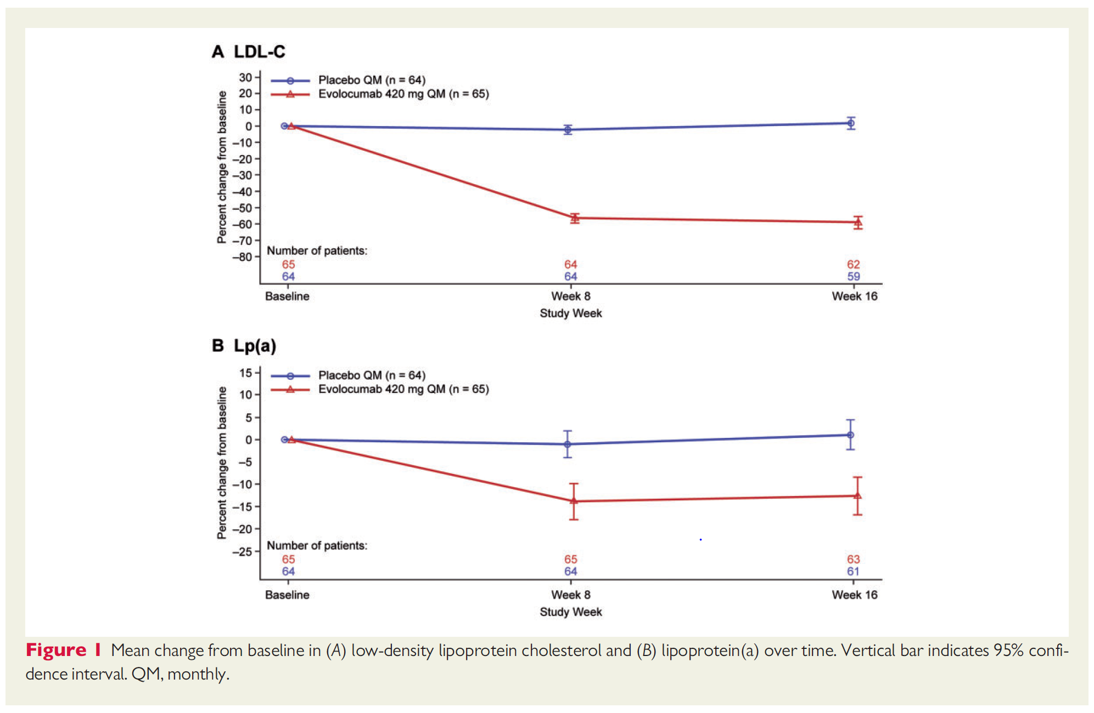
Persistent arterial wall inflammation in patients with elevated lipoprotein(a) despite strong LDL reduction by PCSK9
Stiekima, L., Stroes, E., Verweij., S., et al. Persistent arterial wall inflammation in patients with elevated lipoprotein(a) despite strong LDL reduction by PCSK-9. European Heart J (2018)0,1-8.

Slide 76
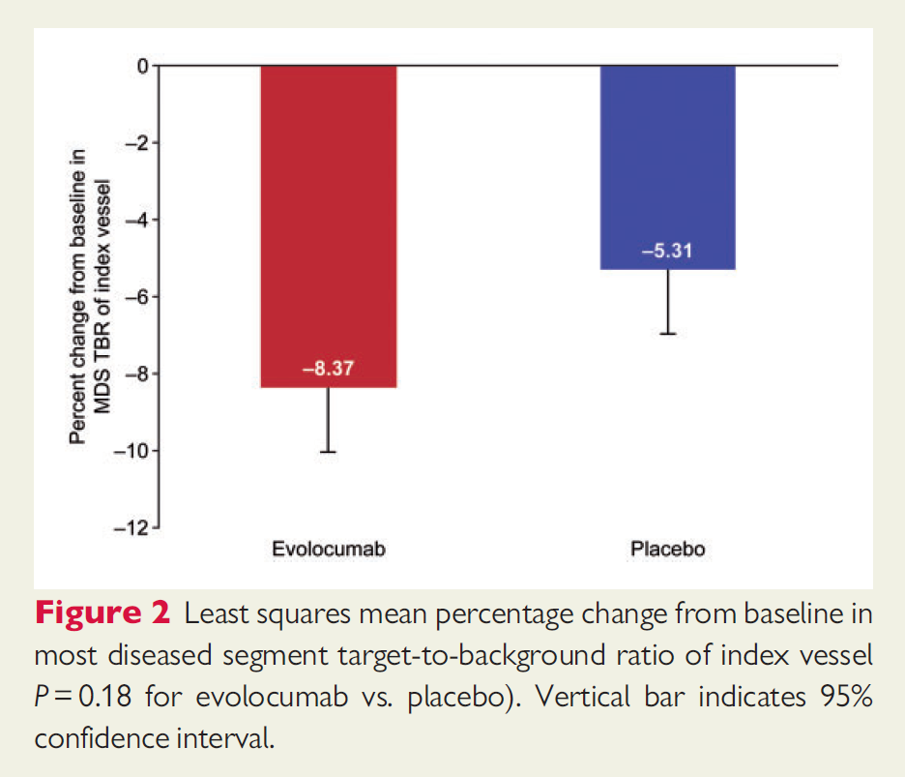
Persistent arterial wall inflammation in patients with elevated lipoprotein(a) despite strong LDL reduction by PCSK9
Stiekima, L., Stroes, E., Verweij., S., et al. Persistent arterial wall inflammation in patients with elevated lipoprotein(a) despite strong LDL reduction by PCSK-9. European Heart J (2018)0,1-8.

Slide 77
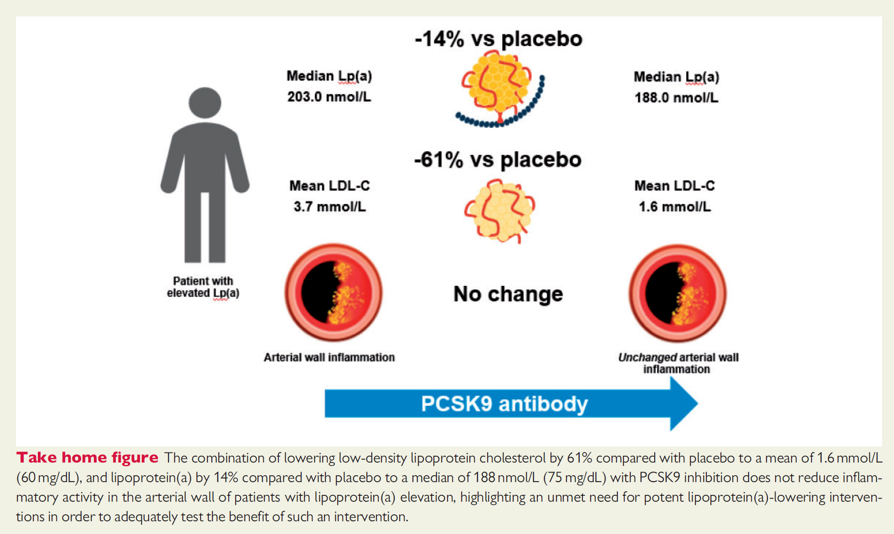
Persistent arterial wall inflammation in patients with elevated lipoprotein(a) despite strong LDL reduction by PCSK9
Stiekima, L., Stroes, E., Verweij., S., et al. Persistent arterial wall inflammation in patients with elevated lipoprotein(a) despite strong LDL reduction by PCSK-9. European Heart J (2018)0,1-8.

Slide 78
Persistent arterial wall inflammation in patients with elevated lipoprotein(a) despite strong LDL reduction by PCSK9
BaleDoneen Take-Away
1. First question is – Would a drop in Lipo(a) of 14% make a statistical difference on CVD? Let’s examine other data
Stiekima, L., Stroes, E., Verweij., S., et al. Persistent arterial wall inflammation in patients with elevated lipoprotein(a) despite strong LDL reduction by PCSK-9. European Heart J (2018)0,1-8.

Slide 79
Lipo (a) Change in One Year Follow-up Predict CV Risk in CAD Pts
An increase >13% relative to a decrease of >13% generated a significant increased risk
HR for CV event- 1.21 (95%CI,1.06–1.39) P=0.005
HR for CHD event- 1.21 (95%CI,1.05–1.39) P=0.009
That is a relative 26% difference = 21% decreased risk in one year
FOURIER decreased lipo (a) 26.9% over two years = ~ 42% decreased risk.
Nestel, P. J., et. al. (2013). Plasma Lipoprotein(a) Concentration Predicts Future Coronary and Cardiovascular Events in Patients With Stable Coronary Heart Disease. Arteriosclerosis, Thrombosis, and Vascular Biology. doi: 10.1161/atvbaha.113.302479

Slide 80
Persistent arterial wall inflammation in patients with elevated lipoprotein(a) despite strong LDL reduction by PCSK9
BaleDoneen Take-Away
1. First question is – Would a drop in Lipo(a) of 14% make a statistical difference on CVD? Let’s examine other data -
2. This data validates the importance of using statin therapy (even low dose) to control vascular disease regardless of LDL levels or lipo(a) levels. Let’s take a look at a statin study that evaluated the inflammatory impact using the same PET technology.
Stiekima, L., Stroes, E., Verweij., S., et al. Persistent arterial wall inflammation in patients with elevated lipoprotein(a) despite strong LDL reduction by PCSK-9. European Heart J (2018)0,1-8.

Slide 81
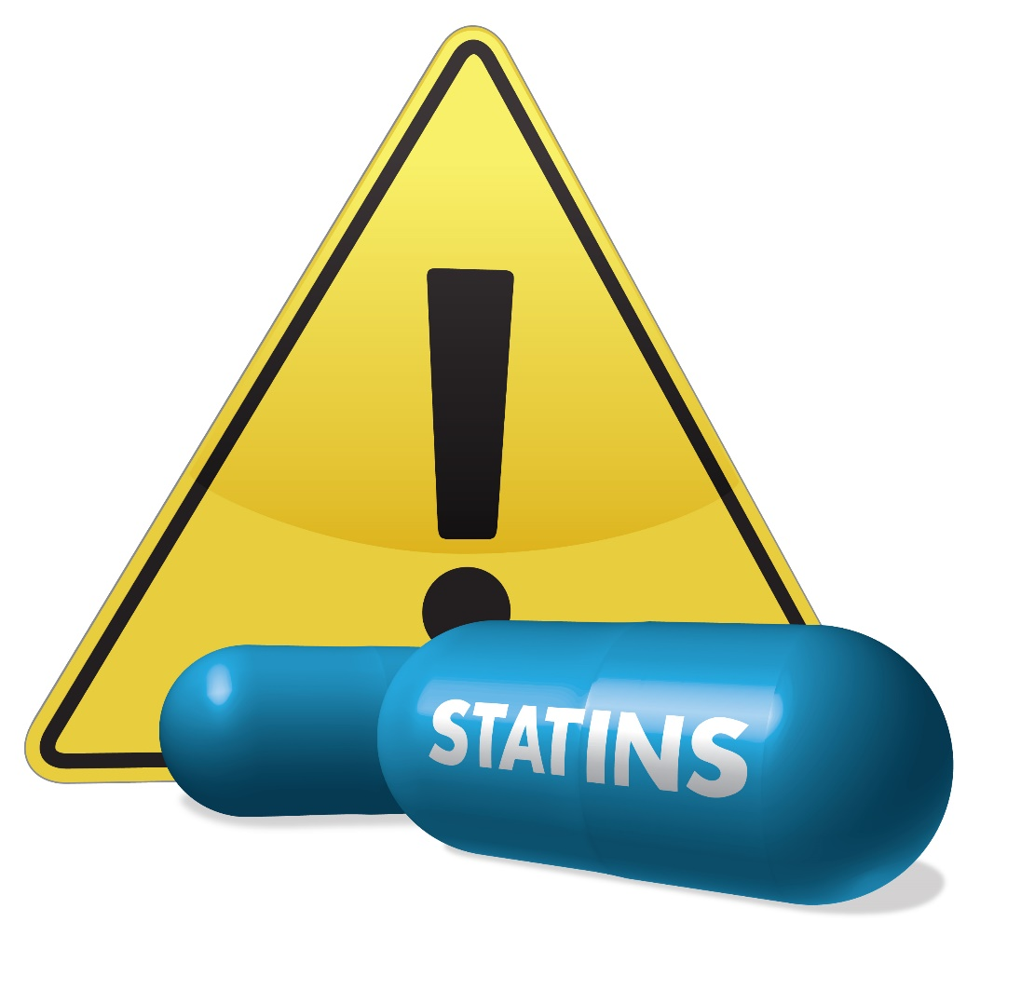
What about statins and inflammation?

Slide 82
Coronary Plaque Morphology and the Anti-Inflammatory impact of Statin Therapy
Multicenter study, 55 subjects with or at high risk for atherosclerosis underwent F-fluorodeoxyglucose positron emission tomographic/computed tomographic (PET) imaging at baseline and after 12 weeks of treatment with atorvastatin.
Intended to characterize the presence of high risk morphology (HRM) - (defined as noncalcified or partially calcified plaque).
Arterial inflammation (target-to-background ratio (TBR) was higher in segments with HRM than those without HRM.
Statin therapy improved the HRM of plaque regardless of LDL.
Singh, P., Emami, H., Subramanian, S., et al. Coronary plaque morphology and the anti-inflammatory impact of atorvastatin. Circ Cardiovasc Imaging. 2016;9.
Notes:
those with known CHD or HF eat four or five oily-fish meals per week or take the equivalent in omega-3 supplements; healthy people should consume around two fatty-fish meals per week or the same in supplements
adding just one [omega-3 PUFA] pill a day reduced HF deaths by between 8% and 9%
more studies are needed to explore the effects of various doses of omega-3 PUFAs on the primary and secondary reduction of AF and to determine whether the benefits are caused by antiarrhythmic effects, benefits on autonomic tone, or even anti-inflammatory effects,
There's no harm in taking extra—the only negative of extra is the calories. I don't think anyone thinks now that fish oil is doing any harm."

Slide 83
Coronary Plaque Morphology and the Anti-Inflammatory impact of Statin Therapy
Background:
Authors aimed to discover whether the anti-atherosclerotic benefits of statins may be differentially imparted depending on the severity of the underlying atherosclerotic process, citing that this may provide a secondary reason to prescribe statins.
Authors also state that atherosclerosis is a systemic inflammatory condition and that the anti-inflammatory actions of statins is one of its most important beneficial effects on atherosclerosis.
Singh, P., Emami, H., Subramanian, S., et al. Coronary plaque morphology and the anti-inflammatory impact of atorvastatin. Circ Cardiovasc Imaging. 2016;9.
Notes:
those with known CHD or HF eat four or five oily-fish meals per week or take the equivalent in omega-3 supplements; healthy people should consume around two fatty-fish meals per week or the same in supplements
adding just one [omega-3 PUFA] pill a day reduced HF deaths by between 8% and 9%
more studies are needed to explore the effects of various doses of omega-3 PUFAs on the primary and secondary reduction of AF and to determine whether the benefits are caused by antiarrhythmic effects, benefits on autonomic tone, or even anti-inflammatory effects,
There's no harm in taking extra—the only negative of extra is the calories. I don't think anyone thinks now that fish oil is doing any harm."

Slide 84
Coronary Plaque Morphology and the Anti-Inflammatory impact of Statin Therapy
Arterial imaging using 18-fluorodeoxy glucose positron emission tomography and computed tomography (FDG-PET/CT) is used to reproducibly measure atherosclerotic inflammation.
Atherosclerotic FDG uptake can be quantified noninvasively and significantly correlates with systemic inflammatory biomarkers, macrophage infiltration, and inflammatory cell gene expression within the arterial wall.
Furthermore, it provides an independent marker of risk for future atherothrombotic events and is modifiable by statin therapy.
Singh, P., Emami, H., Subramanian, S., et al. Coronary plaque morphology and the anti-inflammatory impact of atorvastatin. Circ Cardiovasc Imaging. 2016;9.
Notes:
those with known CHD or HF eat four or five oily-fish meals per week or take the equivalent in omega-3 supplements; healthy people should consume around two fatty-fish meals per week or the same in supplements
adding just one [omega-3 PUFA] pill a day reduced HF deaths by between 8% and 9%
more studies are needed to explore the effects of various doses of omega-3 PUFAs on the primary and secondary reduction of AF and to determine whether the benefits are caused by antiarrhythmic effects, benefits on autonomic tone, or even anti-inflammatory effects,
There's no harm in taking extra—the only negative of extra is the calories. I don't think anyone thinks now that fish oil is doing any harm."

Slide 85
Coronary Plaque Morphology and the Anti-Inflammatory impact of Statin Therapy
Randomized double-blind trial conducted at 10 US centers to investigate the impact of atorvastatin therapy on arterial wall inflammation using PET imaging.
83 subjects (78% men, median age 59 years), underwent baseline PET imaging. Only patients with evidence of arterial inflammation (TBR >1.6) in either aorta or carotids were included. Follow-up FDG-PET/CT images were obrtained after 12 weeks of atorvastatin therapy.
Inclusion criteria (one of the following)
CAD
Carotid artery disease
Cerebrovascular disease
Peripheral arterial disease
Type 2 DM
BMP 30-40 kg/m2 or waist >102 cm in men or >88 cm women
Singh, P., Emami, H., Subramanian, S., et al. Coronary plaque morphology and the anti-inflammatory impact of atorvastatin. Circ Cardiovasc Imaging. 2016;9.
Notes:
those with known CHD or HF eat four or five oily-fish meals per week or take the equivalent in omega-3 supplements; healthy people should consume around two fatty-fish meals per week or the same in supplements
adding just one [omega-3 PUFA] pill a day reduced HF deaths by between 8% and 9%
more studies are needed to explore the effects of various doses of omega-3 PUFAs on the primary and secondary reduction of AF and to determine whether the benefits are caused by antiarrhythmic effects, benefits on autonomic tone, or even anti-inflammatory effects,
There's no harm in taking extra—the only negative of extra is the calories. I don't think anyone thinks now that fish oil is doing any harm."

Slide 86
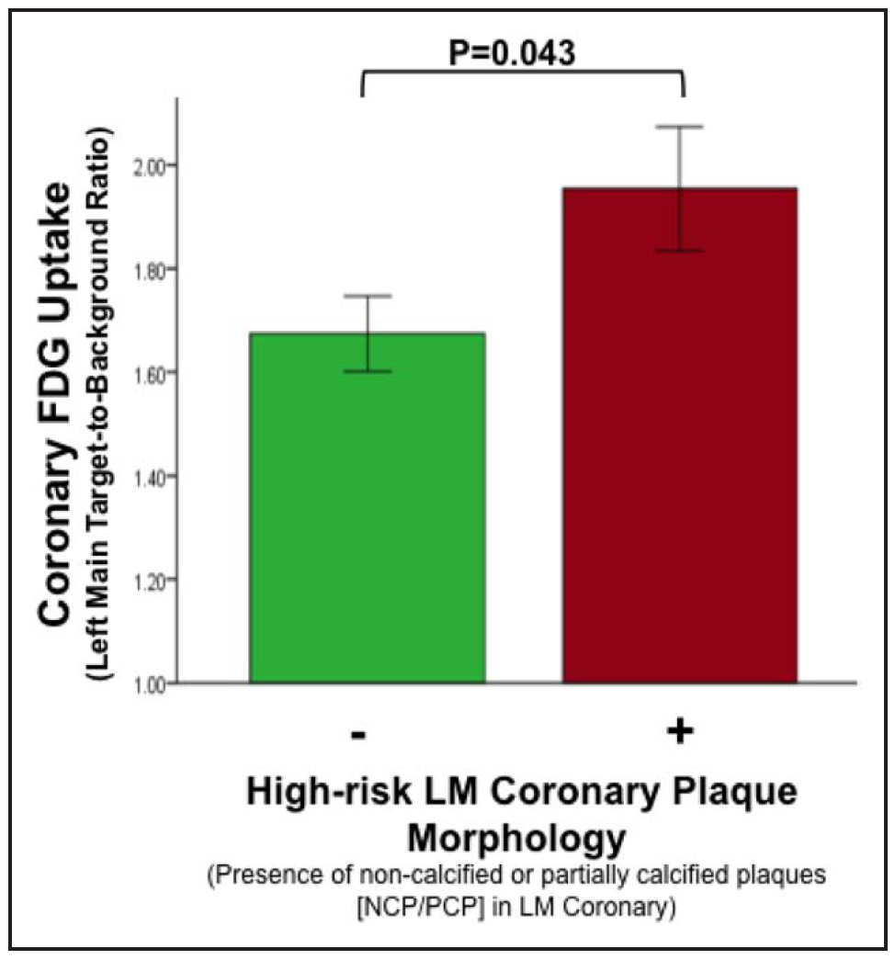
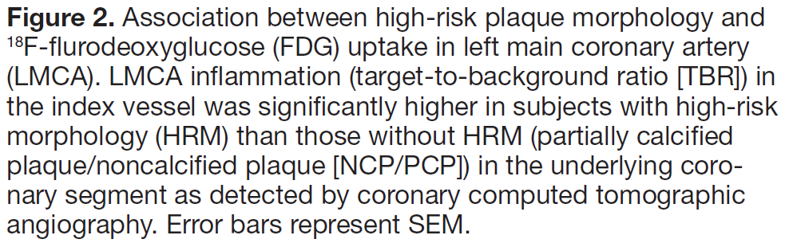
Coronary Plaque Morphology and the Anti-Inflammatory impact of Statin Therapy
Evaluation of the CTA images was performed while blinded to PET data and clinical inflammation. Plaque morphology was assed in the LMCA. An analysis examining morphological features of atherosclerotic plaques in the entire coronary arterial tree and carotid circulation was also performed.
Singh, P., Emami, H., Subramanian, S., et al. Coronary plaque morphology and the anti-inflammatory impact of atorvastatin. Circ Cardiovasc Imaging. 2016;9.

Slide 87
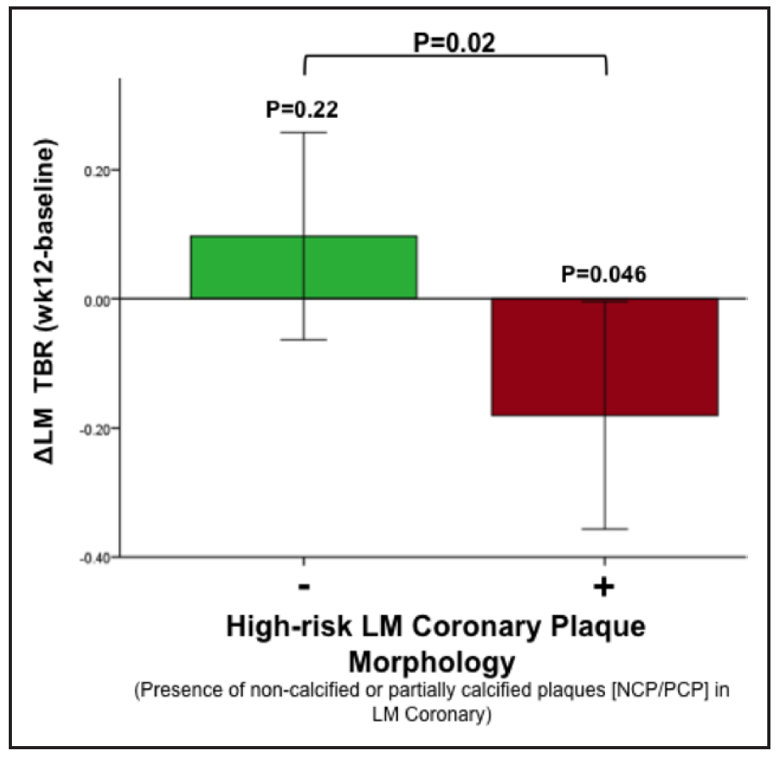
Coronary Plaque Morphology and the Anti-Inflammatory impact of Statin Therapy
Statin therapy results in a greater reduction of F-flurodeoxyglucose (FDG) uptake in the left main coronary artery with high-risk morphology.
Changes in LMCA target-to-background ratio after 12-wk statin therapy were more pronounced in arteries with HRM in coronary computer tomographic angiography.
Singh, P., Emami, H., Subramanian, S., et al. Coronary plaque morphology and the anti-inflammatory impact of atorvastatin. Circ Cardiovasc Imaging. 2016;9.
Notes:
those with known CHD or HF eat four or five oily-fish meals per week or take the equivalent in omega-3 supplements; healthy people should consume around two fatty-fish meals per week or the same in supplements
adding just one [omega-3 PUFA] pill a day reduced HF deaths by between 8% and 9%
more studies are needed to explore the effects of various doses of omega-3 PUFAs on the primary and secondary reduction of AF and to determine whether the benefits are caused by antiarrhythmic effects, benefits on autonomic tone, or even anti-inflammatory effects,
There's no harm in taking extra—the only negative of extra is the calories. I don't think anyone thinks now that fish oil is doing any harm."

Slide 88
Coronary Plaque Morphology and the Anti-Inflammatory impact of Statin Therapy
BaleDoneen Take-Away
Statin therapy results in reduction in coronary inflammation.
The anti-inflammatory impact of statins is substantially greater within morphologically more advanced coronary plaques.
These findings suggest that statin therapy are a a critical component for plaque management.
Inflammation impact remained robust after correcting for potential confounders such as baseline TBR, prestudy statin use, LDL concentration, and statin dose.
This study validates the BDM approach to our foundation therapy for atherosclerosis to include statin therapy regardless of lipid profile.
Inflammation is the keystone of the BDM.
Singh, P., Emami, H., Subramanian, S., et al. Coronary plaque morphology and the anti-inflammatory impact of atorvastatin. Circ Cardiovasc Imaging. 2016;9.

Slide 89

Co-Q10 and statin myopathy

Slide 90
Co-Q10 supplementation ameliorated
Statin-induced myopathy.
Aim – to determine if CoQ10 supplementation ameliorates statin-induced myopathy
PubMed, EMBASE, and Cochrane Library searches to identify randomized controlled trails investigating the effect of CoQ10 on statin-induced myopathy.
Total of 12 randomized controlled trails with a total of 575 patients were enrolled, of them 294 patients were in the CoQ10 supplementation group and 281 in placebo.
Qu, H., Guo, M., Chai, H., et al. Effects of coenzyme Q-10 on statin-induced myopathy: An updated meta-analysis of randomized controlled trials. J Am Heart Assoc. 2018;7:e009835.

Slide 91
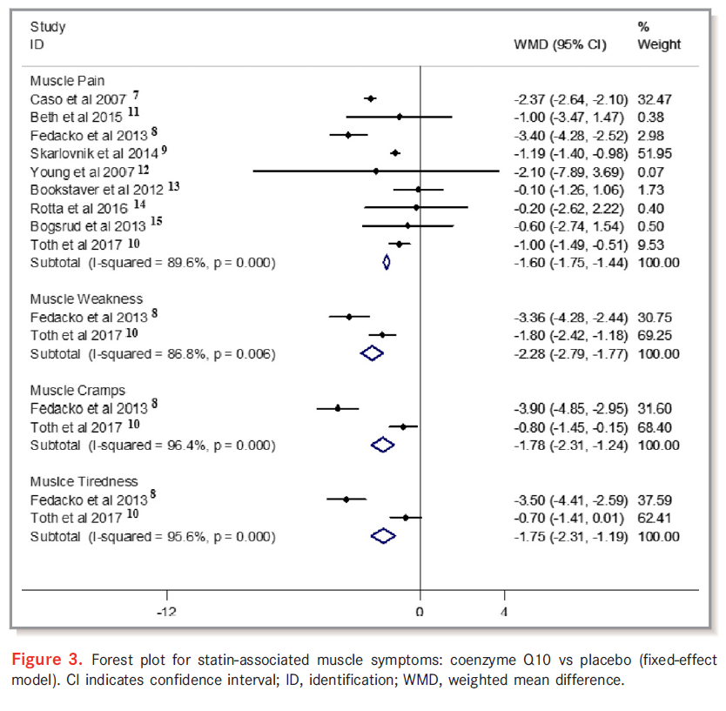
Co-Q10 supplementation ameliorated
Statin-induced myopathy.
Qu, H., Guo, M., Chai, H., et al. Effects of coenzyme Q-10 on statin-induced myopathy: An updated meta-analysis of randomized controlled trials. J Am Heart Assoc. 2018;7:e009835.

Slide 92
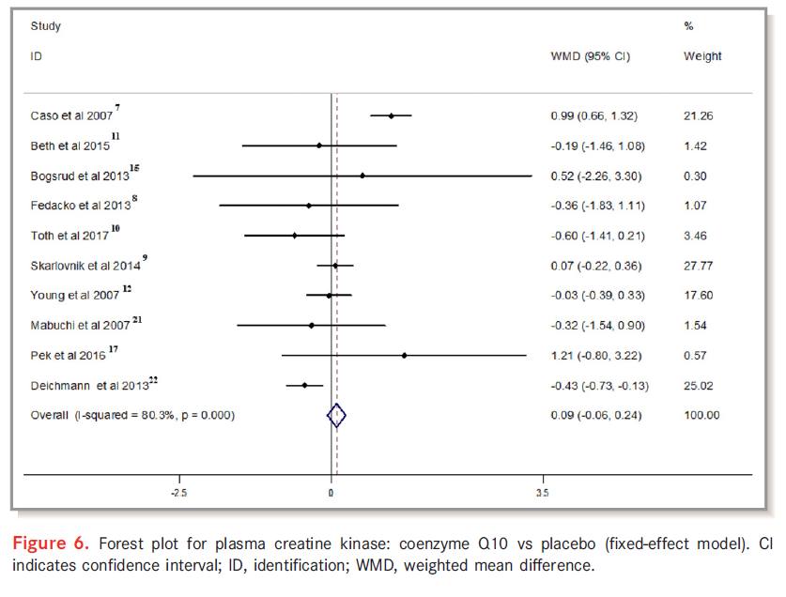
Co-Q10 supplementation ameliorated
Statin-induced myopathy.
Qu, H., Guo, M., Chai, H., et al. Effects of coenzyme Q-10 on statin-induced myopathy: An updated meta-analysis of randomized controlled trials. J Am Heart Assoc. 2018;7:e009835.

Slide 93
Co-Q10 supplementation ameliorated
Statin-induced myopathy.
Compared with placebo, CoQ10 supplementation ameliorated statin-associated muscle symptoms, such as:
muscle pain 1.60; 95% CI, 1.75 to 1.44; P<0.001
muscle weakness 2.28; 95% CI, 2.79 to 1.77; P=0.006
muscle cramp 1.78; 95% CI, 2.31 to 1.24; P<0.001
muscle tiredness 1.75; 95% CI, 2.31 to 1.19; P<0.001
Plasma creatinine kinase level did not change statistically with CoQ10 supplementation: 0.09; 95% CI, 0.06 to 0.24; P=0.23
Qu, H., Guo, M., Chai, H., et al. Effects of coenzyme Q-10 on statin-induced myopathy: An updated meta-analysis of randomized controlled trials. J Am Heart Assoc. 2018;7:e009835.
Notes:
Used weighted mean difference for change.

Slide 94
Co-Q10 supplementation ameliorated
Statin-induced myopathy.
BaleDoneen Take-Away:
Dose of CoQ10 was not taken into account nor was ubiquinol and ubiquinone.
We advocate dosing mg per pound (200lb = 200 mg)
We advocate using Ubiquinol vs Ubiquinone
Important when statin naïve patient is just starting on statin therapy to NOT mask a potential side effect. Start Co-Q10 AFTER they are stable on therapy.
Creatinine Kinase levels did not match symptoms or treatment affect.
Unclear how Co-Q10 serum levels match symptoms or therapy (from this data).
Qu, H., Guo, M., Chai, H., et al. Effects of coenzyme Q-10 on statin-induced myopathy: An updated meta-analysis of randomized controlled trials. J Am Heart Assoc. 2018;7:e009835.
Notes:
Used weighted mean difference for change.

Slide 95
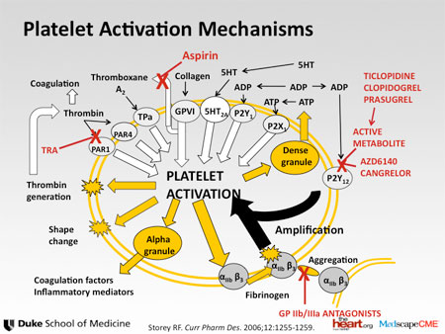
Dual Antiplatelet Therapy post TIA/CVA?

Slide 96
Comparative Effectiveness of Aspirin and Clopidogrel Versus
Aspirin in Acute Minor Stroke or Transient Ischemic Attack
This study aimed to compare the effectiveness of dual antiplatelet therapy with clopidogrel aspirin to that of aspirin monotherapy in patients with acute minor cerebral ischemia using a prospective, nationwide, multicenter, stroke registry database in South Korea.
Kim, J-T., Park, M-S., Choi, K-H., et al. Comparative effectiveness of aspirin and clopidogrel versus aspirin in acute minor stroke or transient ischemic attack. Stroke.2019;50:101-109.

Slide 97
Comparative Effectiveness of Aspirin and Clopidogrel Versus
Aspirin in Acute Minor Stroke or Transient Ischemic Attack
CHANCE trial (Clopidogrel in High-Risk Patients With
Acute Nondisabling Cerebrovascular Events) criteria:
Acute minor ischemic stroke defined as NIH Stroke Scale score ≤3 or lesion positive transient ischemic attack within 24 hours of onset
The primary outcome was the composite of all stroke (ischemic and hemorrhagic), myocardial infarction, and vascular death by 3 months.
Kim, J-T., Park, M-S., Choi, K-H., et al. Comparative effectiveness of aspirin and clopidogrel versus aspirin in acute minor stroke or transient ischemic attack. Stroke.2019;50:101-109.

Slide 98
Comparative Effectiveness of Aspirin and Clopidogrel Versus
Aspirin in Acute Minor Stroke or Transient Ischemic Attack
5590 patients meeting the eligibility criteria, age was 64±13 year and 62.6% were male.
Aspirin and combination of clopidogrel-aspirin were administered in 66.1% and 33.9% of patients, respectively.
Clopidogrel plus aspirin was associated with a lower risk of:
Primary vascular event outcome: HR, 0.76 [0.63–0.92]
All stroke events: HR, 0.74 [0.61–0.90]
Kim, J-T., Park, M-S., Choi, K-H., et al. Comparative effectiveness of aspirin and clopidogrel versus aspirin in acute minor stroke or transient ischemic attack. Stroke.2019;50:101-109.

Slide 99
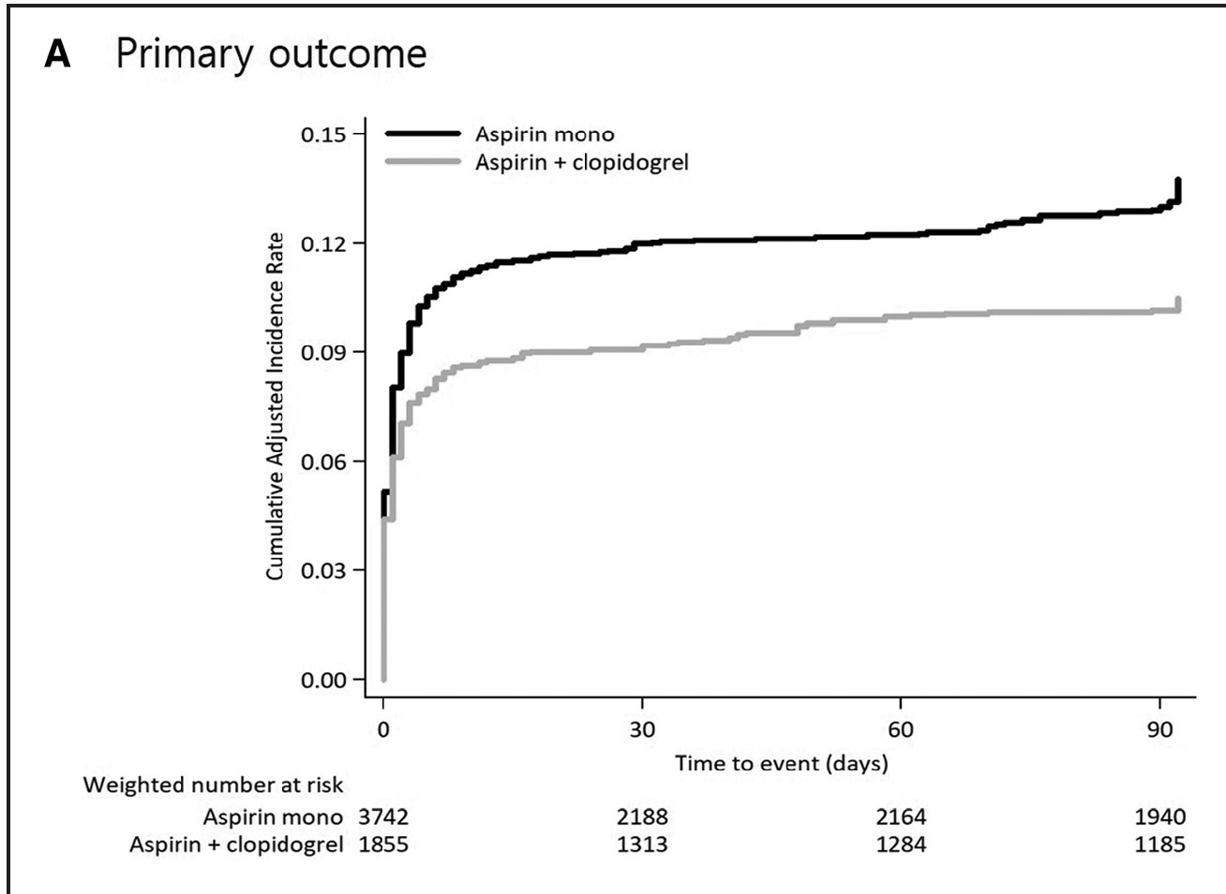
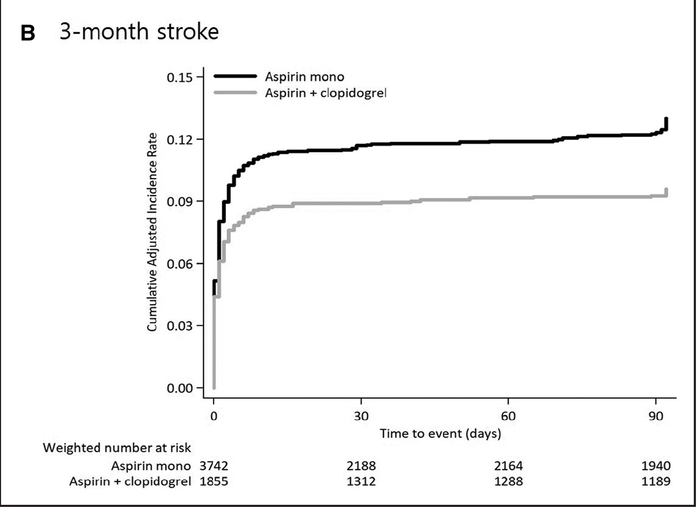
Comparative Effectiveness of Aspirin and Clopidogrel Versus
Aspirin in Acute Minor Stroke or Transient Ischemic Attack
Dual antiplatelet therapy with aspirin and clopidogrel was associated with reduced stroke, myocardial infarction, and vascular death in the 3 months following a presenting minor, non-cardioembolic ischemic stroke.
Kim, J-T., Park, M-S., Choi, K-H., et al. Comparative effectiveness of aspirin and clopidogrel versus aspirin in acute minor stroke or transient ischemic attack. Stroke.2019;50:101-109.

Slide 100
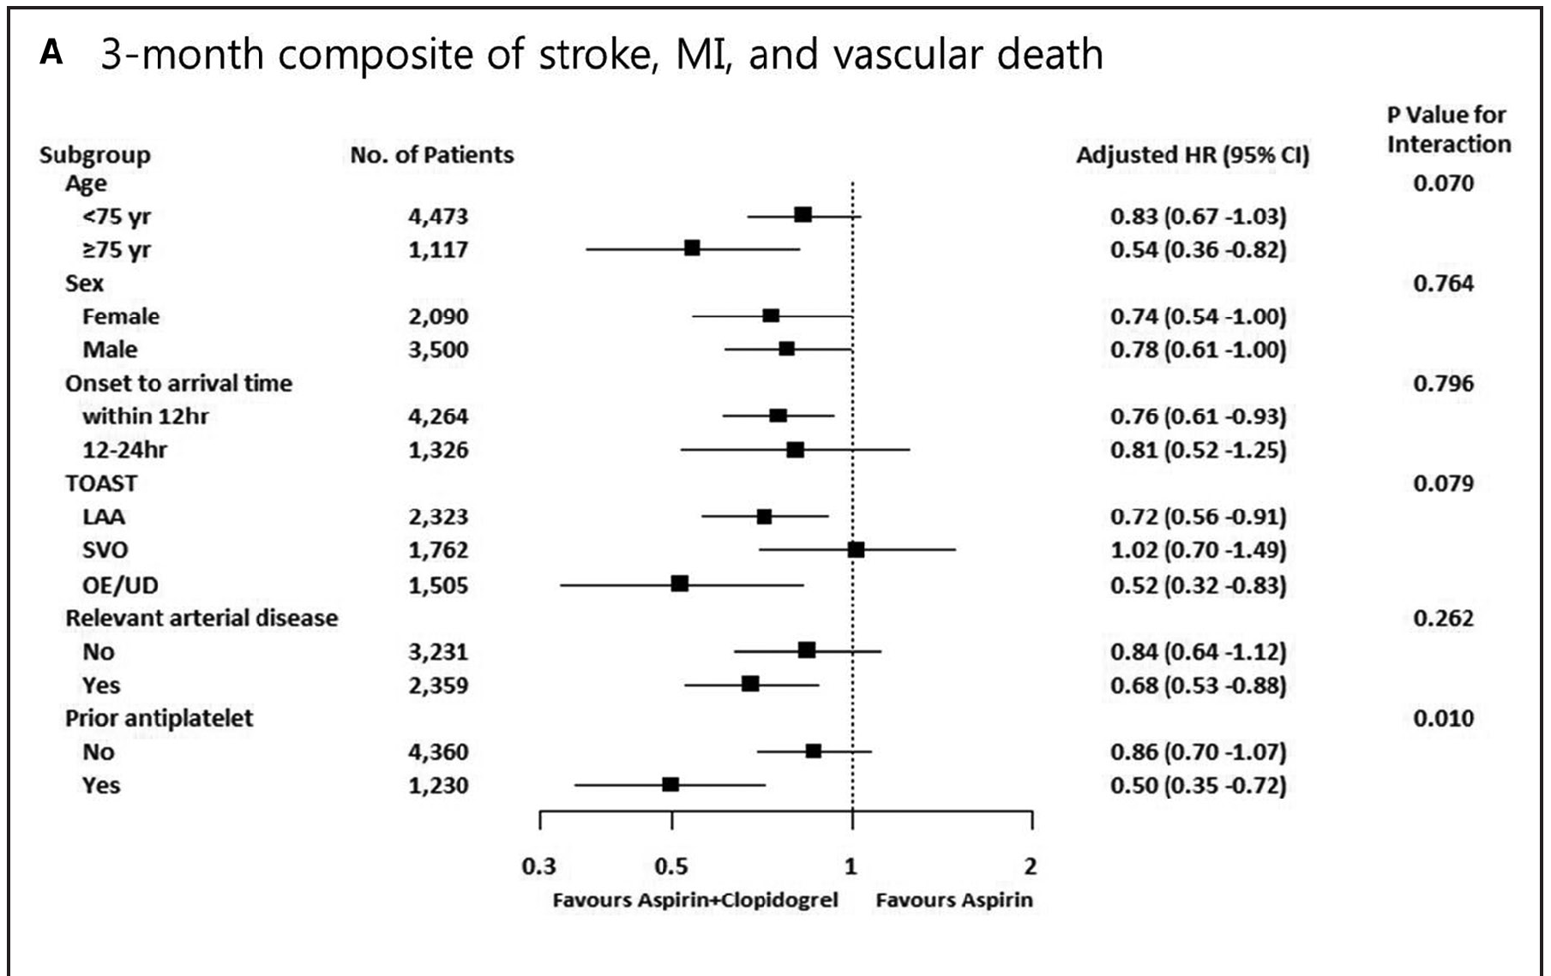
Comparative Effectiveness of Aspirin and Clopidogrel Versus
Aspirin in Acute Minor Stroke or Transient Ischemic Attack
Kim, J-T., Park, M-S., Choi, K-H., et al. Comparative effectiveness of aspirin and clopidogrel versus aspirin in acute minor stroke or transient ischemic attack. Stroke.2019;50:101-109.

Slide 101
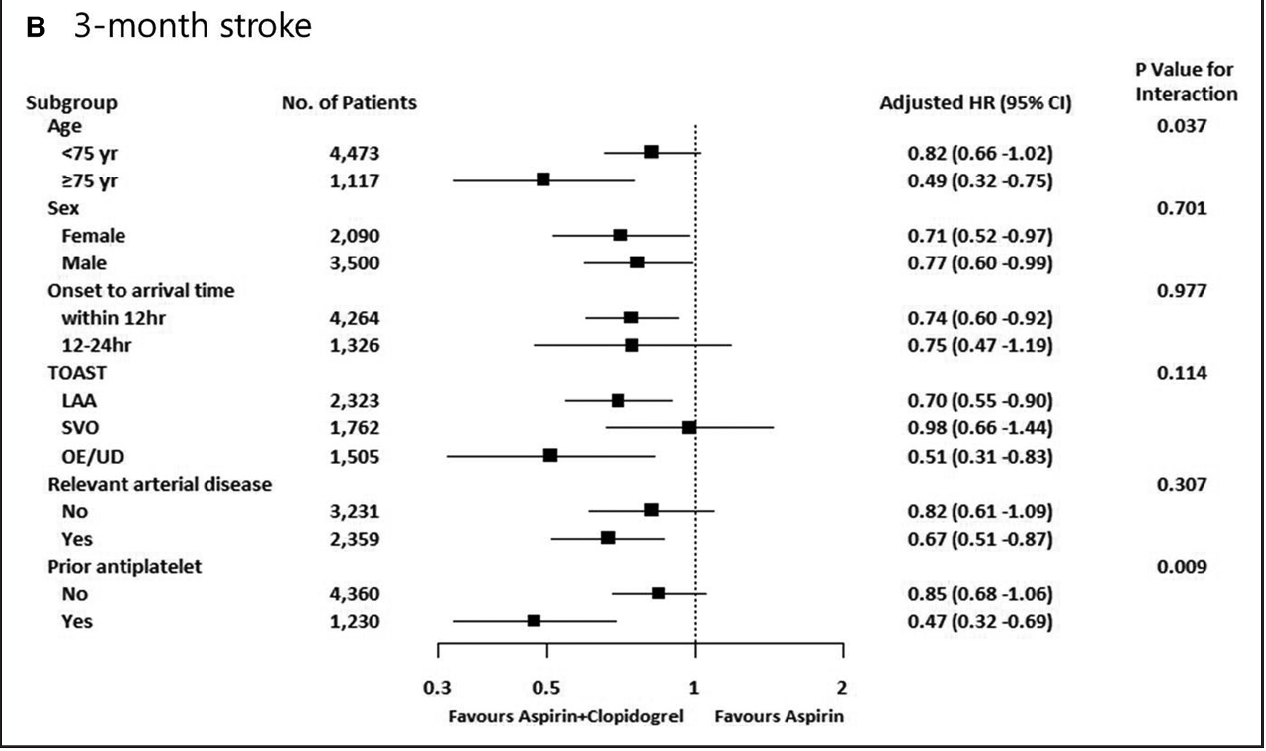
Comparative Effectiveness of Aspirin and Clopidogrel Versus
Aspirin in Acute Minor Stroke or Transient Ischemic Attack
Kim, J-T., Park, M-S., Choi, K-H., et al. Comparative effectiveness of aspirin and clopidogrel versus aspirin in acute minor stroke or transient ischemic attack. Stroke.2019;50:101-109.

Slide 102
Comparative Effectiveness of Aspirin and Clopidogrel Versus
Aspirin in Acute Minor Stroke or Transient Ischemic Attack
BaleDoneen Take-Away:
1. This data matches the Post Charisma Data
2. Each of these patients requires a complete EDFROG work-up.
3. Study did not go past 3 months – however this is adequate time to do a full BDM work-up to determine the root causes of inflammation and get them extinguished!
4. Determine aspirin and clopidogrel effectiveness with resistance and genetic testing.
5. TIA – ‘transient’ – be aware…….always!
Kim, J-T., Park, M-S., Choi, K-H., et al. Comparative effectiveness of aspirin and clopidogrel versus aspirin in acute minor stroke or transient ischemic attack. Stroke.2019;50:101-109.

Slide 103

So many great lifestyle studies to cover but not enough time tonight ☺
Join us in Atlanta next month to hear about……
1. ETOH – favorable in heart failure.
2. Coffee – yes!
3. Fruits and vegetables – cognitive function
4. Vegetarian diet vs AHA diet
5. Sleep of 6-8 hours ideal – 3 studies!
6. Sodium intake – be aware!
7. OGTT 1 hour – Thanks Dr. Larry Greenblatt!
Many MANY more ☺
Kim, J-T., Park, M-S., Choi, K-H., et al. Comparative effectiveness of aspirin and clopidogrel versus aspirin in acute minor stroke or transient ischemic attack. Stroke.2019;50:101-109.

Slide 104
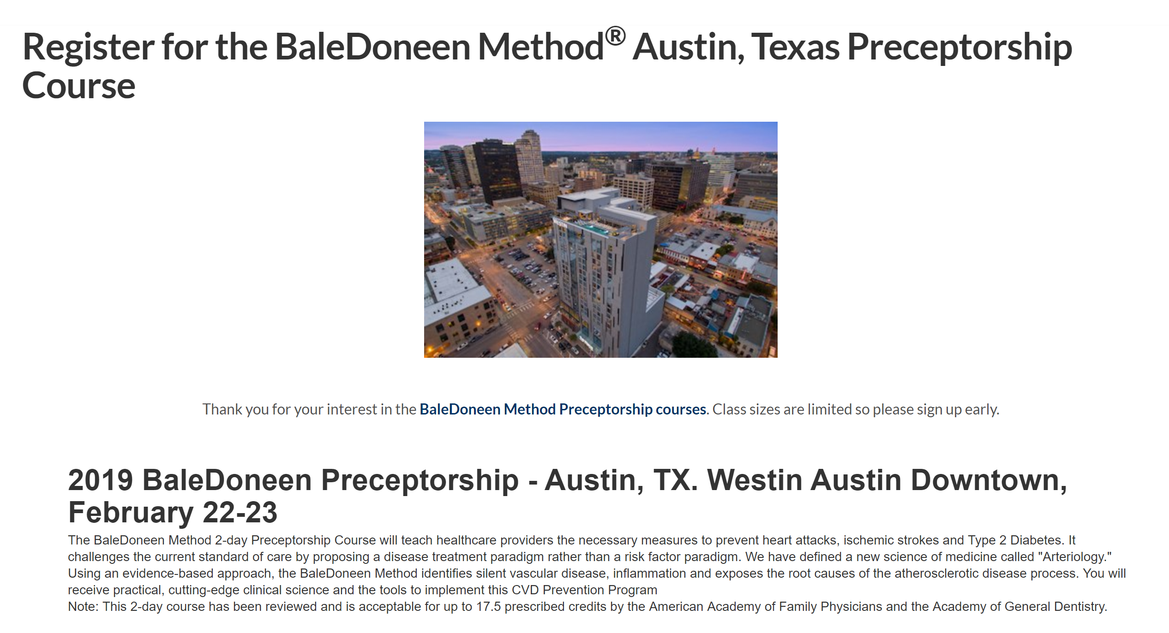
Next Preceptorship!

Slide 105

Sign up NOW! BDM Reunion
Space is filling up QUICKLY!

Slide 106

Thank you!
Keep on moving forward ☺

