Slide 1
Bale/Doneen Live
Scientific Update Session
Amy Doneen DNP, ARNP
July 12, 2017
5:30-6:30 pm PST

Slide 2

Happy Summer to all!

Slide 3
Scientific Update July 2017
1. Red Flags
Psoriasis Rx and CVD
Noise and Aircraft noise
2. Disease
CACS, CIMT, ABI
FFR and Microvascular
TIA and symptoms
3. Roots
Vitamin D.
4. Optimal
BP in puberty sets the stage
BP and CAD risk
BP tx should depend on CV Risk BP systolic <130 is best
5. Genetics
FH testing
6. Treatment
ETOH and Cognitive Risk
Don’t miss Breakfast
Fruits and Veggies lower PAD risk
Red Meat and Mortality Risk

Slide 4


Slide 5

High-risk coronary plaque in Psoriasis
Well known that psoriasis is a chronic inflammatory condition that increased CV risk. Current researcher to assess subclinical coronary artery disease (CAD) burden composed of non-calcified plaques with high risk qualities.
Population
n=105 psoriasis patients (age: average 35-65 years, 2/3 male)
n=100 hyperlipidemic patients eligible for statin therapy (NCEP ATPIII)
n=10 non-psoriasis healthy volunteers (HV)
Definitions:
CAD: Coronary Artery Disease
TB: Total Burden of coronary plaque
NCB: non-calcified burden of coronary plaque
HRP: High risk rupture prone plaque prevalence
Lerman, J., Joshi, A., Chaturvedi, A. et al. (2017). High risk coronary plaque in psoriasis. Circulation; 116.026859

Slide 6

High-risk coronary plaque in Psoriasis
Patients underwent coronary CT angiography (CCTA) for TB and NCB quantification and HRP identification.
HRP defined as:
low-attenuation (<30 HU)
positive remodeling (>1.10)
spotty calcification
A consecutive sample of the first 50 psoriasis patients were scanned again at 1 year following therapy.
Psoriasis therapy included: Methotrexate, anti-TNF, anti-IL12/IL23, anti-II17
Lerman, J., Joshi, A., Chaturvedi, A. et al. (2017). High risk coronary plaque in psoriasis. Circulation; 116.026859

Slide 7

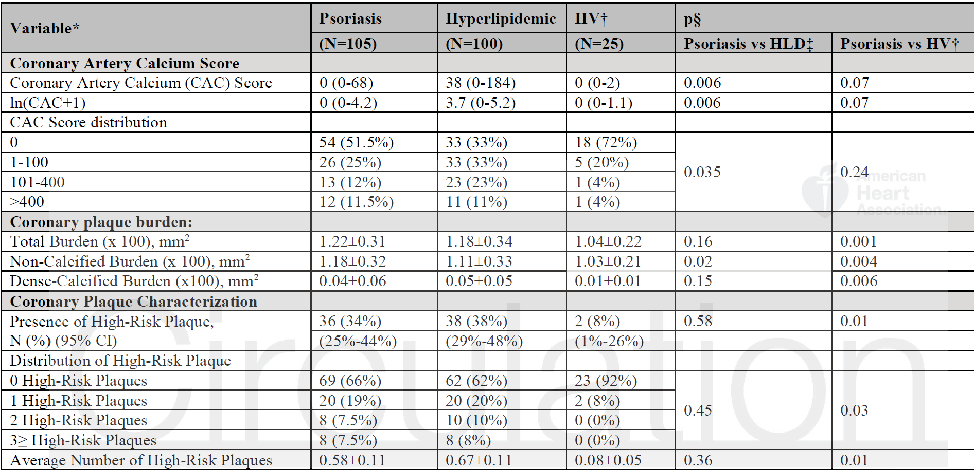
High-risk coronary plaque in Psoriasis
Lerman, J., Joshi, A., Chaturvedi, A. et al. (2017). High risk coronary plaque in psoriasis. Circulation; 116.026859

Slide 8

High-risk coronary plaque in Psoriasis
Psoriasis patients were:
1. Younger and at lower traditional risk than hyperlipidemic patients
2. Had increased NCB (mean + S.D. 1.18 +0.33 vs 1.11 +0.32, p=0.02)
3. Had similar HRP prevalence (p=0.58)
Compared to healthy, psoriasis patients had:
1. Increased TB (1.22+0.31 vs 1.04+0.22, p=0.001)
2. NCB (1.18+0.33 vs 1.03+0.21, p=0.004)
3. HRP prevalence beyond traditional risk (OR=6.0, 95% CI: 1.1-31.7; p=0.03)
Amongst psoriasis patients followed for 1-year,
improvement in psoriasis severity associated with:
1. Improvement in TB (p<0.001)
2. NCB (p<0.001) beyond traditional risk factors.
Leran, J., Joshi, A., Chaturvedi, A. et al. (2017). High risk coronary plaque in psoriasis. Circulation; 116.026859

Slide 9
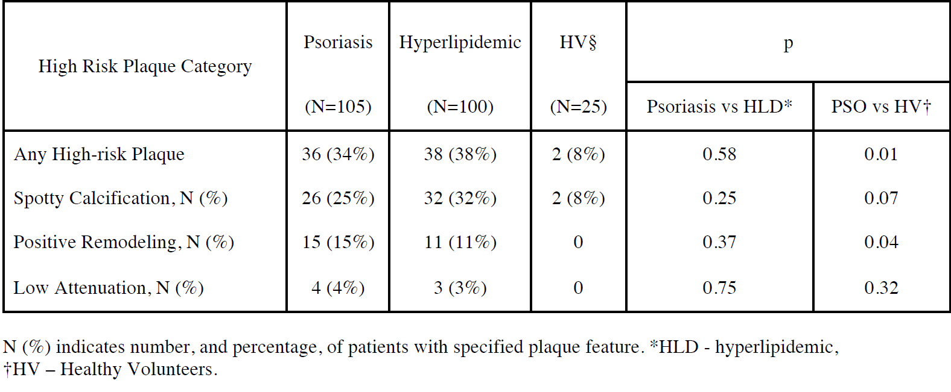
High-risk coronary plaque in Psoriasis
Lerman, J., Joshi, A., Chaturvedi, A. et al. (2017). High risk coronary plaque in psoriasis. Circulation; 116.026859

Slide 10
High-risk coronary plaque in Psoriasis
Psoriasis patients had greater NCB and increased HRP prevalence than healthy volunteers
Psoriasis patients had elevated NCB and equivalent HRP prevalence as older, hyperlipidemic patients.
Modulation of target organ inflammation (skin) associated with an improvement in NCB at 1 year – suggesting that control of remote sites of inflammation may translate to reduced CAD risk.
Lerman, J., Joshi, A., Chaturvedi, A. et al. (2017). High risk coronary plaque in psoriasis. Circulation; 116.026859

Slide 11
High-risk coronary plaque in Psoriasis
BaleDoneen Take-Away:
1. Psoriasis patients are younger when they experience their first CV event yet have lower FRS and often don’t meet the qualifications for statin therapy (Gelfand JM, JAMA. 2006;296:1735-1741).
2. Psoriasis is a systemic auto-immune disorder that increases vascular disease risk.
3. Auto-immune diseases are under the root cause tree – difficult to discriminate between red flag/root cause.
4. This study adds to the literature suggesting improving the auto-immune condition can have a positive impact on vascular inflammation.
4. Utilize our clinical tools for vascular inflammation – particularly in this high risk demographic.
Lerman, J., Joshi, A., Chaturvedi, A. et al. (2017). High risk coronary plaque in psoriasis. Circulation; 116.026859

Slide 12

Aircraft Noise

Slide 13


Aircraft Noise increases Blood Pressure
FLIGHT-RISK study was set out to test the effect of nocturnal aircraft noise on endothelial function, stress hormones, BP and inflammatory markers, sleeping quality, annoyance levels and coagulation markers in patients with established CAD or at high risk for developing CAD based on the Framingham score.
Randomized, cross-over, blinded fashion - subjects were exposed to simulated aircraft noise (own bedrooms – 60 repetitive noise events with window tilted open) vs no noise conditions.
Schmidt, F., Kolle, K., Kreuder, K. et al. (2015). Nightime aircraft noise impairs endothelial function and increases blood pressure in patients with or at risk for coronary artery disease. Clinic Res Cardiol. 104:23-30.

Slide 14
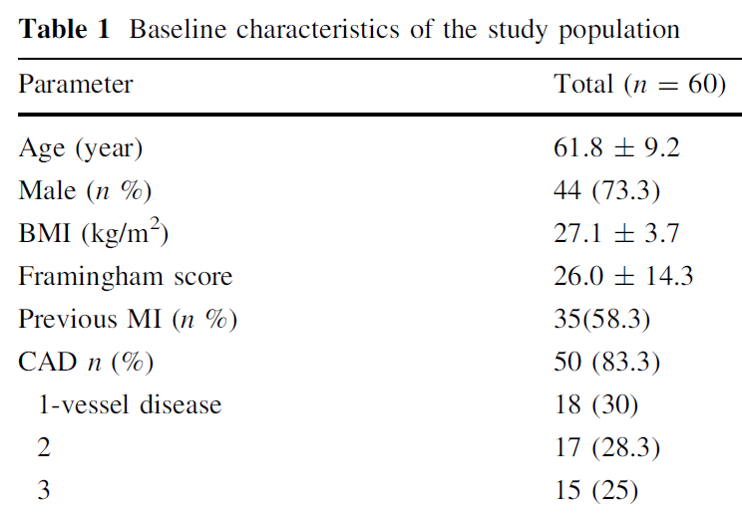
Aircraft Noise increases Blood Pressure
The study population did not have relevant sleep disorders
Schmidt, F., Kolle, K., Kreuder, K. et al. (2015). Nightime aircraft noise impairs endothelial function and increases blood pressure in patients with or at risk for coronary artery disease. Clinic Res Cardiol. 104:23-30.

Slide 15
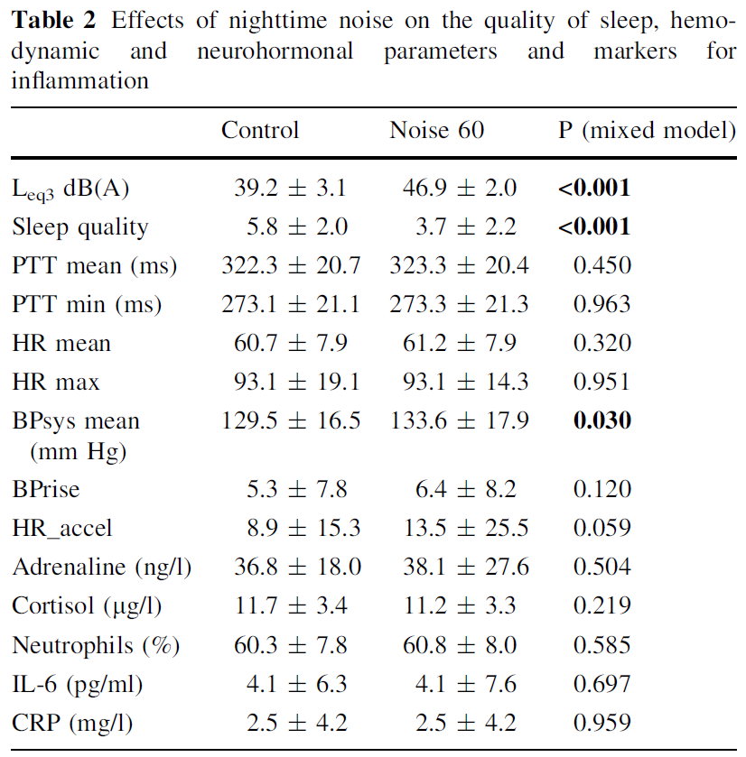
Aircraft Noise increases Blood Pressure
Long-term continuous sound level
Sleep Quality
SBP
Schmidt, F., Kolle, K., Kreuder, K. et al. (2015). Nightime aircraft noise impairs endothelial function and increases blood pressure in patients with or at risk for coronary artery disease. Clinic Res Cardiol. 104:23-30.

Slide 16
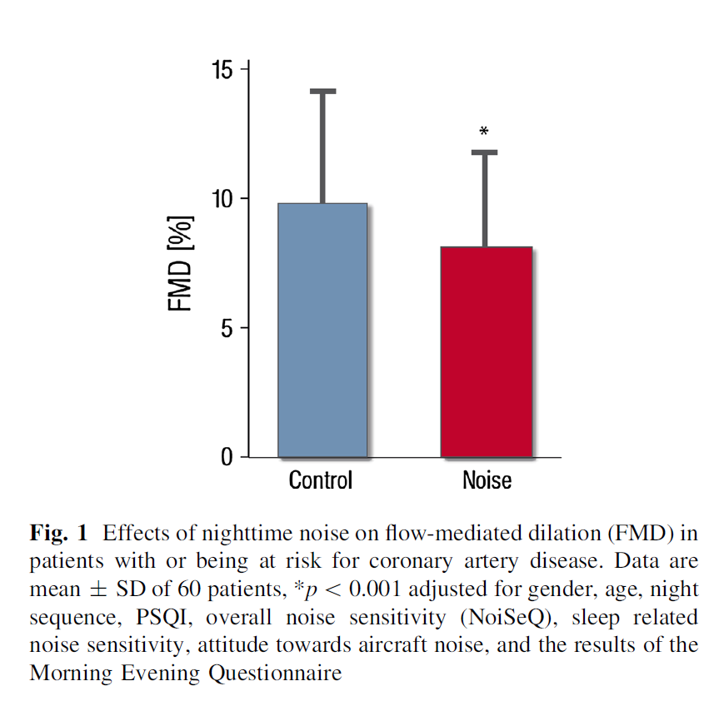
Aircraft Noise increases Blood Pressure
Flow-mediated dilatation (FMD)
P<0.001 with adjustments
Schmidt, F., Kolle, K., Kreuder, K. et al. (2015). Nightime aircraft noise impairs endothelial function and increases blood pressure in patients with or at risk for coronary artery disease. Clinic Res Cardiol. 104:23-30.

Slide 17
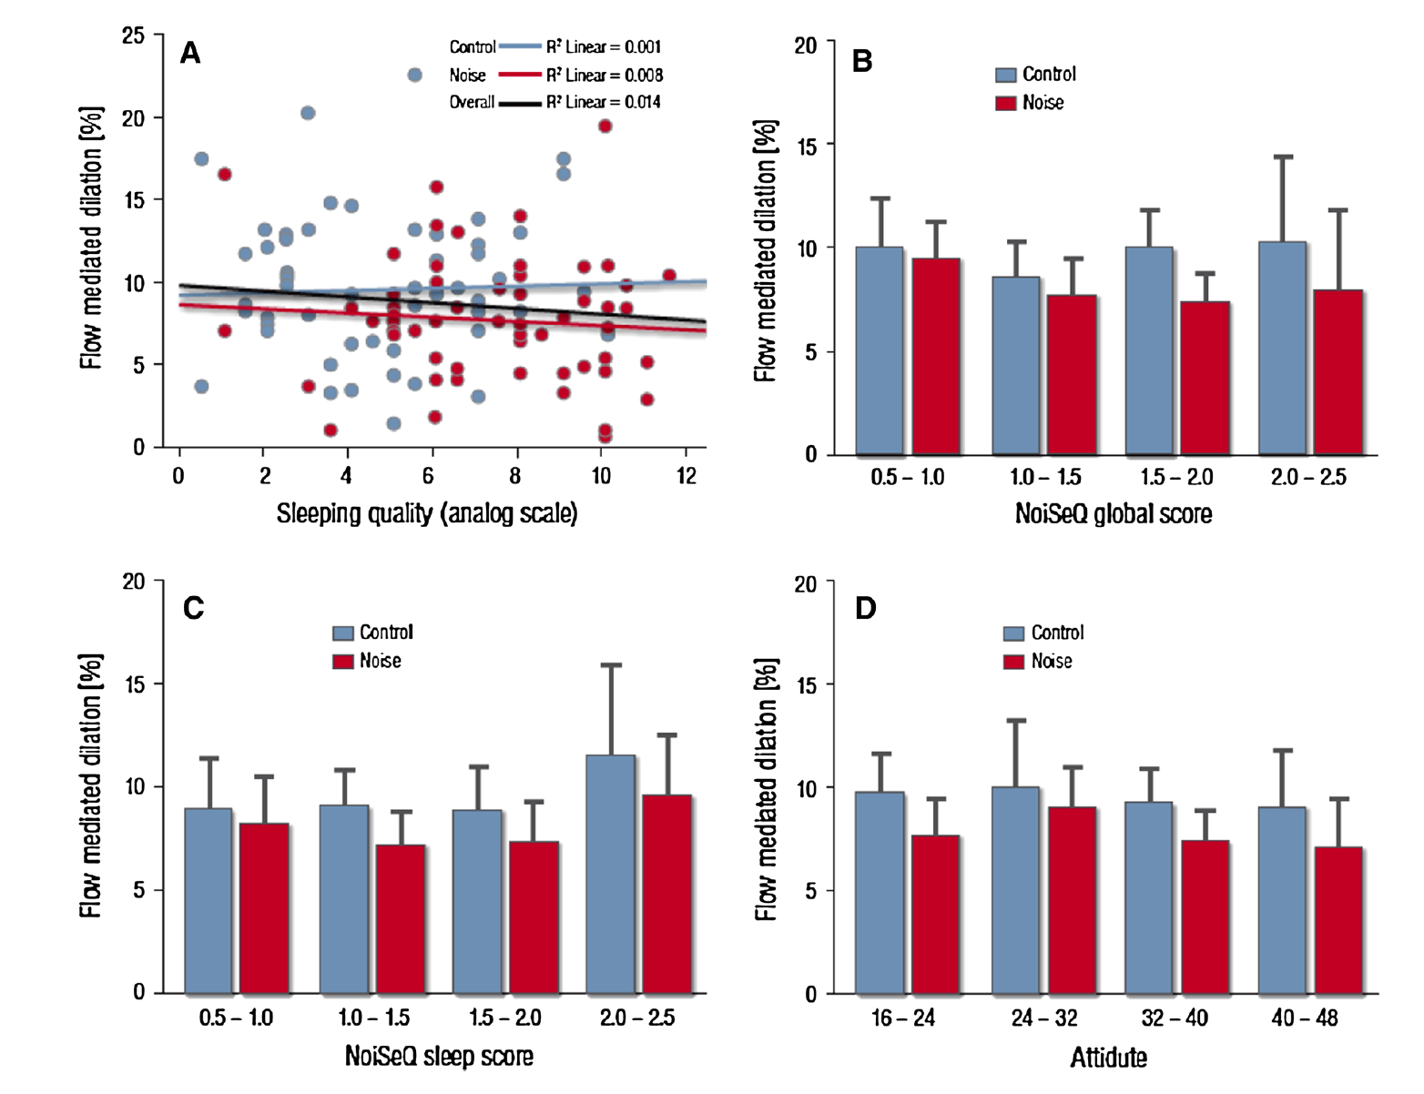
Aircraft Noise increases Blood Pressure
Schmidt, F., Kolle, K., Kreuder, K. et al. (2015). Nightime aircraft noise impairs endothelial function and increases blood pressure in patients with or at risk for coronary artery disease. Clinic Res Cardiol. 104:23-30.

Slide 18
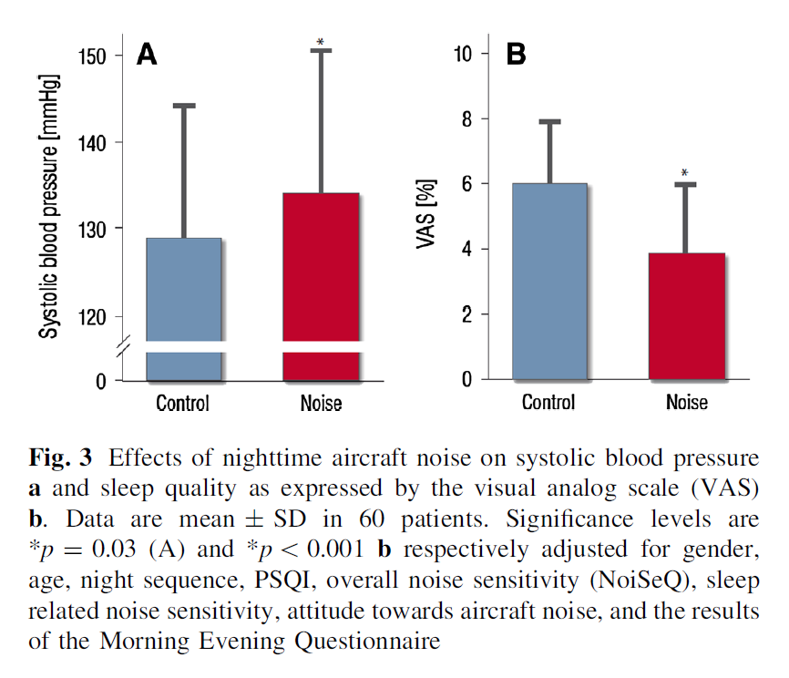
Aircraft Noise increases Blood Pressure
Systolic BP & Sleep Quality statistically worse with airplane noise – after full adjustments
Schmidt, F., Kolle, K., Kreuder, K. et al. (2015). Nightime aircraft noise impairs endothelial function and increases blood pressure in patients with or at risk for coronary artery disease. Clinic Res Cardiol. 104:23-30.

Slide 19
Aircraft Noise increases Blood Pressure
BaleDoneen Take-Away:
1. The present data demonstrates that nighttime aircraft noise markedly attenuates endothelium dependent vasodilation in patients with established and/or at high risk for CAD.
2. An increase in blood pressure and a marked decrease in sleep quality create a backdrop of potentially ‘regular’ risk factors for some people
3. Although airplane noise was utilized in the study – think about this research as the impact of disrupted sleep due to noise pollution.
Schmidt, F., Kolle, K., Kreuder, K. et al. (2015). Nightime aircraft noise impairs endothelial function and increases blood pressure in patients with or at risk for coronary artery disease. Clinic Res Cardiol. 104:23-30.

Slide 20
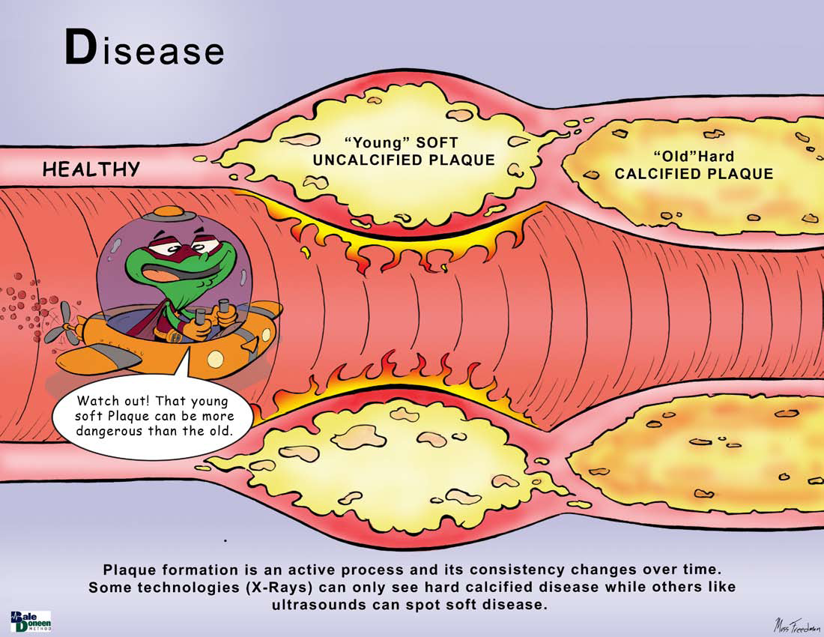

Slide 21
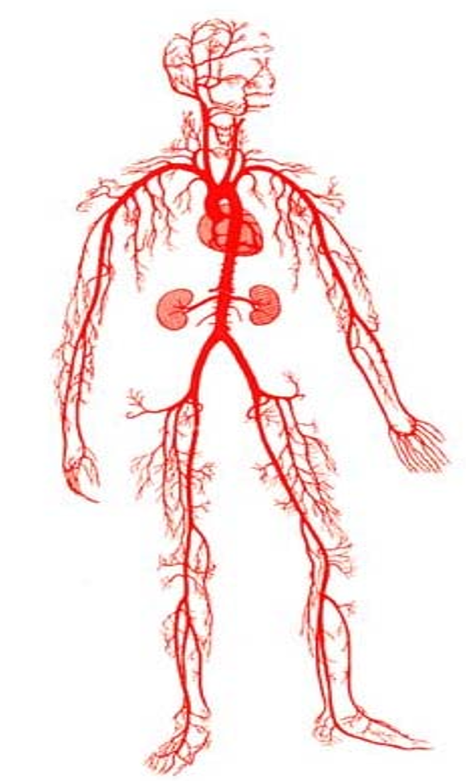
CACS, cIMT, ABI
Quantified CAC, CIMT and ABI: 3108 subjects (mean age 59.2 ± 7.7, 47.1% male) without prevalent CV diseases from the population-based Heinz Nixdorf Recall study.
Associations with incident major CV events (coronary event, stroke, CV death; n = 223) were assessed during a follow-up period of 10.3 ± 2.8 stratified by Framingham risk score
Henrike Geisel, M., Bauer, M., Hennig, F. et al. (2017). Comparison of coronary artery calcification, carotid intima-media thickness and ankle-brachial index for predicting 10-year incident cardiovascular events in the general population.
Eur Heart J; 38(23):1815-1822.

Slide 22
CACS, cIMT, ABI
All three markers were associated with CV events (HR [95%(CI)]:
CAC: 1.31 (1.23–1.39) per 1-unit increase vs.
CIMT: 1.27 (1.13–1.43) per 1 SD vs.
ABI: 1.30 (1.14–1.49) per 1 SD
CAC highest reclassification, while also for CIMT and ABI signif improvement in net-reclassification was observed [NRI (95% CI): CAC: 0.55 (0.42–0.69)
CIMT: 0.32 (0.19–0.45)
ABI: 0.19 (0.10–0.28)
Henrike Geisel, M., Bauer, M., Hennig, F. et al. (2017). Comparison of coronary artery calcification, carotid intima-media thickness and ankle-brachial index for predicting 10-year incident cardiovascular events in the general population.
Eur Heart J; 38(23):1815-1822.

Slide 23
CACS, cIMT, ABI
BaleDoneen Take-Away:
1. Remember – disease is disease – know what you are looking for and how to find it.
2. Plaque is a word utilized for ‘diseae’ or ‘atherosclerosis’ – each testing modality has a different way to find ‘it’.
CACS = plaque is calcium
CIMT = mean CCA IMT doesn’t mean ‘plaque’ – have to have an isolated ‘bump’ that meets criteria of thickness.
ABI = evaluates lumen flow to the periphery
3. When any of these tests are abnormal – it is a big deal.
4. These tests are all looking at different aspects of the atherosclerotic disease process.
Henrike Geisel, M., Bauer, M., Hennig, F. et al. (2017). Comparison of coronary artery calcification, carotid intima-media thickness and ankle-brachial index for predicting 10-year incident cardiovascular events in the general population.
Eur Heart J; 38(23):1815-1822.

Slide 24
Microvascular Disease
Fractional Flow Reserve
Transient Ischemic Attack

Slide 25
FFR: Accuracy, Prognostic Implications, and Limitations.
Fractional Flow Reserve (FFR) is an invasive procedure used during coronary angiography to determine the functional significance of coronary stenosis.
Class II Level A evidence – recommended to perform FFR in angiographyically intermediate stenosis in absence of stress testing or in the presence of discordant stress test results and angiographic findings.
Many revascularization procedures are conducted on the basis of anatomic guidance according to angiography – rather than assessment of the functional significance of a coronary stenosis.
Jeremias, A., Kirtane, A., Stone, G. (2017). Journal of AmerCollCardiology JACC. Vol 69 (22); 2748-2758.

Slide 26
FFR: Accuracy, Prognostic Implications, and Limitations.
FFR helps answer these three questions:
1. How much blood flow is supplied by the epicardial coronary vessel?
2. Amount of collateral blood flow?
3. Myocardial viability?
Basic Principles of Coronary Physiology:
Myocardial perfusion is regulated by the microcirculation –95% of nourishment to the myocardium is through the microvascular system
Possible to have an obstructed epicardial vessel with excellent flow reserve.
Think both ways – women (microvascular disease) – could have normal angio findings with sign FFR deficit. Opposite also true….
Jeremias, A., Kirtane, A., Stone, G. (2017). Journal of AmerCollCardiology JACC. Vol 69 (22); 2748-2758.

Slide 27
Fractional Flow Reserve Measurement -
Toth, G., Johnson, N., Jeremias, A., Fractional Flow Reserve: JACC. Vol 68, No.7; 742-53

Slide 28
FFR: Accuracy, Prognostic Implications, and Limitations.
Basic concept of coronary pressure-based measurements to determine the severity of a coronary stenosis with respect to its effects on the myocardium is to eliminate the resistance of the microcirculation and isolate the effect of a stenosis.
Accuracy of FFR was 93% with PPV (sensitivity) of 100% and NPV (specificity) of 88%
Traditional Thallium perfusion testing has sensitivity (true positive) of 70% and specificity (true negative) of 80%
Adding FFR to traditional angiography lends value into medical vs surgical management of CAD by allowing for precise quantification of the degree of myocardial ischemia
Jeremias, A., Kirtane, A., Stone, G. (2017). Journal of AmerCollCardiology JACC. Vol 69 (22); 2748-2758.

Slide 29
Fractional Flow Reserve
Stenosis severity on the basis of coronary angiography compared with FFR
Intermediate lesions (50-70%) had a 65% rate of hemodynamic insignificance
Even lesions at 90% had a 20% rate of hemodynamic insignificance.
Jeremias, A., Kirtane, A., Stone, G. (2017). Journal of AmerCollCardiology JACC. Vol 69 (22); 2748-2758.

Slide 30
Fractional Flow Reserve
Jeremias, A., Kirtane, A., Stone, G. (2017). Journal of AmerCollCardiology JACC. Vol 69 (22); 2748-2758.

Slide 31
FFR: Accuracy, Prognostic Implications, and Limitations.
BaleDoneen Take-Away:
1. FFR is a valid and reproducible test that enhances the assessment of myocardial viability.
2. This technique is particularly helpful in heart failure patients.
3. FFR has been proven to improve the discrimination for revascularization procedures.
4. Patients with flow obstructing lesions may have adequate myocardial flow based on the microcirculation.
5. Similarly – patients may not have flow obstructive lesions and yet have angina symptoms that are related to microvascular circulation (women). FFR is potentially a very helpful tool.
6. Remember our tests – NT-ProBNP, hsTnL, Galectin 3 and ST2.
Jeremias, A., Kirtane, A., Stone, G. (2017). Journal of AmerCollCardiology JACC. Vol 69 (22); 2748-2758.

Slide 32

Transient Ischemic Attack
That was strange? I felt a little dizzy with double vision but I’m fine now. Weird!

Slide 33
Transient Ischemic Attack
Atypical transient symptoms (TS) are often ignored:
partial sensory deficit
dysarthria
vertigo/unsteadiness
unusual cortical visual deficit
diplopia
Study – 1850 patients with possible or definite ischemic diagnosis – systemic brain, arterial, and cardiac investigation. Compared 1 year risk of major vascular events in patients with typical or atypical TS and non-isolated TS.
Challenge – unable to conclude whether atypical TS are uncommon (only reported in 9% of patients) or under-reported. This study aimed to find out if they were significant….
Lavallee, P, Sissani, L, Labreuche, J., et al. (2017). Clinical significance of isolated atypical transient symptoms in a cohort with transient ischemic attack. StrokeAHA.117.016743

Slide 34
Transient Ischemic Attack
Only statistical difference between the groups was age and HTN.
Lavallee, P, Sissani, L, Labreuche, J., et al. (2017). Clinical significance of isolated atypical transient symptoms in a cohort with transient ischemic attack. StrokeAHA.117.016743

Slide 35
Transient Ischemic Attack
2398 consecutive patients with a suspected TIA admitted to TIA clinic between Jan 2003 and Dec 2008
1850 (77.1%) had a final possible or definite ischemic diagnosis and
of these 798 (43.1%) had isolated symptoms and
of these 177 (9.6%) were atypical and 621 (33.5%) were typical
Lavallee, P, Sissani, L, Labreuche, J., et al. (2017). Clinical significance of isolated atypical transient symptoms in a cohort with transient ischemic attack. StrokeAHA.117.016743

Slide 36
Transient Ischemic Attack
ALWAYS TREAT TO THE N OF 1 = OUR PATIENT!
Lavallee, P, Sissani, L, Labreuche, J., et al. (2017). Clinical significance of isolated atypical transient symptoms in a cohort with transient ischemic attack. StrokeAHA.117.016743

Slide 37
Transient Ischemic Attack
1810 (97.8%) of patients with a dx of TIA or minor stroke were followed up for a median of 13 months.
By 1 year – 52 strokes (37 within 90 days - 6 fatal), 6 MI’s – 2 fatal and 6 other vascular deaths. 14 nonvascular deaths and 5 deaths of unknown cause occurred.
One year risk of combined outcome (stroke, MI or vascular death) was NOT significantly different in the 3 groups (p=0.07)
Lavallee, P, Sissani, L, Labreuche, J., et al. (2017). Clinical significance of isolated atypical transient symptoms in a cohort with transient ischemic attack. StrokeAHA.117.016743

Slide 38
Transient Ischemic Attack
BaleDoneen Take-Away:
1. Isolated atypical TS are often infrequently reported, especially to a clinic depicted as a “TIA” or “Stroke center”
2. Concern – these symptoms are associated with an underlying cause of stroke at high risk for recurrance.
3. These data call for a revision of list of symptoms consistent with TIA.
4. INTERVIEW patients each time – example: Joe.
Lavallee, P, Sissani, L, Labreuche, J., et al. (2017). Clinical significance of isolated atypical transient symptoms in a cohort with transient ischemic attack. StrokeAHA.117.016743

Slide 39
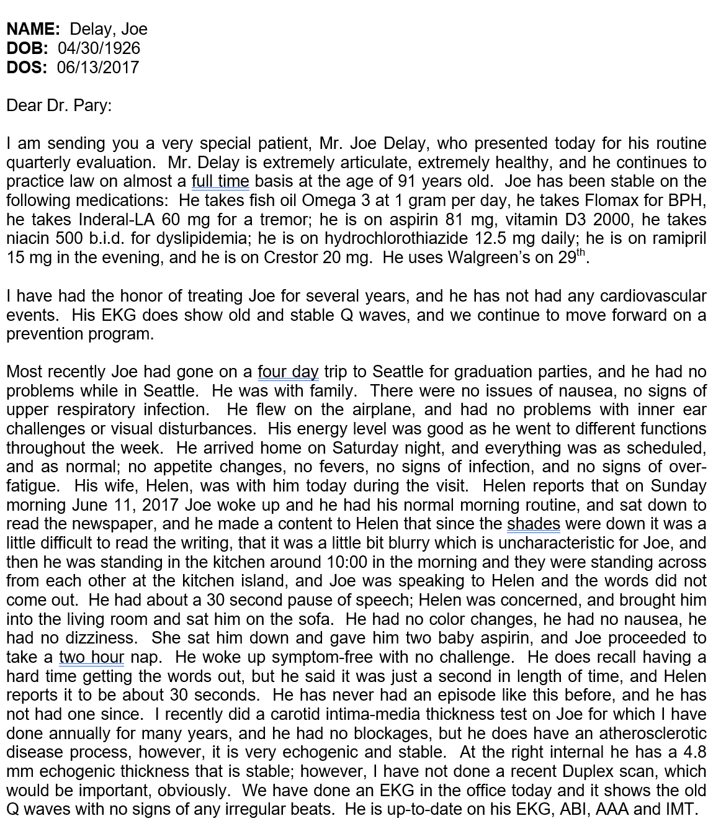



Slide 40
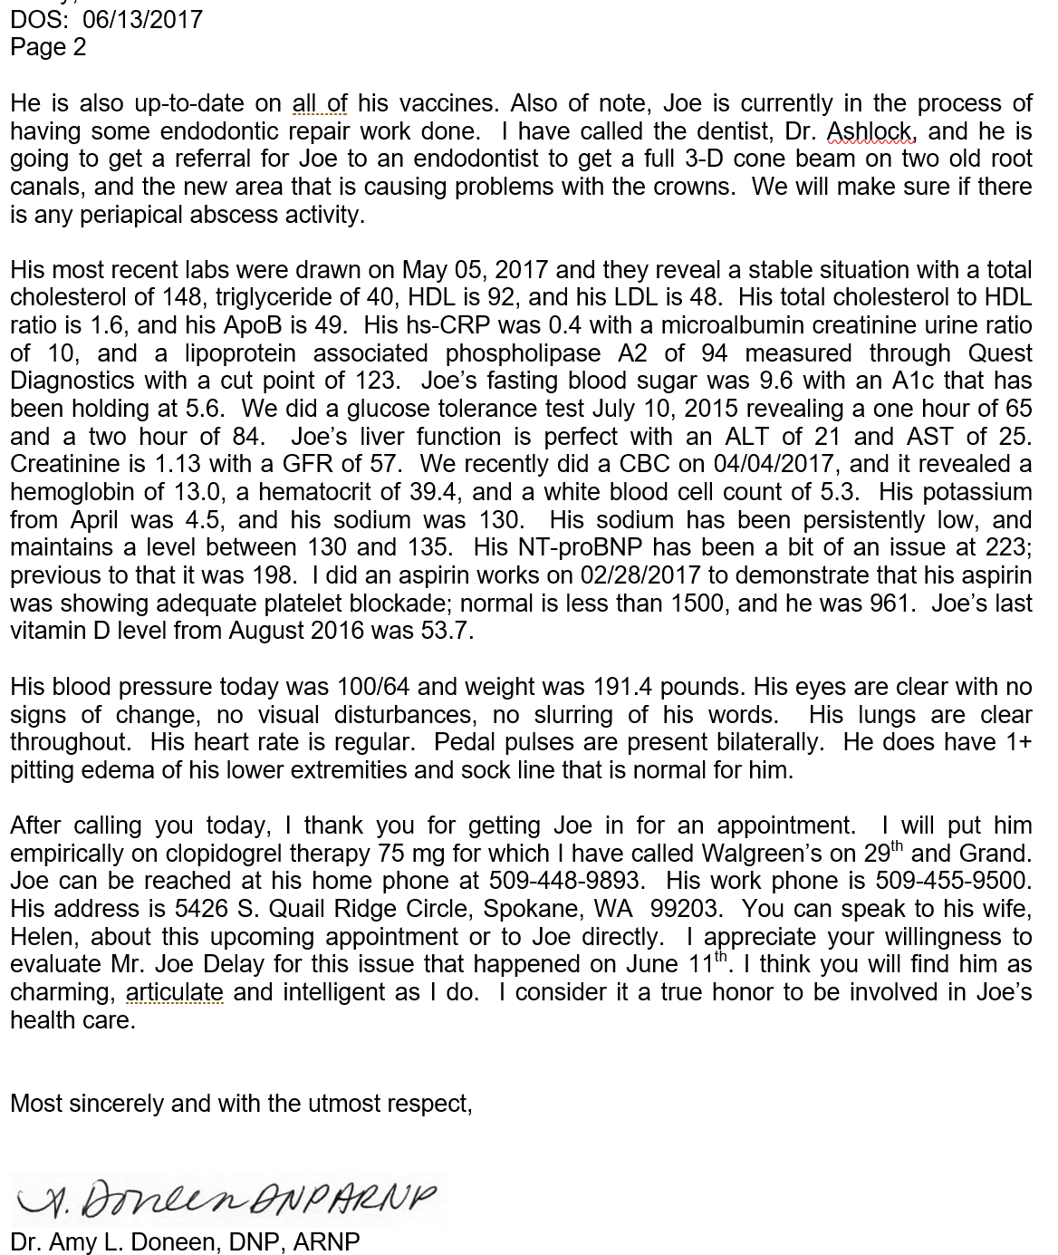

Slide 41
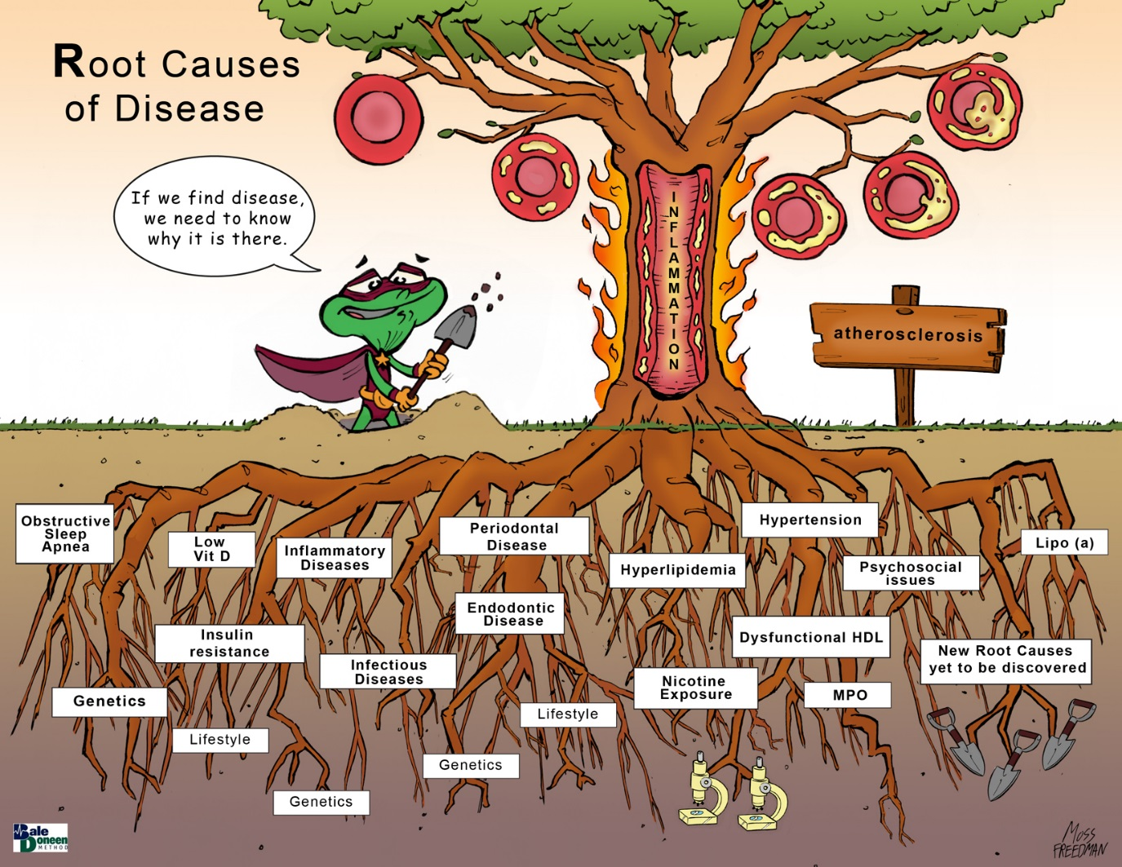
Nicotine
Endodontic Disease
Vitamin D deficiency
Gut dysbiosis

Slide 42
Vitamin D – still a controversy?
Authors question is Vit D deficiency is a ‘epiphenomenon”?
Discussed:
Deficiency versus Insufficiency
Epidemiology of Vit D and CVD
Vit D and CVD: Metabolism
Vit D and CVD: Clinical Evidence
Vit D and DM
Vit D and hyperlipidemia
Vit D and morbidity and mortality
Why the evidence falls short? Await VITAL trial.
Mheid, I., Quyyumi, A. (2017). Vitamin D and cardiovascular disease controversy unresolved. JACC; 70(1), 89-100.

Slide 43
Vitamin D – still a controversy?
Deficiency versus Insufficiency
Guidelines agree levels >20ng/ml for bone health
No ‘guideline’ agreement but data suggest >30 for most issues
Epidemiology of Vit D and CVD
3rd Natl Health and Nutrition Examination and large European cohorts showed a cross-sectional inverse relationship between Vit d levels and HTN, IR, T2DM, and dyslipidemia despite adjustment for co-founders.
Mheid, I., Quyyumi, A. (2017). Vitamin D and cardiovascular disease controversy unresolved. JACC; 70(1), 89-100.

Slide 44
Vitamin D – still a controversy?
Vitamin D and Metabolism
Vit D is photosynthesized in the skin and via dietary intake.
Two hydroxylation steps in the liver and the kidney are required for the Vit D activation, thus forming 1,25-dihyroxyvitamin D
UVB= ultraviolet radiation in the B-wavelength region 320 to 290 nm).
Mheid, I., Quyyumi, A. (2017). Vitamin D and cardiovascular disease controversy unresolved. JACC; 70(1), 89-100.

Slide 45
Vitamin D – still a controversy?
Mheid, I., Quyyumi, A. (2017). Vitamin D and cardiovascular disease controversy unresolved. JACC; 70(1), 89-100.

Slide 46
Vitamin D – still a controversy?
Potential effects of VitD metabolism on the CV system are divergent, but they share common initial steps of nuclear and plasma.
membrane VitD receptor (VDR) activity
1,25-OH VitD = 1,25-dihydroxyvitamin D
ANP = atrial naturiuretic peptide
Ca2+ = calcium cation
MMP = matrix metalloproteinases
RAS – renin-angiotensin system
RXR = retinoid-X receptor
VDRE = VitD response elements
VEGF = vascular endothelial growth factor
VSMC = vascular smooth muscle cell.
Mheid, I., Quyyumi, A. (2017). Vitamin D and cardiovascular disease controversy unresolved. JACC; 70(1), 89-100.

Slide 47
Vitamin D – still a controversy?
Vitamin D and CVD: Clinical Evidence:
Arterial Stiffness and HTN – cross-sectional and prospective inverse relationship between vit D deficiency and elevated BP –
Cause/effect relationship hypothesized on the basis of the modulating effects of VitD promoting sustained RAAS activiation – sufficient VitD levels provide endogenous proximal inhibition.
However – analysis of 46 systemic reviews concluded that vitamin D supplementation is ineffective in lowering BP and should not be used as an antihypertensive agent.
Mheid, I., Quyyumi, A. (2017). Vitamin D and cardiovascular disease controversy unresolved. JACC; 70(1), 89-100.

Slide 48
Vitamin D – still a controversy?
Vit D and DM
1. Increased adipose tissue may partially account for the lower D levels because the lipid soluable vitamin is sequestered in adipose tissue, thus decreasing 25-OH bioavailability.
2. Prospective evidence that supplementing VitD in infants may decrease future incidence of T1DM.
3. T2DM data still waning – WHI and PCOS trials – not conclusive
Vit D and hyperlipidemia
VitD is structurally related to cholesterol and phyosynthesis of cholecalciferol is achieved by irradiation of cutaneous 7-dehyrocholesterol, which is a pre-curser to cholesterol.
Vit D and morbidity and mortality
WHI is largest randomized trial – used sub therapeutic dose (400iu/day)
Mheid, I., Quyyumi, A. (2017). Vitamin D and cardiovascular disease controversy unresolved. JACC; 70(1), 89-100.

Slide 49
Vitamin D – still a controversy?
VITAL (VITamin D and Omega-3 triAL) – be on lookout!
Randomized, placebo-controlled VITAL (VITamin D and Omega-3 triAL) will demonstrate whether cholecalciferol supplementation (2,000 IU/day), with or without omega-3 fatty acids
Outcome is to determine how VitD affects the incidence of CVD, stroke, and cancer in 25,000 healthy, middle-aged U.S. adults.
Mean treatment period is projected at 5 years.
Baseline 25-OH D levels will be measured - repeat measurements will be performed.
Mheid, I., Quyyumi, A. (2017). Vitamin D and cardiovascular disease controversy unresolved. JACC; 70(1), 89-100.

Slide 50
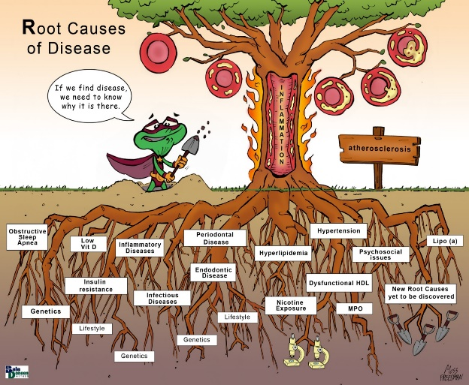
Vitamin D –
BaleDoneen Take-Away:
We will keep vitamin D deficiency as a Root cause - BDM is dynamic – Will this change?
2. Endothelium, ADMA, hsCRP, inflammation, lipids are still the reasons we treat is below 30. Goal is 40-60.
3. We will look forward to reading the VITAL trial and we will provide with a full review upon completion.
Mheid, I., Quyyumi, A. (2017). Vitamin D and cardiovascular disease controversy unresolved. JACC; 70(1), 89-100.

Slide 51
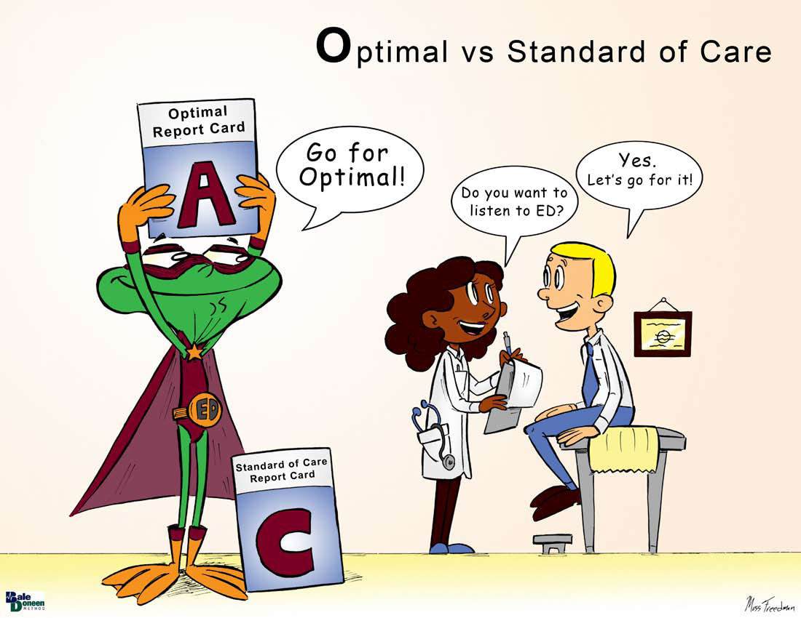

Slide 52
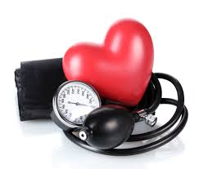
Blood Pressure
1. Race and Sex Differences of Long-Term Blood Pressure Profiles from childhood and adult hypertension.
2. Relationship of HTN to coronary atherosclerosis and Cardiac events in patients with Coronary CT
3. CVD in Conjunction with BP to guide HTN Medication Tx
4. Optimal SBP target after SPRINT

Slide 53

Race and Sex Differences of Long-Term BP Profiles from Childhood to Adult

Slide 54
Race and Sex Differences of Long-Term BP Profiles from Childhood to Adult
Study goal is to characterize longitudinal BP trajectories from childhood in black-white and sex groups. Longitudinal cohort of 2732 adults with BMI and BP measured 4 to 15 times from childhood (14-19 years) to adulthood (20-51 years).
General observations:
Childhood BP linear slopes were associated with adult HTN (p<0.001)
Puberty is a crucial period for the development of HTN in later life.
Shen, W., Zhang, T., Li, S. et al. (2017). Race and sex differences of long-term blood pressure profiles from childhood and adult hypertension. HypertensionAHD.117.09537

Slide 55
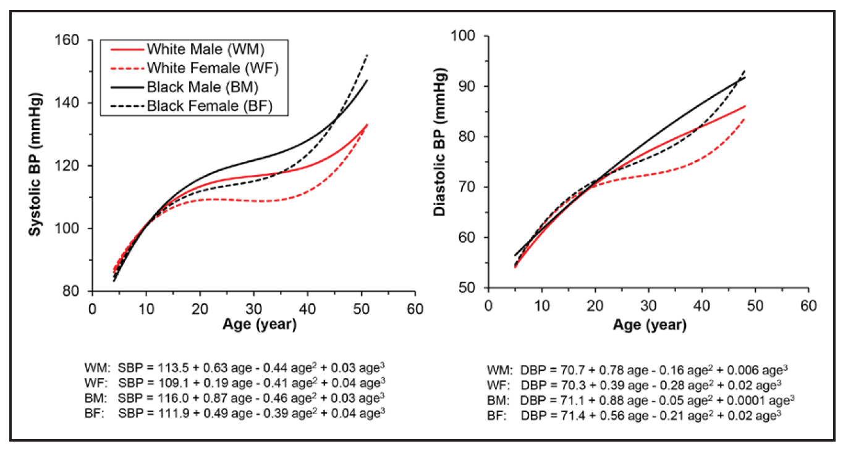
Race and Sex Differences of Long-Term BP Profiles from Childhood to Adult
Growth curves of BP by race-sex groups.
Curve parameters were all significantly different.
Shen, W., Zhang, T., Li, S. et al. (2017). Race and sex differences of long-term blood pressure profiles from childhood and adult hypertension. HypertensionAHD.117.09537

Slide 56
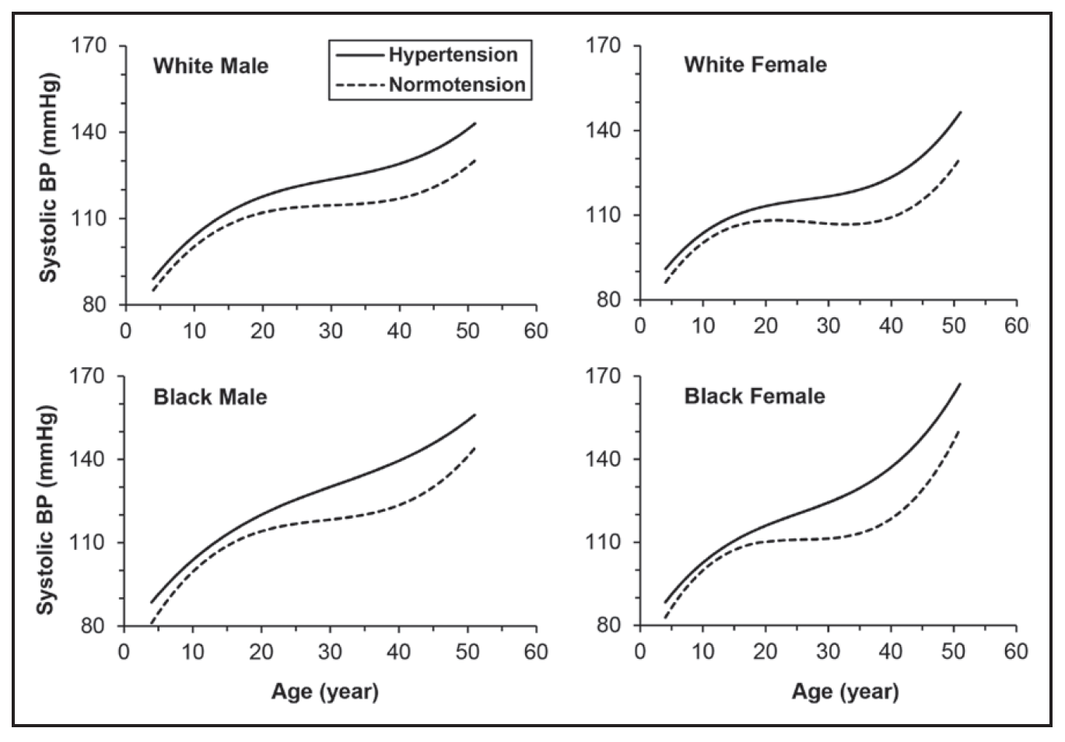
Race and Sex Differences of Long-Term BP Profiles from Childhood to Adult
Shen, W., Zhang, T., Li, S. et al. (2017). Race and sex differences of long-term blood pressure profiles from childhood and adult hypertension. HypertensionAHD.117.09537

Slide 57
Race and Sex Differences of Long-Term BP Profiles from Childhood to Adult
BaleDoneen Take-Away:
Higher levels and rates of increase of BP during puberty and young adulthood are associated with adult HTN.
In contrast to the puberty period, greater rates of BP increase during the prepuberty have a protective effect on the risk of developing later life hypertension,
Puberty period is a critical age window for BP control to reduce the hypertension risk. Our dental colleagues are key to identify HTN in children
These findings underscore the importance of controlling BP in early life to prevent the development of hypertension later in life.
Shen, W., Zhang, T., Li, S. et al. (2017). Race and sex differences of long-term blood pressure profiles from childhood and adult hypertension. HypertensionAHD.117.09537

Slide 58

Relationship of HTN to CAD and CAD events

Slide 59
Relationship of HTN to CAD and CAD events
Investigated the relationship between HTN and the presence, extent, and severity of coronary atherosclerosis in coronary CT angiography and cardiac events risk.
17,181 patients enrolled in the CONFIRM registry who underwent ≥64 slice coronary CT angiography
14,803 patients without known coronary artery disease.
Of these, 1434 hypertensive patients were matched to 1434 patients without hypertension.
Nakanishi, R., Baskaran, L., Gransar, H. et al. (2017). Relationship of HTN to coronary and atherosclerosis and cardiac events in patients with coronary CT Angio. HypertensionAHA.117.09402.
Notes:
(Coronary CT Angiography Evaluation for Clinical Outcomes: An International Multicenter Registry)

Slide 60
Relationship of HTN to CAD and CAD events
Major adverse cardiac events risk of HTN and non-HTN patients was evaluated with Cox proportional hazards models.
The prognostic associations between HTN and no-HTN with increasing degree of coronary stenosis severity (non-obstructive or obstructive ≥50%) and extent of coronary artery disease (segment involvement score of 1–5, >5) was assessed.
Nakanishi, R., Baskaran, L., Gransar, H. et al. (2017). Relationship of HTN to coronary and atherosclerosis and cardiac events in patients with coronary CT Angio. HypertensionAHA.117.09402.

Slide 61
Relationship of HTN to CAD and CAD events
HTN patients had more nonobstructive and 1-, 2-, and 3-vessel disease than the non-HTN group.
During a mean follow-up of 5.2±1.2 years, 180 patients experienced cardiac events, with 104 (2.0%) occurring in the HTN group and 76 (1.5%) occurring in the no-HTN group (HR, 1.4; 95% CI, 1.0–1.9).
Compared with no-hypertension patients, hypertensive patients have increased presence, extent, and severity of coronary atherosclerosis and tend to have an increase in major adverse cardiac events.
Nakanishi, R., Baskaran, L., Gransar, H. et al. (2017). Relationship of HTN to coronary and atherosclerosis and cardiac events in patients with coronary CT Angio. HypertensionAHA.117.09402.

Slide 62
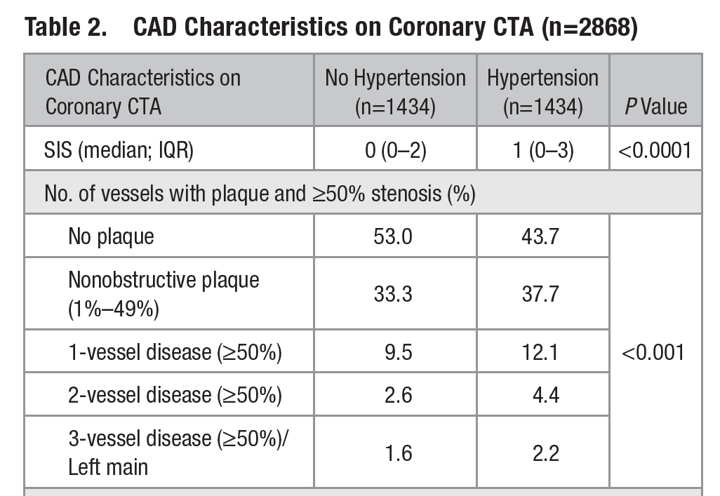
Relationship of HTN to CAD and CAD events
Nakanishi, R., Baskaran, L., Gransar, H. et al. (2017). Relationship of HTN to coronary and atherosclerosis and cardiac events in patients with coronary CT Angio. HypertensionAHA.117.09402.

Slide 63
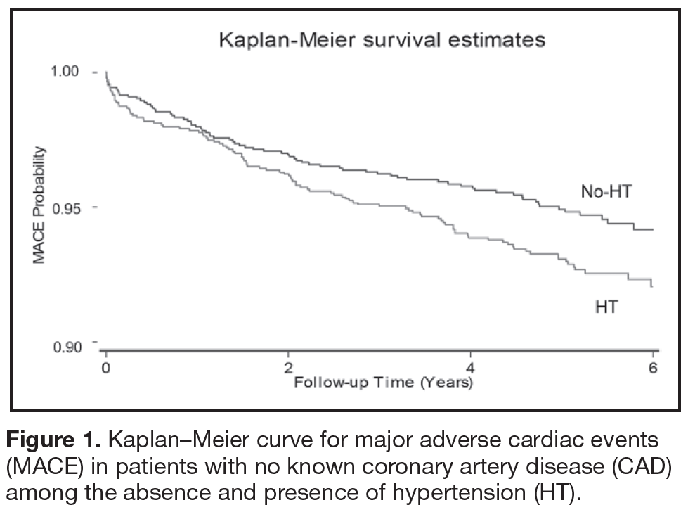
Relationship of HTN to CAD and CAD events
Nakanishi, R., Baskaran, L., Gransar, H. et al. (2017). Relationship of HTN to coronary and atherosclerosis and cardiac events in patients with coronary CT Angio. HypertensionAHA.117.09402.

Slide 64
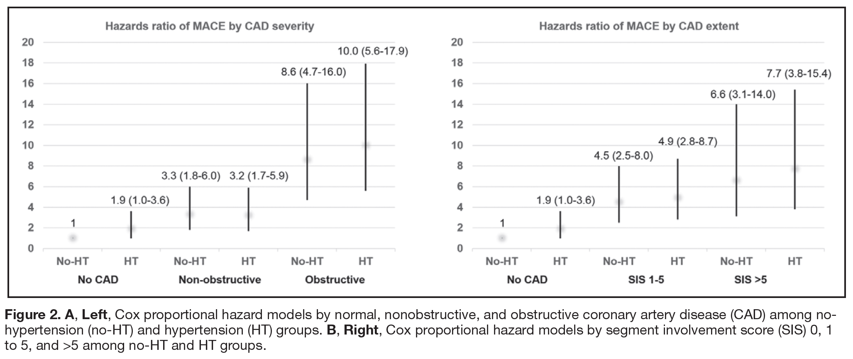
Relationship of HTN to CAD and CAD events
Nakanishi, R., Baskaran, L., Gransar, H. et al. (2017). Relationship of HTN to coronary and atherosclerosis and cardiac events in patients with coronary CT Angio. HypertensionAHA.117.09402.

Slide 65
Relationship of HTN to CAD and CAD events
How does HTN result in increased CAD:
Widening pulse pressure and increased SBP have been reported to contribute to endothelial dysfunction.
HTN is a cause of left ventricular hypertrophy (LVH) – coronary atherosclerosis, MI, arrhythmia, cardiac failure or cardiac death.
LVH is associated with collagen deposition within the left ventricle – midmyocardial scarring on cardiac MRI – associated with increased event risk.
Interesting finding:
Patients with no evidence of CAD, those with HTN had a >2-fold MACE risk compared to those with no-HTN. Researchers suspect LVH however no info on LVH was reported
Nakanishi, R., Baskaran, L., Gransar, H. et al. (2017). Relationship of HTN to coronary and atherosclerosis and cardiac events in patients with coronary CT Angio. HypertensionAHA.117.09402.

Slide 66
Relationship of HTN to CAD and CAD events
BaleDoneen Take-Away:
1. HTN is a root cause of vascular disease
2. We must set optimal goals for BP management
3. Optimal = individualized.
4. Dental offices have a key role here as well to identify these patients with unknown HTN.
5. As with the previous study – identify early and often!
Nakanishi, R., Baskaran, L., Gransar, H. et al. (2017). Relationship of HTN to coronary and atherosclerosis and cardiac events in patients with coronary CT Angio. HypertensionAHA.117.09402.

Slide 67
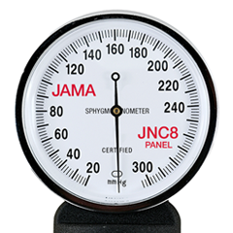
CVD and BP to guide HTN treatment

Slide 68
CVD and BP to guide HTN treatment
Why are we talking about this?
Not a new concept – using the presence of CVD in addition to BP levels to guide antihypertension treatment decisions was first proposed x 20 years ago.
In 1997, JNC6 treatment guidelines for HTN recommended CVD risk and BP levels to guide treatment. However, in 2003 the JNC7 reverted to a paradigm based on BP levels alone.
This research evaluates the evidence to suggest adding ‘disease’ to BP levels to guide HTN treatment decisions.
Muntner, P., Whelton, P. (2017). Using predicted CVD risk in conjunction with BP to guide antihypertensive medication treatment. JACC (69):19, 2447-2456

Slide 69
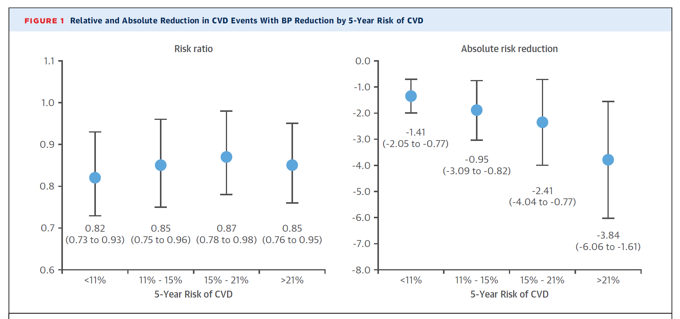
CVD and BP to guide HTN treatment
Participants grouped into strata based on 5 yr predicted risk for CVD events. (95% CI)
Absolute risk reduction assoc with tx versus placebo. (95% CI)
11 randomized trials of HTN tx vs placebo (n=51,917)
Muntner, P., Whelton, P. (2017). Using predicted CVD risk in conjunction with BP to guide antihypertensive medication treatment. JACC (69):19, 2447-2456

Slide 70
CVD and BP to guide HTN treatment
Muntner, P., Whelton, P. (2017). Using predicted CVD risk in conjunction with BP to guide antihypertensive medication treatment. JACC (69):19, 2447-2456

Slide 71
CVD and BP to guide HTN treatment
BaleDoneen Take-Away:
1. BDM is a disease/inflammatory approach –
2. Place ALL treatment decisions in context with disease/inflammation.
3. Blood pressure cannot be an isolated risk factor.
4. Agents of choice for treatment will also depend on disease/inflammation/root causes/optimal goals/genetics.
5. Research suggests – identify BP early and treat appropriately with aim of reducing CV events – micro and macrovascular.
Muntner, P., Whelton, P. (2017). Using predicted CVD risk in conjunction with BP to guide antihypertensive medication treatment. JACC (69):19, 2447-2456

Slide 72

What is optimal Blood Pressure?

Slide 73
Optimal SBP target after SPRINT
Optimal BP target remains a debate.
SPRINT showed significant benefit of a SBP target <120mmHg.
17 randomized trials testing various BP targets – n=55,163, mean follow-up 3.7 years for a total of 204,103 patient-years f/u
Treatment arms were categorized into 5 categories:
SBP <160mmHg, <150mmHg, <140mmHg, <130mmHg, <120mmHg
Outcomes: stroke, MI, death CV death, heart failure.
Bangalore, S., Toklu, B., Gianos, E., et al. (2017). Optimal systolic blood pressure target after SPRINT: Insights from a network meta-analysis of randomized trials. AmJMed:130(6); 707-719.

Slide 74
Optimal SBP target after SPRINT
Results for SBP <120mmHg vs <160mmHg
Stroke: RR 0.54; 95% CI (0.29-1.00)
MI: RR 0.68; 95% CI (0.47-1.00)
No difference in death, CV death or heart failure
Sensitivity analysis for stroke using SBP (compared to <120):
SBP <140 mmHg showed 72% increase risk of stroke
SBP <150 mmHg showed 97% increase risk of stroke
SBP <160 mmHg showed a 227% increase risk of stroke
Bangalore, S., Toklu, B., Gianos, E., et al. (2017). Optimal systolic blood pressure target after SPRINT: Insights from a network meta-analysis of randomized trials. AmJMed:130(6); 707-719.

Slide 75
Optimal SBP target after SPRINT
Overall – SBP of <130mmHg showed greatest benefit with the least side effects – optimal balance between efficacy and safety.
Bangalore, S., Toklu, B., Gianos, E., et al. (2017). Optimal systolic blood pressure target after SPRINT: Insights from a network meta-analysis of randomized trials. AmJMed:130(6); 707-719.

Slide 76
Optimal SBP target after SPRINT
BaleDoneen Take-Away:
1. SPRINT trial is going to save a lot of lives because it has challenged the status-quo.
2. Blood pressure management is ALWAYS about risk vs benefit and using the n of 1.
3. Do NOT ignore pressures that begin to creep about 115 SBP – especially in children.
4. Dental Colleagues – Blood Pressure IS a joint biomarker!
5. For dentistry – BP is a key to provide a backdrop for discussion about the oral/systemic connection and to begin conversations with the patients’ GP.
Bangalore, S., Toklu, B., Gianos, E., et al. (2017). Optimal systolic blood pressure target after SPRINT: Insights from a network meta-analysis of randomized trials. AmJMed:130(6); 707-719.

Slide 77


Slide 78
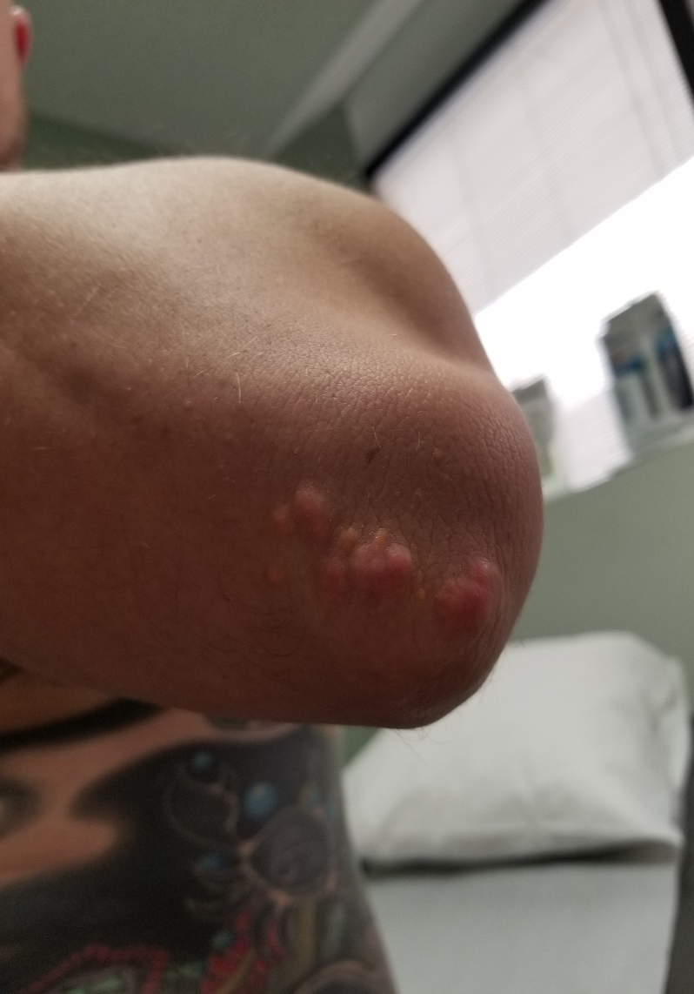
FH patient recently diagnosed in my office –

Slide 79
Familial Hypercholesterolemia (FH)
FH is autosomal-dominant disorder associated with elevated
LDL-C and early development of atherosclerosis and CHD.
This is a treatable genetic disorder that is vastly under-diagnosed.
Evaluates a model using data to estimate the cost effectiveness of DNA testing of relatives of those with monogenic FH.
Results – Cascade testing of relatives of those with suspected FH is HIGHLY cost effective.
Kerr, M., Pears, R., Miedzybrodzka., Z. et al. (2017). Cost effectiveness of cascade testing for familial hypercholesterolemia, based on data from FH services in the UK. Eupean Heart Journal. 38. 1832-1839.

Slide 80
Familial Hypercholesterolemia (FH)
Kerr, M., Pears, R., Miedzybrodzka., Z. et al. (2017). Cost effectiveness of cascade testing for familial hypercholesterolemia, based on data from FH services in the UK. Eupean Heart Journal. 38. 1832-1839.

Slide 81
Familial Hypercholesterolemia (FH)
The economic model estimates that for every 1,000 relatives tested…
Over 20 years –
50 cases of angina, 8 strokes, 16 deaths are averted.
Kerr, M., Pears, R., Miedzybrodzka., Z. et al. (2017). Cost effectiveness of cascade testing for familial hypercholesterolemia, based on data from FH services in the UK. Eupean Heart Journal. 38. 1832-1839.

Slide 82
Familial Hypercholesterolemia (FH)
Incremental cost effectiveness ratio
Over a 30 year perspective, estimate that 139 adverse CVD events and 23 deaths are averted per 1,000 relatives tested, at a tremendous cost savings
Kerr, M., Pears, R., Miedzybrodzka., Z. et al. (2017). Cost effectiveness of cascade testing for familial hypercholesterolemia, based on data from FH services in the UK. Eupean Heart Journal. 38. 1832-1839.

Slide 83
Familial Hypercholesterolemia (FH)
The reduction in CHD mortality in treated relatives is estimated at 44% based on a mean LDL-C reduction of 37%, and 55% with a mean 50% LDL-C reduction.
Simon Broome study reported a 48% reduction in CHD mortality for those without prior CHD.
This model estimates a 60.7% reduction in MI over 8 years for treated relatives achieving a 37% reduction in LDL-C and 68.6% for a mean 50% LDL-C reduction.
*this model assumed patient response to statin treatment similar in FH and non-FH and assumed compliance rates to be similar. Excluded Children due to lack of data to assess effectiveness
Kerr, M., Pears, R., Miedzybrodzka., Z. et al. (2017). Cost effectiveness of cascade testing for familial hypercholesterolemia, based on data from FH services in the UK. Eupean Heart Journal. 38. 1832-1839.

Slide 84
Familial Hypercholesterolemia (FH)
BaleDoneen Take-Away:
1. FH is more common than realized!
2. Watch our course of FH on BaleDoneen.com.
3. Be on the lookout – patients will find you! They come with a complex family history and significant hyperlipidemia.
4. Dental/GP – look for xanthomas!
5. www.mygenetx.com to get genetic testing on patients
6. Children must be screened!
Kerr, M., Pears, R., Miedzybrodzka., Z. et al. (2017). Cost effectiveness of cascade testing for familial hypercholesterolemia, based on data from FH services in the UK. Eupean Heart Journal. 38. 1832-1839.

Slide 85



Slide 86

Alcohol and Brain Health

Slide 87
Alcohol use and decreased cognition
Observational cohort study with weekly alcohol intake and cognitive performance measured repeatedly over 30 years (1985-2015). MRI was performed at study endpoint (2012-15).
550 men and women with mean age 43.0 + 5.4 years at study baseline, none were “alcohol dependent” according to the CAGE screening questionnaire.
The long term effects of non-dependent alcohol consumption on the brain are poorly understood
Topiwala, A., Allan, C., Valkanova., V. et al. (2017).Moderate alcohol consumption as risk factor for adverse brain outcomes and cognitive decline: Longitudinal cohort study. TheBMJ;357:j2353.

Slide 88
Alcohol use and decreased cognition
Structural brain measures included hippocampal atrophy, grey matter density, and white matter microstructure.
Functional measures included cognitive decline over the study and cross sectional cognitive performance at the time of scanning.
Topiwala, A., Allan, C., Valkanova., V. et al. (2017).Moderate alcohol consumption as risk factor for adverse brain outcomes and cognitive decline: Longitudinal cohort study. TheBMJ;357:j2353.

Slide 89
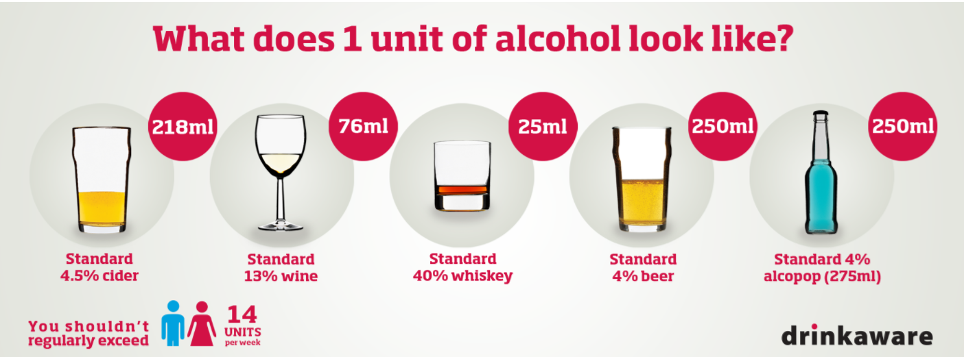
Alcohol use and decreased cognition
Higher alcohol consumption over the 30 year follow-up was associated with increased odds of hippocampal atrophy in a dose dependent fashion.
Over 30 units a week were at the highest risk compared with abstainers (odds ratio 5.8, 95% confidence interval 1.8 to 18.6; P≤0.001),
Moderate drinking (14-21 units/week) had three times the odds of right sided hippocampal atrophy (3.4, 1.4 to 8.1; P=0.007).
Topiwala, A., Allan, C., Valkanova., V. et al. (2017).Moderate alcohol consumption as risk factor for adverse brain outcomes and cognitive decline: Longitudinal cohort study. TheBMJ;357:j2353.

Slide 90
Alcohol use and decreased cognition
There was no protective effect of light drinking
(1-<7 units/week) over abstinence.
Higher alcohol use was also associated with differences in corpus callosum microstructure and faster decline in lexical fluency (executive function).
Topiwala, A., Allan, C., Valkanova., V. et al. (2017).Moderate alcohol consumption as risk factor for adverse brain outcomes and cognitive decline: Longitudinal cohort study. TheBMJ;357:j2353.
.

Slide 91
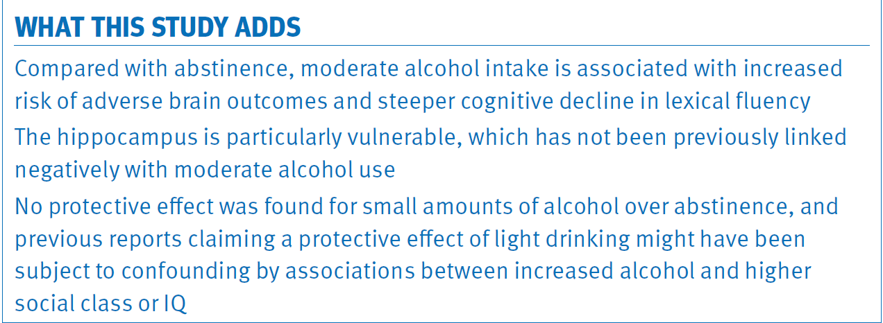
Alcohol use and decreased cognition
Topiwala, A., Allan, C., Valkanova., V. et al. (2017).Moderate alcohol consumption as risk factor for adverse brain outcomes and cognitive decline: Longitudinal cohort study. TheBMJ;357:j2353.

Slide 92
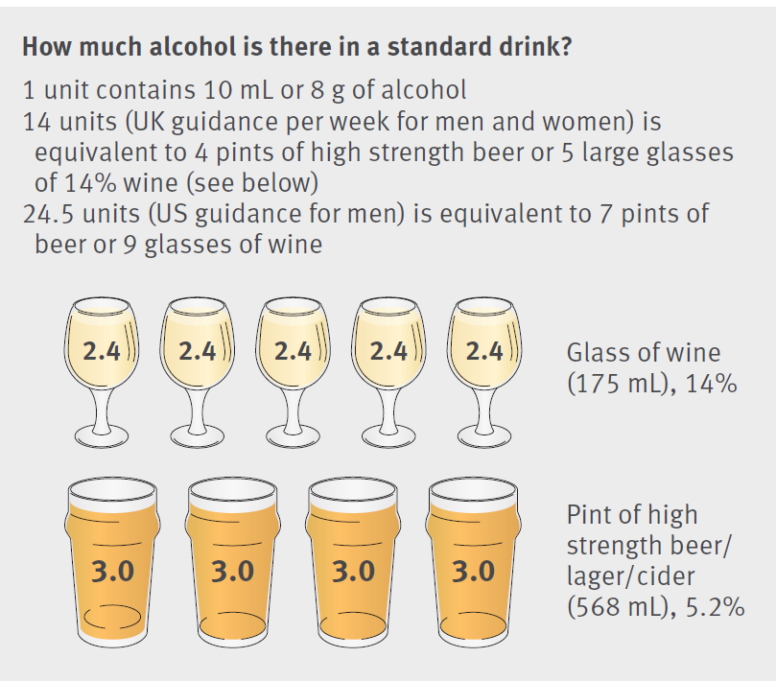
Alcohol use and decreased cognition
Topiwala, A., Allan, C., Valkanova., V. et al. (2017).Moderate alcohol consumption as risk factor for adverse brain outcomes and cognitive decline: Longitudinal cohort study. TheBMJ;357:j2353.

Slide 93
Alcohol use and decreased cognition
BaleDoneen Take-Away:
1. Would LOVE to do a genetic overlay on this research with Haptoglobin and Apo E status – suspicion – more vulnerability of Hp 2 and Apo E 4 individuals for negative brain health with alcohol.
2. Alcohol advice should be given carefully – consider family and personal history of dependency, cancer, Genetics with Apo E and Hp.
3. Careful intake of amount of alcohol with each patient – education on correct amounts – this study relays risk at much lower levels then previously reported.
Topiwala, A., Allan, C., Valkanova., V. et al. (2017).Moderate alcohol consumption as risk factor for adverse brain outcomes and cognitive decline: Longitudinal cohort study. TheBMJ;357:j2353.

Slide 94

Don’t Miss Breakfast!

Slide 95
Don’t Miss Breakfast!
Randomized controlled crossover trial, 17 participants [BMI: 23.7 ± 4.6] underwent 3 isocaloric 24-h interventions (55%, 30%, and 15% carbohydrate, fat, and protein, respectively):
A breakfast skipping day (BSD) and a
A dinner skipping day (DSD)
separated by a 3-meal-structure day (control)
Energy and macronutrient balance was measured in a respiration chamber. Postprandial glucose, insulin, and inflammatory responses in leukocytes as well as 24-h glycemia and insulin secretion were analyzed.
Nas A1, Mirza N2, Hägele F1, et al. (2017). Impact of breakfast skipping compared with dinner skipping on regulation of energy balance and metabolic risk. Am J Clin Nutr ajcn151332

Slide 96
Don’t Miss Breakfast!
When compared with the 3-meal control, 24-h energy expenditure was higher on both skipping days (BSD: +41 kcal/d; DSD: +91 kcal/d; both P < 0.01), whereas fat oxidation increased on the BSD only (+16 g/d; P < 0.001).
Spontaneous physical activity, 24-h glycaemia, and 24-h insulin secretion did not differ between intervention days.
The postprandial homeostasis model assessment index (+54%) and glucose concentrations after lunch (+46%) were higher on the BSD than on the DSD (both P < 0.05).
Breakfast skipping also increased the inflammatory potential of peripheral blood cells after lunch.
Nas A1, Mirza N2, Hägele F1, et al. (2017). Impact of breakfast skipping compared with dinner skipping on regulation of energy balance and metabolic risk. Am J Clin Nutr ajcn151332

Slide 97
Don’t Miss Breakfast!
BaleDoneen Take-Away:
1. Don’t Skip Breakfast ☺
2. Some patients are excited about fasting diets – Don’t eliminate breakfast!
3. Always have patients do a food journal when getting established under your care.
4. Again – dental colleagues – are your patients eating breakfast?
5. Skipping breakfast leads to higher insulin concentrations and increased fat oxidation leading to the development of metabolic challenges and inflammation.
Nas A1, Mirza N2, Hägele F1, et al. (2017). Impact of breakfast skipping compared with dinner skipping on regulation of energy balance and metabolic risk. Am J Clin Nutr ajcn151332

Slide 98

Fruits and Veggies reduce PAD
This Photo by Unknown Author is licensed under CC BY-SA

Slide 99
Fruits and Veggies reduce PAD
US Guidelines recommend the consumption of at least 4.5 cups of Fruits & Veg (F&V) combined daily.
Average American eats much less than this.
Limited info on fruits and vegetables and Peripheral Arterial Disease – goal of this study was to investigate this relationship in large community-based sample of nearly
3.7 million American adults.
Heffron, S., Rockman, C., Adelman, M., et al. (2017). Greater frequency of fruit and vegetable consumption is associated with lower prevalence of peripheral artery disease. ATVB: 37:00-00.

Slide 100
Fruits and Veggies reduce PAD
3,696,778 individuals, mean age 64 + 10.2 years, 64% female and 89% white.
233,958 (6.3%) cases of PAD as defined as ABI <0.9 or history of lower extremity revascularization procedure.
Nearly half of the sample reported consuming at least 3 servings of F&V on fewer than half of the days per week.
F&V intake differed between groups – Older white women had highest intake while younger black men were the least likely to get >3 servings per day.
Heffron, S., Rockman, C., Adelman, M., et al. (2017). Greater frequency of fruit and vegetable consumption is associated with lower prevalence of peripheral artery disease. ATVB: 37:00-00.

Slide 101
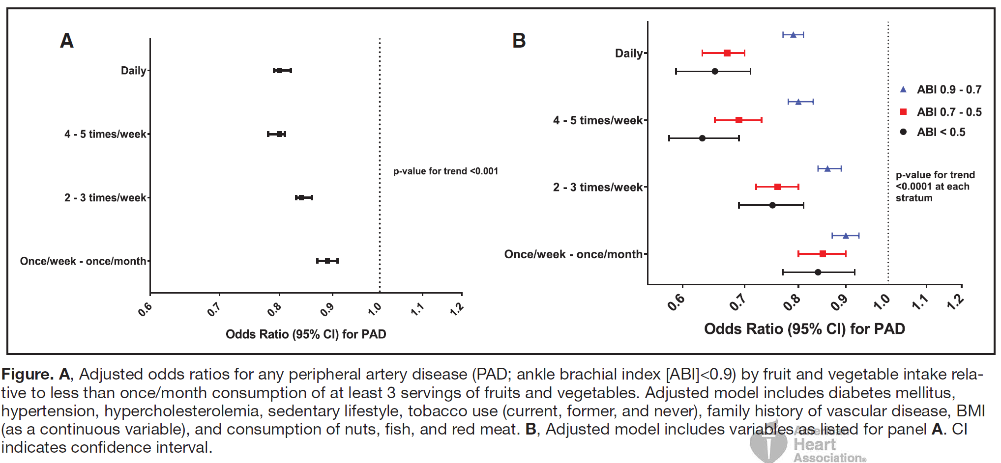
Fruits and Veggies reduce PAD
Among subjects with abnormal ABI, 73.2% (n=121,389) had ABI 0.9-0.7 and 7.1% had ABI <0.5 (n=11,717). F&V intake was stronger with decreasing ABI
Heffron, S., Rockman, C., Adelman, M., et al. (2017). Greater frequency of fruit and vegetable consumption is associated with lower prevalence of peripheral artery disease. ATVB: 37:00-00.

Slide 102
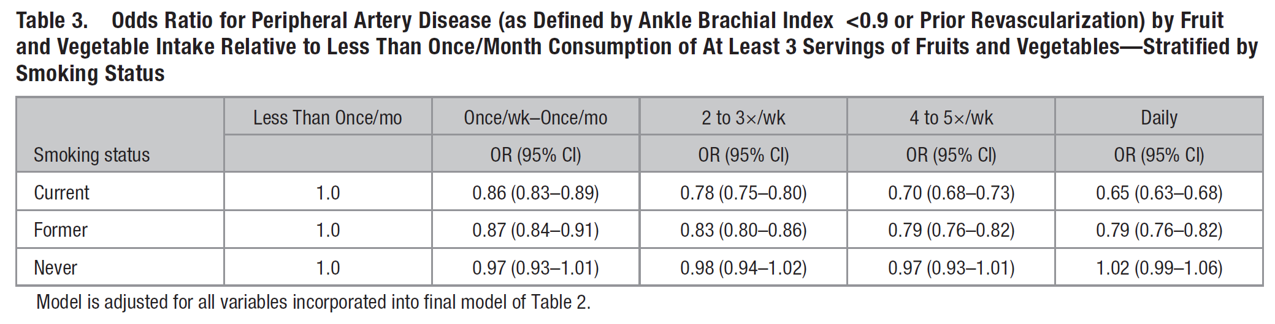
Fruits and Veggies reduce PAD
Association was most significant with past or present smokers.
Heffron, S., Rockman, C., Adelman, M., et al. (2017). Greater frequency of fruit and vegetable consumption is associated with lower prevalence of peripheral artery disease. ATVB: 37:00-00.

Slide 103
Fruits and Veggies reduce PAD
BaleDoneen Take-Away:
1. Participants who reported > 3 servings of F&V had 18% lower odds of PAD than those reporting less than monthly consumption.
2. Smoking is a tremendous risk factor for PAD – eat F&V
3. PAD is a chronic vascular disease manifestation and it is preventable – teach the family about proper eating.
4. Diet counseling isn’t just about what NOT to eat but rather what are you NOT EATING ENOUGH OF EACH DAY!
5. . Educate IR patients on the importance of F&V – microvascular disease!
Heffron, S., Rockman, C., Adelman, M., et al. (2017). Greater frequency of fruit and vegetable consumption is associated with lower prevalence of peripheral artery disease. ATVB: 37:00-00.

Slide 104
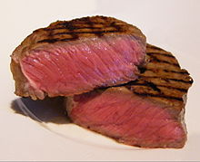
Red Meat is deadly!
Beef, Lamb, Pork

Slide 105
Red meat is deadly!
Population based cohort study – baseline dietary data of the NIH-AARP Diet and Health Study (prospective cohort of the general population from six states and two metropolitan areas in the US) – 16 years follow-up.
536,969 AARP members aged 50-71 at baseline
Intake of total meat, processed and unprocessed red meat (beef, lamb and pork) and white meat (poultry and fish), heme iron and nitrate/nitrite from processed meat based on dietary questionnaire.
Etemadi, A., Sinha, R., Ward, M. et al. (2017). Mortality from different causes associated with meat, heme iron, nitrates, and nitrites in the NIH-AARP diet and health study: population based cohort study. BMJ:357:j1957.

Slide 106
Red meat is deadly!
Red Meat increased risk of all-cause mortality and death due to nine different causes (HR for highest versus lowest fifth 1.26, 95% CI 1.23-1.29).
Heme iron and processed meat nitrate/nitrite were independently associated with increased risk of all cause and cause specific mortality.
Contrarily – top fifth of white meat intake was associated with a 25% reduction in risk of all cause mortality compared to the lowest intake level.
Etemadi, A., Sinha, R., Ward, M. et al. (2017). Mortality from different causes associated with meat, heme iron, nitrates, and nitrites in the NIH-AARP diet and health study: population based cohort study. BMJ:357:j1957.

Slide 107
Red meat is deadly!
Strongest association of death due to red meat consumption was with chronic liver disease (HR 2.30, CI 1.78-2.99)
People with highest category of white meat intake had a 25% reduction in risk of all cause mortality compared with the lowest intake.
All cause death showed an inverse association with white meat intake (excluding death due to Alzheimer’s disease), and the strongest inverse association was observed for death due to chronic liver disease.
Etemadi, A., Sinha, R., Ward, M. et al. (2017). Mortality from different causes associated with meat, heme iron, nitrates, and nitrites in the NIH-AARP diet and health study: population based cohort study. BMJ:357:j1957.

Slide 108
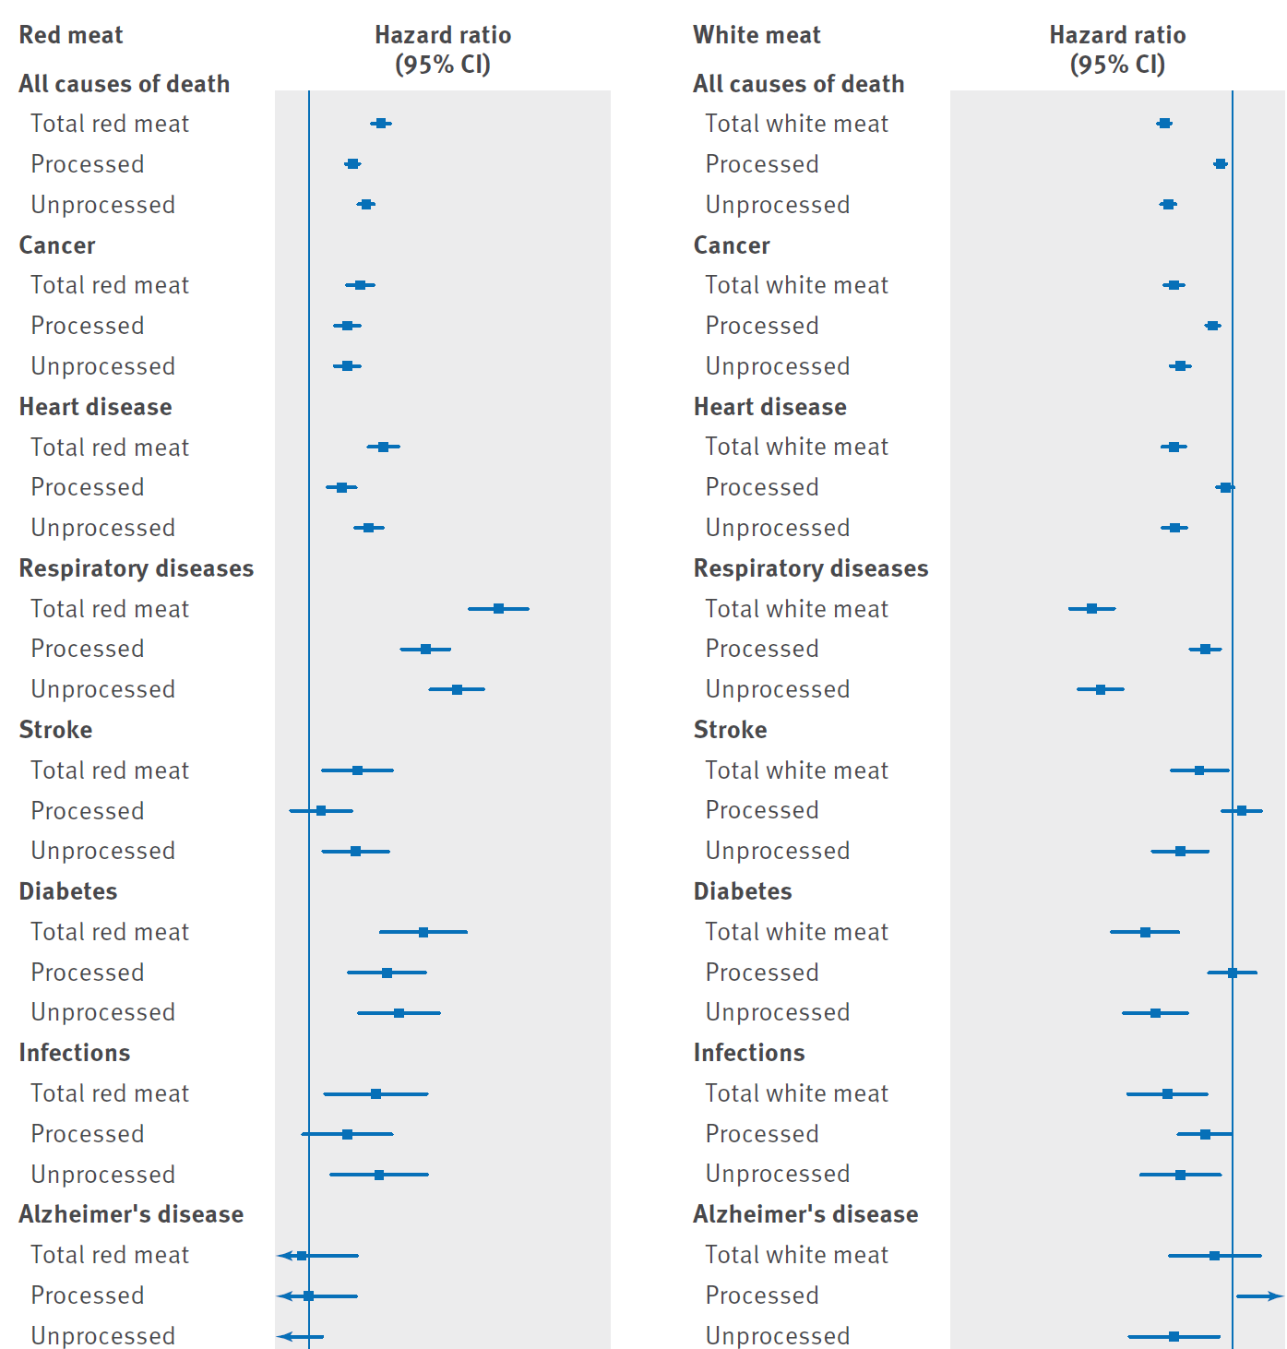
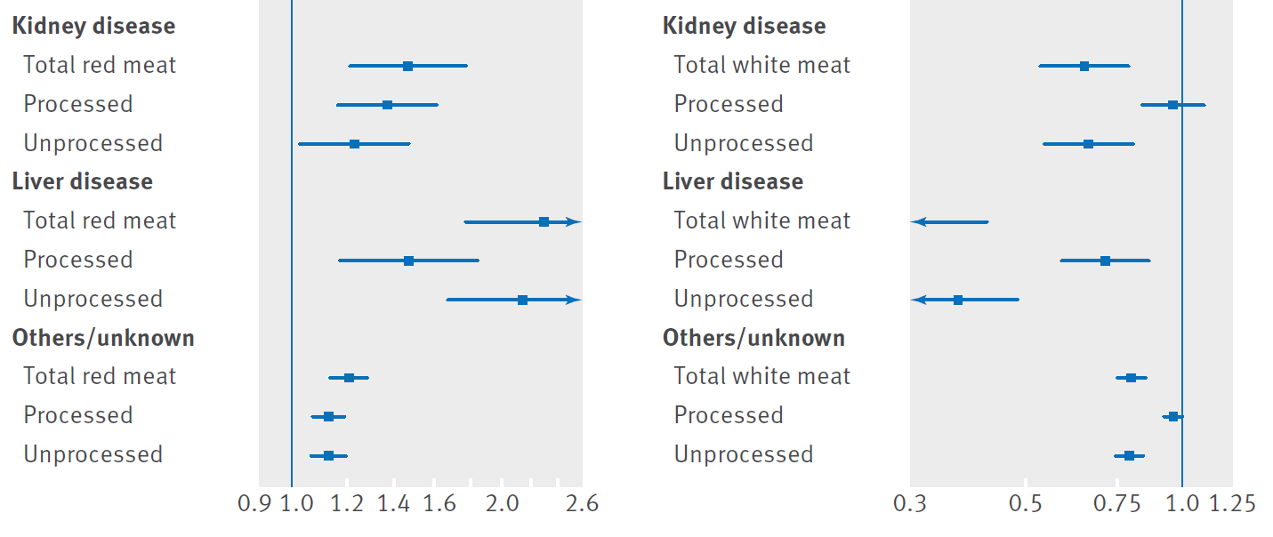
Red meat is deadly!
Increased risks of all cause mortality and nine specific causes of death were associated with both processed and unprocessed red meat.
Replacing the intake of red meat with white meat (chicken or fish), particularly unprocessed white meat, without changing total meat intake, was associated with reduced mortality risk.
Etemadi, A., Sinha, R., Ward, M. et al. (2017). Mortality from different causes associated with meat, heme iron, nitrates, and nitrites in the NIH-AARP diet and health study: population based cohort study. BMJ:357:j1957.

Slide 109
Red meat is deadly!
BaleDoneen Take-Away:
1. Red meat fails to provide health benefits – lots of other ways to get iron and protein.
2. White meat had an inverse relationship
3. Amount of red meat should be assessed during visits.
4. Did not look at wild game meat.
5. TMAO is a lab option when concerned.
6. Limit red meat in diet or eliminate all together – hard pressed to find health benefits.
Etemadi, A., Sinha, R., Ward, M. et al. (2017). Mortality from different causes associated with meat, heme iron, nitrates, and nitrites in the NIH-AARP diet and health study: population based cohort study. BMJ:357:j1957.

Slide 110

Happy July 2017!
Hurry – you must register!......

Slide 111

Dental Colleagues – new BDM CE courses!
1928-2014
Notes:
“my-uh” An-guh-low”
Dr. Maya Angelou is a remarkable Renaissance woman who is hailed as one of the great voices of contemporary literature. As a poet, educator, historian, best-selling author, actress, playwright, civil-rights activist, producer and director, she continues to travel the world, spreading her legendary wisdom. Within the rhythm of her poetry and elegance of her prose lies Angelou's unique power to help readers of every orientation span the lines of race. Angelou captivates audiences through the vigor and sheer beauty of her words and lyrics.

Slide 112
Help us spread the word –
Seattle Oct 2017
www.BaleDoneen.com

Slide 113
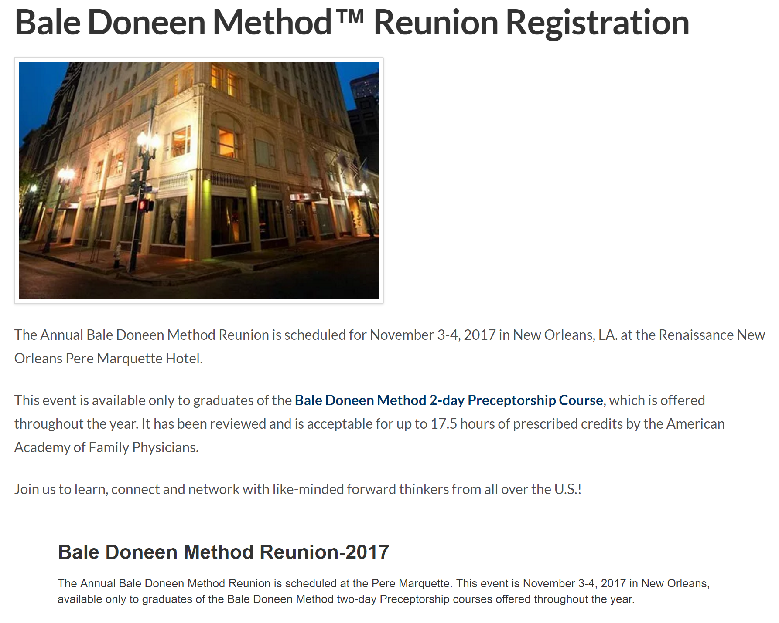

Sign up ASAP for the Reunion!

