Slide 1
HOW TO WORK UP A PATIENT
David B Wright MD
Clinical Coach BDM
22 October 2021
BaleDoneen Academy
Course 2

Slide 2
OBJECTIVES
Steps in diagnosing a new patient
Discuss pathology detected by Inflammation Panel
Educating patient about Inflammation—explaining the results

Slide 3
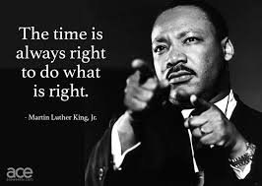
“The time is always right to identify Inflammation and treat Root Causes.”

Slide 4
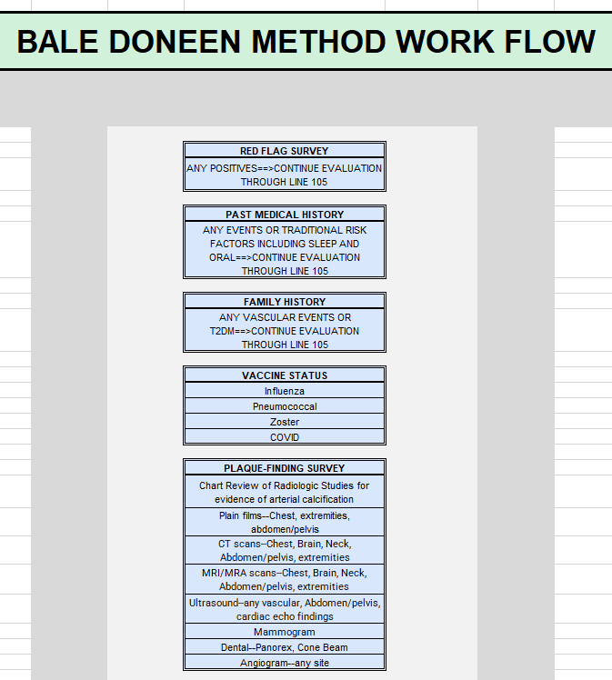
IMPLEMENTATION GUIDE

Slide 5
USE BDM TEMPLATES FOR INTAKE
MARKETING & BUSINESS SECTION
Red Flags Survey
Health History Checklist
May adapt to suit your practice
COACHING AND IMPLEMENTATION SECTION
EDROG with Ease Guide
BaleDoneen Method Checklist
BDM Baseline Labs list
BDM Advantage Guide

Slide 6
STANDARDIZE TAKING BIOMETRICS ON EVERYONE
BIOMETRICS
Waist line just above iliac crest/below rib cage
Peak adult height to calculate BMI
Pulse
Blood Pressure, Right and Left
Neck Circumference

Slide 7
EVALUATION STEPS
Vaccine Status
Influenza
Pneumococcus
Zoster

Slide 8
EVALUATION STEPS
LIFESTYLE EVALUATION
Nutrition Survey
Movement Survey
Sleep Survey
Epworth or STOP-BANG ➔ IF ABNORMAL ➔ Formal Sleep Study (home or facility)
Duration, quality, shift workers
Stress Survey
Connected Mind digital evaluation: https://connectedmind.me/screen-4-life/
Environmental Survey
nicotine, air pollution, marijuana

Slide 9
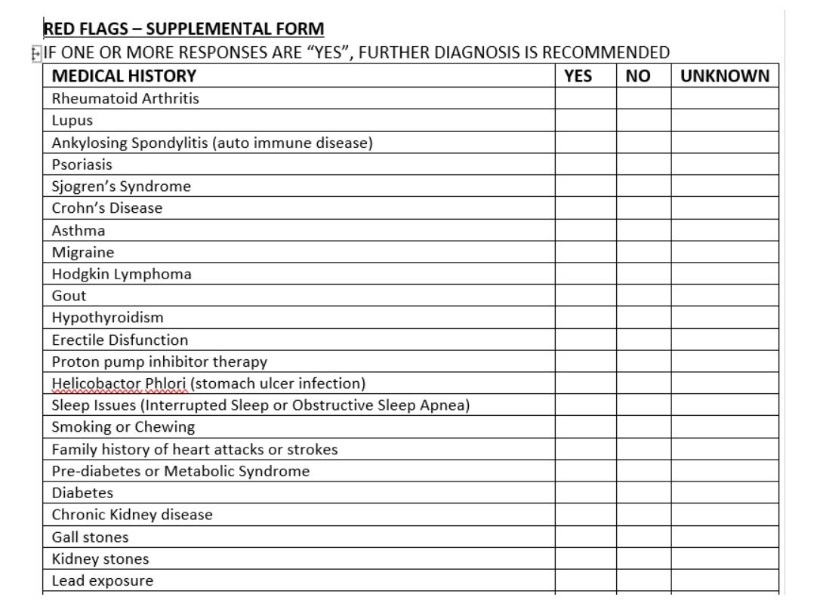
WHOM SHOULD I EDFROG FIRST?
RED FLAG SURVEY
Use the template from the website
ANY POSITIVES ➔
Complete evaluation
NO POSITIVES ➔
Next step

Slide 10
WHOM SHOULD I EDFROG FIRST?
PAST MEDICAL HISTORY
ANY CV EVENTS, DIAGNOSIS, OR DIABETES ➔ Complete evaluation
TRADITIONAL RISK FACTORS INCLUDING SLEEP ➔ Complete evaluation
NO POSITIVES➔Next step
FAMILY HISTORY
ANY VASCULAR EVENTS OR T2DM➔Complete evaluation
NO/INCOMPLETE FH➔Next step

Slide 11
WHOM SHOULD I EDFROG FIRST?
PLAQUE-FINDING SURVEY
Chart Review of Radiologic Studies for evidence of arterial calcification
Plain films--Chest, extremities, abdomen/pelvis
CT scans--Chest, Brain, Neck, Abdomen/pelvis, extremities
MRI/MRA scans--Chest, Brain, Neck, Abdomen/pelvis, extremities
Ultrasound--any vascular, Abdomen/pelvis, cardiac echo findings
Mammogram
Dental X-rays
Cath findings from any vascular bed

Slide 12
CAFES-CAVE FINDINGS

Slide 13
PHYSICAL FINDINGS OF INCREASED RISK
Frank's sign ear creases
Baldness
Xanthoma or Xanthelasma
Corneal arcus
Fordyce's granules
Atrial Fibrillation irregularly irregular rhythm
Resting heart rate > 75
Gum disease

Slide 14
PHYSICAL FINDINGS OF DISEASE
Vascular
Bruits
Pulse discrepancy
Prominent abdominal aorta span
Auscultation
Cardiac murmurs
Aortic stenosis
Mitral regurgitation
Gallops
Peripheral Edema

Slide 15
COGNITIVE ASSESSMENT
MMPI
Montreal Cognitive Assessment—Dr Doneen is evaluating this
Others you may be using

Slide 16
DIAGNOSTIC STUDIES TO PERFORM
Carotid +/- Femoral IMT
Abdominal Aorta US—be sure to ask for plaque assessment!
Ankle-Brachial Index—only identifies obstructive disease or stiff vessels (e.g. diabetics)
Coronary Calcium Score

Slide 17
DETERMINE TERNARY CLASSIFICATION AND GOALS OF THERAPY
PRIMARY
NO disease/events
Goal: PREVENT DISEASE
SECONDARY
Disease, NO events
Goal: PREVENT EVENTS
TERTIARY
Events—including cognitive issues and “extrinsic” CKD
Goal: PREVENT RECIDIVISM

Slide 18
BASIC LAB TESTS
BMP—glucose, CKD
Liver Profile including Bilirubin and GGTP—Gilbert’s, NASH
Magnesium—atrial fibrillation risk
Vitamin D—inflammation risk, insulin resistance, bones
hsCRP—visceral fat (IR), Rosuvastatin benefit (JUPITER)
MACR—NOT an office dipstick (only detects > 30 mg/gr creatinine)—endothelial integrity
Lipoproteins
ApoB, ApoA1, lp(a)

Slide 19
INFLAMMATION PANEL
F2-Isoprostane
hsCRP
MACR
Fibrinogen
LpPLA2 Activity
MPO
Optionals:
ADMA/SDMA
OxLDL
ANY POSITIVE MANDATES EXPEDITED
ROOT CAUSE EVALUATION
AND
TREATMENT INITIATION!

Slide 20
BEGIN ROOT CAUSE ANALYSIS
Plaque presence = Inflammation events have been occurring/reoccurring!
Inflammation presence = Active disease ongoing, risk of vulnerable plaque ➔ MACE!

Slide 21
Fill out the Root Cause Chart as information becomes available.

Slide 22
UNKNOWN
AIR
POLLUTION

Slide 23
DIAGNOSE METABOLIC SYNDROME!!
Waist line
Fasting glucose > 100 mg/dL
Fasting triglyceride > 150 mg/dL
SBP> 130 OR DBP>85
HDL < 40 mg/dL men, < 50 mg/dL women
3 or more positive = MetSyn
ETHNICITY | MEN | WOMEN
CAUCASIAN | > 40 inches | > 35 inches
AFRICAN, MIDDLE EAST | > 37 inches | > 31.5 inches
CHINESE | > 33.5 inches | > 31.5 inches
JAPANESE | > 33.5 inches | > 35.5 inches
ASIAN, CENTRAL/SOUTH AMERICA | > 35.5 inches | > 31.5 inches

Slide 24
2 HOUR OGTT—WHOM FIRST?
ALL Plaque Formers (70% likely)
ALL Abnormal TG/HDL (70% likely)
ALL Metabolic Syndrome (90% likely)
ALL with TG>150 mg/dL
All with SBP>= 130 OR DBP>=85
ALL with HDL < 40 male, < 50 female
All with Fasting glucose > 100 mg/dL
ALL Women with any:
ALL with Periodontal Disease
PCOD | Gestational Diabetes | Gestational HBP | Eclampsia/Pre-eclampsia | Infertility | Miscarriage

Slide 25
GENETICS
9p21
ApoE
KIF6
4q25
Haptoglobin
Lipoprotein (a)—placed here to remind you this also indicates family of origin risks!
CYP 1A2 if coffee drinker
CYP 2C19 if on Clopidogrel
Simon-Broome Criteria for FH

Slide 26
SIMON BROOME CRITERIA
DEFINITE FAMILIAL HYPERCHOLESTEROLEMIA | PROBABLE FAMILIAL HYPERCHOLESTEROLEMIA
CHOLESTEROL > 290 mg/dL or LDL > 190 mg/dL AND | CHOLESTEROL > 290 mg/dL or LDL > 190 mg/dL AND
TENDON XANTHOMAS patient, 1st, or 2nd OR | Family History MI < 50 in 2nd, < 60 in 1st OR
DNA evidence of LDLR, PCSK9, or APOB | Family History Cholesterol > 290 in 1st or 2nd, > 260 in child/sibling

Slide 27
PERIODONTAL AND ENDODONTIC EVALUATION
MPO Positive ➔ Need both ASAP
OralDNA
Periodontal charting
CBCT

Slide 28
SLEEP STUDY DECISION
Hypertension
Insulin Resistant
Plaque
Persistent Inflammation
Snoring with/without witnessed gasping/apnea
Excessive daytime sleepiness
Abnormal Epworth or STOP-BANG score
Atrial fibrillation
Congestive Heart Failure
Cognitive problems

Slide 29
AUTOIMMUNE/INFLAMMATORY DISEASE
Clinical symptoms suggestive
hsCRP above 10 mg/dL
Unexplained persistent inflammation despite optimal control of all Root Causes identified

Slide 30
GUT MICROBIOME
TMAO may have benefit
Other gut panels have not been validated sufficiently
Addressing good nutrition will improve gut microbiome
Insulin Resistance
Pre- and Pro- biotic foods
No artificial sweeteners
More fruits and vegetables
Etc.

Slide 31
CAROTID ARTERY MOSTLY NORMAL
Initial Evaluation
AIR
POLLUTION

Slide 32
INFLAMMATION TESTING WHAT NEXT?
David B Wright MD
Clinical Coach BDM
22 October 2021
BaleDoneen Academy
Course 2

Slide 33
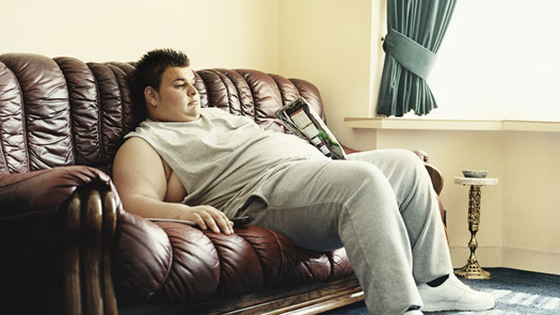
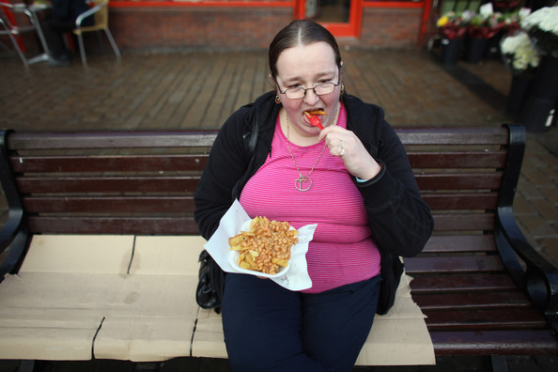
LEADING CAUSES OF DEATH 1990 - 2010
BMI #4
Diet #1
Inactivity #5
Smoking #2
Blood Pressure #3
Fasting Glucose #6
Total Cholesterol #7
JAMA 2013; 310:598

Slide 34
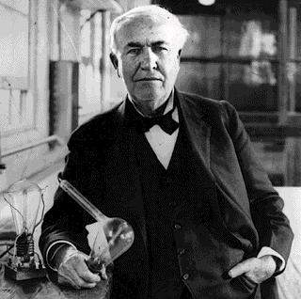
THE FUTURE IS NOW
“The doctor of the future
will give no medicines, but
will interest his patients in
the care of the human
frame, in diet, and in the
causes and prevention of
disease.”
- Thomas Edison, 1847-1931
Notes:
The famous and prolific inventor, Thomas Edison, was way ahead of his time in many areas. While we do believe the right medicine in the right patient is still needed, a focus on what the patient can control is the most important factor in preventing the most common diseases of modern man—Heart Attack, Stroke, and Diabetes.

Slide 35
LIFESTYLE IS CRITICAL
I CAN’T
OUTPRESCRIBE
YOUR
DAILY CHOICES!!

Slide 36
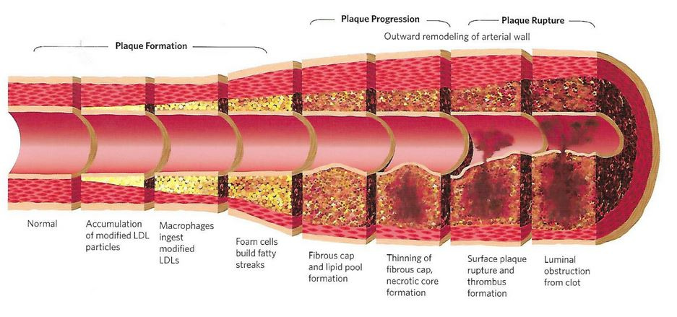
ARTERIAL AGING
Notes:
Explain in Laymen’s terms how plaque develops into unstable plaque
NORMAL HIGHWAY SURFACE IS DAMAGED
INFLAMMATION ACCELERATES DAMAGE
INFLAMMATION DESTABILIZES THE PLAQUE
THE CLOT KILLS

Slide 37
Inflammation: Atherosclerosis and Acute Events
Studies continue to show the value of assessing the degree of inflammation in a patient
Younger Patient
Older Patient
Healthy
Plaque
formation
Vulnerable plaque
Adverse events (MI, stroke, death)
Notes:
If we look at the studies that continue to show the value of assessing the degree of inflammation in a patient, we realize that healthy patients have plaque, vulnerable plaque and adverse events Including MI and stroke. What is becoming more evident is that the difference in presentation is more a function of how the body responds to the plaque rupture. Importantly, thrombosis, in response to plaque rupture will dictate the presentation in patients. The battery of biomarkers developed by CHL will not only define the risk for people who present with acute events, but also the risk in those that are seen in the office every day.

Slide 38
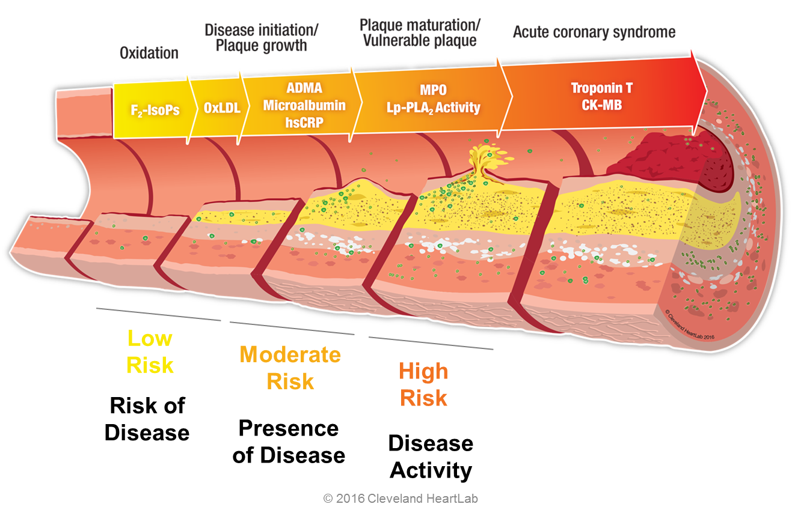
The Artery Wall

Slide 39
Vascular Inflammation
Myeloperoxidase (MPO)
Lp-PLA₂ Activity
FIRE
ALARMS!!
General Inflammation
hsCRP
Endothelial Damage
Urinary Microalbumin
ADMA/SDMA
SMOKE
DETECTORS
Oxidation/Lifestyle
Oxidized LDL (OxLDL)
F₂-Isoprostanes
Notes:
F2Iso/OxLDL—oxidative stress/Lifestyle lie detector
MACR—the “canary in the coal mine”—direct reflection of endothelial dysfunction in the glomerulus.
ADMA/SDMA—predictor of Nitric Oxide inhibition/endothelial dysfunction
hsCRP is a surrogate marker of visceral fat, which is pro-inflammatory. NOT A PLAYER. Marker of endothelial stress/damage risk.
LpPLA2—a PLAYER—produced by Foam Cells sub-intimal, and interacts with OxLDL
MPO—the “JOKER” and a PLAYER; 1:50 incidence

Slide 40
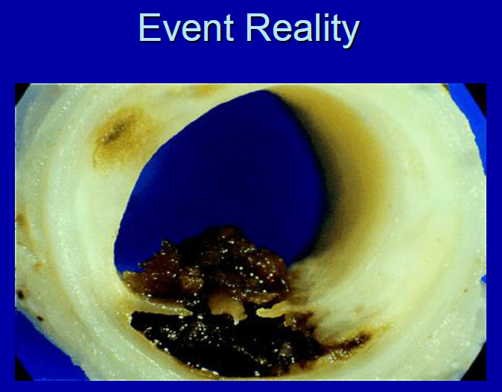
plaque
Inflam-mation
Notes:
Explain BOTH are needed to cause events.

Slide 41
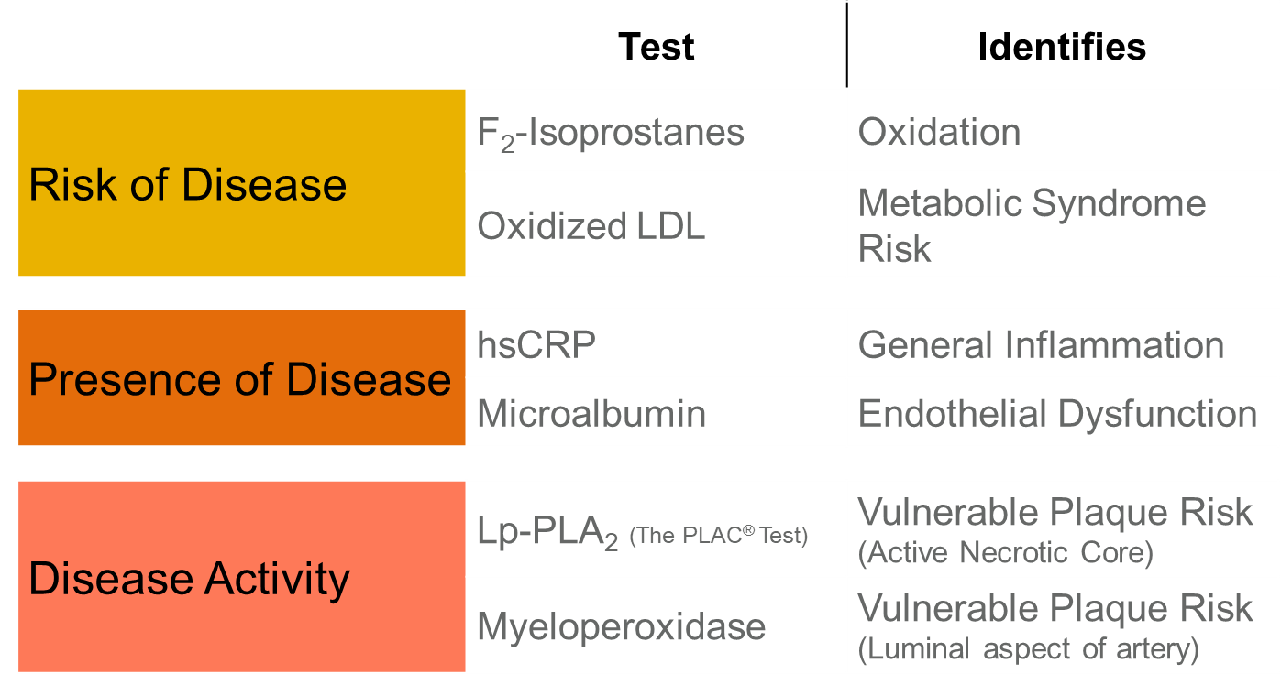
INFLAMMATION TESTING

Slide 42
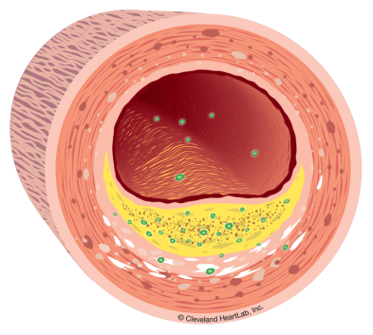
VULNERABLE PLAQUE
Outside the vessel wall
MPO can be used to tell us if circulating white blood cells are being activated in response to fissures, erosions or warming plaque increasing the risk of vulnerable plaque rupture
Inside the vessel wall
Lp-PLA₂ can be used to tell us if there is active inflammation within the vessel wall that could contribute to vulnerable plaque formation

Slide 43
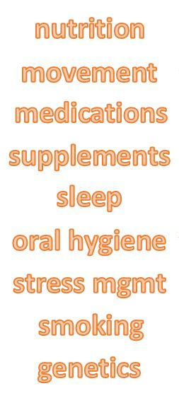
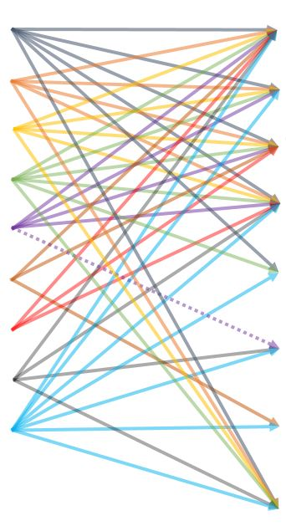
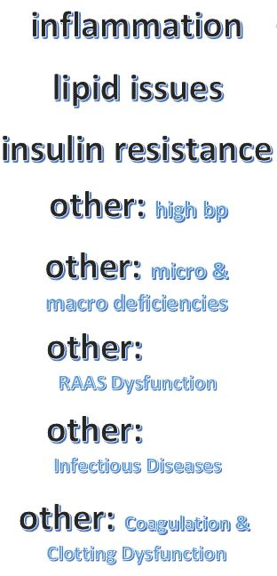

Slide 45
MUST ADDRESS ALL ROOT CAUSES OF ARTERIAL INFLAMMATION
Endothelial Injury➔
Inflammatory (healing) response➔ Resolution OR
Continued Endothelial Injury➔
Inflammatory (destructive) response➔
Plaque formation➔Inflammation➔
Plaque rupture/erosion➔Events
UNLESS THE SOURCE OF INJURY IS ADDRESSED
INFLAMMATION WILL PERSIST
AND LEAD TO ARTERIAL WALL DAMAGE

Slide 46
STEPS TO DIAGNOSIS: INFLAMMATION PANEL
Follow Implementation Guide Work Flow
Order Inflammation Panel
Decide Urgency of Root Cause evaluation
Begin Initial Treatment Strategies

Slide 47
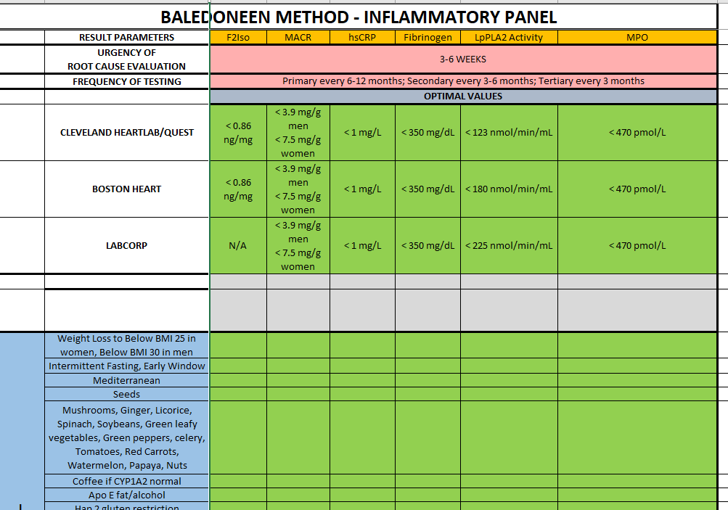

Slide 48
INFLAMMATION PANEL
F2-Isoprostane
hsCRP
MACR
Fibrinogen
LpPLA2 Activity
MPO
Optionals:
ADMA/SDMA
OxLDL
ANY POSITIVE MANDATES EXPEDITED
ROOT CAUSE EVALUATION
AND
TREATMENT INITIATION!

Slide 49
NON-ROOT CAUSES OF ELEVATED INFLAMMATION MARKERS
F2 Isoprostane
Endurance/Extreme Athletes
Red meat
MACR
Nephrotic syndrome
Glomerular diseases
Monoclonal gammopathy
Nephrotoxins
hsCRP
Acute injury or infections
Chronic infections
Autoimmune diseases
IgM Gammopathy

Slide 50
NON-ROOT CAUSES OF ELEVATED INFLAMMATION MARKERS
Fibrinogen
None reported
Lifestyle and Smoking are primary driver
Lp-PLA2
None reported, including sepsis
MPO
Specimen processing—WBC’s not removed properly at draw site
CHF
Extreme athletes, Endurance runners
Bone Marrow dyscrasias
Leukemia/Lymphoma
Myeloma

Slide 51
F2-Isoprostanes (F2-IsoPs)
Intervention to reduce oxidation
As Measured by Urinary F2-IsoPs:
Intervention | Duration of Treatment | Findings
Statin Therapy | 1 month simvastatin | ↓34% F2-IsoPs (↓20% TC)¹
Smoking Cessation | 3 weeks cessation | ↓33% F2-IsoPs²
Caloric Restriction/Weight Loss | 12 weeks calorie intake 1200 kcal/d | ↓32% F2-IsoPs (↓hsCRP & 11-d-TxB2)³
Omega-3 | 8 weeks (Daily Fish Meal; 3.6g ω-3) | ↓20% F2-IsoPs⁴
Brassica vegetables (e.g. broccoli) | 4 weeks (2 cups or more per day) | ↓22% F2-IsoPs⁵
Mediterranean Diet | 1 year | ↓15-18% F2-IsoPs⁶
1.) De Caterina R, et al. Circulation. 2002; 106:2543–2549. 2.) Reilly M, et al. Circulation. 1996; 94:19–25. 3.) Davi G,et al. JAMA. 2002; 288:2008–2014. 4.) Mori TA, et al. Metabolism. 1999; 48:1402-1408. 5.) Fowke JH, et al. Carcinogenesis. 2006; 27:2096-2102. 6.) Mitjavila MT, et al. Clin Nutr. 2013; 32:172-178.

Slide 52
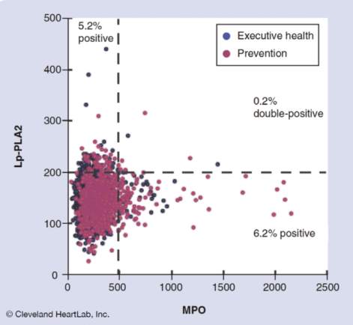
The two sides of vulnerable plaque
RISK OF:
EROSIONS
RUPTURE
BOTH!!!
Low Lp-PLA₂ and High MPO
Less active artery wall, but an unstable collagen cap
High Lp-PLA₂ and Low MPO
Active artery wall, but a stable collagen cap
High Lp-PLA₂ and High MPO
Active artery wall, and an unstable collagen cap
Penn MS, et al. Future Cardiol. 2013;9(4):497-506.
Notes:
Lp-PLA2 and MPO define distinct physiologies of plaque vulnerability, and therefore would not identify the same clinical populations.
Based on graph above of patients originate from Preventive Cardiology (red) or Executive Health (blue) practices.
approximately 6% of patients have increased risk due to luminal irregularities (MPO)
approximately 5% of patients are at risk based on inflammation within the intima–media under the collagen cap (LP-PLA2)
approximately 0.2% of patients have both markers elevated
If one were to take a single marker approach, this would suggest that one is comfortable with assessing only one side of the coin or only half of the patient’s potential for risk.

Slide 53
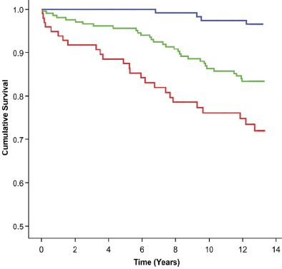
Myeloperoxidase (MPO)
MPO and CRP have combined utility in predicting cardiovascular mortality risk in patients with angiographic evidence of CAD
MPO
CRP
Patients with either a high MPO or high CRP had 5.3-fold higher mortality risk
Patients with high levels of both MPO and CRP had a 4.3-fold risk vs. patients with only one elevated marker
Low and Low
High or High
High and High
Log-rank test: p<0.001 for trend
Modified from: Heslop CL, et al. J Am Coll Cardiol. 2010;55(11):1102-9.

Slide 54
MPO DRIVERS
Always consider In vitro processing error during separation of plasma!
Drivers of Arterial Injury
Dyslipidemia
Insulin Resistance
Hypertension
Obstructive Sleep Apnea
Lifestyle
Extreme Athletes!! ?reason for some of their MACE?

Slide 55
MPO DRIVERS
Autoimmune Inflammatory—known risk factors for MACE!
Inflammatory Bowel Disease
RA
SLE
Vasculitis
Gut Microbiome
Oral Microbiome
Periodontal Disease—drives ASCVD
Endodontic Disease—anecdotal evidence is suggestive
Other Drivers
Diastolic CHF—HFpEF
Myeloproliferative Disorders

Slide 56
PRIMARY NO ROOT CAUSES OR INFLAMMATION “YET”
COMPLETE THE ROOT CAUSE EVALUATION
2-hour OGTT
Genetics
Pharmacogenetics if on polypharmacy
Periodontal/Endodontic referral for evaluation
TMAO
Autoimmune only if clinically indicated
REASSESS ANNUALLY

Slide 57
SECONDARY, TERTIARY, OR ANY ROOT CAUSE, OR INFLAMMATION PRESENT
COMPLETE THE ROOT CAUSE EVALUATION
Re-visit Sleep Apnea question
2-hour OGTT
Genetics
Pharmacogenetics if on polypharmacy
CYP2C19 if on Plavix
Familial Hyperlipidemia if Simon-Broome criteria met (see next slide)
Periodontal/Endodontal referral for evaluation
TMAO
Autoimmune evaluation if clinical indications
Drug Response
Aspirin Works
Plavix Response

Slide 58
TREATMENT STRATEGY
Begin by managing what you DO know to be true while awaiting other studies to define ROOT CAUSES
Optimize Lifestyle
Supplements
Vaccines for Pneumococcus and Zoster
Monitor inflammation every 4-6 months
Foundational Therapy if Plaque present
Nutrition based on Genetics
Aspirin
Ramipril
Statin based on KIF 6, OR Rosuvastatin

Slide 59
TREATMENT STRATEGY
Begin by managing what you DO know to be true while awaiting other studies, e.g. Genetics
Optimize Lifestyle
Supplements
Vaccines for Pneumococcus and Zoster
Monitor inflammation every 4-6 months
Recheck his hsCRP in 3-4 weeks to see if transient
Recheck CIMT annually
Recheck CACS every 1-2 years
Recheck Aorta every 1-2 years

Slide 60
F2-ISOPROSTANE THERAPY
LIFESTYLE!!!
NO SMOKING, NO NICOTINE
Movement!
Nutrition
Reduce red meat
Mediterranean, adjust based on
Genetics
Insulin Resistance
Weight loss
Omega-3, preferably through foods, supplements
Sleep
Stress
Oral Health

Slide 61
F2-ISOPROSTANE THERAPY
SUPPLEMENTS
Omega-3 1000 mg EPA + DHA
Soluble fiber
MEDICATIONS
Statin when appropriate

Slide 62
MACR THERAPY
LIFESTYLE
OPTIMIZE BLOOD PRESSURE
Ramipril preferred, Lisinopril “ok”
Chlorthalidone, Indapamide, Amiloride if diuretic needed
LOOK FOR/TREAT INSULIN RESISTANCE
Cinnamon-biotin-chromium
Berberine
Nicotinic Acid
Natural alpha-D Tocopherol if Hap 2-2 ?
Theoretically beneficial, but published evidence only in Type2DM
Pioglitazone
GLP-1 agents

Slide 63
hsCRP THERAPY
LOOK FOR
Non-CV acute causes of transient high hsCRP when 3-10 mg/dL
Systemic illnesses when > 10 mg/dL
Dental health issues!
LIFESTYLE
LOOK FOR/TREAT INSULIN RESISTANCE
Waistline > 32 women, > 36 men ➔ IR until proven otherwise
JUPITER trial showed benefit of Rosuvastatin for those with plaque if above 2 mg/dL

Slide 64
FIBRINOGEN
LIFESTYLE
WHILE AWAITING PLAQUE EVALUATION:
Aspirin
Ramipril
Statin

Slide 65
Lp-PLA2 THERAPY
LIFESTYLE
Smoking/Nicotine Cessation
LOOK FOR/TREAT INSULIN RESISTANCE
OxLDL is “food” for the macrophage trapped in the arterial wall!
SUPPLEMENTS
Omega-3 1000 mg EPA + DHA
Nicotinic Acid
Natural alpha-D tocopherol if Hap 2-2
Unproven in IR population

Slide 66
Lp-PLA2 THERAPY
MEDICATIONS
WHILE AWAITING PLAQUE EVALUATION:
Aspirin
Ramipril
Statin
IF INSULIN RESISTANT
Pioglitazone—24% reduction in MACE over 4.8 years
IF KNOWN PLAQUE AND PERSISTENT ELEVATION
Colchicine

Slide 67
MPO THERAPY
LIFESTYLE
LOOK FOR/TREAT PERIODONTAL/ENDODONTIC DISEASE
LOOK FOR/TREAT INSULIN RESISTANCE
SUPPLEMENTS
Nicotinic Acid
Melatonin
Natural alpha-D Tocopherol if Hap 2-2 and T2DM
Unproven in IR

Slide 68
MPO THERAPY
MEDICATIONS
WHILE AWAITING PLAQUE EVALUATION:
Aspirin
Ramipril
Statin
IF KNOWN PLAQUE AND PERSISTENT ELEVATION
Colchicine

Slide 69
LIFESTYLE PLAN
NUTRITION
Mediterranean foundation
Dark chocolate 70+% 7-10 grams/day (1/3rd ounce)
Time-restricted feeding
MOVEMENT
Aerobic 22 minutes/day
Strength training 3 days a week, major muscle groups
High intensity interval training if able, 3 days a week, 3 bursts

Slide 70
LIFESTYLE PLAN
SLEEP
7-9 hours
Cool room
No blue screen for 1-2 hours prior
STRESS
Deep breathing
Calm or Muse apps
ORAL HEALTH
Brush twice a day
Floss 1-2 times a day
Brush tongue weekly
No alcohol mouth washes

Slide 71
LIFESTYLE PLAN
VACCINATIONS
Influenza
COVID19
Pneumococcus
Zoster

Slide 72
UNKNOWN
AIR
POLLUTION

Slide 73
CASE PRESENTATION
JANE DOE
INITIAL RISK ASSESSMENT AND ROOT CAUSES
Date
ARTERIAL DISEASE: PRESENT/ABSENT
PLAQUE STATUS—location, type, extent, symptomatic?
INFLAMMATION: PRESENT/ABSENT
ROOT CAUSES OF DAMAGE/INFLAMMATION/DISEASE--listed roughly in order of importance
KNOWN
Listed from your evaluation with “Controlled/Uncontrolled” comment
UNKNOWN
All those not yet tested for

Slide 74
QUESTIONS
AND
ANSWERS

