Slide 1

AUGUST 2019 SCIENTIFIC UPDATE
Guest Presenter
David Wright MD
Premier Prevention Memphis
Memphis, TN

Slide 2
Upcoming events for BaleDoneen
September 20-21 – BDM Reunion in Spokane, WA!
October 17- Amy and Brad AAOSH in Nashville, TN
November 8-9 – BDM Preceptorship Orlando, FL

Slide 3

September 20-21, 2019!
See you in Spokane for the BaleDoneen Reunion!
Sign up TODAY – space is filling up!
www.BaleDoneen.com

Slide 4

“Knowing is not enough,
we must apply;
willing is not enough
we must do.”
Johann Wolfgang vonGoethe
German Poet 1749-1832
Notes:
There is lots of new information out there for you to apply.
I know it is a challenge to change and add something new into your routine. My goal is to give you some nuggets you can apply tomorrow!

Slide 5
Featured Articles
DISEASE
The Prevalence and Correlation of Carotid Artery Calcifications and Dental Pulp Stones in a Saudi Arabian Population
Ali Alsweed, Randa Farah, Satheeshkumar PS and Rafat Farah. Diseases 2019;7:50-59; doi:10.3390/diseases7030050
Association of Coronary Artery Calcium With Long-term, Cause-Specific Mortality Among Young Adults
Michael D. Miedema, MD, MPH, et al. JAMA Network Open 2019;2(7):e197440.
doi:10.1001/jamanetworkopen.2019.7440

Slide 6
Featured Articles
DISEASE
Peripheral Microvascular Function Reflects Coronary Vascular Function
Al-Badri A, Kim JH, Liu C, Mehta PK, Quyyumi AA.
Arterioscler Thromb Vasc Biol. 2019;39:1492–1500. doi:10.1161/ATVBAHA.119.312378
Endothelial Dysfunction: Cardiovascular Disease Pathophysiology Hidden in Plain Sight
Michel T. Corban, Lilach O. Lerman, Amir Lerman
ATVB 2019;39:1272-74.
Notes:
Amy incorporated these papers into her amazing talk last month. If you haven’t listened to it yet, do so ASAP!!
We will take a deeper dive into both

Slide 7
Featured Articles
DISEASE
Did This Patient have Cardiac Syncope? The Rational Clinical Examination Systematic Review
Albassam OT, et al. JAMA 2019;321:2448-2457. dol:10:1001/jama.2019.8001

Slide 8
Featured Articles
ROOT CAUSES
Comparative Relevance of Physical Fitness and Adiposity on Life Expectancy: A UK Biobank Observational Study. Zaccardi et al. Mayo Clin Proc 2019;94:985-994
Editorial: Fitness Equals Longer Life Expectancy Regardless of Adiposity Levels. Laukkanen and Kunutsor Mayo Clin Proc 2019;94:942-945
A Sleeping Beast: Obstructive Sleep Apnea and Stroke. McKee and Auckley. Cleveland Clinic J of Med 2019;86:407-414. doi:10.3949/ccjm.86a.18033
Development, Validation, and Assessment of an Ischemic Stroke or TIA-specific Prediction Tool for Obstructive Sleep Apnea. Sico et al. J Stroke Cerebrovasc Dis 2017;26:1745-1754. Sico et al. doi:10.1016/j.jstrokecerebrovasdis.2017.03.042

Slide 9
Featured Articles
OPTIMAL GOALS
Antiaging Effects of Aerobic Exercise on Systemic Arteries
Hirofumi Tanaka Hypertension. 2019;74:00-00.
DOI: 10.1161/HYPERTENSIONAHA.119.13179.
Knowing Cardiorespiratory Fitness Should be a Vital Sign is Not Enough Ross Mayo Clin Proc 2019;94:1395-97
The Influence of Change in Cardiorespiratory Fitness With Short-Term Exercise Training on Mortality Risk From The Ball State Adult Fitness Longitudinal Lifestyle Study Imboden et al.
Mayo Clin Proc. 2019 Aug;94(8):1406-1414. doi: 10.1016/j.mayocp.2019.01.049. Epub 2019 Jul 11.

Slide 10
Featured Articles
OPTIMAL GOALS
Nonexercise Estimated Cardiorespiratory Fitness and All-Cancer Mortality: the NHANES III Study. Wang et al. Mayo Clin Proc 2018;93:848-856.
Comparing Cardiovascular Safety of Febuxostat and Allopurinol in the Real World: A Population-Based Cohort Study. Su et al. Mayo Clin Proc 2019;94:1147-1157
Editorial by Mankad: pp1128-1130

Slide 11
Featured Articles
DEEPER DIVE ON YOUR OWN
Precision exercise medicine: understanding exercise
response variability Ross R, Goodpaster BH, Koch LG, et al.
Br J Sports Med Epub ahead of print: [9 August 2019]. doi:10.1136/ bjsports-2018-100328

Slide 12
CAROTID ARTERY CALCIFICATION (CAC) and ENDODONTIC STONES on PANOREX
Background:
CAC and Dental Pulp Stones are visible on Panorex
CAC first reported 1981 by Friedlander & Laude
Dental pulp calcification first reported 1921
2015 study of 50 patients with multiple dental pulp stones reported 91 of 100 of Carotids had CAC
This study expands the data base and clarifies the association
Notes:
We KNOW plaque anywhere = Secondary Prevention Patient
CAC 1981
Endo Stones 1921
2015 study raised question whether they are associated

Slide 13
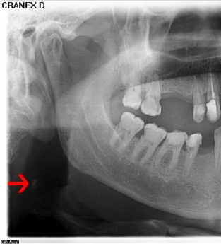
CAROTID ARTERY CALCIFICATION
Look at C3-4 in region of mandibular angle
Notes:
Reminder for dentists to look!

Slide 14
CAROTID ARTERY CALCIFICATION
CONFOUNDERS with CAC
Calcified tracheal cartilage(s)
Hyoid bone
Calcified lymph nodes
Phleboliths
Salivary Stone
Notes:
But many things can also be calcified in this region!

Slide 15
ENDODONTIC STONES
Notes:
Great picture of an endodontic stone

Slide 16
ENDODONTIC STONES
Proposed etiologies and associations:
1921: “same mechanism as calcification in arteriosclerosis”
1956: Hypercalcemia and “other metabolic disturbances”
Commonly associated with genetic and systemic conditions
2013: ?related to ischemic heart disease?
2019: Unknown pathogenesis
Usually asymptomatic “incidental” finding
Notes:
Lots of theories
Bottom line➔UNKNOWN etiology

Slide 17
CAROTID ARTERY CALCIFICATION (CAC) and ENDODONTIC STONES
Purpose:
Define prevalence of CAC
Define correlation of CAC and Dental Pulp Stones
Population:
Saudi Arabia—only 9% of Saudis are > 55 y.o.!!
Gender: 60% Male
Age 34.3 + 13.9 years
  33.6% > 41 y.o.
  10.1% > 55 y.o.
Notes:
Emphasize young age of Saudis
My brother lived there several years:
“pear shaped, middle-aged, high carb diet with lots of Turkish and Lebanese sweets, dates are “holy”, fast foods, sedentary for cultural and weather reasons, religious belief that destiny is decided—most don’t even wear seatbelts.
37% are CVD deaths

Slide 18
CAROTID ARTERY CALCIFICATION (CAC) and ENDODONTIC STONES
2013 Random Panorex from 5 major hospitals in calendar year 2017
FINDING | PREVALENCE | BY AGE GROUPS
CAC | 2% | 2.7% age 41-54 yo
 |  | 12.7% > 55 yo
PULP STONES | 4.6% | 6.9% < 25 yo
 |  | 4.5% 26-40 yo
 |  | 2.3% 41-54 yo
 |  | 2.5% > 55
CONCLUSION: No Statistical Relationship
Notes:
CAC prevalence increases with age
Stone prevalence decreases with age
No statistical association

Slide 19
CAROTID ARTERY CALCIFICATION (CAC) and ENDODONTIC STONES
“Dentists should be trained to detect CACs on PR belonging to patients older than 40 to exclude the presence of CACs. Moverover, pulp stones do not function as a diagnostic marker for CACs.”
Notes:
LOOK for CAC
IGNORE endo stones!

Slide 20
CAROTID ARTERY CALCIFICATION (CAC) and ENDODONTIC STONES
Bale-Doneen Takeaways:
Dental pulp stones are not signs of CVD
Not all Panorex calcifications regional to the carotid artery originate in the carotid artery.
The prevalence of CAC has now been reported in multiple ethnic groups and ranges from 2-12.7% depending on age groups included in studies
Look➔Find➔COLLABORATE!!
Notes:
Stones are not signs of CVD
Not all Ca++ is CAC
Prevalence of CAC across ethnicities
LOOK➔FIND➔COLLABORATE!

Slide 21
CACS TESTING IN 30-49 yo ADULTS
Background:
Studies on CACS in this age group are small, short term, lack cause-specific mortality data
Purpose:
  Define prevalence of CACS < 50 yo
  Discover cause-specific mortality associations over 12.7 + 4 yrs
Notes:
Should we do CACS in younger adults?
WE know the value, but does mainstream medicine? This article can help in your discussions with colleagues on “why are you doing these tests on younger people??

Slide 22
CACS TESTING IN 30-49 yo ADULTS
Demographics—similar to MESA, NHANES 2001, Framingham Offspring
  CAC Consortium Study 1991-2010 population
  California, Minnesota, Ohio—4 centers
  22,346 evaluated with “CVD Indications”
  87% Caucasian
  25% Female
  43.5 yo + 4.5 yrs
Notes:
Large study, but mainly Caucasian men--BOOO

Slide 23
CACS IN 30-49 yo ADULTS
Traditional Risk Factor Burden:
49.6% Lipids—LDL>160, TG>150, HDL<40/50
49.3% FH CAD in at least one 1st degree rel.
11% current smoker
3.9% T2DM
63.7% had > One Risk
2.2% 10-year calculated risk from Pooled Eq., extrapolated for ages below 40
  93% had < 5% calc risk
Notes:
Risk factor burden about typical
93% had a <5% calculated 10 year risk
REMEMBER—BDM is NOT a risk-based method, rather a DISEASE based method!!!

Slide 24
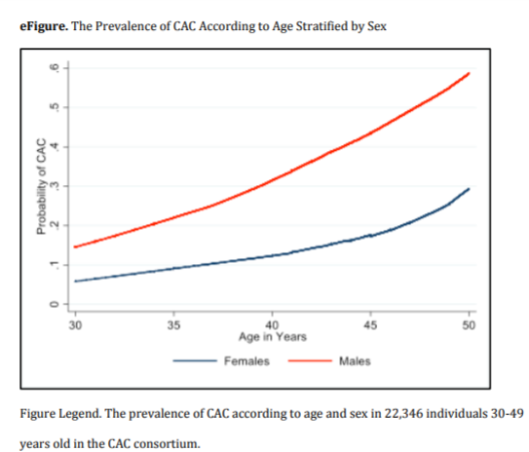
CACS 30-49 yo ADULTS
Prevalence 34.4%
27.2% CACS 1-100
7.2% CACS > 100
Men about 15 years “ahead” of women
Notes:
Men earlier than women by 15 years or so

Slide 25
CACS IN 30-49 yo ADULTS
Mortality HRs compared to Zero CACS
  Any CAC— 4x for CHD mortality
  CAC > 100— 41% had 0-1 Risk Factor
    10x for CHD 0.69/1000 person-years
    2.6x for all-cause mortality
Disease HRs for CACS > 100 vs. Zero
  5.6 x CHD
  3.3 x CVD
Notes:
Markedly higher mortality both CHD and all-cause

Slide 26
CACS IN 30-49 yo ADULTS
Mortality Stats:
67% of CHD deaths had +CAC
28.2% deaths were CVD
28.9% deaths were CA
Males 6x more CHD, 2x more CVD
Notes:
1/3rd of CHD deaths had no CAC at baseline—no surprise—SOFT PLAQUE not seen, yet is highest risk
Many aggressive cancers occur in this younger age group
DON’T LET A ZERO SCORE GIVE YOU OR YOUR PATIENT FALSE COMFORT!!!!

Slide 27
CACS IN 30-49 yo ADULTS
Authors Conclusion:
“CAC may have potential utility for clinical decision-making among select young adults at elevated risk of CVD.”
Mainstream is catching on!
Finding disease is important at any age!
You have another article to share with colleagues who wonder what you are doing!
Notes:
At least mainstream is starting to catch on

Slide 28
CACS IN 30-49 yo ADULTS
Bale-Doneen Takeaways:
BDM is NOT a risk-driven approach, rather a disease-driven method! FIND DISEASE!!
CAFES-CAVE in 2000 informed us that any plaque left untreated has a 40% event rate over 10 years in an otherwise low risk group!
CACS of Zero does NOT mean “no risk for CHD death”—33% CHD deaths in this study! EDFROG THEM TO KNOW!!!!
Notes:
As Cheri LeBlanc would say “EDFROG them”!!!

Slide 29
ENDOTHELIAL FUNCTION
5 TENNIS COURTS OF ENDOTHELIUM!!
Regulates:
  Smooth muscle vasomotion
  Platelet activation
  Endothelial integrity
  ASCVD susceptibility
Arterioscler Thromb Vasc Biol. 2019;39:1492–1500.
Al-Badri A, Kim JH, Liu C, Mehta PK, Quyyumi AA.
Notes:
Amy referenced this article in her phenomenal case presentation last month—if you were on vacation and couldn’t watch it, PLEASE DO SO ASAP!!!!!
Most of these slides are reminders, but I do have a few points to make

Slide 30
ENDOTHELIAL FUNCTION
To meet increased Oxygen demands:
  Skeletal Muscle:
    Occurs during systole;
    20-30% extracted➔simply increase extraction
  Cardiac:
    Occurs during diastole;
    60-80% extracted at rest
    ENDOTHELIUM MUST increase microvascular flow!!
Arterioscler Thromb Vasc Biol. 2019;39:1492–1500.
Al-Badri A, Kim JH, Liu C, Mehta PK, Quyyumi AA.
Notes:
Here’s why the endothelium is so critical for coronary blood flow!

Slide 31
ENDOTHELIAL FUNCTION
Why does it matter?
50% of patients with angina and NonObstructiveCAD have coronary endothelial dysfunction
Coronary endothelial dysfunction is an independent predictor of prognosis, both with/without CAD!
Arterioscler Thromb Vasc Biol. 2019;39:1492–1500.
Al-Badri A, Kim JH, Liu C, Mehta PK, Quyyumi AA.
Notes:
A reminder that NOCAD is a big deal!!!

Slide 32
ENDOTHELIAL FUNCTION
What was already known:
Brachial artery flow-mediated function correlates with Coronary Artery epicardial function
What was not known:
Is Coronary epicardial and microvascular function similar to peripheral endothelial function (as assessed by Acetylcholine, an endothelium-dependent agonist)?
Notes:
We didn’t know if peripheral endothelial dysfunction also reflects the microvascular coronary dysfunction

Slide 33
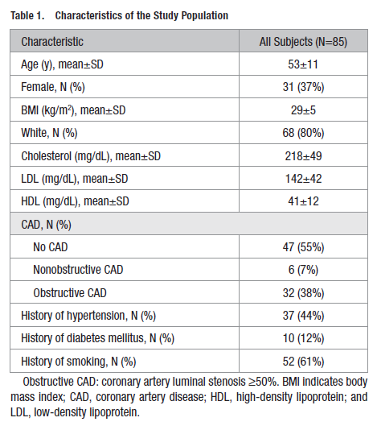
ENDOTHELIAL FUNCTION
One would suspect subintimal disease likely present in many of the “No CAD” group!
Arterioscler Thromb Vasc Biol. 2019;39:1492–1500.
Al-Badri A, Kim JH, Liu C, Mehta PK, Quyyumi AA.
Notes:
For your review

Slide 34
ENDOTHELIAL FUNCTION
STUDY
Infusions via femoral artery sheath at end of cardiac cath
  Acetylcholine—endothelium-dependent
  Nitroprusside—endothelium-independent
  Adenosine—coronary flow reserve
Measured
  Vascular resistance in Coronary/Femoral
  Epicardial coronary diameter changes
Arterioscler Thromb Vasc Biol. 2019;39:1492–1500.
Al-Badri A, Kim JH, Liu C, Mehta PK, Quyyumi AA.
Notes:
Details for FYI

Slide 35
ENDOTHELIAL FUNCTION
CONCLUSIONS
Endothelial function in peripheral and coronary circulation were modestly correlated, and reflects endothelium-dependent coronary epicardial and microvascular function, and coronary flow reserve.
“Our findings suggest that endothelial dysfunction is a systemic disorder rather than a localized one.”
Did not assess whether measures that improve peripheral function also improve coronary function. Or how obstructed arteries behave.
Arterioscler Thromb Vasc Biol. 2019;39:1492–1500.
Al-Badri A, Kim JH, Liu C, Mehta PK, Quyyumi AA.
Notes:
They DO correlate—it is a systemic disorder as Amy discussed last month.
Did not look at interventions to improve

Slide 36
ENDOTHELIAL FUNCTION
Editorialist:
“…the current study…reflects the importance of investigating and developing new therapies that might reduce major adverse cardiovascular events by targeting systemic
endothelial dysfunction, a cardiovascular disease pathophysiology
hidden in plain sight”
W H A T ? ? ?
ATVB 2019;39:1272-4.
Corban, Lerman and Lerman
Notes:
Editorialist opined about “needing new therapies” for a disease “hidden in plain sight”
WHATTTT???

Slide 37
Title
What if we could ask:
“Mrs. Smith, how is your endothelium today??” !!
WE CAN—AND SHOULD!!!
F2 Isoprostanes—Lifestyle Lie Detector--oxidation present (false negatives common)
oxLDL—injures endothelium and is macrophage food!
hsCRP—indirect indicator of cytokine production from visceral fat
MACR—the “canary in the coal mine”—damage present
ADMA/SDMA—nitric oxide inhibitors!!
Notes:
What is the first question we usually ask our patients “How are you today?”
We WANT TO KNOW “How is your endothelium today?”!!
We CAN ANSWER THAT QUESTION—AND SHOULD!!!
Reminder about what the different biomarkers tell us

Slide 38
Title
ATVB 2019;39:1272-4. Corban, Lerman
and Lerman
Notes:
The 60,000 mile highway is ALL at risk!!
I use these in the context of “Smoke Detectors”—action is needed—don’t just fall back to sleep!!!!!!
DON’T downplay or discount “only a few are slightly high”

Slide 39
ENDOTHELIAL FUNCTION
BALE-DONEEN TAKEAWAYS
We HAVE therapies which TARGET systemic endothelial dysfunction!!!
Keep the endothelium healthy and assess it regularly!
Microvascular disease with NOCAD is still high risk for MACE. Find and Rx!!!
  Younger age, women!!
Role of endothelial functional testing remains a research tool—but we HAVE biomarkers!!
Arterioscler Thromb Vasc Biol. 2019;39:1492–1500.
Al-Badri A, Kim JH, Liu C, Mehta PK, Quyyumi AA.
Notes:
Don’t let this disease be hidden in plain sight in your practice!!
Don’t cherry pick who should be tested!
Use the biomarkers!

Slide 40
EXERCISE AND ARTERIAL AGING
BACKGROUND
Age-related arterial stiffness is NOT dependent upon the presence of clinical ASCVD
However, the Root Causes for ASCVD drive increase arterial stiffness!
BDM addresses the entirety of the arterial wall—you ARE arteriologists!
Notes:
Another article that Amy weaved into her patient presentation last month
I want to focus on another aspect of arteriology—that portion of the arterial wall beneath the ASCVD disease—the media/adventitia
Arterial stiffness is separate, but associated with ASCVD and Root Causes

Slide 41
EXERCISE AND ARTERIAL AGING
Downstream Impact of Arterial Stiffness (apart from ASCVD):
  CHF
  Isolated Systolic Hypertension
  Orthostatic Hypotension
  Post-prandial Hypotension
  Microvascular disease in high flow organs
    BRAIN: Dementia, Lacunes, White Matter arteriopathy
    KIDNEY: CKD
Notes:
A reminder of all the downstream effects of stiffer pipes—all unrelated to ASCVD events!

Slide 42
EXERCISE AND ARTERIAL AGING
Aerobic Exercise in Middle-Older Age
Daily brisk walk within 3 months reduces carotid artery stiffness in men and post-menopausal women
Does NOT depend on:
  Weight loss
  Lowering BP, lipids, glucose
  Improved CV fitness
  Don’t let absence of these easily measured effects discourage you OR your patient!!!!!
Notes:
So what can we do about it?
EXERCISE!!!
EVEN IF THEY DON’T LOSE WEIGHT, DROP THEIR BP, ETC ETC

Slide 43
EXERCISE AND ARTERIAL AGING
Mechanism of Exercise Benefit:
NOT related to changes in elastin or collagen
SMOOTH MUSCLE CELL CHANGES!!!!
  Decreased SM contractility
    Decreased muscle sympathetic nerve activity (MSNA)
      A “natural” alpha-blocker!
    Decreased Endothelin-1 activity (a paracrine vaso-constrictor)
Notes:
What a surprise—those smooth muscle cells are critically important AGAIN!!!!
Direct impact on contractility—exercise is a “natural” alpha-blocker!

Slide 44
EXERCISE AND ARTERIAL AGING
Aerobic Choices:
Stand up 3 minutes for every hour you sit!
Walking—marginal added benefit with jogging
Cycling
Water-based
  Easier on joints
  Mobilizes and diureses extracellular fluid
  COPD respiratory muscle benefits (even just sitting in water that is neck deep!)
  Combines aerobic & resistance training
Notes:
Reminder of aerobic movement choices—ALL movement is MEDICINE!!!

Slide 45
EXERCISE AND ARTERIAL AGING
Resistance Exercise
Acute BP rises to as much as 320/250
Isolated resistance training increases arterial stiffness
  Likely due to elastin & collagen changes
  Older adults with existing ^arterial stiffness do not worsen “if within AHA exercise guidelines”
Yoga is an Isometric Resistance activity!
  No de-stiffening with Hatha or Hot Yoga
Notes:
What about resistance training?
Caution needed

Slide 46
EXERCISE AND ARTERIAL AGING
Cross-Training
Theoretically should improve it, since:
  Aerobic decreases arterial stiffness, and
  Resistance increases arterial stiffness, then
  The right combo should be neutral or beneficial
Evidence for lower arterial stiffness?
  Habitual Rowers compared to sedentary peers
  Aerobic + Circuit Training in Post-Menopause
Notes:
The answer?? Cross Training!!!
Aerobic daily (22 minutes) + strength 2-3 times a week

Slide 47
EXERCISE AND ARTERIAL AGING
Advantages to Cross Training
Long term compliance benefits
  Variety helps reduce boredom
  Greater enjoyment
  Less risk of over-use injuries
Reduce progression of age-related sarcopenia
  Endurance runners without strength training lose muscle mass the same as sedentary peers!
  Fall risk benefit??
Notes:
Better compliance
Slower aging

Slide 48
EXERCISE AND ARTERIAL AGING
Are other lifestyle measures additive to the exercise benefit on arterial stiffness?
Not many studies—difficult to enroll, control, and follow multiple combinations
Post-menopause + Aerobic + LTP ingestion
  Lactotripeptide—Japanese cultured skim milk
  ACE-I like effects!
  Greater decline in arterial stiffness and improvement in endothelial function!
Notes:
Interesting info about LTP
We know Lifestyle is foundational—we can NOT outprescribe their poor choices!!

Slide 49
EXERCISE AND ARTERIAL AGING
BALE-DONEEN TAKEAWAYS
It’s never too late to begin a “Movement as Medicine” program
Include Arterial Stiffness importance in your Education talk—it’s not “just” plaque!
Cross-training of Aerobic AND Resistance is vital for Optimal Healthspan Outcomes
Let the patient choose their starting point—”Which activities would you like to start adding into your daily routine?”
TLC are probably of additive benefit—studies needed!
Notes:
Engage the patient in designing their exercise program—empower them!!

Slide 50
CARDIAC SYNCOPE EVALUATION
Definition:
“In cardiac syncope, the primary event is a marked reduction in cardiac output due to cardiopulmonary disease, such as arrhythmia, structural heart disease, or pulmonary embolism that leads to cerebral hypoperfusion.”
Notes:
This is a great review article on evaluating and differentiating cardiac syncope
All of us have patients with this—even if you are “just a prevention doctor”!
I’m not going to dive deeply into it, but I do want to point out how BDM integrates into the evaluation

Slide 51
CARDIAC SYNCOPE EVALUATION
Does not include:
Orthostatic hypotension
Reflex syncope
  Vasovagal
  Situational
  Carotid Sinus Hypersensitivity
Seizure
Subclavian Steal
Vertebrobasilar TIA
Subarachnoid hemorrhage
Notes:
FYI

Slide 52
CARDIAC SYNCOPE BIOMARKERS
Annual Incidence of syncope in adults:
0.6%
2-6% in elderly
Lifetime Prevalence in adults:
18-47%
Etiology in ER cases
Cardiac 5-21%
Vasovagal 21-48%
Orthostatic 4-24%
Unexplained 17-37%
Notes:
FYI

Slide 53
CARDIAC SYNCOPE BIOMARKERS
BIOMARKER | 95% SPEC. “RULE IN” | LIKELIHOOD RATIO | 95% SENS. “RULE OUT” | LIKELIHOOD RATIO
hs-cTpn T Roche | > 42 ng/L | 5.1 | < 5 ng/L | 0.15
hs-cTpn I Abbott | > 31.3 ng/L | 5.4 | < 2.2 ng/L | 0.18
NT-proBNP | 1966 pg/mL * | 5.8 | < 69 pg/mL | 0.16
*Lesser elevations of NT-ProBNP were also associated with cardiac syncope, but with wider ranges of specificity/sensitivity/LR
Notes:
How do biomarkers impact the evaluation?
Can help raise/lower suspicion of a cardiac etiology

Slide 54
CARDIAC SYNCOPE BIOMARKERS
Authors comments:
“Both guidelines (2018 ESC and 2017 ACC/AHA) indicate that cardiac markers…should not be routinely used(emphasis added) but may be useful in select patients.”
“About 65% of patients will have non-diagnostic intermediate values.”
“About 13% of patients in the studies reviewed had a final diagnosis of unexplained syncope.”
Notes:
Mainstream is recognizing a role in “select patients”
Biomarkers usually NOT definitive—you still have to “think it through”

Slide 55
CARDIAC SYNCOPE BIOMARKERS
Bale-Doneen Takeaways:
A thorough History and Physical is always the starting point for evaluating patients!
EDFROG is useful in evaluating not only the causes of ASCVD, but also the etiology of presenting symptoms such as syncope.
Biomarkers are pieces of the puzzle, not the entire picture!
Notes:
Think!

Slide 56
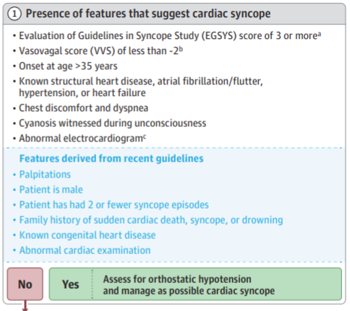
SYNCOPE EVALUATION
Notes:
Extra slides for your review later

Slide 57
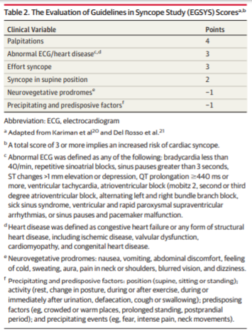
SYNCOPE EVALUATION

Slide 58
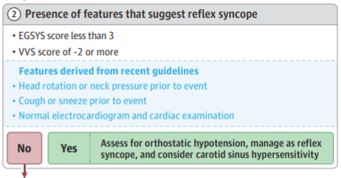
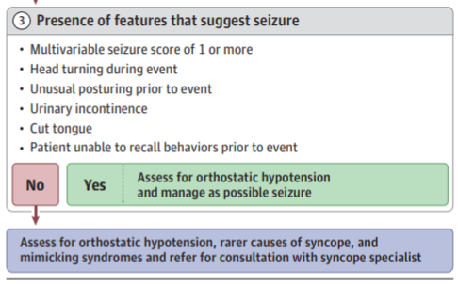
SYNCOPE EVALUATION

Slide 59
CARDIORESPIRATORY FITNESS
CardioRespiratory Fitness (CRF)
Predicts all-cause, CV, and Cancer-specific mortality
Inversely associated with Cancer Incidence!
Improves reclassification of risk
Improvement leads to better outcomes
Does everyone benefit equally from exercise??
Mayo Clin Proc 2019;94:1395-97 Ross R
Mayo Clin Proc. 2019 Aug;94(8):1406-1414. doi: 10.1016/j.mayocp.2019.01.049. Epub 2019 Jul 11.
Notes:
We know Fitness is important for lots of reasons!
Does everyone benefit?

Slide 60
EXERCISE RESISTANCE
Demographics:
683 participants—60% male, 40% female
42.7 yo + 11yrs
Follow up 29.8 + 10.7 yrs
Maximal CPX performed baseline and after AHA guideline training for 4 months
Mayo Clin Proc. 2019 Aug;94(8):1406-1414. doi: 10.1016/j.mayocp.2019.01.049. Epub 2019 Jul 11.
Notes:
Excellent study—good mix—good follow up—
Exercise testing to measure VO2Max is the gold standard—not practical in most settings

Slide 61
EXERCISE RESISTANCE
Findings:
1 MET increase in CRF decreased:
  CV mortality risk by 25%
  Overall mortality by 20% males, 38% females
  Risk reduced in women despite minimal or no weight loss
Improvements over 4 months reduced risk for 28 years!!
  Unknown why such a profound residual effect
CRF did NOT improve in 7-8% despite adherence to the regimen
  All-cause mortality 2-fold higher
  Second CPX was a stronger predictor of mortality!!
Mayo Clin Proc. 2019 Aug;94(8):1406-1414. doi: 10.1016/j.mayocp.2019.01.049. Epub 2019 Jul 11.
Notes:
Improving CRF has dramatic and sustained benefit
Women reduced risk even if minimal or no weight loss
About 1 in 12 did NOT improve their CRF—and had higher mortality!

Slide 62
EXERCISE RESISTANCE
AHA Exercise Guidelines were followed
  CRF response ranges -33% to + 118% !
Non responders are at higher risk for:
    Death
    Future cardiometabolic dysfunction!
    Different training strategies may be necessary—NO STUDIES TO DATE!!
Mayo Clin Proc. 2019 Aug;94(8):1406-1414. doi: 10.1016/j.mayocp.2019.01.049. Epub 2019 Jul 11.
Notes:
Exercise response variability is well known, and the magnitude is large!
NO studies on options
My son would tweak regimens and indirectly remeasure V02max—wish I had know studies were needed!

Slide 63
EXERCISE RESISTANCE
Proposed Causes of Exercise Resistance
Genetic Traits in 50% based on monozygotic twin/nuclear family studies—independent of other factors
Age and gender differences
Exercise resistance in “the real world”
  Non-adherence
  Inadequate dose
  Over-training
Mayo Clin Proc 2019;94:1395-97 Ross R
Mayo Clin Proc. 2019 Aug;94(8):1406-1414. doi: 10.1016/j.mayocp.2019.01.049. Epub 2019 Jul 11.
Notes:
Why does it happen? Not sure
Exercise dose/compliance are the most common reasons in the real world

Slide 64
NONEXERCISE ESTIMATED CRF
Data Points Needed:
Gender
Age
BMI
Waist Circumference in cms
Resting Heart Rate RHR
Physical Activity Status (PAS)
Current Nicotine exposure
Mayo Clin Proc 2018;93:848-856. Wang et al.
Notes:
Measuring CRF without doing an exercise study—2018 article in Mayo Clin Proc
If your patients have had an ETT, look at their performance!!

Slide 65
NONEXERCISE ESTIMATED CRF
Physical Activity Status (PAS)— # of activities over the past 4 weeks
0 = 0-4 at least moderate
1 = 5-11 at least moderate
2 = > 12 at least moderate
3 = > 12 combo of moderate + vigorous
4 = > 12 vigorous
Moderate = 3-6 METS (e.g. walking)
Vigorous > 6 METS (e.g. jogging)
Mayo Clin Proc 2018;93:848-856. Wang et al.

Slide 66
NONEXERCISE ESTIMATED CRF
Calculation of eCRF
Males:
20.8013 + 0.161(age) – 0.022(age²) – 0.224(BMI) – 0.0334 (WC) – 0.0375(RHR) + 0.2163 (PAS-1) + 0.3447 (PAS-2) + 0.787(PAS-3) + 1.1961(PAS-4) – 0.4306(nicotine)
Mayo Clin Proc 2018;93:848-856. Wang et al.
Notes:
NOT user friendly, but well suited for those wanting to do an Excel Spreadsheet….
This article used the simpler PAS formula

Slide 67
NONEXERCISE ESTIMATED CRF
Calculation of eCRF
Females:
14.5493 + 0.1136(age) – 0.016(age²) – 0.15(BMI) – 0.0088 (WC) – 0.0359(RHR) + 0.2091 (PAS-1) + 0.2275(PAS-2) + 0.7021(PAS-3) + 1.007(PAS-4) – 0.3005(nicotine)
Mayo Clin Proc 2018;93:848-856. Wang et al.

Slide 68
EXERCISE RESISTANCE
Bale Doneen Takeaways
CRF is a powerful predictor and can be measured and followed
MOST adults improve CRF with 2-4 months of AHA Guideline exercise
Exercise “resistance” is real and is a root cause for future/persistent metabolic dysfunction and death
Consider partnering with an exercise specialist to evaluate and fine tune exercise programs in your patients with “stubborn” metabolic syndrome
Mayo Clin Proc 2019;94:1395-97 Ross R
Mayo Clin Proc. 2019 Aug;94(8):1406-1414. doi: 10.1016/j.mayocp.2019.01.049. Epub 2019 Jul 11.
Notes:
Consider tracking CRF—either from exercise tests or non-exercise algorithms—exercise specialists can help!
Exercise resistance is a “residual risk” and predictor of problems!

Slide 69
FITNESS, ADIPOSITY, LONGEVITY
Previously, the relationships between BMI, fitness, and residual life expectancy have not been properly studied.
Amazing, isn’t it??!!
“To what extent do walking pace and handgrip strength associate with life expectancy at age 45 across different levels of adiposity?”
Mayo Clin Proc 2019;94:985-994.
Zaccardi et al.
Notes:
This study is novel as it explored the BMI-CRF-Life expectancy relationship

Slide 70
FITNESS, ADIPOSITY, LONGEVITY
Demographics:
UK Biobank recruited middle-aged registered with a family physician from March 2006-July 2010 in England, Scotland, Wales
474,919 participants—54.7% female
58.2 yo
26.7 BMI (obviously not the USA!)
6.97 yrs follow up
Mayo Clin Proc 2019;94:985-994.
Zaccardi et al.
Notes:
Large study, decent follow up
English population

Slide 71
FITNESS, ADIPOSITY, LONGEVITY
Data Points:
Walking pace
Handgrip
BMI
Waist circumference
Body-fat Percentage
Mayo Clin Proc 2019;94:985-994.
Zaccardi et al.

Slide 72
FITNESS, ADIPOSITY, LONGEVITY
“How would you describe your usual walking pace?”
Slow pace
Steady/average pace
Brisk pace
This simple question has previously been validated in a very large cohort!!!
Mayo Clin Proc 2019;94:985-994.
Zaccardi et al.
Notes:
Used a very simple question!! Perhaps you could start with this as you consider how to follow measured/calculated CRF

Slide 73
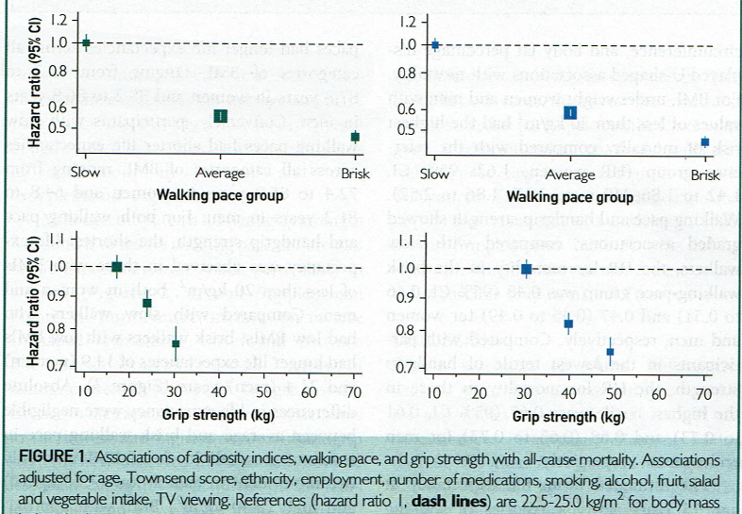
FITNESS, ADIPOSITY, LONGEVITY
WOMEN
MEN
All-cause
Mortality and Fitness
Mayo Clin Proc 2019;94:985-994.
Zaccardi et al.
Notes:
HRs for all cause mortality based on Fitness—all BMIs
The BMI and Waist Circumference mortality curves were both U-shaped with 23-29 BMI having lowest risks

Slide 74
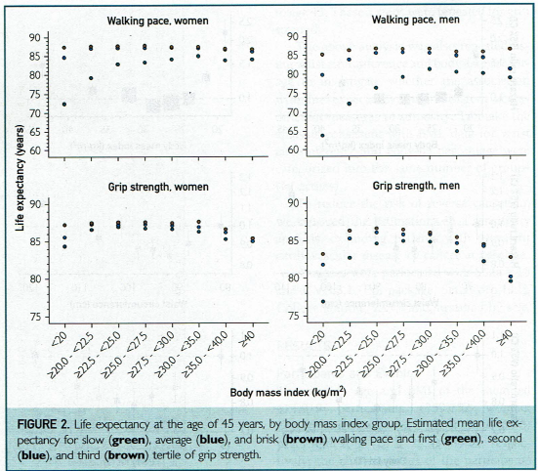
FITNESS, ADIPOSITY, LONGEVITY
Life Expectancy at age 45, Fitness, and
BMI
Mayo Clin Proc 2019;94:985-994.
Zaccardi et al.
Notes:
Hard to see—even in the print journal.
Left side women, top graphs walking pace, bottom hand grip
Very little difference between average and brisk if BMI 20-40
Women 86.7-87.8 yo brisk vs. 72.4-85 for slow
Men 85.2-86.8 yo brisk vs. 64.8-81.2 for slow
Slow were worse regardless of BMI
BMI < 20 + slow: Women 72.4 yo Men 64.8 yo

Slide 75
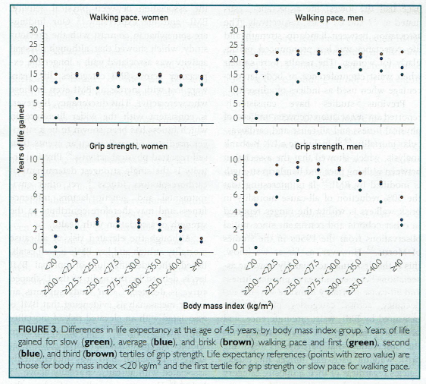
FITNESS, ADIPOSITY, LONGEVITY
Years of Life Gained, Fitness, and
BMI
Mayo Clin Proc 2019;94:985-994.
Zaccardi et al.
Notes:
Years of life gained compared to shortest life expectancy group—slow + BMI < 20
Avg and Brisk essentially same except at below 20 and above 40 BMI

Slide 76
FITNESS, ADIPOSITY, LONGEVITY
Findings: independent of baseline CVD/Cancer
Brisk walking pace had longer life expectancy at age 45 across all BMI levels
  Women 86.7-87.8 yo vs. 72.4-85 for slow
  Men 85.2-86.8 yo vs. 64.8-81.2 for slow
Slow walking pace had shorter life expectancy, with the shortest for BMI < 20
  Women 72.4 yo Men 64.8 yo
Waist and %Body Fat same patterns
Hand grip similar trend, smaller effect
Mayo Clin Proc 2019;94:985-994.
Zaccardi et al.
Notes:
Summary of prior slides
BMI, Waist Circ and %BF all trend in same direction, magnitude of effect greatest for BMI
Walking pace and Hand grip same trends, smaller magnitude for Hand grip

Slide 77
FITNESS, ADIPOSITY, LONGEVITY
Bale Doneen Takeaways:
Avg/Brisk walkers live longer for BMI 20-40
Asking about walking pace is a simple and validated predictor of life expectancy—and which patients have a more urgent need to change their trajectory!!
  Great Motivational Interviewing tool!
NOT known whether improving pace will also improve life expectancy
Slow Pace + Low BMI = Fraility = High risk M&M
Mayo Clin Proc 2019;94:985-994.
Zaccardi et al.
Notes:
Asking “How would you describe your usual walking pace?” is a simple tool!
Slow pace
Steady/average pace
Brisk pace
Can use the result for Motivational Interviewing:
Is it important for you to add more years to your life?
What activities are you willing to consider adding into your routine to become more fit?

Slide 78
GOUT DRUG TIPS
Uric Acid and CVD Pathogenesis
^Uric Acid➔
^Oxidative Stress➔ ^ROS➔
Decreased NO production➔
^Endothelial Dysfunction*
*independent of Insulin Resistance impact!
Notes:
We are coming down the homestretch! Lastly are 2 articles I want to make a couple of points about.
This one is about smarter use of uric acid lowering therapies
A reminder of why high uric acid is bad—independent of associated IR!

Slide 79
GOUT DRUG TIPS
Hyperuricemia CV Impact:
^ MACE independent of traditional risk factors
^ CV risk in those already at high risk
^ Morbidity in moderate to severe HF
CARES Trial in 2018— >6000 post-market safety study
^ All-cause and CV mortality with Febuxostat
Black Box FDA Warning Feb 2019
Notes:
Impact on CVD
CARES trial black box

Slide 80
GOUT DRUG TIPS
Allopurinol
Approved 1996
Doses up to 800 mg are allowed!
  Many patients are under-dosed!
MUST reduce dose if Stage 3 CKD
SEVERE Cutaneous reactions HLA-B*5801
  Chinese, Thai, Korean
Febuxostat
Approved 2009
MUST reduce dose for eGFR < 30
$ is10-15 x Allopurinol
Notes:
Comparison of drugs

Slide 81
GOUT DRUG TIPS
Current “Real World” Study:
88,222 Tawainese
50-50 Allopurinol or Fubuxostat
  Allopurinol avg dose only 133 mg
  Febuxostat avg dose 53 mg
Uric Acid levels not reported—efficacy?
Compliance unknown
Retrospective and observational

Slide 82
GOUT DRUG TIPS
“Real World” Study Outcomes with Febuxostat:
Hospitalization
  Heart Failure 1.22 HR
  Atrial Fibrillation 1.19 HR
CV Death 1.19 HR

Slide 83
GOUT DRUG TIPS
Bale Doneen Takeaways:
Hyperuricemia is a big deal—Think Insulin Resistance!
HYPO-uricemia below 4 mg/dL increases CV Risk especially for CAD and HF
AVOID Febuxostat unless:
  Allopurinol ineffective
    FIRST improve Insulin Sensitivity
    NEXT push the dose up to 800 mg, single dose
  Allopurinol Intolerant—discuss Black Box Warning!
Notes:
Hypo-uricemia risk noted in a 2017 article
Push the dose of Allopurinol!

Slide 84
OSA AFTER STROKE
What you already know:
OSA is a Root Cause of CVD and Events
14% of men, 5% of women have AHI > 5
  Wisconsin Sleep Cohort Study
80-90% are undiagnosed and untreated
STOP-BANG has good sensitivity (few false negatives) but poor specificity (many false positives)
Notes:
What is the association of OSA after a stroke

Slide 85
OSA AFTER STROKE
What happens AFTER a stroke occurs?
5 times higher prevalence of OSA—72%
  Unknown what % developed new SDB
  Central Apnea in 7%
Obesity is LESS of a risk factor post-CVA
  Avg BMI 26.4
Classic symptoms (sleepiness and snoring) are either absent or attributed to the stroke
Notes:
MORE OSA
Atypical presentation

Slide 86
OSA AFTER STROKE
Impact of OSA after CVA:
Hinders recovery
  13 days longer in Rehab facility
  Worse functional recovery at 3 and 12 months
  1.8 RR for recurrent CVA
  1.69 RR for all-cause mortality
Notes:
Huge impact on quality and length of life

Slide 87
OSA AFTER STROKE
Impact of Treatment begun < 3 weeks after CVA:
Improved neurologic outcomes
Delayed time to next CV event
50-60% adherence of at least 4 hours nightly
Alternatives to CPAP may be needed!
Elevated HOB
Nasal Trumpet
AVOID SEDATING DRUGS
Notes:
Treatment benefits—test early!

Slide 88
OSA AFTER STROKE
SLEEP INventory Screening Tool
80% correctly classified after ischemic stroke or TIA
Sex
Left heart failure
Epworth Sleep Scale
Enlarged neck
Pounds of body weight
Insulin resistance or diabetes
NIH Stroke Scale
Notes:
2017 study validated a better screening tool
Algorithm not published—I’ve contacted the authors

Slide 89
OSA AFTER STROKE
Bale Doneen Takeaways:
FIND Sleep-Disordered Breathing BEFORE an event!
70% of Stroke patients have AHI > 5—ALL should be tested! EVEN IF THEY HAD A PRIOR NORMAL SLEEP STUDY!
SLEEP INventory may be useful in cases where arranging a PSG, etc is difficult
  Equation was not published—I have contacted lead author
Notes:
Hopefully you are making your existing patients bulletproof to their first stroke
BUT you will be seeing new patients referred

Slide 90
JUST “ONE THING” WE MUST DO
Endodontic Stones are not signs of ASCVD
CACS before 50 finds disease, but misses up to 1/3rd of CHD deaths
Assess the 60,000 miles/5 tennis courts of endothelium regularly
BDM addresses both Plaque and Arterial Stiffness
EDFROG is useful in evaluating presenting symptoms, e.g. syncope
Exercise resistance occurs in 8% and is dangerous
Walking pace is a predictor of life expectancy across BMI range
Optimize Allopurinol therapy to achieve uric acid > 4 and < 6 mg/dL
Evaluate all stroke patients early for Sleep Disordered Breathing

Slide 91
Q & A

