Slide 1
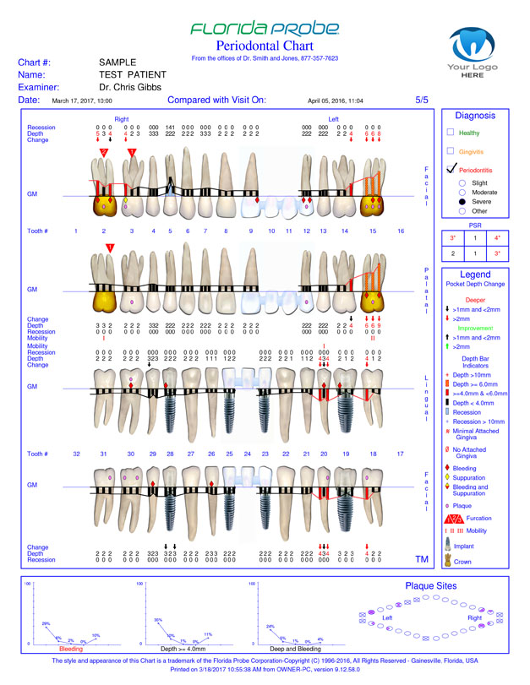
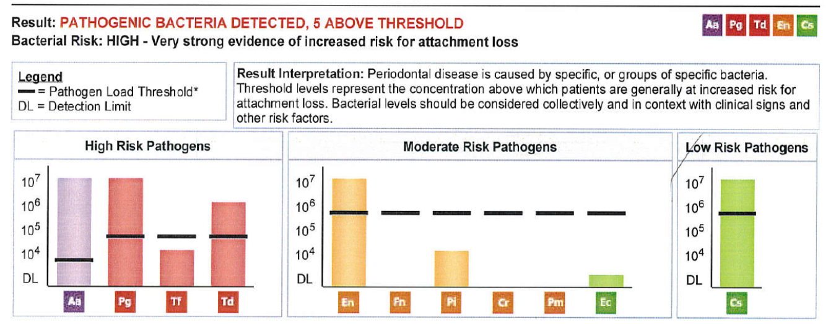
Step One: Must have a unified Definition of Optimal Oral Health
1.
2.
3.
4.
CONE BEAM 3D
We want to know WITH CONFIDENCE via a unified definition that the oral cavity isn’t or is a contributor to CV risk!

