Slide 1
BALEDONEEN METHOD
CORE
Launch Meeting
September 9, 2021
Notes:
Full day in store for you…
We’re glad you’re here!
120 signed up for the event….
Medical & Dental Providers and your teams!
Excited to share valuable information with you….
So let’s begin…

Slide 2
Welcome

Slide 3
CORE Team
Purpose
  CORE – Creating Optimal Referral Enrollment
  Consistent, Timely & Effective Patient Care
Benefits
  Referrals
  Clinical / Business Guidance
  Statistics / Outcomes Data
  Education / Tools (BaleDoneen Method Academy)

Slide 4
CORE Team - continued
Benefits
  BaleDoneen Academy
    Academy Courses – Implementation Focused (4 per year)
    Courses for your Entire Team
    Clinical Mastery - Check points to gauge your understanding of the method
    Live Role Play Sessions
    Implementation Guide
      Workflow
      Lab Tests / Optimal Values
      Treatment Considerations: Lifestyle, Supplements, Medication
    Patient Education – AHAforLife FULL Access

Slide 5
CORE Team - continued
Requirements
  Seeking New Patients
  Willingness to Provide Telemedicine
  Respond to New Patient Requests within 24 hours
  Clear / Simple Pricing
  Provide a “BaleDoneen Care Option”
  Provide Enrollment Data to BDM
  Provide Feedback to BDM
    Courses
    Tools
    Future Developments
  Complete the BDM Assessment Test (in process)

Slide 6
Tonight’s Agenda
Introductions 20 min
Clinical Guidance 5 min
Business Guidance 5 min
Referrals (Preparation & Execution) 15 min
Action Steps 10 min
Q&A

Slide 7
CORE Team
Dr. Eric Goulder, Worthington, OH
Dr. Jim Fontaine, San Diego, CA
Dr. James Bailey, Post Falls, ID
Dr. Roberta Van Zant, Morton, IL
Dr. Charles Willnauer, Overland Park, KS
Dr. Karen Pendleton, Shreveport, LA
Dr. Jeff Mayer, Tucson, AZ

Slide 8
Introductions
When did you attend your first Preceptorship?
How long have you been practicing the BaleDoneen Method?
What is the main reason that you were attracted to CORE?

Slide 9
Clinical Guidance
Academy Courses & Tools
CORE Group Calls
Individual Coaching
Clinical Workflow
Lab Testing
Optimal Values
Treatment Considerations

Slide 10
Business Guidance
Academy Courses & Tools
CORE Group Calls
Individual Coaching
Strategy / Plan
Teamwork
Workflow to Support the Strategy
Financial Goals
Clear Pricing

Slide 11
Referrals
Calls to BaleDoneen Method
New Book ”Healthy Heart, Healthy Brain” Publisher: Little Brown
  February 2022 release
AHAforLife Patient Education / www.AHAforLife.com
  Assessment – 64% no provider
  Module 1 – 31% no provider

Slide 12
Preparing to Manage Referrals
Engage Your Team!
  Do they know about BaleDoneen?
  Have they been educated on the Method?
  Do they know about CORE?
Action Steps
  Preceptorship – NEXT WEEK!
  AHAforLife – FULL ACCESS!
  Academy Training – ONLINE

Slide 13
Academy Training - SAMPLE
New Patient Interview…

Slide 14
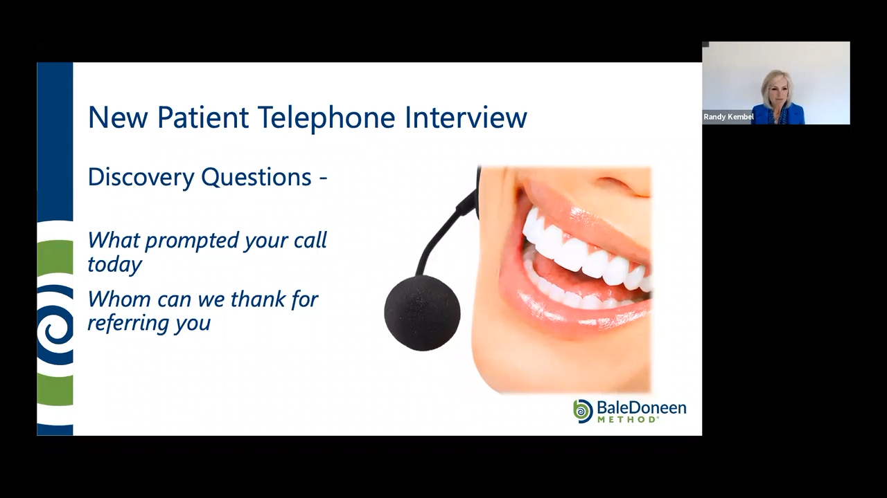

Slide 15
Making Contact…
Reviewing the Referral List
Preparing for the Conversation
Making Contact
Managing the Relationship
Tracking Referrals
Begin with 3 and then Review!

Slide 16
Tracking your Success!
Number of Referrals
Connections Made
Conversations Had
Appointments Made
New Patients

Slide 17
Action Steps
Academy Involvement
  Tomorrow – September 10
Engage Your Team!
  Academy Training – Portal & Live
  AHAforLife
    Access Codes: BDM”LASTNAME”
  Upcoming Preceptorship - FREE
Utilize the Academy Courses!
Review Your Understanding of the Method
  Preceptorship – NEXT week!
  Assessment – In Process
Complete 3 Referral Calls (AFTER TRAINING)
Reach OUT / Ask Questions!
  You are our DREAM Team!

Slide 18
Upcoming Learning Events
September 10 12pm PST Academy Webinar FREE to members
September 17 – 18 Preceptorship FREE to members
October 1 8am-12pm Academy COURSE 1 FREE to members
October 22 8am-12pm Academy COURSE 2 FREE to members
November 4 1pm-5pm Academy Workshop FREE Houston
November 5 – 6 Reunion Houston

Slide 19
Q&A

