Slide 1

BaleDoneen Method Live Scientific Update
12/11/2019
5:30-6:30 pm PST
Bradley Bale, MD

Slide 2


Slide 3
New Studies for 12/11/2019 Scientific Update Session
1. Yu, Y., et al. (2019). "Maternal diabetes during pregnancy and early onset of cardiovascular disease in offspring: population-based cohort study with 40 years of follow-up." Bmj 367: l6398.
2. Honigberg, M. C., et al. (2019). "Long-Term Cardiovascular Risk in Women With Hypertension During Pregnancy." J Am Coll Cardiol 74(22): 2743-2754.

Slide 4
New Studies for 21/11/2019 Scientific Update Session
3. Blaha, M. J., et al. (2019). "All-cause and cause-specific mortality in individuals with zero and minimal coronary artery calcium: A long-term, competing risk analysis in the Coronary Artery Calcium Consortium." Atherosclerosis. (xxxx) xxx–xxx
4. Belibasakis, G. N., et al. (2019). "Virulence and Pathogenicity Properties of Aggregatibacter actinomycetemcomitans." Pathogens 8(4).
5. Ding, J., et. al. (2019) Antihypertensive medications and risk for incident dementia and Alzheimer’s disease: a meta-analysis of individual participant data from prospective cohort studies. Lancet Neurology. https://doi.org/10.1016/ S1474-4422(19)30393

Slide 5
New Studies for 12/11/2019 Scientific Update Session
6. Judith S. Hochman, MD. International Study Of Comparative Health Effectiveness With Medical And Invasive Approaches (ISCHEMIA). AHA Scientific Sessions. Philadelphia, PA 11/14/2019
7. Sripal Bangalore, MD, MHA. International Study of Comparative Health Effectiveness with Medical and Invasive Approaches - Chronic Kidney Disease Primary Report of Clinical Outcomes. AHA Scientific Sessions. Philadelphia, PA 11/14/2019
8. John A. Spertus, MD, MPH. International Study of Comparative Health Effectiveness with Medical and Invasive Approaches ‒ Chronic Kidney Disease Primary Report of Quality of Life Outcomes. AHA Scientific Sessions. Philadelphia, PA 11/14/2019

Slide 6

Red Flags

Slide 7
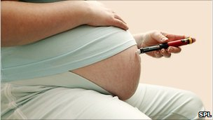
My Mother Was Diabetic

Slide 8
Increased Risk of CVD Before the Age of 40, if Your Mother was a Diabetic at the Time of Your Birth.
2,432,000 children without congenital heart disease in Denmark during 1977-2016; follow-up began at birth and continued until first time diagnosis of CVD, death, emigration, or 12/31/2016; 54,864 diabetic mothers (48% gestational, 40% type 1, 12% type 2)
CVD= CAD, stroke, HF, BP, DVT, PE.
Yu, Y., et al. (2019). "Maternal diabetes during pregnancy and early onset of cardiovascular disease in offspring: population-based cohort study with 40 years of follow-up." Bmj 367: l6398.

Slide 9
Increased Risk of CVD Before the Age of 40, if Your Mother was a Diabetic at the Time of Your Birth.
Adjusted for: offspring’s age, sex, singleton status, parity, maternal smoking, maternal education, maternal cohabitation, maternal residence at birth, maternal history of CVD before childbirth, paternal history of CVD before birth and maternal age.
The child of diabetic mothers had a significant 29% increased risk of CVD before age 40.
The risk was higher if the mothers had diabetic complications and complications plus CVD.
60% & 73%, respectively.
Yu, Y., et al. (2019). "Maternal diabetes during pregnancy and early onset of cardiovascular disease in offspring: population-based cohort study with 40 years of follow-up." Bmj 367: l6398.

Slide 10
Pregestational Type 2 DM Generated Highest Risk
Yu, Y., et al. (2019). Bmj 367: l6398.

Slide 11
Conclusions
Children of mothers with diabetes, especially those with a history of CVD or with diabetic complications, have increased rates of early onset CVD.
Public health strategies need to be designed to target such offspring for efforts to prevent CVD.
Yu, Y., et al. (2019). "Maternal diabetes during pregnancy and early onset of cardiovascular disease in offspring: population-based cohort study with 40 years of follow-up." Bmj 367: l6398.

Slide 12
BDM Thoughts
New red flag.
Needs to be added to the patient history form.
These individuals need to watch module one of AHAforLife.
They should plug into a BDM provider.
We need pediatricians to get on board with our method to start prevention efforts in childhood!

Slide 13

High BP in Pregnancy
OMG!

Slide 14
Hypertensive Disorder of Pregnancy (HDP) Portends Long Term Increased CV Risk
Prospective 7 yr study; 220,024 women with >1 live birth; 2,808 had HDP; mean age 57; 170,000 had arterial stiffness (ASI) testing; followed for incident CVD; conventional risk factor causality analysis was performed.
Incident CVD was significantly higher in women with HDP.
p=0.001
Honigberg, M. C., et al. (2019). "Long-Term Cardiovascular Risk in Women With Hypertension During Pregnancy." J Am Coll Cardiol 74(22): 2743-2754.

Slide 15
Hypertensive Disorder of Pregnancy (HDP) Portends Long Term Increased CV Risk
HDP was significantly associated with higher risk of four incident CVD conditions:
CAD- HR- 1.8
HF – HR – 1.7
Aortic stenosis- HR- 2.9
Mitral regurg. – HR – 5.0
Honigberg, M. C., et al. (2019). "Long-Term Cardiovascular Risk in Women With Hypertension During Pregnancy." J Am Coll Cardiol 74(22): 2743-2754.

Slide 17
Hypertensive Disorder of Pregnancy (HDP) Portends Long Term Increased CV Risk
Women with HDP had greater ASI by 0.32 meters/sec p=0.001.
Women with HDP had much higher incidence of hypertension.
67% vs 25%
Honigberg, M. C., et al. (2019). "Long-Term Cardiovascular Risk in Women With Hypertension During Pregnancy." J Am Coll Cardiol 74(22): 2743-2754.
Notes:
ASI is calculated by dividing standing height by the time between the initial systolic peak and reflected wave, and expressed as meters per second.
Arterial stiffness index
(ASI) is a noninvasive marker of vascular aging and an
independent indicator of cardiovascular risk (23).
Approximately 170,000 UK Biobank participants
had finger photoplethysmography-derived ASI
measured with the PulseTrace PCA2 (CareFusion

Slide 18
Hypertensive Disorder of Pregnancy (HDP) Portends Long Term Increased CV Risk
Causal analysis indicated hypertension explained 64% of the association with CAD and 49% of the association with HF.
HDP is associated with accelerated arterial aging and increased risk of diverse CV conditions including valvular issues.
Honigberg, M. C., et al. (2019). "Long-Term Cardiovascular Risk in Women With Hypertension During Pregnancy." J Am Coll Cardiol 74(22): 2743-2754.

Slide 19
Hypertensive Disorder of Pregnancy (HDP) Portends Long Term Increased CV Risk
The increased risk for CV events persisted until age 65.
It is remarkable there was no increased risk of stroke, AF, PAD or venous thromboembolism (VTE)
Honigberg, M. C., et al. (2019). "Long-Term Cardiovascular Risk in Women With Hypertension During Pregnancy." J Am Coll Cardiol 74(22): 2743-2754.

Slide 20
Honigberg, M. C., et al. (2019). "Long-Term Cardiovascular Risk in Women With Hypertension During Pregnancy." J Am Coll Cardiol 74(22): 2743-2754.

Slide 21
Hypertensive Disorder of Pregnancy (HDP) Portends Long Term Increased CV Risk
Women with HDP need early intervention to mitigate their increased CV risk.
Lifestyle measures will be the pillar of prevention.
Rich-Edwards, J. W. (2019). "The Womb and the Heart." More Connected Than We Knew 74(22): 2755-2757.
.

Slide 22
BDM Thoughts
Since BP is related causally to CAD and HF, early management should be instituted to maintain optimal BP.
That management should include medications, if lifestyle is not enough.
It is logical to believe this would also mitigate the risk of mitral valve regurgitation since high BP causes left ventricle enlargement which stretches the tissue around the mitral valve leading to leakage.
All these patients need to be plugged into a BDM provider.
If they have a lipo (a) issue, it should be managed aggressively as it may be associated with aortic stenosis progression.

Slide 23
Lipo (a) Associated with Aortic Stenosis (AS)
145 pts followed up to 3 yrs for progression of AS.
Pts in the top tertile of lipo (a) had increased progression of AS.
Findings suggest lowering lipo (a) may slow the progression of AS.
Zheng, K. H., et al. (2019). "Lipoprotein(a) and Oxidized Phospholipids Promote Valve Calcification in Patients With Aortic Stenosis.“ J Am Coll Cardiol 73(17): 2150-2162.

Slide 24
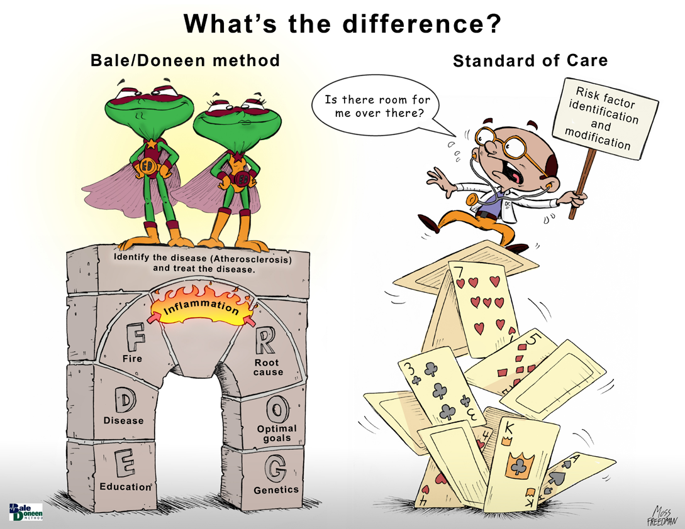

Slide 25
All-cause and cause-specific mortality in individuals with zero and minimal coronary artery calcium: A long-term, competing risk analysis in the Coronary Artery Calcium Consortium
Blaha, M. J., et al. (2019). "All-cause and cause-specific mortality in individuals with zero and minimal coronary artery calcium: A long-term, competing risk analysis in the Coronary Artery Calcium Consortium." Atherosclerosis. (xxxx) xxx–xxx
Blaha

Slide 26
Coronary Artery Calcium Score (CACS) Association With Mortality: Background
Long-term associations between zero, minimal (1-10) and higher CACS and cause-specific mortality are unknown.
Reports have linked zero CACS with low rates of cancer and other non-CVD events.
Blaha, M. J., et al. (2019). "All-cause and cause-specific mortality in individuals with zero and minimal coronary artery calcium: A long-term, competing risk analysis in the Coronary Artery Calcium Consortium." Atherosclerosis. (xxxx) xxx–xxx

Slide 27
Coronary Artery Calcium Score (CACS) Association With Mortality: Background
This has led to the hypothesis that a zero CACS may be a marker of “healthy aging”.
Supporting this view, minimal CACS of 1-10 have been associated with higher CVD events and all-cause mortality as compared to zero CACS.
Blaha, M. J., et al. (2019). Atherosclerosis. (xxxx) xxx–xxx

Slide 28
Coronary Artery Calcium Score (CACS) Association With Mortality: Background
The predominant cause of deaths in people with zero CACS is unknown.
The impact of increasing CACS on CVD versus non-CVD causes of death remains unclear.
Clarification of the above may be important for estimating prognosis and informing preventive strategies.
Blaha, M. J., et al. (2019. Atherosclerosis. (xxxx) xxx–xxx

Slide 29
Coronary Artery Calcium Score (CACS) Association With Mortality
66,636 pts; retrospective study; no known CVD; mean age 55yo; 33% female; 89% White; 57% hyperlipidemic; median 10 yr CV risk 4.4%; all had CACS; mean follow-up 12 yrs.
Primary outcome: death (3,158-~5%)
Secondary outcomes: types of death
Blaha, M. J., et al. (2019). "All-cause and cause-specific mortality in individuals with zero and minimal coronary artery calcium: A long-term, competing risk analysis in the Coronary Artery Calcium Consortium." Atherosclerosis. (xxxx) xxx–xxx
Notes:
Baseline data including demographic characteristics, cardiovascular risk factors, and baseline CAC scores were obtained at cohort entry between 1991 and 2010, and
follow-up information was obtained through June 2014

Slide 30
Coronary Artery Calcium Score (CACS) Association With Mortality
CACS=0 – 44.7%
CACS= 1-10 – 11.7%
CACS=>10 – 43.6% (older, >males, >CV risk factors, >10 yr risk score)
Blaha, M. J., et al. (2019. Atherosclerosis. (xxxx) xxx–xxx

Slide 31
Coronary Artery Calcium Score (CACS) Association With Mortality
Pts with a CACS >10 compared to those with CACS=0 were ~ 4X more likely to be dead within 12 yrs.
Pts with CACS=0 were ~ 2.5X more likely to die from cancer than CVD.
Blaha, M. J., et al. (2019. Atherosclerosis. (xxxx) xxx–xxx

Slide 32
Coronary Artery Calcium Score (CACS) Association With Mortality
After adjusting for traditional risk factors, the risk of death with a CACS 1-10 was no different than CACS=0.
After adjusting for traditional risk factors, the risk of death with CACS>10 was 1.6X greater than CACS=0;
in addition, most deaths were due to CVD than non-CVD.
Blaha, M. J., et al. (2019. Atherosclerosis. (xxxx) xxx–xxx

Slide 33
Coronary Artery Calcium Score (CACS) Association With Mortality
~594 pts with CACS=0 died
~172 died from CVD
Blaha, M. J., et al. (2019. Atherosclerosis. (xxxx) xxx–xxx

Slide 34
Coronary Artery Calcium Score (CACS) Association With Mortality
In a multivariable-adjusted model, CACS>10 compared to CACS=0 carried a significantly higher CV mortality risk:
CVD – HR 2.31 (95% CI, 1.88-2.85)
CHD- HR 2.83 (95% CI, 2.07-3.86)
In such a model there was no significant difference in CV mortality with CACS 1-10 compared to CACS=0.
Blaha, M. J., et al. (2019. Atherosclerosis. (xxxx) xxx–xxx

Slide 35
Coronary Artery Calcium Score (CACS) Association With Mortality
There was a significant interaction btw CACS and age.
The strongest associations with death were found in pts <40yo who had CACS>10 compared to CACS=0.
There were no significant interactions by gender, nicotine, DM and family hx.
Blaha, M. J., et al. (2019. Atherosclerosis. (xxxx) xxx–xxx

Slide 36
Coronary Artery Calcium Score (CACS) Association With Mortality- Age is Important
CACS 1-10 signif. only <40yo
+ CACS not significant for cancer in any age group
Adjusted for: age, sex, BP, lipids, DM, smoking & famhx
Blaha, M. J., et al. (2019. Atherosclerosis. (xxxx) xxx–xxx

Slide 37
Coronary Artery Calcium Score (CACS) Association With Mortality
Results support that a CACS = 0 identifies a population with highly favorable all-cause prognosis.
Pts <40 yo with a positive CACS are at increased risk and should receive preventive interventions early.
At any age, a CAC score>10 is associated with a markedly increased risk of death from any cause and especially CVD.
Blaha, M. J., et al. (2019. Atherosclerosis. (xxxx) xxx–xxx

Slide 38
BDM Thoughts
Pts with CACS>10 should watch AHAforLife; they should have BDM provider.
Pts <40yo with CACS>0 should do the above.
Pts >40yo with CACS>0 should consider themselves harboring subclinical CAD and plug into a BDM provider.
Pts with a CACS=0 should have other vascular beds explored for arterial disease.
Arterial inflammation should be measured and extinguished in all pts regardless of CACS.
If CACS is >0, the additional biomarkers of NT pro-BNP and hsc-Tn should be monitored.

Slide 39
BDM Thoughts
With our current knowledge, it makes sense to explore arterial beds other than the coronaries first.
If arterial disease is found, there is no need to do CAC.
Always remember a CACS=0 does not rule out the possibility of a CVD death: 172 pts with CACS=0 suffered a CVD death.
The BDM treats to the N of 1; we are not in the business of treating populations.

Slide 40

46 yo -Consultation 09/06/2018

Slide 41
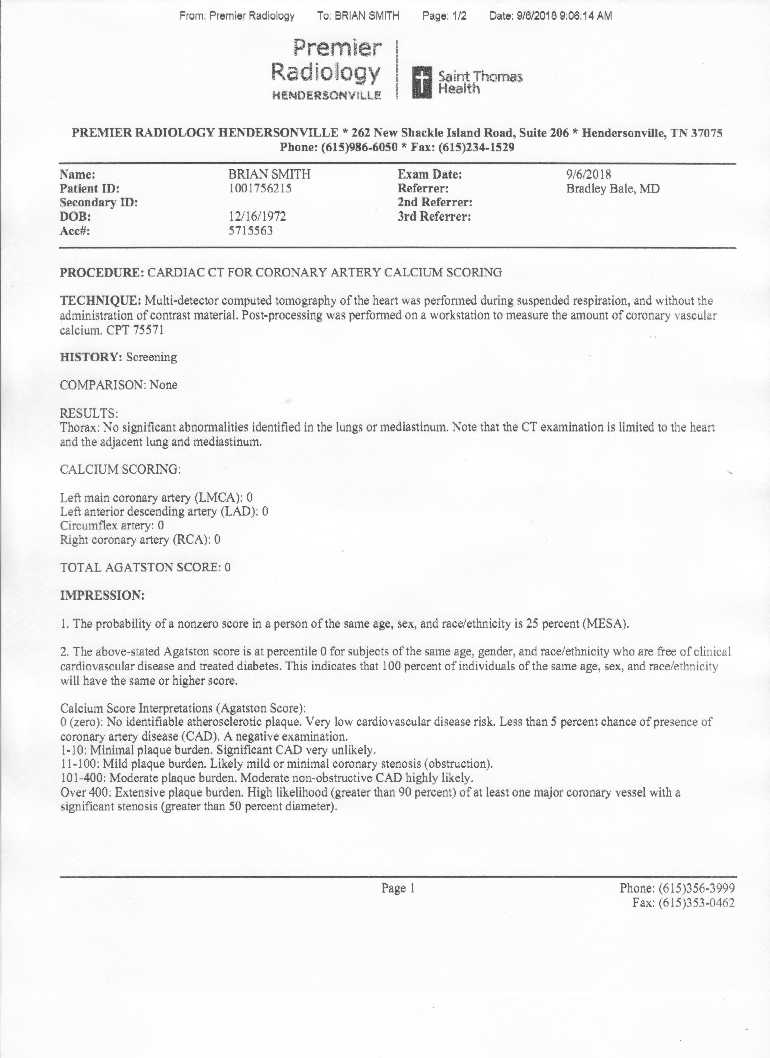

Slide 42
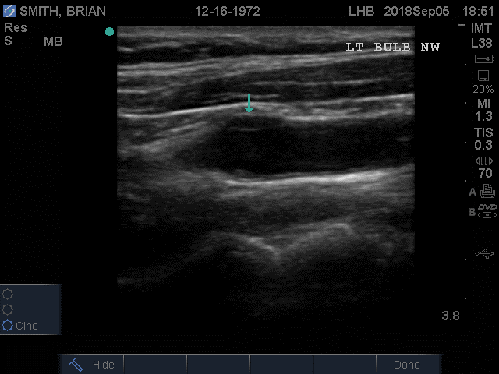
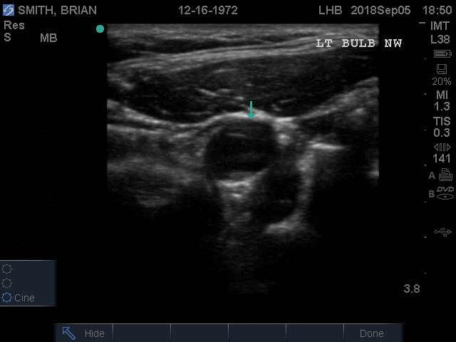

CIMT
Is that soft plaque??!!

Slide 43
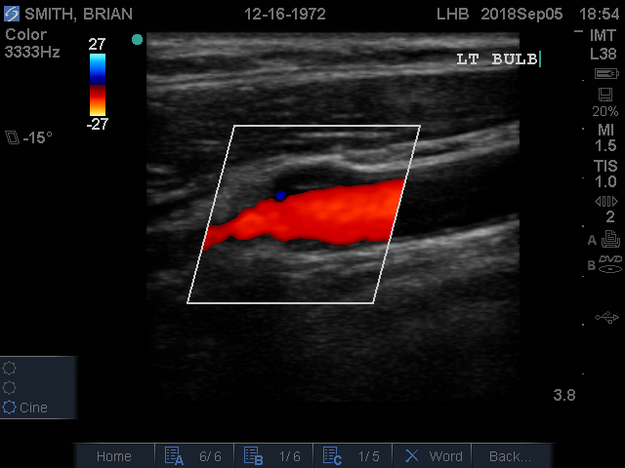
2.2 mm Soft Plaque!!!!
.

Slide 44
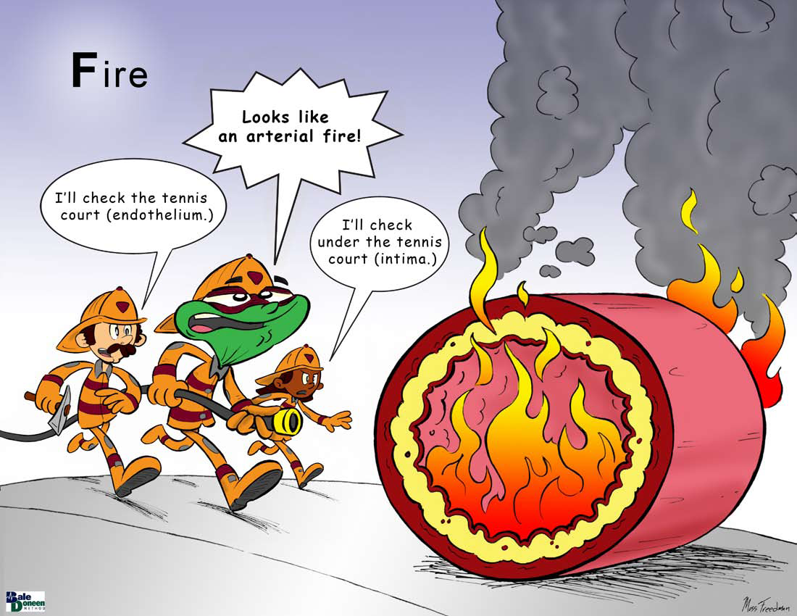
Inflammatory Markers
  hsCRP: 1.1 (<0.5)
  Microalb/creat: 20.6 (<4)
  Fibrinogen: missing
  Lp-PLA-2: 187 (<180)
  MPO: 285 (<470)

Slide 45
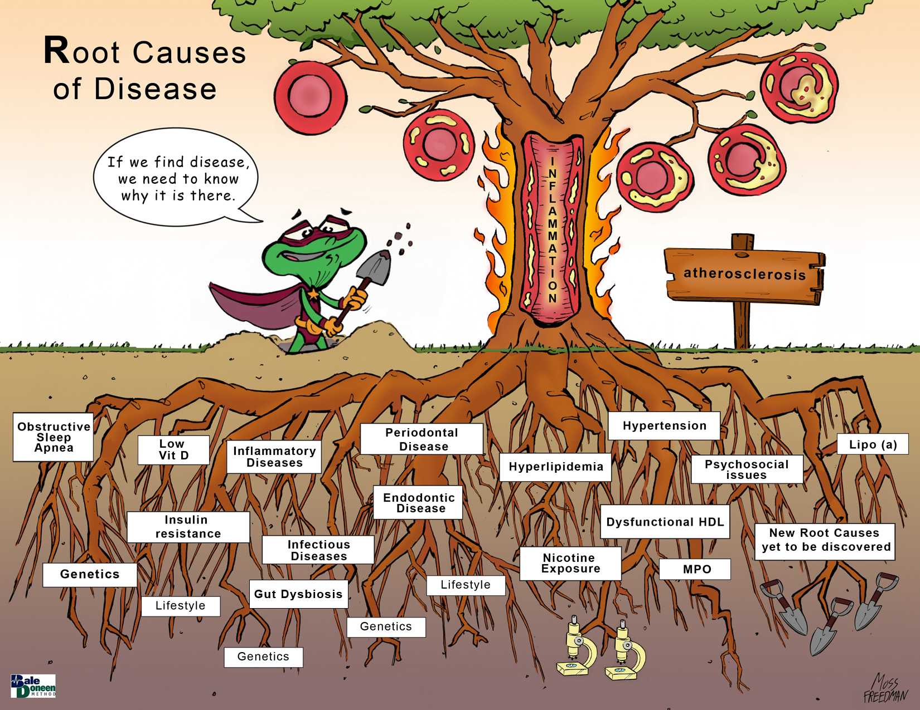
Endodontic Disease

Slide 46
Aggregatibacter actinomycetemcomitans (Aa) a Virulent Periodontal Pathogen
Aa is facultative anaerobic Gram-negative bacterium that expresses several virulence factors.
There is a wealth of genetic diversity within this species generating different degrees of virulence.
Belibasakis, G. N., et al. (2019). "Virulence and Pathogenicity Properties of Aggregatibacter actinomycetemcomitans." Pathogens 8(4).

Slide 47
Aggregatibacter actinomycetemcomitans (Aa) a Virulent Periodontal Pathogen
One virulent factor found in all strains of Aa is leukotoxin.
This toxin activates inflammasomes causing release of IL-1beta and IL-18.
It generates apoptosis of lymphocytes.
Belibasakis, G. N., et al. (2019). "Virulence and Pathogenicity Properties of Aggregatibacter actinomycetemcomitans." Pathogens 8(4).

Slide 48
Leukotoxin from Aa can cause rapid inflammation
Belibasakis, G. N., et al. (2019). Pathogens 8(4).

Slide 49
Aggregatibacter actinomycetemcomitans (Aa) a Virulent Periodontal Pathogen
Cytolethal distending toxin (CDT) is a protein exotoxin which causes DNA damage to the infected host cells leading to cell cycle arrest and apoptosis.
Aa is the only oral microbe that produces CDT with up to 86% of strains expressing it.
Belibasakis, G. N., et al. (2019). "Virulence and Pathogenicity Properties of Aggregatibacter actinomycetemcomitans." Pathogens 8(4).

Slide 50
Aggregatibacter actinomycetemcomitans (Aa) a Virulent Periodontal Pathogen
In addition, CDT can activate osteolytic cytokine production.
It can induce the expression of receptor activator of nuclear factor kappa-B (RANKL) potentiating bone destruction.
Belibasakis, G. N., et al. (2019). "Virulence and Pathogenicity Properties of Aggregatibacter actinomycetemcomitans." Pathogens 8(4).

Slide 51
Aggregatibacter actinomycetemcomitans (Aa) a Virulent Periodontal Pathogen
Aa is covered by lipopolysaccharide (LPS) which trips toll-like receptors leading to activation of NF-KB.
There are at least seven structural differences in the LPSs of Aa which form the basis for PCR serotyping.
Belibasakis, G. N., et al. (2019). "Virulence and Pathogenicity Properties of Aggregatibacter actinomycetemcomitans." Pathogens 8(4).

Slide 52
Aggregatibacter actinomycetemcomitans (Aa) a Virulent Periodontal Pathogen
Aa is able to bind host cytokines, such as IL-1β, IL-8, and IL-6 and internalize them.
This leads to changes in the properties of biofilm, decreasing the metabolic activity, and changing the composition of the extracellular matrix.
Belibasakis, G. N., et al. (2019). "Virulence and Pathogenicity Properties of Aggregatibacter actinomycetemcomitans." Pathogens 8(4).

Slide 53
Aggregatibacter actinomycetemcomitans (Aa) a Virulent Periodontal Pathogen
Aa creates outer membrane vesicles (OMVs) which are shed into the surrounding tissue.
These OMVs can contain CDT, leukotoxins, small molecules capable of facilitating bone resorption and microRNAs.
Belibasakis, G. N., et al. (2019). "Virulence and Pathogenicity Properties of Aggregatibacter actinomycetemcomitans." Pathogens 8(4).

Slide 54
Aggregatibacter actinomycetemcomitans (Aa) a Virulent Periodontal Pathogen
~ 30% of Aa strains are ‘competent’ meaning they can acquire new genes from extracellular DNA.
This type of Aa leads to greater genetic diversity and potentially greater virulence.
Belibasakis, G. N., et al. (2019). "Virulence and Pathogenicity Properties of Aggregatibacter actinomycetemcomitans." Pathogens 8(4).

Slide 55
Aggregatibacter actinomycetemcomitans (Aa) a Virulent Periodontal Pathogen
Aa has the capacity to employ many virulence mechanisms associated to the pathogenesis of periodontitis.
Without doubt, individuals carrying Aa have a significantly increased risk to develop periodontal disease.
Suitable genetic virulence markers may be important tools in future strategies to manage the risk of Aa in an individual pt.
Belibasakis, G. N., et al. (2019). "Virulence and Pathogenicity Properties of Aggregatibacter actinomycetemcomitans." Pathogens 8(4).

Slide 56
BDM Thoughts
This is an excellent in-depth review of Aa.
Anyone who doubts periodontal disease can drive significant systemic inflammation needs to read this paper!
We should have zero tolerance of Aa.

Slide 57

BP Meds

Slide 58
Managing Hypertension with Medications Reduces Dementia and Alzheimer’s Risk
31,090 dementia-free pts from 6 prospective studies; >55yo; 15,537 had BP>140/90 mmHg; pts rx’ed with anti-hypertensive medication (AHM) ranged from 33-62%; most common AHMs – BB, ACEI, diuretic, CCB & ARBs; median follow-up 7-22 yrs.
3,728 incident dementia cases with 1,741 Alzheimer’s (Alz)
Ding, J., et. al. (2019) Antihypertensive medications and risk for incident dementia and Alzheimer’s disease: a meta-analysis of individual participant data from prospective cohort studies. Lancet Neurology. https://doi.org/10.1016/ S1474-4422(19)30393

Slide 59
Managing Hypertension with Medications Reduces Dementia and Alzheimer’s Risk
In a fully adjusted model, there was a significant reduced risk of dementia and Alz with AHD use vs no use in hypertensives.
Dementia HR -0.88 (95% CI, 0·79–0·98)
Alz HR -0.84 (95% CI, 0·73–0·97)
Ding, J., et. al. (2019) Antihypertensive medications and risk for incident dementia and Alzheimer’s disease: a meta-analysis of individual participant data from prospective cohort studies. Lancet Neurology. https://doi.org/10.1016/ S1474-4422(19)30393

Slide 60
Managing Hypertension with Medications Reduces Dementia and Alzheimer’s Risk
The risk of dementia and Alz in treated hypertensives was the same as those without hypertension.
The type of AHD did not matter.
Ding, J., et. al. (2019) Antihypertensive medications and risk for incident dementia and Alzheimer’s disease: a meta-analysis of individual participant data from prospective cohort studies. Lancet Neurology. https://doi.org/10.1016/ S1474-4422(19)30393

Slide 61
Managing Hypertension with Medications Reduces Dementia and Alzheimer’s Risk
Hypertensive ApoE 4 pts rx’ed with AHD had greater risk reduction of dementia.
HR- 0.77 (95%CI, 0.64-0.93)
Use of AHD in the normotensive group did not reduce risk of dementia or Alz regardless of ApoE status.
Ding, J., et. al. (2019) Antihypertensive medications and risk for incident dementia and Alzheimer’s disease: a meta-analysis of individual participant data from prospective cohort studies. Lancet Neurology. https://doi.org/10.1016/ S1474-4422(19)30393

Slide 62
Managing Hypertension with Medications Reduces Dementia and Alzheimer’s Risk
This data coupled with SPRINT MIND suggest AHD use in hypertensive pts reduces the risk of dementia & Alz.
Optimizing blood pressure management strategies to reduce dementia should be prioritized.
Ding, J., et. al. (2019) Antihypertensive medications and risk for incident dementia and Alzheimer’s disease: a meta-analysis of individual participant data from prospective cohort studies. Lancet Neurology. https://doi.org/10.1016/ S1474-4422(19)30393

Slide 63
BDM Thoughts
Love this study.
It is reassuring that the meds do reduce risk as lifestyle alone is frequently not adequate to control BP.
Supports the BDM’s long-time commitment for optimal BP control with one of the reasons being to maintain cognitive function.
Fits our observation over the last 20 yrs of a very low incidence of dementia and Alz in our patients.

Slide 64

Inflammation

Slide 65
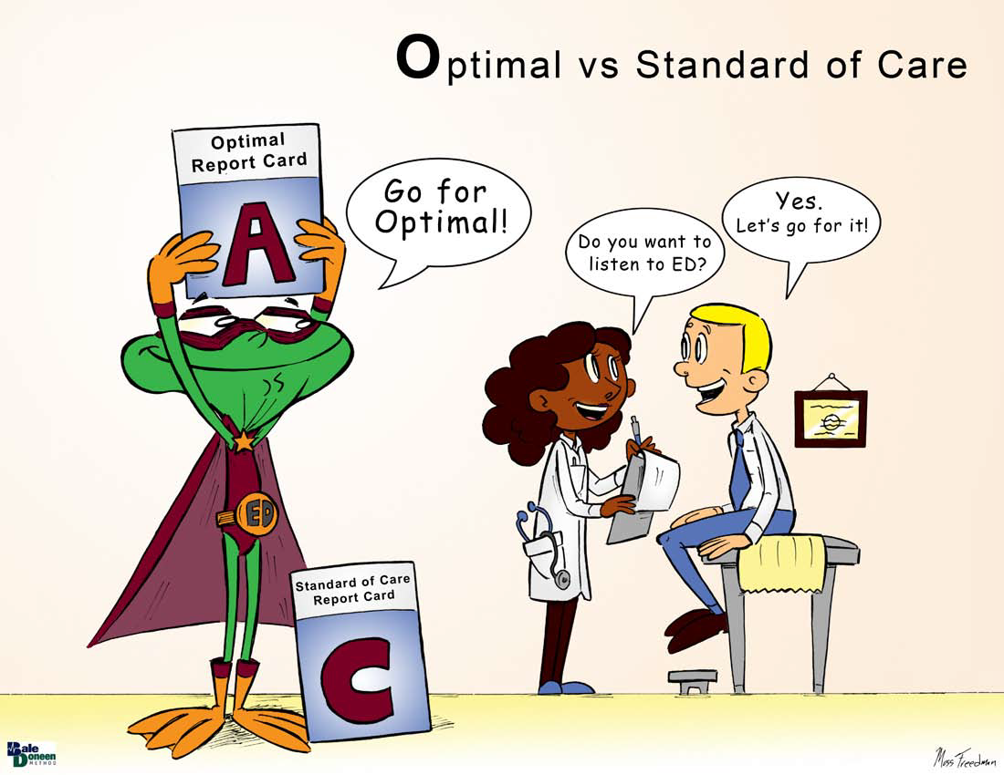
Optimal Care

Slide 66
International Study Of Comparative Health Effectiveness With Medical And Invasive Approaches (ISCHEMIA):
Judith S. Hochman, MD
NYU School of Medicine
On behalf of the ISCHEMIA Research Group

Slide 67
Background: Randomized trials do not demonstrate a survival benefit for revascularization in stable ischemic heart disease (SIHD)
86% of acute coronary syndromes arise from non-obstructing disease (no angina until the ACS).
Obstructing disease (generating angina) is frequently fibrotic and unlikely to rupture.
Notes:
Severe obstruction (angina, no rupture) vs mild obstruction (no angina,
likely to rupture)

Slide 68
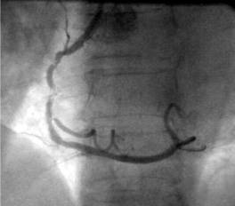
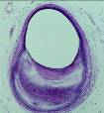
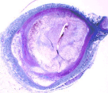
Obstructing Ischemic Plaque Versus Non-obstructing Non-ischemic Plaque
Severe fibrotic plaque
Severe obstruction
No lipid
Fibrosis, Ca²⁺
Vulnerable plaque
Minor obstruction
Eccentric plaque
Lipid pool
Thin cap
No angina
(-) ETT
High risk for ACS
Exertional angina
(+) ETT
Low risk for ACS
Courtesy of PH Stone, MD.
https://ischemiatrial.org › files › ISCHEMIA Mini Slide Set May 2016_Final
Notes:
Severe obstruction (angina, no rupture) vs mild obstruction (no angina,
likely to rupture)

Slide 69
ISCHEMIA Research Question
In stable pts with at least moderate ischemia on a stress test, is there a benefit to adding cardiac catheterization and, if feasible, revascularization to optimal medical therapy?

Slide 70
Study Design
Stable Patient
Moderate or severe ischemia
(determined by site; read by core lab)
CCTA not required, e.g., eGFR 30 to <60 or coronary anatomy previously defined
Blinded CCTA
Core lab anatomy eligible?
NO
Screen failure:
LM disease
No obstructive disease
YES
RANDOMIZE
INVASIVE Strategy
OMT + Cath +
Optimal Revascularization
CONSERVATIVE Strategy
OMT alone
Cath reserved for OMT failure
Maron DJ, et al. American Heart Journal. 2018; 201;124-135.

Slide 71
Endpoints
Primary Endpoint:
Time to CV death, MI, hospitalization for unstable angina, heart failure or resuscitated cardiac arrest
Major Secondary Endpoints:
Time to CV death or MI
Quality of Life (separate presentation)
Other Endpoints include:
All-Cause Death
Net clinical benefit (stroke added to primary endpoint)
Components of primary endpoint
Maron DJ, et al. American Heart Journal. 2018; 201;124-135.

Slide 72
Exclusion Criteria
  NYHA Class III-IV HF
  Unacceptable angina despite medical therapy
  >50% stenosis in LM
  EF < 35%
  ACS within 2 months
  PCI or CABG within 1 year
  eGFR <30 mL/min or on dialysis
Maron DJ, et al. American Heart Journal. 2018; 201;124-135.

Slide 73
Study Flow
Screen Failure (3339)
Major Reasons:
Insufficient ischemia (N = 1350)
No obstructive CAD (N = 1218)
Unprotected LMD (N =434)
Enrolled (8518)
Randomized (5179)
Study CCTA in 73% of randomized participants
Randomized to INV (2588)
Randomized to CON (2591)
Median follow-up for survivors 3.3 years (IQR 2.2 to 4.3 years)
follow-up completed: 99.4%
Median follow-up for survivors 3.3 years (IQR 2.2 to 4.4 years)
follow-up completed: 99.7%

Slide 74
Baseline Characteristics
Characteristic | Total | INV | CON
Clinical
Age at Enrollment (yrs.)
Median | 64 (58, 70) | 64 (58, 70) | 64 (58, 70)
Female Sex (%) | 23 | 23 | 22
Hypertension (%) | 73 | 73 | 73
Diabetes (%) | 42 | 41 | 42
Prior Myocardial Infarction (%) | 19 | 19 | 19
Ejection Fraction, Median (%) (n=4637) | 60 (55, 65) | 60 (55, 65) | 60 (55, 65)
Systolic Blood Pressure, Median (mmHg) | 130 (120, 142) | 130 (120, 142) | 130 (120, 142)
Diastolic Blood Pressure, Median (mmHg) | 77 (70, 81) | 77 (70, 81) | 77 (70, 81)
LDL Cholesterol, Median (mg/dL) | 83 (63, 111) | 83 (63, 111) | 83 (63, 109.5)
History of Angina | 90% | 90% | 89%
Angina Began or Became More Frequent Over the Past 3 Months | 29% | 29% | 29%
Stress Test Modality
Stress Imaging (%) | 75 | 75 | 76
Exercise Tolerance Test (ETT) (%) | 25 | 25 | 24
Median values reported with 25th and 75th percentiles
Hochman JS et al. JAMA Cardiology. 2019 Mar 1;4(3):273-86.

Slide 75
Qualifying Stress Test
Characteristic | Total | INV | CON
Baseline Inducible Ischemia*
Severe | 54% | 53% | 55%
Moderate | 33% | 34% | 32%
Mild/None | 12% | 12% | 12%
Uninterpretable | 1% | 1% | 1%
*Only severe qualified by ETT
Hochman JS et al. JAMA Cardiology. 2019 Mar 1;4(3):273-86.

Slide 76
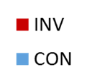
Baseline Coronary Artery Anatomy by CCTA
# of Vessels with >50 % Stenosis (%)
N=2982
(% of total)
Hochman JS et al. JAMA Cardiology. 2019 Mar 1;4(3):273-86.

Slide 77
Baseline Coronary Artery Anatomy by CCTA
Specific Vessels with > 50% Stenosis (%)
N=3739
Hochman JS et al. JAMA Cardiology. 2019 Mar 1;4(3):273-86.

Slide 78
Risk Factor Management- no difference INV vs CON
Baseline vs Last visit
Hochman JS et al. JAMA Cardiology. 2019 Mar 1;4(3):273-86.

Slide 79
Risk Factor Management- no difference INV vs CON
Baseline vs last visit

Slide 80
High Level of Optimal Rx- no difference INV vs CON
Baseline vs last visit
Defined as meeting all of the following goals:
LDL < 70 mg/dL and on any statin
Syst BP < 140 mm/Hg
aspirin or other antiplatelet or anticoagulant
not smoking
Baseline – 20%
Last Visit – 41%

Slide 81
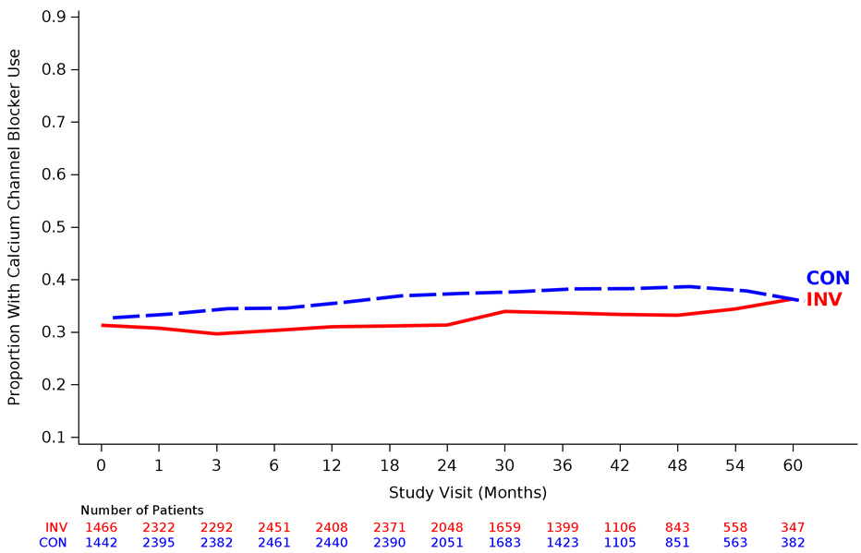
Medication Use Over Time
Calcium Channel Blocker
Beta Blocker
Dual Antiplatelet (DAPT)
Other Anti-Anginal Medication

Slide 82
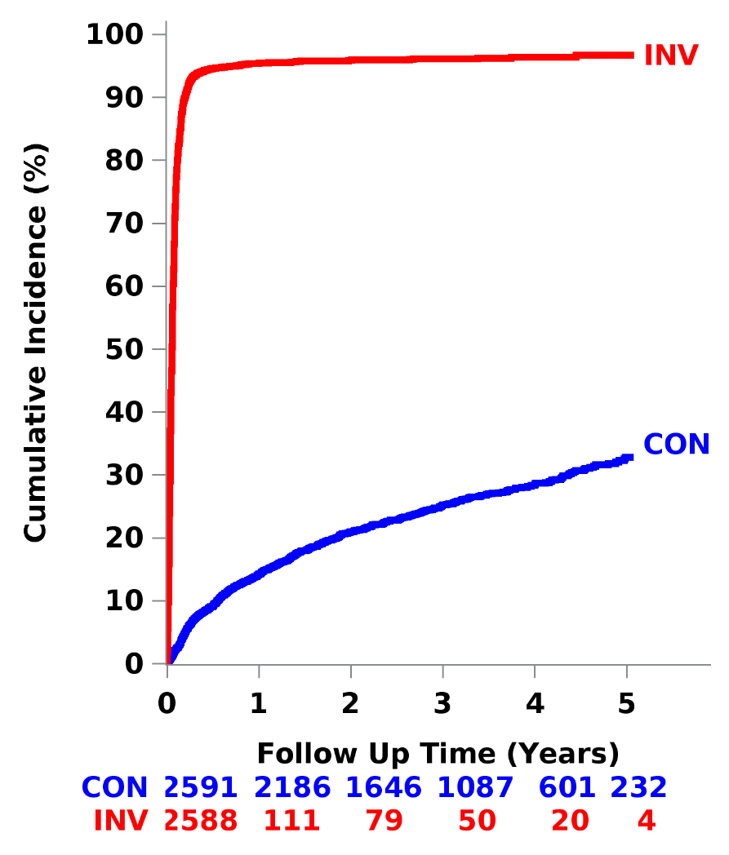
Cardiac Catheterization
96%
95%
Indications for cath in CON*
Suspected/confirmed event 13.8%
OMT Failure 3.9%
Non-adherence 8.1%
28%
9%
12%
*Indications for Cath are percentages of CON patients whereas cumulative event rate shown at 4 years reflects censoring and the rate at that time point.

Slide 83
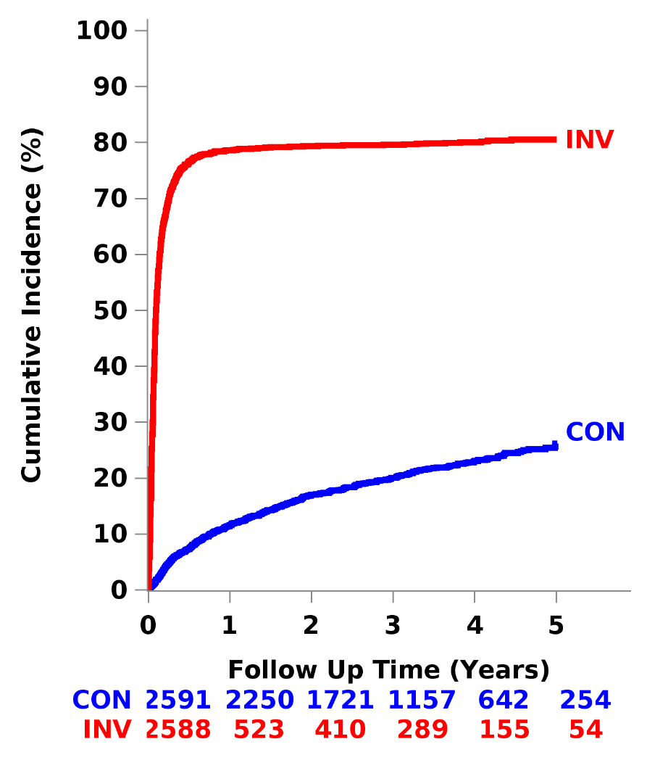
Revascularization
76%
79%
80%
Revascularization in CON at 4 years not preceded by a primary endpoint event - 16%
23%
12%
7%
12%

Slide 84
Mode of Revascularization
First Procedure for Those Revascularized in Invasive Group
(~80% of INV)
Of the ~ 20% with no revascularization
~ 2/3 had insignificant disease on coronary angiogram
~1/3 had extensive disease unsuitable for any mode of revascularization
First Procedure | Total
PCI | 74%
Successful stenting | 93%
Drug eluting stents | 98%
First Procedure | Total
CABG | 26%
Arterial Grafts | 93%
IMA | 92%

Slide 85
Primary Outcome: CV Death, MI, hospitalization for UA, HF or
resuscitated cardiac arrest
Adjusted Hazard Ratio = 0.93 (0.80, 1.08)
P-value = 0.34
cumulative event rate shown at 4 years reflects the rate at that time point.
Absolute Difference INV vs. CON
CON
6 months:
Δ = 1.9% (0.8%, 3.0%)
15.5%
INV
13.3%
4 years:
Δ = -2.2% (-4.4%, 0.0%)
Subjects at Risk
CON | 2591 | 2431 | 1907 | 1300 | 733 | 293
INV | 2588 | 2364 | 1908 | 1291 | 730 | 271

Slide 86
Major Secondary: CV Death or MI
Adjusted Hazard Ratio = 0.90 (0.77, 1.06)
P-value = 0.21
Absolute Difference INV vs. CON
13.9%
CON
6 months:
Δ = 1.9% (0.9%, 3.0%)
INV
11.7%
4 years:
Δ = -2.2% (-4.4%, -0.1%)
Subjects at Risk
CON | 2591 | 2453 | 1933 | 1325 | 746 | 298
INV | 2588 | 2383 | 1933 | 1314 | 752 | 282

Slide 87
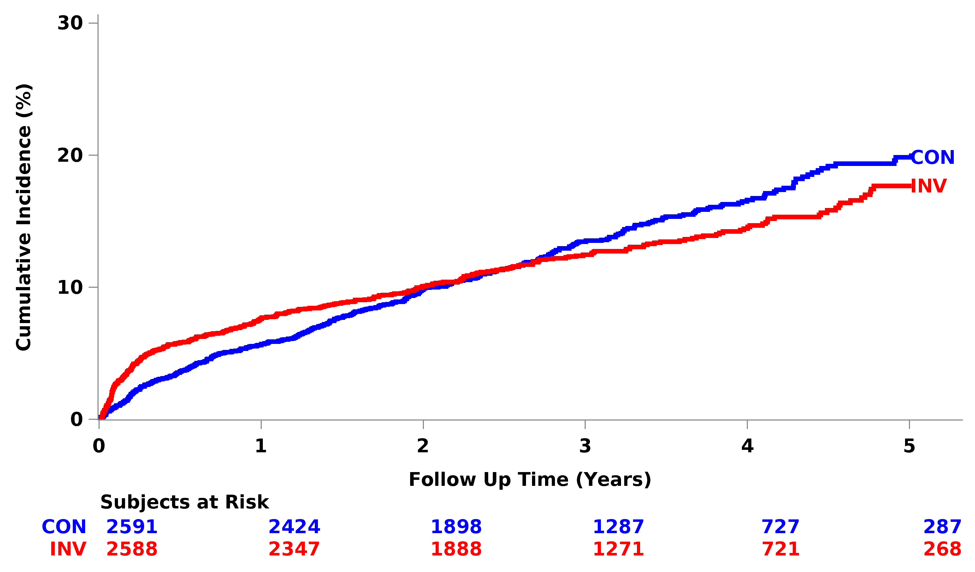
Adding Stroke to the Outcome
HR= 0.95 (0.82,1.10)
P-value= 0.50

Slide 88
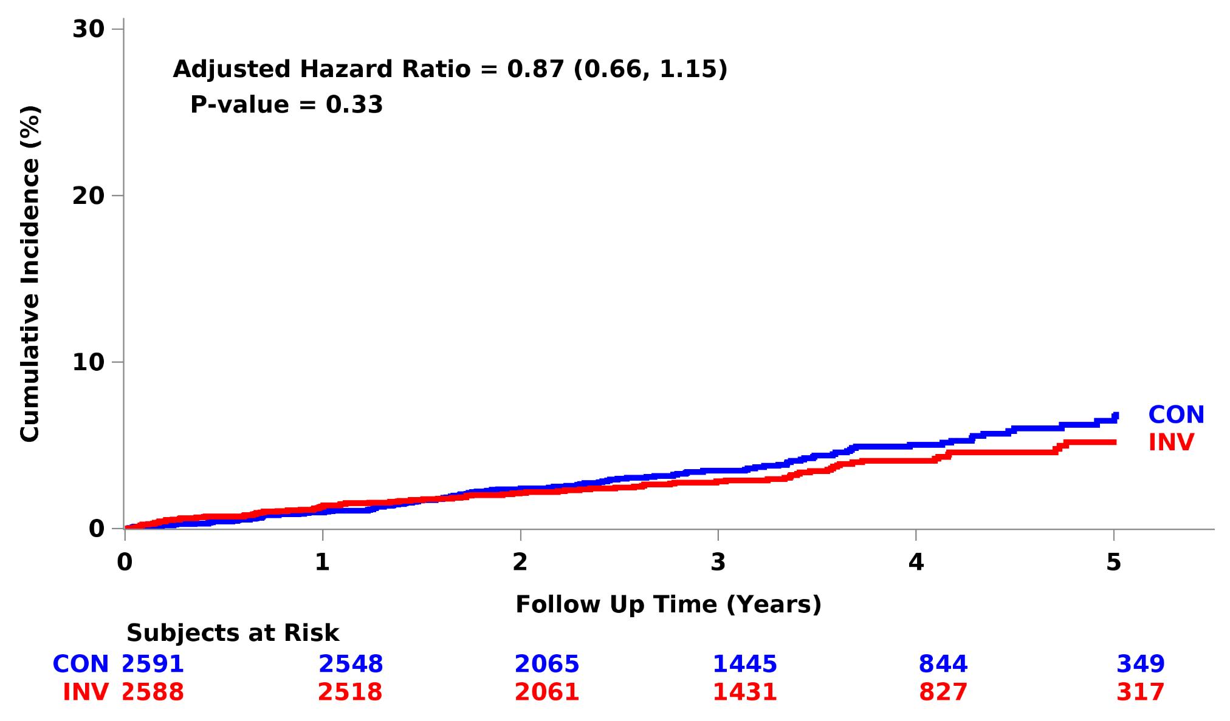
Cardiovascular Death

Slide 89
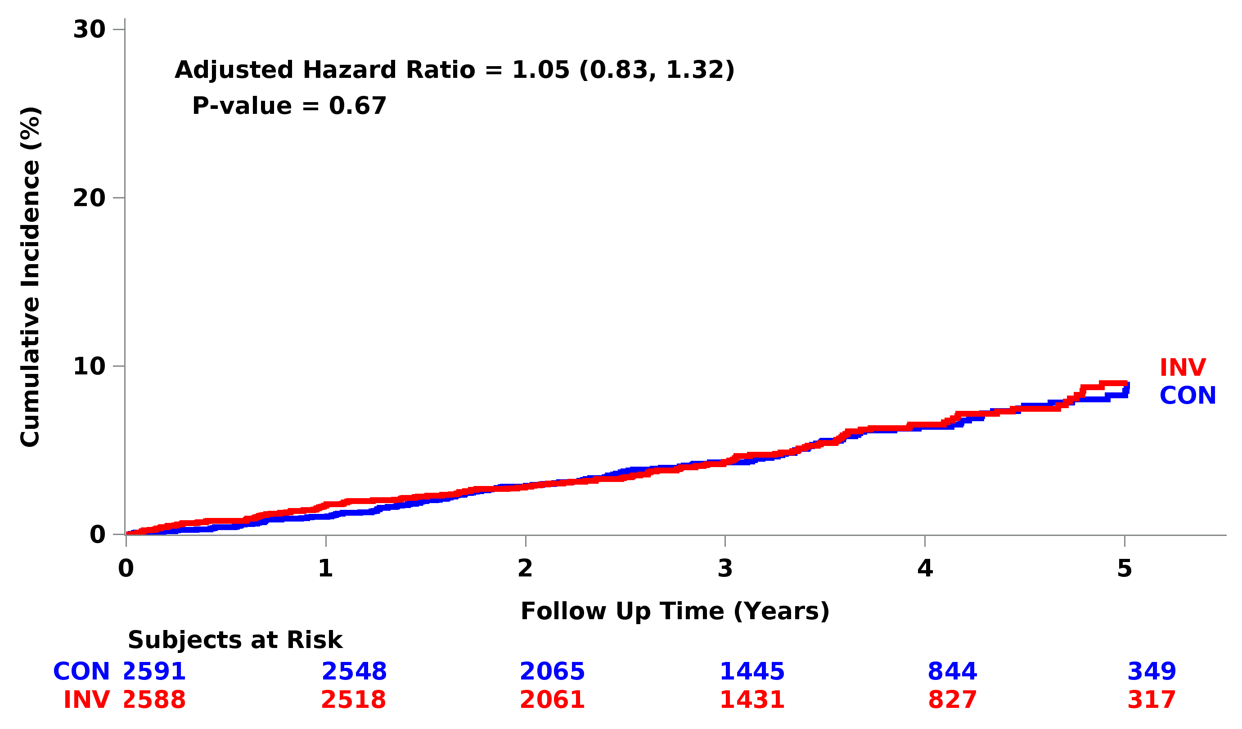
All-Cause Death
6.5%
6.4%

Slide 90
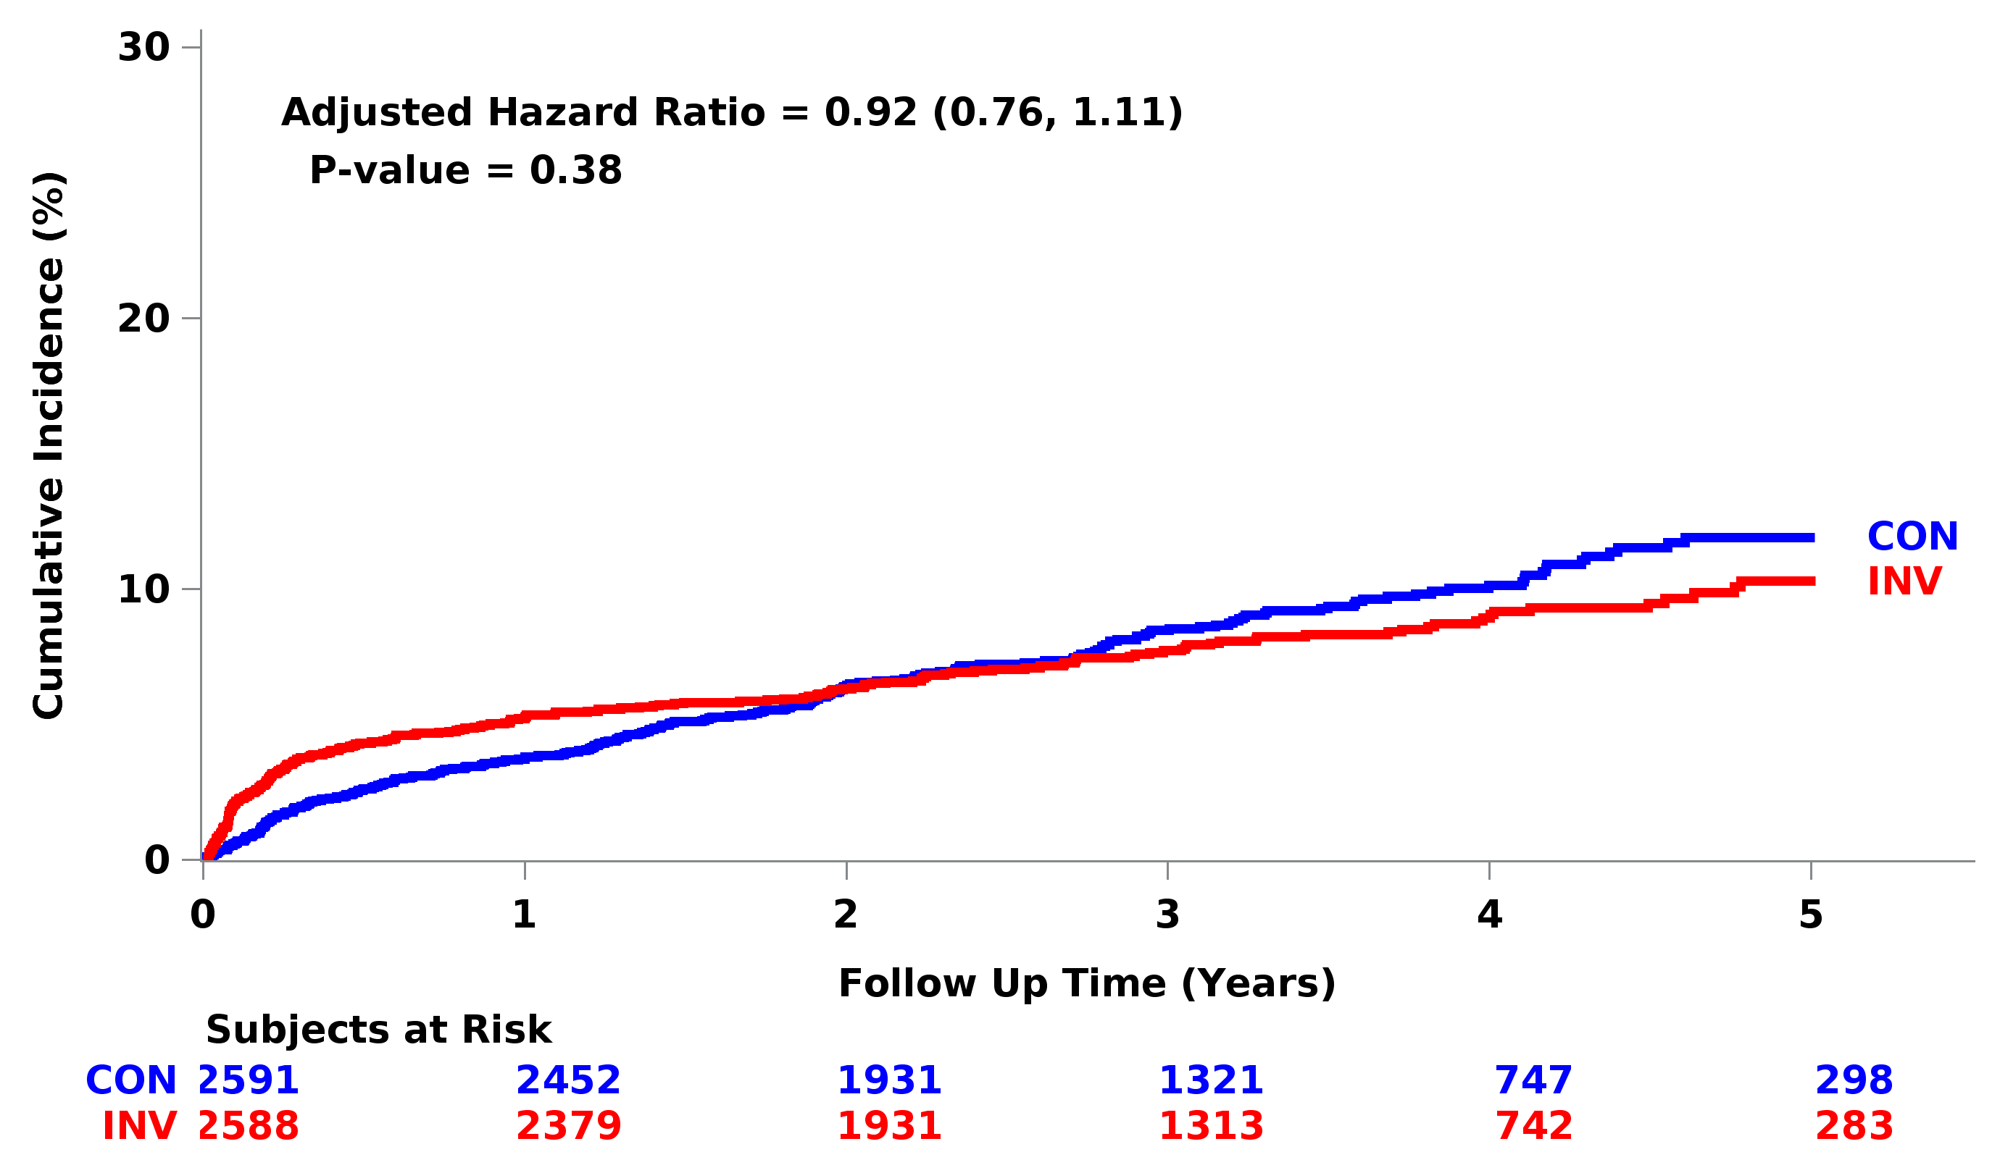
Myocardial Infarction

Slide 91
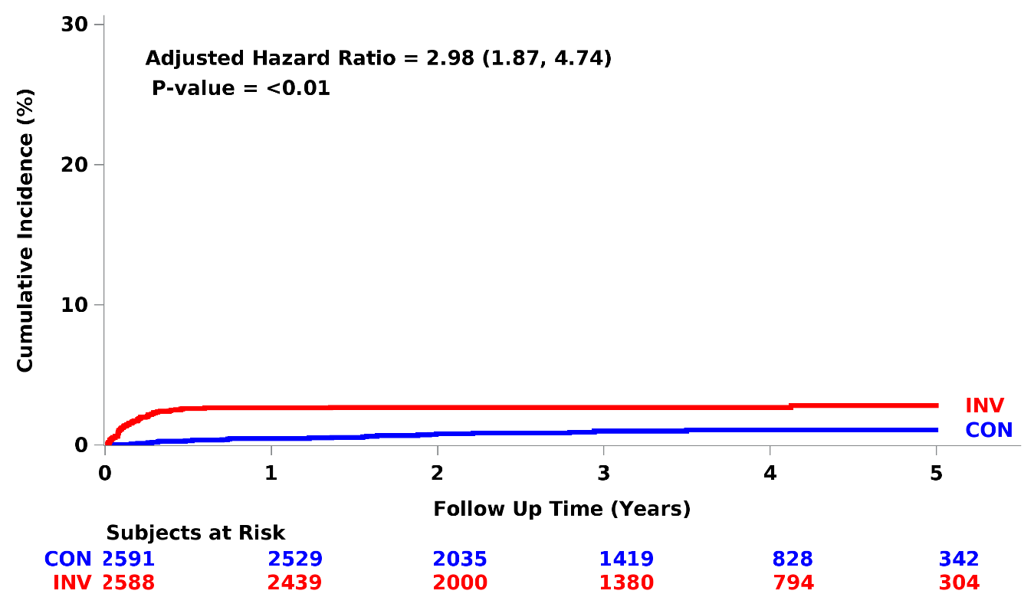
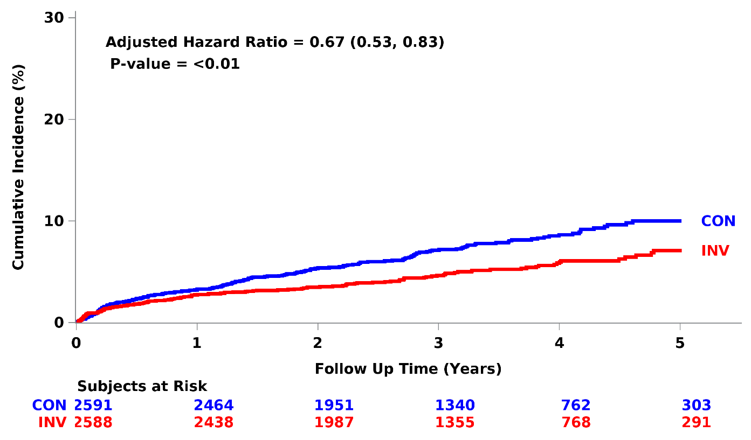
Procedural MI
Spontaneous MI

Slide 92
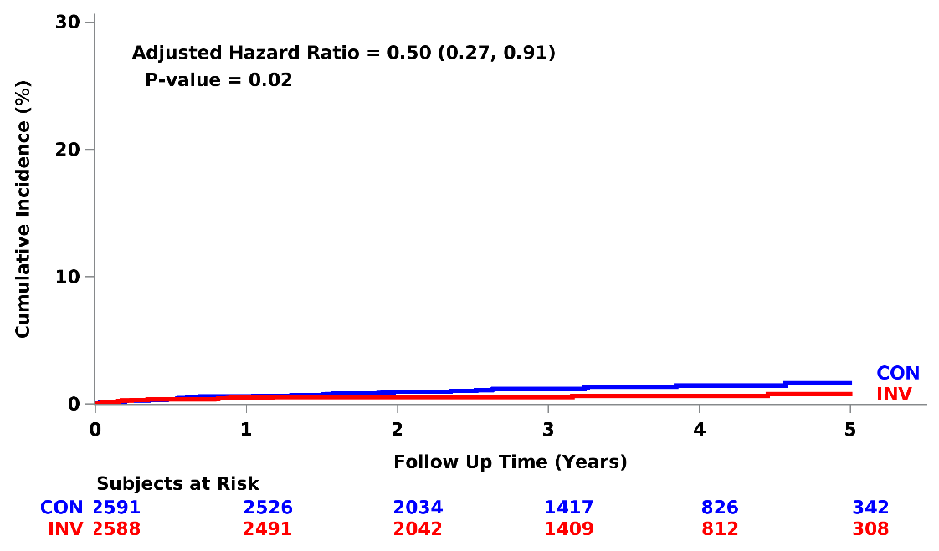
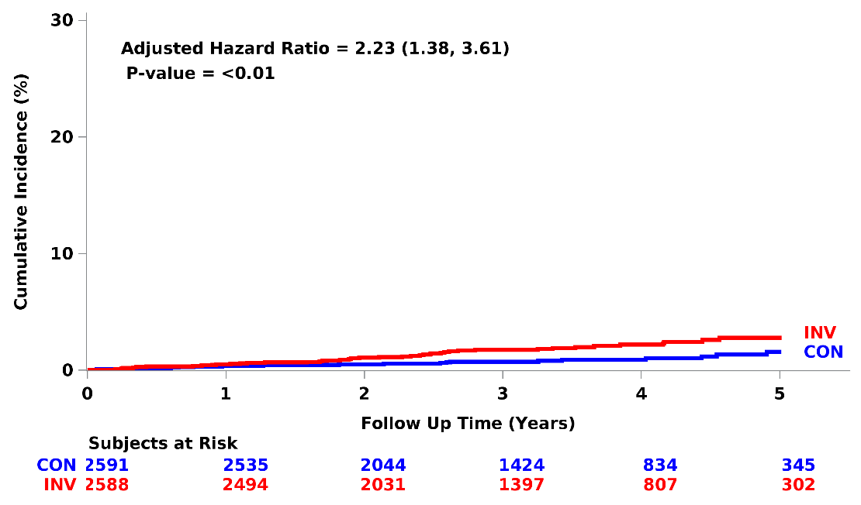
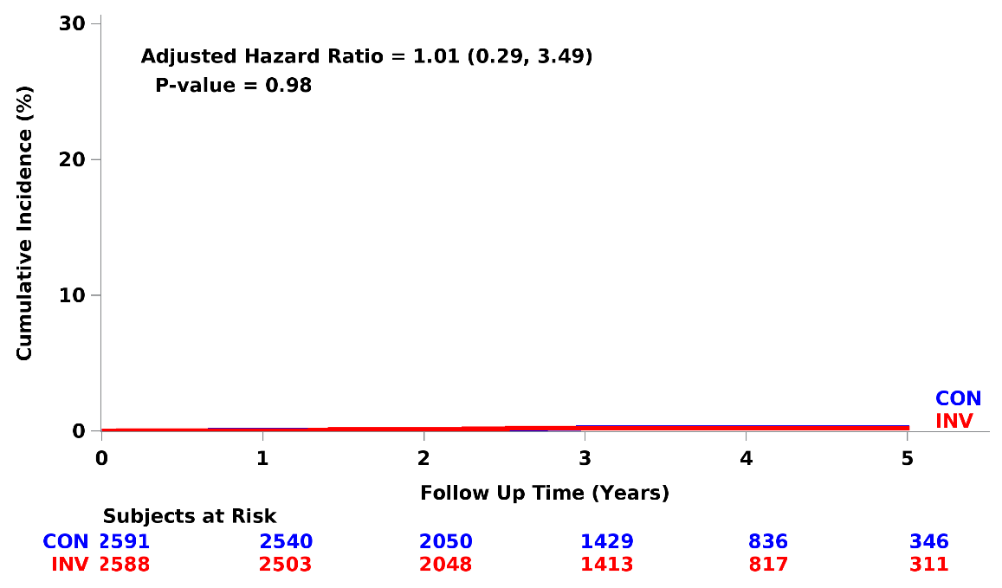
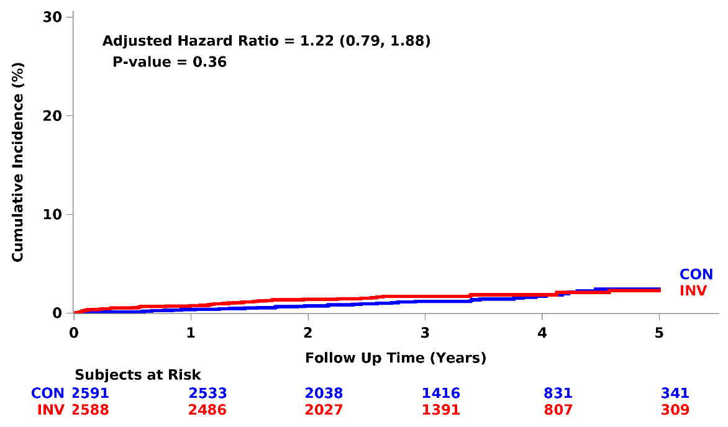
Hospitalization for Unstable Angina
Hospitalization for Heart Failure
Resuscitated Cardiac Arrest
Stroke

Slide 93
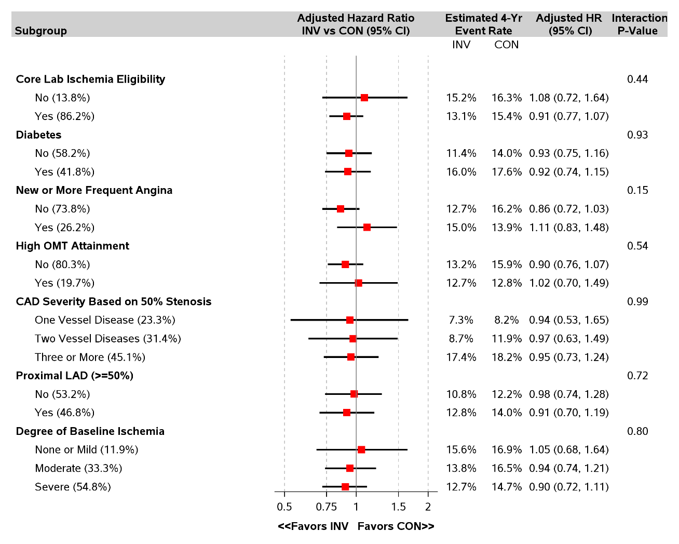
Primary endpoint
Pre-specified Important Subgroups
There was no heterogeneity of treatment effect
High degree of baseline medical Rx optimization
N=3739 for Prox LAD Y/N
N=2982 for # diseased vessels

Slide 94
Primary endpoint and major secondary endpoint
(CV death or MI)
No heterogeneity of treatment effect
based on any characteristic
Age
Sex
Ethnicity
Race
Geographic region
Stress test, imaging vs no imaging
Stress imaging modality
Moderate or severe anterior ischemia
Prior MI
Prior cardiac cath
Prior PCI
Prior CABG
Ejection Fraction
eGFR

Slide 95
Limitations
Unblinded trial – no sham procedure
Based on exclusion criteria, the trial results do not apply to patients with:
  Acute coronary syndromes within 2 months
  Highly symptomatic patients
  Left main stenosis
  LVEF <35%
Trial findings may not be generalizable to centers with higher procedural complication rates
Completeness of revascularization has not yet been assessed
Women were enrolled in the trial but more often excluded from randomization compared to men due to less ischemia and more non-obstructive CAD

Slide 96
Summary
The curves cross for the primary endpoint and the major secondary endpoint at approximately 2 years from randomization
  ~2 in 100 higher estimated rate with INV at 6 months
  ~2 in 100 lower estimated rate with INV at 4 years
Procedural MIs were increased with an invasive strategy
Spontaneous MIs were reduced with an invasive strategy
Low all-cause mortality in both groups despite high-risk clinical characteristics, high-risk ischemia and extensive CAD
No heterogeneity of treatment effect, including by type of stress test, severity of ischemia or extent of CAD
Very low rates of procedure-related stroke and death

Slide 97
Conclusions
ISCHEMIA is the largest trial of an invasive vs conservative strategy for patients with SIHD.
Overall, an initial INV strategy as compared with an initial CON strategy did not demonstrate a reduced risk over median 3.3 years for
  Primary endpoint - CV death, MI, hospitalization for UA, HF, RCA
  Major Secondary endpoint - CV death or MI.

Slide 98
BDM Thoughts
Amy and I would be out of business, if 12% of our SIHD pts were having CV death or MIs four years into our treatment and subsequent risk continuing to rise.
Invasive treatment of SIHD does not mitigate the risk of CV death or MI.
Remember: invasive treatment of acute coronary syndrome (ACS) is life saving!

Slide 99
BDM Thoughts
Extinguishing arterial inflammation is necessary to reduce the risk of CV death and MI in SIHD pts.
Threading a catheter into coronary arteries, smashing stenotic plaque and bypassing narrowed arteries does not reduce arterial inflammation.
“High level optimal medical therapy” will be beneficial.
Stopping smoking, reducing systolic BP to < 140 mmHg, reducing LDL < 70 mg/dL (reducing apoB) will reduce arterial inflammation; providing antiplatelet therapy will reduce the risk of a devastating thrombus.

Slide 100
BDM Thoughts
This study illustrates ‘high level optimal medical therapy’ is not adequate in many individuals with SIHD to prevent CV death and MI.
Let’s compare this therapy to the BDM.

Slide 101
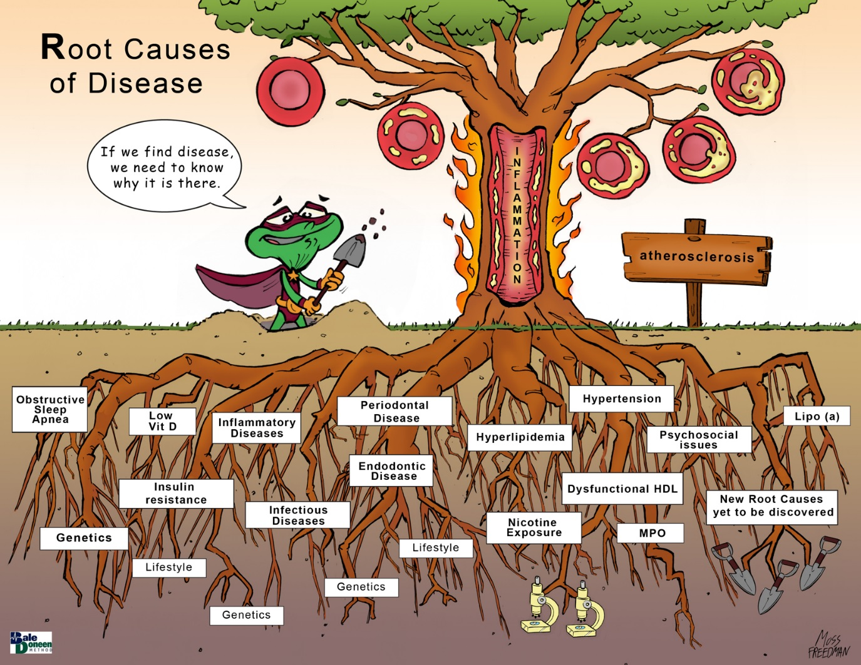
Nicotine
Endodontic Disease
Gut dysbiosis

Slide 102
Root Causes of Arterial Inflammation
Hyperlipidemia
Nicotine
Insulin resistance
Psychosocial
Hypertension
Oral health
Inflammatory disease
Gut dysbiosis
Other Infectious diseases
Vitamin D
Sleep
Lifestyle
Genetics

Slide 103
BDM Thoughts
It is surprising the risk reduction was as good as it was.
Perhaps due to the BDM foundation treatments:
statin use in 95%
RAAS use in 70%
ASA use 97%

Slide 104
BDM Thoughts
The ISCHEMIA trial results are what a BDM provider would expect.
Invasive coronary procedures are not anti-inflammatory.
Medical management extinguishes arterial inflammation and averts CV death and MI in SIHD pts.
To reduce the risk to ~ zero, the management must be comprehensive of all sources of inflammation and needs to be personalized with genetics.

Slide 105
International Study of Comparative Health Effectiveness with Medical and Invasive Approaches - Chronic Kidney Disease
Primary Report of Clinical Outcomes
Funded by the National Heart, Lung, and Blood Institute
Sripal Bangalore, MD, MHA
NYU School of Medicine
On behalf of the ISCHEMIA-CKD Research Group

Slide 106
ISCHEMIA-CKD Research Question
In stable patients with advanced CKD and at least moderate ischemia on a stress test, is there a benefit to adding cardiac catheterization and, if feasible, revascularization to optimal medical therapy?

Slide 107
Study Design
Patients with moderate or severe ischemia and eGFR <30 or on dialysis
RANDOMIZE
1:1
INVASIVE Strategy
Optimal Medical Therapy + Cath +
Optimal Revascularization (if suitable)
CONSERVATIVE Strategy
Optimal Medical Therapy alone
Cath and revascularization (if suitable) reserved for Optimal Medical Therapy failure
Primary Endpoint: Composite of Death or MI
Bangalore et al. Am Heart J. 2018

Slide 108
Eligibility Criteria
Key Inclusion Criteria
At least moderate ischemia on an exercise or pharmacologic stress test (site determined)
End-stage renal disease on dialysis or estimated glomerular filtration rate (eGFR) <30mL/min/1.73m²
Key Exclusion Criteria
Left ventricular ejection fraction <35%
NYHA class III-IV heart failure
Unacceptable level of angina despite maximal medical therapy
ACS within the previous 2 months
PCI or CABG within the previous 12 months
Bangalore et al. Am Heart J. 2018

Slide 109
Optimizing Revascularization
Customized Hydration
Heart/Kidney Team
Ultra low/Zero Contrast PCI
LVEDP based (POSEIDON trial)
Cardiology/Nephrology/CV surgery

Slide 110
Endpoints
Primary Endpoint
  Time to death or MI
Major Secondary Endpoints
  Time to Death, MI, Hospitalization for Unstable Angina, Heart Failure or Resuscitated Cardiac Arrest
  Quality of Life (separate presentation)
Safety Outcomes
  Composite of initiation of maintenance dialysis or death
  Initiation of maintenance dialysis

Slide 111
Patient Flow
Enrolled (802)
Randomized (777)
Invasive (388)
Conservative (389)
Median follow-up for survivors: 2.3y (1.9 to 3.2y)
Follow-up completed: 99.2%
Median follow-up for survivors: 2.5y (1.9 to 3.2y)
Follow-up completed: 99.7%

Slide 112
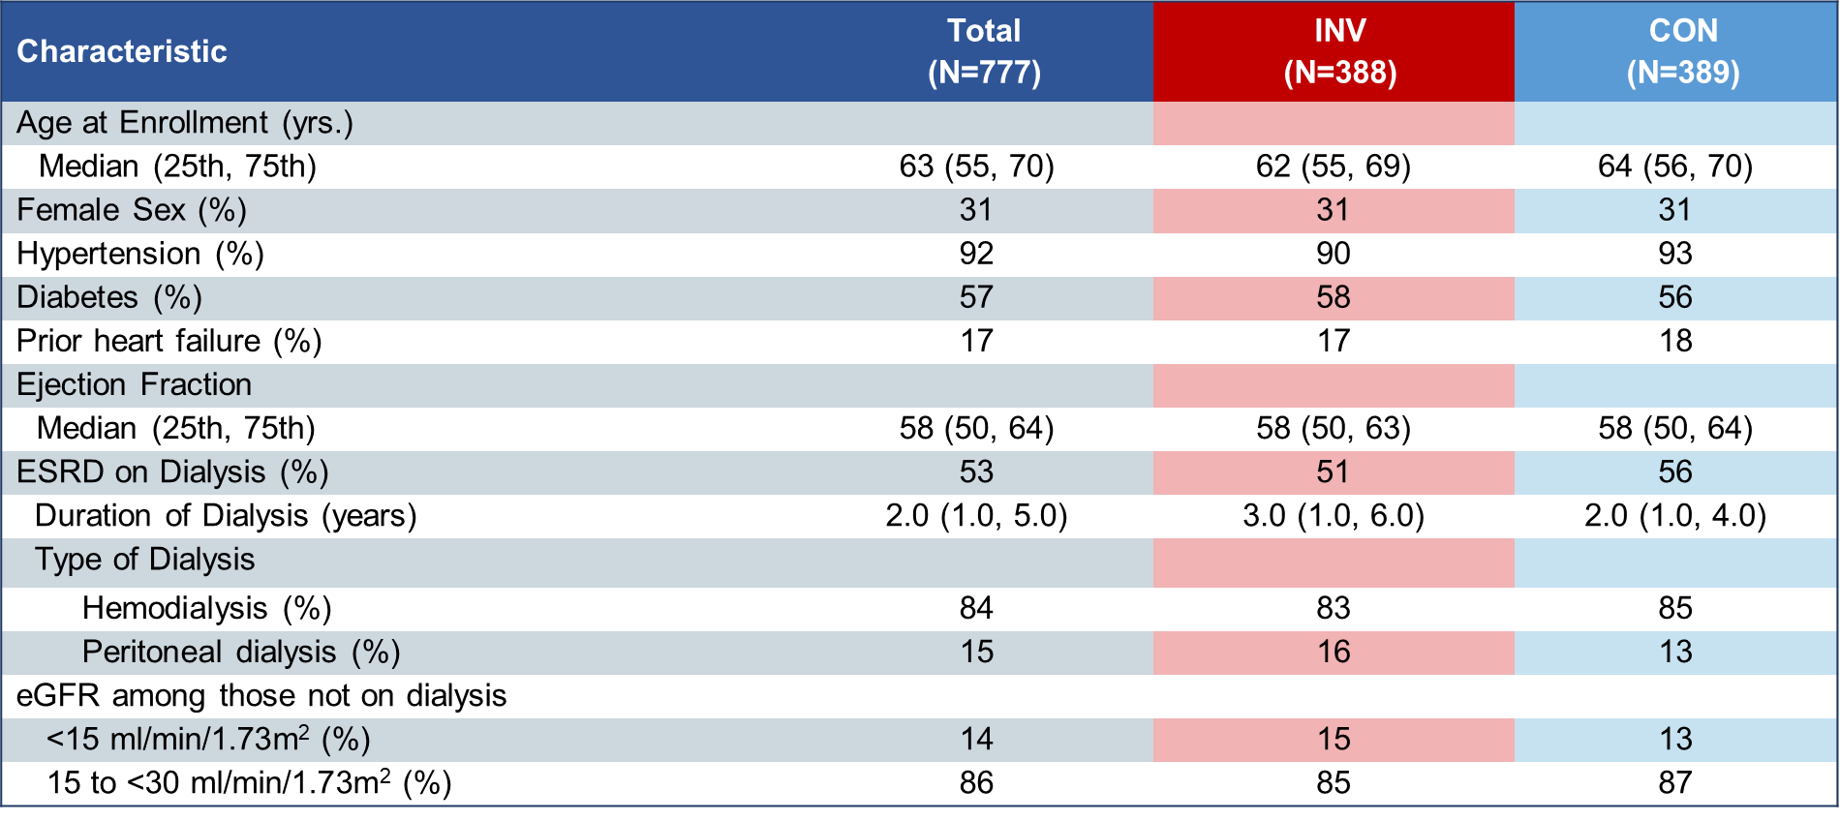
Key Baseline Characteristics

Slide 113
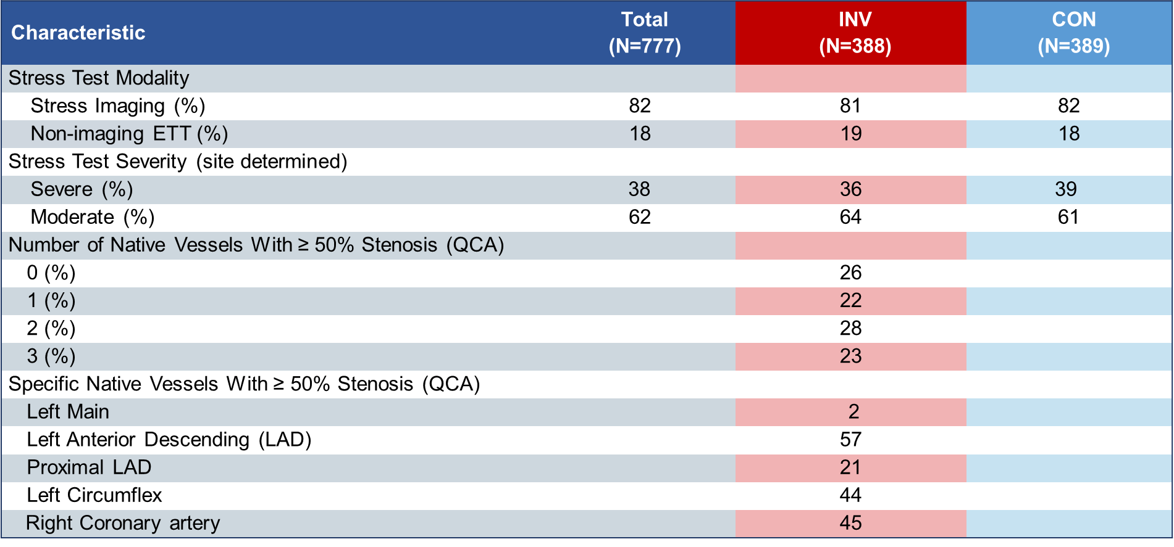
Stress Test and Angiographic Characteristics

Slide 114
Risk Factor Management
No between group differences INV vs CON

Slide 115
Risk Factor Management
No between group differences INV vs CON
High Level of Medical Therapy Optimization is defined as all four elements above accomplished.

Slide 116
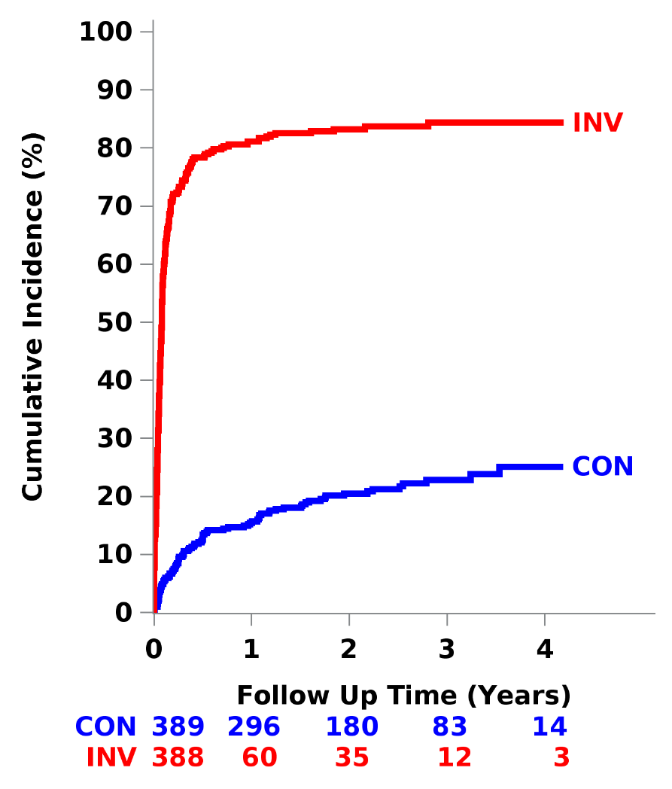
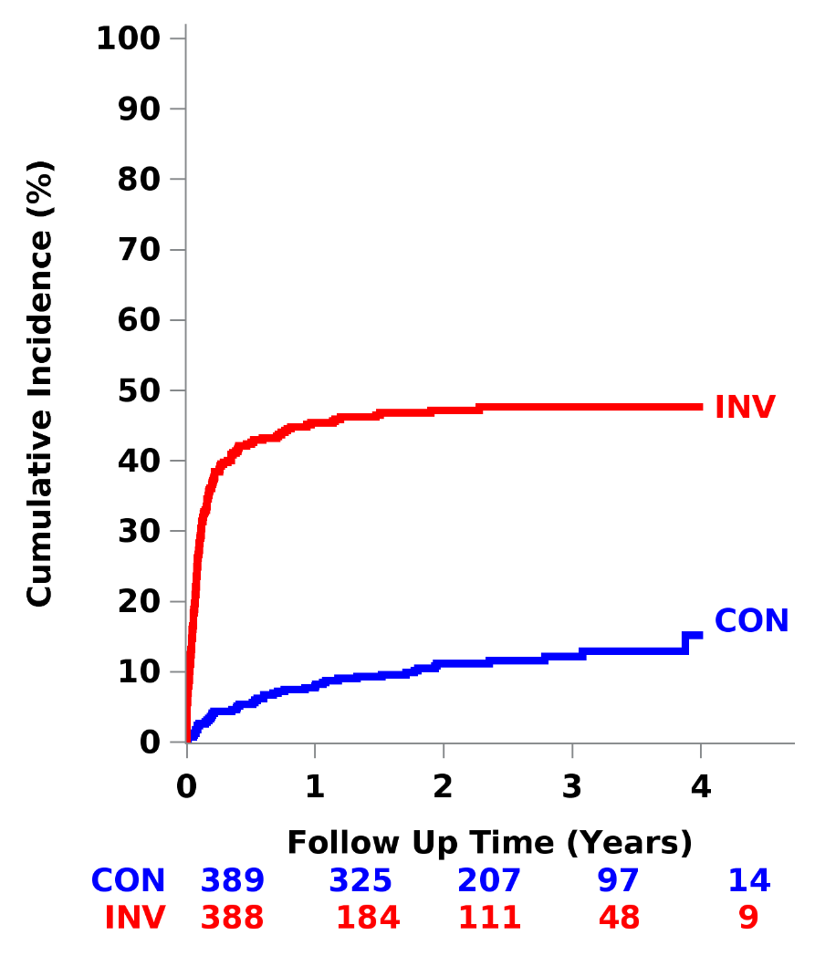
Coronary Angiography and Revascularization*
Coronary Angiography
Revascularization
85%
85% PCI; 15% CABG
50%
22%
12%
*Not preceded by endpoint event

Slide 117
Primary End Point
Death or MI
HR_{adj} = 1.01 (0.79, 1.29)
P-value = 0.95
CON
INV
36.7%
36.4%
Subjects at Risk
CON | 389 | 330 | 213 | 91 | 13
INV | 388 | 323 | 190 | 80 | 18

Slide 118
Major Secondary End Point
Death, MI, Hospitalization for Unstable Angina or Heart Failure or Resuscitated Cardiac Arrest
HR_{adj} = 1.01 (0.79, 1.29)
P-value = 0.93
CON
INV
39.7%
38.5%
Subjects at Risk
CON | 389 | 326 | 206 | 87 | 13
INV | 388 | 315 | 183 | 77 | 18

Slide 119
Secondary End Points
Death
HR_{adj} = 1.02 (0.76, 1.35)
P-value = 0.91
INV
CON
27.2%
27.8%

Slide 120
Secondary End Points
CV Death
HR_{adj} = 0.97 (0.71, 1.33)
P-value = 0.84
INV
CON

Slide 121
Secondary End Points
Myocardial Infarction
HR_{adj} = 0.84 (0.57, 1.25)
P-value = 0.39
CON
INV

Slide 122
Secondary End Points
Procedural MI
Spontaneous MI
HR_{adj} = 2.03 (0.59, 7.01)
P-value = 0.26
HR_{adj} = 0.72 (0.47, 1.09)
P-value = 0.12
CON
INV
INV
CON

Slide 123
Secondary End Points
Unstable Angina
Heart Failure
HR_{adj} = 0.15 (0.02, 1.37)
P-value = 0.09
HR_{adj} = 1.47 (0.69, 3.12)
P-value = 0.31
INV
CON
CON
INV

Slide 124

Secondary End Point
Stroke
HR_{adj} = 3.76 (1.52, 9.32)
P-value = 0.004
INV
CON
Procedural (<30 days)
INV
CON

Slide 125
Safety End Points*
Death or New Dialysis
New Dialysis
HR_{adj} = 1.47 (0.88, 2.44)
P-value = 0.13
HR_{adj} = 1.48 (1.04, 2.11)
P-value = 0.02
INV
INV
CON
CON
AKI after cath/PCI | 7.8% | 5.4%
Dialysis after CABG | 12.5% | 11.1%
Dialysis <30 days after procedure | 2.1% | 0.6%
INV
CON
* In those not on dialysis at baseline

Slide 126
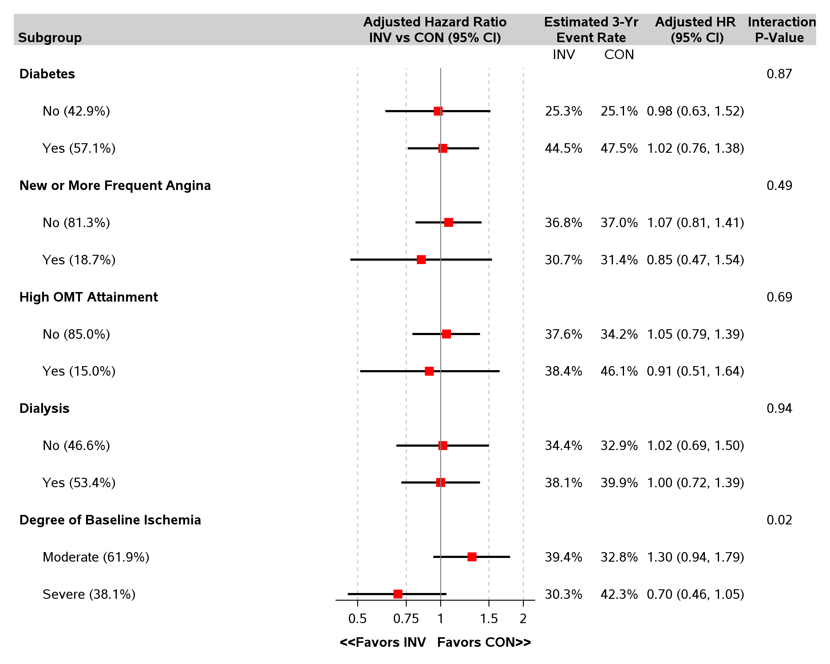
Heterogeneity of Treatment Effect
Death or MI

Slide 127
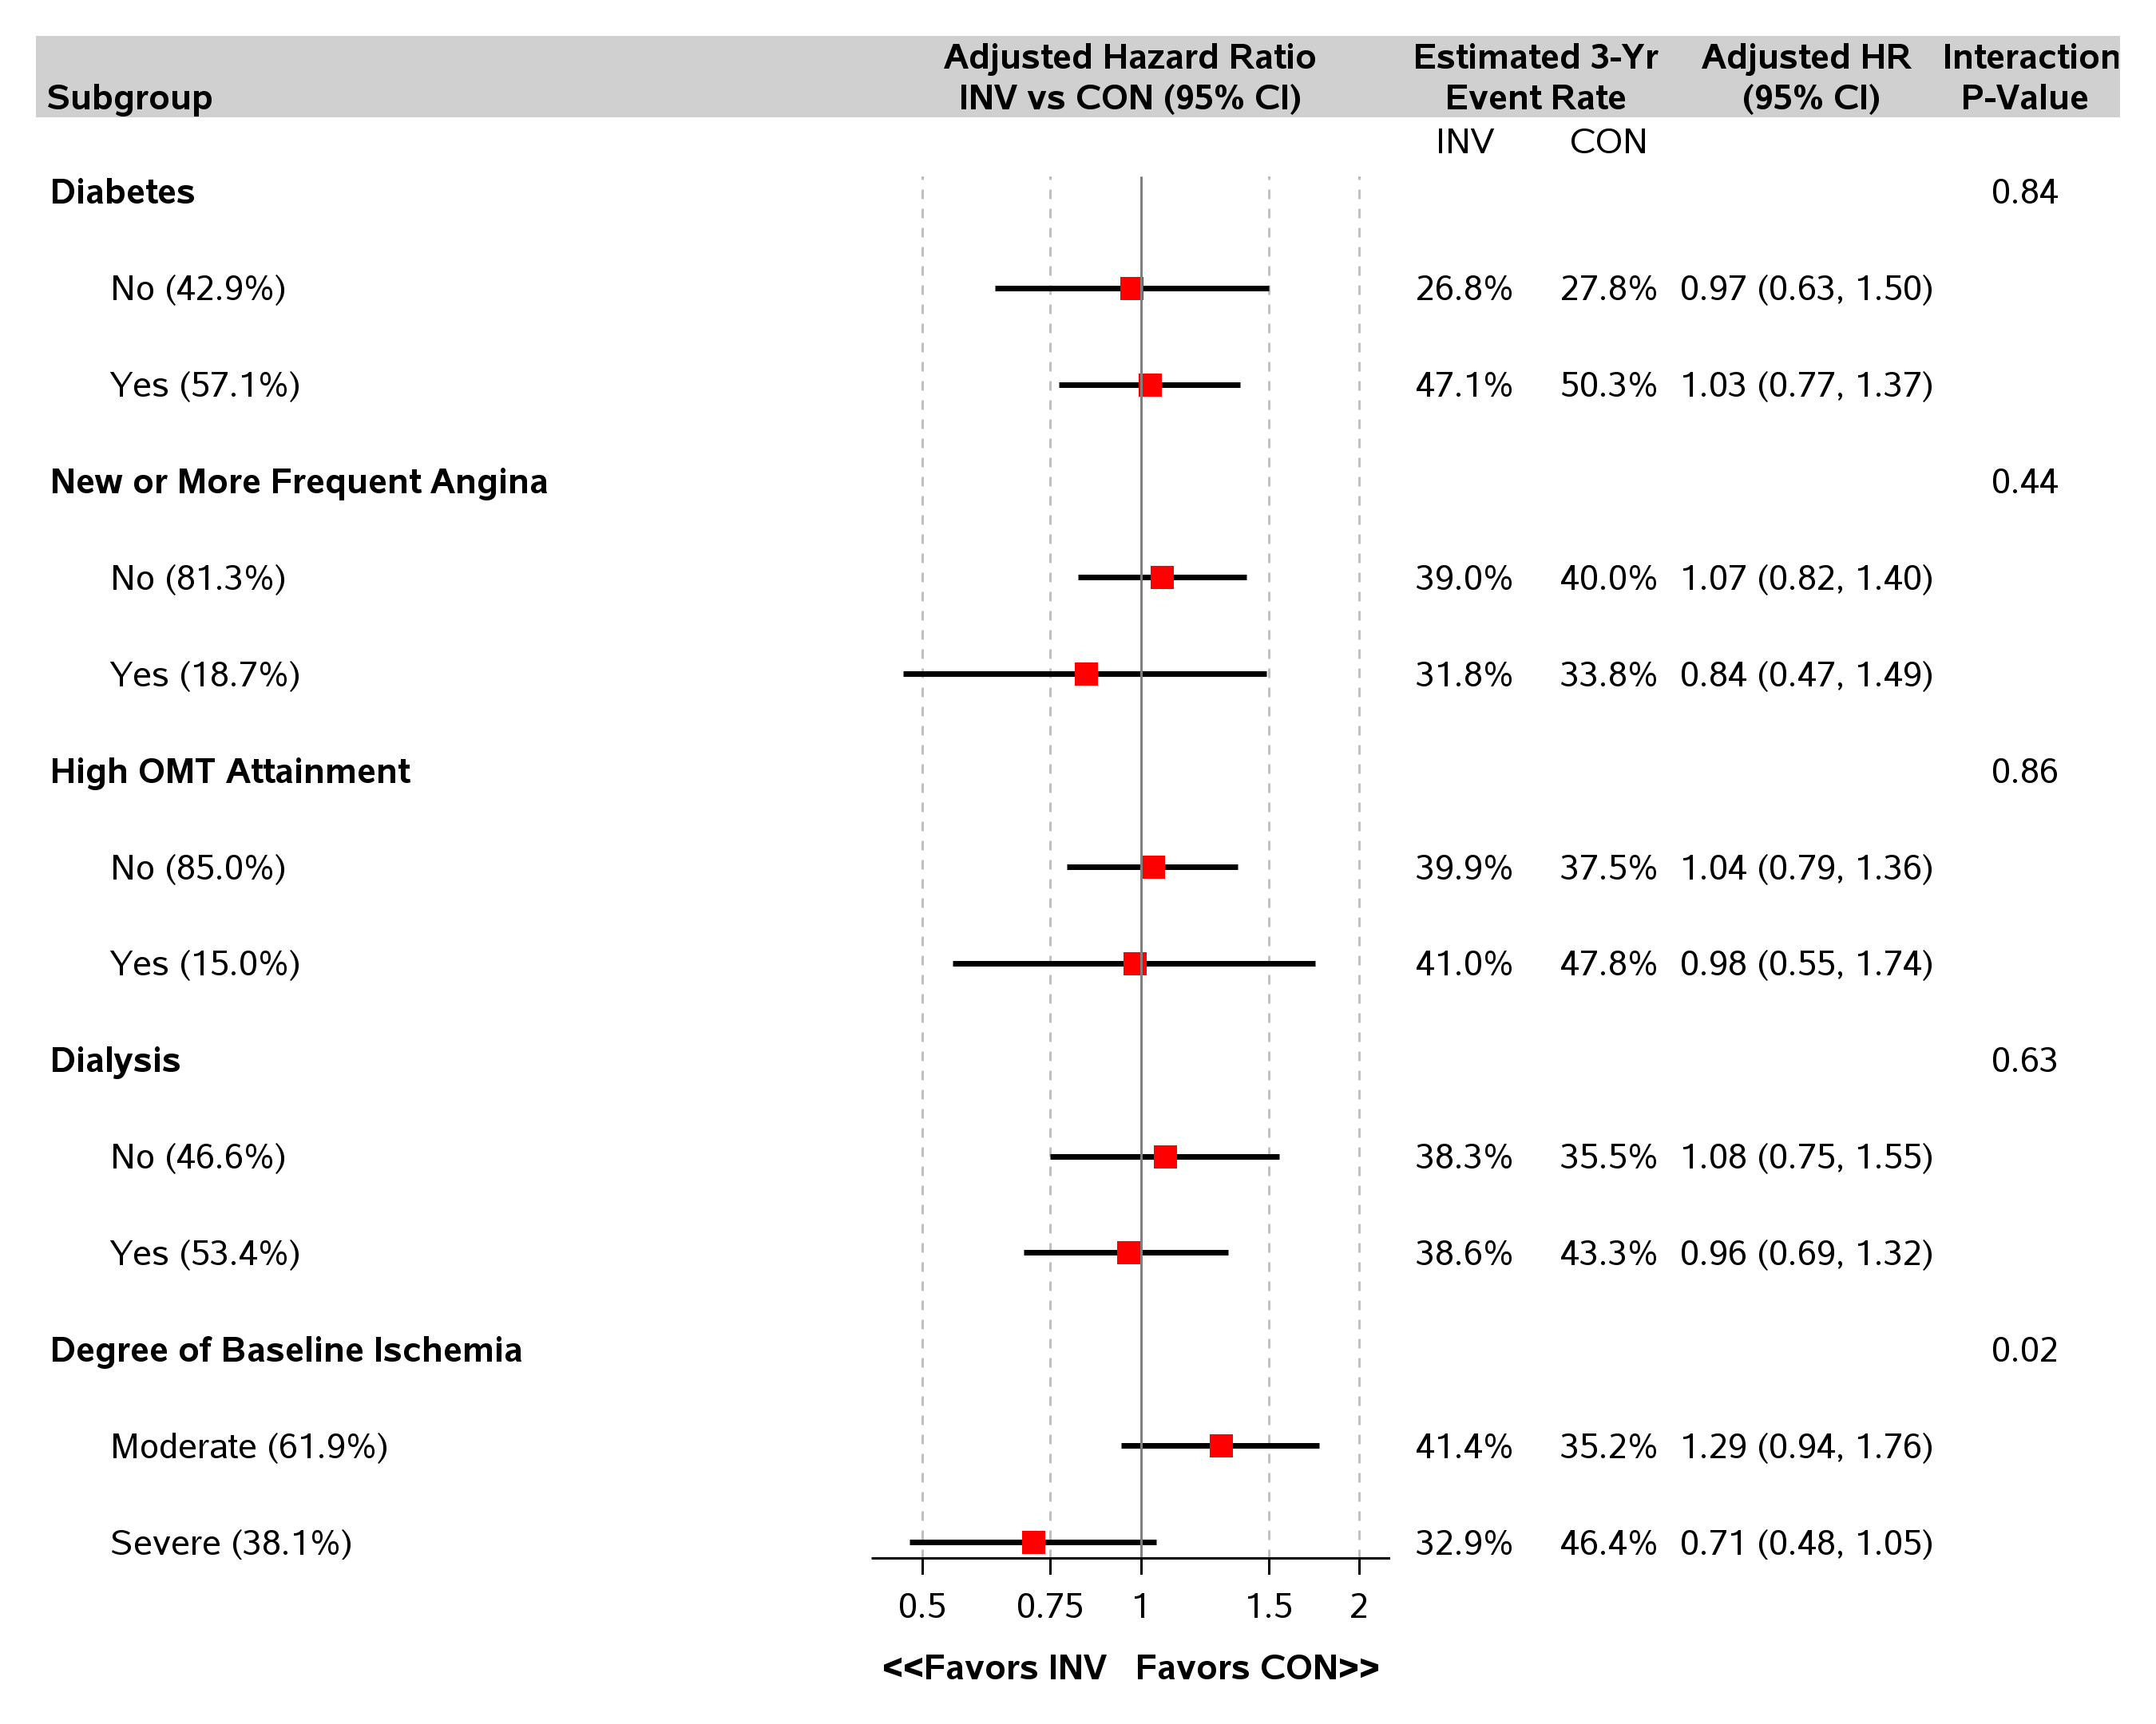
Heterogeneity of Treatment Effect
Death, MI, Hospitalization for Unstable Angina or Heart Failure or Resuscitated Cardiac Arrest

Slide 128
Study Limitations
Low rates of revascularization in the invasive arm
  Sensitivity and specificity of stress testing in CKD cohort is poor
  No requirement for CCTA in the trial
Based on exclusion criteria, the trial results do not apply to patients with:
  Acute coronary syndromes within 2 months
  Highly symptomatic patients
  LVEF <35%
Sites were specifically trained to minimize risk of AKI after cardiac catheterization and revascularization.
  Trial findings not generalizable to centers with higher complication rates

Slide 129
Conclusions
Largest trial of invasive vs. conservative strategy in patients with advanced CKD and SIHD.
An initial invasive strategy did not demonstrate a reduced risk of clinical outcomes as compared with an initial conservative strategy.
There was a significant increased risk of stroke and death or new dialysis with an invasive strategy.

Slide 130
BDM Thoughts
CKD pts with SIHD are extremely high risk - >27% dead at 3 yrs; ~ 15% had MI at 3 yrs; over one third (~36.5%) were either dead or had an MI at 3 yrs!
With a significant increased risk of stroke and death plus new dialysis with an invasive approach, pts with CKD should only have an invasive strategy during an ACS.
In other words, invasion should only be performed during a STEMI or NSTEMI with elevated troponin levels.

Slide 131
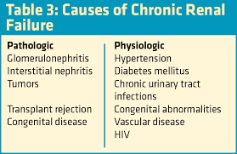
BDM Thoughts
We need to prevent CKD (<30 GFR) in our patients.
~ 75%

Slide 132
International Study of Comparative Health Effectiveness with Medical and Invasive Approaches
Primary Report of Quality of Life Outcomes
John A. Spertus, MD, MPH
Saint Luke’s Mid America Heart Institute/UMKC
On behalf of the ISCHEMIA Research Group
*Abbreviated Title
Notes:
Based on DM SCT presentation

Slide 133
Study Design
Stable Patient
Moderate or severe ischemia
(determined by site; read by core lab)
INVASIVE Strategy + OMT
…
R
1.5m
3m
6m
12m
18m
24m
30m
36m
CONSERVATIVE OMT alone (Cath if needed)
Brief QoL Assessments
Brief QoL Assessment
Brief QoL Assessment:
Seattle Angina Questionnaire – 7
  Angina Frequency
  Quality of Life
  Physical Limitations
**
Con: ~90%
Inv: ~90%
**
SAQ Summary Score*
*Primary QoL Outcome
**Secondary QoL Outcome

Slide 134
Seattle Angina Questionnaire-7
Summary score categories:
0 to <50
(poor to fair)
50 to <75 (good)
75 to 100 (excellent)
Activity
Walking
Daily chores
Lifting
Angina freq
Pain
NG need
Chest pain limits on
enjoying life
Feel about the rest of
your life at current level
Chan, P. S., et al. (2014). "Development and validation of a short version of the Seattle angina questionnaire." Circ Cardiovasc Qual Outcomes 7(5): 640-647.

Slide 135
Baseline Health Status
Scale | Invasive | Conservative
SAQ Summary Score | 73.3$±$19 | 74.8$±$19
Both groups high end of “good”

Slide 136
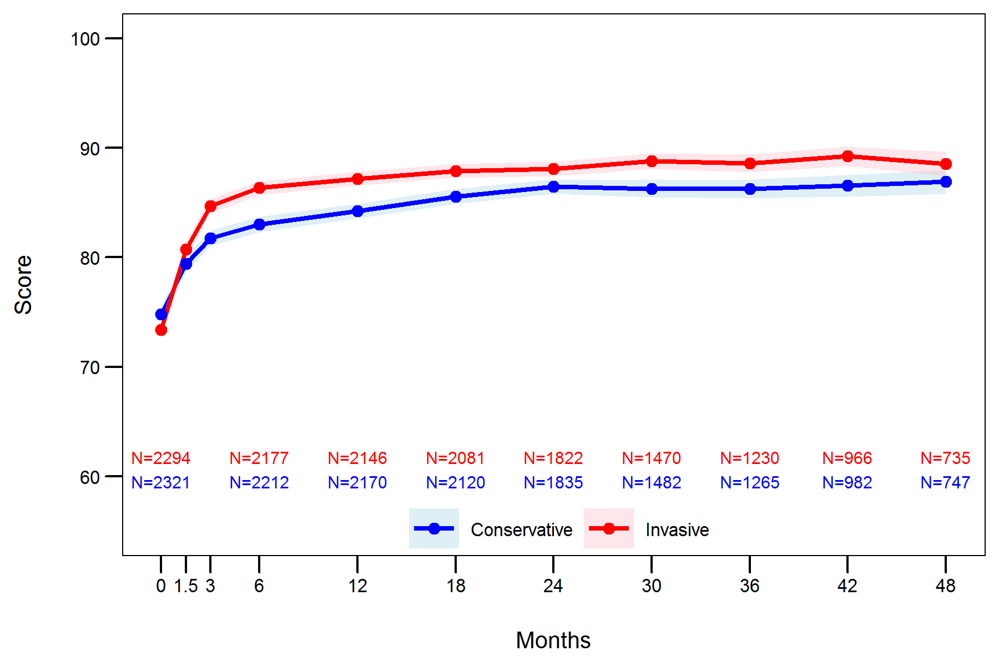
Change in Summary Score- Primary Outcome
SAQ Summary Score
Both groups
quickly migrated to
“excellent” and
stayed there!

Slide 137
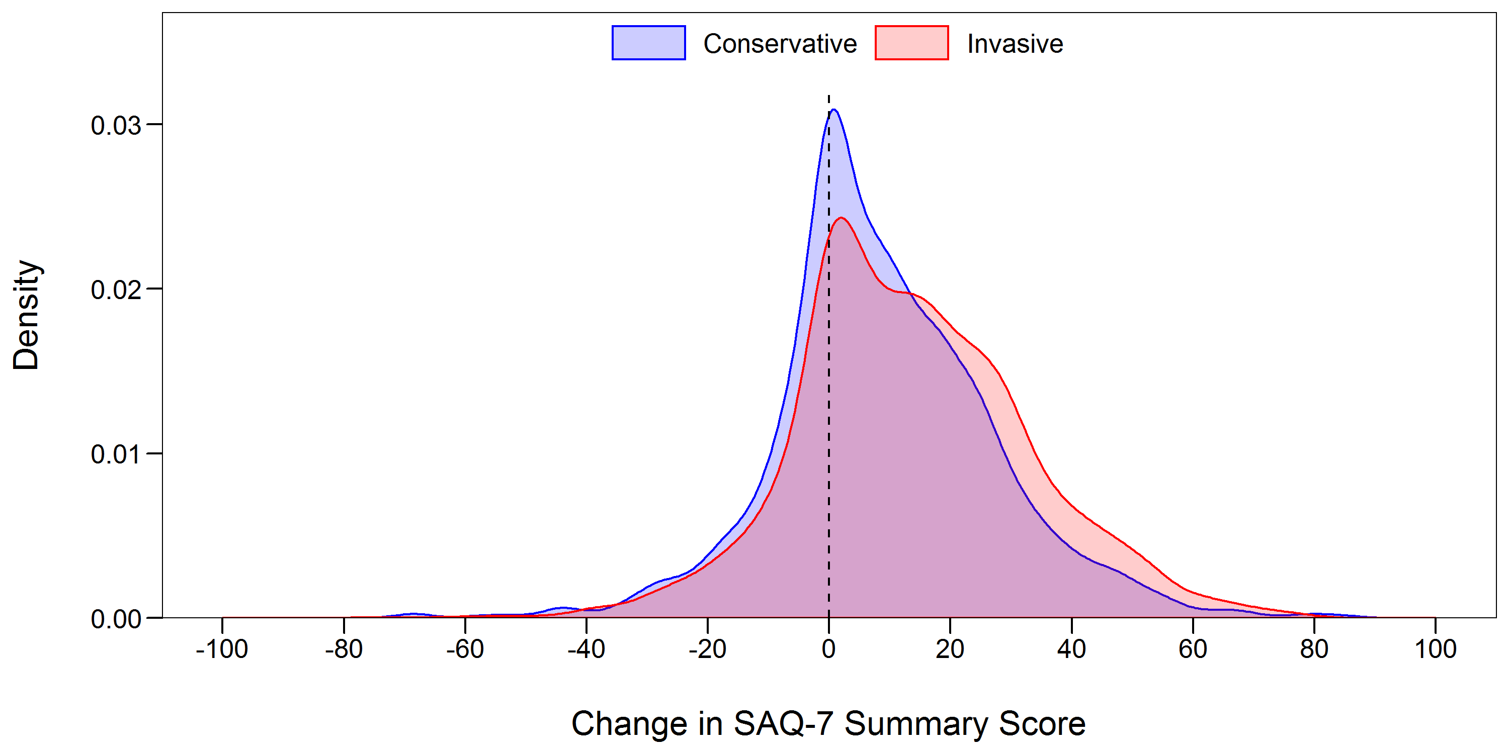
Improvement in SAQ Summary Score at 12 Months

Slide 138
SAQ Angina Frequency Scale- Secondary Outcome
:
Over the past 4 weeks, how often have you had angina?
$≥$4X/day
1-3X/day
$≤$3X/week
1-2X/week
<1X/week
Not at All
0
20
40
60
80
100
Daily
Weekly
Monthly
None
Daily/Weekly

Slide 139
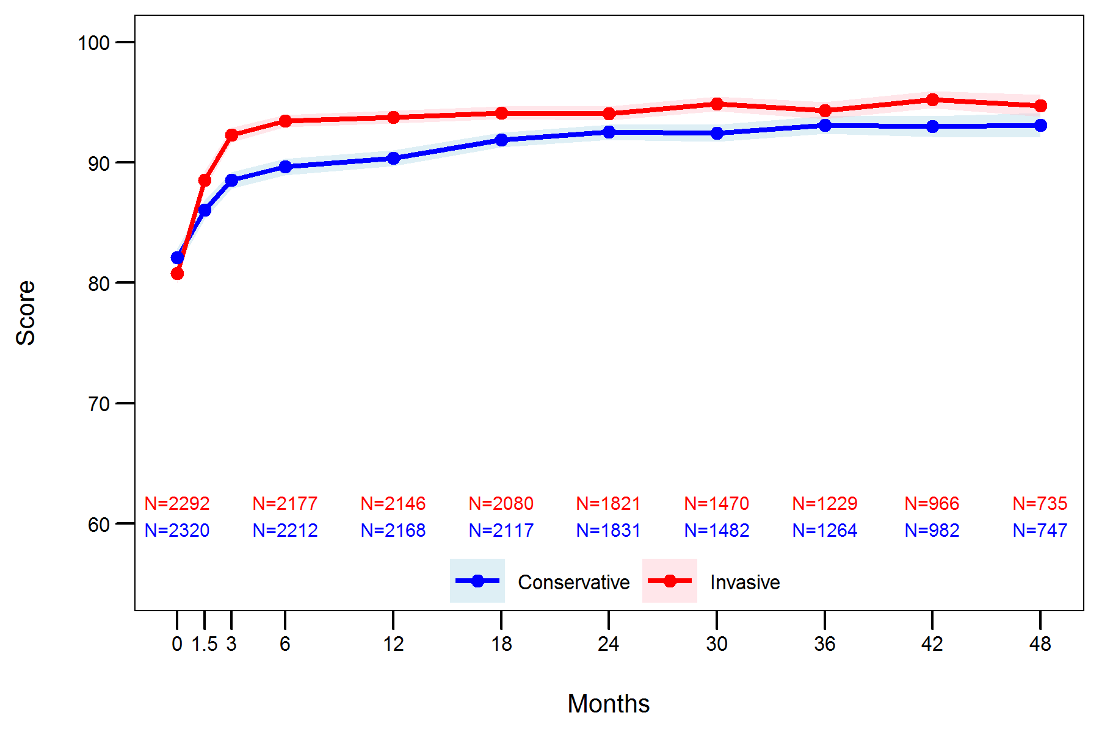
Changes in Angina Frequency
SAQ Angina Frequency
Both groups went from <1X/wk to close to none

Slide 140
Conclusions
Patients with stable CAD and moderate to severe ischemia had significant, durable improvements in angina control and quality of life with an invasive strategy if they had angina (daily/weekly or monthly)
In patients without angina, an invasive strategy led to minimal symptom or quality of life benefits, as compared with a conservative strategy
In patients with angina, shared decision-making should occur to align treatment with patients’ goals and preferences

Slide 141
International Study of Comparative Health Effectiveness with Medical and Invasive Approaches ‒ Chronic Kidney Disease
Primary Report of Quality of Life Outcomes
John A. Spertus, MD, MPH
Saint Luke’s Mid America Heart Institute/UMKC
On behalf of the ISCHEMIA-CKD Research Group

Slide 142
Baseline Health Status
Scale | Invasive | Conservative
SAQ Summary Score | 75.7$±$20 | 76.0$±$19
Everyone started off “excellent”

Slide 143
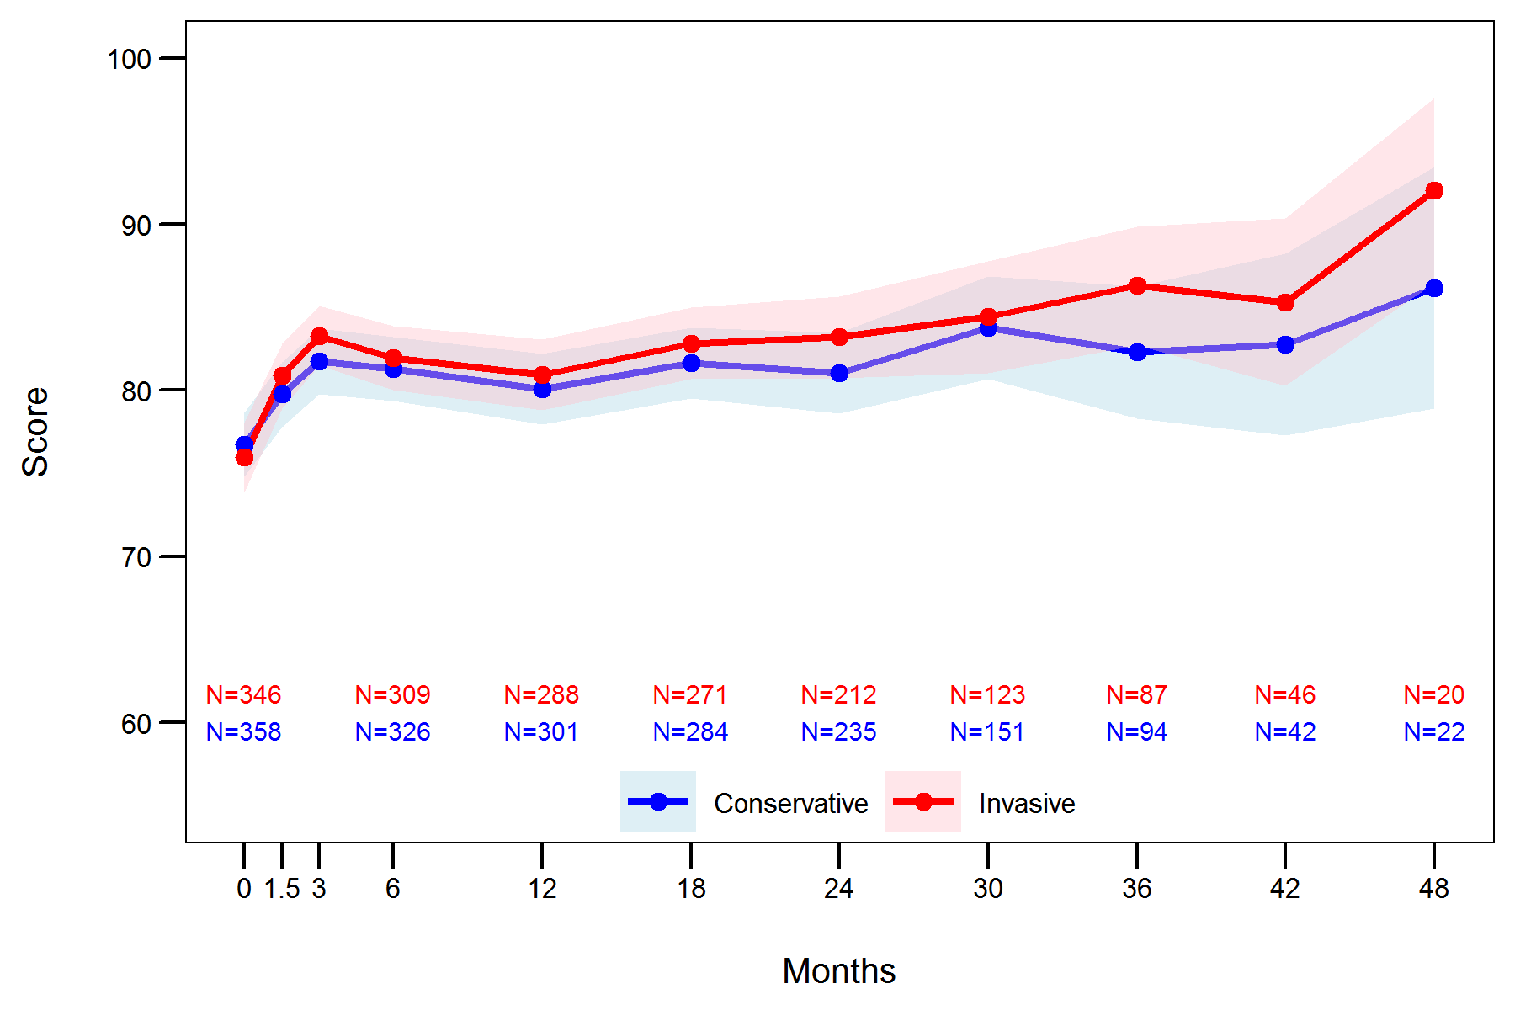
Description of Observed Data – All Patients
SAQ Summary Score
Everyone stayed “excellent”

Slide 144
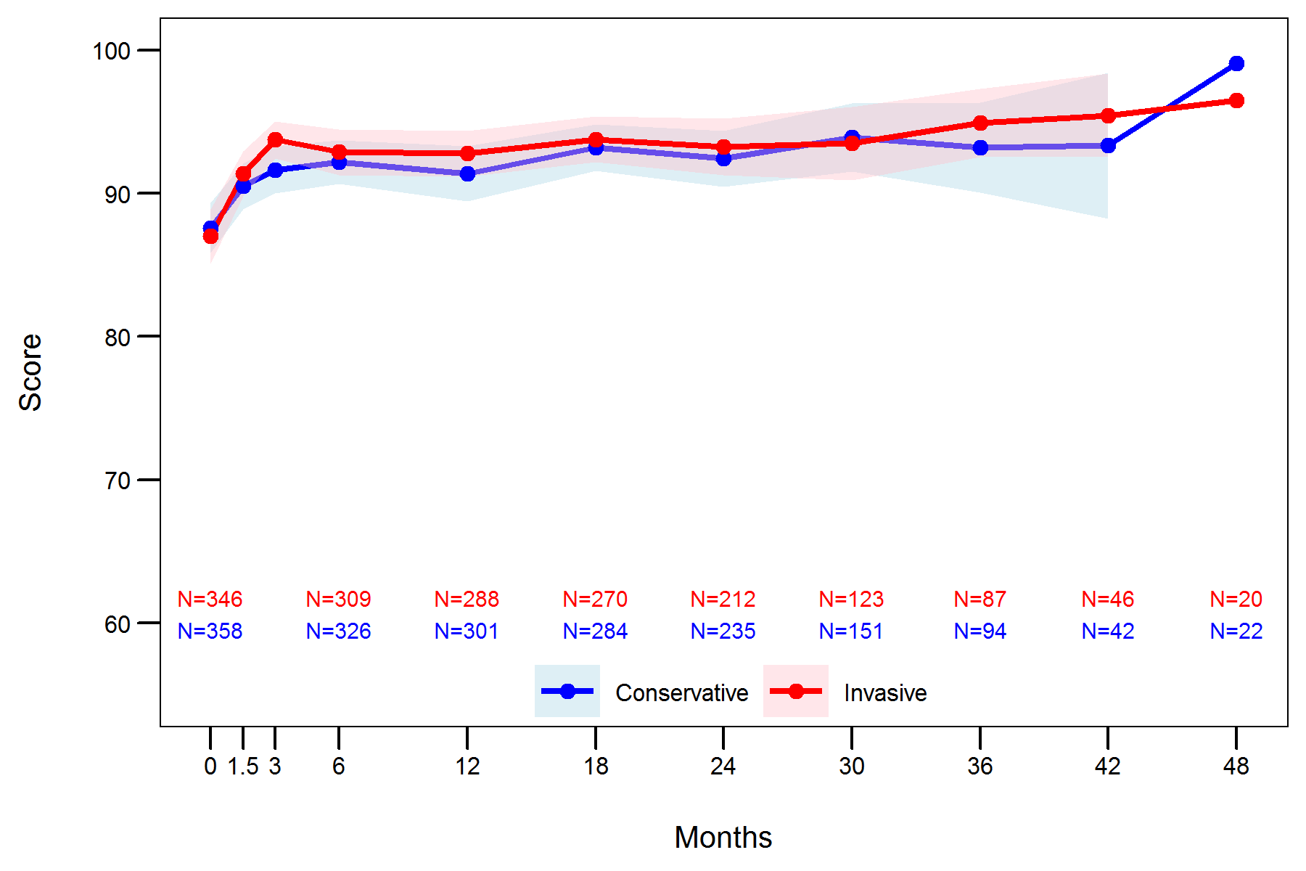
Angina Frequency Changes
SAQ Angina Frequency Score
Both groups went from <1X/wk to virtually none

Slide 145
Conclusions
In patients with stable CAD, advanced CKD and moderate to severe ischemia, we did not observe a substantial improvement in angina control and quality of life over time.
However, given the large proportion of asymptomatic patients at baseline, we cannot exclude the possibility of a small benefit in symptomatic patients.

Slide 146
BDM Thoughts
OMG!!! What in the world are they trying to say??!!!
The SAQ summary scores were excellent in both groups in both studies!!!!
It appears the only people who would possibly derive an improved quality of life from invasion ‘might’ be the few who have SAQ summary scores <50 and angina frequency scores <30 (daily).

Slide 147
BDM Thoughts in Summary of ISCHEMIA
The only CAD pts who critically need invasive procedures are those having an ACS – STEMI or NSTEMI.
Pts with SIHD, EF >35%, GFR >30 and unacceptable angina may be considered for invasive management after pt discussion of the pros and cons.
The SAQ should be administered to pts with SIHD.

Slide 148

Let’s Look at a Case

Slide 149
Joe- 78yo with known CAD
First seen Oct. 2014
CAD: s/p NSTEMI ‘95 –quad CABG; s/p NSTEMI June 2014- four bare metal stents for occluded SVGs circumflex & RCA; akinesis inferior lateral wall; EF 45%
Other known ASVD: carotids-H-bulbs & ICAs and cerebral-CT ‘05.
Inflam: hsCRP-0.4; Lp-PLA2- 175; MPO- 186; F2- 0.25; MACR- 2.1
Meds: ASA 81mg, prasugrel 10mg, simva 40mg, lisinopril 2.5mg, metoprolol 25mg.

Slide 150
Past Hx
High cholesterol life long; rx’ed after CABG
Psoriasis severe as child- occas flare as adult
Kidney stones 2010 & 2012
ED since 2011

Slide 151
FamHx
Father died 60 yo extensive ASVD
Mother died 92 yo with bad Alzheimer’s
Paternal uncle who died of stroke and PAD
Other paternal uncles with extensive ASVD
Exam
BP-144/72, HR- 68, 5’ 6 ½ ‘’, 153 lbs., waist 33 ½ ‘’, BMI- 24.5
No bruits
NT pro-BNP-121; hscTnI-2.9; galectin-3- 17.0

Slide 152
Galectin-3 Predicts HF and Mortality Risk Post-MI
1,342 post MI pts; mean age 67; 61% male; 79% NSTEMI; galectin-3 sorted by tertiles; followed 5.5yrs.
Tertile 1: <15.1 ng/ml
Tertile 2: 15.1-22.4 ng/ml
Tertile 3: >22.4 ng/ml
Outcomes: 368- HF; 484 deaths
Asleh, R., et al. (2019). "Galectin-3 Levels and Outcomes After Myocardial Infarction." A Population-Based Study. JACC. 73(18): 2286-2295.
Notes:
Gal-3 using this assay can range between 1.4 and 94.8 ng/ml, and the overall intra-assay and interassay coefficients of variation have been reported as approximately 3.4% and 8.5%, respectively.

Slide 153
Galectin-3 Predicts HF and Mortality Risk Post-MI
After adjusting for: age, sex, comorbidities and troponin, elevated galectin-3 was associated with increased risk of HF & death.
Tertile 2 compared to 1
HR- HF- 1.4 (95% CI, 1.0-2.0)
HR- death – 1.3 (95% CI, 0.9-1.7)
Tertile 3 compared to 1
HR-HF- 2.3 (95% CI, 1.6-3.2)
HR-death- 2.4 (95% CI, 1.8-3.2)
Asleh, R., et al. (2019). "Galectin-3 Levels and Outcomes After Myocardial Infarction." A Population-Based Study. JACC. 73(18): 2286-2295.

Slide 154
Galectin-3 Predicts HF and Mortality Risk Post-MI
HF risk independent of recurrent MI and remained significant when ST2 was added.
Galectin-3 is an independent prognostic marker after MI for risk of HF and death.
Joe with a tertile 2 galectin-3 had a 40% increased risk of HF by 2019
Asleh, R., et al. (2019). "Galectin-3 Levels and Outcomes After Myocardial Infarction." A Population-Based Study. JACC. 73(18): 2286-2295.

Slide 155
New root causes discovered
Mixed hyperlipidemia with lipo (a) -84 (ULN-30)
Sub-optimally managed hypertension
IR: A1c 5.9%; FBG- 87; 1 hr- 205; 2 hr.- 187
Periodontal disease – some 4mm pockets with BOP, Tf
Vitamin D- deficiency
Depression and anxiety
ApoE- 2/3
KIF6- heterozygous
Hp- 1-1
9p21- neg

Slide 156
Med Changes
Rosuvastatin 20mg
Ramipril 10mg bid
Carvedilol 3.125mg bid
Enduracin 1500mg
Vit. D3 5,000 IU
Cinnamon with chromium 2000mg
Vit. C 1000mg
Drk chocolate 10g
CoQ 10 – 200mg
Omega 3 two qd
Cardiologist d/c’ed prasugrel Aug. 2014

Slide 157
Fast forward
Remained stable and had right shoulder surgery 2015, right hip replaced 2016, two lumbar disc surgeries early 2019.
CIMT June 2019: all plaques echogenic & slightly smaller
Arterial inflam: 9/19/2019: hsCRP- 0.2, Lp-PLA2- 96 (uln-180), MPO-207, F2-0.47, MACR 3.0
Heart 9/19/2019: NT pro-BNP-42; hsc-TnT-16 (uln-22); galectin-3 -13.3 ng/ml

Slide 158
11/8/2019-call
Discomfort in left anterior chest; ache; reminds me of what I had at time of heart attacks; off and on for several months now; not related to exertion; no radiation; no nausea; no SOB; no diaphoresis; maybe a little more tired?
What should I do??
“Recent labs indicated no inflammation which places you are minimal risk for an atherothrombotic event. Your heart tests were also excellent. Inflammation can change quickly. Any dental issues?”
Recent dental check up was fine.

Slide 159
11/8/2019-call
“OK. Let’s recheck inflammation and your heart tests. If they are normal, I would recommend continuing with OMT as opposed to seeing a cardiologist. Told about the recent 10 yr study which showed people with stable ischemia did just as well with OMT as PCI or CABG. If the tests are abnormal, we need a cardiology consult.”

Slide 160
11/13/2019- received 11/18/2019
Inflammation: hsCRP- 0.2, fibrinogen- 192, Lp-PLA2- 96, MPO-218, F2- 0.56, MACR- 9.0
Heart: NT pro-BNP- 79, hscTnT- 10, galectin 3- 14.1 ng/ml
Called Joe. “Very unlikely your pain is due to myocardial ischemia. There is no need for a cardiology consult.”
Joe said he felt better.

Slide 161

11/19/2019
Joe had a successful day with his bow!

Slide 162
2 ½ Weeks Later on 12/6/2019 (5 days ago!)
I am getting dressed ~ 7am when I am suddenly told to see my nurse ASAP!!! Joe woke up at 4:30 am with severe chest pain and is in the hospital!!!
I called him. He said he woke up with the worst ache he has ever had in chest! He wondered if it might have been a dream. His wife immediately called the ambulance. He feels better and wishes he was back home. He indicated the cardiologist semi-chewed him out for traveling hours to see some doc that thought they knew how to prevent heart attacks. He was told his coronaries are certainly blocked up as he is 24 years post CABG!
It is not a STEMI so need to wait for the enzymes to come back elevated before doing a cath.

Slide 163
12/6/2019
I felt nauseated and puzzled as the last tests were excellent. I told Joe if the enzymes are elevated, he for sure needs an invasive intervention. If they are not elevated, considering ISCHEMIA, it is debatable whether to do an invasive intervention.
8 am – we wait for enzymes.

Slide 164

12/6/2019
1pm – his wife lets me know his enzymes are all normal.
This is when ISCHEMIA would be discussed. Should we do a stress test for ischemia?
The only reasonable reason to answer ‘yes’ would be if his SAQ was terrible.
He is bow hunting almost daily; climbing into tree blinds!

Slide 165

12/6/2019
Proceed immediately with an echo and nuclear stress test.

Slide 166

Waiting for results
Informed Joe that since enzymes were normal he did not have a myocardial infarction. That means an invasive approach is not critical. He knows the echo and nuclear stress test will probably be abnormal as he had damage after his two heart attacks with akinesis of inferior lateral wall.
We both realize the tests will likely be abnormal and the cardiologist will recommend invasion. The ISCHEMIA trial calls that into question, but reality means it does not really matter.
This Photo by Unknown Author is licensed under CC BY

Slide 167

12/6/2019
7:22 pm
Cardiologist sends word to Joe.
His heart is fine, and he can go home tomorrow morning.
Echo-LV normal size and function with EF 60%
SPECT scan- fixed basal inferior defect; no ischemia; EF 61%

Slide 168

He is an avid hunter! Today 12/11/2019

Slide 169
BDM Thoughts
How sad the cardiologist had zero interest in the BDM.
Joe never saw the cardiologist again after initial visit where he was told, “of course his coronaries are blocked – the CABG was 24 yrs ago!” He was also told he was not too smart traveling to see someone who professed the disease could be stopped.
Our biomarkers for inflammation and myocardial health are very good markers. Albeit, nothing is perfect, and situations can change fast. It was wise to rule out an ACS!!!

Slide 170
BDM Thoughts
Despite ISCHEMIA the reality is many patients with known ‘stable’ CAD who demonstrate ischemia on a stress test will have invasive procedures.
This could have easily happened to Joe.
Days like this conduct a stress test on my heart.

Slide 171

Upcoming Presentations

Slide 172
Upcoming Events for BaleDoneen
January 17- Amy and Brad – Pinnacle Study Club, Trinity, Florida
March 17-18 -BDM Preceptorship in Scottsdale, AZ
March 24 – Amy and Brad speaking at Long Island Dental Study Club
September 18-19- BDM Preceptorship in Houston, TX
Nov. 6-7 – BDM Reunion Nashville, TN !!!

Slide 173
Open for Discussion

