Slide 1
PREMATURE CAD: What to do when ApoE4 AND 9p21 are Homozygous?
David B Wright MD
Clinical Coach BDM
15 February 2022

Slide 2
OBJECTIVES
Review case of a 45 yo female who is S/P MI at age 41
Discuss ApoE 4/4 and Homozygous 9p21 management

Slide 3
Primordial Unifier
Oxidative
Stress
Air Polution

Slide 4
CASE PRESENTATION
45 y.o. Caucasian female presents 4 years after a STEMI
Her “why”
“Avoid the terror of another one—a big worry for me!”
“So my children don’t have to have their heart attack.”
“I’ve been alone chasing answers.”

Slide 5
HISTORY
Became enraged at her daughter’s soccer coach’s behavior and was discussing the brouhaha afterwards with other moms
Sudden onset of discomfort in upper chest, back “like a shawl” and arms to her elbows
Wanted to stop talking
Took 30 minutes for ambulance to arrive; NTG given and transported another 30 minutes to hospital.
Comfortable at time of arrival to ER
Did not get TPA

Slide 6
CATH RESULTS
Widow-maker proximal LAD lesion
Unable to stent due to size of vessel and proximity to side branch
“Generally small vessels”

Slide 7
TREATMENT
Aspirin 81 mg daily
Metoprolol Succinate ER 25 mg daily
NTG as needed—has never used
Atorvastatin 40 mg daily
Lisinopril 5 mg daily
Omeprazole
Brilinta 90 mg for first year, then 60 mg past 3 years
“My cardiologist said she didn’t know what else to do”
“I find comfort in it”

Slide 8
OUTSIDE RECORDS
Echocardiogram
EF 55%
No wall motion abnormalities
Stress test with nuclear imaging
Negative to 8 METS
97% MPHR
Normal perfusion, no fixed muscle defects
Normal wall motion

Slide 9
FAMILY HISTORY
Mother: died age 75
AMI before menopause, 46 y.o.
Obesity
Prediabetes
Edentulous at age 40
CAD: no others
Stroke: PGF
Autoimmune:
M—thyroid
PGF—RA
MGM—autoimmune lung fibrosis
B—recent onset patchy alopecia

Slide 10
PMH
Gravida 3 Para 2
First trimester fetal loss of 2nd pregnancy
Babies were 9-3 and 8-15; her OGTT reported as negative for GDM
Normal blood pressure with all
G3:
Postpartum edema with weight gain of 7 pounds and BP to 200/100 at end of first week
No proteinuria during or after pregnancy
Amlodipine prescribed; BP has continued to need treatment
Poor sleep for 3 years after G3
Daughter was 3 at time of AMI

Slide 11
POSTPARTUM HYPERTENSION
BP peaks 3-6 days postpartum
Hypertension develops in 20% within 6 weeks¹
50% are de novo, rest had antepartum HBP disorders
High BMI and DM more common
90% were given NSAIDs postpartum—possible contributor?
Antepartum fms-like tyrosine kinase 1: placental growth factor ratios are elevated similar to pre-eclampsia
No abnormal urine, liver, platelet counts to suggest HELLP
?subclinical preeclampsia?
Circulation 2015;132:1726-1733
NOTE: I will discuss this topic further on next month’s Scientific Update

Slide 12
CORONARY ARTERY DISEASE
HEART ATTACK 2017
Initial Root Cause
Records Review
01.14.2022
Green = Not present or optimal
Yellow = unknown or suboptimal
Red = Uncontrolled
AIR
POLLUTION

Slide 13
LAB EVALUATION
Triglycerides 168, HDL 36, Ratio 4.7
ApoB 78 mg/dL
Lp(a) 12 nmol/L
OGTT: 90-143-99
Good beta cell reserve, should fully reverse
Nearly at threshold for 13x risk of diabetes (one hour > 150)
Vitamin D 27.6 (contributes to IR!)
OralDNA: Tf and Fn present
Inflammation: No “Fire Alarms” present (MPO, LpPLA2)
F2Iso elevated 0.87
ADMA elevated 111 mg/dL
Fibrinogen elevated 385 mg/dL
SMOKE DETECTORS

Slide 14
TREATMENT BEFORE GENETICS RESULTED
Nutrition
Intermittent Fasting 16/8
Mediterranean diet, avoid starches and simple sugars
Sodium restriction of 1500-2000 mg
Dark chocolate, 70+%, 7-10 grams daily
Movement
Begin regular walking, goal of 20+ minutes daily/150 minutes/week
Begin simple strength training—I like planking exercises to start
Defer on High Intensity Interval Training until builds a foundation of fitness

Slide 15
TREATMENT BEFORE GENETICS RESULTED
Stress
Mindfulness discussed
CBT-I Coach app for deep breathing and other tools
Dental
Referred to BDM and AAOSH trained dentist
Sleep
Defer on WatchPAT testing until after 3-6 months of life style efforts
Her Epworth Score is 3, and no witnessed apnea

Slide 16
TREATMENT BEFORE GENETICS RESULTED
Continue
Aspirin 81 mg daily
Stop
Metoprolol ER—IR and no evidence for significant scar
Omeprazole—increases oxidative stress and endothelial dysfunction¹; raises ADMA¹; was being tried for nonspecific symptoms
Change
Atorvastatin to Rosuvastatin even without KIF6 test result
Female, Insulin Resistance
Lisinopril to Ramipril, titrate from 5 to 10 mg in 3 weeks
No evidence for improved mortality post-MI with other ACEI
HOPE trial benefit of 30% less MI, CVA and T2DM
1. Redox Biology 2016;9:134-143

Slide 17
TREATMENT BEFORE GENETICS RESULTED
Start:
CVS Cinnamon-Biotin-Chromium TID with meals
Endur-acin (Nicotinic Acid) 250 mg ➔ 1000 mg hs
Health Origins Vitamin K2 as MK7 200 mcg daily
Nature Made Vitamin D3 2000 Units daily
Discussed stopping Brilinta once
ALL Root Causes have been optimized
ALL inflammatory markers are optimal

Slide 18
GENETICS
ApoE 4-4
Highest risk
9p21 Highest risk
Hap 1-2 Moderate risk
KIF6
Lowest risk, but Atorvastatin ineffective
4q25
Lowest risk
CORONARY ARTERY DISEASE
HEART ATTACK 2017
Initial Root Causes
Evaluation
02.08.2022
Green = Not present or optimal
Yellow = present and suboptimal
Red = Uncontrolled
AIR
POLLUTION

Slide 19
HOW DOES GENETICS CHANGE HER PLAN?
I believe her lifelong risks from ApoE 4/4 coupled with Homozygous 9p21 are the most important reasons for her early CAD event
Let’s review why, and what to do about it!

Slide 20
9p21 and CVD
SNPs rs133049 and rs10757278 have the most robust evidence
Twice as common in European and Asians vs. African American
Define a chromosomal region, not a specific gene
Either SNP signifies higher risk
May or may not be found together—risk is same in either case
Comparable in CVD risk to LDL, HDL, age and lp(a) but not smoking

Slide 21
9p21 and CVD
AND Type 2 DM who are poorly controlled are
4x more likely to have an MI, and
2x more likely to die from CAD
CVD TYPE | Noncarrier | Heterozygote | Homozygote Population Risk
Prevalence in Caucasians and Asians | 27% | 50% | 23%
Early MI <50/<60 | 1.0 | 1.49 | 2.02 31%
AAA | 1.0 | 1.36 | 1.74 26%
CHD/MI Stroke | 1.0 1.0 | 1.26 | 1.64 21% 1.47-1.60

Slide 22
9p21 and CVD
33 gene enhancers in this chromosomal region
9p21 variants disrupt interferon signaling and lead to increased ApoB retention in the media
Interferon-gamma activation of STAT1 in vascular endothelial cells is disrupted causing increased inflammatory response
Interferon normally suppresses cSMC transformation into mSMC which secrete the “Velcro” proteoglycans into the arterial wall, thereby retaining ApoB
9p21 variants increase platelet reactivity, which increases PDGF and drives cSMC transformation
?Similar mechanism for aneurysm formation?
THUS: reducing SMC transformation (e.g. oxidative stress!) and ApoB is especially critical in this group

Slide 23
9p21 and AAA
SMC transformation is also thought to be critical to AAA development!
Note: Ascending and Infra-renal aorta have different embryologic origins of their SMCs which then differ in their response to wall stress, cytokine impact and MMP production!
Oxidative Stress (ROS) play an integral role in AAA due to:
SMC transformation AND apoptosis
MMP activation
Induction of inflammatory genes
One study suggests ASCVD per se is not a causal factor¹
1. ATVB 2010;30:1075-77 and 1263-1268

Slide 24
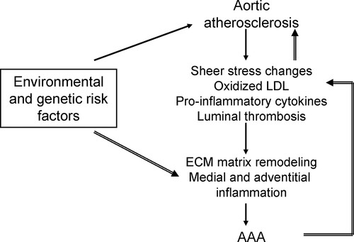
AORTIC ANEURYSM FORMATION
Jonathan Golledge. Arteriosclerosis, Thrombosis, and Vascular Biology. Atherosclerosis and Abdominal Aortic Aneurysm, Volume: 30, Issue: 6, Pages: 1075-1077, DOI: (10.1161/ATVBAHA.110.206573)

Slide 25
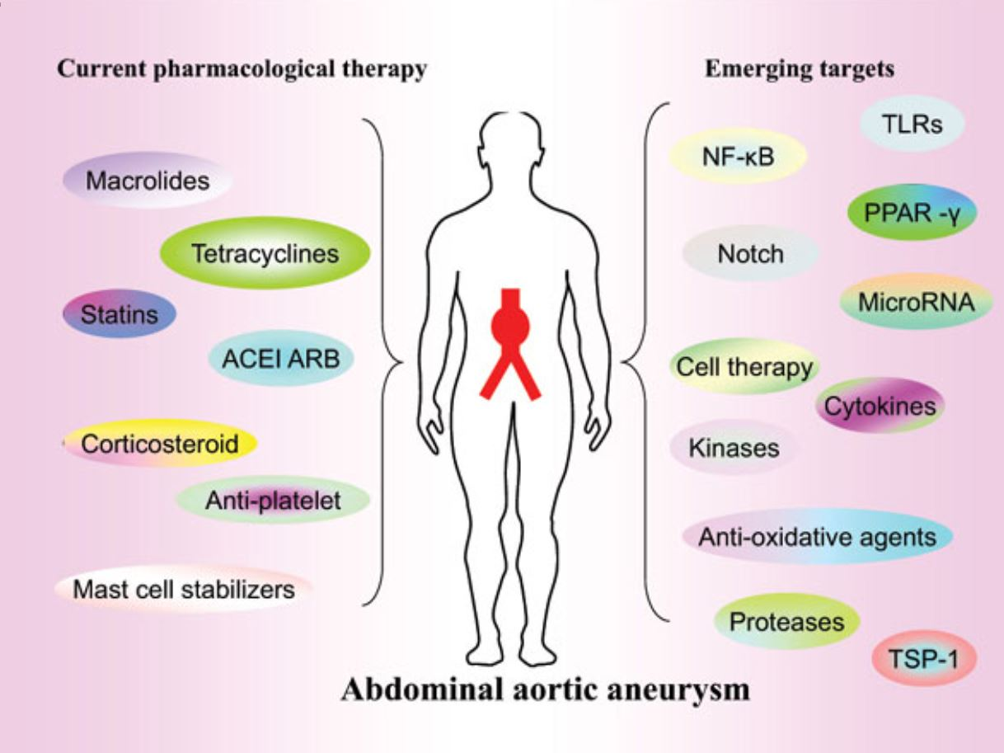
AORTIC ANEURYSM PREVENTION
Do we REALLY need drugs specific for all of these targets??
http://dx.doi.org/10.2174/1570161115666170413145705

Slide 26
9p21 MANAGEMENT
ADDRESS ALL
ROOT CAUSES
Control diabetes to below 6.5% OR
below 6.25% if Hap 1-1 (to reduce dementia risk)

Slide 27
9p21 MANAGEMENT
Aneurysm
Screen for AAA every 1-4 years depending on size and Root Cause control¹
25-29 mm every 4 years
30-39 mm every 3 years
40-44 mm every 2 years
45-54 mm every year
Above 54 mm should refer to vascular surgeon/interventional radiologist
Root Causes—the more, the sooner!
Smoking is associated with 75% and so is the single biggest risk drive
BP is second
Atherosclerosis
Intracranial screening ONLY if first degree relative had cerebral aneurysm
1. Eur H J 2014:35;2873-926.

Slide 28
9p21 MANAGEMENT
Aneurysm
Antibiotics
Avoid quinolones unless absolutely needed—doubles the risk of AAA or dissection over next 60 days! Longer term observations have not been reported
Increased MMP in collagen-rich tissues is the cause
NNH is about 7200 treated for at least 3 days; about 500 in elderly men¹
Duration of use, older age, smoking increase risk
Doxycycline and macrolides are being studied for prevention as they lowers MMP activity
1. Scientific Reports Nature Research 2021;11:11073

Slide 29
9p21 MANAGEMENT
Other drugs?
Statins decrease rate of enlargement and reduced risk for rupture
ACE Inhibitors not proven in a single trial of 224 patients
ARBs are being studied in TEDY trial
Beta blockers are used but surprisingly no published trials show benefit
Of course, treat their HBP as needed!!!
Aspirin—theoretical benefit via reduced platelet aggregation, no trials
BDM: Not recommended unless ASCVD is present
1. Scientific Reports Nature Research 2021;11:11073

Slide 30
APOE 4 and CVD
Risk of early CVD compared to 3/3
GENOTYPE | CVD HAZARD RATIO
2/2 | 0.23
2/3 | 0.61
2/4 | 0.78
3/4 | 1.16
4/4 | 1.33

Slide 31
APOE 4/4 AND FAT HYPERABSORPTION
Hyperabsorption of cholesterol/sterols/stanols is present
Sitostanol blocks ileal absorption of sterols
Majority of cholesterol absorption is from endogenous production
50% is reabsorbed, 50% excreted
Sitostanol 1800 mg/day reduced
Total cholesterol from 236 mg/dL by 24 mg/dL, 10.2%
LDL cholesterol from 159 mg/dL by 25 mg/dL, 14.1%
No change in triglycerides or HDL
ApoB not measured
NEJM 1995;333:1308-1312

Slide 32
APOE 4 and CVD
Taken up more rapidly by hepatic ApoB-E receptor, resulting in decreased LDL receptor expression and increased LDL levels
Lipid catabolic rate is lower
Impairs reverse cholesterol transport
Alcohol effect on LDL/HDL is not yet fully understood
“no safe dose of alcohol”
2001 study showed alcohol in E4 women had no effect on LDL, but in men increased LDL
E4 carriers don’t get increase in HDL
Exercise doesn’t lower post-prandial lipid levels in ApoE 3/4

Slide 33
APOE and ALZHEIMER’S RISK
66% of Alzheimer’s patients have ApoE 4, but not all E4 carry same risk
Klotho-VS heterozygosity carries lower risk for AD in E4 patients—not clinically available
GENOTYPE | PREVALANCE | AD INCIDENCE | AGE OF ONSET
3/3 | 60% | 9% | 60-70s
4/__ | 20% | 25%/47%* | 50-60s
4/4 | 5% | 50%/92%* | 40-50s
*If first degree relative has AD

Slide 34
APOE 4 and ALZHEIMER’S
Three phenotypes of Alzheimer Disease
Inflammatory—ApoE 4 highly associated with this type
Atrophic—ApoE 4 is more frequent
Toxic—Apo E 3 is more common

Slide 35
APOE 4 and ALZHIEMER’S
Apo E is produced in astrocytes
Carried by LDL receptor into neurons
Binds to neurofibrillary tangles
Reduces clearance of amyloid-beta peptides
Increases deposition of fibrillar Beta-amyloid
Binds to nuclearDNA at more than 1700 gene-promoting domains, affecting their transcription
SirT1, the “longevity molecule” is down regulated
NF-kappa B which promotes inflammation, is activated

Slide 36
APOE 4/4
Insulin Resistance is thought by some to be especially important since AD is also called “Type 3 Diabetes”
Neuronal insulin resistance is present in the brain of most AD
Diabetic patients have a higher risk for AD
Peripheral IR is associated with lower cerebral glucose metabolism
ApoE4 traps the IR receptor within the neuron
High fat diet accelerates the neuronal IR in a mouse model¹
1. Neuron 2017;96:115-129.E5

Slide 37
ApoE 4 MANAGEMENT
ADDRESS ALL
ROOT CAUSES
Control diabetes to below 6.5% OR
below 6.25% if Hap 1-1 (to reduce dementia risk)

Slide 38
APOE 4 SPECIFIC OPTIONS
Control ApoB
Nutrition
Consider restricting fat to 20% of calories--??especially if Insulin Resistant??
EVOO 7 tsps/day = 280 calories
If on 2000 cal/day, nearly all of their fat grams will be EVOO!
Monitor ApoB response to decide if higher intake possible
Psyllium, oat bran, guar gum, pectin other soluble fibers decrease LDL by 5-10%, roughly the same as doubling the dose of a statin!
Block intestinal absorption
Sitostanol 900 mg twice daily OR
Zetia 10 mg daily

Slide 39
INTERMITTENT FASTING
Intermittent fasting regimens have favorable impact on multiple pathways promoting CV wellness
Cellular resistance to stress is enhanced
Autophagy and mitophagy are enhanced
DNA repair is enhanced
NO long term CV outcome results are available—and none are likely in the foreseeable future
“Effects of Intermittent Fasting on Health, Aging, and Disease.” deCabo R, and Mattison MP. NEJM 2019;381:2541-51.

Slide 40
EFFECTS of KETONE BODIES
Fuel during fasting—necessary, but not main role!
Signaling molecules for cells and organs with direct impact on health and aging via multiple pathways:
PPAR-gamma coactivator 1 alpha, a BIG player in Arterial Health!
Sirtuins
Brain-derived neurotrophic factor!!
Fibroblast growth factor 21
Nicotinamide Adenine Dinucleotide (NAD+)
Poly(adenosine diphosphate-ribose polymerase 1 (PARP1)
ADP ribosyl cyclase (CD38)
“Effects of Intermittent Fasting on Health, Aging, and Disease.” deCabo R, and Mattison MP. NEJM 2019;381:2541-51.

Slide 41
APO E4 AND INTERMITTENT FASTING
Possibly especially important for E4??
Ketone bodies fuel neurons—even more important if they are insulin resistant??
Brain-derived neurotrophic factor
Optimize intracellular organelle function?

Slide 42
APOE 4 SPECIFIC OPTIONS
Alcohol
No “safe dose” in any group
Potential increase LDL, decrease HDL in Apo E4
Movement
No one can “out-exercise” their fork!!!
For the E4 group this is even more important to prevent post-prandial lipid spikes, e.g. triglyceride and ApoB

Slide 43
TEACHING POINTS
Genetics are essential to fully personalizing your arterial wellness prescription for the n of 1!!!
You can get started on a great gameplan while awaiting testing for genetics, periopathogens, etc!!!

Slide 44
QUESTIONS
AND
ANSWERS

