Slide 1
Heart Attack & Stroke Prevention Center
Initial Consultation
Dr. Amy Doneen

Slide 2
This program is meant to go in conjunction with AhaforLife.com
You will receive a code to access the full AhaforLife program
As we proceed through our time together today, this is the START of a life long educational process. WELCOME!

Slide 3

www.ahaforlife.com

Slide 4

We have a healthcare system focused on “sick care” rather than “wellness care”.

Slide 5

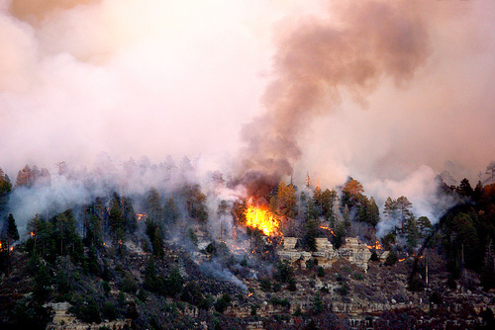

Slide 6

The current medical system catches people AFTER they fall

Slide 7
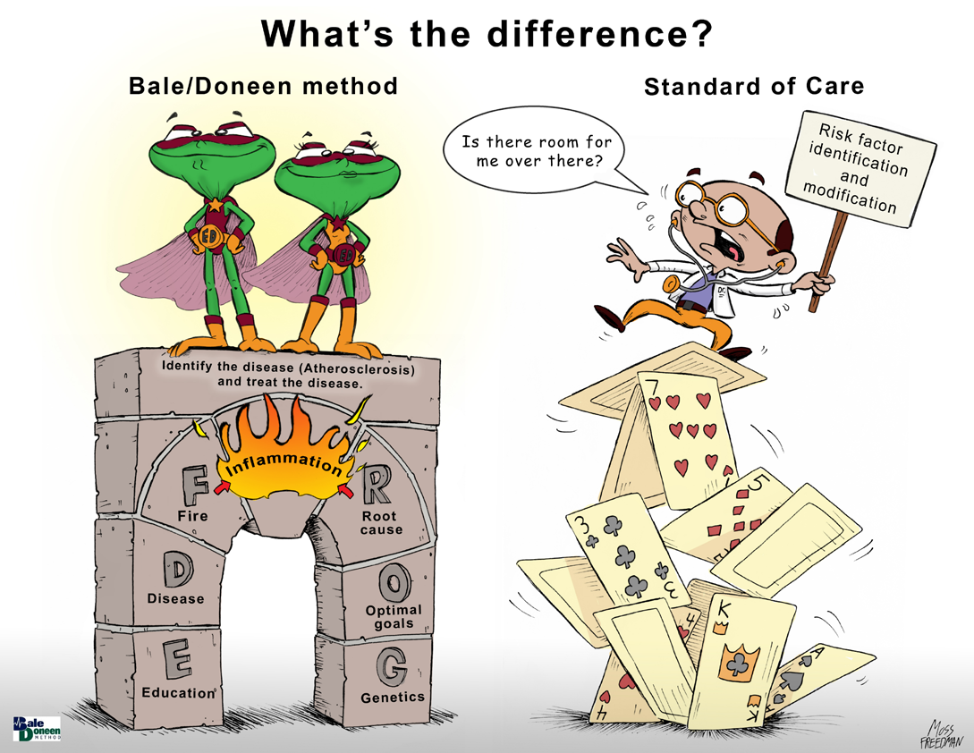

Slide 8

What is YOUR goal of optimal health?

Slide 9
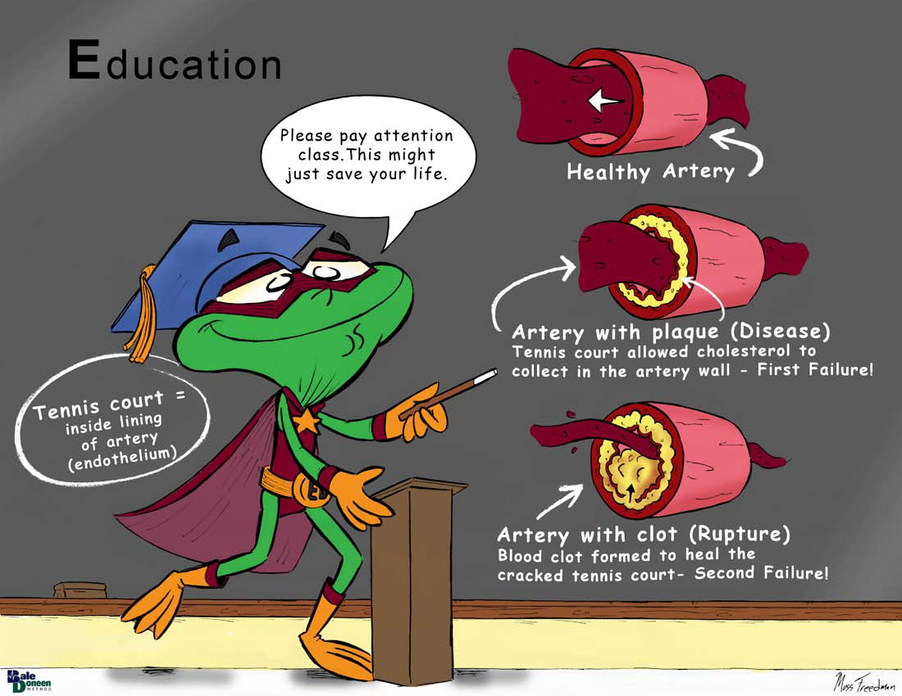

Slide 10
Event reality
99% of all plaque (cholesterol build up) is growing away from the hole where the blood flows (lumen)
No wonder many CV deaths are sudden and unexpected !
Steve Nissen European Atherosclerosis Society Meeting April – May 2004 AHA 2006 Statistical Update Circulation. 2006;113:e85-e151

Slide 11
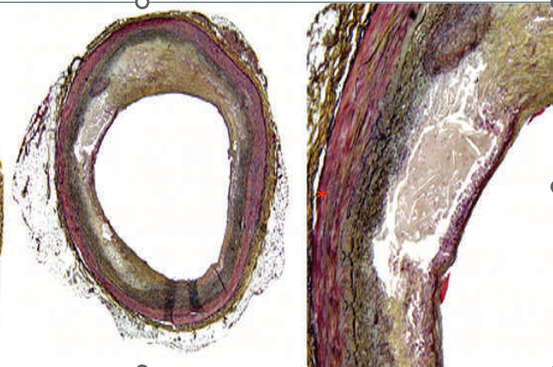
Silent, Potentially Deadly Plaque!
*
*
Histology of vulnerable coronary plaques seen on Movat’s pentachrome staining. (A) Plaque leads to concentric luminal narrowing; the asterisk (*) indicates a focal area of lipid accumulation and the overlying cap is thin. Of note, the preserved luminal area causes detection difficulties for coronary angiography and other forms of luminography. (
Nature Clinical Practice 3/06, Vol 3, NO 3:155
Notes:
11

Slide 12
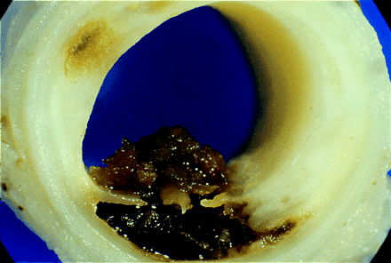
Clot From a Plaque Rupture
lumen for
blood
flow
Clot
Plaque
Notes:
12

Slide 13

Video – event reality

Slide 14
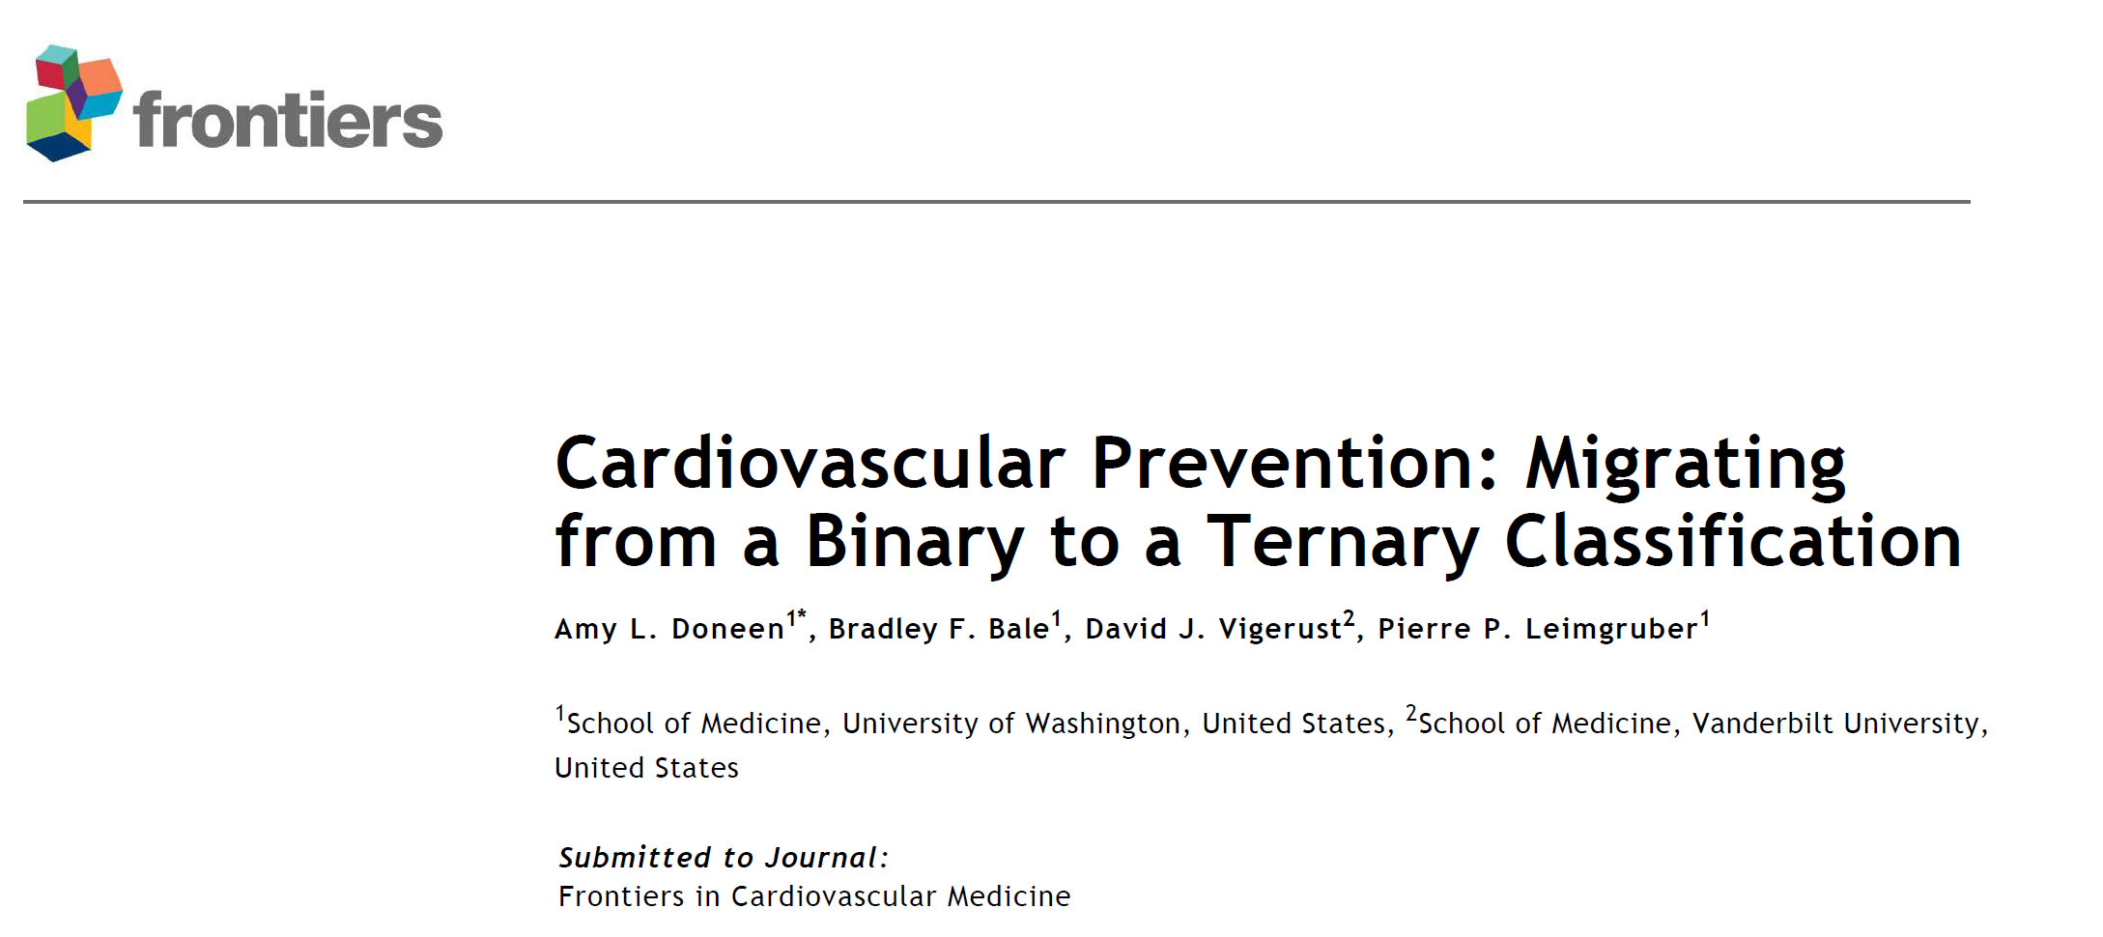
Doneen, A., Bale, B., Vigerust, D., Leimgruber, P. (2020). Cardiovascular Prevention: Migrating from a binary to a ternary classification. Frontiers of CV Med. May 2020.

Slide 15
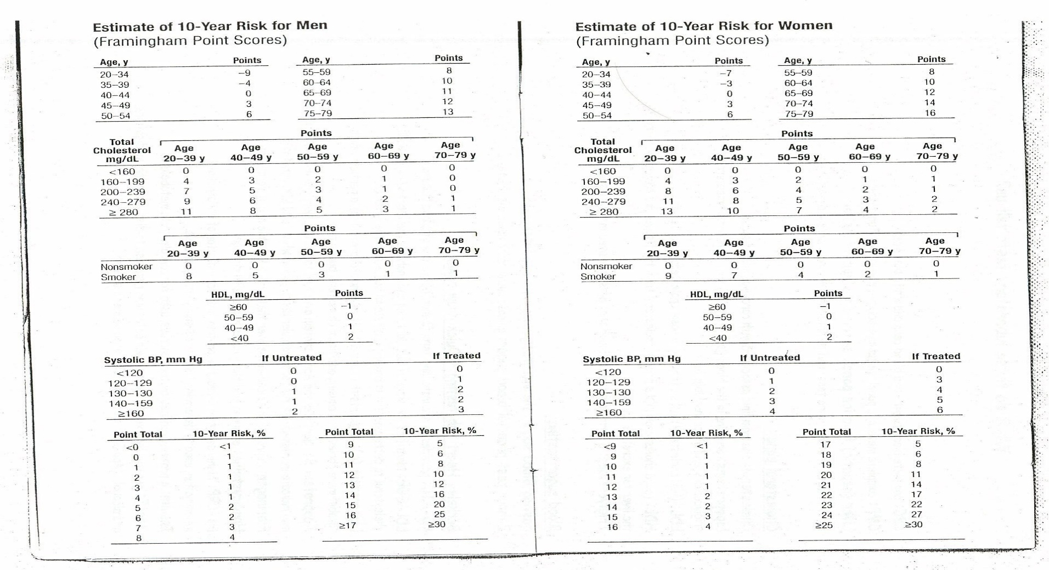
Framingham Risk Score

Slide 16
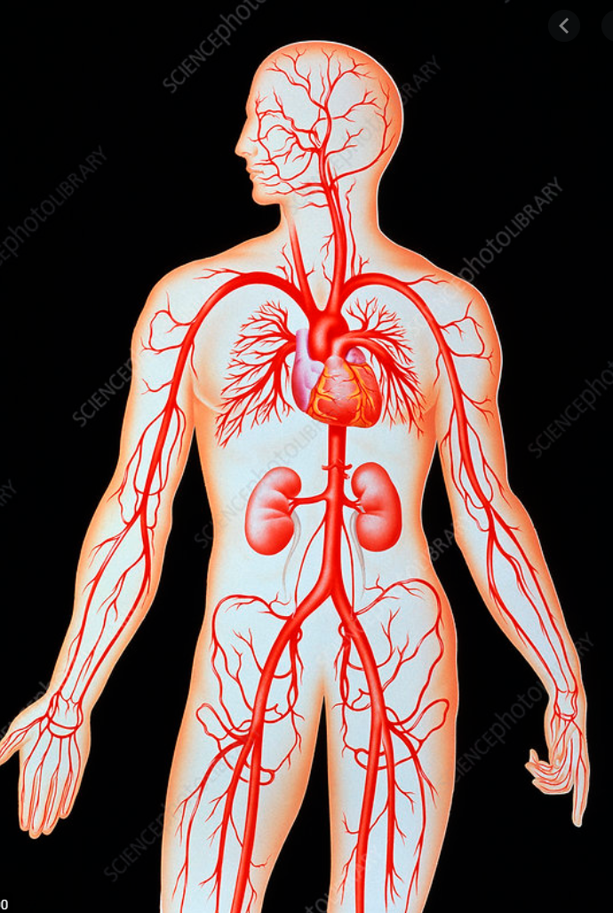
What vantage points can we safely look for plaque in the artery wall?
Carotid IMT
CACS
AAA
Femoral IMT

Slide 17
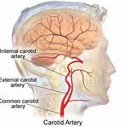
The Carotid Arteries Serve as a Window to Systemic Atherosclerosis
Willeit, K., et. al. (Sept 12, 2013). Carotid Atherosclerosis and Incident Atrial Fibrillation. Arteriosclerosis, Thrombosis, and Vascular Biology. doi: 10.1161/atvbaha.113.302272

Slide 18

IMT of Carotid
American Heart Association
“Carotid Artery B-mode Ultrasound imaging is a safe, non-invasive and relatively inexpensive means of assessing subclinical atherosclerosis. The technique is valid and reliable.”
AHA Expert Panel Statement of Prevention V Conference – Circulation. 2000.

Slide 19
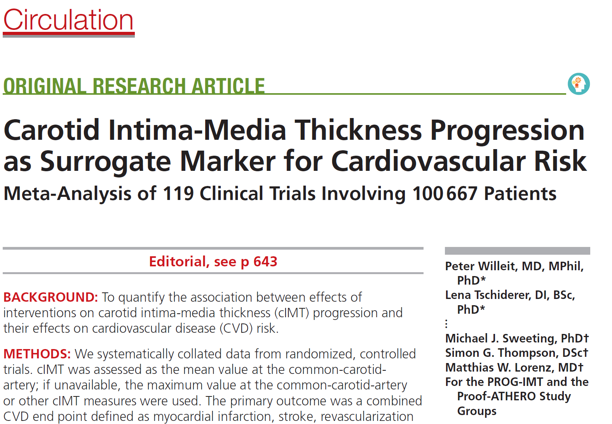
October 2020

Slide 20
Bale/Doneen Method is Effective in Generating a Positive Effect on the Atherosclerotic Disease Process
Retrospective analysis 576 pts; rx’ed in prevention clinic 2000 -2008; mean age 55.5 yo; 39% female.
Endpoint was change in CIMT
Feng, D., Esperat, M. C., Doneen, A. L., Bale, B., Song, H., & Green, A. E. (2015). Eight-year outcomes of a program for early prevention of cardiovascular events: a growth-curve analysis. J Cardiovasc Nurs, 30(4), 281-291.

Slide 21
A Disease/Inflammatory paradigm is Effective in Generating a Positive Effect on the Atherosclerotic Disease Process
Feng, D., Esperat, M. C., Doneen, A. L., Bale, B., Song, H., & Green, A. E. (2015). Eight-year outcomes of a program for early prevention of cardiovascular events: a growth-curve analysis. J Cardiovasc Nurs, 30(4), 281-291.

Slide 22
Generating a Positive Effect on Lp-PLA2: biomarker of intimal inflammation & active atherosclerosis
Feng, D., Esperat, M. C., Doneen, A. L., Bale, B., Song, H., & Green, A. E. (2015). Eight-year outcomes of a program for early prevention of cardiovascular events: a growth-curve analysis. J Cardiovasc Nurs, 30(4), 281-291.

Slide 23
Bale/Doneen Method is Effective in Generating a Positive Effect on the Atherosclerotic Disease Process
Findings suggest that the Bale/Doneen Method is effective in generating a positive effect on the atherosclerotic disease process by achieving regression of disease in the carotid arteries.
Feng, D., Esperat, M. C., Doneen, A. L., Bale, B., Song, H., & Green, A. E. (2015). Eight-year outcomes of a program for early prevention of cardiovascular events: a growth-curve analysis. J Cardiovasc Nurs, 30(4), 281-291.

Slide 24


Comprehensive CVD Risk Management Generates a Positive Effect on Carotid ASVD
Cheng, H. G., Patel, B. S., Martin, S. S., Blaha, M., Doneen, A., Bale, B., & Jones, S. R. (2016). Effect of comprehensive cardiovascular disease risk management on longitudinal changes in carotid artery intima-media thickness in a community-based prevention clinic. Archives of Medical Science, 12(4), 728-735.

Slide 25
Longitudinal changes in carotid artery intima-media thickness in a community-based prevention clinic.
324 pts; treated with BDM for 5 yrs.
Plaque quality analyzed for association with CVD risk reduction treatment.
Cheng, H. G., Patel, B. S., Martin, S. S., Blaha, M., Doneen, A., Bale, B., & Jones, S. R. (2016). Effect of comprehensive cardiovascular disease risk management on longitudinal changes in carotid artery intima-media thickness in a community-based prevention clinic. Archives of Medical Science, 12(4), 728-735.

Slide 26
Longitudinal changes in carotid artery intima-media thickness in a community-based prevention clinic.
% of lipid rich plaque reduced to zero at five yrs!
Cheng, H. G., et. al. (2016). Effect of comprehensive cardiovascular disease risk management on longitudinal changes in carotid artery intima-media thickness in a community-based prevention clinic. Archives of Medical Science, 12(4), 728-735.

Slide 27
Longitudinal changes in carotid artery intima-media thickness in a community-based prevention clinic.
These results show the beneficial effect of the BaleDoneen Method on vulnerable arterial plaque.
Cheng, H. G., B. S. Patel, S. S. Martin, M. Blaha, A. Doneen, B. Bale and S. R. Jones (2016). "Effect of comprehensive cardiovascular disease risk management on longitudinal changes in carotid artery intima-media thickness in a community-based prevention clinic." Archives of Medical Science 12(4): 728-735

Slide 28
What vantage points can we safely look for plaque in the artery wall?
Carotid IMT
CACS
AAA
Femoral IMT

Slide 29
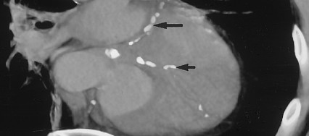
Coronary Artery Calcium (CAC)
CAC documents presence of arterial disease.
Identifies patients at increased risk for heart attack & CV death.
Budoff, M. J., et. al., (2006). Council on Cardiovascular Radiology and Intervention, and Committee on Cardiac Imaging, Council on Clinical Cardiology. Circulation, 114(16), 1761-1791.

Slide 30

Significant Weakness of Coronary Calcium Score MUST be recognized
1. Cannot detect non-calcified plaque
2. A zero score does not rule out stenosis
3. Can’t use to follow disease over time

Slide 31
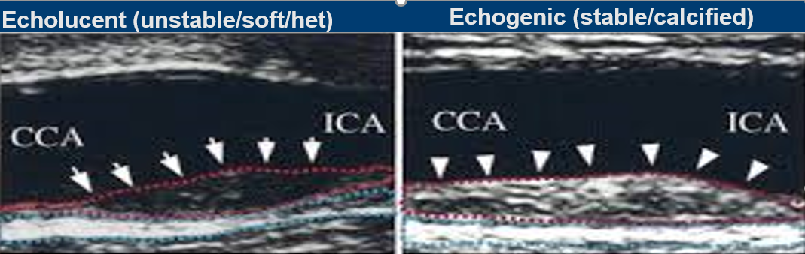
It’s the uncalcified plaque we need to be concerned about!
Echogenic (stable/calcified)
Sun, J., et. al. (2017). Carotid Plaque Lipid Content and Fibrous Cap Status Predict Systemic CV Outcomes. The MRI Substudy in AIM-HIGH, JACC Imaging. 10(3), 241-249.

Slide 32
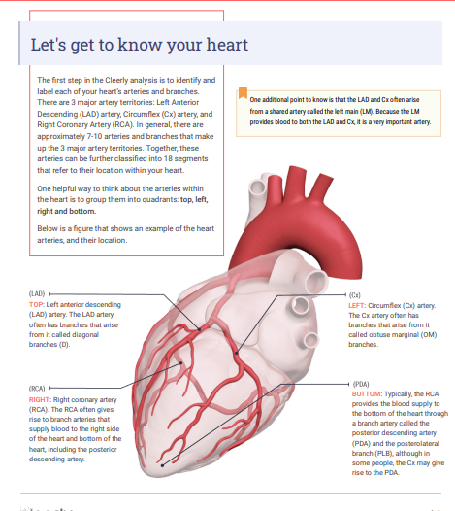
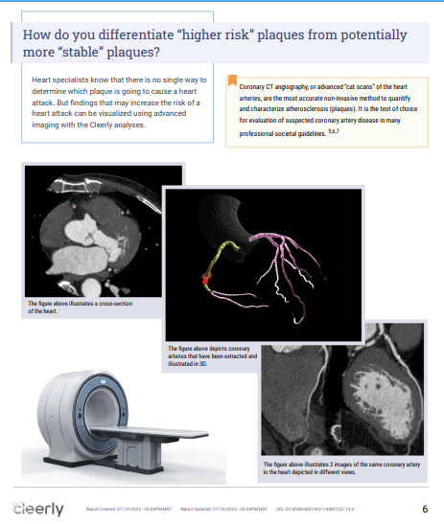
CT Angiography with Cleerly AI

Slide 33
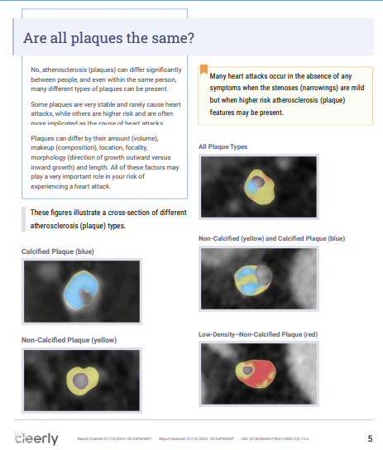
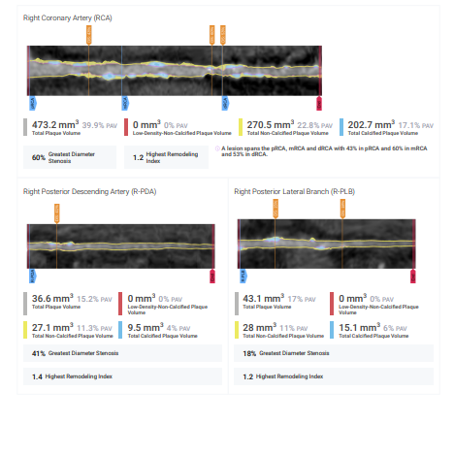
CT Angiography with Cleerly AI

Slide 34
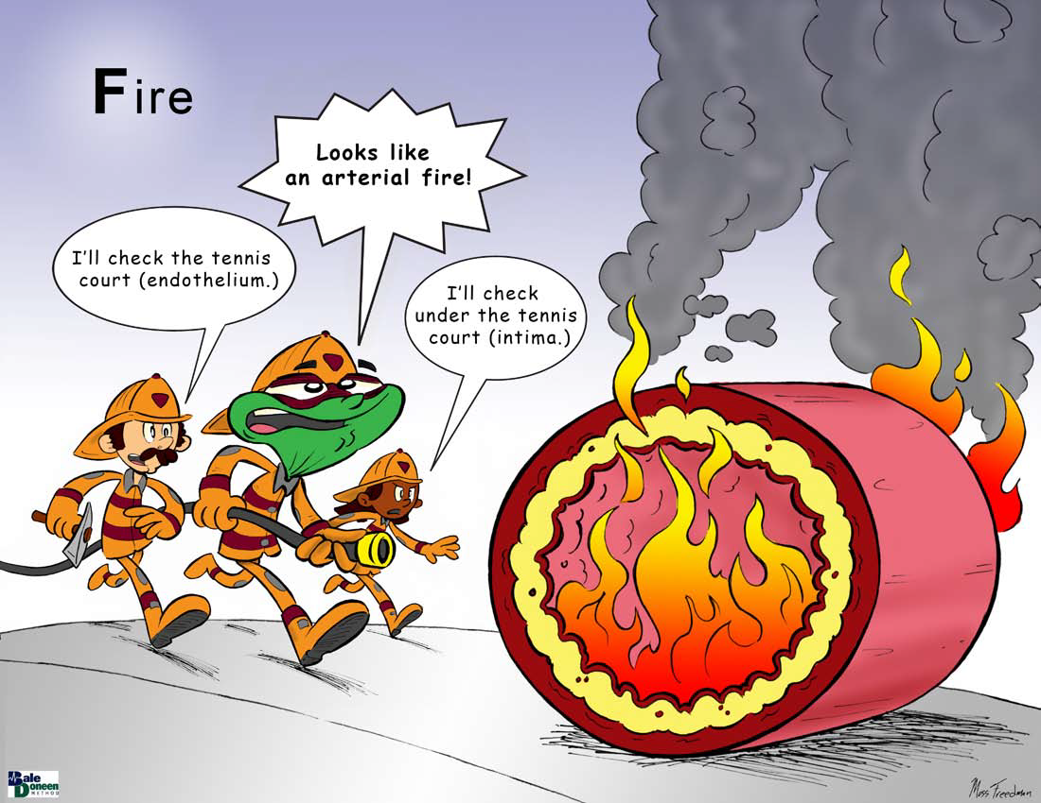

Slide 35
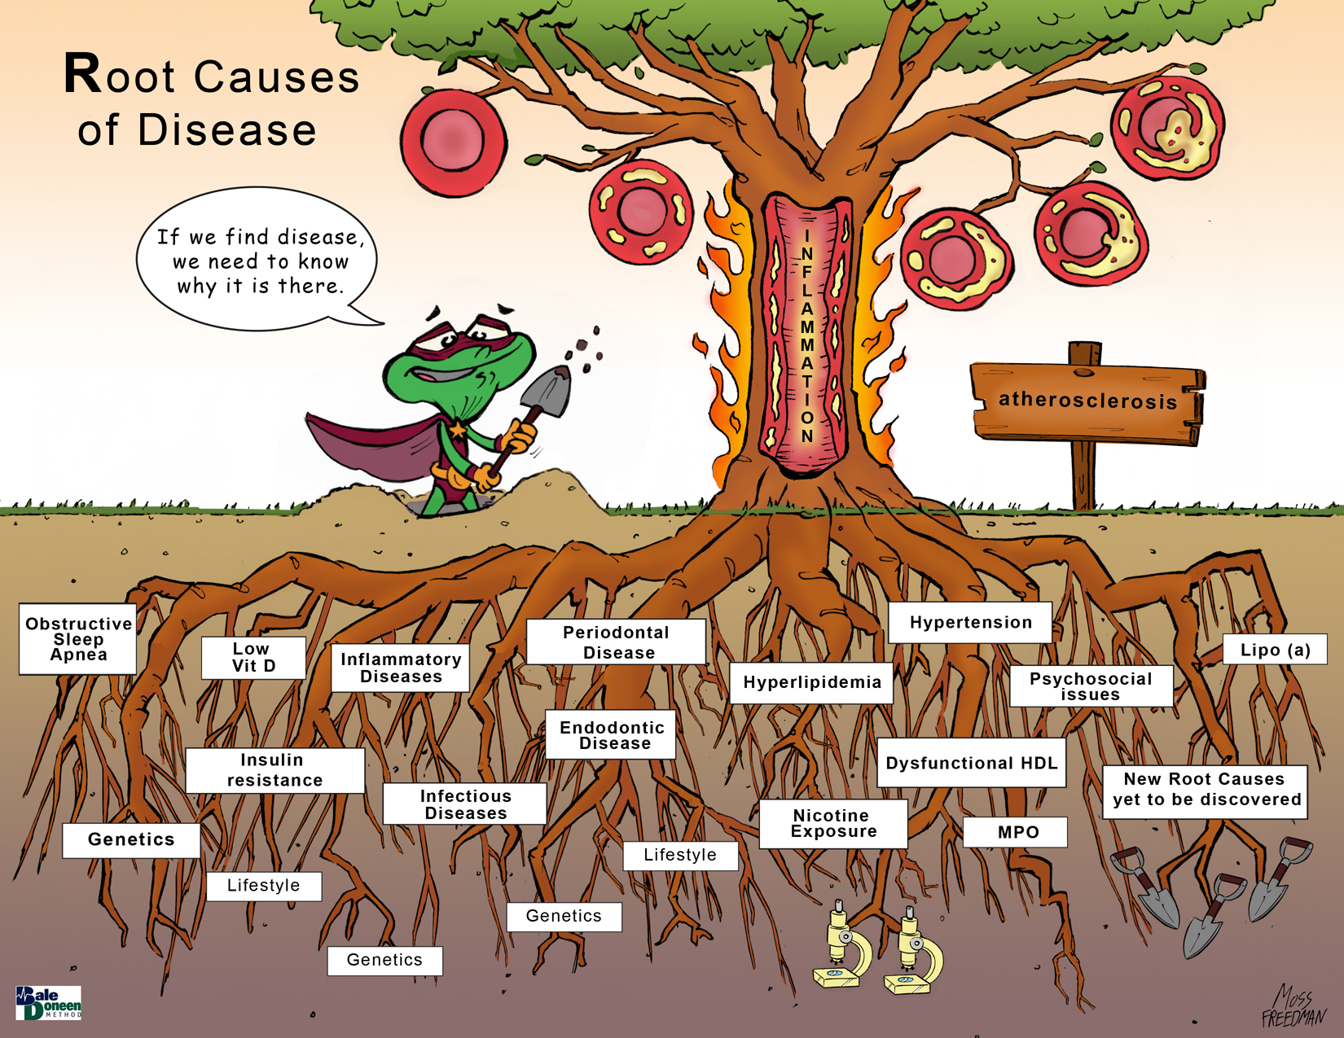

Slide 36
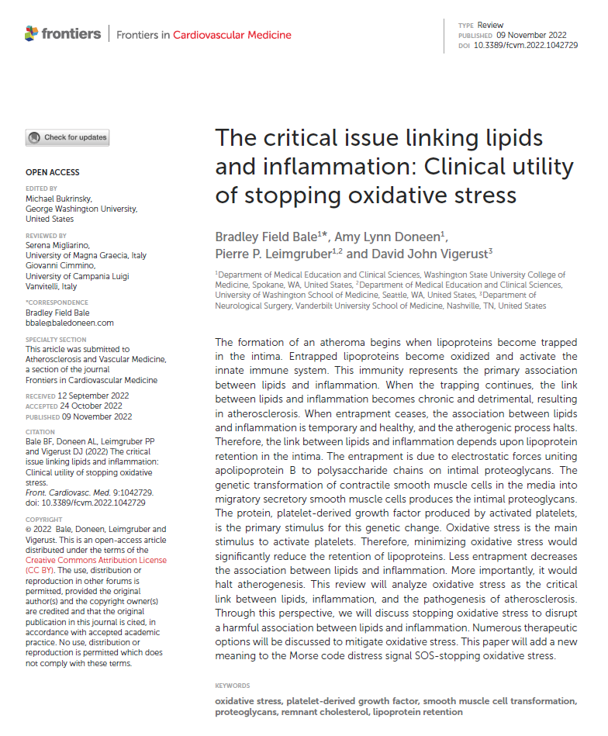

Slide 37
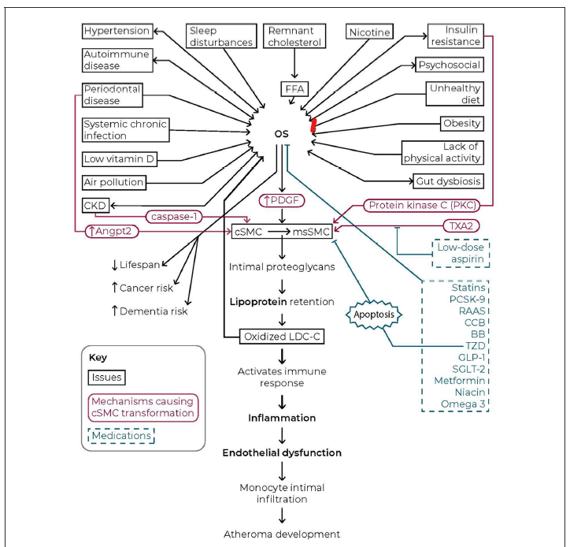

Slide 38
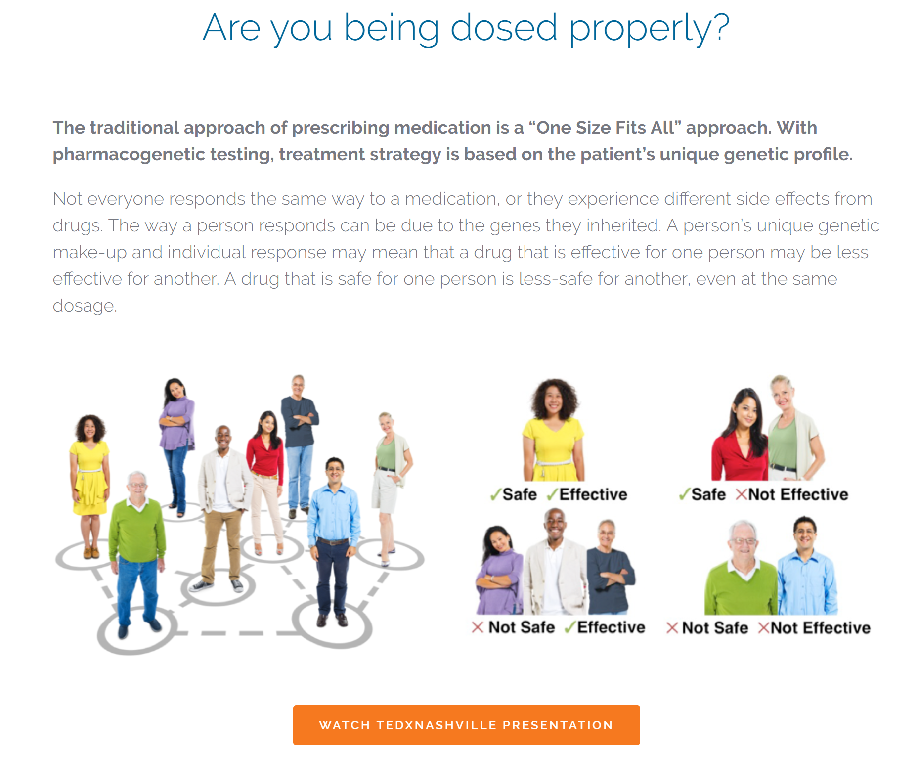

Slide 39
