Slide 1
Bale/Doneen Live Scientific Update Session
Amy Doneen DNP
July 10, 2019
5:30-6:30 pm PST

Slide 2
Studies that we will cover today
Xie, W., Zheng, F., Yan, L. Zhong, B. June 25, 2019. Cognitive decline and incident CHD. JACC Vol 73, No 24: 3041-50.
Laurent, S., Boutouyrie, P., Guimaraes Cunha, P., et al. (2019). Concept of extremes in vascular aging from early vascular aging to supernormal vascular aging. Hypertension. 2019;74:00-00. DOI: 10.1161
Al-Badri, A., Kim, J., Puja, C. et al. (2019). Peripheral microvascular function reflects coronary vascular function. Arterioscler Thromb Vasc Biol. 2019;39:1492-1500. DOI: 10.1161/ATVBAHA.119.312378.
Oscullo, G., Sapina-Beltran, E., Torres, G., et al. (2019). The potential role of obstructive sleep apnea in refractory hypertension. Current Hypertension Reports. (July 2019). 21:57.

Slide 3
Studies that we will cover today
Vakhitov, D., Tuomisto, S., Martiskainen, M. et al. (2019). Bacterial signatures in thrombus aspirates of patients with lower limb arterial and venous thrombosis. J Vasc Surg 2018;67:1902-7.
Polikandrioti, M., Panoutsopoulos, G., Tsami, A., et al. (2019). Assessment of quality of life and anxiety in heart failure outpatients. Arch Med Sci Atheroscler Dis 2019:4:e38-e46.
Shen, B-J., Fan, Y., Lim, K.S., Tay, H. (2019). Depression, anxiety, perceived stress, and their changes predict greater decline in physical health functioning over 12 months among patients with CHD. International Journal of Behavioral Medicine. https://doi.org. July 2019.
Tanaka, H. (2019). Antiaging effects of aerobic exercise on systemic arteries. Hypertension. 2019;74:00-00. DOI: 10.1161/HYPERTENSIONAHA.119.13179.

Slide 4
I am dedicating this month’s Scientific Update session to a case that demonstrates the value of practicing arteriology – the BaleDoneen Method
Introducing – Neal age 51
As I discuss various elements of his situation – I will weave in historical studies with July 2019 data to validate decisions moving forward.

Slide 5
Let me introduce you to Neal
Father of 3 children, Wife (Anne) extremely tearful and scared. Neal works as an IT technician (limited)
Definition of ‘optimal health’
“I would like to be able to go for a walk and not hurt”
“The peripheral arterial disease is far more compromising than my cardiac issues.”
“I love to travel and want to take my family to the Cayman Islands” “I want to snorkel”
“I want to be a good husband and father”
What is your biggest fear with health?
“For sure the progressive nature of my vascular disease.”
“I was told there is nothing more that can be done to stop it”

Slide 6
“No one can help me”
“I don’t want to die but nothing works”
“I am afraid of my systemic disease – including my brain health”
“I don’t know what to do?”

Slide 7
New data that validates Neal’s concerns about his brain health

Slide 8
Cognitive Decline and Incident Coronary Heart Disease
Previous studies have suggested that coronary heart disease (CHD) may be associated with accelerated cognitive decline.
The temporal pattern of cognitive decline before and after incident CHD remains largely unknown.
The purpose of this study was to determine the cognitive trajectory before and after incident CHD diagnosis in a national representative cohort.
Xie, W., Zheng, F., Yan, L. Zhong, B. June 25, 2019. Cognitive decline and incident CHD. JACC Vol 73, No 24: 3041-50.

Slide 9
Cognitive Decline and Incident Coronary Heart Disease
7,888 participants (mean age 62.1 years) with no history of stroke or incident stroke during follow-up from the English Longitudinal Study of Aging.
Participants underwent a cognitive assessment at baseline and at least 1 other time point in 12 year study.
Incident CHD was identified as a diagnosis of MI and/or angina during follow-up.
Xie, W., Zheng, F., Yan, L. Zhong, B. June 25, 2019. Cognitive decline and incident CHD. JACC Vol 73, No 24: 3041-50.

Slide 10
Cognitive Decline and Incident Coronary Heart Disease
COGNITIVE ASSESSMENTS:
First, memory was assessed by testing immediate and delayed recall of 10 unrelated words.
Second, the animal fluency test was used to assess semantic fluency. Participants were asked to orally name as many different animals as possible in 1 min.
Third, 4 questions regarding the date (i.e., day of month, month, year, and day of week) were asked to assess temporal orientation.
Higher scores on the verbal memory, semantic fluency, and temporal orientation tests indicate better cognitive function.
Xie, W., Zheng, F., Yan, L. Zhong, B. June 25, 2019. Cognitive decline and incident CHD. JACC Vol 73, No 24: 3041-50.

Slide 11
Cognitive Decline and Incident Coronary Heart Disease
Incident CHD was associated with accelerated cognitive decline during a median follow-up of 12 years.
In the years following CHD diagnosis, global cognition, verbal memory, and temporal orientation scores declined significantly faster than they did before the event
(after multivariable adjustment)
Xie, W., Zheng, F., Yan, L. Zhong, B. June 25, 2019. Cognitive decline and incident CHD. JACC Vol 73, No 24: 3041-50.

Slide 12
Cognitive Decline and Incident Coronary Heart Disease
Blue lines – represent
trajectory for CHD-free
participants
Red lines – represent the
trajectory for participants
with CHD
Dashed lines – represent
the 95% Conf Interval.
Xie, W., Zheng, F., Yan, L. Zhong, B. June 25, 2019. Cognitive decline and incident CHD. JACC Vol 73, No 24: 3041-50.

Slide 13
Cognitive Decline and Incident Coronary Heart Disease
CONCLUSIONS
Incident CHD is associated with accelerated cognitive decline after, but not before, the event.
Attention should be drawn to the long-term cognitive deterioration related to CHD.
Monitoring of cognitive function is warranted in CHD patients in the years following the event.
Xie, W., Zheng, F., Yan, L. Zhong, B. June 25, 2019. Cognitive decline and incident CHD. JACC Vol 73, No 24: 3041-50.

Slide 14
Cognitive Decline and Incident Coronary Heart Disease
BaleDoneen Take-Away:
MMSE should be performed annually on all BDM patients.
Encourage ‘exercise’ for the brain – I like to promote online tools such as Lumosity.
Xie, W., Zheng, F., Yan, L. Zhong, B. June 25, 2019. Cognitive decline and incident CHD. JACC Vol 73, No 24: 3041-50.

Slide 15
So – let’s return to Neal and find out about his CVD history

Slide 16
Coronary Artery Disease –
3.11.2010 CABG x 4 (Age 41)
3.5.2013 Stent x 3 (Age 44)
8.14.2014 Stent x 1 (Age 45)
3.4.2017 Stent x 2 (Age 48)
6.13.2017 Stent x 3 (Age 48)
6.13.2017 Balloon Angioplasty (Age 48)
7.25.2018 Echocardiogram – est. EF 60% (Age 49)
Peripheral Vascular Disease –
3.11.2010 Erectile Dysfunction
8.1.2016 Stent mid to distal right femoral artery
10.3.2016 Atherectomy and balloon angioplasty to the left femoral
10.1.2017 Mesenteric and Celiac Artery occlusion
7.25.2018 Stent in Right Renal Artery
Stent in Left Renal Artery

Slide 17
Diagnoses and Referral
Coronary Artery Disease
Peripheral Vascular Disease
Hypertension
Hyperlipidemia
Type 2 Diabetes
Erectile Dysfunction
Renal Artery Stenosis
History of atrial fibrillation
Referral – Cardiologist referral –
“There is nothing else we can do.”

Slide 18
Medications upon entry
Metformin 1000 mg BID
Invokana 300 mg BID
Lisinopril 20mg QD
Clopidogrel 75mg
Cilostazol 100mg BID
Amlodipine 5 mg
Metoprolol 12.5 mg BID
Crestor 40 mg
Aspirin 81 mg
MVI, Omega 1 gm, Co-Q10 300mg, Nitro 0.4mg SL

Slide 19
Review of Systems
Persistent Chest Pain & Leg pain Franks Sign
Inability to walk >25 ft Male pattern Baldness
Decreased Muscle Strength
Excessive Daytime Fatigue
Abnormal Breathing pattern at night
History of bleeding gums
Anxiety and tremendous fear
Bleeding gums
GI Nausea
Family History
Mother – Alive 73 – T2DM
Father – Alive 74 – CVA’s
Sister – Alive 49
Paternal GM – Died 81 MI
Paternal GF – Died 84 MI

Slide 20
Too much can be destructive

Slide 21
Current data is beginning to embrace the systemic atherosclerotic approach (BaleDoneen Method) to highlight the challenge of premature vascular aging. I believe Neal’s case highlights this latest review very nicely.

Slide 22
Concepts of Extremes in Vascular Aging
With advancing age, changes in the arterial wall contribute to what has been called vascular aging, and in some prematurely affected subjects even early vascular aging (EVA).
Various components of EVA have been recorded as arteriosclerosis, atherosclerosis, and excess vasoconstriction.
Clinical expressed as: arterial stiffening and increased central pulse pressure, carotid intima media thickening and endothelial dysfunction, and increased total peripheral resistance.
Laurent, S., Boutouyrie, P., Guimaraes Cunha, P., et al. (2019). Concept of extremes in vascular aging from early vascular aging to supernormal vascular aging. Hypertension. 2019;74:00-00. DOI: 10.1161

Slide 23
Concepts of Extremes in Vascular Aging
Authors state that arterial stiffening is the most characteristic clinical feature of the aging process of the arterial system.
Increased pulse wave velocity (PWV) is the established hallmark of arterial stiffening and is suggested to be one of the best biomarkers available to calculate the prospective cardiovascular risk and mortality risk of an individual.
EVA can be diagnosed in subjects who present an abnormally high arterial stiffness for their age and sex.
Laurent, S., Boutouyrie, P., Guimaraes Cunha, P., et al. (2019). Concept of extremes in vascular aging from early vascular aging to supernormal vascular aging. Hypertension. 2019;74:00-00. DOI: 10.1161

Slide 24
Concepts of Extremes in Vascular Aging
Authors state,
“In cardiovascular and metabolic research, we normally focus on risk and disease but not enough on protection.
In the clinical perspective, focusing on risk and disease makes sense to reduce risk and treat disease manifestation.
The ultimate reason for this research is to find biomarkers (including genes) associated with protection from clinical complications to map protective mechanism as they one day could turn into novel therapeutic targets.”
They are asking for the BaleDoneen Method!
Laurent, S., Boutouyrie, P., Guimaraes Cunha, P., et al. (2019). Concept of extremes in vascular aging from early vascular aging to supernormal vascular aging. Hypertension. 2019;74:00-00. DOI: 10.1161

Slide 25
Concepts of Extremes in Vascular Aging
Laurent, S., Boutouyrie, P., Guimaraes Cunha, P., et al. (2019). Concept of extremes in vascular aging from early vascular aging to supernormal vascular aging. Hypertension. 2019;74:00-00. DOI: 10.1161

Slide 26
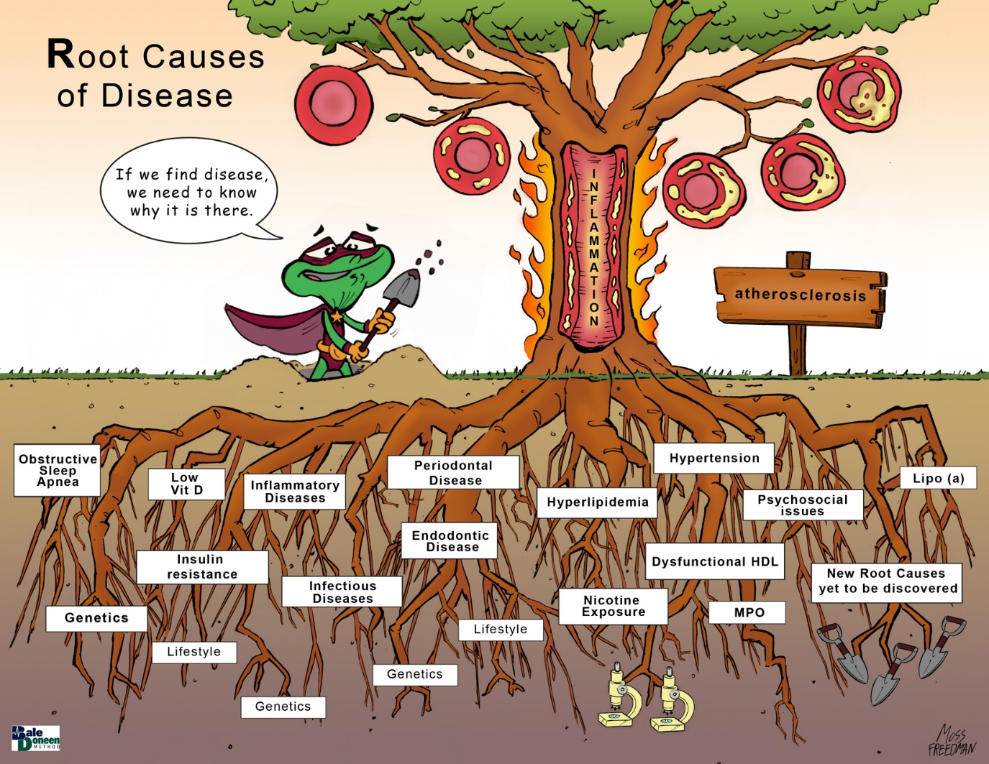
Concepts of Extremes in Vascular Aging
Laurent, S., Boutouyrie, P., Guimaraes Cunha, P., et al. (2019). Concept of extremes in vascular aging from early vascular aging to supernormal vascular aging. Hypertension. 2019;74:00-00. DOI: 10.1161

Slide 27
Concepts of Extremes in Vascular Aging
Laurent, S., Boutouyrie, P., Guimaraes Cunha, P., et al. (2019). Concept of extremes in vascular aging from early vascular aging to supernormal vascular aging. Hypertension. 2019;74:00-00. DOI: 10.1161

Slide 28
Concepts of Extremes in Vascular Aging
Scarce evidence supports that using cfPWV reduction as a treatment target would produce added reduction of major cardiovascular events.
A growing body of evidence shows that subjects with reduced cfPWV, either untreated or after treatment for several cardiovascular risk factors, have reduced risk of developing cardiovascular events.
Laurent, S., Boutouyrie, P., Guimaraes Cunha, P., et al. (2019). Concept of extremes in vascular aging from early vascular aging to supernormal vascular aging. Hypertension. 2019;74:00-00. DOI: 10.1161

Slide 29
Concepts of Extremes in Vascular Aging
Authors conclude that arterial stiffness should be more often measured in clinical practice to determine vascular aging and use the appropriate therapeutic options through an integrated approach for cardiovascular protection.
There is an urgent need for discovering novel molecular targets for slowing arterial aging and protecting against cardiovascular complications
Laurent, S., Boutouyrie, P., Guimaraes Cunha, P., et al. (2019). Concept of extremes in vascular aging from early vascular aging to supernormal vascular aging. Hypertension. 2019;74:00-00. DOI: 10.1161

Slide 30
The BaleDoneen Method has proven that we don’t need ‘novel’ ideas – we need to implement what we have already proven works to stabilize disease!

Slide 31
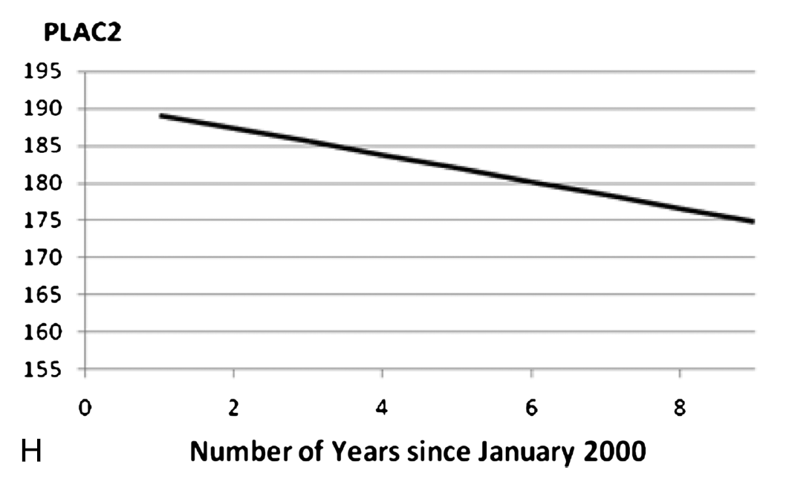
Concepts of Extremes in Vascular Aging
Laurent, S., Boutouyrie, P., Guimaraes Cunha, P., et al. (2019). Concept of extremes in vascular aging from early vascular aging to supernormal vascular aging. Hypertension. 2019;74:00-00. DOI: 10.1161

Slide 32
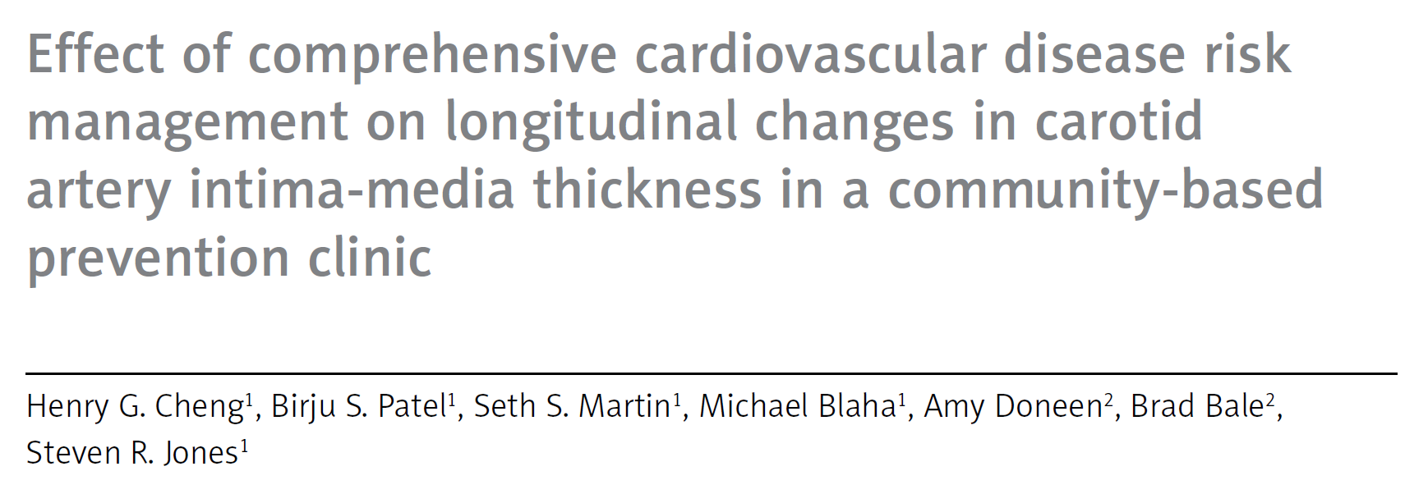
Concepts of Extremes in Vascular Aging
Laurent, S., Boutouyrie, P., Guimaraes Cunha, P., et al. (2019). Concept of extremes in vascular aging from early vascular aging to supernormal vascular aging. Hypertension. 2019;74:00-00. DOI: 10.1161

Slide 33
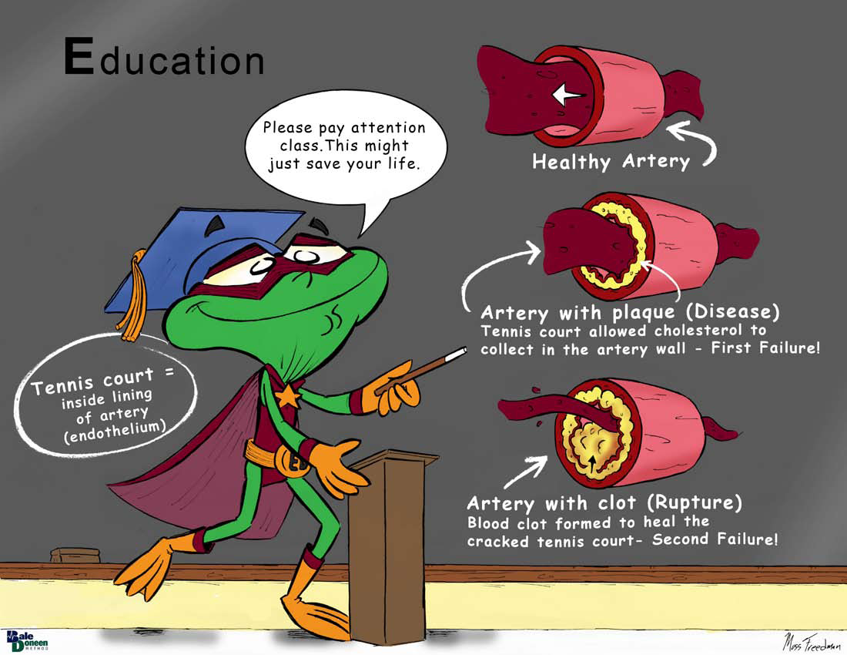

Slide 34
Is Neal stable?

Slide 35
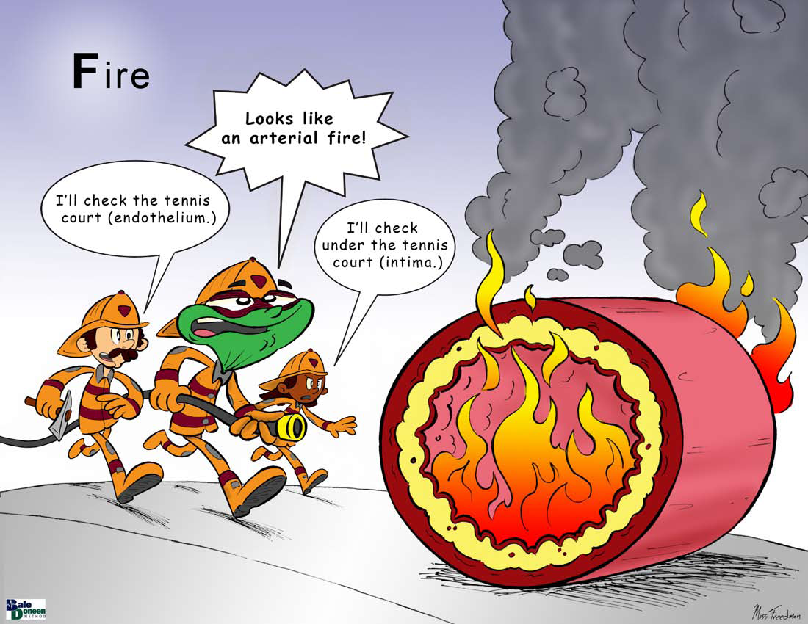

Slide 36
Let’s look at his inflammation
Bilirubin 0.5
F2-Iso 0.55
hsCRP 3.7
MACR 46
Lp-PLA2 115
MPO 127

Slide 37
The development of atherosclerotic plaque is derived from lipid retention within arterial intima that triggers an inflammatory cascade accelerating atherosclerosis progression and rendering plaque more prone to rupture.
The exposed subendothelial space with activated platelets causes arterial occlusion leading to potential fatality.
Therefore, a distinctive approach to characterize these features may offer the opportunity to tailor novel anti atherosclerotic to reduce the residual risk.
The traditional approach of measuring risk factors is beneficial at population-level but maybe less informative upon quantifying risk at an individual-basis
They are asking for the BaleDoneen Method!

Slide 38
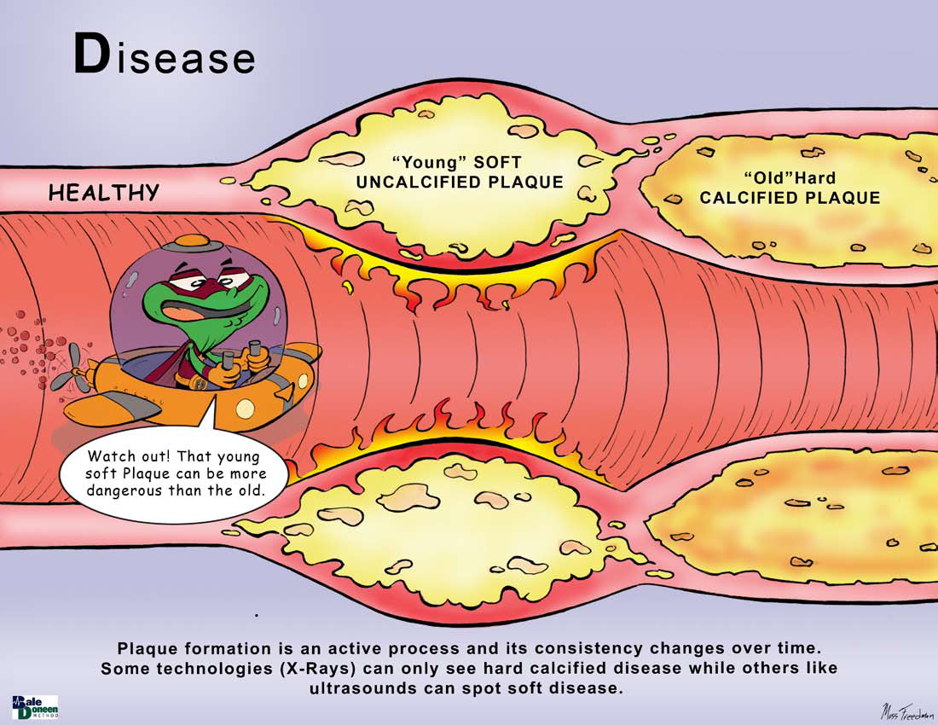

Slide 39
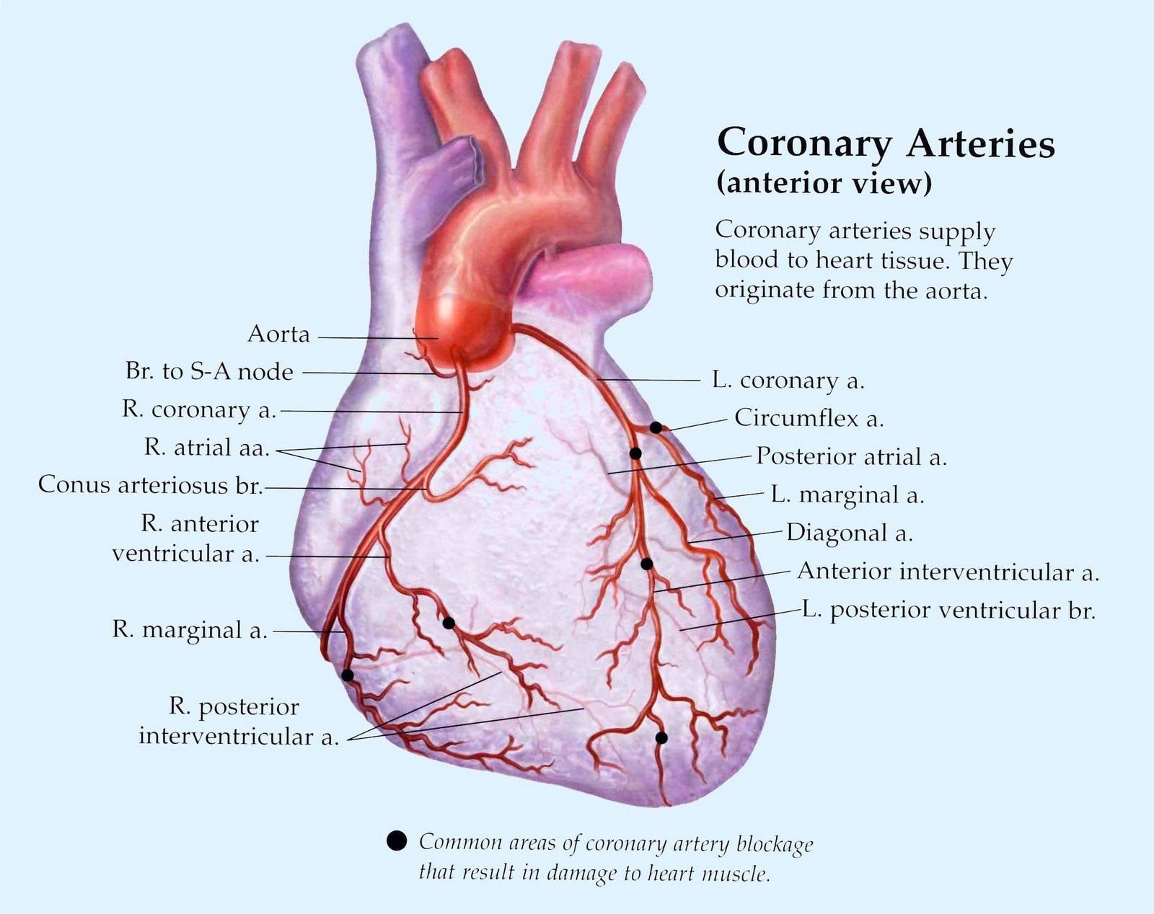
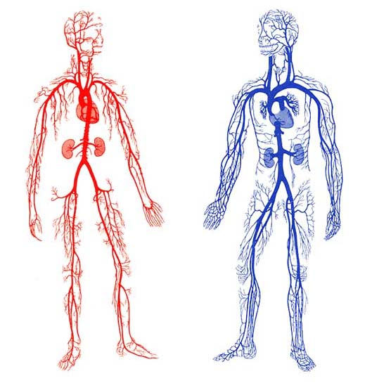

Slide 40
Let’s examine current data regarding Neal’s peripheral vascular disease

Slide 41
Peripheral Microvascular Function Reflects Coronary Vascular Function
Coronary endothelial dysfunction is a precursor of atherosclerosis and adverse outcomes.
Aimed to understand if endothelial dysfunction is a localized or generalized phenomenon in humans.
Simultaneously measured femoral and coronary vascular function with the hypothesis that peripheral vascular endothelial function will be reflective of coronary endothelial function.
Al-Badri, A., Kim, J., Puja, C. et al. (2019). Peripheral microvascular function reflects coronary vascular function. Arterioscler Thromb Vasc Biol. 2019;39:1492-1500. DOI: 10.1161/ATVBAHA.119.312378.

Slide 42
Peripheral Microvascular Function Reflects Coronary Vascular Function
Eighty-five subjects underwent coronary angiography for evaluation of chest pain or abnormal stress tests.
Endothelium-dependent and -independent vascular function were measured using intracoronary and intra femoral infusions of acetylcholine and sodium nitroprusside.
Coronary flow reserve was assessed using intracoronary adenosine infusion. Flow velocity was measured in each circulation using a Doppler wire.
Al-Badri, A., Kim, J., Puja, C. et al. (2019). Peripheral microvascular function reflects coronary vascular function. Arterioscler Thromb Vasc Biol. 2019;39:1492-1500. DOI: 10.1161/ATVBAHA.119.312378.

Slide 43
Peripheral Microvascular Function Reflects Coronary Vascular Function
Mean age was 53±11 years, 37% female, 44% HTN, 12% DM, and 38% had obstructive coronary artery disease.
Al-Badri, A., Kim, J., Puja, C. et al. (2019). Peripheral microvascular function reflects coronary vascular function. Arterioscler Thromb Vasc Biol. 2019;39:1492-1500. DOI: 10.1161/ATVBAHA.119.312378.

Slide 44
Peripheral Microvascular Function Reflects Coronary Vascular Function
Al-Badri, A., Kim, J., Puja, C. et al. (2019). Peripheral microvascular function reflects coronary vascular function. Arterioscler Thromb Vasc Biol. 2019;39:1492-1500. DOI: 10.1161/ATVBAHA.119.312378.

Slide 45
Peripheral Microvascular Function Reflects Coronary Vascular Function
There was a correlation between the change in femoral vascular resistance changes in both the coronary vascular resistance (r=0.27; P=0.014) and in the epicardial coronary artery diameter (r=−0.25; P=0.021).
Subjects with normal endothelial function in the femoral circulation had normal endothelial function in the coronary epicardial and microcirculation and vice versa.
Al-Badri, A., Kim, J., Puja, C. et al. (2019). Peripheral microvascular function reflects coronary vascular function. Arterioscler Thromb Vasc Biol. 2019;39:1492-1500. DOI: 10.1161/ATVBAHA.119.312378.

Slide 46
Peripheral Microvascular Function Reflects Coronary Vascular Function
Why is this data important for
Neal?
Moving forward – it is important that Neal understands that atherosclerosis is a systemic disease and therefore improvements in his peripheral vascular health translate to improvement in his heart as well and vise versa.
Al-Badri, A., Kim, J., Puja, C. et al. (2019). Peripheral microvascular function reflects coronary vascular function. Arterioscler Thromb Vasc Biol. 2019;39:1492-1500. DOI: 10.1161/ATVBAHA.119.312378.

Slide 47
Neal first discovered his vascular disease via a 4-way CABG with 13 stents to follow. He is now 51 years old. Is his disease stable?

Slide 48
Why does Neal have such aggressive vascular disease? What else can be done?

Slide 49
Ruled out….
Nickel allergy
Alpha 1 Antitrypsin (neg)
Factor V (neg)
Testosterone (302)
TSH (4.11)
CBC and CMP all WNL.
Anti-GAD, Anti-Islet Cell testing – r/o T1DM

Slide 50
So….what is being missed?

Slide 51
Nicotine
Endodontic Disease
lipids
Gut dysbiosis

Slide 52
Neal’s Lipids
Treated with Rosuvastatin 40 mg
Total Cholesterol 127
Triglycerides 103
HDL 34 * subs 3593 (goal >9000)
LDL 74
TC/HDL 3.7
TG/HDL 3.0
Apo B 74
Lipo(a) 4 - ok

Slide 53
PCSK9 Alirocumab Effectively Lowers Cholesterol and Reduces CV Events
2,341 high risk pts; LDL-C >70 mg/dL; on max tolerated statin rx; randomized 2:1 alirocumab 150mg subq q 2 wks or placebo; rx’ed 1 ½ yrs.
Primary outcome: change in LDL-C at 24 wks.
Secondary outcome: safety
Post hoc outcome: CV events
Robinson, J. G., et. al. 2015 Efficacy and Safety of Alirocumab in Reducing Lipids and Cardiovascular Events. New England Journal of Medicine, 0(0), null. doi: doi:10.1056/NEJMoa1501031

Slide 54
PCSK9 Alirocumab Effectively Lowers Cholesterol and Reduces CV Events
At 24 wks LDL-C reduced 62% compared to placebo- p<0.001 – sustained 1.5 yrs.
Robinson, J. G., et. al. New England Journal of Medicine, 0(0), null. doi: doi:10.1056/NEJMoa1501031
Notes:
Neurocognitive disorders were related primarily to memory.
no untoward effect with respect to the development or exacerbation of diabetes or with respect to levels of aminotransferases or creatine kinase.

Slide 55
PCSK9 Alirocumab Effectively Lowers Cholesterol and Reduces CV Events
MACE (MI, stroke, CV death, unstable angina) was significantly less in alirocumab arm (1.7% vs. 3.3%):
HR- 0.52 (95% CI: 0.31 to 0.90) p= 0.02
Robinson, J. G., et. al. New England Journal of Medicine, 0(0), null. doi: doi:10.1056/NEJMoa1501031

Slide 56
Nicotine
Sleep & Airway
Endodontic Disease
Hypertension
Gut dysbiosis

Slide 58
Neal’s Blood Pressure
First visit 5/6/2019
BP Right – 138/78
BP Left – 140/80
AM reads from home – 140-150/84-90
Current Treatment upon entry –
(note…rule of 3 note being observed)
Lisinopril 20 mg pm
Amlodipine 5 mg am
Metoprolol 12.5 mg BID

Slide 59
Let’s examine new data that supports perhaps identifying Neal’s OSA and tx with CPAP will help his stubborn blood pressure

Slide 60
Role of OSA in Refractory HTN
Overview of the association between refractory HTN (RfH) and obstructive sleep apnea (OHA).
RfH is defined as an extreme phenotype of resistant HTN characterized by the lack of blood pressure control despite using >5 antihypertensive drugs at optimal doses.
Authors state that the mechanism involved in resistant hypertension is fluid retention whereas in the case of RfH is the sympathetic over-activity.
Oscullo, G., Sapina-Beltran, E., Torres, G., et al. (2019). The potential role of obstructive sleep apnea in refractory hypertension. Current Hypertension Reports. (July 2019). 21:57.

Slide 61
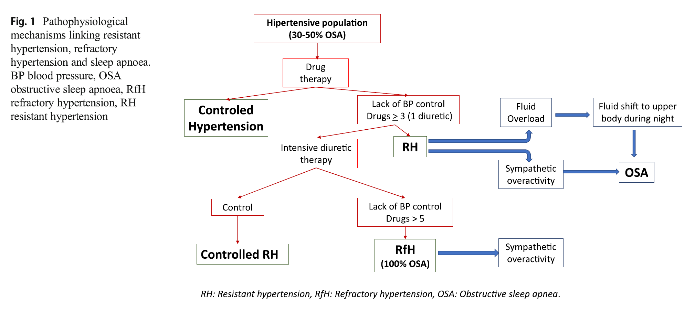
Role of OSA in Refractory HTN
Oscullo, G., Sapina-Beltran, E., Torres, G., et al. (2019). The potential role of obstructive sleep apnea in refractory hypertension. Current Hypertension Reports. (July 2019). 21:57.

Slide 62
Role of OSA in Refractory HTN
Oscullo, G., Sapina-Beltran, E., Torres, G., et al. (2019). The potential role of obstructive sleep apnea in refractory hypertension. Current Hypertension Reports. (July 2019). 21:57.

Slide 63
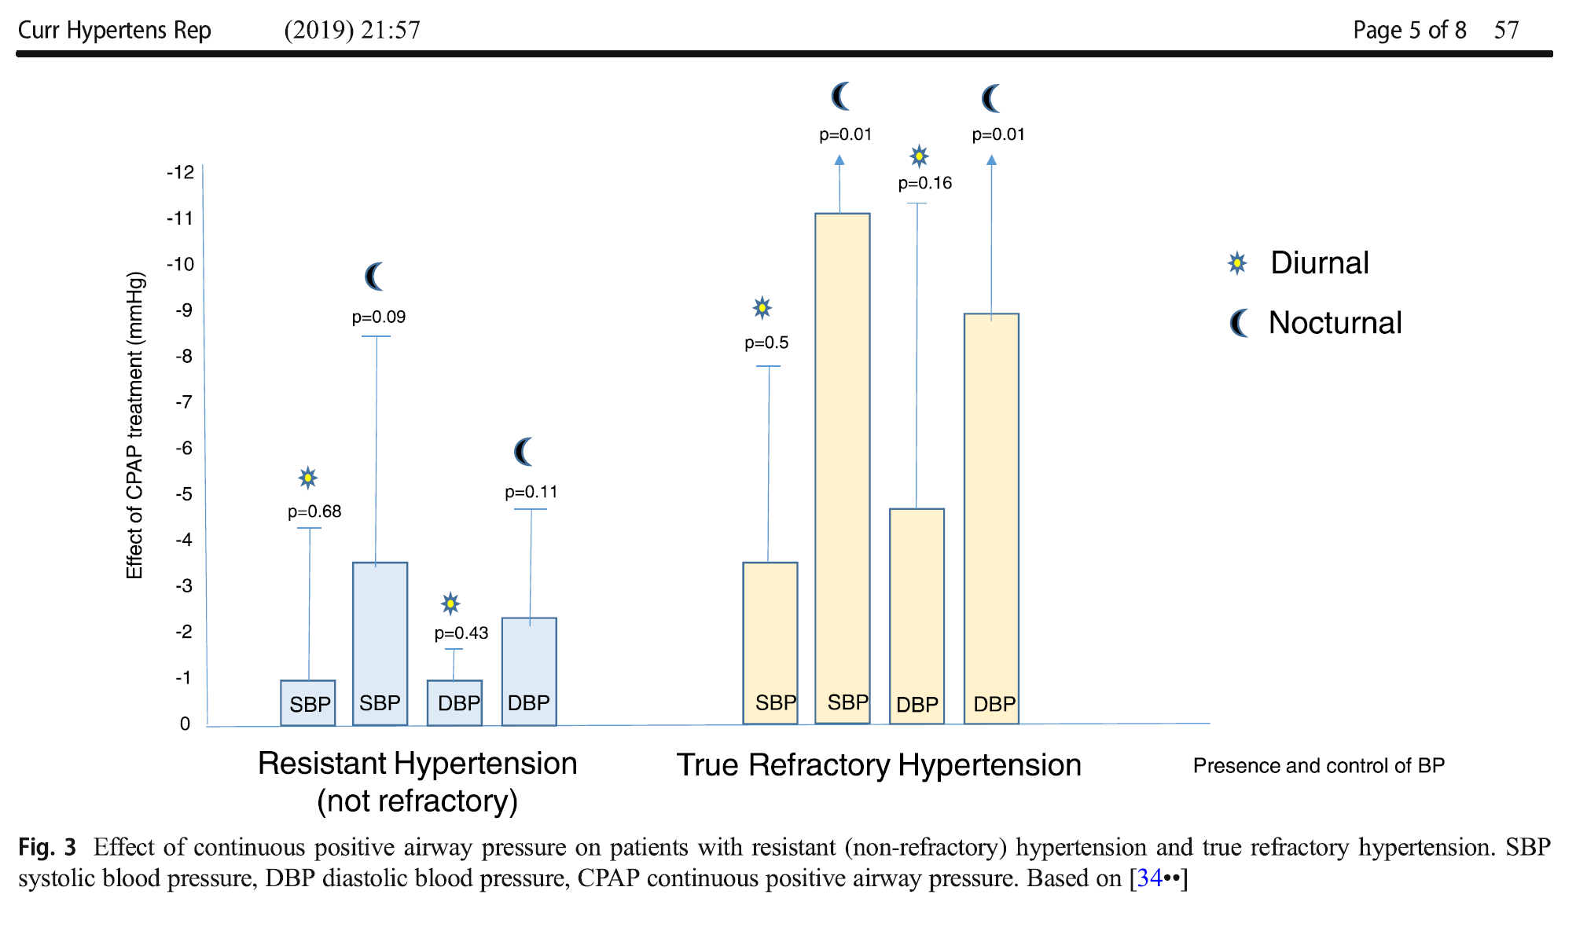
Role of OSA in Refractory HTN
Oscullo, G., Sapina-Beltran, E., Torres, G., et al. (2019). The potential role of obstructive sleep apnea in refractory hypertension. Current Hypertension Reports. (July 2019). 21:57.

Slide 64
Role of OSA in Refractory HTN
The prevalence of OSA in patients with RfH is very high.
CPAP treatment achieves a clinically significant reduction in blood pressure levels in those patients with RfH.
Patients with RfH must be sent to a sleep unit for a study.
Oscullo, G., Sapina-Beltran, E., Torres, G., et al. (2019). The potential role of obstructive sleep apnea in refractory hypertension. Current Hypertension Reports. (July 2019). 21:57.

Slide 65
Nicotine
Endodontic Disease
Insulin Resistance
Gut dysbiosis

Slide 66
Currently on sugar management but no tx for Insulin Resistance
Metformin 1000 mg BID
Invokana 300 mg BID

Slide 67
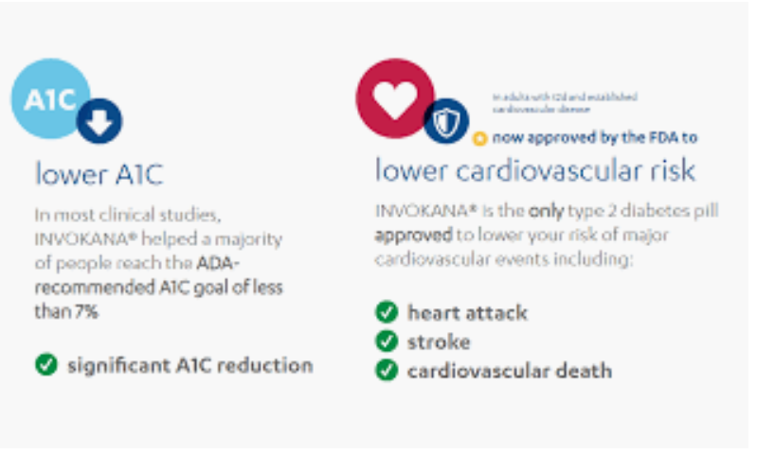
Cardiac and Renal Effects of Sodium-Glucose Co-Transporter 2 Inhibitors (SGLT2) in Diabetes
The largest CV outcome trial with this agent, DECLARE-TIMI 58, may help shed light on relative efficacy in prevention.
Zelniker, T. A., & Braunwald, E. (2018). Cardiac and Renal Effects of Sodium-Glucose Co-Transporter 2 Inhibitors in Diabetes.
Journal of the American College of Cardiology

Slide 68
SGLT2 Inhibitor Only has CV Benefits for HF
Study evaluated the CV outcomes of dapagliflozin vs placebo; over 17,000 DM with CV risk- ~60% ‘primary’ prevention; followed ~ 5 yrs.
A significant reduction was seen in the composite outcome of CV death and hospitalized HF.
The ONLY significant individual outcome benefit was with HEART FAILURE.
AstraZeneca announcement 9/25/2018 -DECLARE-TIMI 58.
more details to come at AHA meeting

Slide 69
“Does your type 2 diabetes treatment get to The Heart of what matters?”
Television Ads can be very misleading
“JARDIANCE and INVOKANA are the only type 2 diabetes medications proven to go beyond lowering A1C to reduce the risk of CV death for adults who have type 2 diabetes and heart disease.”

Slide 70
Does Neal have Heart Failure?
Despite having a 4-way CABG and 13 additional stents in his body – Neal does NOT have heart failure –
He has a preserved EF of 60%
NT ProBNP is 22
HsTnT is 0.4
Galectin 3 is 13.3
Neal has a systemic endothelial, arterial, inflammatory atherosclerosis – a highway problem!!!
One of Neal’s root causes is insulin resistance that went on so long he became diabetic before he was 45 years old and his sugars are being suboptimally treated and his insulin resistance isn’t being addressed at all!

Slide 71
Neal needs the numerous Benefits of Pioglitazone
Lower Free Fatty Acids
Improve HDL’s Efflux Capacity
Reduce TG/HDL ratio
Decrease ADMA & improve endothelial function
Reduce microalbumin-creat. ratio
Rapid anti-inflammatory effects:
MMP-9 & CRP- 3days; MCP- 10days
Creates anti-inflammatory macrophages
Glycemic benefits via liver, adipose tissue, beta cells & muscle.

Slide 72
Yamanouchi, T., (2005). Comparison of metabolic effects of pioglitazone, metformin, and glimepiride over 1 year in Japanese patients with newly diagnosed Type 2 diabetes. Diabetic Medicine, 22(8), 980-985.
Khera, A. V., & Rader, D. J. (2013). Cholesterol Efflux Capacity: Full Steam Ahead or a Bump in the Road? Arteriosclerosis, Thrombosis, and Vascular Biology, 33(7), 1449-1451
Nicholls, S. J., et. al. (2011). Lowering the Triglyceride/High-Density Lipoprotein Cholesterol Ratio Is Associated With the Beneficial Impact of Pioglitazone on Progression of Coronary Atherosclerosis in Diabetic Patients: Insights From the PERISCOPE (Pioglitazone Effect on Regression of Intravascular Sonographic Coronary Obstruction Prospective Evaluation) Study. J Am Coll Cardiol, 57(2), 153-159.
Staniloae, C., et. al. (2007). Pioglitazone improves endothelial function in non-diabetic patients with coronary artery disease. Cardiology, 108(3), 164-169.

Slide 73
Morikawa, A., et. al. (2011). Pioglitazone reduces urinary albumin excretion in renin-angiotensin system inhibitor-treated type 2 diabetic patients with hypertension and microalbuminuria: the APRIME study. Clin Exp Nephrol, 15(6), 848-853.
Forst, T., et. al. (2008). Pleiotrophic and anti-inflammatory effects of pioglitazone precede the metabolic activity in type 2 diabetic patients with coronary artery disease. Atherosclerosis, 197(1), 311-317.
Bloch, M., Prock, et. al. (2012). High-mobility group A1 protein: a new coregulator of peroxisome proliferator-activated receptor-gamma-mediated transrepression in the vasculature. Circ Res, 110(3), 394-405.
DeFronzo, R. A. (2009). From the Triumvirate to the Ominous Octet: A New Paradigm for the Treatment of Type 2 Diabetes Mellitus. Diabetes, 58(4), 773-795.

Slide 74
Pioglitazone Regressed CAD, Reduced Inflammation and Improved Endothelial Function in Pre-diabetics
30 pre-diabetic (2hr. -140-200 mg/dL) pts; 40-70% CAD lesions with thin caps and large necrotic core; randomized to 6 mos. pio 15mg/d or placebo; both got ‘standard’ rx
CAD results via IVUS beneficial for pio:
plaque burden decreased 10.3% p <0.05
thin-cap fibroatheroma prevalence 11% vs. 22% p < 0.05
necrotic core area 16.8% vs. 31.7% p < 0.05
Yang, H. B., et. al. (2012). Pioglitazone induces regression and stabilization of coronary atherosclerotic plaques in patients with impaired glucose tolerance. Diabet Med, 29(3), 359-365.
Notes:
This type of CAD lesions are usually associated with a high prevalence of coronary events (particularly revascularization)
prospective, randomized, placebo-controlled study
Indications for angiography were: (1) chest pain, or angina with painworsening
upon exertion or strenuous physical activity; (2) suspected Prinzmetal’s variant of angina pectoris; and (3) unexplained pain in the jaw, neck or arm (usually the left arm). Patients examed monthly.
standard therapy, included aspirin, b-blockers, nitrates (if necessary), ACEI or ARB All atorvastatin 20 mg daily for 3 months, followed by 10 mg
No significant differences were found in the baseline clinical variables between the two groups.
Fifty lesions from 30 patients were included in this study. Two patients withdrew prematurely because they did not wish to participate in the follow-up study. Hence, the results comprised 48 lesions from 28 patients.

Slide 75
Nicotine
Endodontic Disease
Vitamin D
Neal’s level is low at 23
Gut dysbiosis

Slide 76
Vit. D Levels Associated with Asymmetric Dimethylarginine (ADMA)
253 subjects aged 51-77
On univariate analyses, low vit. D (<30) was inversely correlated with concentrations of ADMA
Seasonal fluctuations in vit. D were associated with reciprocal ADMA concentration fluctuations
On multiple linear analysis, ADMA concentrations were inversely correlated with vit. D concentrations (β=−0.19, P=.003)
Ngo, D.T., BPharm, et. al. American Journal of Medicine,
April 2010. Vol. 123, Issue 4: 335-341
Notes:
other significant correlates were high-sensitivity C-reactive protein (β=−0.14, P=.03); male gender (β=0.19, P=.003), calcium levels (β=0.14, P=.03), and use of angiotensin-converting enzyme inhibitor (β=−0.17, P=.007).

Slide 77
Nicotine
Endodontic Disease
Periodontal Disease
Endodontal Disease
Gut dysbiosis

Slide 78
Oral Pathogens and Acute Heart Attack
101 acute heart attack pts; obstructing clot and arterial blood analyzed by PCR for oral pathogens
Bacterial DNA load 16 times greater in the clots than the arterial blood samples
Oral viridans streptococci found in 78% of thrombi; PD pathogens found in 35% of thrombi
Pessi, T., et. al. (2013). Bacterial signatures in thrombus aspirates of patients with myocardial infarction. Circulation, 127(11), 1219-1228, e1211-1216.
Notes:
consecutive patients with acute myocardial infarction (MI) treated with primary percutaneous coronary intervention (PCI) and successful thrombus aspirations; Aspiration of thrombi from the culprit artery
total bacterial DNA, candidate bacterial DNA for endodontic bacteria (Streptococcus sp. mainly Str. mitisgroup, Str. mitis, Str. oralis, Str. sanguinis & Str. gordonii, Streptococcus anginosus -group, Staphylococcus aureus, Staphylococcus epidermidis, Parvimonas micra and Prevotella intermedia) and periodontal bacteria (Porphyromonas gingivalis, Aggregatibacter (néé
Actinobacillus) actinomycetemcomitans, Fusobacterium nucleatum, Dialister pneumosintes, and Treponema denticola) as well as Chlamydia pneumoniae were determined in thrombus
All patients received aspirin and clopidogrel or prasugrel prior to the intervention. Bivalirudin was used in 55.4 % and glycoprotein IIb/IIIa inhibitors in 18.8%.
None of the samples contained DNA from Chlamydia pneumonia
Viridans streptococcus is a pseudotaxonomic non-Linnean term for a group of human commensals, most commonly found in the oral cavity. Traditionally, six groups have been classified as viridans streptococci: the Str. mitis group, Str. sanguinis group, Str. Mutans group, Str. salivarius group, Str. anginosus group, and Str. bovis group; 98% of oral streptococci belonged to two viridans streptococci groups: Str. mitis and Str. salivarius

Slide 79
Oral Pathogens and Acute Heart Attack
30 pts had panoramic CT imaging
~50% showed periapical abscess
If pt’s thrombus was positive for strep viridans DNA, they were 13 times more likely to have a periapical abscess
OR 13.2 (95% CI 2.11 – 82.5) p=0.004
Pessi, T., et. al. (2013). Bacterial signatures in thrombus aspirates of patients with myocardial infarction. Circulation, 127(11), 1219-1228, e1211-1216.
Notes:
Panoramic x-rays were assessed by a board certified dentist without knowledge of the clinical patient data. For every x-ray picture, 9 parameters of dental findings were scored.
The panoramic tomographies of the 30 MI patients showed that the most common dental findings were signs of dental treatment; fillings (one or more) in 86.7 %, and previous root canal treatments in 66.7 %; further pathological findings; furcating lesions in 63.3 %, vertical bone defects in 50.0 %, and periapical abscesses in 46.6 %; Of the periapical abscesses 33.3% coincided with previous root canal treatment.
There was also a link between periodontal bacteria and periapical abscess (OR 7.00, 1.14 - 43.0; p=0.046, Fisher’s exact test) but this did not remain
Significant after adjustment (p=0.115, logistic regression).

Slide 80
Interesting new data with PAD and endodontic disease – complements PESSI’s work.

Slide 81
Bacterial signatures in thrombus aspirates of patients with lower limb arterial and venous thrombosis
Bacterial inflammation has long been suggested to contribute to inflammation of atherosclerotic plaques, either directly or by indirect mechanisms, where inflammation at nonvascular sites can contribute to the progression of the lesions.
Vakhitov, D., Tuomisto, S., Martiskainen, M. et al. (2019). Bacterial signatures in thrombus aspirates of patients with lower limb arterial and venous thrombosis. J Vasc Surg 2018;67:1902-7.

Slide 82
Bacterial signatures in thrombus aspirates of patients with lower limb arterial and venous thrombosis
Proposed bacteria include respiratory pathogens and periodontal bacteria as well as bacteria from the gastrointestinal tract.
One group of common oral bacterial species, namely, Streptococcus mitis group, has been shown to have an exceptional ability to adhere to an endothelial surface and bind platelets.
Vakhitov, D., Tuomisto, S., Martiskainen, M. et al. (2019). Bacterial signatures in thrombus aspirates of patients with lower limb arterial and venous thrombosis. J Vasc Surg 2018;67:1902-7.

Slide 83
Bacterial signatures in thrombus aspirates of patients with lower limb arterial and venous thrombosis
Previous studies showed that S mitis group DNA was predominant in thrombus aspirates from coronary arteries and cerebral arterial wall samples in patients with acute coronary events and cerebral aneurysms.
Vakhitov, D., Tuomisto, S., Martiskainen, M. et al. (2019). Bacterial signatures in thrombus aspirates of patients with lower limb arterial and venous thrombosis. J Vasc Surg 2018;67:1902-7.

Slide 84
Bacterial signatures in thrombus aspirates of patients with lower limb arterial and venous thrombosis
The S mitis group comprises 13 species. Most of these bacteria can be found in the oral cavity of healthy individuals.
Based on these previous studies, it is likely that oral pathogens may play a certain role in the pathogenesis of cardiovascular diseases.
Vakhitov, D., Tuomisto, S., Martiskainen, M. et al. (2019). Bacterial signatures in thrombus aspirates of patients with lower limb arterial and venous thrombosis. J Vasc Surg 2018;67:1902-7.

Slide 85
Bacterial signatures in thrombus aspirates of patients with lower limb arterial and venous thrombosis
Inclusion criteria.
Patients with symptoms or signs of acute or acute-on-chronic lower limb ischemia presenting with angiographic evidence of native artery or bypass graft thrombosis and patients presenting with deep venous thrombosis of the iliofemoral segment with symptoms’ duration no longer than 2 weeks.
Vakhitov, D., Tuomisto, S., Martiskainen, M. et al. (2019). Bacterial signatures in thrombus aspirates of patients with lower limb arterial and venous thrombosis. J Vasc Surg 2018;67:1902-7.

Slide 86
Bacterial signatures in thrombus aspirates of patients with lower limb arterial and venous thrombosis
Thrombus aspirates and control blood samples taken from 42 patients with acute or acute-on-chronic lower limb ischemia were examined using a quantitative real-time polymerase chain reaction to detect all possible bacterial DNA and DNA of S-mitis group
arterial or graft thrombosis (n=31)
lower limb deep venous thrombosis (n=11)
The samples were considered positive, if the amount of bacterial DNA in the thrombus aspirates was 2-fold or greater in comparison with control blood samples.
Vakhitov, D., Tuomisto, S., Martiskainen, M. et al. (2019). Bacterial signatures in thrombus aspirates of patients with lower limb arterial and venous thrombosis. J Vasc Surg 2018;67:1902-7.

Slide 87
Bacterial signatures in thrombus aspirates of patients with lower limb arterial and venous thrombosis
In the positive samples the mean difference for the total bacterial DNA was 12.1-fold (median, 7.1), whereas the differences for S mitis group DNA were a mean of 29.1 and a median of 5.2-fold.
Of the arterial thrombus aspirates, 57.9% were positive for bacterial DNA, whereas bacterial genomes were found in 75% of bypass graft thrombosis with 77.8% of the prosthetic grafts being positive.
Vakhitov, D., Tuomisto, S., Martiskainen, M. et al. (2019). Bacterial signatures in thrombus aspirates of patients with lower limb arterial and venous thrombosis. J Vasc Surg 2018;67:1902-7.

Slide 88
Bacterial signatures in thrombus aspirates of patients with lower limb arterial and venous thrombosis
This is the first study to report the presence of bacterial DNA, predominantly of Streptococcus mitis group origin, in the thrombus aspirates of patients with lower limb arterial and deep venous thrombosis
Vakhitov, D., Tuomisto, S., Martiskainen, M. et al. (2019). Bacterial signatures in thrombus aspirates of patients with lower limb arterial and venous thrombosis. J Vasc Surg 2018;67:1902-7.

Slide 89
Nicotine
Endodontic Disease
Psychosocial
Gut dysbiosis

Slide 90
“No one can help me”
“I don’t want to die but nothing works”
“I am afraid of my systemic disease – including my brain health”
“I don’t know what to do?”

Slide 91
Quality of Life and Anxiety in Heart Failure Outpatients
The present results showed large impact of HF on Quality of Life (QOL) and moderate impact on anxiety.
This clinical syndrome is associated with substantial impairment of QOL by reducing patients’ ability to undertake prior daily activities or by deteriorating psychosocial state.
The HF patients define QOL as their ability to perform physical and social activities, to meet their needs, to maintain happiness and fulfill relationships with others.
Polikandrioti, M., Panoutsopoulos, G., Tsami, A., et al. (2019). Assessment of quality of life and anxiety in heart failure outpatients. Arch Med Sci Atheroscler Dis 2019:4:e38-e46.

Slide 92
Quality of Life and Anxiety in Heart Failure Outpatients
One hundred HF outpatients were enrolled in the study.
Data collection was performed by completion of the Minnesota Living with Heart Failure Questionnaire (MLHFQ), the Self-rating Anxiety Scale (SAS) and a questionnaire including patients’ characteristics.
Polikandrioti, M., Panoutsopoulos, G., Tsami, A., et al. (2019). Assessment of quality of life and anxiety in heart failure outpatients. Arch Med Sci Atheroscler Dis 2019:4:e38-e46.

Slide 93
Quality of Life and Anxiety in Heart Failure Outpatients
100 HF outpatients, 64% were men and 66% above 70 years old.
Quality of Life Evaluation:
MLHFQ Score: At least 50% of patients scored above 68 (median)
SAS Score: 50% scored above 46 (median).
A statistically significant correlation was observed between QOL and anxiety in HF outpatients (rho > 0.6, p < 0.001).
An increase in anxiety score by one unit implies a statistically significant worsening in QOL by 1.22 points (95% CI: 0.91–1.52, p < 0.001), after adjustment for potential confounders.
Polikandrioti, M., Panoutsopoulos, G., Tsami, A., et al. (2019). Assessment of quality of life and anxiety in heart failure outpatients. Arch Med Sci Atheroscler Dis 2019:4:e38-e46.

Slide 94
Quality of Life and Anxiety in Heart Failure Outpatients
Conclusions
The present findings emphasize the importance of alleviating the emotional burden of anxiety, thus improving patients’ Quality of Life.
Polikandrioti, M., Panoutsopoulos, G., Tsami, A., et al. (2019). Assessment of quality of life and anxiety in heart failure outpatients. Arch Med Sci Atheroscler Dis 2019:4:e38-e46.

Slide 95
Neal’s perceived stress
Neal and Anne felt hopeless when I first met them – they had a definite feeling of lack of control over their environment.
What does Neal’s perceived stress do to his arterial health?

Slide 96
Depression, Anxiety, Perceived Stress and their changes predict greater decline in physical health functioning in pts with CHD.
The deleterious impact of psychological distress on patients with coronary heart disease (CHD) is recognized, few studies have examined the influence of change in psychological distress on health outcomes over time.
Shen, B-J., Fan, Y., Lim, K.S., Tay, H. (2019). Depression, anxiety, perceived stress, and their changes predict greater decline in physical health functioning over 12 months among patients with CHD. International Journal of Behavioral Medicine. https://doi.org. July 2019.

Slide 97
Depression, Anxiety, Perceived Stress and their changes predict greater decline in physical health functioning in pts with CHD.
This study investigated whether three common manifestations of distress (depression, anxiety, and perceived stress) and their changes predicted the decline in physical functioning in CHD patients over 12 months.
In addition, perceived social support was examined as a buffer of psychological distress or a direct predictor of physical functioning.
Shen, B-J., Fan, Y., Lim, K.S., Tay, H. (2019). Depression, anxiety, perceived stress, and their changes predict greater decline in physical health functioning over 12 months among patients with CHD. International Journal of Behavioral Medicine. https://doi.org. July 2019.

Slide 98
Depression, Anxiety, Perceived Stress and their changes predict greater decline in physical health functioning in pts with CHD.
Participants were 255 CHD patients with a mean age of 63 years, including 208 men and 47 women.
Psychological distress and physical functioning were assessed at baseline, 6 months and 12 months.
All models were adjusted for baseline physical functioning, age, gender, marital status, education, BMI, and time at a wellness Ctr
Shen, B-J., Fan, Y., Lim, K.S., Tay, H. (2019). Depression, anxiety, perceived stress, and their changes predict greater decline in physical health functioning over 12 months among patients with CHD. International Journal of Behavioral Medicine. https://doi.org. July 2019.

Slide 99
Depression, Anxiety, Perceived Stress and their changes predict greater decline in physical health functioning in pts with CHD.
For each psychological distress variable
(depression, anxiety, or perceived stress),
Independently and significantly predicted greater decline in physical functioning at 6 and 12 months
(p <0.001)
Shen, B-J., Fan, Y., Lim, K.S., Tay, H. (2019). Depression, anxiety, perceived stress, and their changes predict greater decline in physical health functioning over 12 months among patients with CHD. International Journal of Behavioral Medicine. https://doi.org. July 2019.

Slide 100
Depression, Anxiety, Perceived Stress and their changes predict greater decline in physical health functioning in pts with CHD.
Perceived social support predicted greater improvement in physical functioning at 12 months (β = 0.13, p = 0.050), but it did not buffer impact of psychological distress.
Findings underscore the importance of monitoring various forms of psychological distress continuously over time for CHD patients
Shen, B-J., Fan, Y., Lim, K.S., Tay, H. (2019). Depression, anxiety, perceived stress, and their changes predict greater decline in physical health functioning over 12 months among patients with CHD. International Journal of Behavioral Medicine. https://doi.org. July 2019.

Slide 101
Depression, Anxiety, Perceived Stress and their changes predict greater decline in physical health functioning in pts with CHD.
Take away for Neal and Anne –
1. Family and personal counseling
2. Even after first visit – they both verbally stated they feel “hopeful” and “glad to have a plan” and “we feel heard”.
3. Emphasize the importance of a partnership.
4. Education provides knowledge – which in turn gives Neal and Anne a sense of control over their situation.
5. Mindfulness data is powerful – biofeedback with MUSE
Shen, B-J., Fan, Y., Lim, K.S., Tay, H. (2019). Depression, anxiety, perceived stress, and their changes predict greater decline in physical health functioning over 12 months among patients with CHD. International Journal of Behavioral Medicine. https://doi.org. July 2019.

Slide 102
Nicotine
Endodontic Disease
Gut dysbiosis
Lifestyle

Slide 103
Antiaging Effects of Aerobic Exercise on Systemic Arteries
Tanaka, H. (2019). Antiaging effects of aerobic exercise on systemic arteries. Hypertension. 2019;74:00-00. DOI: 10.1161/HYPERTENSIONAHA.119.13179.

Slide 104
Antiaging Effects of Aerobic Exercise on Systemic Arteries
The precise mechanisms underlying the beneficial effects of physical activity are unclear but have been attributed to improvements in traditional CVD risk factors such as BP, Lipids, and obesity.
However, the contribution of these various risk factors to the physical activity– related risk reduction in coronary heart disease and CVD is surprisingly small with only 35% to 60% can be explained by a comprehensive list of 7 traditional risk factors.
Tanaka, H. (2019). Antiaging effects of aerobic exercise on systemic arteries. Hypertension. 2019;74:00-00. DOI: 10.1161/HYPERTENSIONAHA.119.13179.

Slide 105
Antiaging Effects of Aerobic Exercise on Systemic Arteries
Tanaka, H. (2019). Antiaging effects of aerobic exercise on systemic arteries. Hypertension. 2019;74:00-00. DOI: 10.1161/HYPERTENSIONAHA.119.13179.

Slide 106
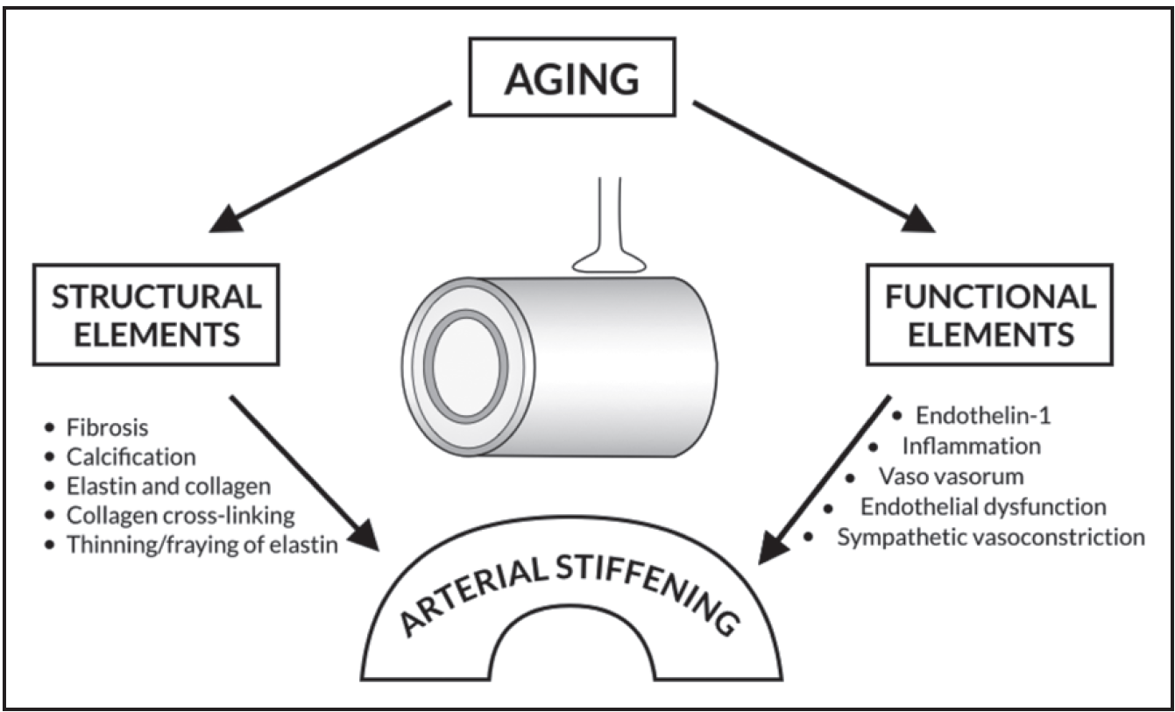
Antiaging Effects of Aerobic Exercise on Systemic Arteries
Tanaka, H. (2019). Antiaging effects of aerobic exercise on systemic arteries. Hypertension. 2019;74:00-00. DOI: 10.1161/HYPERTENSIONAHA.119.13179.

Slide 107
Antiaging Effects of Aerobic Exercise on Systemic Arteries
1. Cross-sectional studies on aerobic exercise
2. Interventional studies on aerobic exercise
3. Physiological Mechanisms
The ability to modify arterial stiffness over a period of days or weeks is thought to be because of modulation of the contractile states and intrinsic stiffening of the vascular smooth muscle cells in the arterial wall
Sympathetic adrenergic vasoconstrictor tone acting on the vasculature was removed with regular aerobic exercise.
4. Effects of Resistance training
5. Effects of Cross Training
6. Exercise as part of the hybrid/Adjunct Therapy
Tanaka, H. (2019). Antiaging effects of aerobic exercise on systemic arteries. Hypertension. 2019;74:00-00. DOI: 10.1161/HYPERTENSIONAHA.119.13179.

Slide 108
Nicotine
Endodontic Disease
Gut Dysbiosis
Gut dysbiosis

Slide 109
Specific guidance for Neal – avoid gluten, take pre and pro biotics, avoid ALL soda, eat fermented foods, etc.
Regarding 400 iu natural source tocopherol…….no – despite being T2DM, he is not Hp 2-2.
Maintain optimal (tight) glucose control
(currently suboptimal with A1C 7.5 with FBS 155).

Slide 111
Neal’s Genetics related to his arterial health
Apo E 3/4
9P21 +/+
LPA -/-
KIF 6 +/+
Hp 1-2
4Q25 +/-

Slide 113
Neal’s comments from last visit 6/25/2019
“For the first time in 12 years, I feel like I have a plan and that I am part of that plan.”
“I hope it isn’t too late for me, but I truly thank you for the time, education and passion for helping me.”
From Anne – “Thank you for giving us hope.”
“Oh ya – meant to tell you – this is expensive but not as much as all the stents and I’m not buying soda anymore so I’m saving money!” ☺

