Slide 1
BaleDoneen Scientific Update
07/12/2023
5:30-6:30 pm PST
Bradley Bale, MD

Slide 2
Happy July 12th- National Simplicity Day
In honor of Henry David Thoreau DOB: 07/12/1817
He advocated living simply.
“In wilderness is the preservation of the world.”
Wishing everyone a wilderness retreat this summer.
Nature is saturated with sanity as opposed to civilization.

Slide 3
Green and Blue Spaces Enhance Mental Health
Numerous scientific studies illustrate the importance of the natural environment for mental and physical well-being.
Two systemic reviews demonstrated numerous health benefits from being immersed in nature.
Green and blue spaces and mental health: new evidence and perspectives for action. Copenhagen: WHO
Regional Office for Europe; 2021. Licence: CC BY-NC-SA 3.0 IGO.
.

Slide 4
Green and Blue Spaces Enhance Mental Health
Benefits from green & blue natural spaces include:
improved short-term and long-term mental health
positive effect on affect
beneficial effects on perceived stress
positive effects on quality of life & subjective well-being
Green and blue spaces and mental health: new evidence and perspectives for action. Copenhagen: WHO
Regional Office for Europe; 2021. Licence: CC BY-NC-SA 3.0 IGO.
.

Slide 5
Green and Blue Spaces Enhance Mental Health
Nature improves mental health which is defined as:
A state of well-being in which a person realizes their abilities, can cope with the normal stresses of life, work productively and is able to contribute to their community.
Healthcare professionals need to be aware of this science so they can promote natural spaces as medicine.
Green and blue spaces and mental health: new evidence and perspectives for action. Copenhagen: WHO
Regional Office for Europe; 2021. Licence: CC BY-NC-SA 3.0 IGO.
.

Slide 6
Exposure to Nature is Associated With Reduced Need for Psychotropic, BP & Asthma Meds
Cross-sectional study 5,987 subjects in Finland; 57% female; 699 athmatics; 1,625 hypertensives; 1,195 on psychotropic meds; surveyed for frequency of visits to natural environments.
Question: is there an association btw frequency of being in a natural space and use of medication for above conditions.
Turunen, A. W., et al. (2023). "Cross-sectional associations of different types of nature exposure with psychotropic, antihypertensive and asthma medication." Occupational and Environmental Medicine 80(2): 111-118.

Slide 7
Exposure to Nature is Associated With Reduced Need for Psychotropic, BP & Asthma Meds
Comparing <1 natural space visit/wk to 3-4 visits/wk, more frequent visits were assoc. with less med :
Psychotropic – OR- 0.67 (95% CI, 0.55- 0.82)
BP med – OR- 0.64 (95% CI, 0.52- 0.78)
Asthma med – OR- 0.74 (95% CI, 0.58 to 0.94)
Turunen, A. W., et al. (2023). "Cross-sectional associations of different types of nature exposure with psychotropic, antihypertensive and asthma medication." Occupational and Environmental Medicine 80(2): 111-118.

Slide 8
Forest Bathing Reduces BP and Improves Mental Health
155 pts; 55% female; mean age 44; day long outing with a 2 hr session of forest bathing; assessed pre and post BP and mood state.
All pts showed significant decreases in both Sys (130 to 121) and Dias (78 to 73) BP as well as enhanced mood.
Furuyashiki, A., et al. (2019). "A comparative study of the physiological and psychological effects of forest bathing (Shinrin-yoku) on working age people with and without depressive tendencies." Environ Health Prev Med 24(1): 46.

Slide 9
Inhaling Natural Organic Forest Compounds Enhance Health
This study demonstrated that inhaling volatile organic chemicals like limonene and pinene while in the forest enhanced health.
There was decreased mental fatigue, increased relaxation, enhance cognitive function and improved mood.
Antonelli, M., et al. (2020). "Forest Volatile Organic Compounds and Their Effects on Human Health: A State-of-the-Art Review." Int J Environ Res Public Health 17(18).
.

Slide 10
Nature Restores Cognitive Function in Children
33 pts; mean age 12; 61% female; two 30 min. walks; one day in urban area & other day in a rural area; cognitive function testing after each walk was performed.
Following the 30 min. rural walk children had faster, more stable pattern of responses to a series of attention-related tests than they did after walking through an urban area.
Stevenson, M. P., et al. (2019). "Cognitive Restoration in Children Following Exposure to Nature: Evidence From the Attention Network Task and Mobile Eye Tracking." Front Psychol 10: 42.

Slide 11
Biophilia Hypothesis
Why nature has a medicinal effect on mind and body.
Humans have an innate desire to connect with nature and other forms of life.
Barbiero, G. and R. Berto (2021). "Biophilia as Evolutionary Adaptation: An Onto- and Phylogenetic Framework for Biophilic Design." Frontiers in Psychology 12.

Slide 12
Viewing Nature Stimulates Mindfulness
Observing natural complex patterns such as ferns, flowers, mountains and ocean waves induces greater brain alpha wave activity.
This activity is associated with a relaxed wakeful state of internalized attention.
Hagerhall, C. M., et al. (2015). "Human physiological benefits of viewing nature: EEG responses to exact and statistical fractal patterns." Nonlinear Dynamics Psychol Life Sci 19(1): 1-12.

Slide 13
Natural Sounds Are Healing
This study quantifies the restorative effects on health of natural soundscapes.
The sounds from birds, other animals, wind and water are associated with reduced stress and annoyance, decreased pain and improved mood.
Buxton, R. T., et al. (2021). "A synthesis of health benefits of natural sounds and their distribution in national parks." Proceedings of the National Academy of Sciences 118(14): e2013097118.
.

Slide 14
Short Natural Breaks Can Improve Mood and Cognitive Function
“Remembering to take the small opportunities to be in natural spaces and soaking up longer times when possible can help your mind, body, and spirit.”
“Take nature breaks to regroup and refresh your mind—by walking in a nearby park or garden during your lunch hour.”
“Even if nature has not been part of someone’s life, it’s never too late to add nature experiences to your life to improve well-being.”
Eileen Anderson, Professor of Bioethics at Case Western Reserve U School of Medicine
.

Slide 15
Interactive Journal to Assist in Connecting With Nature
It is full of calming art, photography, and inspirational quotes, offering prompts and activities that deepen your experience with nature.
“There is no better designer than nature”
Alexander McQueen, designer
Grounded: A Guided Journal to Help You Reconnect with the Power of Nature—and Yourself. By Patricia H. Hasbach

Slide 16
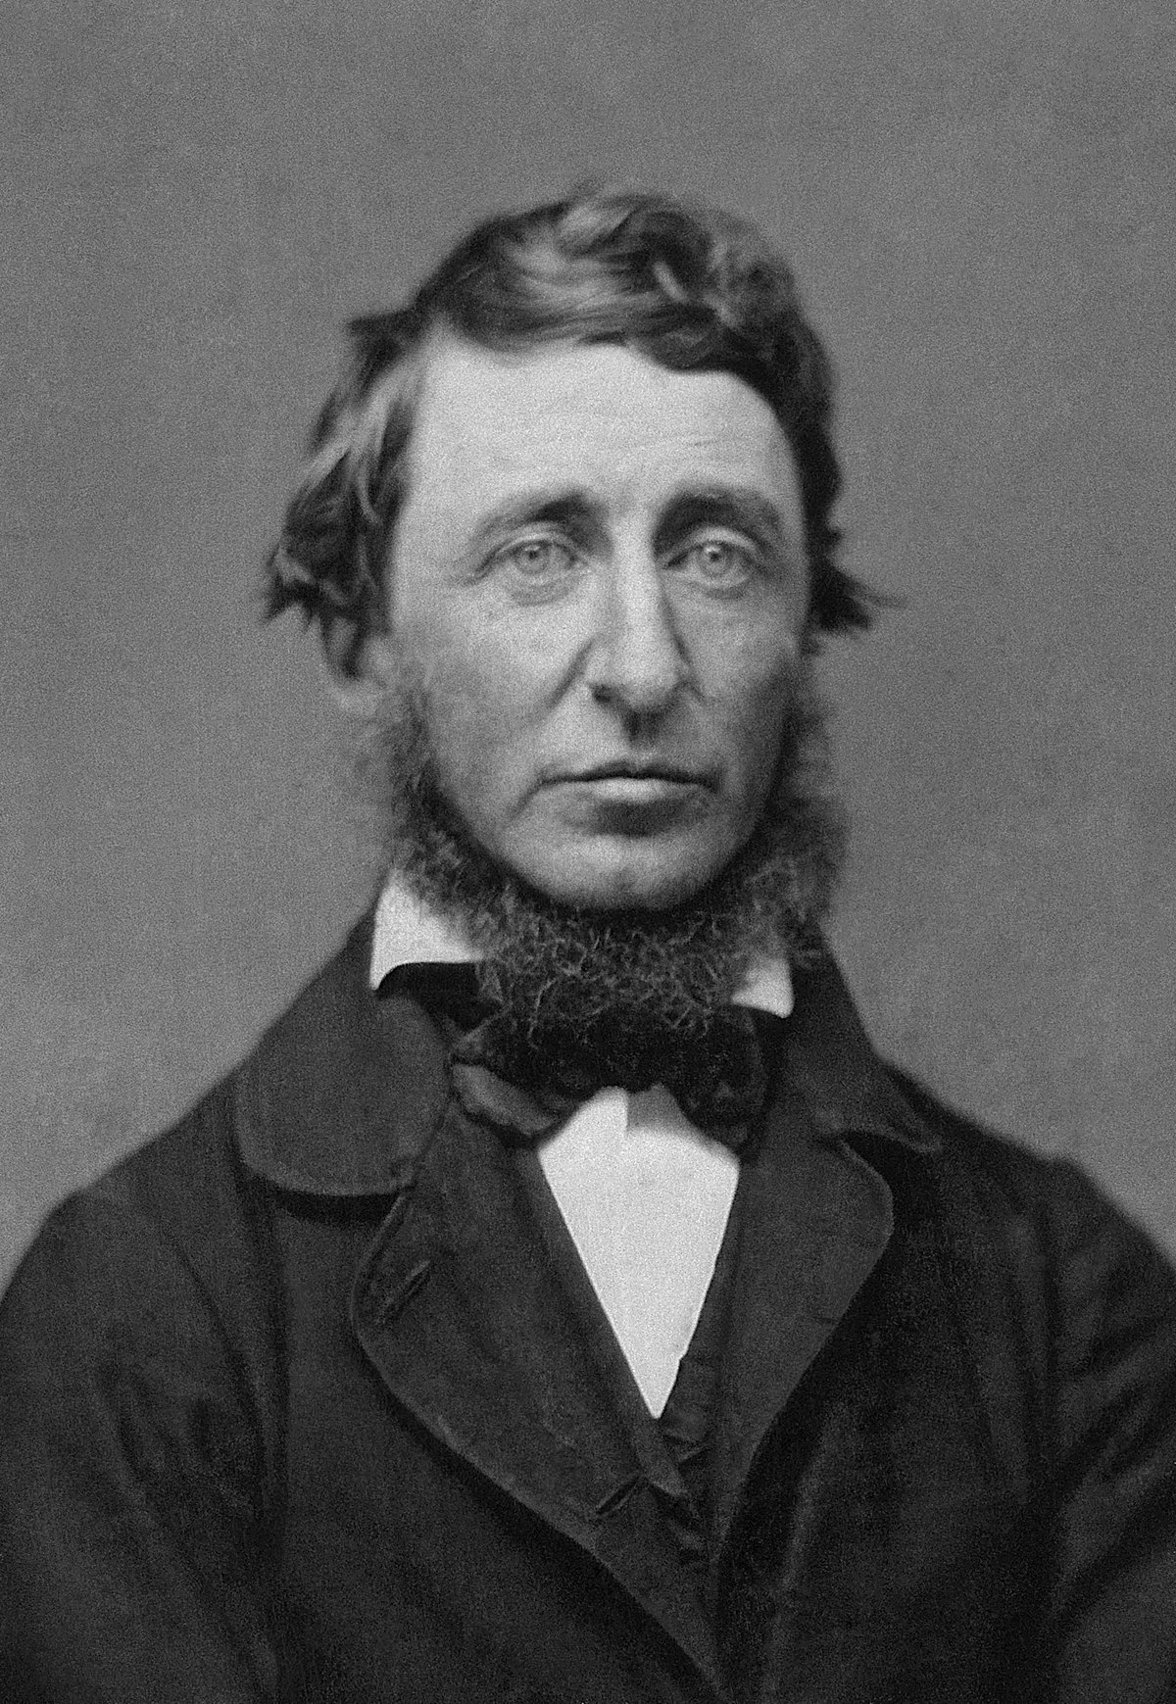
“Nature is full of genius, full of the divinity; so that not a snowflake escapes its fashioning hand.”
Henry David Thoreau

Slide 17
As healthcare providers, we need to promote nature as medicine.
Pierre Leimgruber
Alaska July 2023

Slide 18
New Studies for July 12, 2023 Scientific Update Session
1. Nissen, S. E., et al. (2023). "Bempedoic Acid and Cardiovascular Outcomes in Statin-Intolerant Patients." N Engl J Med 388(15): 1353-1364.
2. Alexander, J. H. (2023). "Benefits of Bempedoic Acid - Clearer Now." N Engl J Med 388(15): 1425-1426.
3. Nissen, S. E., et al. (2023). "Bempedoic Acid for Primary Prevention of Cardiovascular Events in Statin-Intolerant Patients." JAMA. Online June 24,2023. doi:10.1001/jama.2023.9696
4. Kazi, D. S. (2023). "Bempedoic Acid for High-Risk Primary Prevention of Cardiovascular Disease: Not a Statin Substitute but a Good Plan B.“ JAMA

Slide 19
New Studies for July 12, 2023 Scientific Update Session
5. Yogev, Y., et al. (2023). "Limb girdle muscular disease caused by HMGCR mutation and statin myopathy treatable with mevalonolactone." Proceedings of the National Academy of Sciences - PNAS 120(7): e2217831120-e2217831120.
6. Morales-Rosado, J. A., et al. (2023). "Bi-allelic variants in HMGCR cause an autosomal-recessive progressive limb-girdle muscular dystrophy." The American Journal of Human Genetics 110(6): 989-997.
7. Riesen, W. F. (2023). "Pleiotropic Effects of Statins-What is their Clinical Significance?" Journal of Biotechnology and Biomedicine 6(1): 92-94.

Slide 20
New Studies for July 12, 2023 Scientific Update Session
8. Vell, M. S., et al. (2023). "Association of Statin Use With Risk of Liver Disease, Hepatocellular Carcinoma, and Liver-Related Mortality." JAMA Network Open 6(6): e2320222-e2320222.
9. Ahmadi, Y., et al. (2020). "The effects of statins with a high hepatoselectivity rank on the extra-hepatic tissues; New functions for statins." Pharmacological Research 152: 104621.

Slide 21
CLEAR benefit of bempedoic acid!!!

Slide 22
Bempedoic Acid (BA) Reduces CV Risk
RDBPCT; 13,970 pts intolerant of statins, however 23% were on a statin; all other lipid rx allowed including niacin; high CV risk; 18-85 yo; mean age 65.5; 48% female; 46% DM; 70% hx of CV event; mean LDL>139mg/dL; median TG 159 mg/dL; median hsCRP 2.3; randomized to BA 180mg or placebo; follow-up median ~ 3 ½ yrs.
Primary outcome: composite of CV death, nonfatal MI, nonfatal stroke, and coronary revascularization.
Nissen, S. E., et al. (2023). "Bempedoic Acid and Cardiovascular Outcomes in Statin-Intolerant Patients." N Engl J Med 388(15): 1353-1364.
Notes:
Excluded from study if TG >500mg/dL, CV event within 90 days, severe HF, uncontrolled BP or DM.

Slide 23
Bempedoic Acid (BA) Reduces CV Risk
Outcome was significantly lower (13%) with BA.
RR-0.87 (95% CI, 0.79-0.96) p=0.004
The significance was driven by non-fatal MI & revascularization.
RR-0.77 (95% CI, 0.66-0.91) p=0.002
RR-0.81 (95% CI, 0.72-0.92) p=0.001
Nissen, S. E., et al. (2023). "Bempedoic Acid and Cardiovascular Outcomes in Statin-Intolerant Patients." N Engl J Med 388(15): 1353-1364.

Slide 24
Bempedoic Acid (BA) Reduces CV Risk
Non-fatal stroke and CV death (fatal MI & stroke) were not reduced with BA.
RR-0.85 (95% CI, 0.67-1.07) p=0.16
RR-1.04 (95% CI, 0.88-1.24)
However, the results sorting strokes into hemorrhagic and non-hemorrhagic are interesting.
Nissen, S. E., et al. (2023). "Bempedoic Acid and Cardiovascular Outcomes in Statin-Intolerant Patients." N Engl J Med 388(15): 1353-1364.

Slide 25
Bempedoic Acid (BA) Reduces CV Risk
*
*
*
* Significant benefit with BA; * ? significant harm from BA
Nissen, S. E., et al. (2023). "Bempedoic Acid and Cardiovascular Outcomes in Statin-Intolerant Patients." N Engl J Med 388(15): 1353-1364.

Slide 26
Bempedoic Acid (BA) Reduced LDL-C & hs-CRP
Mean LDL-C was 139 mg/dL
P lowered to 124 mg/dL
BA lowered to 103 mg/dL
= BA lowered LDL-C 21 mg/dL more than P
(~15%)
Mean hs-CRP was 2.3 mg/L
P lowered to 2.2 mg/L
BA lowered to 1.9 mg/L (17%)
=BA lowered hs-CRP ~ 0.3 mg/L
more than P
(~13%)
Nissen, S. E., et al. (2023). "Bempedoic Acid and Cardiovascular Outcomes in Statin-Intolerant Patients." N Engl J Med 388(15): 1353-1364.

Slide 27
Bempedoic Acid (BA) Adverse Reactions
Myalgia occurred in 5.6% BA pts & 6.8% placebo.
Hyperuricemia occurred in 10.9% BA pta & 5.6% placebo.
Cholelithiasis occurred in 2.2% BA & 1.2% placebo.
Hepatic enzyme elevation >3X ULN occurred more in BA.
Nissen, S. E., et al. (2023). "Bempedoic Acid and Cardiovascular Outcomes in Statin-Intolerant Patients." N Engl J Med 388(15): 1353-1364.

Slide 28
Bempedoic Acid (BA) Adverse Reactions
The absolute difference in composite primary outcome was 1.6% lower with BA.
In statin intolerant pts, BA lowers MACE risk.
Nissen, S. E., et al. (2023). "Bempedoic Acid and Cardiovascular Outcomes in Statin-Intolerant Patients." N Engl J Med 388(15): 1353-1364.

Slide 29
BA Reduces CV Risk- Editorial
John H. Alexander
Director and Professor of Medicine
Duke University School of Medicine, Durham, NC, US
High-intensity statin rx is recommended for all pts with established ASVD, as well as those at high CVD risk.
~ 10% of pts who would benefit from statins develop muscle-related symptoms which preclude them from taking the medication.
Alexander, J. H. (2023). "Benefits of Bempedoic Acid - Clearer Now." N Engl J Med 388(15): 1425-1426.
.

Slide 30
BA Reduces CV Risk- Editorial
BA is an attractive alternative rx for such pts, but evidence of its ability to reduce CV events has been lacking.
The results of this study are compelling with a 13% decreased risk of the composite outcome of CV death, nonfatal MI, nonfatal stroke and coronary revascularization.
Alexander, J. H. (2023). "Benefits of Bempedoic Acid - Clearer Now." N Engl J Med 388(15): 1425-1426.
.

Slide 31
BA Reduces CV Risk- Editorial
However, it is premature to consider BA as an alternative to statins.
The evidence of the vascular benefits of statins, is overwhelming.
Alexander, J. H. (2023). "Benefits of Bempedoic Acid - Clearer Now." N Engl J Med 388(15): 1425-1426.
.

Slide 32
BA Reduces CV Risk- Editorial
Clinicians should continue to prescribe statins at the maximum tolerated doses even in pts who have discontinued them because of presumed side effects.
Although BA reduces the LDL-C in pts taking statins, the clinical benefits of BA added to standard statin rx are unknown.
Alexander, J. H. (2023). "Benefits of Bempedoic Acid - Clearer Now." N Engl J Med 388(15): 1425-1426.
.

Slide 33
BA Reduces CV Risk- Editorial
It should be noted that BA had no effect on mortality.
However, it is also note worthy that it took meta-analysis of multiple statin trials to demonstrate a mortality benefit.
Alexander, J. H. (2023). "Benefits of Bempedoic Acid - Clearer Now." N Engl J Med 388(15): 1425-1426.
.

Slide 34
BDM Thoughts
In terms of lipid lowering, the trial seems very messy with numerous other lipid lowering agents in place including statins in ~ a quarter of the patients.
Compared to the BDM the outcome results were pathetic with 11.7% of BA pts and 13.3% of P pts suffering a MACE.
Therefore, it is obvious that many pts had unmanaged conditions causing OS.
Investigators are ‘hung up’ on believing outcomes are mainly driven by LDL-C reduction.
We would conjecture that optimally managing all the sources of OS (which does not even include LDL-C until it is trapped) would generate much better results than adding in BA.

Slide 35
BDM Thoughts
The goal of therapy is to prevent CV events both loud and silent.
This requires shutting down the first step in the pathogenesis of atherosclerosis.
This demands halting the transformation of cSMCs to msSMCs.
LDL-C is simply the fuel ramping up the fire when proteoglycans are generated in the intima by msSMCs.
If this ‘Velcro’ is absent in the intima, the amount of LDL-C is a mute point.
TG (remnant-C) can drive cSMC conversion and they were only reduced 4.8%.
Let’s look at the central illustration of our manuscript which addresses the BDM approach.

Slide 36
Stopping OS Will Extinguish the Fire
Bale, B. F., et al. (2022). "The critical issue linking lipids and inflammation: Clinical utility of stopping oxidative stress." Front Cardiovasc Med 9: 1042729.

Slide 37
BDM Thoughts
The study does indicate that BA does not generate myopathy.
We will discuss this in more detail, in a minute.
BA does seem to increase risk of hyperuricemia, cholelithiasis & hepatic enzyme elevations.
BA is an option in pts intolerant of statins.
We will discuss comparison to statins in more detail later.

Slide 38
I agree that those results were not stunning. So, take a look at this twist.

Slide 39
Bempedoic Acid (BA) Reduces CV Risk In Primary Prevention Pts
4,206 primary prevention pts; mean age 68; 59% female; 66% DM; 19% on statins; mean LDL-C 142 mg/dL; mean hs-CRP-2.4 mg/L; high risk=CACS >400; women >65 & men >60 with diabetes; Reynold’s Risk Score >30%; BA 180mg or P; follow-up ~ 3 ½ yrs.
Primary outcome: 4 MACE composite of CV death, non-fatal stroke, non-fatal MI, coronary revascularization.
Nissen, S. E., et al. (2023). "Bempedoic Acid for Primary Prevention of Cardiovascular Events in Statin-Intolerant Patients." JAMA. Online June 24,2023. doi:10.1001/jama.2023.9696

Slide 40
Bempedoic Acid (BA) Reduces CV Risk In Primary Prevention Pts
Primary outcome was significantly reduced (30% vs 13%!).
RR-0.70 (95% CI, 0.55-0.89) p=0.002
NNT to prevent one composite outcome was 43 pts.
Nissen, S. E., et al. (2023). "Bempedoic Acid for Primary Prevention of Cardiovascular Events in Statin-Intolerant Patients." JAMA. Online June 24,2023. doi:10.1001/jama.2023.9696

Slide 41
Bempedoic Acid (BA) Reduces CV Risk In Primary Prevention Pts
BA significantly reduced MI and CV death.
HR-0.61 (95%CI, 0.39-0.98)
HR-0.61 (95% CI, 0.41-0.92)
BA did not significantly reduce stroke or revascularization.
HR-0.76 (95% CI, 0.46-1.26)
HR-0.71 (95% CI 0.49-1.03)
Nissen, S. E., et al. (2023). "Bempedoic Acid for Primary Prevention of Cardiovascular Events in Statin-Intolerant Patients." JAMA. Online June 24,2023. doi:10.1001/jama.2023.9696

Slide 42
Bempedoic Acid (BA) Reduces CV Risk In Primary Prevention Pts
Strokes were not sorted out and reported as hemorrhagic vs non-hemorrhagic.
????? Why ?????, since they were reported in the entire CLEAR population.
I emailed Dr. Nissen for that information on July 10th.
Nissen, S. E., et al. (2023). "Bempedoic Acid for Primary Prevention of Cardiovascular Events in Statin-Intolerant Patients." JAMA. Online June 24,2023. doi:10.1001/jama.2023.9696

Slide 43
Bempedoic Acid (BA) Reduces CV Risk In Primary Prevention Pts
He replied promptly-☺.
“My statisticians and I consciously decided not to assess “subgroups of subgroups.” Since the primary prevention cohort is a subgroup, we did not examine subgroups by stroke type.
BTW: There were too few strokes for such an analysis to yield statistically reliable results. Glad we didn’t assess this.”
Nissen, S. E., et al. (2023). "Bempedoic Acid for Primary Prevention of Cardiovascular Events in Statin-Intolerant Patients." JAMA. Online June 24,2023. doi:10.1001/jama.2023.9696

Slide 44
Bempedoic Acid (BA) Reduces CV Risk In Primary Prevention Pts
BA did not reduce risk of hospitalization for unstable angina.
HR-0.58 (95% CI, 0.26-1.27)
Nissen, S. E., et al. (2023). "Bempedoic Acid for Primary Prevention of Cardiovascular Events in Statin-Intolerant Patients." JAMA. Online June 24,2023. doi:10.1001/jama.2023.9696

Slide 45
Bempedoic Acid (BA) Reduces CV Risk In Primary Prevention Pts
BA reduced LDL-C ~ 16% and a total of 23 mg/dL >than P.
BA reduced hs-CRP a total of 14% & 0.33 mg/L >than P.
Nissen, S. E., et al. (2023). "Bempedoic Acid for Primary Prevention of Cardiovascular Events in Statin-Intolerant Patients." JAMA. Online June 24,2023. doi:10.1001/jama.2023.9696

Slide 46
Bempedoic Acid (BA) Lipid Results
In BA arm TG went from 162 mg/dL to 158 mg/dL (2%).
This was a negligible effect & only 3.2 mg/dL lower than placebo.
Nissen, S. E., et al. (2023). JAMA. Online June 24,2023. doi:10.1001/jama.2023.9696

Slide 47
Bempedoic Acid (BA) Adverse Reactions
Myalgia 4.2% with BA & 5.9% with P
Hyperuricemia 12..1% with BA & 6.3% with P
Cholelithiasis 2.5% with BA & 1.1% with P
Elevated hepatic enzymes 4.5% with BA & 2.6% with P
Nissen, S. E., et al. (2023). "Bempedoic Acid for Primary Prevention of Cardiovascular Events in Statin-Intolerant Patients." JAMA. Online June 24,2023. doi:10.1001/jama.2023.9696

Slide 48
Bempedoic Acid (BA) Reduces CV Risk In Primary Prevention Pts
Conclusion:
In primary prevention pts intolerant of statins, BA reduces CV risk.
Nissen, S. E., et al. (2023). "Bempedoic Acid for Primary Prevention of Cardiovascular Events in Statin-Intolerant Patients." JAMA. Online June 24,2023. doi:10.1001/jama.2023.9696

Slide 49
Bempedoic Acid (BA) Reduces CV Risk In Primary Prevention Pts- Editorial
Dhruv Satish Kazi, M.D.
Associate Professor, Harvard Medical School
Cardiologist and health economist with an interest in CV health economics and its implications for health policy.
Subgroup analyses such as this one must be cautiously interpreted.
Such analyses inflates the risk of false-positive results.
Kazi, D. S. (2023). "Bempedoic Acid for High-Risk Primary Prevention of Cardiovascular Disease: Not a Statin Substitute but a Good Plan B.“ JAMA
.

Slide 50
Bempedoic Acid (BA) Reduces CV Risk In Primary Prevention Pts- Editorial
These analyses are underpowered to detect the effects of a therapy.
In addition, even if true positive results appear they may be exaggerated.
Kazi, D. S. (2023). "Bempedoic Acid for High-Risk Primary Prevention of Cardiovascular Disease: Not a Statin Substitute but a Good Plan B.“ JAMA
.

Slide 51
Bempedoic Acid (BA) Reduces CV Risk In Primary Prevention Pts- Editorial
This CLEAR subgroup analysis is susceptible to all these potential errors.
It is also important to note that the trial enrolled a higher-risk subgroup of primary prevention patients, with elevated clinical risk and a relatively high baseline LDL-C levels.
Kazi, D. S. (2023). "Bempedoic Acid for High-Risk Primary Prevention of Cardiovascular Disease: Not a Statin Substitute but a Good Plan B.“ JAMA
.

Slide 52
Bempedoic Acid (BA) Reduces CV Risk In Primary Prevention Pts- Editorial
BA should not be considered a substitute for statins.
A vast body of evidence supports the long-term safety and effectiveness of statins, including reduction in all-cause mortality.
Kazi, D. S. (2023). "Bempedoic Acid for High-Risk Primary Prevention of Cardiovascular Disease: Not a Statin Substitute but a Good Plan B.“ JAMA
.

Slide 53
Bempedoic Acid (BA) Reduces CV Risk In Primary Prevention Pts- Editorial
Clinicians also need to remember most pts who discontinue a statin due to symptoms may tolerate a statin when challenged in the future.
In addition, BA is markedly more expensive than a generic statin—approximately $415 per month for BA compared with $4 per month.
Kazi, D. S. (2023). "Bempedoic Acid for High-Risk Primary Prevention of Cardiovascular Disease: Not a Statin Substitute but a Good Plan B.“ JAMA
.

Slide 54
Bempedoic Acid (BA) Reduces CV Risk In Primary Prevention Pts- Editorial
Future studies should examine the long-term effectiveness, safety, and cost-effectiveness of BA for primary prevention in pts with established statin intolerance.
Kazi, D. S. (2023). "Bempedoic Acid for High-Risk Primary Prevention of Cardiovascular Disease: Not a Statin Substitute but a Good Plan B.“ JAMA
.

Slide 55
BDM Thoughts
Wow!! Love the editorial!!
Nissen, talk about ‘cherry picking’!!!
“Primary prevention” pts???!!! CACS >400; s/p coronary revascularization; RRS->30%; 60+ yo diabetics!!!!!
Give me a break!!
Anyone believing these pts do not have ASVD is living in LaLa Land!
All these patients were ‘secondary’ prevention pts for BDM providers and some even tertiary (post revascularization).
By dumping the 70% of pts in CLEAR that were post CV events the statisticians were able to generate respectable results for BA.
If this subgroup analysis is true, it would mean there must be no or even negative benefit for post CV event pts!!!

Slide 56
BDM Thoughts
Recognize crazy!

Slide 57
BDM Thoughts
So, in pts with ASVD who have not suffered a CV event and are intolerant of statins, BA reduces risk for fatal and non-fatal MI.
BA does not reduce the risk of stroke.
Many of these pts (5.3%) continue to have residual OS (~ no effect on remnant cholesterol) and risk.
Hyperuricemia, cholelithiasis and elevated hepatic enzymes are a potential risk.
There is no outcome data for BA use in primary prevention pts.
Nissen needs to read: Doneen, A. L., et al. (2020). "Cardiovascular Prevention: Migrating From a Binary to a Ternary Classification." Frontiers in Cardiovascular Medicine 7.
Let’s take a closer look at BA and statins.

Slide 58
LDL-C Management Beyond Statins
In 2020 the FDA approved bempedoic acid and the fixed-dose combination with ezetimibe.
The indicated use is for HeFH or ASCVD pts who need additional reduction in LDL-C after diet and max statin rx.
BA brand name is Nexletol; combo is Nexlizet
Lloyd-Jones, D. M., et al. JACC. 0(0).
.

Slide 59
Bempedoic Acid (BA) Mechanism of Action
BA reduces cholesterol synthesis.
This causes upregulation of hepatic LDL-R which increases LDL-C clearance from the circulation.
Pinkosky, S. L., et al. (2016). "Liver-specific ATP-citrate lyase inhibition by bempedoic acid decreases LDL-C and attenuates atherosclerosis." Nat Commun 7: 13457.

Slide 60
Bempedoic Acid Mechanism of Action
BA decreases cholesterol synthesis by reducing the formation of acetyl-CoA which is necessary to produce HMG-CoA reductase (HMGR).
Statins directly inhibit HMGR.
Therefore, BA and statins lower cholesterol in a very similar manner, but BA’s effect is upstream from statins.
Pinkosky, S. L., et al. (2016). "Liver-specific ATP-citrate lyase inhibition by bempedoic acid decreases LDL-C and attenuates atherosclerosis." Nat Commun 7: 13457.

Slide 61
Bempedoic Acid (BA) Mechanism of Action
BA is also a prodrug requiring activation by the hepatic enzyme acyl-CoA synthetase-1 (ACSVL1).
This activating enzyme ACSVL1 is only present in the liver (not in other tissues including the muscle tissue) making BA extremely hepatic specific.
This generated the hypothesis that BA may not create the muscle issues experienced from statins.
Pinkosky, S. L., et al. (2016). "Liver-specific ATP-citrate lyase inhibition by bempedoic acid decreases LDL-C and attenuates atherosclerosis." Nat Commun 7: 13457.

Slide 62
Bempedoic Acid Mechanism of Action
BA
statin
no substantial evidence at the time
Pinkosky, S. L., et al. (2016) Nat Commun 7: 13457.
Notes:
The mechanism of action of ETC-1002. In liver, ETC-1002 (bempedoic acid) is activated to ETC-1002-CoA by ACSVL1, and subsequently inhibits ACL. Similar to inhibition of HMG-CoA reductase (HMGR) by statins, inhibition of liver ACL by ETC-1002-CoA results in the suppression of cholesterol synthesis and compensatory LDLR upregulation and LDL particle clearance from the blood. Skeletal muscle does not express ACSVL1 and is unable to convert ETC-1002 to its active form. Therefore, ETC-1002 does not suppress the synthesis of cholesterol or the associated biological
intermediates that are required to maintain normal muscle cell function, or promote the associated toxicity. Green and red arrows indicate the effects of
ETC-1002 and statins, respectively.

Slide 63
OMG!
It may be true!

Slide 64
Mevalonolactone May Alleviate Statin Myopathy
Study demonstrated that a form of human limb girdle muscular dystrophy is due to a homozygous loss-of-function in the production of HMGR.
The HMGR mutation causes severe progressive muscular disease with similar features to statin-induced myopathy.
Yogev, Y., et al. (2023). "Limb girdle muscular disease caused by HMGCR mutation and statin myopathy treatable with mevalonolactone." Proceedings of the National Academy of Sciences - PNAS 120(7): e2217831120-e2217831120.

Slide 65
Mevalonolactone May Alleviate Statin Myopathy
Then showed mevalonolactone in mice resolved statin induced myopathy.
Findings indicate that mevalonolactone may be effective rx for statin myopathy and the rare limb girdle genetic myopathy.
Yogev, Y., et al. (2023). "Limb girdle muscular disease caused by HMGCR mutation and statin myopathy treatable with mevalonolactone." Proceedings of the National Academy of Sciences - PNAS 120(7): e2217831120-e2217831120.

Slide 66
HMGR Genetic Variants Cause Progressive Limb Girdle MM Dystrophy (LGMD)
Nine pts with LGMD were demonstrated to have genetic variants that reduce HMGR which led to mm protein instability.
Study adds to the knowledge of mm dystrophy and statin induced myopathy involve the mevalonate pathway.
Morales-Rosado, J. A., et al. (2023). "Bi-allelic variants in HMGCR cause an autosomal-recessive progressive limb-girdle muscular dystrophy." The American Journal of Human Genetics 110(6): 989-997.

Slide 67
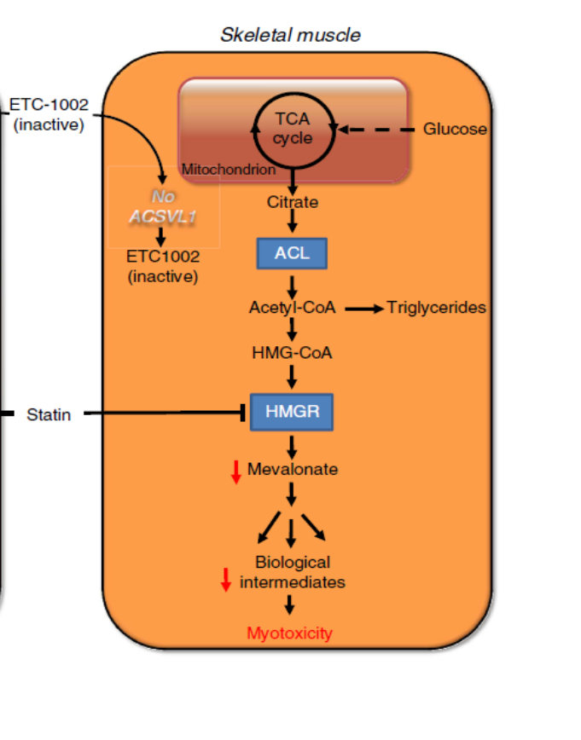
Well, maybe BA will cause less mm issues!
CLEAR indicates it is true.

Slide 68
BDM Thoughts
Let’s review a recent paper discussing some benefits of reducing mevalonic acid with statins.

Slide 69
Statin Pleiotropic Effects
Statins by inhibiting HMG-CoA reductase (HMGR) block the production of mevalonic acid which reduces the synthesis of isoprene units.
The inhibition of isoprenoid synthesis immediately reduces OS.
(keep in mind, BA should do this too,
but just in hepatic tissue)
Riesen, W. F. (2023). "Pleiotropic Effects of Statins-What is their Clinical Significance?" Journal of Biotechnology and Biomedicine 6(1): 92-94.
.
.

Slide 70
Statin Pleiotropic Effects
Reducing OS inhibits platelet activation generating anti-thrombotic effects and decreasing cSMC transformation.
This mitigating effect on trapping lipoproteins in the intima leads to anti-inflammatory effects and reduction in the migration and activation of macrophages.
Riesen, W. F. (2023). "Pleiotropic Effects of Statins-What is their Clinical Significance?" Journal of Biotechnology and Biomedicine 6(1): 92-94.
.
.

Slide 71
Statin Pleiotropic Effects
These actions occur quickly and are independent of cholesterol synthesis.
The effect of lowering cholesterol is a slower process and studies indicate it takes yrs for this effect to impact CV event risk.
Riesen, W. F. (2023). "Pleiotropic Effects of Statins-What is their Clinical Significance?" Journal of Biotechnology and Biomedicine 6(1): 92-94.
.
.

Slide 72
The next eleven slides are review slides about these effects of statins with more detail.
You can come back and review as needed.
.
.

Slide 73
Atorvastatin has Immediate Antioxidant and Antiplatelet Effects
30 hyperlipidemic pts; half Med. Diet or atorva 40mg; assessed oxidative stress and platelet activation at baseline, 2 hrs., 1, 3 & 7 days
Med. Diet demonstrated no effect
Atorvastatin immediately and progressively reduced oxidative stress and platelet activation
Pignatelli, P., et. Al. (2012). Immediate antioxidant and antiplatelet effect of atorvastatin via inhibition of Nox2. Circulation, 126(1), 92-103.
Notes:
Oxidative stress, as assessed by serum Nox2 and
urinary isoprostanes, and platelet activation, as assessed by platelet recruitment, platelet isoprostanes, and thromboxane A2,
platelet Nox2, Rac1, p47phox, protein kinase C, vasodilator-stimulated phosphoprotein, nitric oxide, and phospholipase A2,

Slide 74
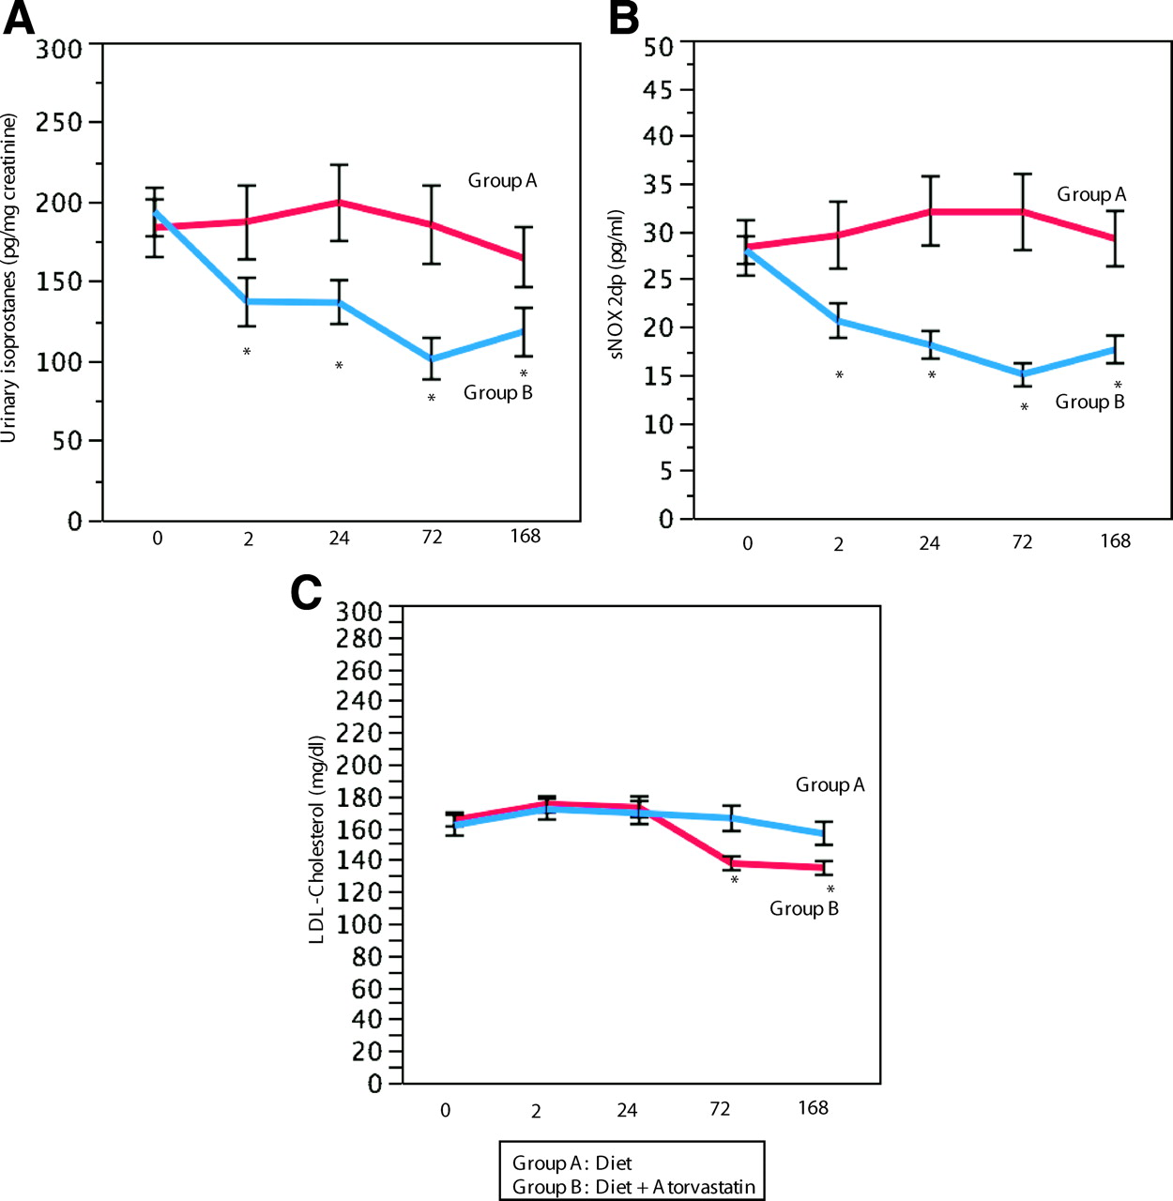
Atorvastatin Reduces Oxidative Stress Independent of LDL-C
Urine isoprostane
Serum Nox2
Diet
Atrova
LDL-C
Diet reduced LDL
better than atorva!!!
*p<0.005
Pignatelli P et al. Circulation 7/2012;126:92-103
Notes:
Interventional study: urinary isoprostanes (A), serum soluble Nox2-derived peptide (sNOX2-dp; B), and serum low-density lipoprotein (LDL) cholesterol (C) in subjects assigned to diet (group A) and atorvastatin (group B). *P<0.005.
study provides the first evidence that atorvastatin exerts an antioxidant effect as early as 2 hours
The parallel decrease of Nox2 activity and urinary isoprostanes reinforces data from previous studies suggesting a major role for Nox2 in the production of isoprostanes

Slide 75
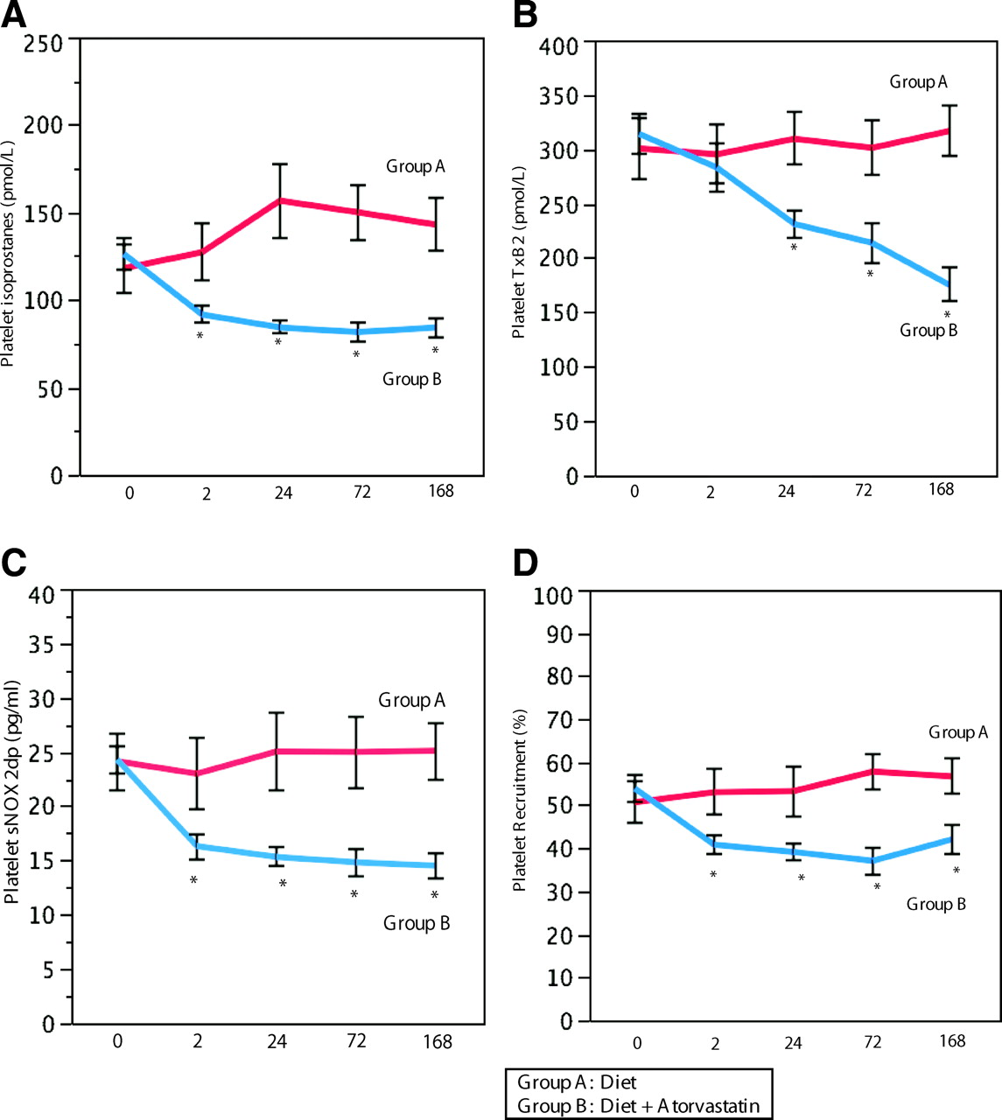
Atorvastatin Reduces Platelet Activation
Platelet isoprostane
Platelet thromboxane B2
Diet
Atrova
Platelet soluble Nox2
Platelet recruitment
Atorva reduced
oxidation & platelet activation better than diet.
*P<0.005
Pignatelli P et al. Circulation 2012;126:92-103
Notes:
Interventional study: platelet isoprostanes (A), platelet thromboxane B₂ (TxB₂; B), platelet soluble Nox2-derived peptide (sNOX2-dp; C), and platelet recruitment (D) in subjects assigned to diet (group A) and atorvastatin (group B). *P<0.005.
A simultaneous antiplatelet effect was also observed, including inhibition of platelet isoprostane and TxB2, suggesting an interplay between oxidative stress and platelet activation inhibition. This hypothesis was corroborated by an in vitro study showing that atorvastatin directly inhibits platelet Nox2 and ultimately platelet eicosanoids.
The inhibition of platelet isoprostanes by atorvastatin is particularly intriguing, taking into account the fact that aspirin does not affect platelet isoprostanes.32 Combining statins with aspirin could provide a deeper inhibition of platelet function via downregulation of platelet NADPH oxidase and COX1, respectively.
An important issue is whether the antiplatelet effect of atorvastatin is comparable to that of other antiplatelet drugs. Analysis of platelet TxB2 could help with the comparison because the inhibition of platelet TxB2 7 days after atorvastatin treatment was 50%, which is less than that achieved by aspirin (95%).33 However, aspirin does not affect platelet isoprostanes,33 whereas atorvastatin reduced it by 50%

Slide 76
Statins Reduce Oxidative Stress
In atherosclerotic disease there is elevated expression and activity of nicotinamide adenine dinucleotide phosphate (NADPH)-oxidase resulting in oxidative stress from increased ROS.
Rac1 is a guanosine triphosphatase and an intracellular transducer; it is vital in assembling the subunits and in activating NADPH-oxidase.
Margaritis, M., et al. (2018). "Statins and Oxidative Stress in the Cardiovascular System." Current Pharmaceutical Design 23(46): 7040-7047.
.

Slide 77
Statins Reduce Oxidative Stress
The reduction in mevalonate by statins not only results in a reduction in cholesterol synthesis, but also causes a reduction in the isoprenoids farnesylpyrophosphate (FPP) and geranyl-geranyl-pyrophosphate (GGPP).
FPP and GGPP are crucial for activation of Rac1.
Net effect is statins lower OS by reducing NADPH-oxidase.
Margaritis, M., et al. (2018). "Statins and Oxidative Stress in the Cardiovascular System." Current Pharmaceutical Design 23(46): 7040-7047.
.

Slide 78
Statins Reduce Oxidative Stress
In addition, GGPP decreases translation of endothelial nitric oxide synthetase (eNOS).
Statins decrease GGPP which results in greater expression of eNOS.
In addition, post translation of eNOS, statins enhance activation of eNOS via phosphorylation sites.
Net effect=restore oxidative balance
Margaritis, M., et al. (2018). "Statins and Oxidative Stress in the Cardiovascular System." Current Pharmaceutical Design 23(46): 7040-7047.
.

Slide 79
Statins Reduce Oxidative Stress
As a bonus, eNOS activity and NO production reduce platelet activation.
This will decrease production PDGF (‘Velcro’) and create a reduced prothrombotic state.
Margaritis, M., et al. (2018). "Statins and Oxidative Stress in the Cardiovascular System." Current Pharmaceutical Design 23(46): 7040-7047.
.

Slide 80
Statins Are Antioxidants
Systematic review and meta-analysis of the effect of statins on two key antioxidant enzymes: glutathione peroxidase (GPx), and superoxide dismutase (SOD).
Statins significantly increased the concentrations of both GPx and SOD.
Zinellu, A. and A. A. Mangoni (2021). "A Systematic Review and Meta-Analysis of the Effect of Statins on Glutathione Peroxidase, Superoxide Dismutase, and Catalase." Antioxidants 10(11): 1841.
.

Slide 81
Statins Are Antioxidants
Statins exert protective effects against oxidative stress by upregulating specific antioxidant mechanisms.
Statins work in many ways on OS!
They are a wonderful answer to the SOS signal.
Zinellu, A. and A. A. Mangoni (2021). "A Systematic Review and Meta-Analysis of the Effect of Statins on Glutathione Peroxidase, Superoxide Dismutase, and Catalase." Antioxidants 10(11): 1841.
.

Slide 82
Reducing Platelet Activation Should Do What??!!

Slide 83
Atorvastatin Inhibits SMC Transformation
Atorvastatin effectively suppressed PDGF induced VSMCs phenotypic modulation.
VSMC transformation is critical in neointimal hyperplasia, astherosclerosis and restenosis.
This characteristic of a statin may be a key factor explaining their significant benefit in ASVD.
Chen, S., et. al. (2015). Atorvastatin Calcium Inhibits Phenotypic Modulation of PDGF-BB-Induced VSMCs via Down-Regulation the Akt Signaling Pathway. PLoS One, 10(4), e0122577.
Notes:
suggests that atorvastatin calcium might suppress phenotypic modulation of VSMCs induced by PDGF-BB via downregulation of the Akt pathway.

Slide 84
BDM Thoughts
Let’s look at a recent paper discussing another potential benefit of blocking the production of mevalonic acid in the liver.

Slide 85
Statins Appear Good for the Liver
Globally, over 2 million die from liver disease annually.
Statins are known to reduce hepatic inflammation by decreasing OS.
Vell, M. S., et al. (2023). "Association of Statin Use With Risk of Liver Disease, Hepatocellular Carcinoma, and Liver-Related Mortality." JAMA Network Open 6(6): e2320222-e2320222.

Slide 86
Statins Appear Good for the Liver
Among pts with hep C statins reduced the incidence of cirrhosis and liver cancer.
Considering the limited options to prevent liver disease a more in-depth assessment of statins as such an agent is warranted.
Vell, M. S., et al. (2023). "Association of Statin Use With Risk of Liver Disease, Hepatocellular Carcinoma, and Liver-Related Mortality." JAMA Network Open 6(6): e2320222-e2320222.

Slide 87
Statins Appear Good for the Liver
~1.8 million people (UK Biobank, Penn Med Biobank, TriNetX cohort); average age 55 to 61 yo; 49% female; follow-up ranged from 15 to 2 yrs; statin users were propensity matched to non-statin users by age, sex, BMI, ethnicity, diabetes, BP, CAD, dyslipidemia, ASA use and # meds.
Outcome was whether statin use was associated with the incidence of liver disease.
Vell, M. S., et al. (2023). "Association of Statin Use With Risk of Liver Disease, Hepatocellular Carcinoma, and Liver-Related Mortality." JAMA Network Open 6(6): e2320222-e2320222.

Slide 88
Statins Appear Good for the Liver
Statin use substantially reduced the risk of hepatic pathology and was associated with duration of use and dose of statin.
Vell, M. S., et al. (2023). "Association of Statin Use With Risk of Liver Disease, Hepatocellular Carcinoma, and Liver-Related Mortality." JAMA Network Open 6(6): e2320222-e2320222.

Slide 89
Statins Appear Good for the Liver
Overall results were significant.
Incident liver disease HR-0.85 (95% CI, 0.78-0.92) p<0.001
Incident hepatic death HR-0.72 (95%CI, 0.59-0.88) p =0.001
Incident hepatic CA HR-0.58 (95%CI, 0.35-0.96)
p= 0.04
Vell, M. S., et al. (2023). "Association of Statin Use With Risk of Liver Disease, Hepatocellular Carcinoma, and Liver-Related Mortality." JAMA Network Open 6(6): e2320222-e2320222.

Slide 90
UKB Specifically-205,057 pts
incident liver disease
Vell, M. S., et al. (2023). JAMA Network Open 6(6): e2320222-e2320222.

Slide 91
UKB Specifically
hepatic death
Vell, M. S., et al. (2023). JAMA Network Open 6(6): e2320222-e2320222.

Slide 92
UKB Specifically
Heterogenicity
No benefit in women
Higher the fibrosis risk, the greater the benefit
Type II DM- benefit except for CA
Vell, M. S., et al. (2023). JAMA Network Open 6(6): e2320222-e2320222.

Slide 93
TriNetX Cohort- 1.5 Million Pts
74% reduced risk CA
The TriNetX research network is a federated multicenter research network that provides real-time access to an anonymized data set from participating health care organizations’ EHRs.
Vell, M. S., et al. (2023 JAMA Network Open 6(6): e2320222-e2320222.

Slide 94
Penn Medicine Biobank (PMBB)- 12,000 Pts
After 360 days of statin treatment, the HR for new liver
diseases was reduced by 24%(HR, 0.76; 95%CI, 0.59-0.98) p= .03
Vell, M. S., et al. (2023). JAMA Network Open 6(6): e2320222-e2320222.

Slide 95
Statins Appear Good for the Liver
Conclusions:
The study indicates a significant association between statin intake and liver disease protection, especially in men & Type II Diabetics.
The findings suggest that statins may be a therapeutic option for liver disease prevention and should be examined as such in further studies.
Vell, M. S., et al. (2023). "Association of Statin Use With Risk of Liver Disease, Hepatocellular Carcinoma, and Liver-Related Mortality." JAMA Network Open 6(6): e2320222-e2320222.

Slide 96
Statins Appear Good for the Liver-? Mechanism
Due to the reduction in mevalonic acid there is less production of guanosine triphosphate hydrolases which leads to decreased inflammation.
Statins upregulate Kruppel-like factor 2 (KLF-2).*
Vell, M. S., et al. (2023). "Association of Statin Use With Risk of Liver Disease, Hepatocellular Carcinoma, and Liver-Related Mortality." JAMA Network Open 6(6): e2320222-e2320222.
*Vargas, J. I., et al. (2017). "Use of Statins in Patients with Chronic Liver Disease and Cirrhosis: Current Views and Prospects." Current Gastroenterology Reports 19(9).

Slide 97
Mechanism ?
KLF-2 induces deactivation of hepatic stellate cells (HSC).
Activated HSCs transform into myofibroblast-like cells to promote fibrosis in response to liver injury or chronic inflammation, leading to cirrhosis and liver CA.*
Vargas, J. I., et al. (2017). "Use of Statins in Patients with Chronic Liver Disease and Cirrhosis: Current Views and Prospects." Current Gastroenterology Reports 19(9).
*Barry, A. E., et al. (2020). "Hepatic Stellate Cells and Hepatocarcinogenesis." Frontiers in Cell and Developmental Biology 8.

Slide 98
Mechanism ?
Isoprenoids (FPP & GGPP) which are created from mevalonic acid are crucial compounds for prenylation and tethering the Ras superfamily proteins to the plasma membrane.
These proteins are the major components of different signaling pathways regulating various aspects of tumor development and progression.
Ahmadi, Y., et al. (2020). "The effects of statins with a high hepatoselectivity rank on the extra-hepatic tissues; New functions for statins." Pharmacological Research 152: 104621.
.

Slide 99
Mechanism ?
In addition to the protein prenylation, the mevalonate pathway provides sterols and non-sterol products for the Hedgehog (Hh) pathway.
The Hh pathway is associated with increased CA risk.
Ahmadi, Y., et al. (2020). "The effects of statins with a high hepatoselectivity rank on the extra-hepatic tissues; New functions for statins." Pharmacological Research 152: 104621.
.

Slide 100
Mechanism ?
The sterols and non-sterol products also aid the nuclear localization of Yes-associated protein (YAP) and transcriptional co-activator with PDZ binding motif (TAZ).
These agents play significant roles in tumorigenesis and functioning of the cancer stem cell.
BA should also have good effects on the liver;
? why hepatic enzyme elevations??
Ahmadi, Y., et al. (2020). "The effects of statins with a high hepatoselectivity rank on the extra-hepatic tissues; New functions for statins." Pharmacological Research 152: 104621.
.

Slide 101
BDM Thoughts
Well, this info seems exciting, and it should also be true for BA.
However, there is always Yin and Yang.
Let’s examine the following information regarding cancer risk keeping in mind BA is very hepatic specific as opposed to statins.

Slide 102
Statin Extrahepatic Effects
The liver synthesizes ~ 60% of the whole-body cholesterol.
Other tissues synthesize cholesterol; the intestinal tract can produce ~ 40%.
Ahmadi, Y., et al. (2020). "The effects of statins with a high hepatoselectivity rank on the extra-hepatic tissues; New functions for statins." Pharmacological Research 152: 104621.
.

Slide 103
Statin Extrahepatic Effects
Statins reduce hepatic cholesterol formation which can induce cholesterol synthesis as an adaptive homeostatic reaction by the extra-hepatic tissues to compensate for cholesterol deficiency in the liver.
Peripheral cells cannot degrade this uptick in cholesterol production which leads to an increase in reverse cholesterol transport bringing extra-hepatically created cholesterol to the liver.
Ahmadi, Y., et al. (2020). "The effects of statins with a high hepatoselectivity rank on the extra-hepatic tissues; New functions for statins." Pharmacological Research 152: 104621.
.

Slide 104
Statins With High Hepatic Specificity
Hepatocyte
Other cholesterol producing tissues
Ahmadi, Y., et al. (2020). "The effects of statins with a high hepatoselectivity rank on the extra-hepatic tissues; New functions for statins." Pharmacological Research 152: 104621.
.

Slide 105
Statin Extrahepatic Effects
This increase in mevalonate in other tissues is greater the more hepatic specific the statin is.
Obviously, if statins work in other tissues like the muscle tissue, they block the formation of mevalonate.
Ahmadi, Y., et al. (2020). "The effects of statins with a high hepatoselectivity rank on the extra-hepatic tissues; New functions for statins." Pharmacological Research 152: 104621.
.

Slide 106
Statin Extrahepatic Effects
The subsequent induction of the mevalonate pathway in other tissues results in an increase in protein prenylation which is associated with cancers including basal cell, pancreatic, breast, colon, ovarian and small-cell lung cancer.
The increased sterol and non-sterol products can stimulate tumorigenesis and cancer stem cells.
Ahmadi, Y., et al. (2020). "The effects of statins with a high hepatoselectivity rank on the extra-hepatic tissues; New functions for statins." Pharmacological Research 152: 104621.
.

Slide 107
Which Statins Are Most Hepatic Selective????
Germershausen, J. I., et al. (1989). "Tissue selectivity of the cholesterol-lowering agents lovastatin, simvastatin and pravastatin in rats in vivo." Biochem Biophys Res Commun 158(3): 667-675.
Lennernäs, H. and G. Fager (1997). "Pharmacodynamics and pharmacokinetics of the HMG-CoA reductase inhibitors. Similarities and differences." Clin Pharmacokinet 32(5): 403-425.
Neuvonen, P. J., et al. (2008). "Pharmacokinetic comparison of the potential over-the-counter statins simvastatin, lovastatin, fluvastatin and pravastatin." Clin Pharmacokinet 47(7): 463-474.
Canestaro, W. J., et al. (2014). "Genetic factors affecting statin concentrations and subsequent myopathy: a HuGENet systematic review." Genet Med 16(11): 810-819.
Alrajeh, K., et al. (2023). "The frequency of major ABCG2, SLCO1B1 and CYP2C9 variants in Asian, Native Hawaiian and Pacific Islander women subgroups: implications for personalized statins dosing." Pharmacogenomics 24(7): 381-398.

Slide 108
BDM Thoughts
BA is extremely hepatic specific.
Will it generate an increase in non-hepatic cancer???
That was not the case in CLEAR, but it was only ~ 3 ½ yrs.
Is this potential risk with BA off set with the decreased incidence of myopathy?
That reduction in myopathy risk is probably real.
However, the very recent study indicates mevalonolactone may negate the statin myopathy.

Slide 109
BDM Thoughts
BA’s specificity to the liver may also explain why it does not appear to be as effective lowering LDL-C & hsCRP?
For example, in JUPITER rosuva lowered LDL-C 50% & hsCRP 37%. (CLEAR-15% & 13%)
BA’s ability to lower OS is probably lower as well.
This would mean it is less effective at inhibiting SMC transformation.
Is that why it did not reduce risk of revascularization in the ‘primary care’ subgroup?
Keep in mind, BA does not appear to reduce stroke and may enhance the risk of hemorrhagic stroke.

Slide 110
Statins Lower Stroke Risk
International guidelines recommend statin therapy to prevent strokes.
Amarenco P, Labreuche J, Lavallee P, et al. Statins in stroke prevention and carotid
atherosclerosis: systematic review and up-to-date meta-analysis. Stroke 2004;35 (12):2902-2909.
Baigent C, Keech A, Kearne PM, et al. Cholesterol treatment Trialists’ (CTT) collaborators.
Efficacy and safety of cholesterol-lowering treatment: prospective metaanalysis
of data from 90,056 participants in 14 randomised trials of statins. Lancet 2005;366(8483):1267-1278.
Amarenco P, Labreuche J. Lipid management in the prevention of stroke: review and
updated meta-analysis of statins for stroke prevention. Lancet Neurol 2009;8(5):453-463.

Slide 111
PCSK9-inhibitors Reduce Stroke Risk
PCSK9 inhibitors reduce stroke risk 25% & MI risk 19%.
PCSK9 inhibitors reduced total stroke 23% & ischemic stroke by 24% (no increase in hemorrhagic stroke).
Cordero, A., et al. (2020). "Prevention of myocardial infarction and stroke with PCSK9 inhibitors treatment: a metanalysis of recent randomized clinical trials." J Diabetes Metab Disord 19(2): 759-765.
Qin J, Liu L, Su XD et al. The effect of PCSK9 inhibitors on brain stroke prevention: a systematic review and meta-analysis. Nutr Metab Cardiovasc Dis 2021;31:2234–2243.

Slide 112
BDM Thoughts
Wow! What seems CLEAR now is:
it is hard to get excited about BA especially with a price tag of ~ $400/mo.

Slide 113
Upcoming Presentations

Slide 114
Upcoming Events for BaleDoneen
9/1/2023- Amy webinar with Direct Diagnostics.
11/11/2023- Amy speaking at a Pacific Dental Services course.
4/1-20/2024- BDM Preceptorship followed by reunion in Scottsdale, Az.
Our 4/21-22/23 course is online and approved for 17 CME hrs.

Slide 115
Open for Discussion

