Slide 1
E-mail sent to the BDM community 6/1/2022
Good morning,
I would very much appreciate your ideas and recommendations regarding one of my patients.
He is a 66-year-old architect with atherosclerotic disease based on CIMT tests and without major improvements on the second CIMT. 6’ tall, weight 190, Waist 40 inches
The second CIMT test revealed improvements in the numbers as compared to the first one (the plaque burden went down from 14 to 13.3, and the second showed echogenicity in a plaque as compared to all heterogeneous plaques in the first CIMT). In spite of that, he still has elevated early event risk, and elevated mean and maximum CCAs.
Contributing factors to his atherosclerosis are: hypertension, mildly elevated FBS (normal insulin and HgA1c), asymptomatic mild hyperuricemia, mildly elevated apoB, and low testosterone.
He does not appear to have any sleep disorders, he tries to follow a low glycemic index nutritional plans, and he walks regularly. His stress level appears very reasonable.
His evaluation included: 9p21 non carrier, apoE2/3, and optimal levels of myeloperoxidase, oxidized LDL, lp-pla2, ADMA, homocysteine, vitamin D, and CRP.
He is on testosterone, amlodipine/benazepril (blood pressure not very well controlled), aspirin, metformin, rosuvastatin, coQ10, resveratrol, and magnesium.
What else could I explore? Shall I do OGTT? Ramipril instead of Amlodipine? Try Actos instead of metformin? Others?
Thank you so much for your time,
Jorge Pelaez.

Slide 2
My patient is a 66-year-old male architect with fairly unremarkable PMH.
His primary care physician first diagnosed him with hypertension in 2018. Besides that, he was overweight ( BMI now is 28), he had hyperuricemia, and low testosterone. Non-smoker, but his nutrition and exercise habits were poor ( not anymore).
His family history is significant for hypertension and dementia.

Slide 3
THANK YOU, Jorge for submitting!
Summary of questions –
cIMT interpretation
Should current treatment be changed/augmented?
Any missed root causes?
Plan moving forward for this patient.

Slide 5
1st Question - cIMT
He is a 66-year-old architect with atherosclerotic disease based on CIMT tests and without major improvements on the second CIMT.
The second CIMT test revealed improvements in the numbers as compared to the first one (the plaque burden went down from 14 to 13.3, and the second showed echogenicity in a plaque as compared to all heterogeneous plaques in the first CIMT).
Despite that, he still has elevated early event risk, and elevated mean and maximum CCAs.

Slide 8
Validation that cIMT imaging is an effective clinical strategy for identifying and monitoring ASVD and improves patient compliance

Slide 9
21 years later (2020) Carotid IMT is an effective clinical tool
Histology of ASVD is highly correlated to CIMT
Reproducibility is acceptable
CIMT correlated to risk factors and CVD
CIMT correlated to ASVD systemically
Associated with risk of CV events
CIMT changes over time
CIMT change influenced by rx
Willeit, P., Tschiderer, L., Sweeting, M. et al. (2020). Carotid intima-media thickness progression as surrogate marker for cardiovascular risk. Circulation. 2020;142:621–642
Notes:
The third major group of patients who may considered as having CHD risk equivalent to those with established clinical CHD are those with atherosclerotic disease elsewhere in the arterial tree. Obviously, the cellular and molecular forces which lead to development of fatty streaks and their ultimate development into plaques which may occlude and/or rupture are not confined only to the coronary arterial circulation. Atherosclerosis in one region is often associated with and predictive of disease in other branches of the arterial tree. As a result, peripheral arterial atherosclerosis is considered to be a powerful predictor of future CHD in patients without clinical CHD symptoms or signs as yet.
The three most important subgroups, as discussed by the ATP III study group, include those with peripheral arterial disease, abdominal aortic aneurysm, and carotid artery disease.

Slide 10
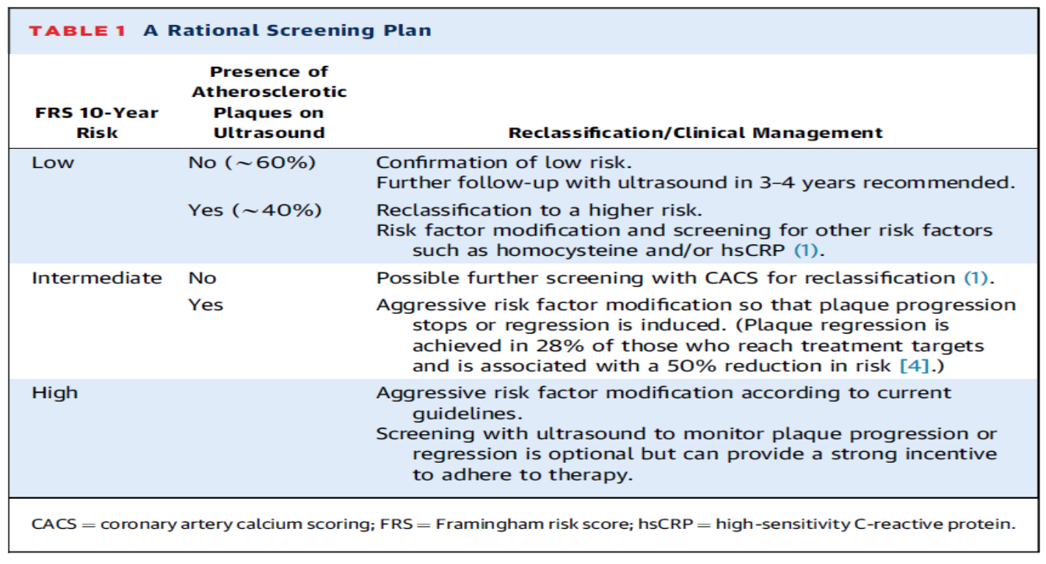
6 years ago (2016) – Ultrasound can be used to reclassify risk and monitor treatment effects
Risk Stratification
Monitoring
Nicolaides, A., & Panayiotou, A. G. (2016). Screening for Atherosclerotic Cardiovascular Risk Using Ultrasound∗. J Am Coll Cardiol, 67(11), 1275-1277.

Slide 11
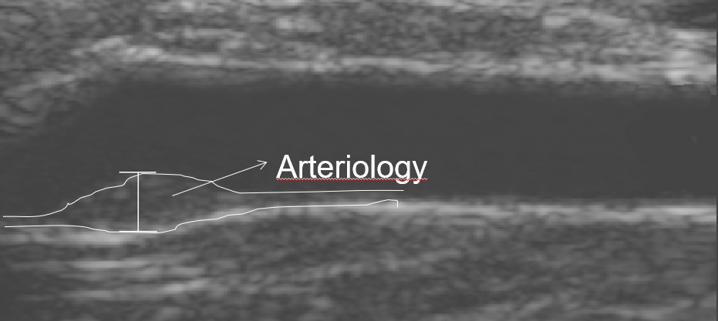
Imaging increases Compliance!
Image-based information is an effective tool in prevention.
Compliance with management is enhanced
Ulf Näslund, et. al. Visualization of asymptomatic atherosclerotic disease for optimum cardiovascular prevention (VIPVIZA): a pragmatic, open-label, randomised controlled trial. The Lancet (2018). http://dx.doi.org/10.1016/S0140-6736(18)32818-6

Slide 12
Is CIMT a valid surrogate marker for systemic CVD and events?
Does reducing the CIMT progression translate to a reduction in CV events?
If so, it would mean CIMT progression is a valid surrogate marker for systemic CVD.
Willeit, P., et al. (2020). "Carotid Intima-Media Thickness Progression as Surrogate Marker for Cardiovascular Risk." Circulation 142(7): 621-642.
.
.
Notes:
The third major group of patients who may considered as having CHD risk equivalent to those with established clinical CHD are those with atherosclerotic disease elsewhere in the arterial tree. Obviously, the cellular and molecular forces which lead to development of fatty streaks and their ultimate development into plaques which may occlude and/or rupture are not confined only to the coronary arterial circulation. Atherosclerosis in one region is often associated with and predictive of disease in other branches of the arterial tree. As a result, peripheral arterial atherosclerosis is considered to be a powerful predictor of future CHD in patients without clinical CHD symptoms or signs as yet.
The three most important subgroups, as discussed by the ATP III study group, include those with peripheral arterial disease, abdominal aortic aneurysm, and carotid artery disease.

Slide 13
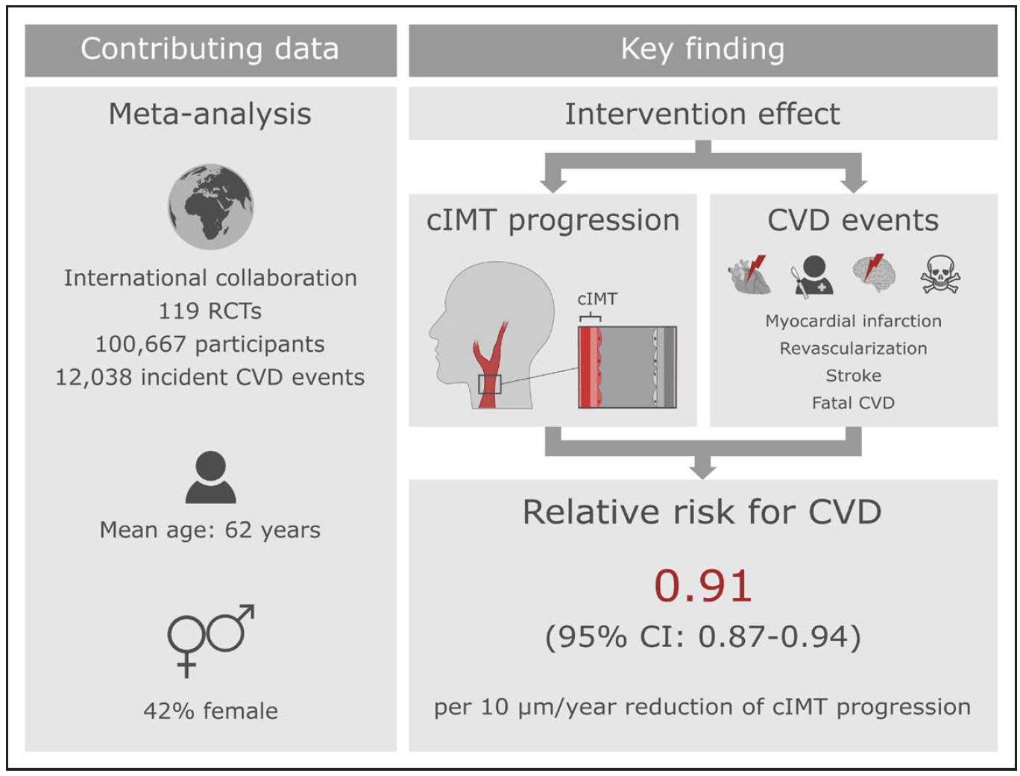
Carotid Intima-Media Thickness is a surrogate marker for CV risk.
18 trials:
antidiabetic agents
19 trials: antihypertensives
20 trials:
dietary/vitamin D
33 trials:
lipid lowering therapy
37 trials:
other treatments
Willeit, P., Tschiderer, L., Sweeting, M. et al. (2020). Carotid intima-media thickness progression as surrogate marker for cardiovascular risk. Circulation. 2020;142:621–642

Slide 14
Carotid Intima-Media Thickness is a surrogate marker for CV risk.
For each 0.010 mm annual reduction in CIMT progression there was a 12% decrease in risk of CV events.
RR-0.88 (95% CI, 0.85-0.91)
Change in CIMT with rx is a strong surrogate marker for the risk of CV events.
Willeit, P., Tschiderer, L., Sweeting, M. et al. (2020). Carotid intima-media thickness progression as surrogate marker for cardiovascular risk. Circulation. 2020;142:621–642
Notes:
The third major group of patients who may considered as having CHD risk equivalent to those with established clinical CHD are those with atherosclerotic disease elsewhere in the arterial tree. Obviously, the cellular and molecular forces which lead to development of fatty streaks and their ultimate development into plaques which may occlude and/or rupture are not confined only to the coronary arterial circulation. Atherosclerosis in one region is often associated with and predictive of disease in other branches of the arterial tree. As a result, peripheral arterial atherosclerosis is considered to be a powerful predictor of future CHD in patients without clinical CHD symptoms or signs as yet.
The three most important subgroups, as discussed by the ATP III study group, include those with peripheral arterial disease, abdominal aortic aneurysm, and carotid artery disease.

Slide 15
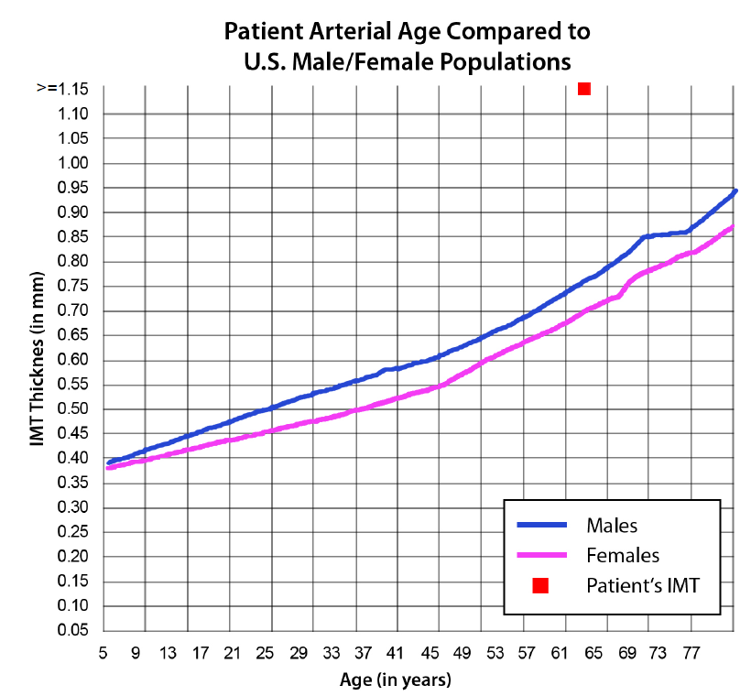
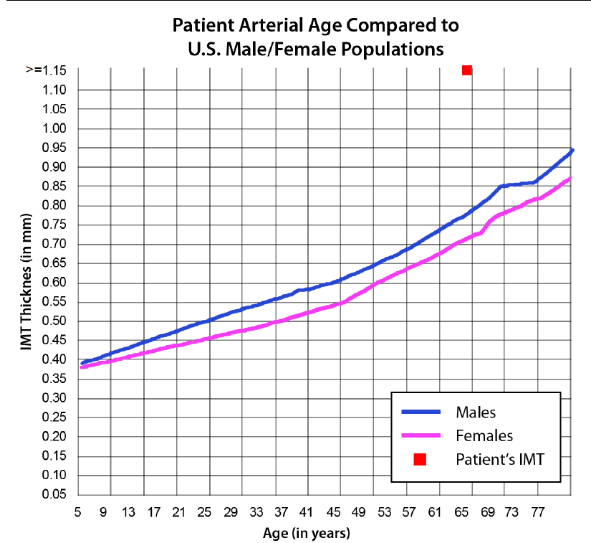
So, with Jorge’s patient – let’s evaluate:
CCA IMT : 6 one cm segments (3 angles R and L) = 6 linear cm total surface area
Mean CCA IMT – average high and low, Max Mean CCA – average high
2020 Mean CCA IMT: 1.47mm
2022 Mean CCA IMT: 1.37mm
This represents a 0.10mm regression – EXCELLENT!
2020
2022

Slide 16
Lipid Core of Carotid Plaque Independently Predicts Risk of CV Events
1,256 symptomatic patients (56% women) baseline MRI of carotid arteries; follow-up 10.5 yrs
After adjusting for plaque burden and clinical factors,
only the presence of lipid core was significantly associated
with incident CV events.
Sun, J., et. al. (2017). JACC Imaging. 10(3), 241-249.
Brunner, G., et al. (2020). JAMA Cardiol. Online Nov. 18. E1-8 doi:10.1001/jamacardio.2020.5573
.
Notes:
The third major group of patients who may considered as having CHD risk equivalent to those with established clinical CHD are those with atherosclerotic disease elsewhere in the arterial tree. Obviously, the cellular and molecular forces which lead to development of fatty streaks and their ultimate development into plaques which may occlude and/or rupture are not confined only to the coronary arterial circulation. Atherosclerosis in one region is often associated with and predictive of disease in other branches of the arterial tree. As a result, peripheral arterial atherosclerosis is considered to be a powerful predictor of future CHD in patients without clinical CHD symptoms or signs as yet.
The three most important subgroups, as discussed by the ATP III study group, include those with peripheral arterial disease, abdominal aortic aneurysm, and carotid artery disease.

Slide 17
Plaque all heterogeneous
Early Event Risk – largest plaque 3.4mm

Slide 19
Plaque Burden Score isn’t reproducible.
Simply represents the sum of the areas that meet a qualification of “plaque” within a field of view
“Plaque” definition happens to be > 1.3mm

Slide 20
BDM Generates a Positive Effect on Carotid Artery Disease
Lipid rich plaque reduced to zero at five yrs!
Cheng, H. G., Patel, B. S., Martin, S. S., Blaha, M., Doneen, A., Bale, B., & Jones, S. R. (2016). Effect of comprehensive cardiovascular disease risk management on longitudinal changes in carotid artery intima-media thickness in a community-based prevention clinic. Archives of Medical Science, 12(4), 728-735.

Slide 21
1st Question - cIMT
He is a 66-year-old architect with atherosclerotic disease based on CIMT tests and without major improvements on the second CIMT.
The second CIMT test revealed improvements in the numbers as compared to the first one (the plaque burden went down from 14 to 13.3, and the second showed echogenicity in a plaque as compared to all heterogeneous plaques in the first CIMT).
Despite that, he still has elevated early event risk, and elevated mean and maximum CCAs.
(He will remain high risk until all plaque stable and ALL inflammatory markers and risk factors are optimized)

Slide 22
Second part of Jorge’s question(s) -
Should current treatment be changed/augmented?
Any missed root causes?
Plan moving forward for this patient.

Slide 23
From Jorge:
Contributing factors to his atherosclerosis are: hypertension, mildly elevated FBS (normal insulin and HgA1c), asymptomatic mild hyperuricemia, mildly elevated apoB, and low testosterone. Lipo(a) negative.
He does not appear to have any sleep disorders, he tries to follow a low glycemic index nutritional plans, and he walks regularly. His stress level appears very reasonable.
His evaluation included: 9p21 non carrier, apoE2/3, and optimal levels of myeloperoxidase, oxidized LDL, lp-pla2, ADMA, homocysteine, vitamin D, and CRP.
He is on testosterone, amlodipine/benazepril (blood pressure not very well controlled), aspirin, metformin, rosuvastatin, coQ10, resveratrol, and magnesium.
What else could I explore? Shall I do OGTT? Ramipril instead of Amlodipine? Try Actos instead of metformin? Others?

Slide 24
Concerns:
Waist 40”
BP 130/94
Apo B 97
FBS 104
A1C 5.1
Hx uric acid
Hx low T

Slide 25
A1c Significantly Predicts New Onset DM in ‘Healthy’ Subjects Only if >6.5%
11,092 ‘healthy’ ARIC pts.; mean age 57; follow-up 14 yrs.
Five categories of A1c%: <5.0; 5.0 to <5.5; 5.5 to <6.0; 6.0 to < 6.5; >6.5
HR for new onset DM after # adjustments was only significant with A1c >6.5 with p<0.001
Selvin, E., et al. (2010). "Glycated hemoglobin, diabetes, and cardiovascular risk in nondiabetic adults." N Engl J Med 362(9): 800-811.
Notes:
2.4 million Americans have A1c >6.5%; 7 million have A1c > 6.0%; this study: 77.6% Caucasian; 57.7% female; mean age 56.7; mean A1c was 5.5 and fasting glucose 104.7 mg/dL; mean follow-up 14 yrs.
Incidence of DM was 6%, 12%, 21%, 44%, 79% for the A1c categories; interesting that an A1c of <5% had half the risk of 5-5.5%
Stroke risk went up with A1c >5.5%: 1.17,2.22, 3.16 respectively
Interestingly all cause mortality was higher with A1c<5% compared to 5-5.5%
FBG btw 100-125 mg/dL did not predict CHD, stroke or mortality
When adjusted for: age, sex, race, LDL, HDL, TG, BMI, waist-hip ratio, FamHx DM, education, alcohol, smoking and exercise only the A1c’s >6.5% were significant with a p value of <0.001 for trend

Slide 26
A1c Misses ~Half of Patients with Pre-diabetes
501 pts screened for pre-diabetes with 75-gram OGTT; also had A1c drawn.
193 pts had IFG and or IGT-’pre-diabetic’
A1c missed 90 of the pre-diabetics
47% missed!
Chilelli, N. C., et. al. (2014). Screening with HbA1c identifies only one in two individuals with diagnosis of prediabetes at oral glucose tolerance test: findings in a real-world Caucasian population. Acta Diabetol, 51(5), 875-882.

Slide 27
(OGTT) Should be Used to Accurately Evaluate for Diabetes and Pre-diabetes As Opposed to Hg A1c
9,000 non-diabetic adults; evaluated accuracy of HbA1c compared to OGTT for diagnosing DM and normal glucose tolerance.
HbA1c over-diagnosed normal glucose tolerance (NGT) by 42% and under-diagnosed DM in 73% of adults.
Chang Villacreses MM, et. al. Underestimation of the prevalence of diabetes and overestimation of the prevalence of glucose tolerance by using hemoglobin A1c criteria. Presented at: ENDO 2019; March 23-26, 2019; New Orleans, LA. Abstract SAT-125.

Slide 28
Why is pioglitazone a missing treatment for this patient?

Slide 29
Pioglitazone Slows Progression of Carotid Atherosclerosis in Pre-diabetics
ACTNOW data
CIMT progression in pre-diabetics reduced compared to placebo.
p=0.025
Reaven PD, Schwenke DC, Buchanan TZ, et al. Pioglitazone reduces long-term progression of carotid atherosclerosis in IGT. American Diabetes Association 2009 Scientific Sessions; June 7, 2009; New Orleans, LA. Abstract 15-LB
Notes:
Serial CIMTs over 39 months
393 patients with IGT (FG 95-125mg/dL & or OGTT 140-199 mg/dL)
Baseline: avg age 53 yrs, 54% female, avg BMI 33.2, avg A_{1C} 5.4%.
Randomized pioglitazone 30 -45 mg or placebo
annual rate of change in CIMT was 38% lower
The findings reinforce the notion that pioglitazone prevents macrovascular disease," echoed Dr R Paul Robertson (Swedish Medical Center, Seattle, WA), the ADA's president of medicine and science
"We should be treating all patients with prediabetes with early, aggressive treatment," Robertson advised
"By waiting, we are wasting time and allowing subclinical disease progression; with early treatment, we might even be able to head off disease."

Slide 30
Pioglitazone Regressed CAD, Reduced Inflammation and Improved Endothelial Function in Pre-diabetics
30 pre-diabetic pts; IVUS; 40-70% stenotic CAD lesions with thin caps and large necrotic core; randomized to 6 mos. pio 15mg/d or placebo; both got ‘standard’ rx
1) plaque burden decreased 10.3% p <0.05
2) thin-cap fibroatheroma prevalence 11% vs. 22% p < 0.05
3) necrotic core area 16.8% vs. 31.7% p < 0.05
Yang, H. B., et. al. (2012). Pioglitazone induces regression and stabilization of coronary atherosclerotic plaques in patients with impaired glucose tolerance. Diabet Med, 29(3), 359-365.
Notes:
This type of CAD lesions are usually associated with a high prevalence of coronary events (particularly revascularization)
prospective, randomized, placebo-controlled study
Indications for angiography were: (1) chest pain, or angina with painworsening
upon exertion or strenuous physical activity; (2) suspected Prinzmetal’s variant of angina pectoris; and (3) unexplained pain in the jaw, neck or arm (usually the left arm). Patients examed monthly.
standard therapy, included aspirin, b-blockers, nitrates (if necessary), ACEI or ARB All atorvastatin 20 mg daily for 3 months, followed by 10 mg
No significant differences were found in the baseline clinical variables between the two groups.
Fifty lesions from 30 patients were included in this study. Two patients withdrew prematurely because they did not wish to participate in the follow-up study. Hence, the results comprised 48 lesions from 28 patients.

Slide 31
Pioglitazone Regressed CAD, Reduced Inflammation and Improved Endothelial Function in Pre-diabetics
Pio regressed and stabilized CAD.
Pio is beneficial in insulin resistant individuals at high risk for coronary events.
Yang, H.-B., et. al. Diabet. Med. 3/1/2012. 29:359–365
Notes:
No significant differences were found in left ventricular ejection fraction and serum lipid levels pre- and post-trial

Slide 32
Pioglitazone Has Anti-thrombotic Effects
Pioglitazone inhibits platelet function, directly.
Pio also potentiates the anti-platelet effect of aspirin.
.Mongan, J., et al. (2012). "Pioglitazone inhibits platelet function and potentiates the effects of aspirin: a prospective observation study." Thromb Res 129(6): 760-764.
Notes:
No significant differences were found in left ventricular ejection fraction and serum lipid levels pre- and post-trial

Slide 33
Pioglitazone Reduces CV Risk in Post Stroke Non-Diabetics
3,876 pts 6 mos. post ischemic stroke (IS) or TIA; >40 yo (mean 63.5); 88% had IS; IR in highest quartile of HOMA without DM (mean A1c 5.8%).
Randomly assigned to therapy with pio 45mg (after titration over 8 wks) or placebo for five years.
Primary outcome was fatal or nonfatal stroke or myocardial infarction.
Kernan, W. N., et. al. Pioglitazone after Ischemic Stroke or Transient Ischemic Attack. New England Journal of Medicine, 0(0), null. doi:doi:10.1056/NEJMoa1506930
Notes:
Insulin Resistance Intervention after Stroke (IRIS) trial
HOMA-IR value was calculated as the level of fasting glucose (measured in millimoles per liter) times the level of fasting insulin (measured in microunits per milliliter) divided by 22.5.
Because insulin sensitivity may be transiently impaired after a stroke,21 the screening blood test was conducted at least 14 days after the index event.
Diabetes was diagnosed if a potential participant was taking medication for diabetes or met the 2005 criteria of the American Diabetes Association (ADA) for fasting plasma glucose (i.e., ≥126 mg per deciliter [7 mmol per liter]), as confirmed by repeated testing.22 We did not perform an oral glucose-tolerance test but excluded
patients with a glycated hemoglobin level of 7.0% or more. We also excluded patients with New York Heart Association class 3 or 4 heart failure or class 2 heart failure with a reduced ejection fraction.
A reduction in study-drug dose was included in the algorithms and was also permitted by the internal safety committee if such a reduction allowed the patient
to continue taking the drug. Pioglitazone and placebo were permanently discontinued if heart failure or bladder cancer developed or if a patient had two distinct low-energy bone fractures (i.e., resulting from a fall from a sitting or standing position or from a low platform, such as a bed).

Slide 34
Pioglitazone Reduces CV Risk Post Stroke Non-diabetics
Pio significantly lowered risk of stroke 24% and MI 31%.
The MI reduction was driven by severe STEMIs and fatal MIs.*
HR- 0.50 (95% CI, 0.28-0.88) p=0.02
Kernan, W. N., et. al. New England Journal of Medicine, 0(0), null. doi:doi:10.1056/NEJMoa1506930
*Young, L. H., et. al. (2017). Cardiac Outcomes After Ischemic Stroke or TIA: Effects of Pioglitazone in Patients with Insulin Resistance Without Diabetes. Circulation. doi:10.1161/circulationaha.116.024863

Slide 35
Pio Reduces CV Risk in IR NDM Pts With ASVD
Current analysis supports the efficacy of pio for prevention of CV events in pts with ASVD and IR, regardless of DM status.
Pio stabilizes coronary artery plaque.
Young, L. H., et. al. (2017). Circulation. doi:10.1161/circulationaha.116.024863

Slide 36
Pioglitazone Slashes Risk of Diabetes Conversion 72%
602 patients with IGT (FG 95-125mg/dL & or OGTT 140-199 mg/dL); median follow-up 2.4 yrs.
Randomized pioglitazone 30 -45 mg or placebo
HR for DM -0.28; p<0.00
DeFronzo, R. A., et. al. (2011). Pioglitazone for Diabetes Prevention in Impaired Glucose Tolerance. New England Journal of Medicine, 364(12), 1104-1115.
Notes:
7.6% of pts. in placebo arm converted to DM; 2.1% in pioglitazone arm = approx. 22 vs. 6

Slide 37
What about his blood pressure?
Currently – Amlodipine and Benazepril
BP remains high at 130/94
Insulin resistance is likely the driver of his stubborn BP
Absolutely obtain a sleep study (even if he says sleep is ok)
Consider switch from Benazepril to Ramipril 10mg am and pm
Pioglitazone will not only improve his IR but will improve everything associated with his insulin resistance including BP.
Narrowed food window 16:8 for inflammation and IR
HIIT training 2 times/week with Cardio daily – 30min minimum
Get waist down to 35 inches!

Slide 38
Time Restricted Eating

Slide 39
Intermittent Fasting Improves CV Health
Intermittent Fasting (IF) involves taking a normal, daily caloric intake with the use of short, strict calorie restriction. Meals are only consumed within a defined time within a day or week.
The most popular variation is time-restricted feeding.
16 hour fast with 8 hour eating period (16:8)
Other variations include days - In the 5:2 system, in which caloric restriction is used for two days a week, and a regular diet for 5 days
(400-600 kcal on fasting days)
Malinowski B, Zalewska K, Węsierska A, Sokołowska MM, Socha M, Liczner G, Pawlak-Osińska K, Wiciński M. Intermittent Fasting in Cardiovascular Disorders-An Overview. Nutrients. 2019 Mar 20;11(3):673.

Slide 40
Intermittent Fasting Improves CV Health
In 2 different studies in overweight/obese individuals 10 & 12 weeks – intermittent fasting statistically improved:
CRP, Leptin and Adiponectin
Malinowski B, Zalewska K, Węsierska A, Sokołowska MM, Socha M, Liczner G, Pawlak-Osińska K, Wiciński M. Intermittent Fasting in Cardiovascular Disorders-An Overview. Nutrients. 2019 Mar 20;11(3):673.

Slide 41
Intermittent Fasting Improves CV Health
Fasting (day and hour) plus caloric restriction reduces systolic and diastolic BP
Malinowski B, Zalewska K, Węsierska A, Sokołowska MM, Socha M, Liczner G, Pawlak-Osińska K, Wiciński M. Intermittent Fasting in Cardiovascular Disorders-An Overview. Nutrients. 2019 Mar 20;11(3):673.

Slide 42
Intermittent Fasting Improves CV Health
Intermittent fasting has been shown to improve glucose metabolism and increases the sensitivity of tissues to insulin by increasing the Beta cells of the pancreatic islets.
The Intermittent fasting diet also limits cardiac hypertrophy. It remains questionable if benefits are solely due to weight loss or non-weight loss mechanisms.
Intermittent fasting lowers vascular inflammation and lowers blood pressures
Malinowski B, Zalewska K, Węsierska A, Sokołowska MM, Socha M, Liczner G, Pawlak-Osińska K, Wiciński M. Intermittent Fasting in Cardiovascular Disorders-An Overview. Nutrients. 2019 Mar 20;11(3):673.

Slide 43
Intermittent Fasting will also allow you to Live Longer
Enhances Autophagy*
Mitigates premature senescence*
deCabo R, Mattison, MP. (2019) “Effects of Intermittent Fasting on Health, Aging, and Disease.” NEJM 381:2541-51.
*Bale, B. F. D. A. L. (2013). Autophagy, Senescence, and Arterial Inflammation: Relationship to Arterial Health and Longevity. Alternative Therapies in Health & Medicine, 19(4), 8-10.

Slide 44
Thank you, Jorge for submitting such a wonderful case! Your patient is so fortunate to be under your care!

