Slide 1
BaleDoneen Live Scientific Update
06/10/2020
5:30-6:30 pm PST
Bradley Bale, MD

Slide 2
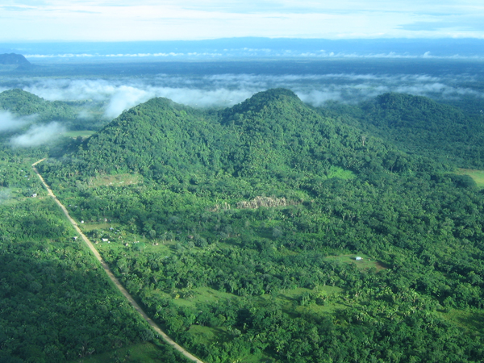
BDM Refocusing Perspective on Benefit

Slide 3
New Studies for June 10, 2020 Scientific Update Session
1. SEER Training Modules, Classification & Structure of Blood Vessels. U. S. National Institutes of Health, National Cancer Institute. 16-05-2020. https://training.seer.cancer.gov/anatomy/cardiovascular/blood/classification.html
2. Åstrand, P.-O., et al. (2003). Textbook of work physiology: physiological bases of exercise, Human Kinetics.
3. Hakim, A. M. (2019). "Small Vessel Disease.“ Frontiers in Neurology 10: 1020-1020.
4. Hsia CC, Raskin P. The diabetic lung: relevance of alveolar microangiopathy for the use of inhaled insulin. Am J Med 2005;118:205–211

Slide 4
New Studies for June 10, 2020 Scientific Update Session
5. Roberts, T. J., et al. (2018). "Diagnosis and Significance of Pulmonary Microvascular Disease in Diabetes." Diabetes Care 41(4): 854-861.
6. Chade, A. R. (2017). "Small Vessels, Big Role: Renal Microcirculation and Progression of Renal Injury.“ Hypertension, 69(4): 551-563.
7. Cannistraro, Rocco, et al. CNS small vessel disease: A clinical review. Neurology. 2019; 92 (24):1146-1156.
8. Reriani, M., et al. (2014). "Microvascular endothelial dysfunction predicts the development of erectile dysfunction in men with coronary atherosclerosis without critical stenoses." Coronary artery disease 25(7): 552-557.

Slide 5
Vital Substance of the BDM

Slide 6
Blood
Blood is the fluid of life transporting cell nutrients and waste.
Blood is also alive with living cells providing nourishment and protection.
SEER Training Modules, Classification & Structure of Blood Vessels. U. S. National Institutes of Health, National Cancer Institute. 16-05-2020. https://training.seer.cancer.gov/anatomy/cardiovascular/blood/classification.html .

Slide 7
Critical Goal of the BDM

Slide 8
Maintain the Highways for Blood Transport
The system of blood transportation is essential for the maintenance of health.
The heart is the engine moving blood through the pulmonary and systemic vessels.
SEER Training Modules, Classification & Structure of Blood Vessels. U. S. National Institutes of Health, National Cancer Institute. 16-05-2020. https://training.seer.cancer.gov/anatomy/cardiovascular/blood/classification.html .

Slide 9
Arteries
Larger arteries branch repeatedly until the microscopic arterioles are reached.
Arterioles play a critical role in regulating flow of blood to tissue capillaries.
SEER Training Modules, Classification & Structure of Blood Vessels. U. S. National Institutes of Health, National Cancer Institute. 16-05-2020. https://training.seer.cancer.gov/anatomy/cardiovascular/blood/classification.html .

Slide 10
Arteries
The smallest and most numerous vessels are the capillaries.
Their function is the exchange of vital materials to cells.
SEER Training Modules, Classification & Structure of Blood Vessels. U. S. National Institutes of Health, National Cancer Institute. 16-05-2020. https://training.seer.cancer.gov/anatomy/cardiovascular/blood/classification.html .

Slide 11
Arteries
Capillary distribution is extensive in metabolically active tissue such as the lungs, kidney, brain, digestive system and heart.
These areas understandably receive a disproportionate amount of the cardiac output/ % body mass.
SEER Training Modules, Classification & Structure of Blood Vessels. U. S. National Institutes of Health, National Cancer Institute. 16-05-2020. https://training.seer.cancer.gov/anatomy/cardiovascular/blood/classification.html .

Slide 12
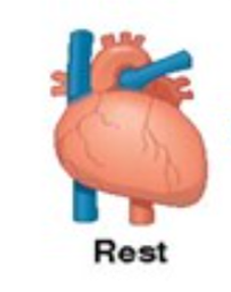
Cardiac Output Distribution at Rest
% body mass
~2.5%
~8%
~0.7%
~0.5%
~ 2%
~15%
~40%
Fat ~20%
%CO/%BM
40X
3X
3.5X
40X
7.5X
Cardiac Output 100% 20-25% 4-5% 20% 15% 3-5% 15-20% 4-5%
5L/min lung gut heart kidney brain bone muscle skin
Åstrand, P.-O., et al. (2003). Textbook of work physiology: physiological bases of exercise, Human Kinetics.
.
.

Slide 13
Arteries
About 10% of the total blood volume is in the lung at any moment in time.
The lung has the largest capillary bed with over 300 million capillaries.
SEER Training Modules, Classification & Structure of Blood Vessels. U. S. National Institutes of Health, National Cancer Institute. 16-05-2020. https://training.seer.cancer.gov/anatomy/cardiovascular/blood/classification.html .

Slide 14
Arteries
About 10% of the total blood volume is in the systemic arterial system at any moment in time.
Half of the arterial blood is in the capillaries.
SEER Training Modules, Classification & Structure of Blood Vessels. U. S. National Institutes of Health, National Cancer Institute. 16-05-2020. https://training.seer.cancer.gov/anatomy/cardiovascular/blood/classification.html .
Notes:
About 2% of the blood volume is in the heart.
About 8% of blood volume is in the lymphatic system
About 70% of blood volume is in the systemic venous system

Slide 15
Normal Structure and Function of Arteries
Conduit Arteries
majority of arterial blood
75% of resistance to flow
is in microvessels
Conduit Arteries
Taqueti, V. R. and M. F. Di Carli (2018) J Am Coll Cardiol 72(21): 2625-2641.
Notes:
~ 35% of people who suffer a heart attack will die from CHD within one year of the attack; ~ 14% of heart attacks are immediately fatal

Slide 16
BDM Benefit is Inclusive
Conduit arteries
Microvessels

Slide 17
Microvascular Disease (MVD)
MVD refers to any pathology that damages arterioles and capillaries.
It is becoming more appreciated due to its prevalence and relevance to chronic diseases.
Hakim, A. M. (2019). "Small Vessel Disease.“ Frontiers in Neurology 10: 1020-1020.

Slide 18
Microvascular Disease
The main organ damaged in MVD is the endothelium.
Dysfunction of the endothelium results in increased permeability, impaired vasomotor tone and enhanced aggregation of platelets and leukocytes.
Hakim, A. M. (2019). "Small Vessel Disease.“ Frontiers in Neurology 10: 1020-1020.

Slide 19
Microvascular Disease
The injured endothelium results in a mismatch between blood flow and metabolic demand.
It also enhances the risk for thrombotic events.
Hakim, A. M. (2019). "Small Vessel Disease.“ Frontiers in Neurology 10: 1020-1020.

Slide 20
MVD-Health Consequences
MVD found in any vascular bed indicates a high probability of MVD in other organs perfused at a high rate of flow: the heart, the brain, the kidney, the retina and the lung.
The link appears multidirectional.
Hakim, A. M. (2019). "Small Vessel Disease.“ Frontiers in Neurology 10: 1020-1020.

Slide 21
MVD-Health Consequences
Retinal neurodegeneration due to MVD can predict cognitive impairment.
Retinal MVD is associated with an increased risk of renal failure.
Hakim, A. M. (2019). "Small Vessel Disease.“ Frontiers in Neurology 10: 1020-1020.

Slide 22
MVD-Health Consequences
MVD in the heart is associated with type 2 MI, cardiomyopathies and heart failure.
MVD is a main etiology for blindness.
Hakim, A. M. (2019). "Small Vessel Disease.“ Frontiers in Neurology 10: 1020-1020.

Slide 23
MVD-Health Consequences
MVD in the brain is associated with stroke, dementia, gait impairment and psychiatric conditions.
MVD is perhaps the main etiology for all major medical and neurological conditions.
Hakim, A. M. (2019). "Small Vessel Disease.“ Frontiers in Neurology 10: 1020-1020.

Slide 24
MVD
MVD is a major and growing threat to health.
Research focusing on MVD is urgently needed.
Hakim, A. M. (2019). "Small Vessel Disease.“ Frontiers in Neurology 10: 1020-1020.

Slide 25
MVD
Therapeutic tools are needed to decrease the concentration of endothelial toxins.
Perhaps efforts to enhance angiogenesis are needed.
Hakim, A. M. (2019). "Small Vessel Disease.“ Frontiers in Neurology 10: 1020-1020.

Slide 26
MVD
Many subspecialties are currently occupied with MVD.
These include neurologists, cardiologists, nephrologists, ophthalmologists, geriatricians, family practice.
Hakim, A. M. (2019). "Small Vessel Disease.“ Frontiers in Neurology 10: 1020-1020.

Slide 27
MVD
The involvement of multiple specialties creates an enormous duplication of effort.
We might be better served by a ‘vascular clinic’ that focuses on optimizing vascular health.
Hakim, A. M. (2019). "Small Vessel Disease.“ Frontiers in Neurology 10: 1020-1020.

Slide 28
MVD
MVD puts a very heavy burden on our individual and national health care budgets.
Society needs to respond with a cohesive and integrated set of actions.
Hakim, A. M. (2019). "Small Vessel Disease.“ Frontiers in Neurology 10: 1020-1020.

Slide 29
Microvascular Disease
We need to educate the public about the damaging consequences of vascular risk factors.
MVD is a major health threat, aggravated by the current lifestyle trends in our society.
We need to mobilize energies to improve its prevention and treatment.
Hakim, A. M. (2019). "Small Vessel Disease.“ Frontiers in Neurology 10: 1020-1020.

Slide 30
BDM Thoughts
Dr. Hakim is asking for arteriology and the BDM!
Arteriology will evolve into a board-certified multidisciplinary specialty.
Arteriologists will be among the most respected healthcare providers.
The BDM extinguishes endothelial inflammation. The BDM shuts down active ASVD which not only establishes and maintains the health of conduit arteries, but also the microvessels.
The BDM’s greatest achievement may be the prevention of MVD.
Notes:
~ 35% of people who suffer a heart attack will die from CHD within one year of the attack; ~ 14% of heart attacks are immediately fatal

Slide 31
Unheralded Benefit of BDM

Slide 32
Microvascular Disease Confers Additional Risk to COVID-19 Infection
Propose MVD as a major reason for heightened risk in the known high-risk populations.
Endothelin-1 receptor antagonists and Rho-kinase inhibitors (Fasudil) might be beneficial.
Reinforce long term benefit of CVD prevention.
Blaha
Medical Hypotheses
Notes:
ambrisentan (Volibris)
bosentan (Tracleer and now “generic” i.e. not branded)
macitentan (Opsumit)

Slide 33
Pulmonary Circulation
Notes:
~ 35% of people who suffer a heart attack will die from CHD within one year of the attack; ~ 14% of heart attacks are immediately fatal

Slide 34
Pulmonary Microvascular Disease (MVD) Under Recognized
MVD is a systemic issue and its presence in any arterial bed is associated with other areas.
MVD in the kidneys, brain, retina and heart is frequently overt with organ failure.
Hsia CC, Raskin P. The diabetic lung: relevance of alveolar microangiopathy for the use of inhaled insulin.
Am J Med 2005;118:205–211

Slide 35
Pulmonary Microvascular Disease Under Recognized
Pulmonary capacity for oxygen uptake is ~ twice that of other organs.
This allows pulmonary MVD to frequently remain occult.
Hsia CC, Raskin P. The diabetic lung: relevance of alveolar microangiopathy for the use of inhaled insulin.
Am J Med 2005;118:205–211

Slide 36
Pulmonary MVD in Diabetes
The entire cardiac output must be accommodated by the pulmonary vessels.
The pulmonary circulation has the largest capillary network in the body.
Roberts, T. J., et al. (2018). "Diagnosis and Significance of Pulmonary Microvascular Disease in Diabetes." Diabetes Care 41(4): 854-861.

Slide 37
Pulmonary MVD in Diabetes
Diabetes is associated with increased risk for MVD in the kidney, brain, retina and heart.
Autopsy studies in diabetics have shown similar MVD structural abnormalities in all the above organs plus the pulmonary vessels.
Roberts, T. J., et al. (2018). "Diagnosis and Significance of Pulmonary Microvascular Disease in Diabetes." Diabetes Care 41(4): 854-861.

Slide 38
Pulmonary MVD in Diabetes
Detecting pulmonary MVD in diabetics could have important clinical implications.
This knowledge could influence therapies and aid in understanding a patient’s cardiovascular function capacity.
Roberts, T. J., et al. (2018). "Diagnosis and Significance of Pulmonary Microvascular Disease in Diabetes." Diabetes Care 41(4): 854-861.

Slide 39
Pulmonary Microvascular Disease (MVD) in Diabetes
Exercise generates significant hemodynamic stress on the RV and pulmonary circulation.
The ability to respond is a major determinant of exercise capacity.
Roberts, T. J., et al. (2018). "Diagnosis and Significance of Pulmonary Microvascular Disease in Diabetes." Diabetes Care 41(4): 854-861.

Slide 40
Pulmonary MVD in Diabetes
Performing exercise echocardiography utilizing agitated colloid contrast could measure pulmonary MVD non-invasively.
This is done by evaluating the pulmonary transit of the agitated contrast (PTAC) through the lung into the left atrium.
Roberts, T. J., et al. (2018). "Diagnosis and Significance of Pulmonary Microvascular Disease in Diabetes." Diabetes Care 41(4): 854-861.

Slide 41
Pulmonary MVD in Diabetes
It has been demonstrated greater PTAC is associated with higher pulmonary vascular compliance and lower pulmonary vascular resistance.
Therefore, less PTAC is associated with greater MVD.
Roberts, T. J., et al. (2018). "Diagnosis and Significance of Pulmonary Microvascular Disease in Diabetes." Diabetes Care 41(4): 854-861.

Slide 42
Pulmonary MVD in Diabetes
This study hypothesized that diabetic pts with evidence of MVD in other territories would have reduced PTAC.
In addition, the potential impact on RV function, cardiac output and exercise capacity was assessed.
Roberts, T. J., et al. (2018). "Diagnosis and Significance of Pulmonary Microvascular Disease in Diabetes." Diabetes Care 41(4): 854-861.

Slide 43
Pulmonary MVD in Diabetes
60 pts.; 20 type 1 diabetics; 20 type 2 diabetics; 20 age and sex matched non-diabetics; mean age 44; 70% male; no significant difference in MET hrs/wk of exercise; LV & RV systolic function was normal in all pts.
Half of both types of diabetics had evidence of MVD with retinopathy, microalbuminuria and or neuropathy.
Roberts, T. J., et al. (2018). "Diagnosis and Significance of Pulmonary Microvascular Disease in Diabetes." Diabetes Care 41(4): 854-861.

Slide 44
Pulmonary MVD in Diabetes
Pts with MVD had significantly higher (albeit-wnl) pulmonary artery systolic pressure (PASP).
These pts also had a significantly higher (albeit clinically insignificant) diffusing capacity of the lungs of carbon monoxide (DLCO) per alveolar volume (VA).
Roberts, T. J., et al. (2018). "Diagnosis and Significance of Pulmonary Microvascular Disease in Diabetes." Diabetes Care 41(4): 854-861.

Slide 45
Pulmonary MVD in Diabetes
All pts exercised to VO2 max.
Ventilatory efficiency was normal is all groups, but diabetics had significantly lower VO2 max.
Roberts, T. J., et al. (2018). "Diagnosis and Significance of Pulmonary Microvascular Disease in Diabetes." Diabetes Care 41(4): 854-861.

Slide 46
Pulmonary MVD in Diabetes
During exercise cardiac index was significantly less in diabetics due to lower stroke volume and attenuated increase in heart rate.
Increase in LV peak systolic velocity was slightly diminished during exercise in diabetics.
All other cardiac functional measures were similar.
Roberts, T. J., et al. (2018). "Diagnosis and Significance of Pulmonary Microvascular Disease in Diabetes." Diabetes Care 41(4): 854-861.

Slide 47
Pulmonary MVD in Diabetes
PTAC was measured in 55 pts.
It was low in 16 diabetics (41%) and 11 of those (69%) had MVD in other vascular beds.
Roberts, T. J., et al. (2018). "Diagnosis and Significance of Pulmonary Microvascular Disease in Diabetes." Diabetes Care 41(4): 854-861.

Slide 48
Pulmonary MVD in Diabetes
It was low in 2 controls (12%) and none of those had known MVD.
Low PTAC was seen in heavier and older pts.
Roberts, T. J., et al. (2018). "Diagnosis and Significance of Pulmonary Microvascular Disease in Diabetes." Diabetes Care 41(4): 854-861.

Slide 49
Low PTAC Associated With MVD
Roberts, T. J., et al. (2018). "Diagnosis and Significance of Pulmonary Microvascular Disease in Diabetes." Diabetes Care 41(4): 854-861.
Notes:
Figure 1—Lower PTAC in patients with diabetes and microvascular complications. PTAC is graded into high- and low-PTAC categories according to the number of
bubbles reaching the LV via the pulmonary veins (arrows). The frequency of low PTAC was greater in subjects with diabetic microvascular complications as compared
with subjects with diabetes without microvascular complications and control subjects (55% vs. 26% vs. 13%, P = 0.02). LA, left atrium; RA, right atrium.

Slide 50
Pulmonary MVD in Diabetes
VO2 max was significantly lower (~24%) in the low PTAC pts.
Pulmonary artery systolic pressure (PASP) was significantly higher (~8mmHg) in the low PTAC pts.
Roberts, T. J., et al. (2018). "Diagnosis and Significance of Pulmonary Microvascular Disease in Diabetes." Diabetes Care 41(4): 854-861.

Slide 51
Low PTAC Associated With Reduced Exercise Capacity
Roberts, T. J., et al. (2018). "Diagnosis and Significance of Pulmonary Microvascular Disease in Diabetes." Diabetes Care 41(4): 854-861.
Notes:
Figure 2—Greater exercise capacity associatedwith high PTAC. As comparedwith subjects with low
PTAC, there was significantly greater maximal oxygen uptake (VO2max) and power output in those
with high PTAC. Error bars represent one SD.

Slide 52
Pulmonary MVD in Diabetes
RV systolic function was reduced in pts with low PTAC.
LV systolic function was not significantly different in the low PTAC pts.
Roberts, T. J., et al. (2018). "Diagnosis and Significance of Pulmonary Microvascular Disease in Diabetes." Diabetes Care 41(4): 854-861.

Slide 53
Pulmonary MVD is Associated With Reduced RV Function & Decreased Exercise Capacity
Roberts, T. J., et al. (2018. Diabetes Care 41(4): 854-861.
Notes:
Figure 3—High PTAC is associated with lower pulmonary artery pressures, better right heart function,
higher cardiac output, and greater exercise capacity. The passage of bubbles through the
pulmonary microvasculature offers insights into pulmonary vascular compliance and resistance
(central schema illustrating the central premise of variable microvessel diameter obstructing or
permitting transit of bubbles). Compared with low PTAC, high PTAC is associated with improved RV
function, greater exercise capacity, and higher VO2peak

Slide 54
Pulmonary MVD in Diabetes
Renal MVD and microalbuminuria were significantly correlated with low PTAC.
52% p=0.002; 60% p=0.011, respectively.
Duration of diabetes and current Hgb A1c control were not correlated with low PTAC.
Roberts, T. J., et al. (2018). "Diagnosis and Significance of Pulmonary Microvascular Disease in Diabetes." Diabetes Care 41(4): 854-861.

Slide 55
Pulmonary MVD in Diabetes
The findings support that low PTAC is mediated through increased pulmonary vascular resistance and reduced compliance (MVD).
Historically, exercise capacity was thought to be linked mainly to LV function.
This study illustrates the importance of pulmonary MVD in exercise capacity.
Roberts, T. J., et al. (2018). "Diagnosis and Significance of Pulmonary Microvascular Disease in Diabetes." Diabetes Care 41(4): 854-861.

Slide 56
Pulmonary MVD in Diabetes
Low PTAC as a marker of pulmonary MVD is further supported by the greater prevalence in diabetics with known MVD.
MVD rarely occurs in an isolated vascular bed.
Roberts, T. J., et al. (2018). "Diagnosis and Significance of Pulmonary Microvascular Disease in Diabetes." Diabetes Care 41(4): 854-861.

Slide 57
Pulmonary MVD in Diabetes
Exercise limitation in diabetics may be mainly determined by the pulmonary circulation and RV function.
PTAC may be a sensitive measurement of the efficacy of arterial health therapies.
Roberts, T. J., et al. (2018). "Diagnosis and Significance of Pulmonary Microvascular Disease in Diabetes." Diabetes Care 41(4): 854-861.

Slide 58
BDM Thoughts
The study of pulmonary MVD is in its infancy.
It can remain occult much longer than MVD in other organs.
The silent presence of pulmonary MVD places individuals at high risk of serious complications from infectious conditions of the lung (i.e. COVID-19).
Effective immunity depends of blood flow!
The study reinforces atherosclerosis as a systemic disease and the notion that conditions like diabetes can be managed to avoid ASVD.
(how long you were diabetic was not related)
Notes:
~ 35% of people who suffer a heart attack will die from CHD within one year of the attack; ~ 14% of heart attacks are immediately fatal

Slide 59
BDM Thoughts
We need to remember that decreased exercise capacity may be related to pulmonary MVD.
We should investigate the availability of PTAC testing.
Cardiorespiratory fitness testing is a good indirect test for both pulmonary and cardiac MVD.
It should be a metric in any study involving the BDM.
Notes:
~ 35% of people who suffer a heart attack will die from CHD within one year of the attack; ~ 14% of heart attacks are immediately fatal

Slide 60
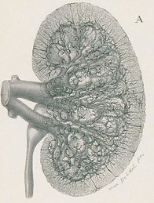
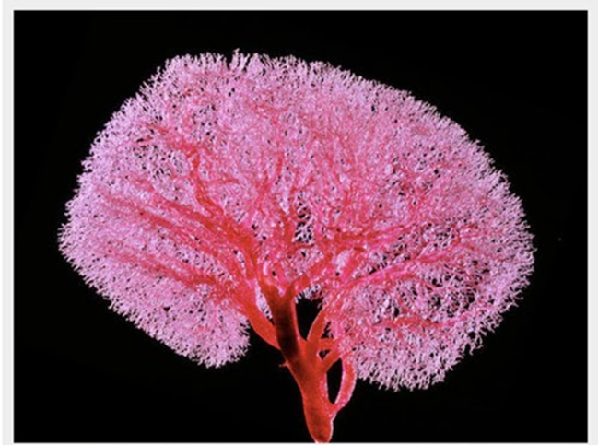
Renal Circulation
Notes:
~ 35% of people who suffer a heart attack will die from CHD within one year of the attack; ~ 14% of heart attacks are immediately fatal

Slide 61
Microvascular Disease (MVD) and Chronic Kidney Disease (CKD)
The vasculature is the core for the survival and function of every organ.
The kidney not only needs excellent circulation for its own nutrition, but also for the normal function of the rest of the body.
Chade, A. R. (2017). "Small Vessels, Big Role: Renal Microcirculation and Progression of Renal Injury.“ Hypertension, 69(4): 551-563.

Slide 62
Microvascular Disease (MVD) and Chronic Kidney Disease (CKD)
End stage renal disease (ESRD) has increased 60-fold in last four decades.
ESRD is incompatible with a high quality of life.
Chade, A. R. (2017). "Small Vessels, Big Role: Renal Microcirculation and Progression of Renal Injury.“ Hypertension, 69(4): 551-563.

Slide 63
MVD and CKD
The prevalence of CKD and ESRD is projected to continue increasing.
There is an urgent need to better understand the pathology of CKD so more effective therapies can be realized.
Chade, A. R. (2017). "Small Vessels, Big Role: Renal Microcirculation and Progression of Renal Injury.“ Hypertension, 69(4): 551-563.

Slide 64
MVD and CKD
Renal MVD is a universal pathological feature of CKD.
The renal microvasculature (MV) is critical for the metabolic and functional demands.
Chade, A. R. (2017). Hypertension, 69(4): 551-563.

Slide 65
MVD and CKD
The renal MV handles ~ 1.1 liters/min of cardiac output (~20%).
The majority of this flow is necessary to maintain body homeostasis as metabolic demands of the kidney only require ~10% of the flow.
Chade, A. R. (2017). Hypertension, 69(4): 551-563.

Slide 66
MVD and CKD
These vessels are responsible for removing waste from the body and tubular reabsorption of vital substances.
They are also involved in the nutrition of the kidney.
Chade, A. R. (2017). Hypertension, 69(4): 551-563.

Slide 67
MVD and CKD
Renal MVD plays a prominent role in renal injury and progression to ESRD.
More effective renal MVD therapies are needed.
Chade, A. R. (2017). Hypertension, 69(4): 551-563.

Slide 68
MVD and CKD
Increased incidence of obesity, DM, hyperlipidemia and hypertension are associated with increased CKD/ESRD.
Chronic systemic inflammation is frequently associated with CKD.
Chade, A. R. (2017). Hypertension, 69(4): 551-563.

Slide 69
MVD and CKD
These conditions not only drive ASVD in conduit arteries, but also in the micro vessels.
Renal MVD represents the silent phase of CKD.
Chade, A. R. (2017). Hypertension, 69(4): 551-563.

Slide 70
Unheralded Benefit of BDM

Slide 71
MVD and CKD
Studies show that superimposing dyslipidemia on renal artery stenosis accelerates renal MVD.
This can lead to loss of micro vessels underscoring the harmful effects of atherogenic factors on the renal parenchyma.
Chade, A. R. (2017). "Small Vessels, Big Role: Renal Microcirculation and Progression of Renal Injury.“ Hypertension, 69(4): 551-563.

Slide 72
MVD and CKD
MVD in the kidney involves both decreased function and decreased number of vessels.
Both vessel impairments cause renal dysfunction.
Chade, A. R. (2017). Hypertension, 69(4): 551-563.

Slide 73
MVD and CKD
Endothelial dysfunction is a key mechanism leading to renal MVD.
Endothelial dysfunction is a consequence of numerous CVD risk factors.
Chade, A. R. (2017). "Small Vessels, Big Role: Renal Microcirculation and Progression of Renal Injury.“ Hypertension, 69(4): 551-563.

Slide 74
MVD and CKD
Studies have shown that antioxidant vitamins, statins and RAAS blockers can preserve or recover endothelial function.
This in turn reduces the development and progression of renal injury.
Chade, A. R. (2017). Hypertension, 69(4): 551-563.

Slide 75
MVD and CKD
Hypertension and DM are the leading ‘causes’ of CKD/ESRD.
These conditions are known to significantly increase the risk of renal MVD.
Chade, A. R. (2017). Hypertension, 69(4): 551-563.

Slide 76
MVD and CKD
Maintaining a healthy renal microvasculature is key for the prevention of CKD/ESRD.
Therapeutic efforts must be instituted while the window of opportunity is open to halt or reverse renal MVD.
Chade, A. R. (2017). Hypertension, 69(4): 551-563.

Slide 77
BDM Thoughts
I must tell you that reading this paper brought tears to my eyes. The BDM has been silently enhancing lives beyond my realization. What a privilege and blessing to be involved in BDM.
We have never had a patient need dialysis; now I know why!
Notes:
~ 35% of people who suffer a heart attack will die from CHD within one year of the attack; ~ 14% of heart attacks are immediately fatal

Slide 78
Cerebral Circulation
Notes:
~ 35% of people who suffer a heart attack will die from CHD within one year of the attack; ~ 14% of heart attacks are immediately fatal

Slide 79
Cerebral Microvascular Disease (CMVD)
CMVD is one of most prevalent pathologic processes seen by neurologists.
MRI has increased detection.
Cannistraro, Rocco, et al. CNS small vessel disease: A clinical review. Neurology. 2019; 92 (24):1146-1156.
Notes:
~ 35% of people who suffer a heart attack will die from CHD within one year of the attack; ~ 14% of heart attacks are immediately fatal

Slide 80
CMVD- MRI Biomarker Diagnosis
Subcortical infarct
White matter hyperintensity (WMH)
Lacune
Cerebral microbleed (CMB)
Enlarged perivascular space (PVS)
Cerebral atrophy
Cannistraro, Rocco, et al. CNS small vessel disease: A clinical review. Neurology. 2019; 92 (24):1146-1156.
Notes:
A
lacune typically is a lesion ≤20 mm in diameter that affects the subcortical white matter and the deep gray matter of the brain and brainstem. It is a fluid-filled, gliotic cavity thought to be secondary to prior small subcortical infarcts
WMH, also known as leukoaraiosis, is by definition punctate, patchy, or confluent T2-weighted hyperintensity seen on MRI .
An enlarged PVS is a dilated space filled with CSF that surrounds perforating arterioles and venules, as they course from the subarachnoid space through the brain parenchyma.
CMB is a small area of focal hemosiderin deposition that indicates the previous extravasation of blood from damaged small vessels. Susceptibility-weighted imaging
(SWI), gradient-recalled echo (GRE), and T2*-weighted sequences detect small distortions in the magnetic field that can be induced by heavy metals, such as iron. These distortions are shown as a hypointense signal with “blooming artifact,” which is useful for identification of CMB (figure 4B). SWI is preferred for assessing CMB because it is considerably more sensitive than GRE and T2*-weighted sequences.

Slide 81
CMVD and Dementia
Endothelial cells are damaged by inflammation.
Increased cytokines such as TNF-alpha, IL-1 beta, IL-10, IL-21, IL-23 have been linked to white matter hyperintensities (WMH) which is the main surrogate marker for CMVD.
Hakim, A. M. (2019). "Small Vessel Disease.“ Frontiers in Neurology 10: 1020-1020.

Slide 82
CMVD and Dementia
CMVD causes reduced cerebral blood flow (CBF).
Decreased CBF heightens the risk of dementia.
Hakim, A. M. (2019). "Small Vessel Disease.“ Frontiers in Neurology 10: 1020-1020.

Slide 83
Microvascular Cerebral Disease (CMVD)
CMVD contributes to at least 45% of dementia cases and global functional decline.
CMVD causes about 25% of strokes.
Cannistraro, Rocco, et al. CNS small vessel disease: A clinical review. Neurology. 2019; 92 (24):1146-1156.
Notes:
~ 35% of people who suffer a heart attack will die from CHD within one year of the attack; ~ 14% of heart attacks are immediately fatal

Slide 84
MVD and Dementia
Reduced CBF not only prevents an adequate supply of energy to the brain, but also, impairs the ability to remove toxic molecules such as amyloid beta and tau proteins.
Therefore, no surprise that decreased CBF is also associated with Alzheimer’s disease (AD).
Hakim, A. M. (2019). "Small Vessel Disease.“ Frontiers in Neurology 10: 1020-1020.

Slide 85
Microvascular Cerebral Disease (CMVD)
CMVD includes the arterioles and capillaries.
These micro vessels are imbedded in the neurovascular unit (NVU).
Cannistraro, Rocco, et al. CNS small vessel disease: A clinical review. Neurology. 2019; 92 (24):1146-1156.
Notes:
~ 35% of people who suffer a heart attack will die from CHD within one year of the attack; ~ 14% of heart attacks are immediately fatal

Slide 86
Microvascular Cerebral Disease (CMVD)
The NVU architecture is involved in cerebrovascular and neurodegenerative disease.
The NVU regulates pathogen entry, entry of substances through the blood (BBB), delivery of oxygen and nutrients along with removal metabolic by-products and heat.
Cannistraro, Rocco, et al. CNS small vessel disease: A clinical review. Neurology. 2019; 92 (24):1146-1156.
Notes:
~ 35% of people who suffer a heart attack will die from CHD within one year of the attack; ~ 14% of heart attacks are immediately fatal

Slide 87
CMVD - Pathogenesis
Decreased CBF is associated with NVU dysfunction.
The reduced CBF can cause hypoxia, BBB leakage, inflammation, edema and oligodendrocyte dysfunction.
Cannistraro, Rocco, et al. CNS small vessel disease: A clinical review. Neurology. 2019; 92 (24):1146-1156.
Notes:
~ 35% of people who suffer a heart attack will die from CHD within one year of the attack; ~ 14% of heart attacks are immediately fatal

Slide 88
Microvascular Disease
Communication between the endothelium and various cells in the neurovascular unit (SMCs, pericytes, glial cells, astrocytes) is critical for a healthy blood brain barrier (BBB).
Therefore, CMVD leads to an impaired BBB.
Hakim, A. M. (2019). "Small Vessel Disease.“ Frontiers in Neurology 10: 1020-1020.

Slide 89
Microvascular Cerebral Disease (CMVD)
The NVU architecture differs in each vascular segment.
Cannistraro, Rocco, et al. CNS small vessel disease: A clinical review. Neurology. 2019; 92 (24):1146-1156.
Notes:
~ 35% of people who suffer a heart attack will die from CHD within one year of the attack; ~ 14% of heart attacks are immediately fatal

Slide 90
CMVD (arteriole)- NVU
Cannistraro, Rocco, et al. CNS small vessel disease: A clinical review. Neurology. 2019; 92 (24):1146-1156.
Notes:
~ 35% of people who suffer a heart attack will die from CHD within one year of the attack; ~ 14% of heart attacks are immediately fatal

Slide 91
CMVD (capillary)- NVU
Pericytes found in capillaries
SMCs found in arterioles
Cannistraro, Rocco, et al. CNS small vessel disease: A clinical review. Neurology. 2019; 92 (24):1146-1156.
Notes:
~ 35% of people who suffer a heart attack will die from CHD within one year of the attack; ~ 14% of heart attacks are immediately fatal

Slide 92
CMVD – Risk Factors
#1 is BP > 140/90
Age
DM
OSA
Smoking
CKD
ASVD with subcortical stroke
Hypercholesterolemia
Genetic –cerebral autosomal dominant arteriopathy with subcortical infarcts and leukoencephalopathy (CADASIL) ~3/100,000s
Cannistraro, Rocco, et al. CNS small vessel disease: A clinical review. Neurology. 2019; 92 (24):1146-1156.
Notes:
~ 35% of people who suffer a heart attack will die from CHD within one year of the attack; ~ 14% of heart attacks are immediately fatal

Slide 93
CMVD- Pathogenesis
The pathogenesis is believed to involve atherosclerosis and microaneurysm.
As the media-to-lumen ratio increases (akin to increasing CIMT) there is decreased cerebral blood flow (CBF).
Cannistraro, Rocco, et al. CNS small vessel disease: A clinical review. Neurology. 2019; 92 (24):1146-1156.
Notes:
~ 35% of people who suffer a heart attack will die from CHD within one year of the attack; ~ 14% of heart attacks are immediately fatal

Slide 94
CMVD - Pathogenesis
CMVD due to amyloid-B deposition occurs in the larger arterioles.
The deposits are in the tunica media surrounding the SMCs.
Cannistraro, Rocco, et al. CNS small vessel disease: A clinical review. Neurology. 2019; 92 (24):1146-1156.
Notes:
~ 35% of people who suffer a heart attack will die from CHD within one year of the attack; ~ 14% of heart attacks are immediately fatal

Slide 95
CMVD - Pathogenesis
This amyloid angiopathy causes loss of vessel compliance, decreased vessel reactivity and increased risk of CMB.
The above leads to altered NVU connectivity along with increased WMH and cortical atrophy.
Cannistraro, Rocco, et al. CNS small vessel disease: A clinical review. Neurology. 2019; 92 (24):1146-1156.
Notes:
~ 35% of people who suffer a heart attack will die from CHD within one year of the attack; ~ 14% of heart attacks are immediately fatal

Slide 96
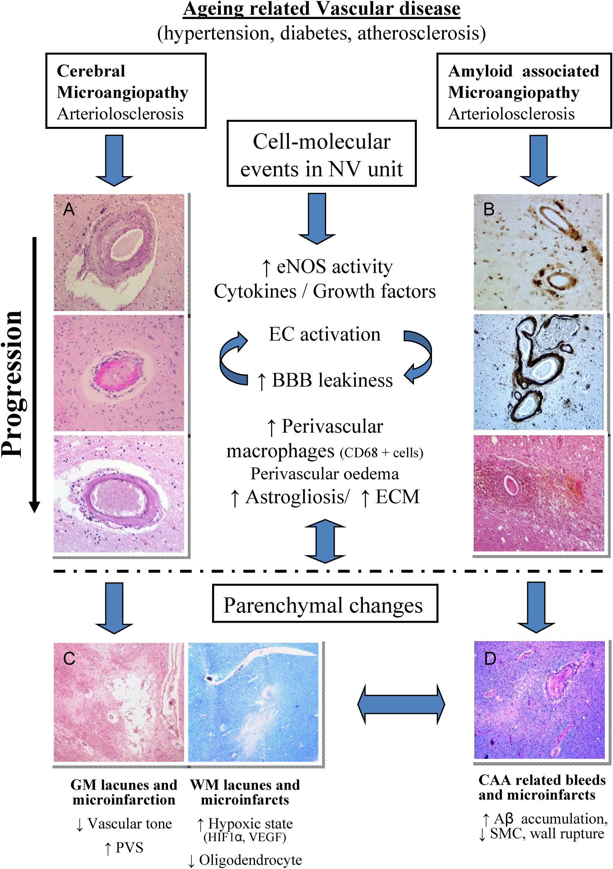
Vascular Dementia (VaD)
Kalaria, R. N. (2012). Stroke, 43(9), 2526-2534.
Notes:
Scheme showing progressive vascular and parenchymal changes linked to different but interconnected mechanisms. Microangiopathies occurring as nonamyloid, for example, hypertensive type (A) involve vascular degenerative processes progressing from loss of smooth muscle cells, wall thickening, fibroid necrosis to hyalinosis, and collagenosis. Cerebral amyloid angiopathies (CAAs; B) involve deposition of fibrillar protein, loss of smooth muscle cells, and intimal thickening. Both processes may lead to common parenchymal
changes involving gray matter (GM) and white matter (WM) microinfarctions and rarefaction. A series of molecular and perivascular cellular stages is apparent manifested by activation of the endothelium, concomitant breach of the blood–brain barrier and perivascular glial responses. Microhemorrhages or bleeds (B, D) within the tissue may be caused by leakage from microvessels through both mechanisms include microaneurysms and rupture of walls due to deposition of fibrillar proteins or iron. Increased perivascular spacing occurs because of reduction in arterial vascular tone and lack of perivascular solute drainage. The WM changes ensue due to a chronic hypoxic state and decline in oligodendrocytes. A, Vessel wall thickening, fibroid necrosis, lipohyalinosis, or hyalinization. B, arteriolar and focal A deposits, severe CAA, and CAA-related microhaemorrhage. C, Microinfarcts in putamen and WM. D, CAA-related rarefaction and microhemorrhages. A indicates amyloid protein; BBB, blood–brain barrier; CD68, cluster of differentiation marker. for microglia; EC, endothelial cell; ECM, extracellular matrix; eNOS, endothelial nitric oxide synthase; HIF-1, hypoxia inducible factor 1; NV, neurovascular; PVS, perivascular space; SMC, smooth muscle cell; VEGF, vascular endothelial growth factor; WM, white matter.

Slide 97
CMVD Clinical Presentation
Clinical findings range from asymptomatic to mild sx’s of cognitive dysfunction with incidental MRI dx.
Others may have acute strokes, dementia, mood disturbances, gait dysfunction, movement disorders and general decline in function.
Cannistraro, Rocco, et al. CNS small vessel disease: A clinical review. Neurology. 2019; 92 (24):1146-1156.
Notes:
~ 35% of people who suffer a heart attack will die from CHD within one year of the attack; ~ 14% of heart attacks are immediately fatal

Slide 98
CMVD Clinical Presentation
Amyloid angiopathy may present with focal spells of weakness or numbness.
This condition may also present with various stages of cognitive impairment.
Cannistraro, Rocco, et al. CNS small vessel disease: A clinical review. Neurology. 2019; 92 (24):1146-1156.
Notes:
~ 35% of people who suffer a heart attack will die from CHD within one year of the attack; ~ 14% of heart attacks are immediately fatal

Slide 99
CMVD- Presentation
Capillary amyloid angiopathy is associated with Alzheimer dementia.
One form is related to inflammation from amyloid deposits which causes altered mental status, focal neurological deficits and seizures.
Cannistraro, Rocco, et al. CNS small vessel disease: A clinical review. Neurology. 2019; 92 (24):1146-1156.
Notes:
~ 35% of people who suffer a heart attack will die from CHD within one year of the attack; ~ 14% of heart attacks are immediately fatal

Slide 100
CMVD- Prevention & Treatment
Prevention is limited due to incomplete understanding of the pathogenesis.
Treatment is based on risk factors, MRI biomarkers and severity of clinical presentation.
Cannistraro, Rocco, et al. CNS small vessel disease: A clinical review. Neurology. 2019; 92 (24):1146-1156.
Notes:
~ 35% of people who suffer a heart attack will die from CHD within one year of the attack; ~ 14% of heart attacks are immediately fatal

Slide 101
MVD and Dementia
Success in lowering the risk of dementia depends on reducing vascular risk factors.
Several books are available now giving dementia reducing advice.
Hakim A. Save Your Mind. Seven Rules to Avoid Dementia. Toronto, ON: Barlow Publishing (2017).
Sherzai D, Sherzai A. The Alzheimer’s Solution: A Breakthrough Program to Prevent and Reverse the Symptoms of Cognitive Decline at Every Age. New York, NY: Harper Collins Publishers (2017).
Hakim, A. M. (2019). "Small Vessel Disease.“ Frontiers in Neurology 10: 1020-1020.

Slide 102
BDM Thoughts
There is no question CMVD is a significant player in dementia and Alzheimer’s.
It is reasonable to believe halting, stabilizing and regressing arterial disease will have a positive impact on CMVD and the related conditions of dementia and Alzheimer’s.
We have anecdotal evidence of that with a very low incidence of cognitive impairment.
There is accumulating evidence that virtually all of the root causes of arterial inflammation managed by the BDM influence dementia and Alzheimer’s risk.
Notes:
~ 35% of people who suffer a heart attack will die from CHD within one year of the attack; ~ 14% of heart attacks are immediately fatal

Slide 103
Dementia and Alzheimer’s -Who is at Risk?
Anyone with vascular risk factors including:
Depression
Smoking
BP (syst >120 mmHg)
Age
Obesity
Insulin resistance
Hyperlipidemia
Sleep disorders
Gut microbiome
Harmful lifestyles
Hakim, A. M. (2019). "Small Vessel Disease.“ Frontiers in Neurology 10: 1020-1020.

Slide 104
BDM Thoughts
He missed some! ☺
Periodontal disease
Infectious disease
Vitamin D deficiency
Psychosocial – paucity of mental stimulation
Autoimmune diseases
Notes:
~ 35% of people who suffer a heart attack will die from CHD within one year of the attack; ~ 14% of heart attacks are immediately fatal

Slide 105
Dominy, S. S., et. al. (2019). Porphyromonas gingivalis in Alzheimer’s disease brains: Evidence for disease causation and treatment with small-molecule inhibitors. J Science Advances 5(1):eaau3333.
Riviere, G. R., Riviere, K. H., & Smith, K. S. (2002). Molecular and immunological evidence of oral Treponema in the human brain and their association with Alzheimer's disease. Oral Microbiology and Immunology, 17(2), 113-118.
Almeida, O., & Lautenschlager, N. (2005). Dementia associated with infectious diseases. International Psychogeriatrics, 17(S1), S65-S77.
Littlejohns, T. J., et. al. (2014). Vitamin D and the risk of dementia and Alzheimer disease. Neurology, 83(10), 920-928.
Wilson, R. S., et. al. (2002). Participation in cognitively stimulating activities and risk of incident alzheimer disease. JAMA, 287(6), 742-748.
Wotton CJ, Goldacre MJ. Associations between specific autoimmune diseases and subsequent dementia: retrospective record-linkage cohort study, UK. J Epidemiol Community Health. 2017;71(6):576‐583

Slide 106
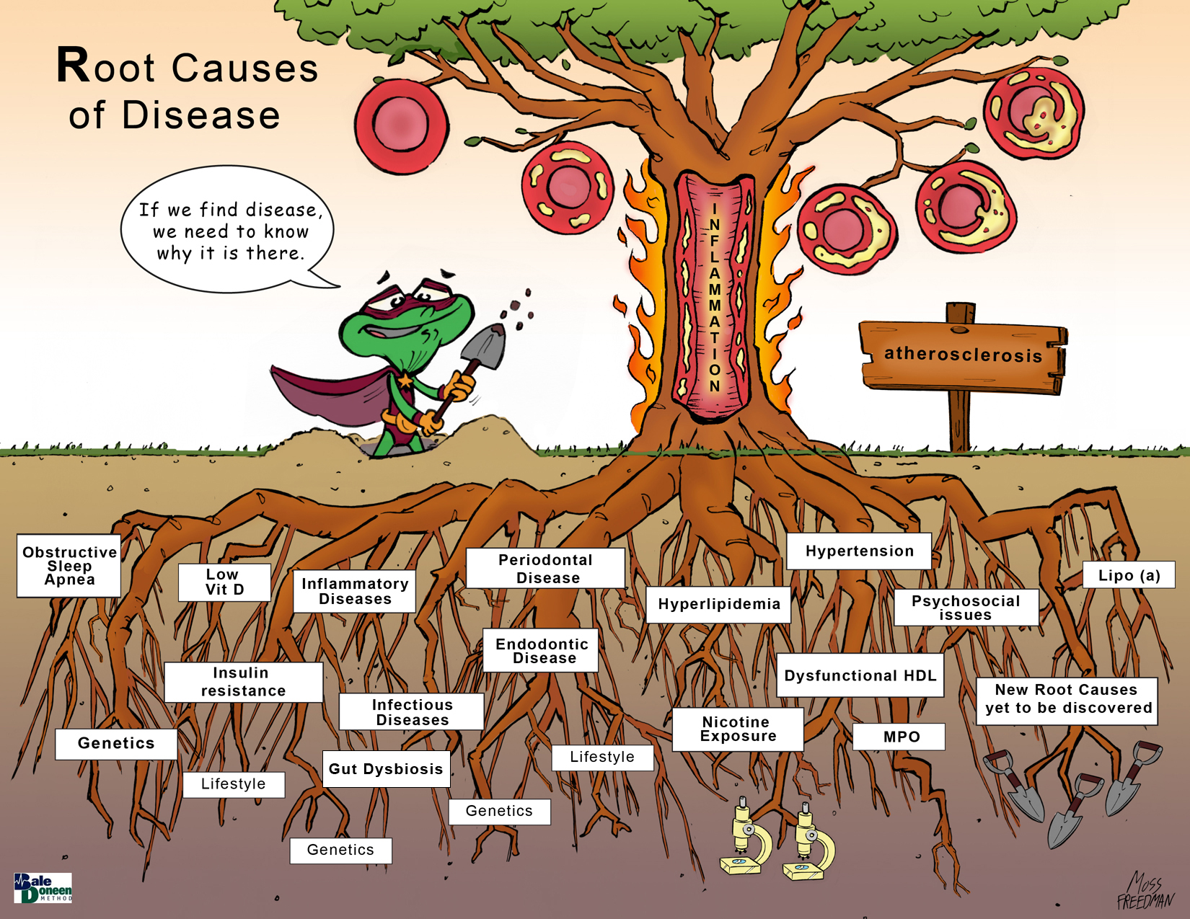
Endodontic Disease
Kinney, J. W., et al. (2018). "Inflammation as a central mechanism in Alzheimer's disease." Alzheimer's & dementia (New York, N. Y.) 4: 575-590.

Slide 107
Penial Circulation
This Photo by Unknown Author is licensed under CC BY-NC-ND
Notes:
~ 35% of people who suffer a heart attack will die from CHD within one year of the attack; ~ 14% of heart attacks are immediately fatal

Slide 108
Penile Artery Flow During an Erection
20 healthy volunteers 45 to 60 yo with histories of normal sexual function.
Blood flow volume increased 3-fold for the superficial penile arteries and 4-fold for the deep cavernous arteries.
>10 cc per min of blood flow volume.
Lee, B., et al. (1993). "Standardization of Penile Blood Flow Parameters in Normal Men Using Intracavernous Prostaglandin E1 and Visual Sexual Stimulation." Journal of Urology 149(1): 49-52.

Slide 109
Cardiac Output Relatively High to Erect Penis
% body mass
~2.5%
~8%
~0.7%
~0.5%
~ 2%
~15%
~40%
Fat ~20%
%CO/%BM
40X
3X
3.5X
40X
7.5X
Cardiac Output 100% 20-25% 4-5% 20% 15% 3-5% 15-20% 4-5%
5L/min lung gut heart kidney brain bone muscle skin
Åstrand, P.-O., et al. (2003). Textbook of work physiology: physiological bases of exercise, Human Kinetics.
.
.

Slide 110
Microvascular Disease (MVD) Associated with Erectile Dysfunction (ED)
ED is known to be predominantly a vascular disease of penile circulation.
ED usually precedes CV events by 3-5 years.
Reriani, M., et al. (2014). "Microvascular endothelial dysfunction predicts the development of erectile dysfunction in men with coronary atherosclerosis without critical stenoses." Coronary artery disease 25(7): 552-557.
.

Slide 111
MVD Associated with ED
Coronary endothelial dysfunction is independently associated with ED.
It is unknown if coronary microvascular endothelial dysfunction (MVD) is associated with ED
Reriani, M., et al. (2014). Coronary artery disease 25(7): 552-557.
.

Slide 112
MVD Associated with ED
130 pts with non-stenotic CAD and without ED; baseline evaluation for coronary MVD; MVD defined as <50% increase in coronary blood flow (CBF) in response to the maximal dose of ACh compared with baseline CBF; mean follow-up 8.5 yrs.
Primary outcome: new onset ED.
Reriani, M., et al. (2014). Coronary artery disease 25(7): 552-557.
.

Slide 113
MVD Associated with ED
Pts. mean age 50; 44% BP; 64% hyperlipid.; 10% DM; 60% fam hx CAD.
68 (52%) had MVD.
Reriani, M., et al. (2014). Coronary artery disease 25(7): 552-557.
.

Slide 114
MVD Associated with ED
54 pts developed new onset ED.
35 had MVD.
Reriani, M., et al. (2014). Coronary artery disease 25(7): 552-557.
.

Slide 115
MVD Associated with ED
After adjusting for age, BMI, smoking, BP, lipids, DM, ASVD, Fam hx CAD, only MVD and age predicted ED.
MVD OR- 2.67 (95% CI, 1.13-6.6) p=0.024
Reriani, M., et al. (2014). Coronary artery disease 25(7): 552-557.
.

Slide 116
MVD Associated with ED
MVD in pts with non-stenotic CAD independently predicts ED development.
This supports an important role of MVD as a mechanism for ED.
Reriani, M., et al. (2014). Coronary artery disease 25(7): 552-557.
.

Slide 117
MVD Associated with ED
Since ASVD is a systemic condition, MVD in any vascular bed should signal increased risk for ED.
MVD within the penis would have a negative effect on the perfusion and oxygenation of the penis and its autonomic nerves.
Reriani, M., et al. (2014). Coronary artery disease 25(7): 552-557.
.

Slide 118
MVD Associated with ED
Conclusion:
This study supports the role of MVD as a mechanism and potential therapeutic target in ED.
Reriani, M., et al. (2014). Coronary artery disease 25(7): 552-557.
.

Slide 119
BDM Thoughts
MVD appears to be a very important player in ED.
There are over 620,000 new cases of ED annually.
The association of ED & MVD helps explain the low incidence of new onset ED in BDM pts.
ED significantly impacts the quality of life.
The great news it is preventable with comprehensive CVD care- BDM!
We should investigate the potential association of MVD with sexual dysfunction in women.
Notes:
~ 35% of people who suffer a heart attack will die from CHD within one year of the attack; ~ 14% of heart attacks are immediately fatal

Slide 120
Overall BDM Thoughts
As noted in Dr. Hakim’s paper, MVD is related to diseases of the retina including blindness.
We invite our ophthalmologist BDM providers to develop a webinar for us on that subject.
Advances in vascular biology have outlined a central and multifaceted pathogenic role of MVD in the initiation and perpetuation of irritable bowel disease (IBD). (Am J Pathol. 2008 Jun; 172(6): 1457–1466)
It seems reasonable to believe there will be an explosion of GI tract MVD research.
If any BDM provider uncovers such work, please let us know.
Notes:
~ 35% of people who suffer a heart attack will die from CHD within one year of the attack; ~ 14% of heart attacks are immediately fatal

Slide 121
BDM Thoughts
Characteristics of periodontitis that are unexplained may be accounted for because of MVD. (Microsc Res Tech. 2002 Jan 1;56(1):15-31)
It appears exploration of MVD in oral disease is wide open!
We invite our dental colleagues to keep us up to date with evolving research in this arena.
Dr. Hakim: “MVD is perhaps the main etiology for all major medical and neurological conditions.”
The BDM AHAforLife program is a solution.
Notes:
~ 35% of people who suffer a heart attack will die from CHD within one year of the attack; ~ 14% of heart attacks are immediately fatal

Slide 122
This Benefit of BDM Will Drive the Future

Slide 123
Upcoming Presentations

Slide 124
Upcoming Events for BaleDoneen
Our virtual preceptorship delivered April 17-18 is CME and CE approved for 16 hrs; it will be available on June 15th as enduring material.
Virtual preceptorship delivered live Sept. 18-19.
Great response with over 1,100 views of the Ternary paper in Frontiers of CV Medicine!
https://www.frontiersin.org/articles/10.3389/fcvm.2020.00092/full
Notes:
~ 35% of people who suffer a heart attack will die from CHD within one year of the attack; ~ 14% of heart attacks are immediately fatal

Slide 125
Open for Discussion

