Slide 1
Bale/Doneen Live Scientific Update Session
Amy Doneen DNP, ARNP
March 13, 2019
5:30-6:30 pm PST

Slide 2
Is it March?
March 12, 2019 (5:30 am)
March 13, 2019 (7:45 am)

Slide 3
There has been so much attention on sleep recently and in light of the new basic science article in Nature about sleep and ASVD – it seemed warranted to focus this month on sleep!
However – that left many great articles out of the ‘top’ to cover due to time constraints! Stay engaged – these will be in preceptorship of course!
Vaping and CV risk
Gut and Depression
Testosterone and increased CV risk
Methotrexate fails to reduce CV risk
BP and AHA statement
Blueberries and CV reduction.

Slide 4
Its all about sleep this month!
A pulse of the current science – sleep fragmentation and OSA
1. Fragmented sleep is associated with atherosclerosis - Nature
2. Poor sleep is associated with ASVD in humans – JACC
3. Poor sleep causes microvascular damage to the heart
Demographics:
4. Men – libido and nocturia
5. Women – Menopause
6. Women – Pre-eclampsia
7. Adolescence and Sleep
Treatment opportunities beyond CPAP:
8. Mandibular Advancement Devices
9. Oral Appliances
10. Myofunction Therapy
Agenda for March 2019
BaleDoneen Study Club

Slide 5
Nicotine
Sleep Issues
Endodontic Disease
Gut dysbiosis

Slide 6
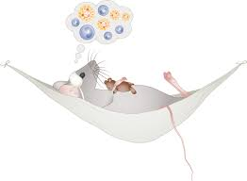
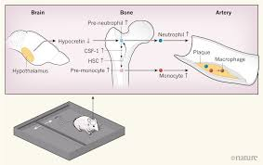
This article in NATURE really shaped this month’s scientific update session and left me wanting to know more

Slide 7
Sleep modulates haematopoiesis and protects against atherosclerosis
Disrupted sleep increases risk of multiple pathological conditions – including CVD.
McAlpine et al took a deep dive int the cellular and molecular mechanisms by which sleep maintains CV health.
Albeit a mice study – research demonstrated that sleep fragmentation produces an increase in Ly-6C monocytes, larger atherosclerotic lesions and less hypocretin in the lateral hypothalamus.
McAlpine, Ca., Kiss, M., Rattik, S. et al. (2019). Sleep modulates haemoatopoiesis and protects against atherosclerosis. Nature. https://doi.org/10.1038/s41586-019-0948-2.

Slide 8
Sleep modulates haematopoiesis and protects against atherosclerosis
A few definitions to aid in understanding the importance of this research.
Haematopoiesis – the growth and maturation of blood cells in bone marrow.
Atherosclerosis – defined in this research as the recruitment monocytes into the intima/media of the artery. They used dissected aortic tissue.
Hypocretin - neuropeptide that regulates arousal, wakefulness, and appetite – Current research cites that reduced plasma hypocrein is associated with risk of myocardial infarction, heart failure and obesity
Myelopoiesis - production of bone marrow and of all cells that arise from it.
CSF1 - The colony stimulating factor 1, also known as macrophage colony-stimulating factor, is a secreted cytokine which causes hematopoietic stem cells to differentiate into macrophages or other related cell types.
Ly6C Monocyte – endothelial cell differentiation antigen – in early phase of inflammation, Ly6C monocytes invade tissue.
McAlpine, Ca., Kiss, M., Rattik, S. et al. (2019). Sleep modulates haemoatopoiesis and protects against atherosclerosis. Nature. https://doi.org/10.1038/s41586-019-0948-2.

Slide 9
Sleep modulates haematopoiesis and protects against atherosclerosis
What was the study design (oversimplified)
Subjected mice to chronic sleep fragmentation
Evaluated circulating leukocyte migration to tissues and profiled leukocytes in various organs.
Then focused on haematopoiesis – showing SF increased proliferation of lineage haematopoietic progenitors in bone marrow.
Then focused on hypothalamus – expression of transcripts that encode sleep-regulating proteins – showing SF decreased expression of hypocretin (Hcrt) in the hypothalamus which correlated inversely to leukocytes.
Then tested whether hypocretin can affect haematopoiesis and atherosclerosis. Found that hypothalmus produced nearly all of the hypocretin, not the bone marrow.
Then finding a link between hypocretin, haematopoiesis and atherosclerosis, examined the underlying mechanism.
Ulimately determining that sleep protects against atherosclerosis.
McAlpine, Ca., Kiss, M., Rattik, S. et al. (2019). Sleep modulates haemoatopoiesis and protects against atherosclerosis. Nature. https://doi.org/10.1038/s41586-019-0948-2.

Slide 10
Sleep modulates haematopoiesis and protects against atherosclerosis
To investigate how sleep might protect against cardiovascular disease, researches subjected atherosclerosis-prone mice to chronic sleep fragmentation (SF).
Researchers found no changes in body weight, plasma cholesterol or glucose tolerance, however, mice developed progressively larger atherosclerotic lesions compared to controls
Not only did lesion volume increase in SF mice but aortas from SF mice contained more Ly-6C high monocytes, neutrophils and macrophages.
McAlpine, Ca., Kiss, M., Rattik, S. et al. (2019). Sleep modulates haemoatopoiesis and protects against atherosclerosis. Nature. https://doi.org/10.1038/s41586-019-0948-2.

Slide 12
Sleep modulates haematopoiesis and protects against atherosclerosis
Hypocretin controls myelopoiesis by restricting the production of CSF1 by hypocretin-receptor-expressing pre-neutrophils in the bone marrow.
Hypocretin-null and haematopoietic hypocretin-receptor-null mice develop monocytosis and accelerated atherosclerosis.
Sleep fragmented mice with either haematopoietic CSF1 deficiency or hypocretin supplementation have reduced numbers of circulating monocytes and smaller atherosclerotic lesions.
These results identify a neuro-immune axis that links sleep to haematopoiesis and atherosclerosis.
McAlpine, Ca., Kiss, M., Rattik, S. et al. (2019). Sleep modulates haemoatopoiesis and protects against atherosclerosis. Nature. https://doi.org/10.1038/s41586-019-0948-2.

Slide 13
Sleep modulates haematopoiesis and protects against atherosclerosis
Mice subjected to sleep fragmentation had significantly more circulating Ly-6C high monocytes and neutrophils during the light period.
To understand the influence of sleep on circadian leukocyte migration researchers profiled leukocytes in various organs.
Both control and SF mice had elevated Ly-6C high monocyte and neutrophil levels in various tissues during the dark period, and these increases were higher in SF mice.
These observations align with human studies that have linked sleep curtailment or interruption with leukocyte number
McAlpine, Ca., Kiss, M., Rattik, S. et al. (2019). Sleep modulates haemoatopoiesis and protects against atherosclerosis. Nature. https://doi.org/10.1038/s41586-019-0948-2.

Slide 14
Sleep modulates haematopoiesis and protects against atherosclerosis
Researchers focused on the hypothalamus and, specifically, on expression of transcripts that encode sleep-regulating proteins.
Sleep fragmentation decreased expression of hypocretin (Hcrt, also known as orexin) in the hypothalamus, correlating with reduced levels of the isoform hypocretin-1 in plasma and bone marrow.
Hypothalamic hypocretin reduced gradually and correlated inversely with leukocytosis.
Hypocretin mediates metabolism, sleep and appetite, and autoimmune destruction of hypocretin neurons causes narcolepsy and a pro-inflammatory immune signature.
McAlpine, Ca., Kiss, M., Rattik, S. et al. (2019). Sleep modulates haemoatopoiesis and protects against atherosclerosis. Nature. https://doi.org/10.1038/s41586-019-0948-2.

Slide 15
Sleep modulates haematopoiesis and protects against atherosclerosis
Some Conclusions by the research –
Mice subjected to sleep fragmentation that received hypocretin had fewer monocytes and neutrophils in the blood and reduced proliferation and lower levels of CSF1 in the bone marrow and smaller atherosclerotic lesions. These results demonstrated that hypocretin loss during sleep fragmentation aggravates haematopoiesis and atherosclerosis.
Data indicate that sleep protects against atherosclerosis. Undisturbed sleep maintains proper hypothalamic release of hypocretin, which limits pre-neutrophil activity in the bone marrow, thereby curtailing haematopoeiesis and atherosclerosis.
This neuro-immune axis directly connects sleep to immune function and cardiovascular disease.
McAlpine, Ca., Kiss, M., Rattik, S. et al. (2019). Sleep modulates haemoatopoiesis and protects against atherosclerosis. Nature. https://doi.org/10.1038/s41586-019-0948-2.

Slide 16
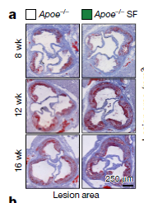
Sleep modulates haematopoiesis and protects against atherosclerosis
A. Cross-sections of aortic roots stained with oil red O and quantification of atherosclerotic lesion areas after varying lengths of sleep fragmentation
K. Model of the role of sleep in regulating hypocretin production, haematopoiesis and atherosclerosis.
McAlpine, Ca., Kiss, M., Rattik, S. et al. (2019). Sleep modulates haemoatopoiesis and protects against atherosclerosis. Nature. https://doi.org/10.1038/s41586-019-0948-2.

Slide 17
Sleep modulates haematopoiesis and protects against atherosclerosis
BaleDoneen Take-Away:
This is extremely eloquent and complex microbiology research that highlights the importance of sleep quality and sleep fragmentation.
Because of this research, we must not simply focus on OSA in CV Prevention but rather sleep quality and sleep fragmentation.
Many mechanisms (external forces and internal forces) can effect sleep fragmentation – do a thorough sleep discussion with your patients.
Appreciate the various substances that can affect hypocretin – alcohol, opiods, sleeping agents, hormone misbalance.
Get patients properly diagnosed – be aware of narcolepsy and the complexity of the neuro-hypocretin system. Extremely complex. Can’t fix this with a CPAP, sleep appliance or manipulative therapy!
McAlpine, Ca., Kiss, M., Rattik, S. et al. (2019). Sleep modulates haemoatopoiesis and protects against atherosclerosis. Nature. https://doi.org/10.1038/s41586-019-0948-2.

Slide 18
Now let’s move to humans and sleep fragmentation

Slide 19
Association of Sleep Duration and Quality With Subclinical Atherosclerosis
The purpose of this study was to evaluate the association of sleep parameters with subclinical atherosclerosis in an asymptomatic middle-aged population.
Also to investigate interactions among sleep, conventional risk factors, psychosocial factors, dietary habits, and inflammation.
Dominguez, R., Fuster, V., Fernadez-Alvira, J. et al. (2019). Association of sleep duration and quality with subclinical atherosclerosis.JACC. Vol.73 (2). 135-144.

Slide 20
Association of Sleep Duration and Quality With Subclinical Atherosclerosis
Seven-day actigraphic recording was performed in 3,974 participants (age 45.8 4.3 years; 62.6% men) from the PESA
(Progression of Early Subclinical Atherosclerosis)
N=2,488 men (62.6%) and 1,486 women (37.4%)
Four groups were defined:
Very short sleep duration <6 hours
Short sleep duration 6 to 7 hours
Reference sleep duration 7 to 8 hours
Long sleep duration >8 hours
Dominguez, R., Fuster, V., Fernadez-Alvira, J. et al. (2019). Association of sleep duration and quality with subclinical atherosclerosis.JACC. Vol.73 (2). 135-144.

Slide 21
Association of Sleep Duration and Quality With Subclinical Atherosclerosis
Sleep fragmentation index:
The sum of the movement index and fragmentation index.
Subclinical Atherosclerosis:
Carotid and femoral 3-dimensional vascular ultrasound and cardiac computed tomography were performed to quantify noncoronary atherosclerosis and coronary calcification
Dominguez, R., Fuster, V., Fernadez-Alvira, J. et al. (2019). Association of sleep duration and quality with subclinical atherosclerosis.JACC. Vol.73 (2). 135-144.

Slide 22
Association of Sleep Duration and Quality With Subclinical Atherosclerosis
Sleep quality:
Assessed by the total sleep Fragmentation Index (SFI), which is defined as the sum of the movement index (MI) and the fragmentation index (FI).
MI is the percentage of epochs with y-axis counts >0 in the sleep period.
FI is the percentage of 1-min periods of sleep versus all periods of sleep.
Sleep Habits Questionnaire - developed and validated by the Sleep Heart Health Study
Dominguez, R., Fuster, V., Fernadez-Alvira, J. et al. (2019). Association of sleep duration and quality with subclinical atherosclerosis.JACC. Vol.73 (2). 135-144.

Slide 23
Association of Sleep Duration and Quality With Subclinical Atherosclerosis
Psychosocial Evaluation
The presence of depressive symptoms was evaluated by the Center for Epidemiological Studies-Depression
(CES-D) scale.
Participants also completed the Perceived Stress Scale (PSS) (30), which is widely used for measuring nonspecific perceived stress.
Dominguez, R., Fuster, V., Fernadez-Alvira, J. et al. (2019). Association of sleep duration and quality with subclinical atherosclerosis.JACC. Vol.73 (2). 135-144.

Slide 24
Association of Sleep Duration and Quality With Subclinical Atherosclerosis
Assessment of Subclinical Atherosclerosis
Carotid and Femoral Arteries:
3D VUS studies using a volumetric-linear array transducer to evaluate plaque burden in the bilateral carotid and femoral arteries (currently no standard definition for plaque presence using 3D VUS)
Coronary Arteries:
A 16-slice CT scan was used to quantify the Agatston coronary calcium score (CACS), which was categorized as 0, <1, 1 to 100, 101 to 400, and >400
Dominguez, R., Fuster, V., Fernadez-Alvira, J. et al. (2019). Association of sleep duration and quality with subclinical atherosclerosis.JACC. Vol.73 (2). 135-144.

Slide 25
Association of Sleep Duration and Quality With Subclinical Atherosclerosis
Assessment of Inflammatory Biomarkers:
Neutrophil count
P selectin*
hs-CRP
VCAM**
**protein that functions as a cell adhesion molecule on endothelial cells.
*vascular cell adhesion molecule
Dominguez, R., Fuster, V., Fernadez-Alvira, J. et al. (2019). Association of sleep duration and quality with subclinical atherosclerosis.JACC. Vol.73 (2). 135-144.

Slide 26
Association of Sleep Duration and Quality With Subclinical Atherosclerosis
Statistically significant baseline characteristics and worsening sleep time:
Age, male, smoking, alcohol, BMI, BP, HTN, HTN Rx, HDL, TG, Metabolic Syndrome, Worsening STOP-Bang, VCAM, P-selectin, Benzodiazepine Rx
Dominguez, R., Fuster, V., Fernadez-Alvira, J. et al. (2019). Association of sleep duration and quality with subclinical atherosclerosis.JACC. Vol.73 (2). 135-144.

Slide 27
Association of Sleep Duration and Quality With Subclinical Atherosclerosis
Dominguez, R., Fuster, V., Fernadez-Alvira, J. et al. (2019). Association of sleep duration and quality with subclinical atherosclerosis.JACC. Vol.73 (2). 135-144.

Slide 28
Association of Sleep Duration and Quality With Subclinical Atherosclerosis
Dominguez, R., Fuster, V., Fernadez-Alvira, J. et al. (2019). Association of sleep duration and quality with subclinical atherosclerosis.JACC. Vol.73 (2). 135-144.

Slide 29
Association of Sleep Duration and Quality With Subclinical Atherosclerosis
Dominguez, R., Fuster, V., Fernadez-Alvira, J. et al. (2019). Association of sleep duration and quality with subclinical atherosclerosis.JACC. Vol.73 (2). 135-144.

Slide 30
Association of Sleep Duration and Quality With Subclinical Atherosclerosis
Dominguez, R., Fuster, V., Fernadez-Alvira, J. et al. (2019). Association of sleep duration and quality with subclinical atherosclerosis.JACC. Vol.73 (2). 135-144.

Slide 31
Association of Sleep Duration and Quality With Subclinical Atherosclerosis
< 6 hours sleep was independently associated with a higher atherosclerotic burden with 3-d VUS compared to the reference group
(OR: 1.27; 95% CI 1.06 to 1.52; p < 0.008)
Participants within the highest quintile of sleep fragmentation presented a higher prevalence of multiple affected noncoronary territories
(OR: 1.34; 95% CI: 1.09 to 1.64; p < 0.006)
No differences were observed regarding coronary artery calcification score in the different sleep groups.
Lower sleeping times and fragmented sleep are independently associated with an increased risk of subclinical multi territory atherosclerosis.
Dominguez, R., Fuster, V., Fernadez-Alvira, J. et al. (2019). Association of sleep duration and quality with subclinical atherosclerosis.JACC. Vol.73 (2). 135-144.

Slide 32
Association of Sleep Duration and Quality With Subclinical Atherosclerosis
BaleDoneen Take-Away:
1. Poor sleep quality and fragmentation of sleep are risk factors for ASVD.
2. Several metabolic parameters are statistically associated with poor sleep.
3. Screening for sleep quality must be part of a BaleDoneen work up.
4. Add a sleep quality questionnaire in addition to the STOP-BANG.
5. Root should say “Sleep Issues” and not just “OSA”
6. While study was good – wish they would have included more inflammatory markers such as: Lp-PLA2, MACR, MPO, hsTn, Galectin 3, NT-ProBNP
Dominguez, R., Fuster, V., Fernadez-Alvira, J. et al. (2019). Association of sleep duration and quality with subclinical atherosclerosis.JACC. Vol.73 (2). 135-144.

Slide 33
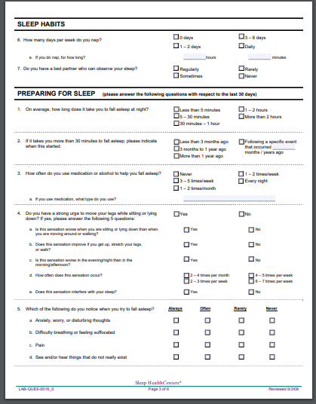
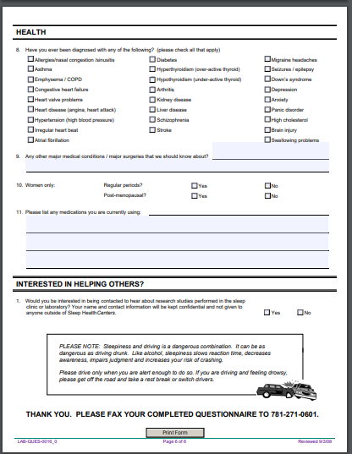
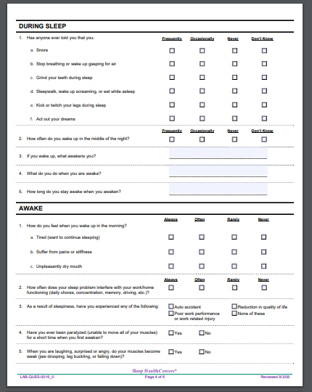
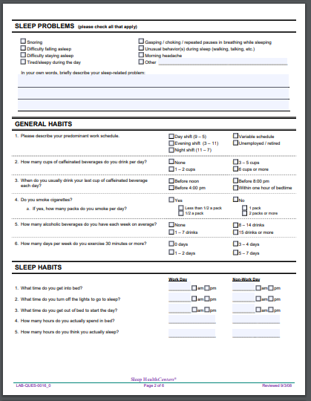
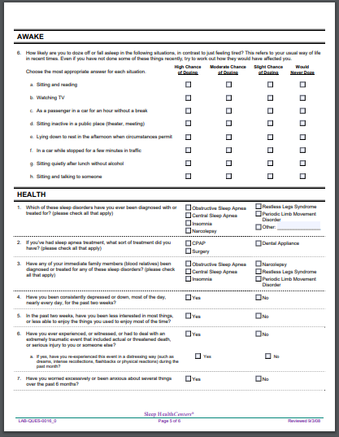
An example of a sleep quality questionnaire
Dominguez, R., Fuster, V., Fernadez-Alvira, J. et al. (2019). Association of sleep duration and quality with subclinical atherosclerosis.JACC. Vol.73 (2). 135-144.

Slide 34
Let’s move into Obstructive Sleep Apnea but through the lens of subclinical injury of the myocardium using hsTnT as an assessment tool.

Slide 35
Sleep Apnea Is Associated with Subclinical Myocardial Injury in the Community The ARIC-SHHS Study
Aimed to determine whether more severe OSA, measured by the Respiratory Disturbance Index (RDI), is associated with subclinical myocardial injury and increased myocardial wall stress
A total of 1,645 participants (62.5 6 5.5 yr and 54% women) free of coronary heart disease and heart failure and participating in both the Atherosclerosis Risk in the Communities (ARIC) and the Sleep Heart Health Studies underwent overnight polysomnography and measurement of hs-TnT and NT-proBNP.
Roca, G., Redline, S., Punjabi, N. et al. (2013). Sleep apnea in associated with subclinical myocardial injury in the community: The ARIC-SHHS Study. Am J Respir Crit Care Med Vol 188, Iss. 12, pp 1460–1465, Dec 15, 2013

Slide 36
Sleep Apnea Is Associated with Subclinical Myocardial Injury in the Community The ARIC-SHHS Study
OSA severity was defined using conventional clinical categories: none (RDI < 5), mild (RDI 5–15), moderate (RDI 15–30), and severe (RDI >30).
Hs-TnT, but not NTproBNP, was associated with OSA after adjusting for 17 potential confounders (P < 0.02).
Over a median of 12.4 years follow-up, hs-TnT was related to risk of death or incident heart failure in all OSA categories (P<0.05 in each category).
Roca, G., Redline, S., Punjabi, N. et al. (2013). Sleep apnea in associated with subclinical myocardial injury in the community: The ARIC-SHHS Study. Am J Respir Crit Care Med Vol 188, Iss. 12, pp 1460–1465, Dec 15, 2013

Slide 37
Sleep Apnea Is Associated with Subclinical Myocardial Injury in the Community The ARIC-SHHS Study
Roca, G., Redline, S., Punjabi, N. et al. (2013). Sleep apnea in associated with subclinical myocardial injury in the community: The ARIC-SHHS Study. Am J Respir Crit Care Med Vol 188, Iss. 12, pp 1460–1465, Dec 15, 2013

Slide 38
Sleep Apnea Is Associated with Subclinical Myocardial Injury in the Community The ARIC-SHHS Study
Conclusions:
In middle-aged to older individuals, OSA severity is independently associated with higher levels of hs-TnT, suggesting that subclinical myocardial injury may play a role in the association between OSA and risk of heart failure.
Interestingly, OSA was not associated with NT-proBNP levels after adjusting for multiple possible confounders.
Roca, G., Redline, S., Punjabi, N. et al. (2013). Sleep apnea in associated with subclinical myocardial injury in the community: The ARIC-SHHS Study. Am J Respir Crit Care Med Vol 188, Iss. 12, pp 1460–1465, Dec 15, 2013

Slide 39
Sleep Apnea Is Associated with Subclinical Myocardial Injury in the Community The ARIC-SHHS Study
Roca, G., Redline, S., Punjabi, N. et al. (2013). Sleep apnea in associated with subclinical myocardial injury in the community: The ARIC-SHHS Study. Am J Respir Crit Care Med Vol 188, Iss. 12, pp 1460–1465, Dec 15, 2013

Slide 40
Sleep Apnea Is Associated with Subclinical Myocardial Injury in the Community The ARIC-SHHS Study
BaleDoneen Take-Away:
This is not a study that prioritizes hsTnT over NT proBNP but speaks to the value of using both.
All patients with elevated (or elevating) levels of hsTnT should get a formal sleep study and sleep quality assessment.
Be aware of the potential for subclinical myocardial damage when OSA is missed.
The definition of prevention should include heart failure prevention!
Roca, G., Redline, S., Punjabi, N. et al. (2013). Sleep apnea in associated with subclinical myocardial injury in the community: The ARIC-SHHS Study. Am J Respir Crit Care Med Vol 188, Iss. 12, pp 1460–1465, Dec 15, 2013

Slide 41
Different demographics related to sleep issues…
Men
Women
Adolescence/Children

Slide 42
Men

Slide 43
Sleep and Libido in men with OSA
The objectives of this study were to investigate the relationship between a low libido and objective sleep parameters as well as mood disturbances in patients with OSA
Methods:
Enrolled 436 untreated male pts, newly diagnosed with OSA (mean age 42.8 yrs)
Patients completed the Symptom checklist-90-Revised (SCL-90-R), Epworth Sleepiness Scale (ESS), Beck Depression Inventory-II (BDI), and Beck Anxiety Inventory (BAI).
Patients were divided into low-libido and normal-libido groups according to their response to the statement “Loss of sexual interest or pleasure” on the SCL-90-R.
Mun, J., Choi, S., Kang, M., et al. (2018). Sleep and libido in men with obstructive sleep apnea syndrome. Sleep Medicine 52 (2018) 158e162

Slide 44
Sleep and Libido in men with OSA
Sexual dysfunction is characterized by disturbances in sexual desire and in the psychophysiological changes associated with the sexual response cycle.
Male sexual dysfunction includes difficulty with one of the following components: initiating and maintaining an erection, ejaculation disorders, delayed or inhibited orgasm, and a low libido.
Among these problems, libido is a comprehensive word that reflects the mental state involved in the initiation of sexual behavior.
Therefore, a low libido refers to a decline in sexual drive for sexual activity.
Mun, J., Choi, S., Kang, M., et al. (2018). Sleep and libido in men with obstructive sleep apnea syndrome. Sleep Medicine 52 (2018) 158e162

Slide 45
Sleep and Libido in men with OSA
Mun, J., Choi, S., Kang, M., et al. (2018). Sleep and libido in men with obstructive sleep apnea syndrome. Sleep Medicine 52 (2018) 158e162

Slide 46
Sleep and Libido in men with OSA
Approximately 23% of patients reported a low libido.
Patients with a low libido were:
Older (47.5 vs 41.4 years) p < 0.001
More Nocturia (33.3% vs. 16.6%; p < 0.001
Higher Depression (p < 0.001)
Higher Anxiety (p < 0.001).
Mun, J., Choi, S., Kang, M., et al. (2018). Sleep and libido in men with obstructive sleep apnea syndrome. Sleep Medicine 52 (2018) 158e162

Slide 47
Sleep and Libido in men with OSA
These patients had a lower non-REM sleep stage 3
(p < 0.001)
Multivariate analysis revealed that older age and higher depression (BDI) score were independent factors associated with a low libido.
Men with untreated OSA suffered from a low libido. Older age and depressed mood were the most important factors of low libido in middle-aged men with OSA.
Mun, J., Choi, S., Kang, M., et al. (2018). Sleep and libido in men with obstructive sleep apnea syndrome. Sleep Medicine 52 (2018) 158e162

Slide 48
Sleep and Libido in men with OSA
Mun, J., Choi, S., Kang, M., et al. (2018). Sleep and libido in men with obstructive sleep apnea syndrome. Sleep Medicine 52 (2018) 158e162

Slide 49
Sleep and Libido in men with OSA
(<6 hours)
(<6 hours)
Mun, J., Choi, S., Kang, M., et al. (2018). Sleep and libido in men with obstructive sleep apnea syndrome. Sleep Medicine 52 (2018) 158e162

Slide 50
Sleep and Libido in men with OSA
This study also lends insight into why nocturia is a red flag for OSA!
Mun, J., Choi, S., Kang, M., et al. (2018). Sleep and libido in men with obstructive sleep apnea syndrome. Sleep Medicine 52 (2018) 158e162

Slide 51
Sleep and Libido in men with OSA
1. Nocturia is often accompanied by OSA – 40% of OSA patients suffer from nocturia – even those less than age 50.
2. Increased atrial natriuretic peptide release is related to nocturia.
3. Low body O2 sat and increased venous return to R. atrium secondary to increased intrathoracic pressure during sleep apneas can lead to increased atrial natriuretic peptide secretion in OSA which can lead to increased nocturia.
4. Nocturia leads to nocturnal awakening which is related to sleep fragmentation.
5. This can lead to decreased serum testosterone levels (levels decreased by 0.142 ng/mL every time the patients woke up at night to urinate) – this is a hypothesized contributor to low libido in men with OSA.
Mun, J., Choi, S., Kang, M., et al. (2018). Sleep and libido in men with obstructive sleep apnea syndrome. Sleep Medicine 52 (2018) 158e162
Notes:
Moriyama Y, Miwa K, Tanaka H, et al. Nocturia in men less than 50 years of
age may be associated with obstructive sleep apnea syndrome. Urology
2008;71:1096e8.
[22] Lin C, Tsan K, Lin C-Y. Plasma levels of atrial natriuretic factor in moderate to
severe obstructive sleep apnea syndrome. Sleep 1993;16:37e9.
[23] Shigehara K, Izumi K, Mizokami A, et al. Testosterone deficiency and nocturia:
a review. World J Mens Health 2017;35:14e21.

Slide 52
Sleep and Libido in men with OSA
BaleDoneen Take-Away:
This study evaluated young men (<60 years old) – this helped to exclude confounding issue of age and libido.
Also excluded hx of epilepsy, psychiatric diseases, metabolic disorders, uncontrolled medical diseases and meds – allowing an isolated look at OSA and libido in young men.
Sleep fragmentation is OSA can contribute to low libido.
Anxiety and Depression and decreased libido – all reasons to assess for sleep fragmentation and OSA.
If patient has increased nocturia – don’t simply blame on BPH or fluid intake – get a formal sleep evaluation (Natiuretic Peptide).
Get men evaluated for sleep disorders! It isn’t just about quantity of life but also quality of life!
Mun, J., Choi, S., Kang, M., et al. (2018). Sleep and libido in men with obstructive sleep apnea syndrome. Sleep Medicine 52 (2018) 158e162

Slide 53
Women and Sleep

Slide 54
Menopause and OSA
Despite established sex differences and longstanding hypotheses of sex hormone influence in the etiology of obstructive sleep apnea (OSA), lack of studies that evaluated type of menopause and age at menopause, which affect postmenopausal hormonal milieu, in relation to OSA risk in women.
Study followed 50,473 postmenopausal women from the Nurses’ Health Study during 2002–2012 and 53,827 postmenopausal women from the Nurses’ Health Study II during 1995–2013,
with 1,712 and 2,560 incident OSA diagnoses, respectively
Huang, T., Lin, B., Redline, S., Curhan, G. et al. (2018). Type of menopause, age at menopause, and risk of developing obstructive sleep apnea in postmenopausal women. Amer J Epidemiology. Vol 187(7). DOI:10.1093/aje/kwy011

Slide 55
Menopause and OSA
Nurses’ Health Study (NHS)
NHS est. in 1976 - 121,700 US female RNs aged 30–55 years completed the first questionnaire regarding medical history and lifestyles.
The Nurses’ Health Study II (NHSII) started in 1989 when 116,429 female nurses aged 25–42 years completed a similar questionnaire at enrollment. A biennial follow-up questionnaire utilized.
The present study was restricted to women who were postmenopausal and free of known OSA, cancer, and cardiovascular disease before entry into the analysis.
Huang, T., Lin, B., Redline, S., Curhan, G. et al. (2018). Type of menopause, age at menopause, and risk of developing obstructive sleep apnea in postmenopausal women. Amer J Epidemiology. Vol 187(7). DOI:10.1093/aje/kwy011

Slide 56
Menopause and OSA
Huang, T., Lin, B., Redline, S., Curhan, G. et al. (2018). Type of menopause, age at menopause, and risk of developing obstructive sleep apnea in postmenopausal women. Amer J Epidemiology. Vol 187(7). DOI:10.1093/aje/kwy011

Slide 57
Menopause and OSA
Compared with natural menopause, the pooled hazard ratio for OSA was 1.27 (95% confidence interval (CI): 1.17, 1.38) for surgical menopause by hysterectomy/oophorectomy.
The association remained the same after further accounting for age at menopause (hazard ratio = 1.26, 95% CI: 1.15, 1.38).
The risk associated with surgical menopause was higher among women who were not obese as well as among women who never used hormone therapy (P for interaction < 0.05).
Huang, T., Lin, B., Redline, S., Curhan, G. et al. (2018). Type of menopause, age at menopause, and risk of developing obstructive sleep apnea in postmenopausal women. Amer J Epidemiology. Vol 187(7). DOI:10.1093/aje/kwy011

Slide 58
Menopause and OSA
Earlier menopause was associated with higher OSA risk prior to adjustment for type of menopause (comparing those aged 50–54 years, hazard ratio = 1.21, 95% CI: 1.08, 1.35; P for trend = 0.008)
Surgical as compared with natural menopause was independently associated with higher OSA risk in postmenopausal women.
These results provide additional evidence for a role for sex hormones, particularly abrupt hormonal changes, in modulating OSA risk.
Huang, T., Lin, B., Redline, S., Curhan, G. et al. (2018). Type of menopause, age at menopause, and risk of developing obstructive sleep apnea in postmenopausal women. Amer J Epidemiology. Vol 187(7). DOI:10.1093/aje/kwy011

Slide 59
Menopause and OSA
A growing body of evidence suggests that early cessation of the production of endogenous sex hormones, such as estrogen, is detrimental for women’s long-term health.
Early onset of menopause, particularly as a result of bilateral oophorectomy, has been adversely associated with cardiovascular disease, cognitive decline, and mortality.
It remains unknown whether these menopausal factors also influence OSA risk, therefore it is necessary to examine the risk of developing OSA according to type of menopause and age at menopause.
Huang, T., Lin, B., Redline, S., Curhan, G. et al. (2018). Type of menopause, age at menopause, and risk of developing obstructive sleep apnea in postmenopausal women. Amer J Epidemiology. Vol 187(7). DOI:10.1093/aje/kwy011

Slide 60
Menopause and OSA
Huang, T., Lin, B., Redline, S., Curhan, G. et al. (2018). Type of menopause, age at menopause, and risk of developing obstructive sleep apnea in postmenopausal women. Amer J Epidemiology. Vol 187(7). DOI:10.1093/aje/kwy011

Slide 61
Menopause and OSA
Huang, T., Lin, B., Redline, S., Curhan, G. et al. (2018). Type of menopause, age at menopause, and risk of developing obstructive sleep apnea in postmenopausal women. Amer J Epidemiology. Vol 187(7). DOI:10.1093/aje/kwy011

Slide 62
Menopause and OSA
A few conclusions from the researchers:
The mechanisms through which sex hormones may influence the development of OSA remain unclear. Estrogen and progesterone may act upon upper airway dilator muscles to control ventilation and airway collapsibility during sleep.
The increased OSA risk we observed for surgical menopause due to oophorectomy or simple hysterectomy, which both lead to reduction in testosterone levels, suggests that androgens may also be involved in OSA etiology.
Additional research is warranted to understand the role of androgen and its potential interaction with other sex hormones in postmenopausal OSA development.
One potential limitation of the present study is our reliance on self-reported OSA.
Final Conclusion, we found that surgical as compared with natural menopause was independently associated with higher OSA risk in postmenopausal women
Huang, T., Lin, B., Redline, S., Curhan, G. et al. (2018). Type of menopause, age at menopause, and risk of developing obstructive sleep apnea in postmenopausal women. Amer J Epidemiology. Vol 187(7). DOI:10.1093/aje/kwy011

Slide 63
Menopause and OSA
BaleDoneen Take-Away:
Hormones and endogenous/exogenous hormone regulation is a complex issue, particularly with women and menopause.
This epidemiological study has value to help appreciate the fact that surgical menopause should be considered a red flag for OSA – ask about why, timing, management.
This study does NOT provide conclusive evidence about exogenous hormone regulation.
Place menopause (surgical and natural) on health and history forms in all medical and dental settings.
Obtain sleep ‘quality’ evaluation – sleep disruption and menopause is a big deal…..
Get sleep studies on women! Don’t leave them out!
Huang, T., Lin, B., Redline, S., Curhan, G. et al. (2018). Type of menopause, age at menopause, and risk of developing obstructive sleep apnea in postmenopausal women. Amer J Epidemiology. Vol 187(7). DOI:10.1093/aje/kwy011

Slide 64
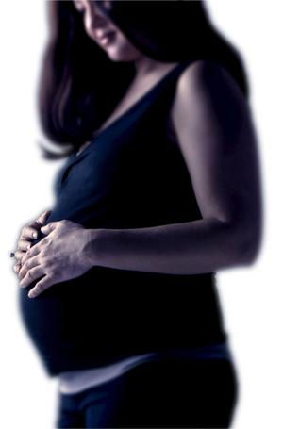
Women Pre-eclampsia and OSA

Slide 65
Obstructive sleep apnea as a risk factor for preeclampsia–eclampsia
Preeclampsia–eclampsia is a hypertensive, multiple-organ disorder of pregnancy, which occurs in 3–5% of pregnancies in developed countries and in up to 7.5% worldwide.
It remains one of the leading causes of maternal and perinatal mortality and morbidity.
Preventing preeclampsia–eclampsia appears to be one of the most significant challenges in obstetrics, and one area of investigation of interest relates to obstructive sleep apnea.
Jaimchariyatam, N., Narungsri, K., Tungsanga, S., et al. (2018). Obstructive sleep apnea as a risk factor for preeclampsia-eclampsia. Sleep and Breathing https://doi.org/10.1007/s11325-018-1758-8

Slide 66
Obstructive sleep apnea as a risk factor for preeclampsia–eclampsia
Researchers aimed to examine the association between OSA and preeclampsia–eclampsia among Thai pregnant women.
Conducted a large prospective cohort study among Thai pregnant women who were in the second trimester of singleton pregnancy.
The Berlin Questionnaire was administered to evaluate the risk for OSA. Preeclampsia–eclampsia was diagnosed by standard clinical assessment.
Jaimchariyatam, N., Narungsri, K., Tungsanga, S., et al. (2018). Obstructive sleep apnea as a risk factor for preeclampsia-eclampsia. Sleep and Breathing https://doi.org/10.1007/s11325-018-1758-8

Slide 67
Obstructive sleep apnea as a risk factor for preeclampsia–eclampsia
Study was evaluating “high risk for OSA” using the Berlin Questionnaire - developed in 1996, consisting of three categories :
Category 1: Snoring
Category 2: Daytime somnolence
Category 3: Obesity and/or hypertension
Excluded all participants with known chronic hypertension at the time of screening, a positive response in the category 3 was based on the presence of the BMI criteria.
Consideration for high risk for OSA (high-risk group) required the presence of at least two symptom categories, otherwise it would be considered as low risk for OSA.
Jaimchariyatam, N., Narungsri, K., Tungsanga, S., et al. (2018). Obstructive sleep apnea as a risk factor for preeclampsia-eclampsia. Sleep and Breathing https://doi.org/10.1007/s11325-018-1758-8

Slide 68
Obstructive sleep apnea as a risk factor for preeclampsia–eclampsia
Enrolled were 1345 pregnant women.
The overall prevalence of high risk for OSA was 10.1%
(95% CI 8.5–11.7)
OSA also associated with pre-pregnancy BMI and score on the Perceived Stress Scale.
An adjusted odds ratio (OR) for preeclampsia–eclampsia in women with high risk for OSA was 2.72 (95% CI 1.33–5.57).
Jaimchariyatam, N., Narungsri, K., Tungsanga, S., et al. (2018). Obstructive sleep apnea as a risk factor for preeclampsia-eclampsia. Sleep and Breathing https://doi.org/10.1007/s11325-018-1758-8

Slide 69
Obstructive sleep apnea as a risk factor for preeclampsia–eclampsia
BaleDoneen Take-Away:
1. Eclampsia/Pre-eclampsia is a well established metabolic risk.
2. This study carries significant weakness in that it did not actually assess for the presence of OSA
3. Appreciating that Pre-eclampsia/eclampsia provides a window peak into the woman’s lifestime CV risk – it seems reasonable to place clinical importance of obtaining a formal sleep evaluation.
4. At the very least – Pre-eclampsia/ecplampsia are a red flag for lifestime risk of CVD, VTE, and OSA. Need EDFROG!
Jaimchariyatam, N., Narungsri, K., Tungsanga, S., et al. (2018). Obstructive sleep apnea as a risk factor for preeclampsia-eclampsia. Sleep and Breathing https://doi.org/10.1007/s11325-018-1758-8

Slide 70
Adolescence

Slide 71
Objective Sleep Characteristics and Cardiometabolic Health in Young Adolescents
Study purpose and intention:
Shorter sleep duration is associated with childhood obesity.
Few studies measure sleep quantity and quality objectively or examine cardiometabolic biomarkers other than obesity
Metabolic parameters evaluated:
waist circumference, SBP, HDL, TG, and IR (HOMA).
Feliciano, E., Quante, J., Rifas-Shiman, S., et al. (2018). Objective sleep characteristics and cardiometabolic health in young adolescents. PEDIATRICS Volume 142, number 1, July 2018:e20174085

Slide 72
Objective Sleep Characteristics and Cardiometabolic Health in Young Adolescents
This cross-sectional study of 829 adolescents derived sleep duration, efficiency and moderate-to-vigorous physical activity from >5 days of wrist actigraphy recording for >10 hours/day.
Primary outcome was a metabolic risk score (mean of 5 sex-specific z-scores for waist, SBP, HDL scaled inversely, TG, and homeostatic model assessment of insulin resistance), for which higher scores indicate greater metabolic risk.
Secondary outcomes included score components and dual-energy radiograph absorptiometry fat mass, socioeconomic status, race and/or ethnicity, pubertal status, and obesity-related behaviors (television-viewing and fast food and sugar-sweetened beverage consumption) using questionnaires.
Feliciano, E., Quante, J., Rifas-Shiman, S., et al. (2018). Objective sleep characteristics and cardiometabolic health in young adolescents. PEDIATRICS Volume 142, number 1, July 2018:e20174085

Slide 73
Objective Sleep Characteristics and Cardiometabolic Health in Young Adolescents
The sample was 51.5% girls; mean age 13.2 years, median (interquartile range) sleep duration was 7.3 hours per day and sleep efficiency was 84.0%.
Longer sleep duration was associated with lower metabolic risk scores
(−0.11 points; 95% CI: −0.19 to −0.02)
per interquartile range
Feliciano, E., Quante, J., Rifas-Shiman, S., et al. (2018). Objective sleep characteristics and cardiometabolic health in young adolescents. PEDIATRICS Volume 142, number 1, July 2018:e20174085

Slide 74
Objective Sleep Characteristics and Cardiometabolic Health in Young Adolescents
Associations with sleep efficiency were similar and persisted after adjustment for BMI and physical activity, television viewing, and diet quality.
Longer sleep duration and greater sleep efficiency were also favorably associated with waist circumference, systolic blood pressure, high-density lipoprotein cholesterol, and fat mass
Feliciano, E., Quante, J., Rifas-Shiman, S., et al. (2018). Objective sleep characteristics and cardiometabolic health in young adolescents. PEDIATRICS Volume 142, number 1, July 2018:e20174085

Slide 75
Objective Sleep Characteristics and Cardiometabolic Health in Young Adolescents
This research appreciates that sleep duration and efficiency are associated with cardiometabolic health in early adolescence.
Intervention trials have been used to attempt to extend sleep duration, but few have been used to target sleep efficiency or other aspects of sleep quality.
In adults, exercise increases sleep efficiency and in children, television-viewing and other forms of screen time reduce sleep efficiency.
Preventive interventions to improve sleep health should be used to target behavioral and environmental factors that influence sleep continuity as well as duration, such as screen time, stress, noise, caffeine, and exercise.
Feliciano, E., Quante, J., Rifas-Shiman, S., et al. (2018). Objective sleep characteristics and cardiometabolic health in young adolescents. PEDIATRICS Volume 142, number 1, July 2018:e20174085

Slide 76
Objective Sleep Characteristics and Cardiometabolic Health in Young Adolescents
BaleDoneen Take-Away:
The earlier we can initiate healthy habits in a family – the greater opportunity we have to prevent metabolic issues later in life – IR, DM, ASVD, HTN, MS, etc.
Adolescence is a vulnerable time and the most fragile are at the highest risk.
Discuss sleep with the household.
Insulin resistance and T2DM are of epidemic proportions – don’t wait until adulthood to discuss the value of sleep quality and quantity with your families – medical and dental offices!
Feliciano, E., Quante, J., Rifas-Shiman, S., et al. (2018). Objective sleep characteristics and cardiometabolic health in young adolescents. PEDIATRICS Volume 142, number 1, July 2018:e20174085

Slide 77
Treatment opportunities
Assess for sleep quality, fragmented sleep and obstructed sleep apnea
Treatment options are many!
Sleep Hygiene teaching
Get patients properly evaluated!
CPAP/BIPAP
ENT – Surgery
Oral Appliances
Myofunctional Therapy/surgery

Slide 78
Always start with Education!
www.cci.health.wa.gov.

Slide 79
Realize sleep requires a multi-disciplinary approach!

Slide 80
Email from a dental colleague on 3/12/2019
Amy,
I wanted to share a story of a patient in my practice. I had been treating this 75 year old man for some time. At each visit we discussed his sleeping habits since I had a suspicion that he had sleep apnea. I advised many times that he be tested. Last month he presented asking me to restore all of his front teeth with porcelain veneers because his grand daughter said he had "yellow teeth".
I told him that I would be happy to help him but not until he takes care of his health and get tested for sleep apnea. We called the pulmonologist's office and set up the appointment together. Unfortunately, the doctor couldn't see him until April 5th. In the meantime, he had a heart attack and had stents placed.
He is recovering nicely and now fully appreciates the gravity of his sleep apnea and it's potential consequences. He was also able to move up his appointment at his insisting
I'll let you know how it develops. Just thought I'd share.
All the best,
Drew DDS

Slide 81
I am not going to focus on the effectiveness of CPAP as that has been well established in the literature – my goal is to examine other modalities….

Slide 82
Mandibular Advancement Devices in Patients with Symptoms of Obstructive Sleep Apnea: A Review
Untreated OSA is associated with many adverse health effects, such as hypertension, coronary artery disease, stroke, atrial fibrillation, congestive heart failure, and daytime sleepiness.
Excessive mortality of OSA patients, especially in men under 50 years of age, associated with advanced disease, obesity, cardiovascular complications, and a greater risk of road accidents, requires an urgent extension of the diagnostic–therapeutic database dealing with this problem.
Wojda, M., Jurkowski, A., Lewandowska, A. et al. (2019). Mandibular advancement devices in patietns with symptoms of obstructive sleep apnea: A Review. Adv Exp Med Biol. https://doi.org/10.1007/5584_2019-334.

Slide 83
Mandibular Advancement Devices in Patients with Symptoms of Obstructive Sleep Apnea: A Review
In recent years, intraoral devices have become an increasingly common method of OSA and snoring treatment.
The use of devices producing continuous positive airway pressure (CPAP) remains the most effective treatment method.
Intraoral devices have the advantage of not requiring a source of electricity and are less troublesome.
Intraoral devices are well tolerated by the majority of patients, and their therapeutic efficacy is confirmed
Wojda, M., Jurkowski, A., Lewandowska, A. et al. (2019). Mandibular advancement devices in patietns with symptoms of obstructive sleep apnea: A Review. Adv Exp Med Biol. https://doi.org/10.1007/5584_2019-334.

Slide 84
Mandibular Advancement Devices in Patients with Symptoms of Obstructive Sleep Apnea: A Review
The purpose of this review:
1. Present the procedures, indications, and recommendations involved with intraoral devices while taking into consideration a variety of dental conditions.
2. The side effects of the use of intraoral devices and their influence on the entire stomatognathic system were also described
Wojda, M., Jurkowski, A., Lewandowska, A. et al. (2019). Mandibular advancement devices in patietns with symptoms of obstructive sleep apnea: A Review. Adv Exp Med Biol. https://doi.org/10.1007/5584_2019-334.

Slide 85
Mandibular Advancement Devices in Patients with Symptoms of Obstructive Sleep Apnea: A Review
Conservative and surgical methods have been used to treat OSA:
Lifestyle:
1. Weight loss (10% reduction in body weight can result in 50% decrease in the number of apneas and an increase in O2 Sat).
2. Discontinuation of drugs influencing breathing, stopping alcohol and drug abuse
3. Sleep hygiene and sleep positioning
Wojda, M., Jurkowski, A., Lewandowska, A. et al. (2019). Mandibular advancement devices in patietns with symptoms of obstructive sleep apnea: A Review. Adv Exp Med Biol. https://doi.org/10.1007/5584_2019-334.

Slide 86
Mandibular Advancement Devices in Patients with Symptoms of Obstructive Sleep Apnea: A Review
The primary conservative treatment method for apnea is breathing with air delivered to the airways under positive pressure using a continuous airway pressure (CPAP).
The beneficial effect of CPAP in patients with OSA is based on the pneumatic stiffening of the upper respiratory tract.
The CPAP method is safe & effective; however, its long-term use is subject to certain complications and challenges including equipment failure, maintenance, hygiene and compliance.
Wojda, M., Jurkowski, A., Lewandowska, A. et al. (2019). Mandibular advancement devices in patietns with symptoms of obstructive sleep apnea: A Review. Adv Exp Med Biol. https://doi.org/10.1007/5584_2019-334.

Slide 87
Mandibular Advancement Devices in Patients with Symptoms of Obstructive Sleep Apnea: A Review
Mandibular Advancement Device (MAD):
The American Academy of Sleep Medicine (AASM) &
American Academy of Dental Sleep Medicine (AADSM):
1. Snoring without OSA, with mild OSA in combination with a reduction in the risk factors for sleep apnea.
2. With moderate-to-severe OSA in those who do not tolerate CPAP, do not express consent for their use, or do not qualify for surgical treatment.
3. The guidelines recommend as a standard that sleep physicians consider the prescription of oral appliances, rather than no treatment, for adult patients.
4. Severe OSA should start with CPAP.
Wojda, M., Jurkowski, A., Lewandowska, A. et al. (2019). Mandibular advancement devices in patietns with symptoms of obstructive sleep apnea: A Review. Adv Exp Med Biol. https://doi.org/10.1007/5584_2019-334.

Slide 88
Mandibular Advancement Devices (MAD) in Patients with Symptoms of Obstructive Sleep Apnea: A Review
Before patients can be qualified for treatment with dental appliances and after they meet the criteria set out in the indications for MAD treatment, they should have a thorough extra- and intraoral examination.
It is estimated that about one-third of OSA patients are excluded from MAD treatment solely on the basis of local dental issues.
The selection of patients in whom treatment with MAD could be effective is difficult due to a large number of factors determining treatment success using this method.
Wojda, M., Jurkowski, A., Lewandowska, A. et al. (2019). Mandibular advancement devices in patietns with symptoms of obstructive sleep apnea: A Review. Adv Exp Med Biol. https://doi.org/10.1007/5584_2019-334.

Slide 89
Mandibular Advancement Devices in Patients with Symptoms of Obstructive Sleep Apnea: A Review
Best responders to MAD:
less severe form of OSA, a younger age, a lower body mass index (BMI), and a smaller neck circumference, female vs male
Morphological structure of the facial part of the skull and the physiology of the upper respiratory tract affect the therapeutic effect of MAD:
longer maxilla, smaller overjet, shorter soft palate and facial height, reduced distance between the mandible and hyoid bone, and a smaller retropalatal airway space, distance from the posterior pharyngeal wall to the soft palate and from the angle formed by the ramus of the mandible with the line running through the sella turcica, patients whose upper airway collapses during sleep in the oropharyngeal region and in those with lower nasal resistance
Wojda, M., Jurkowski, A., Lewandowska, A. et al. (2019). Mandibular advancement devices in patietns with symptoms of obstructive sleep apnea: A Review. Adv Exp Med Biol. https://doi.org/10.1007/5584_2019-334.

Slide 90
Mandibular Advancement Devices in Patients with Symptoms of Obstructive Sleep Apnea: A Review
BaleDoneen Take-Away:
1. Disrupted airway breathing requires a multi-disciplinary approach.
2. MAD must be considered an option for many people to improve compliance and long term treatment.
3. Therapeutic lifestyle recommendations must be appreciated.
4. Get Oral health specialists certified in sleep dentistry on the team!
5. If patient is a candidate for MAD – must identify oral health providers in your area that are skilled and certified in this.
6. MAD is a serious treatment that (if done incorrectly) can have very negative consequences.
7. When MAD is prescribed and managed correctly – it is a life-saving option for many OSA patients.
Wojda, M., Jurkowski, A., Lewandowska, A. et al. (2019). Mandibular advancement devices in patietns with symptoms of obstructive sleep apnea: A Review. Adv Exp Med Biol. https://doi.org/10.1007/5584_2019-334.

Slide 91
So….do mandibular advancement devices work?

Slide 92
Oral Appliance Effectiveness and Patient Satisfaction with OSA Treatment in Adults
Indication of oral appliances for the treatment of an obstructive sleep apnea (OSA) includes both patients with primary snoring and mild OSA, as well as patients with moderate to severe OSA who refuse other treatment or in whom such treatment failed.
The aim of this study was to verify the effectiveness of current OSA treatment by objective measurements, and to assess by means of a questionnaire patients’ satisfaction with oral appliances manufactured in our laboratory.
Skalna, M., Novak, V., Buzga, M. et al. (2019). Oral appliance effectiveness and patient satisfaction with OSA treatment in adults. Med Sci Monit. 2019;
25:516-524.

Slide 93
Oral Appliance Effectiveness and Patient Satisfaction with OSA Treatment in Adults
The study enrolled 58 adult patients
(40 men, 18 women) with mean age of 50.5 years. Most were overweight or had class I obesity.
Mean baseline apnea-hypopnea index (AHI) value prior to the beginning of treatment was 31.3,
range 0.6–71 AHI.
Skalna, M., Novak, V., Buzga, M. et al. (2019). Oral appliance effectiveness and patient satisfaction with OSA treatment in adults. Med Sci Monit. 2019;
25:516-524.

Slide 94
Oral Appliance Effectiveness and Patient Satisfaction with OSA Treatment in Adults
Average AHI reduction in the entire group was 10.4.
31% of patients experienced AHI reduction by at least 50%.
Significant AHI reduction was proven when using the appliance.
Appliances affect the reduction of AHI and
patients tolerate the appliances well.
Skalna, M., Novak, V., Buzga, M. et al. (2019). Oral appliance effectiveness and patient satisfaction with OSA treatment in adults. Med Sci Monit. 2019;
25:516-524.

Slide 95
Oral Appliance Effectiveness and Patient Satisfaction with OSA Treatment in Adults
What is an oral appliance?
Typically, it is a plastic aid inserted into the mouth to dilate the upper respiratory tract and prevent its further constriction, collapse, or vibrations during sleep.
Different mechanisms are employed to affect the airway, depending on the type of appliance. Upon insertion into the mouth, the appliance may affect mandibular advancement (mandibular advancing device, MAD), fix the tongue and prevent it from falling back, or advance the hyoid bone by means of advancing the mandible or support the soft palate (directly or indirectly by acting on other structures).
Skalna, M., Novak, V., Buzga, M. et al. (2019). Oral appliance effectiveness and patient satisfaction with OSA treatment in adults. Med Sci Monit. 2019;
25:516-524.

Slide 96
Oral Appliance Effectiveness and Patient Satisfaction with OSA Treatment in Adults
What are indications for an oral appliance (OA)?
Indication for treatment of OSA was established by the
American Academy of Sleep Medicine (AASM) and includes:
1. patients with primary snoring or mild OSA who do not respond to sleep regimen change
2. patients with moderate or severe OSA who do not tolerate or who refuse continuous positive airway pressure (CPAP) treatment
3. patients who refuse surgical treatment or in whom such treatment is not indicated or already failed.
Skalna, M., Novak, V., Buzga, M. et al. (2019). Oral appliance effectiveness and patient satisfaction with OSA treatment in adults. Med Sci Monit. 2019;
25:516-524.

Slide 97
Oral Appliance Effectiveness and Patient Satisfaction with OSA Treatment in Adults
In general, efficacy of treatment with OAs ranges between 19% and 80%, depending on selected parameters.
Many studies of OA efficacy indicated that their effect depends on many factors, including: type and design of the OA; the patient’s age, sex, state of health, and BMI; cephalometric parameters; and OSA severity.
OA’s adverse effects such as excessive salivation, pressure on the teeth and jaws, contusions of the tongue or gums, possible development of pain or stiffness of the temporomandibular joint or muscles of mastication, and bite change or even bite impairment after prolonged use of an inappropriate OA.
Skalna, M., Novak, V., Buzga, M. et al. (2019). Oral appliance effectiveness and patient satisfaction with OSA treatment in adults. Med Sci Monit. 2019;
25:516-524.

Slide 98
Oral Appliance Effectiveness and Patient Satisfaction with OSA Treatment in Adults
Patients referred to University Hospital Ostrava with complaints indicating obstructive sleep apnea (OSA) participated in the study.
Severe OSA with CPAP intolerance was the most frequent indication for treatment, followed by moderate or mild OSA or simple snoring in patients who did not want to undergo a surgical procedure of the soft palate and tongue at the Dept of Otorhinolaryngology (ENT) or maxillomandibular advancement at the Dept of Maxillofacial Surgery.
The appliance was further indicated in patients with relapse after ENT surgery or after unsuccessful ENT treatment.
Skalna, M., Novak, V., Buzga, M. et al. (2019). Oral appliance effectiveness and patient satisfaction with OSA treatment in adults. Med Sci Monit. 2019;
25:516-524.

Slide 99
Oral Appliance Effectiveness and Patient Satisfaction with OSA Treatment in Adults
Contraindications for the appliance were:
1. Refusal of the patient, absence of teeth, bite disorder, prominent gagging reflex, or the presence of extensive fixed dental bridges anchored to limited abutment teeth (posing a risk that the appliance may dislodge the bridge).
2. Corrective dental work (treatment of caries, extraction of loose teeth) was mandatory before treatment.
3. Appliance not indicated in patients who had problems with nasal patency.
Skalna, M., Novak, V., Buzga, M. et al. (2019). Oral appliance effectiveness and patient satisfaction with OSA treatment in adults. Med Sci Monit. 2019;
25:516-524.

Slide 100
Oral Appliance Effectiveness and Patient Satisfaction with OSA Treatment in Adults
Skalna, M., Novak, V., Buzga, M. et al. (2019). Oral appliance effectiveness and patient satisfaction with OSA treatment in adults. Med Sci Monit. 2019;
25:516-524.

Slide 101
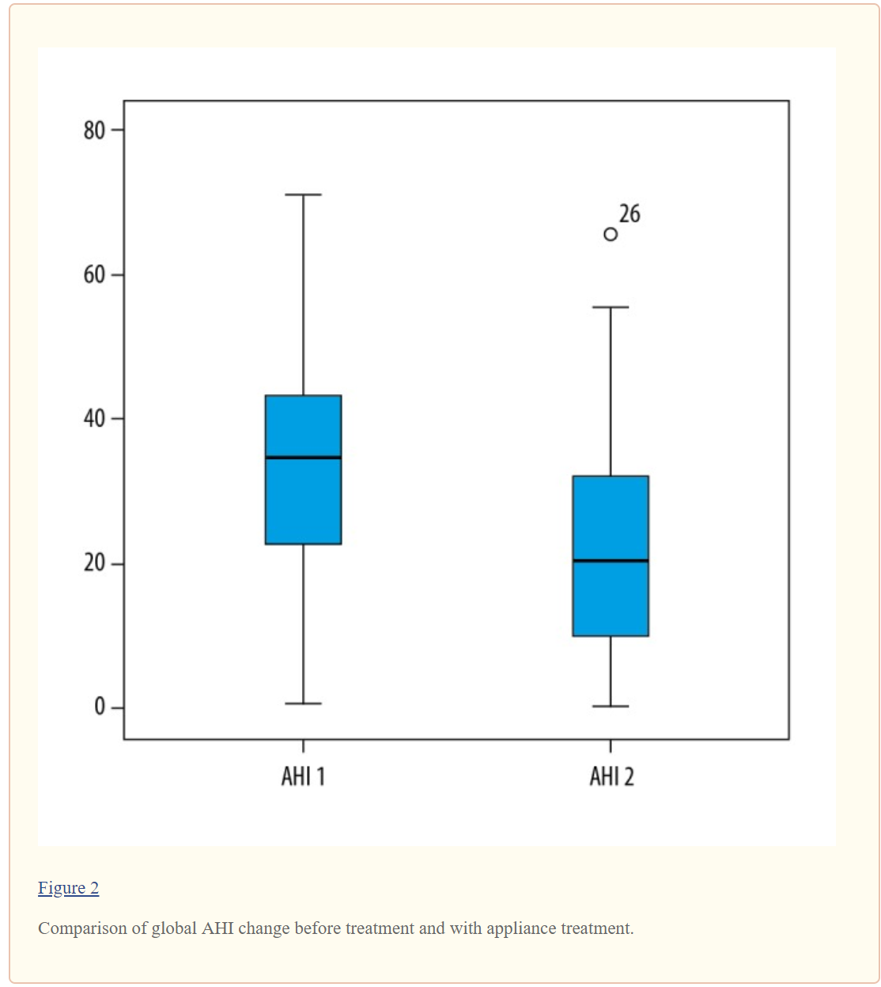
Oral Appliance Effectiveness and Patient Satisfaction with OSA Treatment in Adults
The average AHI reduction in the whole group was 10.4, where 13 of 41 patients (31%) experienced AHI reduction by at least 50%;
AHI improved with the appliance in additional 22 patients, but the reduction was less than 50%
Skalna, M., Novak, V., Buzga, M. et al. (2019). Oral appliance effectiveness and patient satisfaction with OSA treatment in adults. Med Sci Monit. 2019;
25:516-524.

Slide 102
Oral Appliance Effectiveness and Patient Satisfaction with OSA Treatment in Adults
Skalna, M., Novak, V., Buzga, M. et al. (2019). Oral appliance effectiveness and patient satisfaction with OSA treatment in adults. Med Sci Monit. 2019;
25:516-524.

Slide 103
Oral Appliance Effectiveness and Patient Satisfaction with OSA Treatment in Adults
The appliance led to AHI reduction in almost 86% of patients, on average by 45%, while the baseline AHI mean was 31.3 (severe OSA).
The highest number of patients showed improvement by 5–25 AHI units.
AHI was reduced to <10 in 12% of patients.
Skalna, M., Novak, V., Buzga, M. et al. (2019). Oral appliance effectiveness and patient satisfaction with OSA treatment in adults. Med Sci Monit. 2019;
25:516-524.

Slide 104
Oral Appliance Effectiveness and Patient Satisfaction with OSA Treatment in Adults
BaleDoneen Take-Away:
Oral Appliance therapy for OSA does show effectiveness to reduce AHI to acceptable levels.
Oral appliance therapy is not a perfect solution for all patients but should be considered as a treatment for OSA.
Educate patients to use a certified OA provider!
Sometimes the refusal of a patient getting a sleep test has to do with the fear of treatment (CPAP) – educate each patient that there are effective treatment options!
OA isn’t only for people who have failed a trial of CPAP.
Skalna, M., Novak, V., Buzga, M. et al. (2019). Oral appliance effectiveness and patient satisfaction with OSA treatment in adults. Med Sci Monit. 2019;
25:516-524.

Slide 105
Myofunctional Therapy

Slide 106
Obstructive sleep apnea: focus on myofunctional therapy
Orofacial myofunctional therapy (OMT) is a modality of treatment for children and adults with obstructive sleep apnea (OSA) to promote changes in the musculature of the upper airways.
This review summarizes and discusses the effects of OMT on OSA, the therapeutic programs employed, and their possible mechanisms of action.
Felicio, C., da Silva Dias, F., Trawitzki, L. (2018). Obstructive sleep apnea: focus on myofunctional therapy. Nat Sci Sleep. 2018; 10: 271-286

Slide 107
Obstructive sleep apnea: focus on myofunctional therapy
Online literature search using MEDLINE/PubMed, EMBASE, and Web of Science.
Eleven studies were included in this review.
The studies reviewed reveal that several benefits of OMT were demonstrated in adults, which include significant decrease of apnea–hypopnea index (AHI), reduced arousal index, improvement in subjective symptoms of daytime sleepiness, sleep quality, and life quality.
In children with residual apnea, OMT promoted a decrease of AHI, increase in oxygen saturation, and improvement of orofacial myofunctional status.
Felicio, C., da Silva Dias, F., Trawitzki, L. (2018). Obstructive sleep apnea: focus on myofunctional therapy. Nat Sci Sleep. 2018; 10: 271-286

Slide 108
Obstructive sleep apnea: focus on myofunctional therapy
Felicio, C., da Silva Dias, F., Trawitzki, L. (2018). Obstructive sleep apnea: focus on myofunctional therapy. Nat Sci Sleep. 2018; 10: 271-286

Slide 109
Obstructive sleep apnea: focus on myofunctional therapy
The present review showed that OMT is effective for the treatment of adults in reducing the severity of OSA and snoring, and improving the quality of life.
OMT is also successful for the treatment of children with residual apnea.
In addition, OMT favors the adherence to continuous positive airway pressure. However, randomized and high-quality studies are still rare, and the effects of treatment should also be analyzed on a long-term basis, including measures showing if changes occurred in the musculature
Felicio, C., da Silva Dias, F., Trawitzki, L. (2018). Obstructive sleep apnea: focus on myofunctional therapy. Nat Sci Sleep. 2018; 10: 271-286

Slide 110
Obstructive sleep apnea: focus on myofunctional therapy
BaleDoneen Take-Away:
Oral Myofunctional therapists go through extensive training and a live and written certification process.
If the OMT is something available for your patients, it might be an adjunct to the care model for OSA.
Keep a multi-disciplinary approach to the identification and treatment of OSA.
Children with structural breathing issues should be referred to a OMT for evaluation.
Bottom line – there are many options for treatment of breathing disorders – keep the care team multi-disciplinary.
Felicio, C., da Silva Dias, F., Trawitzki, L. (2018). Obstructive sleep apnea: focus on myofunctional therapy. Nat Sci Sleep. 2018; 10: 271-286

Slide 111
Cost considerations -
Some cost averages – will depend on insurance and ICD10 codes for billing – Published online Oct 8, 2018
Overnight polysomnograms may cost from $600 to $5,000 (or more) for each night; the average is typically around $1000 to $2000 per night. Insurance, including Medicare, may cover the majority of this expense.
Home sleep studies range between 150-600 per night.
CPAP Average price for CPAP machine ranges from about $500 –$3000, with an estimated average price around $850.
Mandibular advancement device average cost for is estimated at $1800 – $2000.
Myofunctional Therapy – found averages of $1500 to 2500
Education – PRICELESS (and free!)

Slide 112
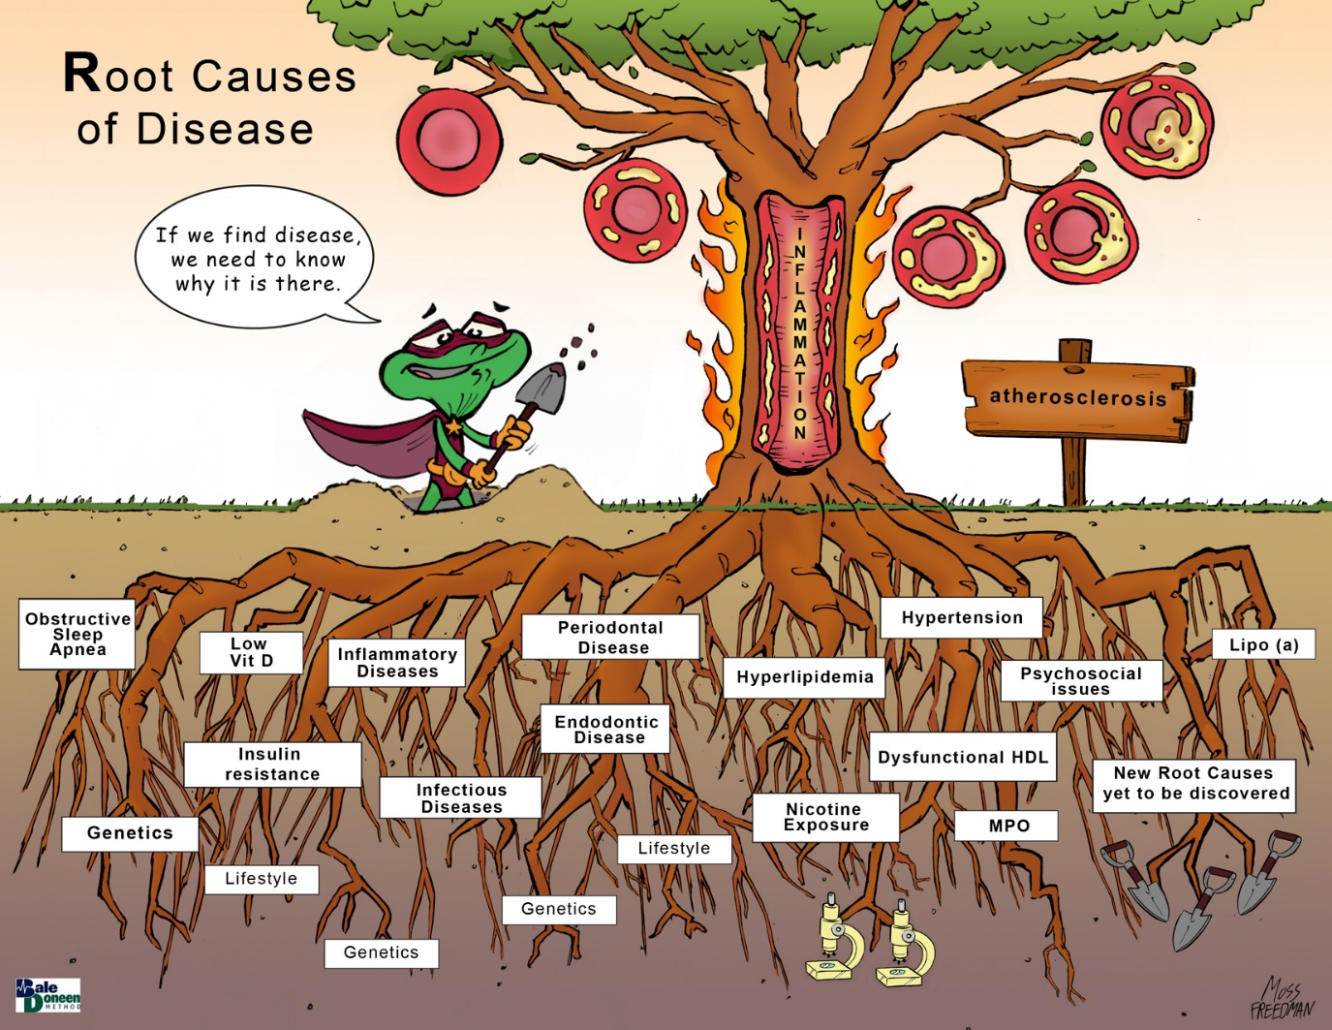
IN REVIEW
A pulse of the current science – sleep fragmentation and OSA
1. Fragmented sleep is associated with atherosclerosis - Nature
2. Poor sleep is associated with ASVD in humans – JACC
3. Poor sleep causes microvascular damage to the heart
Demographics:
4. Men – libido and nocturia
5. Women – Menopause
6. Women – Pre-eclampsia
7. Adolescence and Sleep
Treatment opportunities beyond CPAP:
8. Mandibular Advancement Devices
9. Oral Appliances
10. Myofunction Therapy

Slide 113
Upcoming Lectures in next 6 weeks!
March 16: Dawson Clearwater Fl
March 21-23: Hinman Atlanta GA
April 6: Oregon Dental Portland OR
April 10: BaleDoneen Study Club – online!
DON’T MISS OUT! Sign up!
www.BaleDoneen.com

Slide 115
If you know anyone you would like to invite to join the BaleDoneen community – please encourage them to:
Text the word
‘SAVE’
to
509-245-2424

Slide 116
Thank you and Go ZAGS!
It is pronounced – “GonzAAAAga!

