Slide 1
March 11, 2020
Scientific Update Session
Amy Doneen DNP
BaleDoneen Method
Blaha

Slide 2
Mission Statement of
The BaleDoneen Method
Enhance and save lives by offering the cure
for arterial disease!
Blaha

Slide 3
Vision Statement - RESCUE
Remove heart attacks and strokes off the top of the list of death and disability.
Educate all healthcare providers of the relevance of Arteriology.
Secure the reality that Arterial health span matches life span.
Create a business model to successfully implement the BaleDoneen Method.
Utilize partnerships to propel our success.
Ensure that all individuals have access to the BaleDoneen method.

Slide 4
Today’s outline – March 2020
Hot Topics -
‘Dr. Amy Letter’ from March Newsletter – COVID 19
COVID 19 update
COVID 19 and gender differences
COVID 19 and ACE Inhibition
Roots –
New Oral Health Connection Video – all roots this month are important for medical and dental.
Endodontic Therapy and incident CVD
OSA and increased Alzheimer’s risk
Sleep Disordered Breathing & recidivistic stroke risk
Sleep Disorders and epigenetic aging.
Treatment –
Estrogen and Women
Omega 3 supplementation and reduction of CV death and events.
Error in USPSTF regarding Statin benefit

Slide 5
Questions that are discussed in the March newsletter -
1. Coronavirus: How Worried Should You Be?
2. What is the new coronavirus and where did it come from?
3. What are the symptoms of covid-19 and how likely it is to cause serious illness?
4. How does the danger of covid-19 compare to that of the flu?
5. How effective is hand washing?
6. What else can you do to protect yourself against covid-19?
Through this avenue – BaleDoneen will be providing weekly updates for pts.

Slide 6
As of today 3/11/2020 –
WHO declares Corona Virus a Pandemic
Pandemic = “a new disease for which people do not have immunity
spreads around the world beyond expectations”

Slide 7
Sporting events?
College Nationals!
Go Dev!
Final 4
Go Zags!

Slide 8
Clinical course and risk factors for mortality of adult inpatients with COVID-19 in Wuhan, China
NEWEST STUDY 3/9/2020 - Monday
Since December 2019, Wuhan, China, has experienced an outbreak of coronavirus disease (COVID-19), caused by the severe acute respiratory syndrome coronavirus 2 (SARS-CoV-2).
Epidemiological and clinical characteristics of patients with COVID-19 have been reported but risk factors for mortality and a detailed clinical course of illness, including viral shedding, have not been well described.
Zhou, F., Yu, T., Du, R. et all (3/9/2020). Clinical course and risk factors for mortality of adult inpatients with COVID-19 in Wuhan, China: a retrospective cohort study. Lancet. Published online 3/9, 2020 https://doi.org/10.1016/S0140-6736(20)30566-3

Slide 9
Clinical course and risk factors for mortality of adult inpatients with COVID-19 in Wuhan, China
Retrospective, multi-center cohort study, all adult inpatients (≥18 years old) with laboratory-confirmed COVID-19 who had been discharged or had died by Jan 31, 2020.
Demographic, clinical, treatment, and laboratory data, including serial samples for viral RNA detection, were extracted records and compared between survivors and non-survivors.
Zhou, F., Yu, T., Du, R. et all (3/9/2020). Clinical course and risk factors for mortality of adult inpatients with COVID-19 in Wuhan, China: a retrospective cohort study. Lancet. Published online 3/9, 2020 https://doi.org/10.1016/S0140-6736(20)30566-3

Slide 10
Who are these non-survivors?

Slide 11
Clinical course and risk factors for mortality of adult inpatients with COVID-19 in Wuhan, China
The median age of the 191 patients was 56 years,
ranging (18 to 87) most patients were male.
Comorbidities were present in nearly half of patients, with hypertension being the most common comorbidity, followed by diabetes and coronary heart disease.
Most common symptoms on admission were fever and cough, followed by sputum production and fatigue.
Lymphocytopenia occurred in 77 (40%) patients.
.
Zhou, F., Yu, T., Du, R. et all (2020). Clinical course and risk factors for mortality of adult inpatients with COVID-19 in Wuhan, China: a retrospective cohort study. Lancet. Published online 3/9, 2020 https://doi.org/10.1016/S0140-6736(20)30566-3

Slide 12
Clinical course and risk factors for mortality of adult inpatients with COVID-19 in Wuhan, China
181 (95%) patients received antibiotics and 41 (21%) received antivirals
Systematic corticosteroid and intravenous immunoglobulin use differed significantly between non-survivors and survivors.
The median time from illness onset (before admission) to discharge was 22 days, whereas the median time to death was 18.5 days.
32 patients required mechanical ventilation, of whom 31 (97%) died.
The median time from illness onset to invasive ventilation was 14.5 days.
.
Zhou, F., Yu, T., Du, R. et all (2020). Clinical course and risk factors for mortality of adult inpatients with COVID-19 in Wuhan, China: a retrospective cohort study. Lancet. Published online 3/9, 2020 https://doi.org/10.1016/S0140-6736(20)30566-3

Slide 13
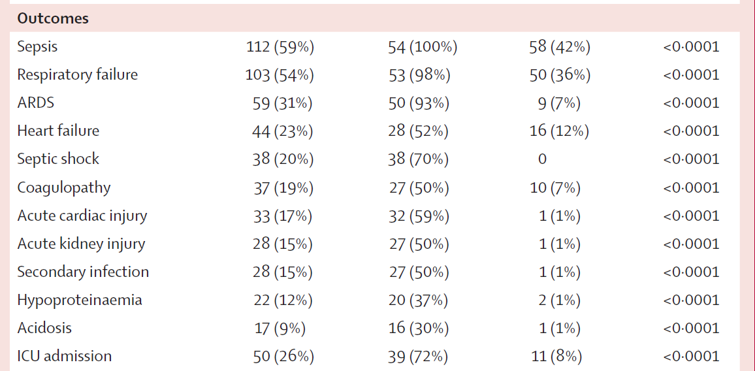
Clinical course and risk factors for mortality of adult inpatients with COVID-19 in Wuhan, China
Zhou, F., Yu, T., Du, R. et all (2020). Clinical course and risk factors for mortality of adult inpatients with COVID-19 in Wuhan, China: a retrospective cohort study. Lancet. Published online 3/9, 2020 https://doi.org/10.1016/S0140-6736(20)30566-3

Slide 14
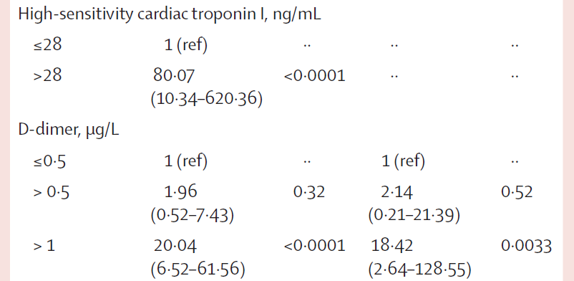
Clinical course and risk factors for mortality of adult inpatients with COVID-19 in Wuhan, China
.
Zhou, F., Yu, T., Du, R. et all (2020). Clinical course and risk factors for mortality of adult inpatients with COVID-19 in Wuhan, China: a retrospective cohort study. Lancet. Published online 3/9, 2020 https://doi.org/10.1016/S0140-6736(20)30566-3

Slide 15
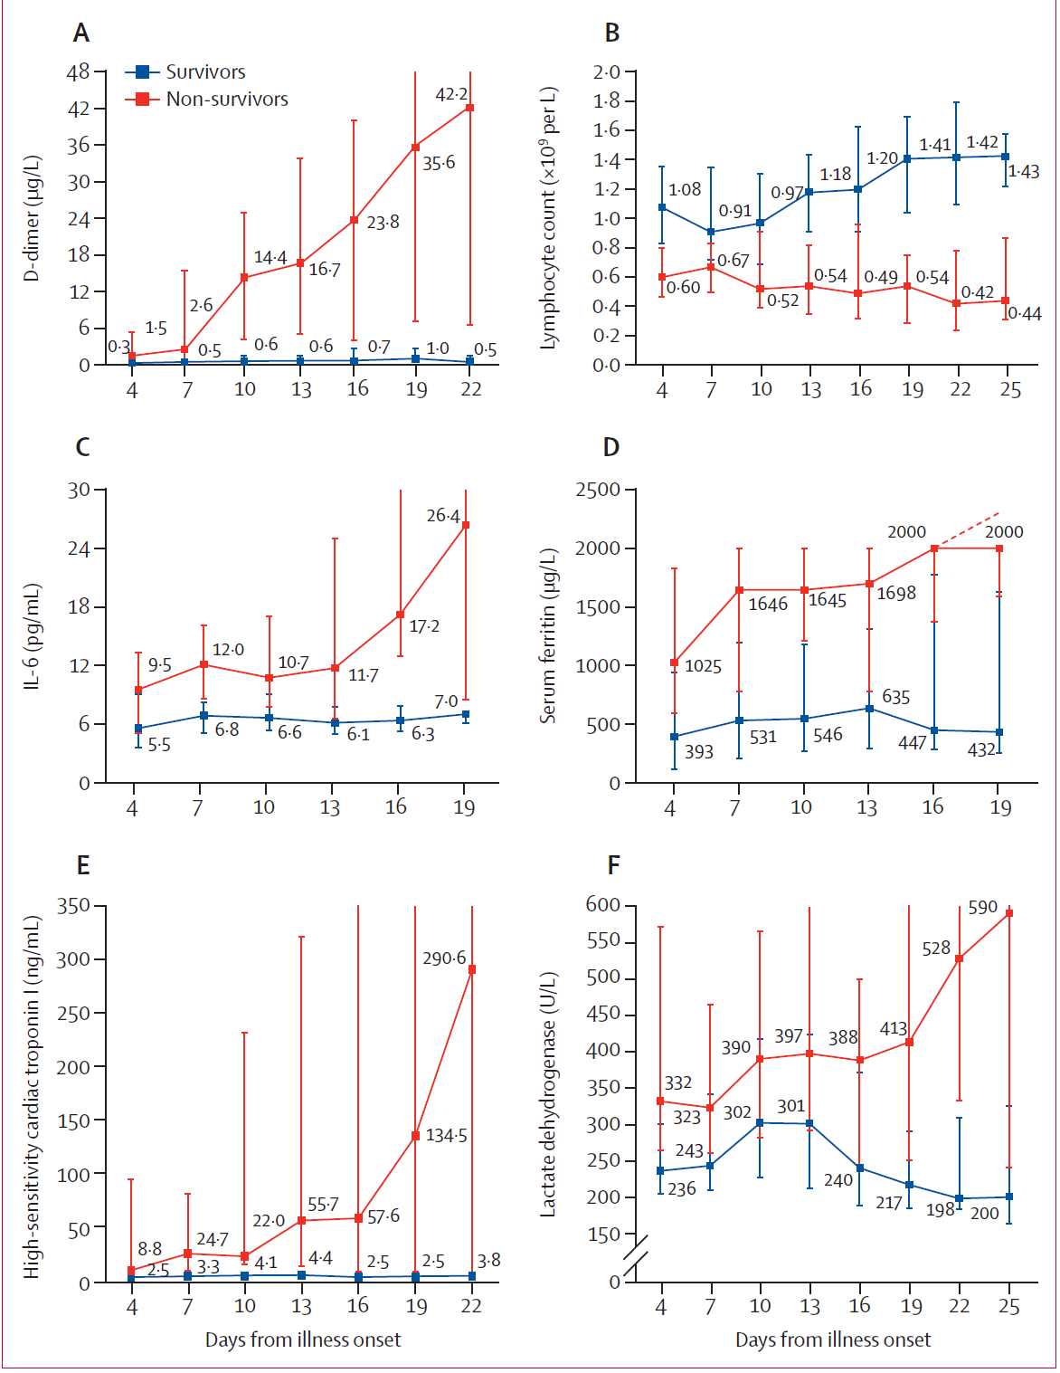
Clinical course and risk factors for mortality of adult inpatients with COVID-19 in Wuhan, China
nonsurvivors
D-dimer
Lymphocyte count
IL-6
Serum ferritin
hsTnt
Lactate Dehydrogenase
Zhou, F., Yu, T., Du, R. et all (2020). Clinical course and risk factors for mortality of adult inpatients with COVID-19 in Wuhan, China: a retrospective cohort study. Lancet. Published online 3/9, 2020 https://doi.org/10.1016/S0140-6736(20)30566-3

Slide 16
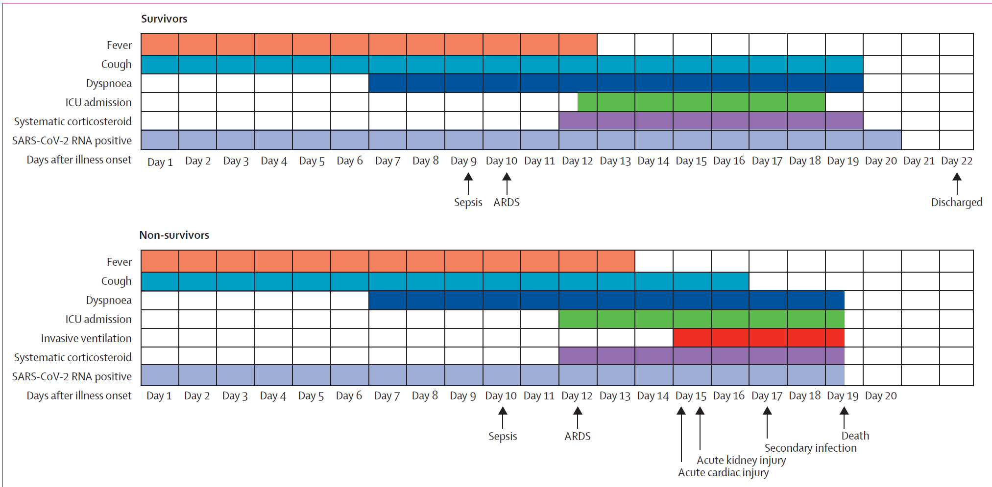
Clinical course and risk factors for mortality of adult inpatients with COVID-19 in Wuhan, China
.
Zhou, F., Yu, T., Du, R. et all (2020). Clinical course and risk factors for mortality of adult inpatients with COVID-19 in Wuhan, China: a retrospective cohort study. Lancet. Published online 3/9, 2020 https://doi.org/10.1016/S0140-6736(20)30566-3

Slide 17
Clinical course and risk factors for mortality of adult inpatients with COVID-19 in Wuhan, China
Increasing odds of in-hospital death on admission associated with:
Older age
(OR 1·10, 95% CI 1·03–1·17; p=0·0043)
Higher SOFA Score (Sequential Organ Failure Assessment)
(5·65, 2·61–12·23; p<0·0001)
d-dimer levels greater than 1·0 μg/L
(18·42, 2·64–128·55; p=0·0033)
Duration of viral shedding ranged between 8 and 37 days. The median duration of viral shedding was 20 days (IQR 17·0–24·0) in survivors & continued until death in fatal cases.
.
Zhou, F., Yu, T., Du, R. et all (2020). Clinical course and risk factors for mortality of adult inpatients with COVID-19 in Wuhan, China: a retrospective cohort study. Lancet. Published online 3/9, 2020 https://doi.org/10.1016/S0140-6736(20)30566-3

Slide 18
Clinical course and risk factors for mortality of adult inpatients with COVID-19 in Wuhan, China
.
This information can help clinicians decide at an early stage which patients may have a poor prognosis.
Prolonged shedding of the virus supports the strategy to develop a strategy of isolation of infected patients and lead to optimal antiviral interventions in the future.
Zhou, F., Yu, T., Du, R. et all (2020). Clinical course and risk factors for mortality of adult inpatients with COVID-19 in Wuhan, China: a retrospective cohort study. Lancet. Published online 3/9, 2020 https://doi.org/10.1016/S0140-6736(20)30566-3

Slide 19
Covid 19 and sex differences?

Slide 20
Do sex differences exist with covid-19?
2/27/2020 - Data of 47 patients diagnosed as severe type of COVID-19 from February 8 to 22, 2020.
Results: Of the 47 patients, 28 (59.6%) were men, median age 62 years, and 30 (63.8%) had comorbidities.
The initial symptoms were mainly fever (34 [72.3%]), cough (36 [76.6%]), myalgia (5 [10.6%]) and fatigue (7 [14.9%]).
N-terminal-pro brain natriuretic peptide increased in
16 (57.1%) men and 5 (26.3%) women (p=0.037).
Li, J., Zhang, Y., Wang, F. et al (2020). Sex differences in clinical findings among patients with coronavirus disease 2019 (COVID-19) and severe condition. https://doi.org/10.1101/2020.02.27.

Slide 21
Do sex differences exist with covid-19?
During 2-week admission, 5 (17.9%) men and 1 (5.3%) woman were reclassified into the critical type due to deterioration.
Mortality was 3.6% in men and 0 in women respectively.
Four (21.1%) women and one man (3.6%) recovered and discharged from hospital.
Sex differences may exist in COVID-19 patients of severe type. Men are likely to have more complicated clinical condition and worse in-hospital outcomes as compared to women.
Li, J., Zhang, Y., Wang, F. et al (2020). Sex differences in clinical findings among patients with coronavirus disease 2019 (COVID-19) and severe condition. https://doi.org/10.1101/2020.02.27.

Slide 22
Do sex differences exist with covid-19?
Li, J., Zhang, Y., Wang, F. et al (2020). Sex differences in clinical findings among patients with coronavirus disease 2019 (COVID-19) and severe condition. https://doi.org/10.1101/2020.02.27.

Slide 23
Do sex differences exist with covid-19?
2/27/2020 hypothesis –
NT-proBNP but not cTnI was higher in men, suggesting more damage in heart function might exist in men after SARS-CoV-2 infection.
It was reported that women were associated with less remodeling after cardiac injury, due to the protection of estrogens (??).
“Our findings imply that physicians should pay more attention to cardiac function in men with severe COVID-19”. (??)
Li, J., Zhang, Y., Wang, F. et al (2020). Sex differences in clinical findings among patients with coronavirus disease 2019 (COVID-19) and severe condition. https://doi.org/10.1101/2020.02.27.

Slide 24
Clinical course and risk factors for mortality of adult inpatients with COVID-19 in Wuhan, China
3/9/2020 - Previously reviewed article discussed Sex demographic differences and did not show statistical significance
*.
Of note – this latest trial did NOT break down d-dimer and cTn between male and female nor did it measure/report NT-ProBNP
Zhou, F., Yu, T., Du, R. et all (2020). Clinical course and risk factors for mortality of adult inpatients with COVID-19 in Wuhan, China: a retrospective cohort study. Lancet. Published online 3/9, 2020 https://doi.org/10.1016/S0140-6736(20)30566-3

Slide 25
Novel Treatments for COVID-19
This Photo by Unknown Author is licensed under CC BY-NC

Slide 26
Inhibitors of RAS Might be a Good Choice for the Therapy of COVID-19 Pneumonia
Two pathways related to the renin/angiotensin system –
ACE2/Ang/Mas (ACE 2)= anti-inflammatory
(CORONA Virus binds to these receptors)
ACE/AngII/AT1R (ACE1)= inflammatory
(ACE & ARBS block this pathway)
COVID-19 infected patients by binding to human ACE2, leading to severe pneumonia and high mortality rates.
Sun ML, Yang JM, Sun YP, Su GH. Zhonghua Jie He He Hu Xi Za Zhi. 2020;43(0):E014. doi:10.3760/cma.j.issn.1001-0939.2020.0014

Slide 27
Inhibitors of RAS Might be a Good Choice for the Therapy of COVID-19 Pneumonia
COVID-19 creates an imbalance of this system
The binding of COVID-19 and ACE2 resulted in the exhaustion of ACE2 creating an imbalance with the RAS system (ACE2 decrease and ACE1 increase = inflammation/pneumonia.
Therefore, ACEI and AT1R inhibitors (ACE-Inhibitors and ARBs) could be used in patients with COVID-19 pneumonia and might reduce the pulmonary inflammatory response and mortality.
Sun ML, Yang JM, Sun YP, Su GH. Zhonghua Jie He He Hu Xi Za Zhi. 2020;43(0):E014. doi:10.3760/cma.j.issn.1001-0939.2020.0014

Slide 28
Inhibitors of RAS Might be a Good Choice for the Therapy of COVID-19 Pneumonia
Can this help explain symptom variation of COVID-19?
ACE2 is highly expressed in lung tissue, GI tract, vascular endothelial cells and arterial smooth muscle cells in the body. In addition, skin, nasal cavity, and oral mucosa basal cells all expressed ACE2.
COVID-19 has mild symptoms such as nasal congestion, runny nose, sore throat, and diarrhea.
COVID-19 Severe patients quickly develop complications such as severe pneumonia, septic shock, & coagulopathy, all of which may be related to the distribution of ACE2 in humans
Sun ML, Yang JM, Sun YP, Su GH. Zhonghua Jie He He Hu Xi Za Zhi. 2020;43(0):E014. doi:10.3760/cma.j.issn.1001-0939.2020.0014

Slide 29
Inhibitors of RAS Might be a Good Choice for the Therapy of COVID-19 Pneumonia
Can this also explain some of the demographic differences?
The expression of ACE2 in children and young people is significantly higher than that of elderly people (elderly women higher than men) – sex difference in outcomes?
Researchers believe that for patients with COVID-19 infection, ACEI and AT1R inhibitors (ACE or ARB) can be considered with close monitoring of BP
This is likely to be an effective way to reduce the body damage of patients with COVID-19 infection
Sun ML, Yang JM, Sun YP, Su GH. Zhonghua Jie He He Hu Xi Za Zhi. 2020;43(0):E014. doi:10.3760/cma.j.issn.1001-0939.2020.0014

Slide 30
Inhibitors of RAS Might be a Good Choice for the Therapy of COVID-19 Pneumonia
What about patients who have been (and are) on an ACE Inhibitor or an ARB = thus increasing ACE 2 receptors….Does this make them more vulnerable to contracting COVID-19?
This data does not suggest this however, the hypothesis would be that everyone has ACE 2 receptors and is vulnerable to COVID-19, regardless of the amount of ACE 2 receptors.
Another way to appreciate this hypothesis would be to determine if those with naturally more ACE 2 receptors (children) were more heavily infected with COVID19? This is unknown of course because they are healthy and likely not being tested.
Regardless – it seems appropriate to value the benefit of being on an ACE or ARB to protect against the most dangerous manifestation of COVID 19 - severe pneumonia.
Sun ML, Yang JM, Sun YP, Su GH. Zhonghua Jie He He Hu Xi Za Zhi. 2020;43(0):E014. doi:10.3760/cma.j.issn.1001-0939.2020.0014

Slide 31
BaleDoneen Take-Away with COVID-19
Virus is spreading quickly
Protect our most vulnerable – the elderly, people with systemic organ disease, and those with inflammation
Watch HsTnt, NT-ProBNP and inflammatory panels on patients with symptoms
If patient not on an ACE-I, the previous data shows potential benefit
Keep YOURSELF safe
Stay Current (changes by the moment)
Be an objective resource to your patients

Slide 32
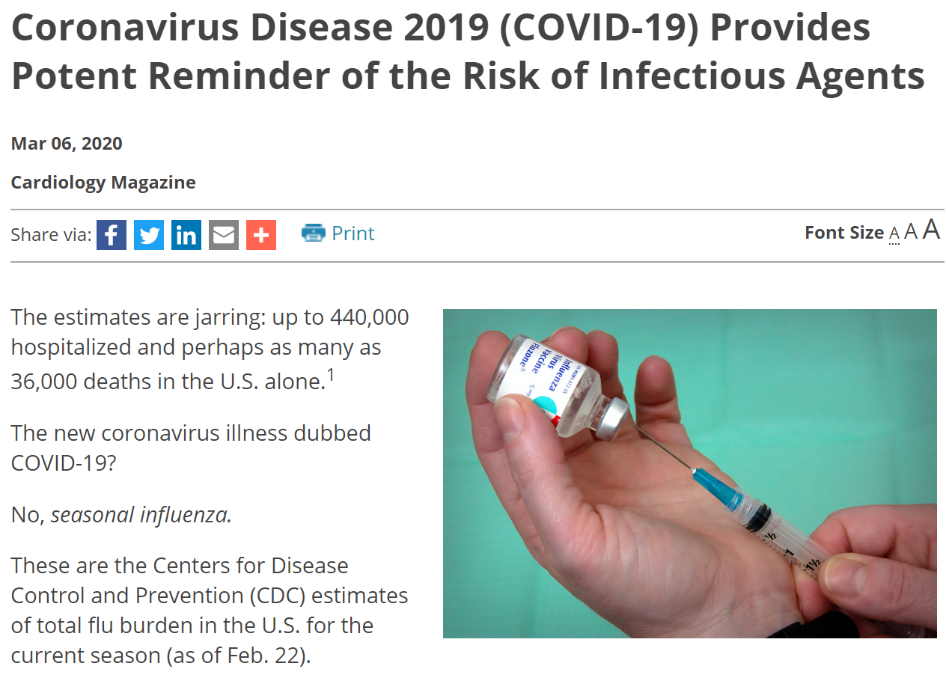
Remember – please don’t forget about influenza
Article provided by Dr. Pierre Leimgruber 3/6/2020

Slide 33
Why should we be so concerned with this pandemic of COVID-19 Our population is aging.
This Photo by Unknown Author is licensed under CC BY

Slide 34
Association between aging of the US Population and heart disease mortality between 2011-2017
The rate of decrease of heart disease (HD) mortality between 2011 and 2014 has been reported.
Heart disease must be discussed in the context of the rapid increase in the population of adults aged 65 years and older.
Examine changes in the age-adjusted mortality rate and the number of deaths within subcategories of HD from 2011 to 2017 in conjunction with the change in the size of the US population during the same period.
Sydney, S., Go, A., Jaffee, M. et al. Association between aging of the US Population and heart disease mortability from 2011-2017. JAMA Cardiology 2019; 4(12):1280-1286

Slide 35
Association between aging of the US Population and heart disease mortality between 2011-2017
AGE-ADJUSTED DEATH RATE is a death rate that controls for the effects of differences in population age distributions. Used to control for the influence that different population age distributions might have on health event rates.
Sydney, S., Go, A., Jaffee, M. et al. Association between aging of the US Population and heart disease mortability from 2011-2017. JAMA Cardiology 2019; 4(12):1280-1286

Slide 36
Association between aging of the US Population and heart disease mortality between 2011-2017
Sydney, S., Go, A., Jaffee, M. et al. Association between aging of the US Population and heart disease mortability from 2011-2017. JAMA Cardiology 2019; 4(12):1280-1286

Slide 37
Association between aging of the US Population and heart disease mortality between 2011-2017
Sydney, S., Go, A., Jaffee, M. et al. Association between aging of the US Population and heart disease mortability from 2011-2017. JAMA Cardiology 2019; 4(12):1280-1286

Slide 38
Association between aging of the US Population and heart disease mortality between 2011-2017
Despite a decrease in age-adjusted mortality the increasing HF deaths coupled with continued rapid increase in the population of adults aged 65 years and older, are associated with a steady, substantial increase in the total number of HD deaths.
The projected 44% increase in the number of adults aged 65 years and older from 2017 to 2030 can be expected to create challenges for the capacity of public health and management of chronic HD.
Innovative and effective approaches for surveillance, prevention, and tx are needed to address the expanding burden of HD mortality, particularly for the substantially increasing rates of HF.
Hint……How about the BaleDoneen Method?
AHAforLife.com!
Sydney, S., Go, A., Jaffee, M. et al. Association between aging of the US Population and heart disease mortability from 2011-2017. JAMA Cardiology 2019; 4(12):1280-1286

Slide 39
If Heart Failure death is increasing in our age-adjusted models – what is causing this?

Slide 40
Multimorbidity and Multiple causes of death in Heart Failure (HF)
6530 adults aged18 & 69 yrs, collected between 2000 and 2011.
Mortality was determined through National Death Index.
HF patients (92.2%) had at least one additional medical condition.
Most common: hypertension, arrhythmia, dyslipidemia, & CAD
Patients with a history of HF had 3.6 (95% CI: 2.45, 5.24) times higher hazard of mortality from kidney disease.
Haregu, T.N., Nanayakkara, S., Carrington, M. et al. Multimorbidity and multiple causes of death in heart failure. J Public Health (Berl.) (2020). https://doi.org/10.1007/s10389-020-01223-0

Slide 41
Association between aging of the US Population and heart disease mortality between 2011-2017
BaleDoneen Take-Away:
“Adults aged 65 years and older projected to increase an additional 44% from 2017-2030; innovative and effective approaches to prevent and treat heart disease are needed”
Kidney disease is the most common associated cause of death that is increasing in heart failure patients (3.8 fold increased risk). THIS IS CHRONIC ARTERIAL DISEASE!
Whose job is this? Do we wait until patient is so ill that they reach the end-stage disease model of nephrology and cardiac transplant lists?
It is OUR JOB – the BaleDoneen Method is what they are asking for – www.ahaforlife.com.
Sydney, S., Go, A., Jaffee, M. et al. Association between aging of the US Population and heart disease mortability from 2011-2017. JAMA Cardiology 2019; 4(12):1280-1286

Slide 42
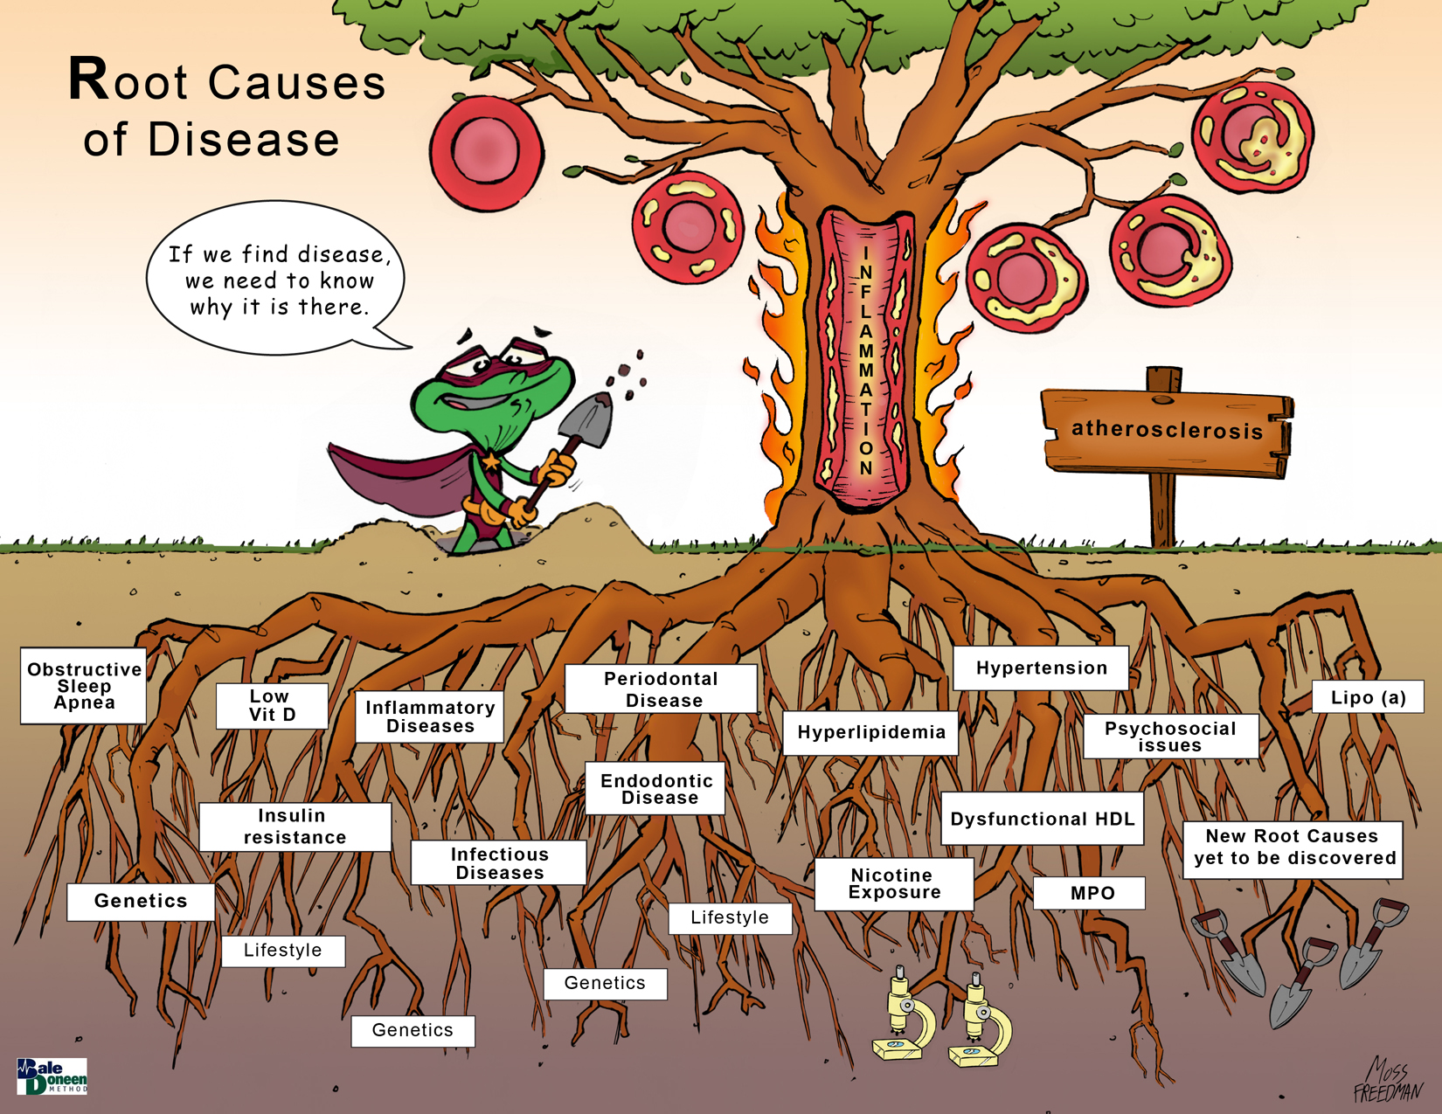
Airway
Sleep
Oral
Health

Slide 43
Endodontic Therapy and Incident CVD in the ARIC Trial
What is the ARIC Trial?
Enrolled approximately 16,000 adults from four U.S. communities and has monitored them for 30 years.
The NHLBI study helped assess rates of heart attack, hospitalizations from heart failure, and deaths due to heart disease in over 400,000 adults.
Findings have shaped clinical guidelines that are now used to treat coronary heart disease, diabetes, stroke, and chronic kidney disease and has led to more than 1,800 published articles.
Cowan, L., Lakshminarayn, K., Lutsey, P. (2020). Endodontic therapy and incident cardiovascular disease: The atherosclerosis risk in communities (ARIC) study. Public health Dent 2020.

Slide 44
Endodontic Therapy and Incident CVD in the ARIC Trial
ABSTRACTS CAN BE MISLEADING!
ARIC participants who completed the dental ancillary study exam:
Participants were followed through 2013 for CHD, stroke, and HF and 2011 for VTE.
Over a median of 15.8 years of follow-up, there were 506 incident CHD events, 311 IS events, 739 HF events, and 219 VTE events.
Conclusions: Our results do not support an independent association between ET and development of CHD, IS, HF, or VTE.
Cowan, L., Lakshminarayn, K., Lutsey, P. (2020). Endodontic therapy and incident cardiovascular disease: The atherosclerosis risk in communities (ARIC) study. Public health Dent 2020.

Slide 45
Endodontic Therapy and Incident CVD in the ARIC Trial
So – we will likely hear or read a statement that:
‘the ARIC trial does NOT support a relationship between endodontic disease and coronary artery disease’
It is important to be aware of the misleading
Information in this analysis
Cowan, L., Lakshminarayn, K., Lutsey, P. (2020). Endodontic therapy and incident cardiovascular disease: The atherosclerosis risk in communities (ARIC) study. Public health Dent 2020.

Slide 46
Endodontic Therapy and Incident CVD in the ARIC Trial
The exposure of interest was self-reported history of root canal treatment, which was assessed as part of the D-ARIC study during visit 4 (1996–1998).
Exposure was classified according to responses to the questions, “Have you ever had root canal therapy?” and “If you have had root canal therapy”, “Have you had more than one?”
Exposure was divided as:
multiple root canals, one root canal, and no root canals.
Participants whose ET status was unknown were excluded
Cowan, L., Lakshminarayn, K., Lutsey, P. (2020). Endodontic therapy and incident cardiovascular disease: The atherosclerosis risk in communities (ARIC) study. Public health Dent 2020.

Slide 47
Endodontic Therapy and Incident CVD in the ARIC Trial
What is the value of this trial?
This trial provides more insight into who is getting endodontic therapy than who has Endodontic Disease!
Endodontic Therapy (root canals) can NOT be used as surrogate marker for endodontic dx.
Cowan, L., Lakshminarayn, K., Lutsey, P. (2020). Endodontic therapy and incident cardiovascular disease: The atherosclerosis risk in communities (ARIC) study. Public health Dent 2020.

Slide 48
Endodontic Therapy and Incident CVD in the ARIC Trial
Might this be a bigger lesson – who is actually getting treatment?
This trial analysis isn’t about endodontic disease at all – it is really about who is getting endodontic therapy (ie Root Canals) –
91.6% were white
66.7% had a bachelors degree or higher vs 6% with H.S or less
66.7% had incomes >$35,000 per year
Only 5% of ET patients had elevated BMI’s
Only 12% of ET patients were current smokers.
Those with past ET were more likely to have medical insurance, a current dentist, and visit the dentist regularly.
Cowan, L., Lakshminarayn, K., Lutsey, P. (2020). Endodontic therapy and incident cardiovascular disease: The atherosclerosis risk in communities (ARIC) study. Public health Dent 2020.

Slide 49
Endodontic Therapy and Incident CVD in the ARIC Trial
How can they appropriately make this leap?
“Endodonic infection (EI) and apical periodontitis (AP) is treated through root canal or endodontic treatment (ET)” – therefore …
“One way to estimate history of EI/AP is through
self-reported previous ET”
Cowan, L., Lakshminarayn, K., Lutsey, P. (2020). Endodontic therapy and incident cardiovascular disease: The atherosclerosis risk in communities (ARIC) study. Public health Dent 2020.

Slide 50
Endodontic Therapy and Incident CVD in the ARIC Trial
BaleDoneen Take-Away:
This trial – evaluation of the ARIC patients had absolutely nothing to do with an association of endodontic disease and CAD association.
The leap that these researchers make is unbelievable – determining that the self-reported history of having a root canal determines the presence or absence of endodontic disease is NOT OK.
Rather - this trial points out the obvious disparity of the lack of dental care in a very vulnerable group of individuals.
Cowan, L., Lakshminarayn, K., Lutsey, P. (2020). Endodontic therapy and incident cardiovascular disease: The atherosclerosis risk in communities (ARIC) study. Public health Dent 2020.

Slide 51
Let’s talk about brain health in regard to obstructive sleep apnea

Slide 52
OSA, Cognition and Alzheimer’s disease
Evidence links cognitive-decline and Alzheimer's disease (AD) to various sleep disorders, including obstructive sleep apnea (OSA)
An important question for sleep and AD researchers is whether OSA's heterogeneity results in varying cognitive-outcomes in older-adults compared to middle-aged adults.
Researchers performed integrated research examining OSA and cognition, mild cognitive-impairment (MCI) and AD/AD biomarkers; including the effects of continuous positive airway pressure (CPAP) treatment, focusing on characterizing the heterogeneity of OSA and its cognitive-outcomes
Buba, O., Andrade, A., Umasabor, O., et al (2020). Obstructive sleep apnea, cognition and Alzheimer’s disease: a systematic review integrating three decade of multidisciplinary research. Sleep Medicine Reviews 50 (2020) 101250

Slide 53
OSA, Cognition and Alzheimer’s disease
OSA is often associated with mild impairment in attention, memory and executive function.
In older-adults, OSA is not associated with any particular pattern of cognitive-impairment at cross-section; however, OSA is associated with the development of MCI or AD with symptomatic patients
Recent trends demonstrate links between OSA and AD biomarkers of neurodegeneration across all age-groups.
These distinct patterns provide the foundation for envisioning better characterization of OSA and the need for more sensitive/novel sleep-dependent cognitive assessments to assess OSA and cognition
Buba, O., Andrade, A., Umasabor, O., et al (2020). Obstructive sleep apnea, cognition and Alzheimer’s disease: a systematic review integrating three decade of multidisciplinary research. Sleep Medicine Reviews 50 (2020) 101250

Slide 54
OSA, Cognition and Alzheimer’s disease
Buba, O., Andrade, A., Umasabor, O., et al (2020). Obstructive sleep apnea, cognition and Alzheimer’s disease: a systematic review integrating three decade of multidisciplinary research. Sleep Medicine Reviews 50 (2020) 101250

Slide 55
OSA, Cognition and Alzheimer’s disease: A systemic review.
A systematic literature search identified all eligible studies (published prior to May 1st, 2019) that examined associations between:
OSA and cognitive function
OSA and subsequent cognitive decline
OSA and AD.
Buba, O., Andrade, A., Umasabor, O., et al (2020). Obstructive sleep apnea, cognition and Alzheimer’s disease: a systematic review integrating three decade of multidisciplinary research. Sleep Medicine Reviews 50 (2020) 101250

Slide 56
OSA, Cognition and Alzheimer’s disease: A systemic review.
Buba, O., Andrade, A., Umasabor, O., et al (2020). Obstructive sleep apnea, cognition and Alzheimer’s disease: a systematic review integrating three decade of multidisciplinary research. Sleep Medicine Reviews 50 (2020) 101250

Slide 57
OSA, Cognition and Alzheimer’s disease
Buba, O., Andrade, A., Umasabor, O., et al (2020). Obstructive sleep apnea, cognition and Alzheimer’s disease: a systematic review integrating three decade of multidisciplinary research. Sleep Medicine Reviews 50 (2020) 101250

Slide 58
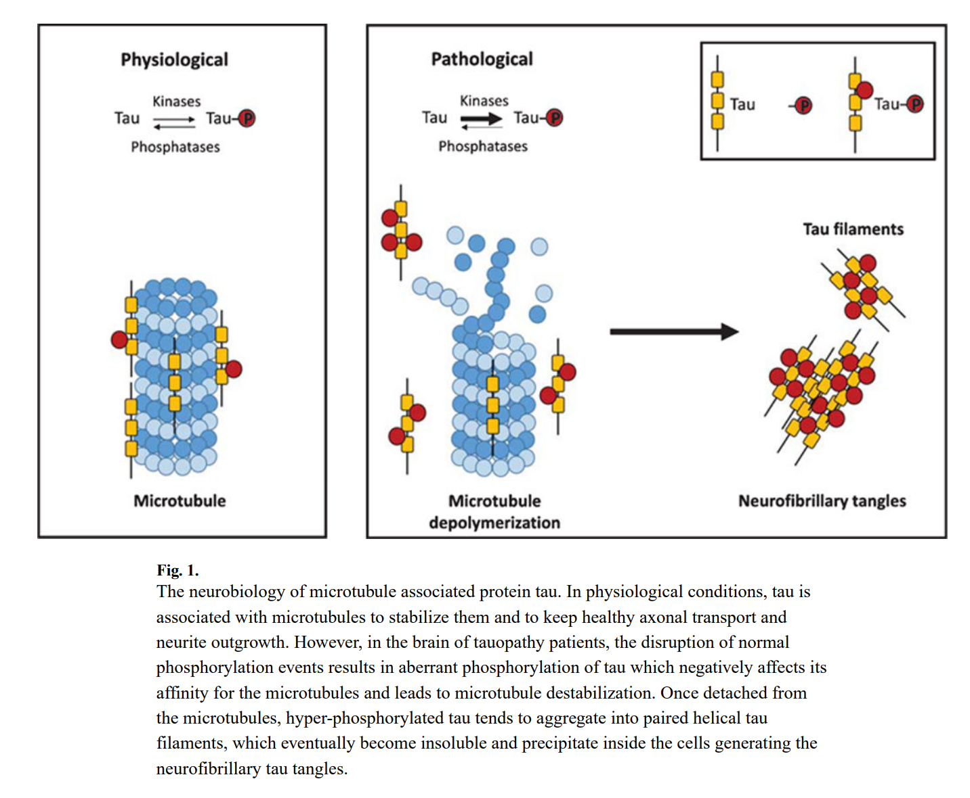
Novel Key Players in the development of Tau Neuropathology
One of the hallmarks of Alzheimer's disease is the tau tangles. Tau is a protein contained within the axons of the nerve cells. Tau helps form microtubules — essential structures that transport nutrients within nerve cells
.
Lauretti, E., Pratico, D. et al. (2018). Novel players in the development of tau neuropathology. Alzheimers Dis. 2018; 64(1): S481-S489.

Slide 59
OSA, Cognition and Alzheimer’s disease
Two studies by Ju et al. have demonstrated associations
between OSA and AD pathology.
In the cross-sectional study, Ju et al. examined CSF AD biomarkers and other neuronal derived protein in a group of 31 control (AHI<5) and 10 moderate to severe OSA patients (AHI>15) - neuronally derived proteins were all lower in OSA patients. Also there was a significant negative correlation between slow wave activity (SWA) and OSA patients.
Ju YE, Finn MB, Sutphen CL, Herries EM, Jerome GM, Ladenson JH, et al. Obstructive sleep apnea decreases central nervous system-derived proteins in the cerebrospinal fluid. Ann Neurol 2016;80(1):154e9.
In the interventional study SWA and CSF Ab were measured in participants with OSA before and 14mo after treatment with CPAP. OSA treatment increased SWA and normalized the inverse association between SWA and CSF Ab levels.
Ju YS, Zangrilli MA, Finn MB, Fagan AM, Holtzman DM. Obstructive sleep apnea treatment, slow wave activity, and amyloid-beta. Ann Neurol 2018.
Buba, O., Andrade, A., Umasabor, O., et al (2020). Obstructive sleep apne , cognition and Alzheimer’s disease: a systematic review integrating three decade of multidisciplinary research. Sleep Medicine Reviews 50 (2020) 101250

Slide 60
OSA, Cognition and Alzheimer’s disease
Study Conclusions
OSA is often associated with cognitive impairment in young and middle-aged adults. In older adults, OSA is associated with the development of MCI or AD with OSA patients seeking treatment driving these findings.
There is a link between OSA and AD biomarkers of neurodegeneration in cognitively normal individuals of all age groups.
OSA worsens metabolic injury that is particularly significant in middle-age and exacerbates neuronal injury and facilitates memory and cognitive impairment, particularly impressive in older adults.
Intermittent hypoxia, sleep fragmentation, reduced SWS and intrathoracic pressure swings are possible mechanisms by which OSA induces neurodegenerative changes.
CPAP treatment may be effective in improving cognition in OSA patients with AD.
Buba, O., Andrade, A., Umasabor, O., et al (2020). Obstructive sleep apnea, cognition and Alzheimer’s disease: a systematic review integrating three decade of multidisciplinary research. Sleep Medicine Reviews 50 (2020) 101250

Slide 61
OSA, Cognition and Alzheimer’s disease
BaleDoneen Take-Away:
Despite noted study limitations, the OSA-AD relationship appears to have many connections.
There needs to be improved sleep-dependent cognitive assessments to assess OSA-related impairment.
Study did cite several limitations to the cognitive testing.
As our population ages and microvascular disease develops – we must begin to appreciate the differences and similarities between microvascular dementia and AD.
Proper sleep evaluation is essential in all BaleDoneen patients – regardless of age – OSA and sleep disruption.
Cognitive testing in our BaleDoneen Patients must become a standard evaluation – Question is….which test to use?
Buba, O., Andrade, A., Umasabor, O., et al (2020). Obstructive sleep apnea, cognition and Alzheimer’s disease: a systematic review integrating three decade of multidisciplinary research. Sleep Medicine Reviews 50 (2020) 101250

Slide 62
As our population is aging – what is best clinical tool to assess memory function?

Slide 63
Mini Menta Stat Examination (MMSE)

Slide 64
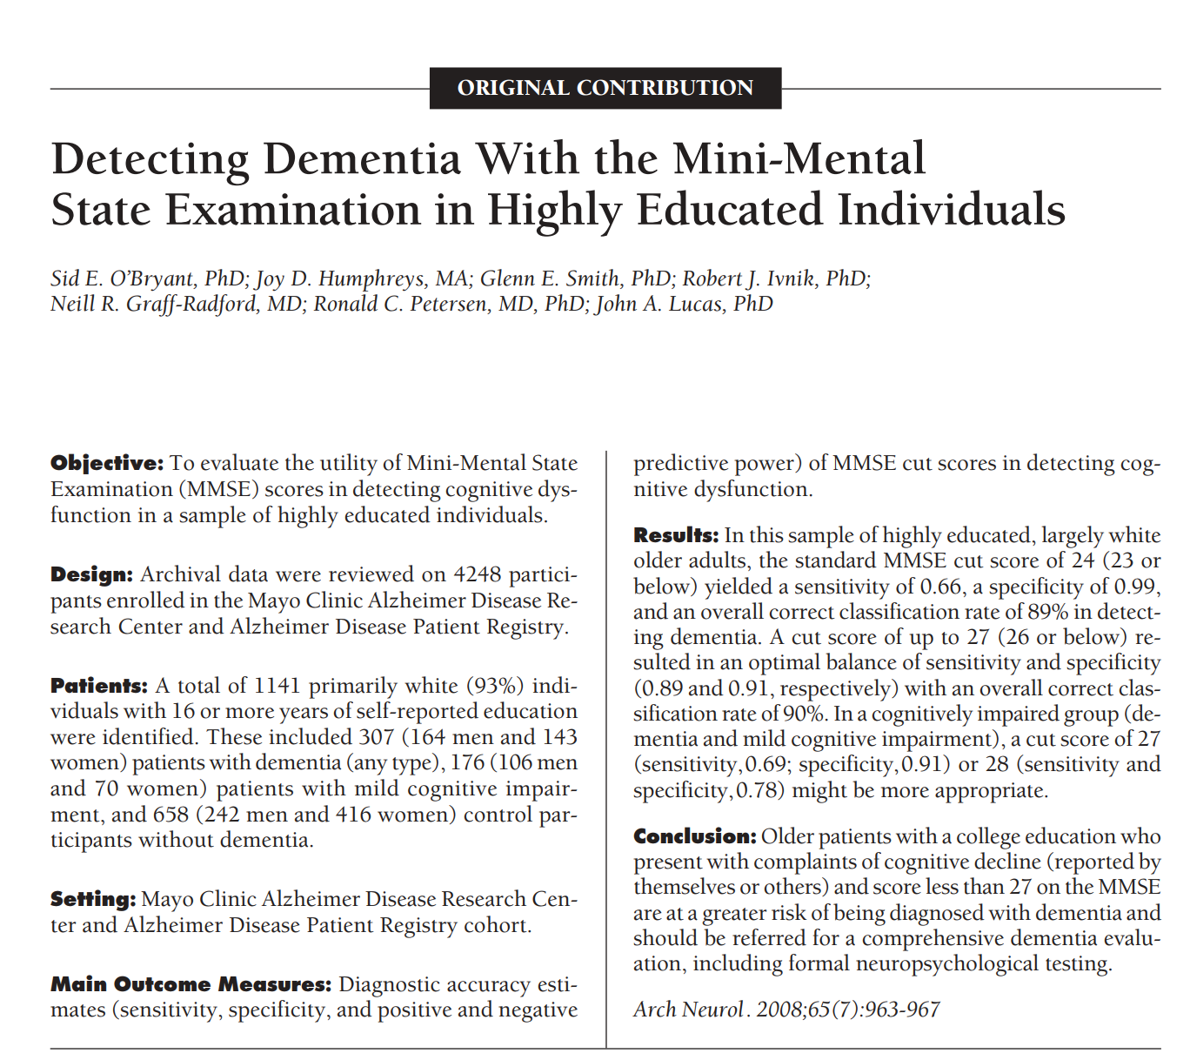

Slide 65
App- and Web-Based Self-Testing of Cognitive Impairment
Researchers identified 3057 tools, of which 25 were included in the review. Only 7 tools had any information concerning psychometric quality, and only 1 tool reported data on performance norms, reliability, validity, sensitivity, and specificity for the detection of cognitive impairment.
Conclusions: The number of cognitive self-assessment electronic health tools for cognitive impairment is increasing, but most are of uncertain quality.
There is a need for well-validated tools and guidance for users concerning which tools provide reliable information about possible cognitive impairment testing.
Charalambous AP, Pye A, Yeung WK, Leroi I, Neil M, Thodi C, Dawes P Tools for App- and Web-Based Self-Testing of Cognitive Impairment: Systematic Search and Evaluation J Med Internet Res 2020;22(1):e14551

Slide 66
Sleep Disordered breathing and Stroke Risk
This Photo by Unknown Author is licensed under CC BY-NC-ND

Slide 67
Sleep Disordered breathing (SDB) is Associated with Recurrent Ischemic Stroke
BASIC project (Brain Attack Surveillance in Corpus Christi), ischemic stroke patients between 2010–2015)
Subjects were offered screening for SDB with the ApneaLink Plus device, from which a respiratory event index (REI) score ≥10 defined SDB.
Assess the association between REI and ischemic stroke recurrence and all-cause poststroke mortality, adjusted for multiple potential confounders.
Brown, D., Shafie-Khorassani, F., Kim, S. et al (2020). Stroke.
2019;50:571-576. DOI: 10.1161/STROKEAHA.118.023807.)

Slide 68
Sleep Disordered breathing is Associated with Recurrent Ischemic Stroke
842 subjects, the median age was 65 (57–76), 47% were female, and 58% were Mexican American (MA).
The median REI score was 14 (6–26); 63% had SDB.
SDB was associated with male sex, MA ethnicity, being insured, nonsmoking status, diabetes mellitus, hypertension, lower educational attainment, and higher BMI.
In fully adjusted models, REI was associated with recurrent ischemic stroke (HR, 1.02 [CI, 1.01–1.03]), but not with mortality alone (hazard ratio, 1.00 [95% CI, 0.99–1.02])
Brown, D., Shafie-Khorassani, F., Kim, S. et al (2020). Stroke.
2019;50:571-576. DOI: 10.1161/STROKEAHA.118.023807.)

Slide 69
Sleep Disordered breathing is Associated with Recurrent Ischemic Stroke
Results from this large population-based study show that SDB is associated with recurrent ischemic stroke, but not mortality.
SDB may therefore represent an important modifiable risk factor for poor stroke outcomes.
For a 20-unit increase in REI scores, the association between REI and ischemic stroke recurrence in the fully adjusted model was HR, 1.51 (1.16–1.97).
Brown, D., Shafie-Khorassani, F., Kim, S. et al (2020). Stroke.
2019;50:571-576. DOI: 10.1161/STROKEAHA.118.023807.)

Slide 70
Sleep Disordered breathing is Associated with Recurrent Ischemic Stroke
BaleDoneen Take-Away:
RDI - respiratory distress Index — is a formula used in reporting polysomnography (sleep study) findings. Unlike AHI (respiratory events during sleep), it it also includes respiratory-effort related arousals (RERAs).
This study is strong enough that ALL stroke patients should get a formal sleep study – regardless of reported symptoms of daytime fatigue or witnessed apnea.
OSA (RDI/AHI) is a very modifiable risk factor.
This study did not evaluate treatment for OSA (ie: CPAP) – BaleDoneen requests our dental colleagues to participate in this assessment and, as long as a mandibular device is effective (repeat test), we are comfortable with either oral appliance or CPAP.
Stroke patients are VERY motivated to not have another stroke! ALL risk factors must be identified and optimally managed.
Brown, D., Shafie-Khorassani, F., Kim, S. et al (2020). Stroke.
2019;50:571-576. DOI: 10.1161/STROKEAHA.118.023807.)

Slide 71
Is Sleep Disordered Breathing making us age more quickly?

Slide 72
Sleep Disordered Breathing is associated with epigenetic age acceleration
Sleep disordered breathing (SDB) is a common disorder that results in oxidative stress and inflammation and is associated with multiple age-related health outcomes.
Epigenetic age acceleration is a DNA methylation (DNAm)-based marker of fast biological aging.
Examined the associations of SDB traits with epigenetic age acceleration in MESA – 2261 sleep participants
Lia, X., Joehanesc, R., Hoescheled, I. et al. (2019). Association between sleep disordered breathing and epigenetic age acceleration: Evidence from the Multi-Ethnic Study of Atherosclerosis. EBioMedicine 50 (2019) 387-394

Slide 73
Sleep Disordered Breathing is associated with epigenetic age acceleration
This is the first empirical study to investigate the associations between sleep disordered breathing traits and epigenetic age acceleration and to assess potential sex differences
Sleep disordered breathing, is underdiagnosed and might carry unique prospects in terms of developing interventions to delay aging progression and preventing age-related disorders, which might help to extend the human health span and lifespan.
Lia, X., Joehanesc, R., Hoescheled, I. et al. (2019). Association between sleep disordered breathing and epigenetic age acceleration: Evidence from the Multi-Ethnic Study of Atherosclerosis. EBioMedicine 50 (2019) 387-394

Slide 74
Sleep Disordered Breathing is associated with epigenetic age acceleration
A sample of 622 participants from the Multi-Ethnic Study of Atherosclerosis (MESA)
Blood DNAm measured
In-home polysomnography that assessed:
a) AHI
b) % of time with O2 sats <90% (Per90),
c) arousal index.
The association of each trait with age acceleration was estimated using linear regression, controlling for covariates.
In secondary analysis, studied association of SDB traits with epigenetic age acceleration 2-10 year after sleep study in 530 individuals from the Framingham Heart Study (FHS)
Lia, X., Joehanesc, R., Hoescheled, I. et al. (2019). Association between sleep disordered breathing and epigenetic age acceleration: Evidence from the Multi-Ethnic Study of Atherosclerosis. EBioMedicine 50 (2019) 387-394

Slide 75
Sleep Disordered Breathing is associated with epigenetic age acceleration
Results:
AHI was associated with greater DNAm-PhenoAge acceleration (0.03; 95% CI [0.001, 0.06]).
Arousal index was associated with greater DNAm-Age acceleration (0.04; 95% CI [0.01, 0.07]).
Both associations were stronger in women than men.
Per90 was associated with greater DNAm-Age acceleration and this association was stronger in men than women.
More severe SDB was associated with epigenetic age acceleration in both cohorts.
Lia, X., Joehanesc, R., Hoescheled, I. et al. (2019). Association between sleep disordered breathing and epigenetic age acceleration: Evidence from the Multi-Ethnic Study of Atherosclerosis. EBioMedicine 50 (2019) 387-394

Slide 76
Sleep Disordered Breathing is associated with epigenetic age acceleration
Apnea Hypopnea Index:
1-SD AHI was associated with 215 days of DNAm-PhenoAge acceleration.
Arousal Index:
1-SD AI representing 321 days of DNAm-Age acceleration
Per90:
Per90 on both epigenetic age acceleration measures was as expected (positive) but not statistically significant.
Lia, X., Joehanesc, R., Hoescheled, I. et al. (2019). Association between sleep disordered breathing and epigenetic age acceleration: Evidence from the Multi-Ethnic Study of Atherosclerosis. EBioMedicine 50 (2019) 387-394

Slide 77
Sleep Disordered Breathing is associated with epigenetic age acceleration
Individuals with SDB might be more vulnerable to advanced epigenetic age for a few reasons.
The hallmarks of SDB is intermittent hypoxemia and repetitive arousals and sleep fragmentation which then stimulates oxidative stress, inflammation, sympathetic nervous system activation, and endothelial dysfunction = all may to contribute to accelerated aging
Reactive oxygen species (ROS) can damage surrounding tissues and alter cellular functions, and consequently promote inflammation.
Ultimately decreasing an individual’s ability to respond to stressors
Lia, X., Joehanesc, R., Hoescheled, I. et al. (2019). Association between sleep disordered breathing and epigenetic age acceleration: Evidence from the Multi-Ethnic Study of Atherosclerosis. EBioMedicine 50 (2019) 387-394

Slide 78
What exactly is DNAm-PhenoAge Acceleration vs DNAm-Age Acceleration?

Slide 79
What exactly is DNAm-PhenoAge vs DNAm-Age Acceleration
Phenotypic aging measures, derived from clinical biomarkers strongly predict differences in the risk of all-cause mortality, cause-specific mortality, physical functioning, cognitive performance measures, and facial aging among same-aged individuals.
Proven to be better indicators of remaining life expectancy than chronological age.
Replacing prediction of chronological age with prediction of a surrogate measure of "phenotypic age" that differentiates morbidity and mortality risk among same-age individuals.
Lenne, M., Lu, A., Quach, A. et al. (2018). An epigenetic biomarker of aging for lifespan and healthspan. Aging 2018, V10, No4.

Slide 80
What exactly is DNAm-PhenoAge vs DNAm-Age Acceleration
DNAm Pheno Age is said to measure ‘extrinsic” aging.
DNAm-Age is said to measure “intrinsic” aging.
Lenne, M., Lu, A., Quach, A. et al. (2018). An epigenetic biomarker of aging for lifespan and healthspan. Aging 2018, V10, No4.

Slide 81
This whole concept is interesting because one of our visions is to: Secure the reality that Arterial health span matches life span

Slide 82
Epigenetic biomarker of aging for lifespan and healthspan
Incorporation of composite clinical measures of phenotypic age capture differences in
lifespan and healthspan.
DNAm PhenoAge strongly outperforms previous measures for a variety of aging outcomes, including all‐cause mortality, cancers, healthspan, physical functioning, and Alzheimer's disease.
Lenne, M., Lu, A., Quach, A. et al. (2018). An epigenetic biomarker of aging for lifespan and healthspan. Aging 2018, V10, No4.

Slide 83
Epigenetic biomarker of aging for lifespan and healthspan
DNAm Pheno-Age correlates strongly
with age in every tissue and cell tested.
Increased epigenetic aging relative to chronological age, is associated with increased activation of pro‐inflammatory and interferon pathways, decreased activation of transcriptional/translational machinery, DNA damage response, and mitochondrial signatures.
Lenne, M., Lu, A., Quach, A. et al. (2018). An epigenetic biomarker of aging for lifespan and healthspan. Aging 2018, V10, No4.

Slide 84
So….let’s go back to Lai’s and colleague’s study regarding epigenetic age acceleration and sleep disordered breathing

Slide 85
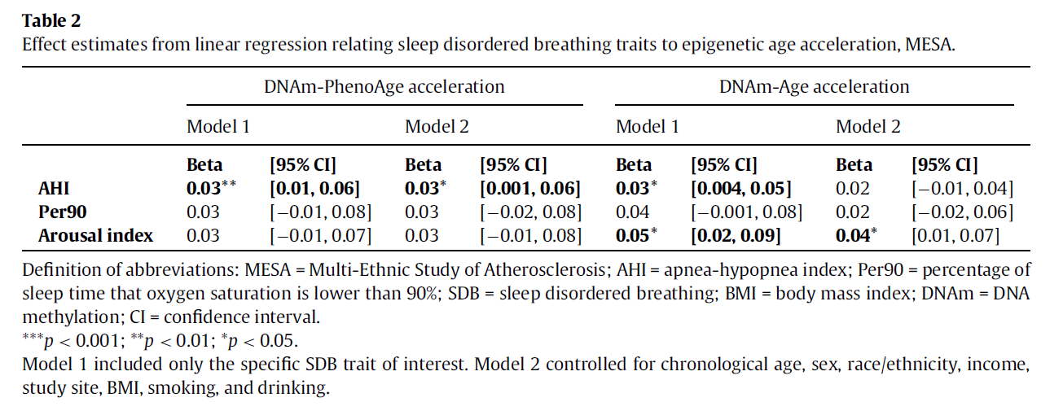
Sleep Disordered Breathing is associated with epigenetic age acceleration
Lia, X., Joehanesc, R., Hoescheled, I. et al. (2019). Association between sleep disordered breathing and epigenetic age acceleration: Evidence from the Multi-Ethnic Study of Atherosclerosis. EBioMedicine 50 (2019) 387-394

Slide 86
Sleep Disordered Breathing is associated with epigenetic age acceleration
AHI
Lia, X., Joehanesc, R., Hoescheled, I. et al. (2019). Association between sleep disordered breathing and epigenetic age acceleration: Evidence from the Multi-Ethnic Study of Atherosclerosis. EBioMedicine 50 (2019) 387-394

Slide 87
Sleep Disordered Breathing is associated with epigenetic age acceleration
Per90
Lia, X., Joehanesc, R., Hoescheled, I. et al. (2019). Association between sleep disordered breathing and epigenetic age acceleration: Evidence from the Multi-Ethnic Study of Atherosclerosis. EBioMedicine 50 (2019) 387-394

Slide 88
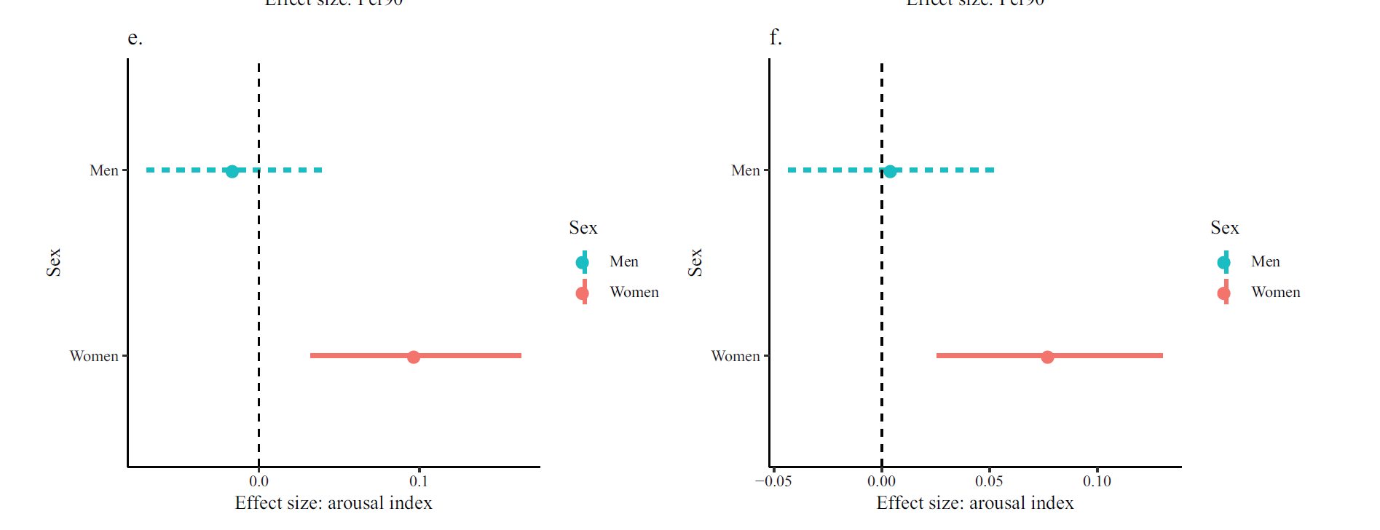
Sleep Disordered Breathing is associated with epigenetic age acceleration
Arousal Index
Lia, X., Joehanesc, R., Hoescheled, I. et al. (2019). Association between sleep disordered breathing and epigenetic age acceleration: Evidence from the Multi-Ethnic Study of Atherosclerosis. EBioMedicine 50 (2019) 387-394

Slide 89
Sleep Disordered Breathing is associated with epigenetic age acceleration
Researchers concluded that this analyses suggests an association with SDB severity and epigenetic age acceleration.
One of the most promising features of DNAm biomarkers is that epigenetic changes are reversible, indicating that epigenetic age estimators might be useful to identifying and validating anti-aging interventions.
Lia, X., Joehanesc, R., Hoescheled, I. et al. (2019). Association between sleep disordered breathing and epigenetic age acceleration: Evidence from the Multi-Ethnic Study of Atherosclerosis. EBioMedicine 50 (2019) 387-394

Slide 90
Sleep Disordered Breathing is associated with epigenetic age acceleration
BaleDoneen Take-Away:
How does this related to our vision to secure the reality that Arterial health span matches life span?
I have shown previously (5/10/2017) how OSA affects all three areas of the atherogenic triad.
This study demonstrates that sleep disordered breathing IS associated with epigenetic age acceleration (ie: healthspan vs lifespan). Sadly, SDB is often not recognized and under diagnosed
Again – this is another area where we must ensure our dental colleagues are participating in the assessment of this condition.
While BaleDoneen medical providers are very thorough in obtaining sleep evaluations, our oral health colleagues are in a prime position to inform their patients of this association.
Lia, X., Joehanesc, R., Hoescheled, I. et al. (2019). Association between sleep disordered breathing and epigenetic age acceleration: Evidence from the Multi-Ethnic Study of Atherosclerosis. EBioMedicine 50 (2019) 387-394

Slide 91
Let’s go there…..yes….hormones! Nothing divides a CV conference more than the discussion of HRT

Slide 92
New abstract presented at the AHA meeting discussed follow-up data from the ELITE trial
In order to appreciate the new data coming forward, let’s first quickly review the ELITE Trial from 2016.

Slide 93
ELITE Trial: Menopausal hormone timing hypothesis
Early versus Late Intervention Trial with Estradiol (ELITE), the only clinical trial designed to specifically test the timing hypothesis of postmenopausal hormone therapy (HT)
Randomized, double-blinded, placebo-controlled trial with a 2x2 factorial design. 643 healthy postmenopausal women without CVD randomized to oral estradiol or placebo for up to 6-7 years according to number of years-since-menopause, <6 years of >10 years
Carotid artery intima-media thickness (CIMT) and cardiac computed tomography were conducted to determine HT effects on subclinical atherosclerosis across menopause strata
Hodis, H., Mack, W., Shoupe, D. et al (2016). Methods and baseline cardiovascular data from the early versus late intervention trial with estradiol testing the menopausal hormone timing hypothesis. Gynecol Endocrinol, 2016; 32(7): 581–586

Slide 94
ELITE Trial: Menopausal hormone timing hypothesis
Participants in the early and late postmenopausal strata were well-separated by mean age, 55.4 versus 65.4 years and median time-since-menopause, 3.5 versus 14.3 years, respectively.
Significant associations between CIMT and factors (LDL-C, HDL-C, sex hormone binding globulin and serum total estradiol) were found to play a role in responsiveness of atherosclerosis progression according to timing of HT initiation.
Hodis, H., Mack, W., Shoupe, D. et al (2016). Methods and baseline cardiovascular data from the early versus late intervention trial with estradiol testing the menopausal hormone timing hypothesis. Gynecol Endocrinol, 2016; 32(7): 581–586

Slide 95
ELITE Trial: Menopausal hormone timing hypothesis
The primary trial endpoint is the rate of change of the right distal common carotid artery (CCA) far wall intima-media thickness IMT over the 2 baseline examinations and serial examinations completed every 6 months over trial follow-up
Hodis, H., Mack, W., Shoupe, D. et al (2016). Methods and baseline cardiovascular data from the early versus late intervention trial with estradiol testing the menopausal hormone timing hypothesis. Gynecol Endocrinol, 2016; 32(7): 581–586

Slide 96
Abstract presented at the 2020 AHA
Authors Roksana Karim, Wenrui Xu, Univ of Southern California, Los Angeles, CA; Howard N Hodis, UNIV SOUTHERN CALIFORNIA, Los Angeles, CA; Naoko Kono, Intira Sriprasert, Yanji Li, Univ of Southern California, Los Angeles, CA; Mingzhu Yan, UNIVERSITY OF SOUTHERN CALIFORNIA, Los Angeles, CA; Frank Stanczyk, Univ of Southern California, Los Angeles, CA; Wendy MacK, UNIV SOUTHERN CALIFORNIA, Los Angeles, CA
Abstract
This is a secondary analysis from ELITE. A total of 643 healthy postmenopausal women were randomized within time-since-menopause strata (early (<6 years) and late (>10 years) postmenopause to daily 1 mg estradiol or placebo.
The atherosclerosis outcome for the current analysis is grey scale median (GSM), a qualitative measure of atherosclerosis based on echogenicity obtained by high resolution ultrasonography of the CCA.
Lower GSM values indicate more lipid deposition.
GSM and serum concentrations of estradiol (E2) were assessed every 6 months over a median 5-year trial period.

Slide 97
Results: The effect of ET on the annual rate of GSM progression significantly differed between early and late postmenopause strata (p-value for interaction = 0.006).
Annual GSM progression rate (95% CI) among women in early postmenopause decreased by -0.30 (-0.63, 0.04) per year among women taking ET compared to -1.41 (-1.77, -1.06) per year among the placebo group (p<0.0001).
The positive association between mean on-trial E2 level (pg/ml) and GSM progression rate was significant among early postmenopausal women (0.008 (0.0007, 0.016)) compared to women in the late postmenopause group (0.003 (-0.006, 0.01)).

Slide 98
Conclusion:
Compared to placebo, oral ET significantly reduced progression of lipid deposition in the carotid arterial wall among women in early postmenopause.
ET had no such beneficial effect in late postmenopause.
Associations between serum estradiol levels and lipid deposition validated those findings.
Qualitative assessment of subclinical atherosclerosis (GSM) complements the anatomic assessment by carotid artery intima-media thickness.

Slide 99
Why might this be the case? Let’s examine estrogens effect on smooth muscle transition – first step in the atherogenic disease process.

Slide 100
Estradiol effects on vascular smooth muscle cells.
The first step in the atherosclerotic disease cycle (atherogenic triad) is actually the vascular smooth muscle transition.
Can estradiol do this?
Li et al - Estrogen is known to retard atherogenesis via direct actions on vasculature. Previously reported that 17b-estradiol (E2) improves vascular endothelial functions and promotes endothelial migration.
Additionally, E2 inhibits lipopolysaccharide-promoted VSMCs migration. However, the mechanism underlying the regulatory effect had remained unclear.
Li, Hengchang, Cheng, Y., Simoncini, T. et al. (2016). Estradiol effects on vascular smooth muscle cells. Gynecol Endocrinol, 2016;32(7):581-586

Slide 101
Estradiol effects on vascular smooth muscle cells.
TNF-related apoptosis-inducing ligand (TRAIL) regulates cardiovascular functions.
TRAIL is a homolog of cytokines of the TNF family. It has potent anti-tumor activities to induce tumor cell apoptosis and has entered into clinical trials for cancer therapy.
In addition to this, TRAIL exerts broad biological functions in other systems including CV system by promoting VSMCs proliferation and migration induced by platelet-derived growth factor.
Li, Hengchang, Cheng, Y., Simoncini, T. et al. (2016). Estradiol effects on vascular smooth muscle cells. Gynecol Endocrinol, 2016;32(7):581-586

Slide 102
Estradiol effects on vascular smooth muscle cells.
The first step in the atherosclerotic disease cycle (atherogenic triad) is actually the vascular smooth muscle transition.
Can estradiol do this?
Li et al - recognized there is no evidence whether estrogen regulates VSMCs functions via the regulation of this TRAIL protein.
Li, Hengchang, Cheng, Y., Simoncini, T. et al. (2016). Estradiol effects on vascular smooth muscle cells. Gynecol Endocrinol, 2016;32(7):581-586

Slide 103
Estradiol effects on vascular smooth muscle cells.
E2 inhibited TNF-a-induced TRAIL expression, VSMCs proliferation and migration.
E2 inhibits VSMCs proliferation and migration by downregulation of TRAIL expression via suppression of NF-kB pathway.
This provides reason why estrogen (when taken appropriately CAN effect smooth muscle transition and increase plaque echogeneity (Grey Scale Matter evaluation) = plaque stabilization.
Li, Hengchang, Cheng, Y., Simoncini, T. et al. (2016). Estradiol effects on vascular smooth muscle cells. Gynecol Endocrinol, 2016;32(7):581-586

Slide 104
Omega 3….music to my ears! Finally some validation ☺

Slide 105
Habitual fish oil supplementation improves CV outcomes and all-cause mortality
A total of 427 678 men and women aged 40 and 69 who had no CVD or cancer at baseline were enrolled between 2006 and 2010 and followed up to the end of 2018.
All participants answered questions on the habitual use of supplements, including fish oil
1=yes
2=no
MAIN OUTCOME MEASURES
All cause mortality, CVD mortality, and CVD events.
Li, Z-H., Zhong, W-F., Liu, S., et al. (2000). Associations of habitual fish oil supplementation with cardiovascular outcomes and all cause mortality: evidence from a large population based cohort study. BMJ 2020:368:m456.

Slide 106
Habitual fish oil supplementation improves CV outcomes and all-cause mortality
Li, Z-H., Zhong, W-F., Liu, S., et al. (2000). Associations of habitual fish oil supplementation with cardiovascular outcomes and all cause mortality: evidence from a large population based cohort study. BMJ 2020:368:m456.

Slide 107
Habitual fish oil supplementation improves CV outcomes and all-cause mortality
All cause mortality
Li, Z-H., Zhong, W-F., Liu, S., et al. (2000). Associations of habitual fish oil supplementation with cardiovascular outcomes and all cause mortality: evidence from a large population based cohort study. BMJ 2020:368:m456.

Slide 108
Habitual fish oil supplementation improves CV outcomes and all-cause mortality
CVD
Mortality
CVD events
Li, Z-H., Zhong, W-F., Liu, S., et al. (2000). Associations of habitual fish oil supplementation with cardiovascular outcomes and all cause mortality: evidence from a large population based cohort study. BMJ 2020:368:m456.

Slide 109
Habitual fish oil supplementation improves CV outcomes and all-cause mortality
Habitual fish oil supplementation was inversely associated with the risk of CVD outcomes and all cause mortality.
Future studies are needed to examine the extent to which the dose of fish oil supplements influences the ability to achieve a clinically meaningful effect.
Li, Z-H., Zhong, W-F., Liu, S., et al. (2000). Associations of habitual fish oil supplementation with cardiovascular outcomes and all cause mortality: evidence from a large population based cohort study. BMJ 2020:368:m456.

Slide 110
Habitual fish oil supplementation improves CV outcomes and all-cause mortality
BaleDoneen Take-Away:
We will continue to utilize Apo E to guide dosing recommendations.
This trial is especially important because it validates the previous primary prevention data from JELIS which was not powered for mortality but did show a 19% drop in events.
After all adjustments made – all outcomes were significant except stroke mortality.
Yes – we remain fans of Omega 3.
Li, Z-H., Zhong, W-F., Liu, S., et al. (2000). Associations of habitual fish oil supplementation with cardiovascular outcomes and all cause mortality: evidence from a large population based cohort study. BMJ 2020:368:m456.

Slide 112
Error in USPSTF Report on Statin Use The 2016 review1 for the US Preventive Services Task Force on statins for prevention of CVD in adults had errors in the analysis of statins vs placebo and cardiovascular mortality.
For the JUPITER trial, we interpreted “MI, stroke or cardiovascular death” as reported in the main trial publication as “myocardial death, stroke death, or cardiovascular death,” when it meant “nonfatal myocardial infarction, nonfatal stroke, or cardiovascular death.”
Therefore, the analysis erroneously included nonfatal myocardial infarction and stroke events (83/8901 vs 157/8901 in the rosuvastatin vs placebo groups, respectively) in the analysis of cardiovascular mortality
*BaleDoneen TakeAway – NO BIG DEAL – our recommendation for statin use is based on its ability to reduce arterial inflammation.

Slide 113
In conclusion
AHA for Life!
www.ahaforlife.com
Join us for the next preceptorship in
Scottsdale Arizona April 16-17th
^{Stay Current with COVID19!}

