Slide 1
Bale/Doneen Live Scientific Update Session
Amy Doneen DNP, ARNP
May 15, 2019
5:30-6:30 pm PST

Slide 2
Happy Mother’s Day

Slide 3
Disease:
Atherosclerosis
2019 ACC/AHA Guidelines for CVD prev.
Plaque Characteristics
CACS >1000 & Mortality
Roots:
Oral Health & Rheumatoid Arthritis
Stress and CVD
Tobacco, Nicotine and PD
Probiotics and Oral health
Treatment:
Eggs – good or bad?
Sugar Sweetened Beverages
Testosterone Therapy & DM prevention
Testosterone Therapy Reduces NT-ProBNP
PCSK9 new indication in “primary” prevention.

Slide 4
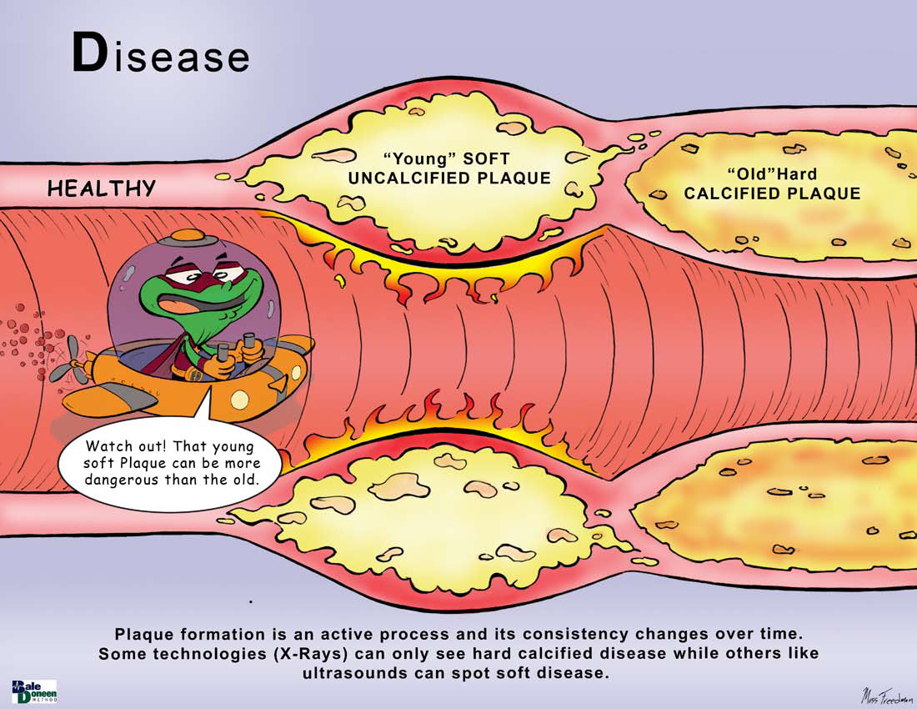

Slide 5
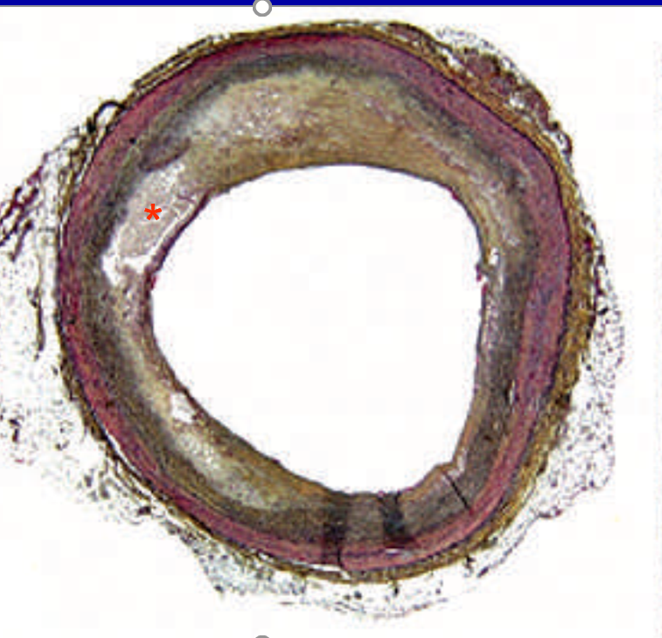
“Atherosclerosis is much smarter than the technology that has historically been designed to find it!”
The world is catching on!
Well…..at least Europe!

Slide 6
Imaging subclinical atherosclerosis promises better CV Primary Prevention
Cardiovascular disease (CVD) remains a leading cause of morbidity and mortality worldwide with enormous social and economic cost implications.
The ideal strategy for altering such a trend is optimum primary prevention.
The European Society of Cardiology (ESC) guidelines and recent American Heart Association/American College of Cardiology (AHA/ACC) guidelines for CVD prevention stress the central role of promoting a healthy lifestyle throughout life.
Faggiano, P., Dasseni, N., Henein, M. (2019). Imaging subclinical atherosclerosis promises a better cardiovascular primary prevention. European Journal of Preventive Cardiology. 0(00) 1-2. DOI 10.1177?2047487319849323

Slide 7
Imaging subclinical atherosclerosis promises better CV Primary Prevention
The two guidelines recommend assessing conventional cardiovascular risk factors and calculate the 10-year risk of fatal CVD or 10-year probability of developing a first major cardiovascular event by using the risk charts or scores.
However, the benefit of using current CVD risk estimation models is limited.
Concern is to under or over-estimation of CV risk, particularly in asymptomatic subjects.
Faggiano, P., Dasseni, N., Henein, M. (2019). Imaging subclinical atherosclerosis promises a better cardiovascular primary prevention. European Journal of Preventive Cardiology. 0(00) 1-2. DOI 10.1177?2047487319849323

Slide 8
Imaging subclinical atherosclerosis promises better CV Primary Prevention
Based on this, the European guidelines for CVD prevention proposed other factors that should be considered in order to better classify individuals into more appropriate risk categories.
Among these factors is the search for objective evidence for subclinical atherosclerosis, such as coronary calcification or atherosclerotic plaque detection and measurements obtained from carotid artery ultrasound scans.
CACS
cIMT Imaging
Faggiano, P., Dasseni, N., Henein, M. (2019). Imaging subclinical atherosclerosis promises a better cardiovascular primary prevention. European Journal of Preventive Cardiology. 0(00) 1-2. DOI 10.1177?2047487319849323

Slide 9
Imaging subclinical atherosclerosis promises better CV Primary Prevention
Coronary artery scanning performed using cardiac CT and calculation of the Agatston calcium score is the most common tool for prognostic stratification of asymptomatic individuals and implementation of preventive strategies.
A routine echo examination may offer an evaluation of subclinical atherosclerosis disease by calcifications at different sites:
mitral apparatus
(annulus, leaflets and papillary muscles)
aortic valve
ascending aorta
Faggiano, P., Dasseni, N., Henein, M. (2019). Imaging subclinical atherosclerosis promises a better cardiovascular primary prevention. European Journal of Preventive Cardiology. 0(00) 1-2. DOI 10.1177?2047487319849323

Slide 10
Imaging subclinical atherosclerosis promises better CV Primary Prevention
This is very exciting and still……not perfect (yet) ☺
“A calcium score greater than 300 accurately identified subjects at high risk for future coronary heart disease events”
However – “visualization of asymptomatic subclinical carotid atherosclerosis can improve an individual’s risk classification and consequently guide towards a tailored optimum prevention strategy, one of the most important being lipid lowering therapy, and the eligibility for statin therapy.”
Faggiano, P., Dasseni, N., Henein, M. (2019). Imaging subclinical atherosclerosis promises a better cardiovascular primary prevention. European Journal of Preventive Cardiology. 0(00) 1-2. DOI 10.1177?2047487319849323

Slide 11
Things are getting closer….

Slide 12
Imaging subclinical atherosclerosis promises better CV Primary Prevention
“The accurate identification of high risk individuals using an approach that integrates the conventional atherosclerosis risk factor score and the imaging of subclinical atherosclerosis should allow appropriate use of pharmacological interventions in primary prevention but also support the prescription of a healthy lifestyle such as physical activity, weight reduction, and stress control”
BaleDoneen – If atherosclerosis – start building foundation immediately!
Faggiano, P., Dasseni, N., Henein, M. (2019). Imaging subclinical atherosclerosis promises a better cardiovascular primary prevention. European Journal of Preventive Cardiology. 0(00) 1-2. DOI 10.1177?2047487319849323

Slide 13
Imaging subclinical atherosclerosis promises better CV Primary Prevention
So, why does prevention fail?
“The likely answer to this question is probably to do with the inefficiency of the current strategies of information delivery and
lack of optimum education”.
“However, a personalized approach towards highlighting individuals’ risks, race, arterial health status and available methods for improving it should have a significant impact on patients’ adherence to clinical, pharmacological and lifestyle instructions”.
Faggiano, P., Dasseni, N., Henein, M. (2019). Imaging subclinical atherosclerosis promises a better cardiovascular primary prevention. European Journal of Preventive Cardiology. 0(00) 1-2. DOI 10.1177?2047487319849323

Slide 14
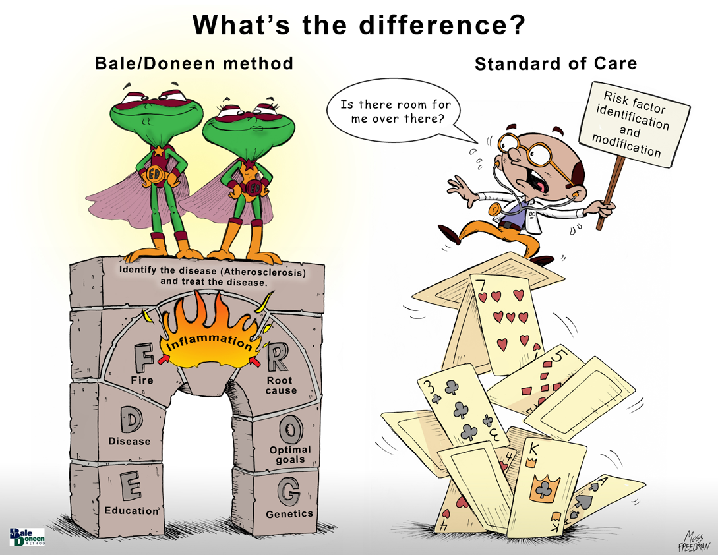
Imaging subclinical atherosclerosis promises better CV Primary Prevention
They are asking for The BaleDoneen Method!
Faggiano, P., Dasseni, N., Henein, M. (2019). Imaging subclinical atherosclerosis promises a better cardiovascular primary prevention. European Journal of Preventive Cardiology. 0(00) 1-2. DOI 10.1177?2047487319849323

Slide 15
Imaging subclinical atherosclerosis promises better CV Primary Prevention
BaleDoneen Take-Away:
This article is a huge step in the right direction.
The BaleDoneen Method remains in the lead on this – we have been using this approach x 18 years and continue to fine tune our understanding of the ‘root causes’ and inflammatory story – both in its causal influence and in treatment.
The more we know – the more we can use inflammation and genetics to provide optimal, precision based care for CV Prevention (at all levels).
There are still misconceptions –
Using the guidelines to determine ‘lipid management’ therapy is missing the concept of disease identification and disease stabilizing therapy.
A positive CACS of ANY level is serious.
While lifestyle is heavily promoted, the oral/systemic component is not a focus.
Faggiano, P., Dasseni, N., Henein, M. (2019). Imaging subclinical atherosclerosis promises a better cardiovascular primary prevention. European Journal of Preventive Cardiology. 0(00) 1-2. DOI 10.1177?2047487319849323

Slide 16
The 2019 ACC/AHA guidelines for the Primary Prevention of CVD are still lacking!

Slide 17
Arnett et al. 2019 ACC/AHA guildeline on the primary prevention of CVD: Executive summary. J Am Coll Cardiol 2019;000

Slide 18
2019 Guidelines still lack an inflammatory/disease, precision-based approach utilizing disease identification and a genetically guided treatment approach with disease and inflammatory response to treatment monitoring. ie: The BaleDoneen Method!
Arnett et al. 2019 ACC/AHA guildeline on the primary prevention of CVD: Executive summary. J Am Coll Cardiol 2019;000

Slide 19
SO COOL! Optical Coherence Tomography

Slide 20
Plaque Characteristics with Optical Coherence Tomography
Question: Why are some patients experiencing multiple recurrent acute coronary syndromes (rACS) and others demonstrate long-standing clinical stability?
OBJECTIVE:
To assess in vivo the coronary atherosclerotic phenotype as well as the prevalence and characteristics of healed coronary plaques by optical coherence tomography (OCT) imaging in patients at the extremes of the CAD spectrum.
Vergallo, R., Porto, I., E’Amerio, D., et al. (2019). Coronary atherosclerotic phenotype and plaque healing in patients with recurrent acute coronary syndromes compared with patietns with long-term clinical stability. JAMA Cardiology. 2019;4(4):321-329.

Slide 21
Plaque Characteristics with Optical Coherence Tomography
DESIGN: Observational, single-center cohort study with prospective clinical follow-up. N= 823 consecutive patients enrolled in OCT Registry, Rome, Italy, from 2009 to 2016, of these -
105 patients were included in the following groups:
Patients with rACS, defined as history of at least 3 acute myocardial infarctions (AMIs) or at least 4ACS with at least 1 AMI
Patients with long-standing stable angina pectoris (ls-SAP), defined as a minimum 3-year history of stable angina
Patients with a single unheralded AMI followed by a minimum 3-year period of clinical stability (sAMI).
Data were analyzed from January to August 2018
Vergallo, R., Porto, I., E’Amerio, D., et al. (2019). Coronary atherosclerotic phenotype and plaque healing in patients with recurrent acute coronary syndromes compared with patietns with long-term clinical stability. JAMA Cardiology. 2019;4(4):321-329.

Slide 22
Plaque Characteristics with Optical Coherence Tomography
Vergallo, R., Porto, I., E’Amerio, D., et al. (2019). Coronary atherosclerotic phenotype and plaque healing in patients with recurrent acute coronary syndromes compared with patietns with long-term clinical stability. JAMA Cardiology. 2019;4(4):321-329.

Slide 23
Plaque Characteristics with Optical Coherence Tomography
Vergallo, R., Porto, I., E’Amerio, D., et al. (2019). Coronary atherosclerotic phenotype and plaque healing in patients with recurrent acute coronary syndromes compared with patietns with long-term clinical stability. JAMA Cardiology. 2019;4(4):321-329.

Slide 24
Plaque Characteristics with Optical Coherence Tomography
Vergallo, R., Porto, I., E’Amerio, D., et al. (2019). Coronary atherosclerotic phenotype and plaque healing in patients with recurrent acute coronary syndromes compared with patietns with long-term clinical stability. JAMA Cardiology. 2019;4(4):321-329.

Slide 25
Plaque Characteristics with Optical Coherence Tomography
Vergallo, R., Porto, I., E’Amerio, D., et al. (2019). Coronary atherosclerotic phenotype and plaque healing in patients with recurrent acute coronary syndromes compared with patietns with long-term clinical stability. JAMA Cardiology. 2019;4(4):321-329.

Slide 26
Plaque Characteristics with Optical Coherence Tomography
One of the main findings of our study is the observation that healed coronary plaques are rarely detected in patients with a history of multiple recurrent ACS, while they are observed in about one-third of patients with a history of long term clinical stability.
Lipid-rich plaques were equally frequent in patients with multiple recurrent events (rACS group) and in those with a single unheralded MI followed by long-term clinical stability (sAMI group).
Lipid-rich plaques were significantly less common in patients who had never been unstable (ls-SAP group).
Vergallo, R., Porto, I., E’Amerio, D., et al. (2019). Coronary atherosclerotic phenotype and plaque healing in patients with recurrent acute coronary syndromes compared with patietns with long-term clinical stability. JAMA Cardiology. 2019;4(4):321-329.

Slide 27
Plaque Characteristics with Optical Coherence Tomography
These findings suggest that although atherosclerotic disease phenotype and burden are important predisposing factors for acute coronary disease, other factors, including plaque healing, may lead the natural history of a patient toward either recurrence of acute events or long-term clinical stability.
Vergallo, R., Porto, I., E’Amerio, D., et al. (2019). Coronary atherosclerotic phenotype and plaque healing in patients with recurrent acute coronary syndromes compared with patietns with long-term clinical stability. JAMA Cardiology. 2019;4(4):321-329.

Slide 28
Plaque Characteristics with Optical Coherence Tomography
CONCLUSIONS AND RELEVANCE
Patients with rACS have a distinct atherosclerotic phenotype compared with those with ls-SAP, including higher prevalence of thin-cap fibroatheroma and lower prevalence of healed coronary plaques
Atherosclerotic profile and plaque healing may play a role in leading the natural history of patients with CAD.
Vergallo, R., Porto, I., E’Amerio, D., et al. (2019). Coronary atherosclerotic phenotype and plaque healing in patients with recurrent acute coronary syndromes compared with patietns with long-term clinical stability. JAMA Cardiology. 2019;4(4):321-329.

Slide 29
Plaque Characteristics with Optical Coherence Tomography
Of 105 patients, 85 were men (81.0%); the median (interquartile range) age was 68 (63-75) years.
Median time of clinical stability was 9 (5.0-15.0) years in the ls-SAP group and 8 (4.5-14.5) years in the sAMI group.
Vergallo, R., Porto, I., E’Amerio, D., et al. (2019). Coronary atherosclerotic phenotype and plaque healing in patients with recurrent acute coronary syndromes compared with patietns with long-term clinical stability. JAMA Cardiology. 2019;4(4):321-329.

Slide 30
Plaque Characteristics with Optical Coherence Tomography
Lipid-rich plaque
80.0% (rACS) vs 76.3% (sAMI) vs 37.8% (Is-SAP); P < .001
Thin-cap fibroatheroma
40.0% (rACS) vs 34.2% (sAMI) vs 8.1% (Is-SAP); P = .006
Spotty calcifications
70.0% (rACS) vs 40.5% (sAMI) vs 44.7% (Is-SAP); P = .04
Healed Coronary Plaques
3.3% (rACS) vs 29.7% (sAMI) vs 28.9% (Is-SAP); P = .01
Vergallo, R., Porto, I., E’Amerio, D., et al. (2019). Coronary atherosclerotic phenotype and plaque healing in patients with recurrent acute coronary syndromes compared with patietns with long-term clinical stability. JAMA Cardiology. 2019;4(4):321-329.

Slide 31
Plaque Characteristics with Optical Coherence Tomography
BaleDoneen Take-Away:
1. Previous data supports these findings -
Vergallo, R., Porto, I., E’Amerio, D., et al. (2019). Coronary atherosclerotic phenotype and plaque healing in patients with recurrent acute coronary syndromes compared with patietns with long-term clinical stability. JAMA Cardiology. 2019;4(4):321-329.

Slide 32
Amount of Lipid in Plaque Predicts Risk of Heart Attack and Stroke
Madder, R. D., et. al. (2016). Large lipid-rich coronary plaques detected by near-infrared spectroscopy at non-stented sites in the target artery identify patients likely to experience future major adverse cardiovascular events. Eur Heart J Cardiovasc Imaging, 17(4), 393-399.
Sun, J., et. al. (2017). Carotid Plaque Lipid Content and Fibrous Cap Status Predict Systemic CV Outcomes. The MRI Substudy in AIM-HIGH, JACC Imaging. 10(3), 241-249.
Xing, L., et. al. (2017). Clinical Significance of Lipid-Rich Plaque Detected by Optical Coherence Tomography. A 4-Year Follow-Up Study. JACC. 69(20), 2502-2513.

Slide 33
Plaque Characteristics with Optical Coherence Tomography
BaleDoneen Take-Away:
Previous data supports these findings –
Only inflammatory marker utilized was hsCRP – NS results
This data continues to strengthen our data from John’s Hopkins showing that in 100% of patients followed x 5 years – plaque went to a completely stable pattern utilizing cIMT plaque characteristics.
The data from Post-hoc AIM-HIGH demonstrated that it was indeed the lipid rich plaque and the fibrous cap as the two statistically significant predictors of risk.
The BaleDoneen approach always couples structure (cIMT) with activity (inflammatory markers) to follow patients over time.
Vergallo, R., Porto, I., E’Amerio, D., et al. (2019). Coronary atherosclerotic phenotype and plaque healing in patients with recurrent acute coronary syndromes compared with patietns with long-term clinical stability. JAMA Cardiology. 2019;4(4):321-329.

Slide 34
What about a CACS >1000?

Slide 35
Prognostic Implications of Extensive CAC
Current Guidelines suggest a CACS >300 if highest risk – literature has little discussion with CACS scores >1000.
N=66,636 asymptomatic adults were included from the CAC consortium – a large retrospective multicenter clinical cohort.
Mean follow-up was 12.3 + 3.9 years for patients with CVD, CHD, Cancer and all-cause mortality.
Adjustments for age, sex and conventional CVD risk factors.
Aim – Regression models to assess the relative mortality hazard of individuals with CAC > 1000 compared with –
1. CACS of 0 (reference), 2. CAC score of 400-999.
Peng, A., Mirbolouk, M., Orimoloye, O., et al. (2019). Long-term all-cause and cause-specific mortality in asymptomatic patients with CAC >1000. JACC: Cardiovascular Imaging. April 29, 2019.

Slide 36
Prognostic Implications of Extensive CAC
Results:
2,869 patients with CAC > 1000
(86% male, mean age 66.3 + 9.7 years)
Observations:
Most patients with CACS >1000 had 4-vessel CAC and had greater total CAC area, higher mean CAC density more extra-coronary calcium (thoracic and valvular (mitral and aortic).
Those with CAC >1000 had a significant increased risk of:
CAD (5.05), CVD (6.79), cancer (1.55) & all-cause mortality (2.89)
Peng, A., Mirbolouk, M., Orimoloye, O., et al. (2019). Long-term all-cause and cause-specific mortality in asymptomatic patients with CAC >1000. JACC: Cardiovascular Imaging. April 29, 2019.

Slide 37
Peng, A., Mirbolouk, M., Orimoloye, O., et al. (2019). Long-term all-cause and cause-specific mortality in asymptomatic patients with CAC >1000. JACC: Cardiovascular Imaging. April 29, 2019.

Slide 38
Prognostic Implications of Extensive CAC
Peng, A., Mirbolouk, M., Orimoloye, O., et al. (2019). Long-term all-cause and cause-specific mortality in asymptomatic patients with CAC >1000. JACC: Cardiovascular Imaging. April 29, 2019.

Slide 39
Prognostic Implications of Extensive CAC
Peng, A., Mirbolouk, M., Orimoloye, O., et al. (2019). Long-term all-cause and cause-specific mortality in asymptomatic patients with CAC >1000. JACC: Cardiovascular Imaging. April 29, 2019.

Slide 40
Prognostic Implications of Extensive CAC
Peng, A., Mirbolouk, M., Orimoloye, O., et al. (2019). Long-term all-cause and cause-specific mortality in asymptomatic patients with CAC >1000. JACC: Cardiovascular Imaging. April 29, 2019.

Slide 41
Prognostic Implications of Extensive CAC
Peng, A., Mirbolouk, M., Orimoloye, O., et al. (2019). Long-term all-cause and cause-specific mortality in asymptomatic patients with CAC >1000. JACC: Cardiovascular Imaging. April 29, 2019.

Slide 42
Prognostic Implications of Extensive CAC
Authors Conclusion:
Patients with extensive CAC are unique in their burden of coronary and extra-coronary disease and in their long-term outcomes.
The present data argue for consideration of patients with CAC scores > 1,000 as a distinct group with CVD mortality greater than that of contemporary secondary prevention trials like FORTIER.
Peng, A., Mirbolouk, M., Orimoloye, O., et al. (2019). Long-term all-cause and cause-specific mortality in asymptomatic patients with CAC >1000. JACC: Cardiovascular Imaging. April 29, 2019.

Slide 43
Prognostic Implications of Extensive CAC
BaleDoneen Take-Away:
This trial highlights the importance of recognizing that extensive atherosclerosis is also a marker for systemic health compromise.
CACS of extreme levels can also demonstrate the length of time of CVD burden – since these are primary care patients and 22% of them had FRS of <10% - many had extensive CVD for YEARS potentially with no idea!
Any level of calcium is high risk –
Do a complete work-up including biomarkers such as hsTnT, Galectin, NT-ProBNP, Inflammation and Coronary testing if concerned about blood flow compromise to the heart.
9P21 can possibly lead insight on who these people are
Peng, A., Mirbolouk, M., Orimoloye, O., et al. (2019). Long-term all-cause and cause-specific mortality in asymptomatic patients with CAC >1000. JACC: Cardiovascular Imaging. April 29, 2019.

Slide 44
9p21: Two Choices- CAD or Heart Attack
2,352 CAD/MI pts; 2,116 asx’ic without known CAD controls >60 yo
Haplotypes at the 9p21 locus examined to see if they influence different phenotypes
Haplotype rs1333049 associated with CAD more than MI; earlier more severe CAD
Haplotype rs518394 associated with prevalent MI; inversely with severity of CAD
Fan, M., et. al. (2013). Two Chromosome 9p21 Haplotype Blocks Distinguish Between Coronary Artery Disease and Myocardial Infarction Risk. Circulation: Cardiovascular Genetics. doi: 10.1161/circgenetics.113.000104
Notes:
The chromosome 9p21.3 locus, which spans a genomic region of 58kb in chromosome 9, encompasses multiple single nucleotide polymorphisms (SNPs) in tight linkage disequilibrium (LD). This genomic interval contains no protein-coding genes; however, it overlaps a long Noncoding RNA (ncRNA) known as ANRIL (CDKN2BAS) which might have a role in the regulation of gene expression
CAD/MI pts had at least 1 epicardial stenosis > 50%; The chromosome 9p21.3 locus, which spans a genomic region of 58kb in chromosome 9,
encompasses multiple single nucleotide polymorphisms (SNPs) in tight linkage disequilibrium
(LD). This genomic interval contains no protein-coding genes; however, it overlaps a long Noncoding RNA (ncRNA) known as ANRIL (CDKN2BAS) which might have a role in the regulation of gene expression

Slide 45
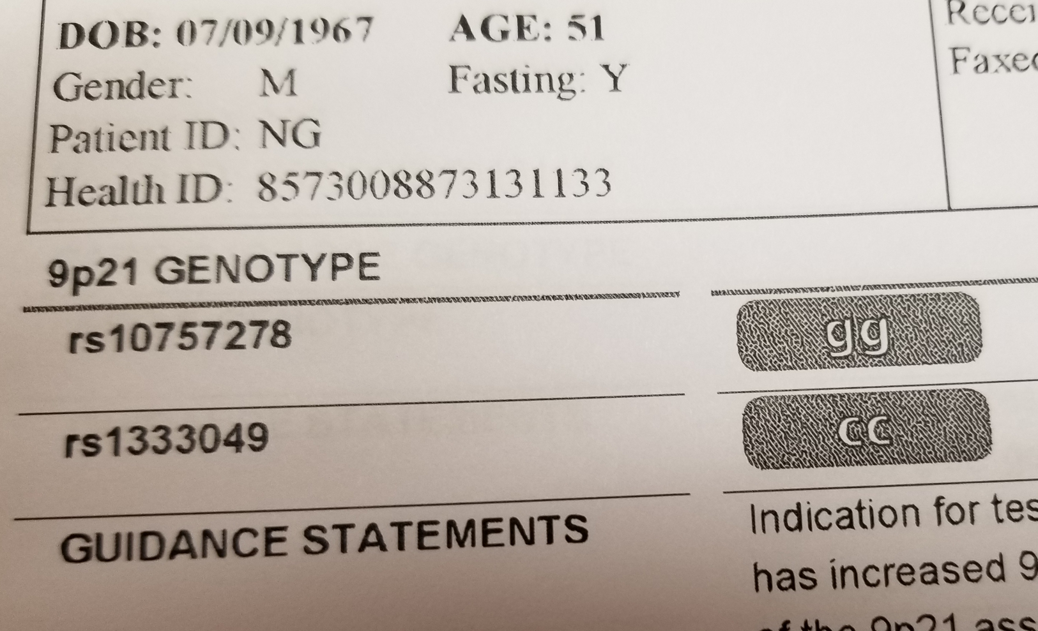
Meet Neal – age 51 with 4 way bypass at 42 years and in 8 years collected 13 more cardiac stents along with both femoral arteries (one already re-stenosed) and both renal arteries stented.

Slide 46
Nicotine
Endodontic Disease
Gut dysbiosis

Slide 47
Nicotine
Endodontic Disease
Periodontal
Disease
Rheumatoid Arthritis
Gut dysbiosis

Slide 48
RA and Oral Health
Rheumatoid arthritis (RA) and periodontal diseases (PD) are common chronic, inflammatory, destructive and progressive diseases that may have similar pathophysiological mechanisms and risk factors.
RA affects more than 1.5% of the world’s population, with a higher percentage of females than males.
PD is present in around 20% of the population and has multifactorial etiology.
The purpose of this study is to describe patients' self‐reported oral health and the association with RA disease activity.
Radwan-Oczko, M., Dus-Ilnicka, I., Richards, P., et al. (2019). Rheumatoid arthritis patients’ oral health and disease activity. International Journal of Rheumatic Diseases. April 2019. DOI: 10.1111/1756.

Slide 49
RA and Oral Health
Method: 300 patients under treatment for RA from the Division of Rheumatology, Clinical Medicine, North Jutland Region Hospital, Hjørring, Denmark and were eligible for the study.
Questionnaires were emailed to the patients and 164 completed answers were received.
Radwan-Oczko, M., Dus-Ilnicka, I., Richards, P., et al. (2019). Rheumatoid arthritis patients’ oral health and disease activity. International Journal of Rheumatic Diseases. April 2019. DOI: 10.1111/1756.

Slide 50
RA and Oral Health
The mean age of the group of 164 pts (61% female) was 65 ± 11 years.
The average value of Disease Activity Score of 28 joints was 2.31 ± 0.83.
Only 12% of responders were active smokers.
Patients estimated their status of their teeth and gingiva respectively as poor in 13% and 11% of cases, good, in 46% and 49%, and excellent, both as 40%.
Spontaneous and/or provoked gingival bleeding were experienced by 15% and 49% of patients.
Only 14% of patients declared feelings of loose or movable teeth and 10% declared difficulties in biting or chewing.
Radwan-Oczko, M., Dus-Ilnicka, I., Richards, P., et al. (2019). Rheumatoid arthritis patients’ oral health and disease activity. International Journal of Rheumatic Diseases. April 2019. DOI: 10.1111/1756.

Slide 51
RA and Oral Health
The status of oral cavity reported by Danish patients indicates a significant proportion with symptoms of gingival/periodontal disease, which may negatively influence RA activity and disease management.
Cooperation between rheumatologists and dentists is important in oral health management in periodontal inflammation.
Radwan-Oczko, M., Dus-Ilnicka, I., Richards, P., et al. (2019). Rheumatoid arthritis patients’ oral health and disease activity. International Journal of Rheumatic Diseases. April 2019. DOI: 10.1111/1756.

Slide 52
RA and Oral Health
BaleDoneen Take-Away:
This trial is weak in power – observational and self-perceived as to the degree of PD symptoms. No dental exams were obtained.
Additionally, the amount of PD population cited (20%) is woefully below the averages that are recently reported in other literature – as high as 70% of people >70 years.
Appreciating the RA is a systemic inflammatory condition and places people at >7-fold increase risk of events – the fact that the PD self-recognition is so low creates a tremendous educational opportunity.
Education – of both the general public and the medical public must take place in order to improve systemic health.
Using an optimal definition of PD – using pathogens, standardized exam findings and non-biovariable inflammatory markers will provide an improved objective evaluation.
Radwan-Oczko, M., Dus-Ilnicka, I., Richards, P., et al. (2019). Rheumatoid arthritis patients’ oral health and disease activity. International Journal of Rheumatic Diseases. April 2019. DOI: 10.1111/1756.

Slide 53
Nicotine
Endodontic Disease
Psychosocial Issues
Gut dysbiosis

Slide 54
Psychological Distress and CV events
Higher symptom levels of a variety of measures of emotional distress have been associated with cardiovascular disease (CVD), especially among women.
Goal was to investigate the association between a composite measure of psychological distress and incident cardiovascular events.
Pimple, P., Lima, B., Hammadah, M., et al. (2019). Psychological distress and subsequent CV events in individuals with CAD. J Am Heart Assoc. 2019;8e01166.

Slide 55
Psychological Distress and CV events
Prospective cohort study, assessed 662 individuals
(28% women; 30% blacks) with stable coronary artery disease.
Used a composite score of psychological distress derived through summation of psychological distress symptom scales (depression, post traumatic stress, anxiety, anger, hostility, and perceived stress) as a predictor of an adjudicated composite end point of adverse events (cardiovascular death, myocardial infarction, stroke, heart failure, or unstable angina).
Pimple, P., Lima, B., Hammadah, M., et al. (2019). Psychological distress and subsequent CV events in individuals with CAD. J Am Heart Assoc. 2019;8e01166.

Slide 56
Psychological Distress and CV events
During a mean follow-up of 2.8 years, 120 (18%) subjects developed CVD events.
In women, higher psychological distress was associated with a higher incidence of CVD events; 1.44 times adjusted hazard of CVD events (95% CI, 1.09–1.92).
No such association was found in men
Among patients with coronary artery disease, higher psychological distress is associated with future cardiovascular events in women only.
Pimple, P., Lima, B., Hammadah, M., et al. (2019). Psychological distress and subsequent CV events in individuals with CAD. J Am Heart Assoc. 2019;8e01166.

Slide 57
Psychological Distress and CV events
Pimple, P., Lima, B., Hammadah, M., et al. (2019). Psychological distress and subsequent CV events in individuals with CAD. J Am Heart Assoc. 2019;8e01166.

Slide 58
Psychological Distress and CV events
Pimple, P., Lima, B., Hammadah, M., et al. (2019). Psychological distress and subsequent CV events in individuals with CAD. J Am Heart Assoc. 2019;8e01166.

Slide 59
Psychological Distress and CV events
Authors conclude that, among CAD patients, a higher level of psychological distress is associated with higher CV events in women, but not in men.
These findings suggest that the value of a regular assessment of psychological measures in cardiovascular practices, especially for women, should be considered.
Equally important should be the exploration of treatment modalities for ameliorating psychological distress in patients with CAD, especially among women, including holistic approaches, like meditation or relaxation techniques, in addition to traditional medical therapy.
Pimple, P., Lima, B., Hammadah, M., et al. (2019). Psychological distress and subsequent CV events in individuals with CAD. J Am Heart Assoc. 2019;8e01166.

Slide 60
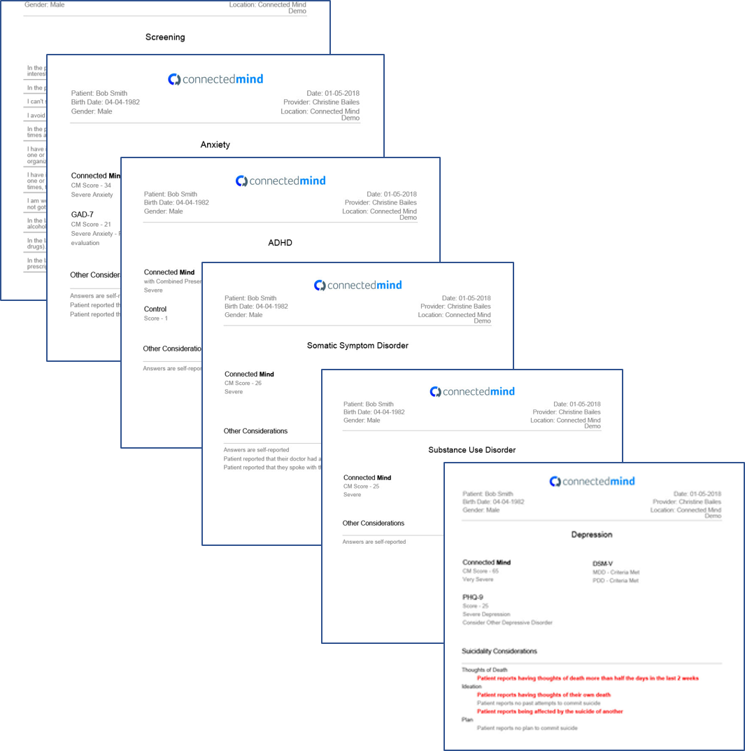
Try It Free at ConnectedMind.me
FAST Check^{tm}
Mental Health Triage Tool checks for 6 conditions with 8 question
Custom Screening
Builds a custom screening for the patient only for the conditions that FAST Check^{tm} indicates
Mental Health Profile
Instant mental health profile on each patient before you enter the exam room (including suicide risk)
6 Conditions
Depression, Bipolar, Anxiety, Somatic Symptom Disorder, ADHD, Substance Use Disorder
Validations
Maps to DSM-V
Administers PHQ-9, and GAD-7 alongside other screenings
Prospective Study in process with UNT
For Additional Info Call 407-569-7810
Notes:
When underlying depression is identified and addressed, outcomes improve
What we did :
create mental health screening and testing platform designed from ground up to integrate
6 mental health tests that most affect physical medicine
Intelligent layered branching logic engine designed to ask min number of questions to rule out/rule in diagnoses

Slide 61
Psychological Distress and CV events
BaleDoneen Take-Away:
This data supports the current BaleDoneen approach to keep psychosocial factors under the root cause tree – for both men and women.
The Amygdala study validates that unadapted stress causes vascular activity
BaleDoneen definition of stress – “To be in an environment for which you perceive a lack of control”. Goal – gain a perception of control.
Agree with authors that mindfulness and talk therapy needs to be part of a treatment plan, especially for CAD patients at risk.
Assess MD is the tool I use in my office – on all patients and get an annual assessment.
Pimple, P., Lima, B., Hammadah, M., et al. (2019). Psychological distress and subsequent CV events in individuals with CAD. J Am Heart Assoc. 2019;8e01166.

Slide 62
Nicotine
Endodontic Disease
Gut dysbiosis
Nicotine, Diabetes with PD

Slide 63
Tobacco and DM with PD
Periodontitis is multifactorial disease that along with dental caries remains one of the commonest cause of tooth loss worldwide.
Effective management requires clear understanding of risk factors. Smoking has a dose-dependent effect on periodontium.
Similarly, individuals with diabetes have severe forms of periodontal diseases. We aim to assess the prevalence of periodontal disease in dental patients in relation to smoking & DM.
Gupta, S., Maharjan, A., Dhami, B., et al. (2018). Status of tobacco smoking and diabetes with periodontal disease. J Nepal Med Assoc 2018;56(213):818-24.

Slide 64
Tobacco and DM with PD
The study was conducted among 522 patients visiting the Periodontics Department, Kantipur Dental College.
Individuals willing to participate had to sign an informed consent and undergo interview and clinical examination.
Inclusion Criteria – periodontal disease (gingivitis or periodontitis) with bleeding on probing (BOP), and/or periodontal probing depth (PPD) > 4mm or loss of attachment (LOA) > 1mm on at least one tooth (anterior or posterior) and minimum of 16 natural uncrowned teeth.
Gupta, S., Maharjan, A., Dhami, B., et al. (2018). Status of tobacco smoking and diabetes with periodontal disease. J Nepal Med Assoc 2018;56(213):818-24.

Slide 65
Tobacco and DM with PD
Gupta, S., Maharjan, A., Dhami, B., et al. (2018). Status of tobacco smoking and diabetes with periodontal disease. J Nepal Med Assoc 2018;56(213):818-24.

Slide 66
Tobacco and DM with PD
Gupta, S., Maharjan, A., Dhami, B., et al. (2018). Status of tobacco smoking and diabetes with periodontal disease. J Nepal Med Assoc 2018;56(213):818-24.

Slide 67
Tobacco and DM with PD
Gupta, S., Maharjan, A., Dhami, B., et al. (2018). Status of tobacco smoking and diabetes with periodontal disease. J Nepal Med Assoc 2018;56(213):818-24.

Slide 68
Tobacco and DM with PD
Periodontitis was significantly associated with smoking, diabetes, hypertension and age.
It is recommended that tobacco cessation and diabetes control be promoted as an integral component of periodontal therapy and oral health be included as an essential element of general health when conducting national health surveys.
Gupta, S., Maharjan, A., Dhami, B., et al. (2018). Status of tobacco smoking and diabetes with periodontal disease. J Nepal Med Assoc 2018;56(213):818-24.

Slide 69
Tobacco and DM with PD
BaleDoneen Take-Away:
Patients are complex – when multiple risk factors are present – a collaborative approach to care must be taken.
In dental offices – discuss smoking cessation programs.
Gupta, S., Maharjan, A., Dhami, B., et al. (2018). Status of tobacco smoking and diabetes with periodontal disease. J Nepal Med Assoc 2018;56(213):818-24.

Slide 70
Probiotic rinses as an adjunct to therapy?

Slide 71
Probiotic and chlorhexidine oral rinses in orthodontic patients – a randomized clinical trial.
Aim and Objective.
To compare efficacy of probiotic and chlorhexidine oral rinses in orthodontic patients.
30 healthy patients undergoing fixed orthodontic treatment randomly selected for the study by block randomization and allocation concealment and were divided into three groups:
Group a: 0.2% chlorhexidine mouthwash
Group b: probiotic mouthwash
Group c: a control group.
Shah, S., Nambiar, S., Kamath, D., et al. (2019). Comparative evaluation of plaque inhibitory and antimicrobial efficacy of probiotic and chlorhexidine or rinses in orthodontic patients. International Journal of Dentistry. V.2019. 1964158.

Slide 72
Probiotic and chlorhexidine oral rinses in orthodontic patients – a randomized clinical trial.
Probiotic is the term currently used to name ingested live microorganisms which, when administered in adequate amounts, confer a health benefit on the host.
Probiotic microorganisms may shape the immune system both at the local and systemic level and have emerged as an alternative way to combat infections.
A space in a biofilm that would otherwise be colonized by a pathogen is occupied by harmless microorganisms such as strains of Lactobacilli or Bifidobacteria.
Shah, S., Nambiar, S., Kamath, D., et al. (2019). Comparative evaluation of plaque inhibitory and antimicrobial efficacy of probiotic and chlorhexidine or rinses in orthodontic patients. International Journal of Dentistry. V.2019. 1964158.

Slide 73
Probiotic and chlorhexidine oral rinses in orthodontic patients – a randomized clinical trial.
.
They are capable of influencing many components of epithelial barrier function either by decreasing apoptosis of epithelial cells or increasing mucin production.
They act either by inducing host cells to produce peptides, thus interfering with pathogens and preventing epithelial invasion.
Probiotic bacteria compete with invading pathogens for binding sites on epithelial cells, thus boosting the body’s defense mechanism
Shah, S., Nambiar, S., Kamath, D., et al. (2019). Comparative evaluation of plaque inhibitory and antimicrobial efficacy of probiotic and chlorhexidine or rinses in orthodontic patients. International Journal of Dentistry. V.2019. 1964158.

Slide 74
Probiotic and chlorhexidine oral rinses in orthodontic patients – a randomized clinical trial.
Lactobacilli: there are more than 50 species of Lactobacillus. They produce natural antibiotics such as lactocidin and acidophilin which enhance immunity. Lactobacilli inhibit the growth of periodontopathogens. Daily consumption reduces the probing depths, resulting in decreased loss of clinical attachment of gingiva to support bone
Bifidobacteria: there are approximately 30 species of Bifidobacterium. They produce favorable changes in pH by producing lactic and acetic acid. They also help in increased absorption of minerals.
Streptococcus thermophilus: they help in reduction of lactose intolerance.
Enterococcus faecium: they are very resistant to antibiotics and hence help persistently in the body’s defense mechanism.
Saccharomyces boulardii: they are the only probiotic species of yeast.
Shah, S., Nambiar, S., Kamath, D., et al. (2019). Comparative evaluation of plaque inhibitory and antimicrobial efficacy of probiotic and chlorhexidine or rinses in orthodontic patients. International Journal of Dentistry. V.2019. 1964158.

Slide 75
Probiotic and chlorhexidine oral rinses in orthodontic patients – a randomized clinical trial.
This investigation was undertaken with the objectives as to compare the effect of probiotics on the oral health status and gingival status, to evaluate the effect of probiotics on the salivary S. mutans colony count and also to compare the effects of probiotic and chlorhexidine mouth rinses on patients undergoing orthodontic treatment.
Shah, S., Nambiar, S., Kamath, D., et al. (2019). Comparative evaluation of plaque inhibitory and antimicrobial efficacy of probiotic and chlorhexidine or rinses in orthodontic patients. International Journal of Dentistry. V.2019. 1964158.

Slide 76
Probiotic and chlorhexidine oral rinses in orthodontic patients – a randomized clinical trial.
Results:
Probiotic and chlorhexidine groups had significantly decreased plaque indices as compared to the control group.
However, greater improvement was seen in the gingival indices than plaque indices with better results in the probiotic group than the chlorhexidine group.
Shah, S., Nambiar, S., Kamath, D., et al. (2019). Comparative evaluation of plaque inhibitory and antimicrobial efficacy of probiotic and chlorhexidine or rinses in orthodontic patients. International Journal of Dentistry. V.2019. 1964158.

Slide 77
Probiotic and chlorhexidine oral rinses in orthodontic patients – a randomized clinical trial.
BaleDoneen Take-Away:
1. Our RDH colleagues have been preaching probiotic rinses for oral health for a long time! Thank you!
2. A lot of ‘wishes’ in this study.
1. Pathogen testing – particularly Pg in these young orthodontic patients.
2. Haptoglobin would have been an interesting addition to this study
3. Probiotic Therapy is safe and potentially provides additive support of healthy tissues long term.
4. Would love to do a formal look at a multispecialty look – using BDM teams to effectively evaluate these types of therapy for long term maintenance.
5. Wonder about probiotic use in tools such as PerioProtect?
Shah, S., Nambiar, S., Kamath, D., et al. (2019). Comparative evaluation of plaque inhibitory and antimicrobial efficacy of probiotic and chlorhexidine or rinses in orthodontic patients. International Journal of Dentistry. V.2019. 1964158.

Slide 79
Eggs – good or bad?

Slide 80
Association of dietary cholesterol or egg consumption with incident CVD and mortality
Zhong, V., Van Horn, L., Cornelis, M. (2019). Associations of dietary cholesterol or egg consumption with incident CVD and mortality. JAMA. 2019;321(11):1081-1095

Slide 81
Are you reading my blogs? www.TheHaspc.com & www.BaleDoneen.com

Slide 82
Association of dietary cholesterol or egg consumption with incident CVD and mortality
Using a standardized protocol and data dictionary, diet data were harmonized cohort by cohort.
Consumption frequencies were converted into estimated number per day using the middle value (eg, 3-4 times per week = 0.5 times per day).
One serving unit was standardized across cohorts. Food groups were constructed using the same definitions. Ingredients in mixed dishes were considered and the appropriate portions were determined for each cohort.
Only baseline measures/assessments of diet/eggs were included for this study
Zhong, V., Van Horn, L., Cornelis, M. (2019). Associations of dietary cholesterol or egg consumption with incident CVD and mortality. JAMA. 2019;321(11):1081-1095

Slide 83
Association of dietary cholesterol or egg consumption with incident CVD and mortality
Zhong, V., Van Horn, L., Cornelis, M. (2019). Associations of dietary cholesterol or egg consumption with incident CVD and mortality. JAMA. 2019;321(11):1081-1095

Slide 84
Association of dietary cholesterol or egg consumption with incident CVD and mortality
Zhong, V., Van Horn, L., Cornelis, M. (2019). Associations of dietary cholesterol or egg consumption with incident CVD and mortality. JAMA. 2019;321(11):1081-1095

Slide 85
Association of dietary cholesterol or egg consumption with incident CVD and mortality
Zhong, V., Van Horn, L., Cornelis, M. (2019). Associations of dietary cholesterol or egg consumption with incident CVD and mortality. JAMA. 2019;321(11):1081-1095

Slide 86
Association of dietary cholesterol or egg consumption with incident CVD and mortality
This study has several limitations.
1, Appropriate interpretation of the study findings requires consideration of measurement error for self-reported diet data.
2. This study relied on single measurement of egg and dietary cholesterol consumption.
3. All cohorts used different dietary assessment tools
4. Residual confounding was likely, although a number of covariates were adjusted.
5. Data were not available for investigating subtypes of CHD, stroke, and heart failure, as well as more detailed cause-specific mortality such as cancer mortality.
6. Generalizing our results to non-US populations requires caution due to different nutrition and food environments and chronic disease epidemiology.
7. The study findings are observational and cannot establish causality
Zhong, V., Van Horn, L., Cornelis, M. (2019). Associations of dietary cholesterol or egg consumption with incident CVD and mortality. JAMA. 2019;321(11):1081-1095

Slide 87
Despite all that…..it garnered a LOT of attention!
Zhong, V., Van Horn, L., Cornelis, M. (2019). Associations of dietary cholesterol or egg consumption with incident CVD and mortality. JAMA. 2019;321(11):1081-1095

Slide 88
Association of dietary cholesterol or egg consumption with incident CVD and mortality
BaleDoneen Take-Away:
Eggs and ALL cholesterol containing foods must be added into the equation of daily quantity of fats (particularly saturated fats).
Diet should be genetically guided to be precise and accurate – Utilizing genetics such as Apo E, Hp, IR and CYP P-450.
There is no panacea diet for anyone.
Assessing someone’s egg intake once 17 years ago and making long term projections should NOT have garnered so much attention (in my humble opinion ☺)
Zhong, V., Van Horn, L., Cornelis, M. (2019). Associations of dietary cholesterol or egg consumption with incident CVD and mortality. JAMA. 2019;321(11):1081-1095

Slide 89
So what’s the ‘skinny’ on these?

Slide 90
Sugar-Sweetened and Artificially sweetened beverages are deadly.
Examined associations between consumption of SSBs and ASBs with risk of total and cause-specific mortality among:
37 716 men from the Health Professional’s Follow-up study (1986 to 2014)
80 647 women from the Nurses’ Health study
(1980 to 2014)
who were free from chronic diseases at baseline.
Malik, V., Li, Y., Pan, A. et al. (2019). Long-term consumption of sugar-sweetened and artificially sweetened beverages and risk of mortality in US Adults. Circulation. 2019;139:2113–2125

Slide 91
Sugar-Sweetened and Artificially sweetened beverages are deadly.
In these 2 large prospective cohorts of US men and women, we found a positive graded association with dose between intake of SSBs and risk of mortality after adjusting for diet and lifestyle factors.
This association was driven by CVD mortality with a stronger association observed among women compared to men, although no significant interaction with sex was observed.
Malik, V., Li, Y., Pan, A. et al. (2019). Long-term consumption of sugar-sweetened and artificially sweetened beverages and risk of mortality in US Adults. Circulation. 2019;139:2113–2125

Slide 92
Sugar-Sweetened and Artificially sweetened beverages are deadly.
Sugar Sweetened Beverage (SSB):
CVD mortality : 1.31 P trend <0.0001
Cancer mortality: 1.16 P trend =0.0004
Artificially Sweetened Beverage (ASB):
CVD Mortality: 1.13* P trend = 0.02
*highest intake category only
ASBs were associated with mortality in NHS (Nurses’ Health Study)
but not in HPFS (Health Professionals Follow-up Study) (P interaction, 0.01). ASBs were not associated with cancer mortality in either cohort.
Malik, V., Li, Y., Pan, A. et al. (2019). Long-term consumption of sugar-sweetened and artificially sweetened beverages and risk of mortality in US Adults. Circulation. 2019;139:2113–2125

Slide 93
Sugar-Sweetened and Artificially sweetened beverages are deadly.
A modest positive association between SSB intake and risk of cancer mortality.
Intake of ASBs was positively associated with total and CVD mortality at high intake levels (at least 4 servings/d), and associations were statistically significant only among women.
ASB intake was not associated with cancer mortality. Substituting 1 serving/d of SSB with ASB was associated with modest reductions in total and cause-specific mortality
Malik, V., Li, Y., Pan, A. et al. (2019). Long-term consumption of sugar-sweetened and artificially sweetened beverages and risk of mortality in US Adults. Circulation. 2019;139:2113–2125

Slide 94
Sugar-Sweetened and Artificially sweetened beverages are deadly.
BaleDoneen does not agree with these researchers and their clinical Implications!
Malik, V., Li, Y., Pan, A. et al. (2019). Long-term consumption of sugar-sweetened and artificially sweetened beverages and risk of mortality in US Adults. Circulation. 2019;139:2113–2125

Slide 95
Sugar-Sweetened and Artificially sweetened beverages are deadly.
BaleDoneen Method:
1. Still stand strong that best liquid is water – good ol’ fashioned water ☺
2. Again – this trial is observational and lots of co-variants.
3. Wonder in this case about Haptoglobin as well!
4. Gut dysbiosis/inflammation/CVD/Cancer – all tie together and the impact of sugar and sugar substitutes interact in ways that we are still discovering.
6. Goal – drink ½ body weight in ounces of water.
Malik, V., Li, Y., Pan, A. et al. (2019). Long-term consumption of sugar-sweetened and artificially sweetened beverages and risk of mortality in US Adults. Circulation. 2019;139:2113–2125

Slide 96
Testosterone

Slide 97
Testosterone therapy prevents T2DM
N=316 men with prediabetes (defined as HbA1c 5.7–6.4%) and total testosterone levels <12.1 nmol/L (350 ng/dL) combined with symptoms of hypogonadism were analyzed.
N=229 men received parenteral testosterone undecanoate (T-group), and 87 men with hypogonadism served as untreated control subjects.
Metabolic and anthropometric parameters were measured twice yearly for 8 years
Yassin, A., Haider, A., Haider, K. et al. (2019). Testosterone therapy in men with hypogonadism prevents progression from prediabetes to type 2 DM. Diabetes Care https://doi.org/10.2337/dc18-2388

Slide 98
Testosterone therapy prevents T2DM
T. therapy resulted in normalization of total testosterone after the first injection.
Trough levels measured before the next injection were 16–18 nmol/L (461–519 ng/dL) throughout the 8-year follow-up.
In the untreated group, testosterone levels remained in the 9–11 nmol/L (260–317 ng/dL) range
Yassin, A., Haider, A., Haider, K. et al. (2019). Testosterone therapy in men with hypogonadism prevents progression from prediabetes to type 2 DM. Diabetes Care https://doi.org/10.2337/dc18-2388

Slide 99
Testosterone therapy prevents T2DM
T. Therapy led to substantial improvements in glycemic parameters.
Both fasting blood glucose and HbA1c values were reduced in the T-group but increased in the untreated group.
At 8 years, HbA1c decreased in the T-group by 0.39 + 0.03% (P <0.0001), whereas it increased by 0.63 + 0.1% in the untreated group (P < 0.0001)
Yassin, A., Haider, A., Haider, K. et al. (2019). Testosterone therapy in men with hypogonadism prevents progression from prediabetes to type 2 DM. Diabetes Care https://doi.org/10.2337/dc18-2388

Slide 100
Testosterone therapy prevents T2DM
The differences in glucose concentrations & HbA1c were significant between the two groups throughout the entire follow-up period: a difference in HbA1c of 1.02% at 8 years.
At the last observation, all 229 patients in the T-group had an HbA1c of <6.5%, and 205 (90%) achieved normal glucose regulation with an HbA1c <5.7%.
In the untreated group, only 1 (1%) of the 87 patients had an HbA1c <5.7%, whereas 35 (40.2%) had progressed to frank T2D with an HbA1c >6.5%.
Yassin, A., Haider, A., Haider, K. et al. (2019). Testosterone therapy in men with hypogonadism prevents progression from prediabetes to type 2 DM. Diabetes Care https://doi.org/10.2337/dc18-2388

Slide 101
Testosterone therapy prevents T2DM
Yassin, A., Haider, A., Haider, K. et al. (2019). Testosterone therapy in men with hypogonadism prevents progression from prediabetes to type 2 DM. Diabetes Care https://doi.org/10.2337/dc18-2388

Slide 102
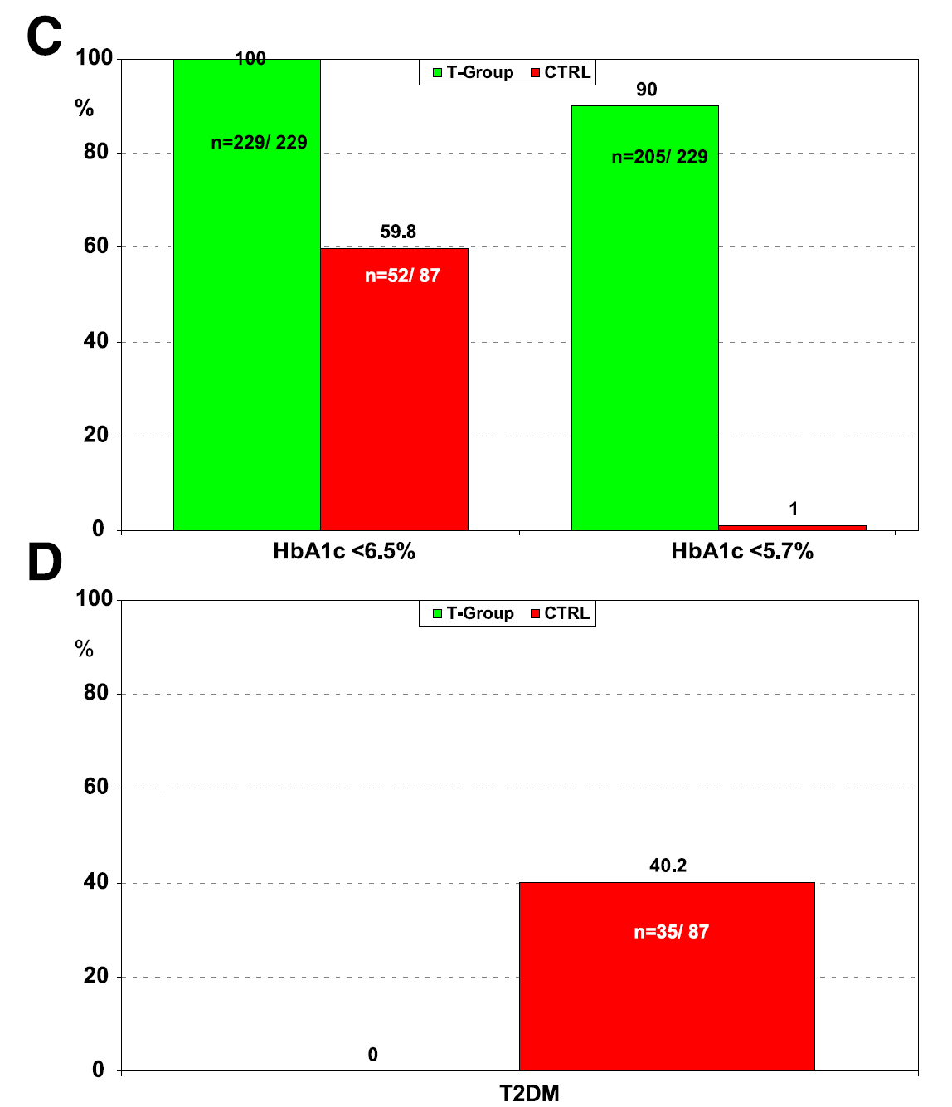
Testosterone therapy prevents T2DM
Yassin, A., Haider, A., Haider, K. et al. (2019). Testosterone therapy in men with hypogonadism prevents progression from prediabetes to type 2 DM. Diabetes Care https://doi.org/10.2337/dc18-2388

Slide 103
Testosterone therapy prevents T2DM
Yassin, A., Haider, A., Haider, K. et al. (2019). Testosterone therapy in men with hypogonadism prevents progression from prediabetes to type 2 DM. Diabetes Care https://doi.org/10.2337/dc18-2388

Slide 104
Testosterone therapy prevents T2DM
Yassin, A., Haider, A., Haider, K. et al. (2019). Testosterone therapy in men with hypogonadism prevents progression from prediabetes to type 2 DM. Diabetes Care https://doi.org/10.2337/dc18-2388

Slide 105
Testosterone therapy prevents T2DM
BaleDoneen Take-Away:
Optimizing testosterone levels from < 350 to levels in range of 450-550 over 8 years DID prevent conversion from IR to DM and improved parameters associated with metabolic profiles – waist, glucose, TG/HDL.
For men with metabolic syndrome – Testosterone levels should be checked and consider normalization – remember: watch PSA, H&H, and Estradiol levels – manage carefully
Hyper levels above normal range were not evaluated and should not be considered endogenously equal or safe.
Yassin, A., Haider, A., Haider, K. et al. (2019). Testosterone therapy in men with hypogonadism prevents progression from prediabetes to type 2 DM. Diabetes Care https://doi.org/10.2337/dc18-2388

Slide 106
Testosterone Therapy and NT-ProBNP

Slide 107
Testosterone therapy normalizes natriuretic peptide levels
Circulating natriuretic peptide (NP) levels are markedly lower in healthy men than women. A relative NP deficiency in men could contribute to their higher risk of hypertension and cardiovascular disease. Epidemiological studies suggest testosterone may contribute to sex-specific NP differences.
OBJECTIVES:
This study aimed to determine the effect of testosterone administration on NP levels using a randomized, placebo-controlled design.
Bachmann, K., Huang, S., Lee, H. et al. (2019). Effect of testosterone on natriuretic peptide levels. Journal of Amer Coll Cardiology (72), 11. 2019.

Slide 108
Testosterone therapy normalizes natriuretic peptide levels
Interestingly, circulating NP levels are approximately 40% lower in healthy men compared with healthy women*. This makes sex the single largest determinant of interindividual variability in NP levels in healthy individuals*.
This phenomenon raises the possibility that a relative “NP deficiency” in men might contribute to their higher propensity to develop hypertension and cardiovascular disease.
*Wang TJ, Larson MG, Levy D, et al. Impact of age and sex on plasma natriuretic peptide levels in healthy adults. Am J Cardiol 2002;90:254–8
Bachmann, K., Huang, S., Lee, H. et al. (2019). Effect of testosterone on natriuretic peptide levels. Journal of Amer Coll Cardiology (72), 11. 2019.

Slide 109
Testosterone therapy normalizes natriuretic peptide levels
Goserelin, sold under the brand name Zoladex among others, is a medication which is used to suppress production of the sex hormones (testosterone and estrogen), particularly in the treatment of breast and prostate cancer.
It is an injectable gonadotropin releasing hormone agonist (GnRH agonist).
Bachmann, K., Huang, S., Lee, H. et al. (2019). Effect of testosterone on natriuretic peptide levels. Journal of Amer Coll Cardiology (72), 11. 2019.

Slide 110
Testosterone therapy normalizes natriuretic peptide levels
Post hoc analysis of a randomized, placebo-controlled trial
All subjects received goserelin acetate 3.6 mg subcutaneously at baseline and every 4 weeks throughout the study in order to suppress endogenous production of testosterone and estradiol, as well as anastrazole 1 mg daily in order to inhibit the aromatization of testosterone to estradiol.
Subjects were randomly assigned to 1 of 5 testosterone replacement doses: 0 g (placebo gel), 1.25 g, 2.5 g, 5 g, or 10 g of a topical 1% testosterone gel (AndroGel).
Bachmann, K., Huang, S., Lee, H. et al. (2019). Effect of testosterone on natriuretic peptide levels. Journal of Amer Coll Cardiology (72), 11. 2019.

Slide 111
Testosterone therapy normalizes natriuretic peptide levels
N=151 healthy men (20 to 50 years of age) received goserelin acetate to suppress endogenous production of gonadal steroids, and anastrazole to suppress conversion of testosterone to estradiol.
Subjects were randomized to placebo gel or 4 different doses of testosterone (1%) gel for 12 weeks.
Serum N-terminal-pro–B-type natriuretic peptide (NT-proBNP) and total testosterone levels were measured at baseline and follow-up.
Bachmann, K., Huang, S., Lee, H. et al. (2019). Effect of testosterone on natriuretic peptide levels. Journal of Amer Coll Cardiology (72), 11. 2019.

Slide 112
Testosterone therapy normalizes natriuretic peptide levels
Bachmann, K., Huang, S., Lee, H. et al. (2019). Effect of testosterone on natriuretic peptide levels. Journal of Amer Coll Cardiology (72), 11. 2019.

Slide 113
Testosterone therapy normalizes natriuretic peptide levels
Bachmann, K., Huang, S., Lee, H. et al. (2019). Effect of testosterone on natriuretic peptide levels. Journal of Amer Coll Cardiology (72), 11. 2019.

Slide 114
Testosterone therapy normalizes natriuretic peptide levels
Researchers concur:
Our findings suggest that testosterone reduces circulating NP levels and indicate that gonadal steroids may play a role in the development of a relative NP deficiency in men compared with women.
Further investigation is needed to elucidate the mechanisms by which testosterone suppresses NP levels, such as whether testosterone influences the transcription of genes involved in NP production or regulation.
Moreover, as the NP system exerts cardioprotective effects, future studies are warranted to determine whether addressing the relative NP deficiency in men can reduce cardiovascular risk.
Bachmann, K., Huang, S., Lee, H. et al. (2019). Effect of testosterone on natriuretic peptide levels. Journal of Amer Coll Cardiology (72), 11. 2019.

Slide 115
Testosterone therapy normalizes natriuretic peptide levels
Men who did not receive testosterone replacement (placebo gel group) after suppression of endogenous gonadal steroid production experienced a profound decrease in serum testosterone
(median 540 to 36 ng/dl; p < 0.0001).
This was accompanied by an increase in median NT-proBNP
Each 1-g increase in testosterone dose was associated with a 4.3% lower NT-proBNP at follow-up (95% CI: 7.9% to 0.45%; p < 0.029).
An individual whose serum testosterone decreased by 500 ng/dl had a 26% higher predicted follow-up NT-proBNP than someone whose serum testosterone remained constant.
Bachmann, K., Huang, S., Lee, H. et al. (2019). Effect of testosterone on natriuretic peptide levels. Journal of Amer Coll Cardiology (72), 11. 2019.

Slide 116
Testosterone therapy normalizes natriuretic peptide levels
CONCLUSIONS
Suppression of testosterone production in men led to increases in circulating NT-proBNP, which were attenuated by testosterone replacement.
Inhibition of NP production by testosterone may partly explain the lower NP levels in men.
Bachmann, K., Huang, S., Lee, H. et al. (2019). Effect of testosterone on natriuretic peptide levels. Journal of Amer Coll Cardiology (72), 11. 2019.

Slide 117
Testosterone therapy normalizes natriuretic peptide levels
BaleDoneen Take-Away:
1. In light of the previous trial, it does appear that low levels of endogenous testosterone can contribute to vascular risk.
2. NT-ProBNP improved when serum testosterone levels >300.
3. In patients (men) with higher levels of NT ProBNP, a good idea to measure free and total testosterone levels. Consider it (at least) part of the work-up for an explanation.
4. There are many limitations to this trial –
Approx 25% of the NT-proBNP values were below the assay’s lower limit of detection, which reduced our statistical power.
Circulating NP levels offer an indirect index of NP production, secretion and clearance.
Serum NT-proBNP levels were not available at both baseline and week 12 in all men who were originally randomized in the study.
Bachmann, K., Huang, S., Lee, H. et al. (2019). Effect of testosterone on natriuretic peptide levels. Journal of Amer Coll Cardiology (72), 11. 2019.

Slide 118
PCSK 9 Inhibitors proprotein convertase subtilisin/kexin type 9

Slide 119
PCSK9 Inhibition in pts with and without prior MI and ischemic stroke
BACKGROUND: Patients with prior cardiovascular events are at very high risk of recurrent events and may benefit from low-density lipoprotein cholesterol (LDL-C) lowering beyond that achieved with maximally tolerated statins.
OBJECTIVE: To assess potential differences between the efficacy and safety of the PCSK9 inhibitor, alirocumab, in patients with vs without prior MI/ischemic stroke.
Bruckert, E., Kereiakes, D., Koren, M., et al. (2019). PCSK9 in patients with and without prior MI and ischemic stroke. Journal of Clinical Lipidology. https://doi.org/10.1016/j.jacl.2019.04.005

Slide 120
PCSK9 Inhibition in pts with and without prior MI and ischemic stroke
This analysis included patient-level data from nine phase 3 ODYSSEY studies of 24–104 weeks’ duration, including COMBO I, COMBO II, OPTIONS I, OPTIONS II, FH I, FH II, LONG TERM, HIGH FH and ALTERNATIVE.
The phase 3 ODYSSEY MONO study was not included in this analysis as it excluded patients with a history of CHD or CHD risk equivalents
Bruckert, E., Kereiakes, D., Koren, M., et al. (2019). PCSK9 in patients with and without prior MI and ischemic stroke. Journal of Clinical Lipidology. https://doi.org/10.1016/j.jacl.2019.04.005

Slide 121
PCSK9 Inhibition in pts with and without prior MI and ischemic stroke
N= 54,880 were pooled from nine ODYSSEY phase 3 trials of alirocumab 75/ 150 mg or 150 mg every 2 weeks, mostly on background statins 6 other lipid-lowering therapies.
The studies included in this analysis enrolled patients with heterozygous FH (HeFH) and/or patients with non-FH who had established CHD or CV risk factors.
Analyses were performed according to statin status, alirocumab dose, and control (placebo or ezetimibe). status
Bruckert, E., Kereiakes, D., Koren, M., et al. (2019). PCSK9 in patients with and without prior MI and ischemic stroke. Journal of Clinical Lipidology. https://doi.org/10.1016/j.jacl.2019.04.005

Slide 122
PCSK9 Inhibition in pts with and without prior MI and ischemic stroke
RESULTS:
Baseline LDL-C, HDL, and Apo B levels were lower and lipoprotein(a) higher in patients with than without prior MI/ischemic stroke.
LDL-C levels were reduced from baseline to week 24 in patients with (51.1%–62.9%) and without (43.6%–58.3%) prior MI/ischemic stroke, with no significant interaction between prior MI/ischemic stroke status and LDL-C–lowering efficacy of alirocumab vs controls.
Bruckert, E., Kereiakes, D., Koren, M., et al. (2019). PCSK9 in patients with and without prior MI and ischemic stroke. Journal of Clinical Lipidology. https://doi.org/10.1016/j.jacl.2019.04.005

Slide 123
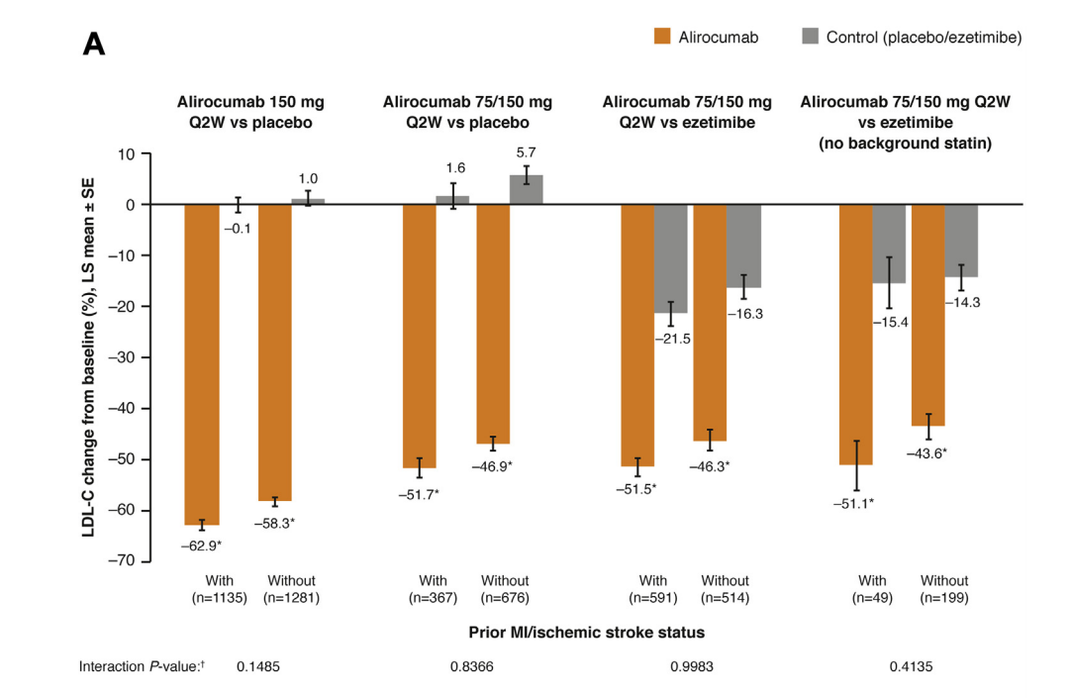
PCSK9 Inhibition in pts with and without prior MI and ischemic stroke
LDL-C
Bruckert, E., Kereiakes, D., Koren, M., et al. (2019). PCSK9 in patients with and without prior MI and ischemic stroke. Journal of Clinical Lipidology. https://doi.org/10.1016/j.jacl.2019.04.005

Slide 124
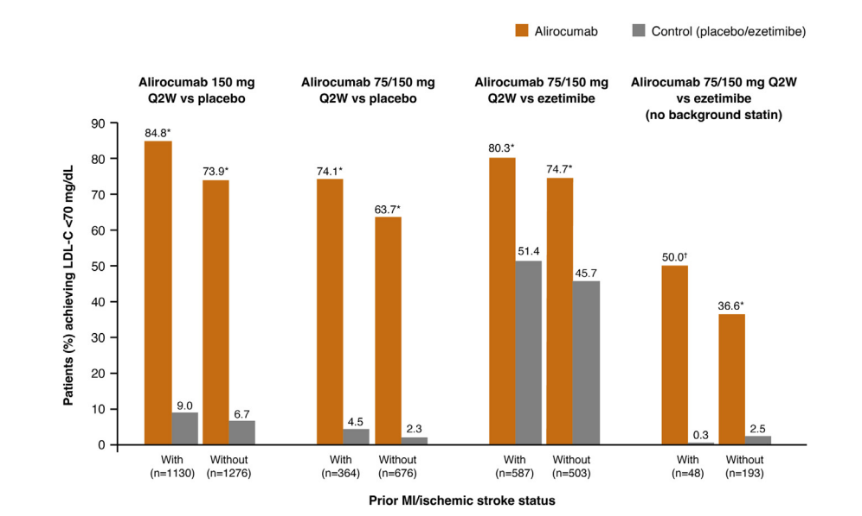
PCSK9 Inhibition in pts with and without prior MI and ischemic stroke
Achieving LDL <70
Bruckert, E., Kereiakes, D., Koren, M., et al. (2019). PCSK9 in patients with and without prior MI and ischemic stroke. Journal of Clinical Lipidology. https://doi.org/10.1016/j.jacl.2019.04.005

Slide 125
PCSK9 Inhibition in pts with and without prior MI and ischemic stroke
Alirocumab significantly reduced other lipid/lipoproteins (including lipoprotein[a]) similarly in patients with/without MI/ischemic stroke.
Week 24 LDL-C goal attainment rates for subgroups with/without prior MI/ischemic stroke on background statins were 74.1%–84.8% and 63.7%–74.7%, respectively.
The safety profile of alirocumab was generally similar regardless of prior MI/ischemic stroke status
Bruckert, E., Kereiakes, D., Koren, M., et al. (2019). PCSK9 in patients with and without prior MI and ischemic stroke. Journal of Clinical Lipidology. https://doi.org/10.1016/j.jacl.2019.04.005

Slide 126
PCSK9 Inhibition in pts with and without prior MI and ischemic stroke
Non-HDL
Bruckert, E., Kereiakes, D., Koren, M., et al. (2019). PCSK9 in patients with and without prior MI and ischemic stroke. Journal of Clinical Lipidology. https://doi.org/10.1016/j.jacl.2019.04.005

Slide 127
PCSK9 Inhibition in pts with and without prior MI and ischemic stroke
Apo B
Bruckert, E., Kereiakes, D., Koren, M., et al. (2019). PCSK9 in patients with and without prior MI and ischemic stroke. Journal of Clinical Lipidology. https://doi.org/10.1016/j.jacl.2019.04.005

Slide 128
PCSK9 Inhibition in pts with and without prior MI and ischemic stroke
Lipo(a)
Bruckert, E., Kereiakes, D., Koren, M., et al. (2019). PCSK9 in patients with and without prior MI and ischemic stroke. Journal of Clinical Lipidology. https://doi.org/10.1016/j.jacl.2019.04.005

Slide 129
PCSK9 Inhibition in pts with and without prior MI and ischemic stroke
New Indication
Bruckert, E., Kereiakes, D., Koren, M., et al. (2019). PCSK9 in patients with and without prior MI and ischemic stroke. Journal of Clinical Lipidology. https://doi.org/10.1016/j.jacl.2019.04.005

Slide 130
PCSK9 Inhibition in pts with and without prior MI and ischemic stroke
BaleDoneen Take-Away:
1. This trial was not powered for outcomes.
2. Again, as with all PCSK9 trials – because we still lack inflammatory endpoints – we wait.
3. This new indication does open the door for more access.
4. For patients with vascular disease (BDM secondary or tertiary) – statins are still a vital cornerstone for therapy but…..perhaps at lowest possible doses (2.5 Rosuvastatin every 3rd day using PCSK9 to treat risk factors such as cholesterol – particularly Apo B and Lipo(a).
5. Treatment options are becoming more accessible!
Bruckert, E., Kereiakes, D., Koren, M., et al. (2019). PCSK9 in patients with and without prior MI and ischemic stroke. Journal of Clinical Lipidology. https://doi.org/10.1016/j.jacl.2019.04.005

Slide 131
September 20-21, 2019!
See you in Spokane for the BaleDoneen Reunion!
Sign up TODAY – space is filling up!
www.BaleDoneen.com

