Slide 1
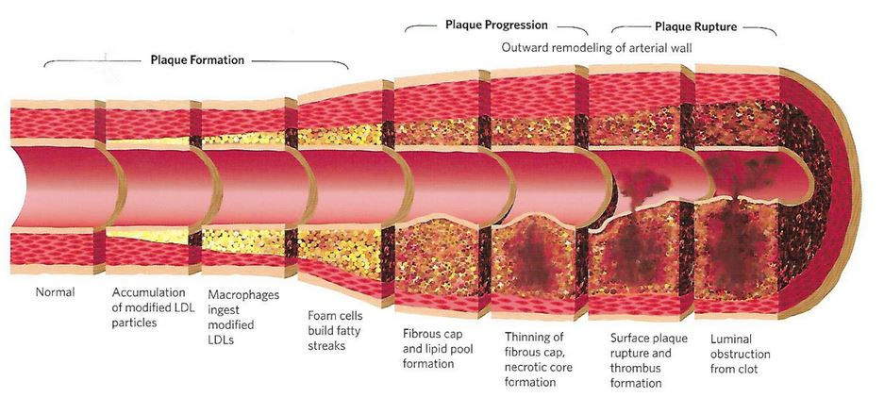
ARTERIAL AGING
Notes:
Explain in Laymen’s terms how plaque develops into unstable plaque
NORMAL HIGHWAY SURFACE IS DAMAGED
INFLAMMATION ACCELERATES DAMAGE
INFLAMMATION DESTABILIZES THE PLAQUE
THE CLOT KILLS

