Slide 1
Bale/Doneen Live Scientific Update Session
Amy Doneen DNP, ARNP
November 14, 2018
5:30-6:30 pm PST

Slide 2
Guideline Updates this week
1. ACC/AHA Guidelines – 11.10.2018
2. AHA Exercise Update - 11.11.2018
Red Flags
3. Heavy Metals
Roots
4. Periodontal Disease
Treatment
5. ACE-I & Lung Cancer?
6. PCSk-9
7. PD treatment
Agenda for November 2018
Scientific Update Session

Slide 3
Too much can be destructive

Slide 4
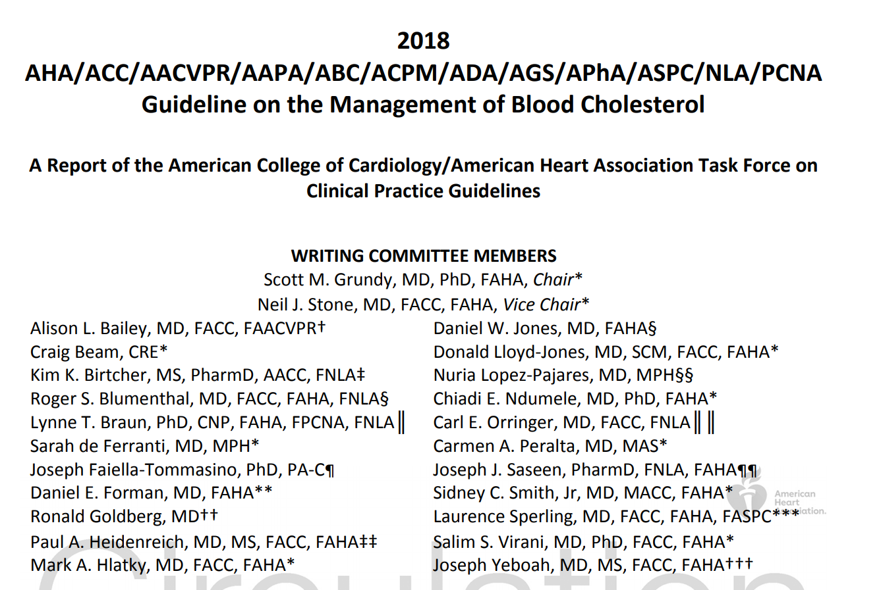
Grundy SM, et al. 2018 Cholesterol Clinical Practice Guidelines. Nov 10.2018.
A Report of the American College of Cardiology/American Heart Association Task Force on Clinical Practice Guidelines

Slide 5
Top 10 Take-Home Messages to Reduce Risk of Atherosclerotic Cardiovascular Disease Through Cholesterol Management
Lifestyle modifications: Mediterranean Diet, exercise, nicotine.
Not listed or discussed:
Genetically guided lifestyle advice (Apo E, Hp, IR), Oral health, psychosocial support, gut health, vaccines.
1. In all individuals, emphasize a heart-healthy lifestyle across the life course. In young adults 20 to 39 years of age, an assessment of lifetime risk facilitates the clinician–patient risk discussion and emphasizes intensive lifestyle efforts. In all age groups, lifestyle therapy is the primary intervention for metabolic syndrome.
2. In patients with clinical ASCVD, reduce LDL-C with high intensity statin therapy or maximally tolerated statin therapy. The more LDL-C is reduced on statin therapy, the greater will be subsequent risk reduction. Use a maximally tolerated statin to lower LDLC levels by ≥50%.
Article states that a lowering of LDL-C levels of 1% gives an approximate 1% reduction in the risk of ASCVD—
Challenge – response to treatment is NOT guided or evaluated by the baseline or subsequent inflammatory response of the treatment.
Grundy SM, et al. 2018 Cholesterol Clinical Practice Guidelines. Nov 10.2018.
A Report of the American College of Cardiology/American Heart Association Task Force on Clinical Practice Guidelines

Slide 6
Statin Recommendation
Grundy SM, et al. 2018 Cholesterol Clinical Practice Guidelines. Nov 10.2018.
A Report of the American College of Cardiology/American Heart Association Task Force on Clinical Practice Guidelines

Slide 7
Top 10 Take-Home Messages to Reduce Risk of Atherosclerotic Cardiovascular Disease Through Cholesterol Management
“Among lipid-lowering drugs, statins are the cornerstone of therapy, in addition to healthy lifestyle interventions. Other LDL-lowering drugs include ezetimibe, bile acid sequestrants, and PCSK9 inhibitors. Triglyceride-lowering drugs are fibrates and niacin; they have a mild LDL-lowering action, but RCTs do not support their use as add-on drugs to statin therapy”
NO Discussion is released on how to treat lipo(a) or dyslipidemia or residual inflammation
3. In very high-risk ASCVD, use a LDL-C threshold of 70 mg/dL to consider addition of nonstatins to statin therapy. Suggesting if you can’t get LDL <70mg/dL, add ezetimibe and/or PCSK9.
4. In patients with severe primary hypercholesterolemia (LDL-C level ≥190 mg/dL [≥4.9 mmol/L]), without calculating 10-year ASCVD risk, begin high-intensity statin therapy without calculating 10- year ASCVD risk. If the LDL-C level remains ≥100 mg/dL, adding ezetimibe and possibly PCSK9. Note that long term (>3 years) with PCSK9 ad statin therapy has not been established.
Unfortunately the guidelines fail to discuss the opportunity to examine for the presence of Familial Hypercholesterolemia.
No genetic testing for FH or utilizing the Simon-Broome Criteria
Grundy SM, et al. 2018 Cholesterol Clinical Practice Guidelines. Nov 10.2018.
A Report of the American College of Cardiology/American Heart Association Task Force on Clinical Practice Guidelines

Slide 8
Top 10 Take-Home Messages to Reduce Risk of Atherosclerotic Cardiovascular Disease Through Cholesterol Management
In a patient with DM – one of the biggest concern is the underlying insulin resistance which is a complex, inflammatory syndrome that has many complex components that go beyond the ability of mono-statin therapy to treat adequately.
5. In patients 40 to 75 years of age with DM and LDL-C ≥70 mg/dL, start moderate-intensity statin therapy without calculating 10-year ASCVD risk. In patients with DM at higher risk, especially those with multiple risk factors or those 50 to 75 years of age, it is reasonable to use a high-intensity statin to reduce the LDL-C level by ≥50%.
6. In adults 40 to 75 years of age evaluated for primary ASCVD prevention, have a clinician–patient risk discussion before starting statin therapy. Risk discussion should include a review of major risk factors (e.g., cigarette smoking, elevated blood pressure, LDL-C, hemoglobin A1C, and calculated 10-year risk of ASCVD.
Grundy SM, et al. 2018 Cholesterol Clinical Practice Guidelines. Nov 10.2018.
A Report of the American College of Cardiology/American Heart Association Task Force on Clinical Practice Guidelines

Slide 9
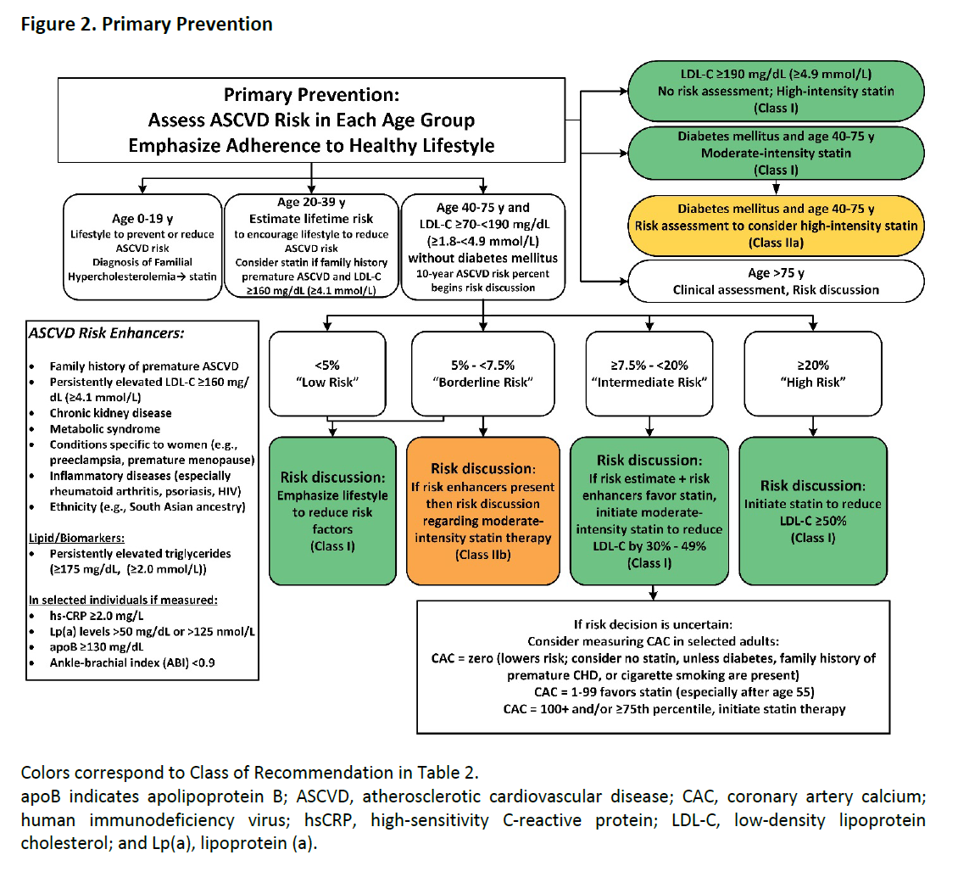
Primary Prevention
This approach varies from the BaleDoneen Method by using the word “risk” –
“Primary Prevention: Assess ASCVD Risk in Each Age Group”
Grundy SM, et al. 2018 Cholesterol Clinical Practice Guidelines. Nov 10.2018.
A Report of the American College of Cardiology/American Heart Association Task Force on Clinical Practice Guidelines

Slide 11
Top 10 Take-Home Messages to Reduce Risk of Atherosclerotic Cardiovascular Disease Through Cholesterol Management
7. In adults 40 to 75 years of age without DM and with LDL-C levels ≥70 mg/dL (≥1.8 mmol/L), at a 10-year ASCVD risk of ≥7.5%, start a moderate-intensity statin if a discussion of treatment options favors statin therapy. If statins are indicated, reduce LDL-C levels by ≥30%, and if 10-year risk is ≥20%, reduce LDL-C levels by ≥50%.
8. In adults 40 to 75 years of age without DM and 10-year risk of 7.5% to 19.9% (intermediate risk), risk-enhancing factors favor initiation of statin therapy
Risk enhancing factors include: family history of premature ASCVD, persistently, elevated LDL-C levels ≥160 mg/dL, metabolic syndrome, chronic kidney disease, history of preeclampsia or premature menopause (age<40), psoriasis, chronic HIV, high-risk ethnic groups (e.g., South Asian), TG ≥175 mg/dL, apo B ≥130 mg/dL, hsCRP ≥2.0 mg/L, ABI < 0.9, lipoprotein (a) ≥50 mg/dL.
While it is pleasing to see the AHA recognize the inflammatory impact of these root causes – the guidelines suggest that statin therapy is the necessary treatment for these conditions and provide the potentially false hope that auto-immune inflammation and genetically inherited root causes - Lipo(a).
Grundy SM, et al. 2018 Cholesterol Clinical Practice Guidelines. Nov 10.2018.
A Report of the American College of Cardiology/American Heart Association Task Force on Clinical Practice Guidelines

Slide 12
Top 10 Take-Home Messages to Reduce Risk of Atherosclerotic Cardiovascular Disease Through Cholesterol Management
9. In adults 40 to 75 years of age without DM and with LDL-C levels ≥70 mg/dL- 189 mg/dL (≥1.8-4.9 mmol/L), at a 10-year ASCVD risk of ≥7.5% to 19.9%, if a decision about statin therapy is uncertain, consider measuring CAC.
CAC score of 1 to 99 favors statin therapy
CAC score is ≥100 or ≥75th percentile – yes statin therapy
Grundy SM, et al. 2018 Cholesterol Clinical Practice Guidelines. Nov 10.2018.
A Report of the American College of Cardiology/American Heart Association Task Force on Clinical Practice Guidelines

Slide 13
Subclinical Atherosclerosis Enhances CV Risk Prediction: Background
Most initial cardiac events do not occur among those considered “high risk” by risk factor scores.
This current approach of risk stratification needs enhancement.
Baber, U., et. al. (2015). Prevalence, Impact, and Predictive Value of Detecting Subclinical Coronary and Carotid Atherosclerosis in Asymptomatic AdultsThe BioImage Study. J Am Coll Cardiol, 65(11), 1065-1074.
Notes:
novel 3-dimensional carotid ultrasound. Plaque areas from both carotid arteries were summed as the carotid plaque burden (cPB).
primary endpoint was the composite of major adverse cardiac events (MACE) (cardiovascular death, myocardial infarction, and ischemic stroke). A broader secondary MACE endpoint also included all-cause death, unstable angina, and coronary revascularization.

Slide 14
Subclinical Atherosclerosis Enhances CV Risk Prediction
Rates of events increased with greater
CAC or carotid Plaque Burden.
Detecting subclinical carotid or coronary
atherosclerosis identifies healthy individuals at
increased risk for adverse events and can enhance pt management decisions.
Baber, U., et. al. (2015). J Am Coll Cardiol, 65(11), 1065-1074.

Slide 15
US Screening for ASVD May Enhance CV Risk Assessment and Management
The presence and size of subclinical carotid and femoral plaques have a strong association with CHD and stroke risk.
They can be used to reclassify an individual’s CV risk.
Nicolaides, A., & Panayiotou, A. G. (2016). Screening for Atherosclerotic Cardiovascular Risk Using Ultrasound∗. J Am Coll Cardiol, 67(11), 1275-1277.

Slide 16
ASVD Presence is a Continuum of Risk: Implications for Defining CAD
Risk stratification should be determined by the presence, extent, and location of ASVD.
Allocation of therapy should depend on presence of disease as opposed to simply its degree of stenosis.
Arbab-Zadeh, A., & Fuster, V. (2016). J Am Coll Cardiol, 68(22), 2467-2478.

Slide 17
The Majority of Coronary Plaque Volume is Un-calcified
NCP in subjects <55yo accounted for >70% of plaque in males; >80% females
Coronary calcification is a late manifestation of atherosclerosis.
Kral, B. G., et. al. (2014). Noncalcified Coronary Plaque Volumes in Healthy People with a Family History of Early-Onset Coronary Artery Disease. Circ Cardiovasc Imaging. doi: 10.1161/CIRCIMAGING.113.000980
Notes:
Coronary plaque was significantly associated with older age, male sex, white race, hypertension, diabetes, lower HDL cholesterol and higher triglyceride levels.

Slide 18
Top 10 Take-Home Messages to Reduce Risk of Atherosclerotic Cardiovascular Disease Through Cholesterol Management
10. Assess adherence and percentage response to LDL-C–lowering medications and lifestyle changes with repeat lipid measurement 4 to 12 weeks after statin initiation or dose adjustment, repeated every 3 to 12 months as needed.
Define responses to lifestyle and statin therapy by percentage reductions in LDL-C levels compared with baseline.
Grundy SM, et al. 2018 Cholesterol Clinical Practice Guidelines. Nov 10.2018.
A Report of the American College of Cardiology/American Heart Association Task Force on Clinical Practice Guidelines

Slide 19
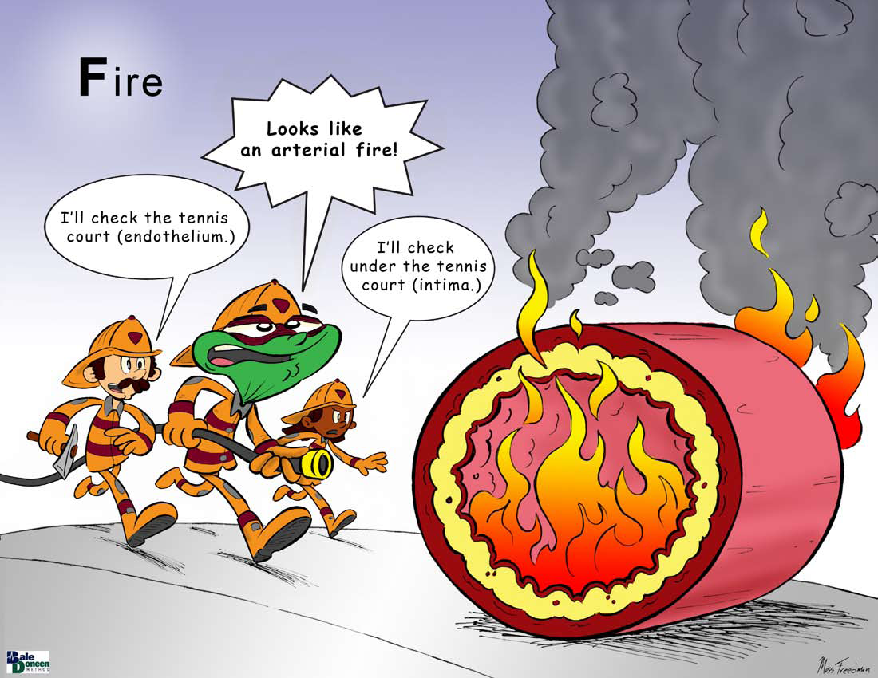

Slide 20
Inflammation is Causal- 2012
The interleukin-6 receptor as a target for prevention of coronary heart disease: a mendelian randomisation analysis. The Lancet, 379(9822), 1214-1224.
IL6R Genetics Consortium and Emerging Risk Factors Collaboration, Dr Nadeem Sarwar, Dr Adam S Butterworth, et. al. Lancet 3/31/2012; 379: 1205–13

Slide 21
CANTOS- Anti-inflammatory Therapy Reduces CV Risk
10,061 post MI pts; 80% post coronary intervention; 74% male; mean age 61; vast majority on optimal medical therapy; CRP> 2 (mean 4.2).
Randomized to monoclonal antibody to IL-1 beta or placebo; followed 3.7 yrs for CV outcomes.
Ridker, P., Thuren, E., MacFadyen, T., et al. (2017). Antiinflammatory therapy with canakinumab for atherosclerotic disease. The New Eng J of Med. DOI:10.1056/NEJMoa1707914

Slide 22
CANTOS- Anti-inflammatory Therapy Reduces CV Risk
Higher dose of medication significantly reduced incidence of non-fatal MI & stroke and CV death 14% without any change in cholesterol.
Ridker, P., Thuren, E., MacFadyen, T., et al. (2017). Antiinflammatory therapy with canakinumab for atherosclerotic disease. The New Eng J of Med. DOI:10.1056/NEJMoa1707914

Slide 23
Inflammation and Atherosclerosis - The End of a Controversy
The CANTOS trial establishes beyond doubt that inflammation is a treatable pathogenic mechanism in atherosclerosis.
Hansson, G. K. (2017). Inflammation and Atherosclerosis - The End of a Controversy. Circulation. doi:10.1161/circulationaha.
Published online 09/15/2017

Slide 24
Inflammation is causal AND can be monitored!
Tests to monitor routinely:
F2 - isoprostane –urine
MACR –urine
LpPLA2 – serum
MPO - serum
hs-CRP -serum
fibrinogen - serum

Slide 25
Top 10 Take-Home Messages to Reduce Risk of Atherosclerotic Cardiovascular Disease Through Cholesterol Management
BaleDoneen Take-Away:
Baseline LDL and LDL reduction are NOT predictive! Let’s look at some historical data to support this statement -
Grundy SM, et al. 2018 Cholesterol Clinical Practice Guidelines. Nov 10.2018.
A Report of the American College of Cardiology/American Heart Association Task Force on Clinical Practice Guidelines

Slide 26
ORs by quartile for future CAD after taking into account the Framingham risk score
LDL-C Does Not Predict CAD Risk:
LDL Particle Number Does
Measure | 1 | 2 | 3 | 4 | p
LDL-C | 1.00 | 1.17 | 1.09 | 1.24 | 0.15
LDL-P | 1.00 | 1.10 | 1.22 | 1.34 | 0.02
EPIC- Norfolk data > 25,000 pts.; followed 6 yrs.
1003 cases with 1885 matched controls
El Harchaoui, et. al. (2007). Value of Low-Density Lipoprotein Particle Number and Size as Predictors of Coronary Artery Disease in Apparently Healthy Men and Women: The EPIC-Norfolk Prospective Population Study. J Am Coll Cardiol, 49(5), 547-553.

Slide 27
Baseline LDL-C Not Associated with CV Events in Jupiter
In the placebo arm baseline LDL-C was not associated with CV events
HR per SD- 1.03 (95% CI, 0.88-1.21) p=0.71
In contrast, apoB, TG, VLDL, LDL-p, non-HDL were associated with CV events with p values ~ 0.001
Mora, S., et. al. (2015). Circulation. doi:10.1161/circulationaha.115.016857

Slide 28
ASCOT: Atorvastatin Trial Summary and Conclusions
Risk reductions for CHD events were unrelated to baseline cholesterol levels.
Risk reductions were consistent across the whole range of cholesterol.
Sever, P. S., et. al. (2003). Prevention of coronary and stroke events with atorvastatin in hypertensive patients who have average or lower-than-average cholesterol concentrations, in the Anglo-Scandinavian Cardiac Outcomes Trial--Lipid Lowering Arm (ASCOT-LLA): a multicentre randomised controlled trial. Lancet, 361(9364), 1149-1158.

Slide 29
Statins Beneficial Even if LDL is Very Low
4295 pts.; average age 65; 50% DM & or CAD; 2 yr. follow-up
60% of pts with LDL levels <60 mg/dL prescribed statins
Statin rx reduced mortality 35%
Leeper, N. J., et. al. (2007). Statin use in patients with extremely low low-density lipoprotein levels is associated with improved survival. Circulation, 116(6), 613-618.
Notes:
half had diabetes mellitus or ischemic heart disease
there were 510 deaths
49% reduction among those with LDL-cholesterol levels <40 mg/dL

Slide 30
Degree of LDL Lowering Unrelated to Event Reduction – WOSCOPS
Post-hoc analysis from the West of Scotland Coronary Prevention Study (WOSCOPS) randomized, placebo-controlled trial 4.9 yr follow-up.
Primary prevention of CHD among 2,560 pts with LDL-C >190 mg/dL without pre-existing ASVD.
Vallejo-Vax, A., Robertson, M., Catapano, A., et al. (2017). LDL-cholesterol lowering for the primary prevention of cardiovascular disease among men
with primary elevations of LDL. WOSCOPS 20 year f/u. Circulation AHA.117.027966.

Slide 31
LDL Lowering Unrelated to Event Reduction
Important BDM Message – statins reduce inflammation – the same risk reduction was obtained when LDL was treated to between 145 to <174 as those on treatment with <145!!
The same risk reduction was obtained when LDL was treated to between 145 to <174 as those on treatment with <145!!
Vallejo-Vax, A., Robertson, M., Catapano, A., et al. (2017). LDL-cholesterol lowering for the primary prevention of cardiovascular disease mong men
with primary elevations of LDL. WOSCOPS 20 year f/u. Circulation AHA.117.027966.

Slide 32
Top 10 Take-Home Messages to Reduce Risk of Atherosclerotic Cardiovascular Disease Through Cholesterol Management
BaleDoneen Take-Away:
Baseline LDL and LDL reduction are NOT predictive!
Statins have OTHER benefits that go beyond LDL reduction and…….will love to learn what the additive benefits of PCSK-9s have on vascular activity/inflammation.
Grundy SM, et al. 2018 Cholesterol Clinical Practice Guidelines. Nov 10.2018.
A Report of the American College of Cardiology/American Heart Association Task Force on Clinical Practice Guidelines

Slide 33
Effects of Statins Beyond Cholesterol
Reduces inflammation inside the artery
Reduces LDL getting engulfed by the WBCs
Reduces WBCs adhering to the endothelium
Makes plaque less likely to rupture by
decreasing content of cholesterol in plaque; reducing inflammation in the plaque; strengthening the fibrous cap
Reduces risk of forming a clot
Rosenson R, et al. JAMA. 1998;279:1643-1650
Gotto AM, et al. Curr Opin Lipidology. 2001;12:391-394
Maron DJ, et al. Circulation. 2000;101:207-213
White CM. J Clin Pharmacol. 1999;39:111-118
Notes:
However, not all of the beneficial effects of statins relate solely to their lipid-lowering properties, just as not all of those affected by CHD have elevated LDL-C levels. Elevated LDL-C levels identify less than half of those who will die from CHD. Furthermore, as we shall see shortly, a number of studies demonstrating the effectiveness of statins in reducing mortality and nonfatal CHD events show that benefit is often unrelated to degree of cholesterol lowering.
In fact, statins are drugs with multiple complexities, demonstrating a wide variety of fascinating effects on blood vessels, clotting, and a number of other processes vital to the occurrence and outcome of vascular pathophysiologic events. Such so-called “pleiotropic effects” are likely to be independent of the lipid-modifying characteristics of statins, and may ultimately broaden their indication from lipid-lowering to anti-atherogenic effects.
Rosen et al. JAMA 279(20):1643-50,1998.
Gotto AM et al. Current Opinion in Lipidology 12(4):391-4,2001; Maron DJ et al. Circulation 101(2):207-13, 2000; White CM. J Clin Pharmacol 39(2):111-8, 1999.

Slide 34
Top 10 Take-Home Messages to Reduce Risk of Atherosclerotic Cardiovascular Disease Through Cholesterol Management
BaleDoneen Take-Away:
Baseline LDL and LDL reduction are NOT predictive!
Statins have OTHER benefits that go beyond LDL reduction and…….will love to learn what the additive benefits of PCSK-9s have on vascular activity/inflammation.
While it is wonderful they site the value of CACS and now have it in the guidelines…….what is the backup plan for 0 scores…….cIMT/fIMT, Inflammation?
Grundy SM, et al. 2018 Cholesterol Clinical Practice Guidelines. Nov 10.2018.
A Report of the American College of Cardiology/American Heart Association Task Force on Clinical Practice Guidelines

Slide 35
The Majority of Coronary Plaque Volume is Un-calcified
CAC cannot detect the true extent of coronary artery plaque.
The extent of subclinical Non-calcified plaque, a putative precursor for CAD events, may have important implications for primary prevention.
Kral, B. G., et. al. (2014). Noncalcified Coronary Plaque Volumes in Healthy People with a Family History of Early-Onset Coronary Artery Disease. Circ Cardiovasc Imaging. doi: 10.1161/CIRCIMAGING.113.000980

Slide 36
Top 10 Take-Home Messages to Reduce Risk of Atherosclerotic Cardiovascular Disease Through Cholesterol Management
BaleDoneen Take-Away:
Baseline LDL and LDL reduction are NOT predictive!
Statins have OTHER benefits that go beyond LDL reduction and…….will love to learn what the additive benefits of PCSK-9s have on vascular activity/inflammation.
While it is wonderful they site the value of CACS and now have it in the guidelines…….what is the backup plan for 0 scores…….cIMT/fIMT, Inflammation?
Using moderate to high dose statin without genetic testing, root cause evaluation, disease and inflammatory testing will likely lead to continued events, adverse side effects and ultimately poor compliance.
Grundy SM, et al. 2018 Cholesterol Clinical Practice Guidelines. Nov 10.2018.
A Report of the American College of Cardiology/American Heart Association Task Force on Clinical Practice Guidelines

Slide 37
2018 Physical Activity Guidelines Advisory Committee. Their extensive review and deliberations regarding the scientific literature on physical activity and health are summarized in the 2018 Physical Activity Guidelines Advisory Committee Scientific Report,

Slide 38
Physical Activity Guidelines for Americans 2018
2018 Physical Activity Guidelines Advisory Committee. Their extensive review and deliberations regarding the scientific literature on physical activity and health are summarized in the 2018 Physical Activity Guidelines Advisory Committee Scientific Report,

Slide 39
Physical Activity Guidelines for Americans 2018
2018 Physical Activity Guidelines Advisory Committee. Their extensive review and deliberations regarding the scientific literature on physical activity and health are summarized in the 2018 Physical Activity Guidelines Advisory Committee Scientific Report,

Slide 40
Physical Activity Guidelines for Americans 2018
2018 Physical Activity Guidelines Advisory Committee. Their extensive review and deliberations regarding the scientific literature on physical activity and health are summarized in the 2018 Physical Activity Guidelines Advisory Committee Scientific Report,

Slide 41
Physical Activity Guidelines for Americans 2018
2018 Physical Activity Guidelines Advisory Committee. Their extensive review and deliberations regarding the scientific literature on physical activity and health are summarized in the 2018 Physical Activity Guidelines Advisory Committee Scientific Report,

Slide 42
Physical Activity Guidelines for Americans 2018
2018 Physical Activity Guidelines Advisory Committee. Their extensive review and deliberations regarding the scientific literature on physical activity and health are summarized in the 2018 Physical Activity Guidelines Advisory Committee Scientific Report,

Slide 43
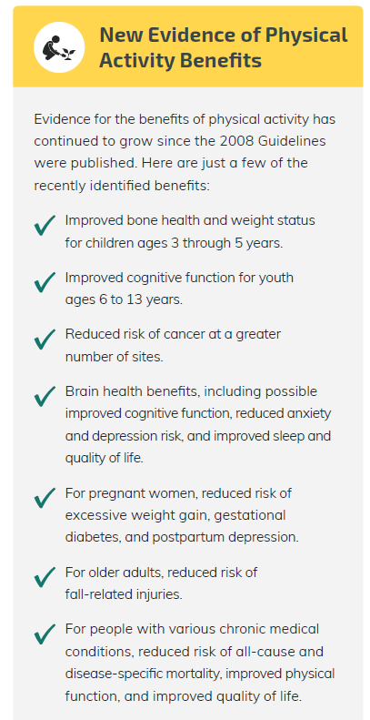
Physical Activity Guidelines for Americans 2018
2018 Physical Activity Guidelines Advisory Committee. Their extensive review and deliberations regarding the scientific literature on physical activity and health are summarized in the 2018 Physical Activity Guidelines Advisory Committee Scientific Report,

Slide 44
GREAT JOB to this committee!
MOVE AMERICA!
2018 Physical Activity Guidelines Advisory Committee. Their extensive review and deliberations regarding the scientific literature on physical activity and health are summarized in the 2018 Physical Activity Guidelines Advisory Committee Scientific Report,

Slide 45
Heavy Metals – should we be screening for them?

Slide 46
Cu
copper
As
arsenic
Cd
cadmium
Pb
lead
Hg
mercury

Slide 47
Environment toxic metal and risk of CVD: Risk: arsenic, lead, cadmium & copper (not mercury)
AIM: To conduct a systematic review and meta-analysis of epidemiological studies investigating the association of arsenic, lead, cadmium, mercury, and copper with cardiovascular disease.
DESIGN: Systematic review and meta-analysis. Data Sources PubMed, Embase, and Web of Science searched up to December 2017.
Chowdhury, R., Ramond, A., O’Keeffe, L. et al. Environmental toxic metal and risk of CVD. BMJ 2018;362:k3310

Slide 48
Environment toxic metal and risk of CVD: Risk: arsenic, lead, cadmium & copper (not mercury)
Review methods Studies reporting risk estimates for total cardiovascular disease, coronary heart disease, and stroke for levels of arsenic, lead, cadmium, mercury, or copper
The review identified 37 unique studies comprising 348 259 nonoverlapping participants, with 13 033 coronary heart disease, 4205 stroke, and 15 274 cardiovascular disease outcomes in aggregate.
Chowdhury, R., Ramond, A., O’Keeffe, L. et al. Environmental toxic metal and risk of CVD. BMJ 2018;362:k3310

Slide 49
Environment toxic metal and risk of CVD: Risk: arsenic, lead, cadmium & copper (not mercury)
Exclusion: Six studies (one reporting on arsenic, two on cadmium, three on mercury) which did not use an appropriate assessment of heavy metal exposure
(ie, use of cadmium levels in toenails)
or did not adjust for important confounders of heavy metal exposure (eg, smoking for cadmium or seafood intake for mercury) were excluded from the analysis.
Chowdhury, R., Ramond, A., O’Keeffe, L. et al. Environmental toxic metal and risk of CVD. BMJ 2018;362:k3310

Slide 50
Environment toxic metal and risk of CVD: Risk: arsenic, lead, cadmium & copper (not mercury)
Increased relative risk with coronary heart disease (95% CI):
Arsenic: 1.23 (1.04 to 1.45)
Lead: 1.85 (1.27 to 2.69)
Cadmium: 1.29 (0.98 to 1.71) *
Copper: 2.22 (1.31 to 3.74)
There was no association of mercury levels with coronary heart disease, relative risk of 0.99 (0.65 to 1.49)
Chowdhury, R., Ramond, A., O’Keeffe, L. et al. Environmental toxic metal and risk of CVD. BMJ 2018;362:k3310

Slide 51
Environment toxic metal and risk of CVD: Risk: arsenic, lead, cadmium & copper (not mercury)
Chowdhury, R., Ramond, A., O’Keeffe, L. et al. Environmental toxic metal and risk of CVD. BMJ 2018;362:k3310

Slide 52
Environment toxic metal and risk of CVD: Risk: arsenic, lead, cadmium & copper (not mercury)
Chowdhury, R., Ramond, A., O’Keeffe, L. et al. Environmental toxic metal and risk of CVD. BMJ 2018;362:k3310

Slide 53
Environment toxic metal and risk of CVD: Risk: arsenic, lead, cadmium & copper (not mercury)
Arsenic exposure has been reported the production of reactive oxygen species in endothelial cells, up regulation of inflammatory signals, and increase in blood pressure.
These findings extend several previous epidemiological studies that reported strong assoc with severe PVD (Blackfoot disease) in people exposed to extremely high cumulative doses of arsenic.
Arsenic Sources: Contaminated groundwater is the most common cause of arsenic poisoning. Arsenic is already present in the earth and can seep into groundwater
Chowdhury, R., Ramond, A., O’Keeffe, L. et al. Environmental toxic metal and risk of CVD. BMJ 2018;362:k3310

Slide 54
Environment toxic metal and risk of CVD: Risk: arsenic, lead, cadmium & copper (not mercury)
Lead toxicity levels have been in decline in the developed world, mainly due to decreased usage of leaded gasoline and leaded paint.
However, lead exposure remains considerably high in many areas reinforcing lead exposure as a major public health concern.
Two key pathways by which lead has been implicated in the risk of CVD are mediation through accelerated SBP and damage to renal function.
Previous studies have also suggested an association of lead with atherosclerosis as a result of lead-induced oxidative stress and inflammation after exposure.
Chowdhury, R., Ramond, A., O’Keeffe, L. et al. Environmental toxic metal and risk of CVD. BMJ 2018;362:k3310

Slide 55
Environment toxic metal and risk of CVD: Risk: arsenic, lead, cadmium & copper (not mercury)
Copper is an essential trace element however in excess, it can induce oxidative stress by generation of reactive oxygen species.
Copper mediated lipid peroxidation has been demonstrated in several in vivo and in vitro studies.
Another possible mechanism is through a copper-homocysteine complex which have been suggested to induce endothelial dysfunction and vascular injury.
Common Copper Sources: Oysters and other shellfish, whole grains, beans, nuts, potatoes, organ meats (kidneys, liver), Dark leafy greens, dried fruits such as prunes, cocoa, black pepper, and yeast are also sources of copper in the diet.
Chowdhury, R., Ramond, A., O’Keeffe, L. et al. Environmental toxic metal and risk of CVD. BMJ 2018;362:k3310

Slide 56
Environment toxic metal and risk of CVD: Risk: arsenic, lead, cadmium & copper (not mercury)
Cadmium’s adverse effects on the vascular system are thought to be mediated by oxidative stress, inflammation, and endothelial cell damage, which can result in atherosclerosis.
Cadmium is widely prevalent in groundwater and common plant based foods (eg, rice and vegetables).
Products: cigarettes, batteries, craft glazes, jewelry, and metal coatings.
Food - some shellfish, kidney meats, grain cereals, and vegetables.
Air - cigarette smoke, second-hand smoke, emissions from fossil fuels.
Chowdhury, R., Ramond, A., O’Keeffe, L. et al. Environmental toxic metal and risk of CVD. BMJ 2018;362:k3310

Slide 57
Environment toxic metal and risk of CVD: Risk: arsenic, lead, cadmium & copper (not mercury)
Mercury, a potentially toxic trace metal that humans are exposed to primarily through fish consumption,
was not significantly associated with the risk of cardiovascular disease in the current review.
There is currently no accepted biological explanation that supports a link between Mercury and CVD.
Chowdhury, R., Ramond, A., O’Keeffe, L. et al. Environmental toxic metal and risk of CVD. BMJ 2018;362:k3310

Slide 58
What? That can’t be true – we KNOW mercury is the worst of them all!

Slide 59
Mercury Exposure not associated with CVD
Among subjects from two U.S. cohorts (a total of 51,529 men and 121,700 women) whose toenail clippings had been stored, we prospectively identified incident cases of CVD in 3427 participants and matched them to risk-set–sampled controls according to age, sex, race, and smoking status.
Toenail mercury and selenium concentrations were assessed with the use of neutron-activation analysis.
Mozaffarian, D., Shi, P, Morris, S., et al. 2011. Mercury exposure and risk of cardiovascular disease in two U.S. cohorts. New Engl J Med 364;12.

Slide 60
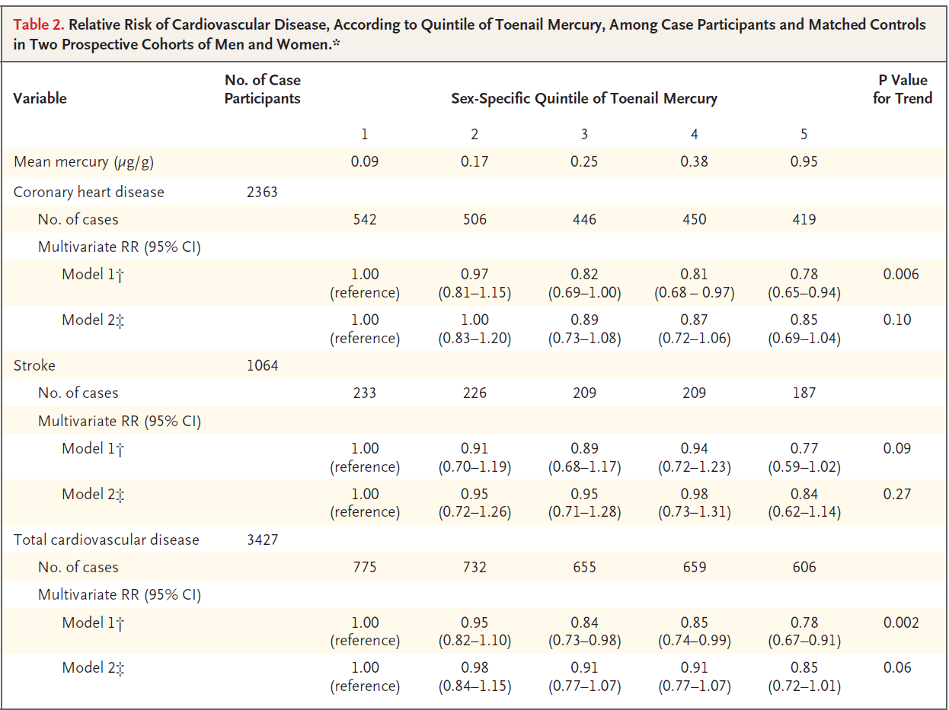
Mercury Exposure not associated with CVD
Higher mercury exposures were actually associated with trends toward lower CVD Risk, although these trends were not significant in the fully adjusted models (++)
Mozaffarian, D., Shi, P, Morris, S., et al. 2011. Mercury exposure and risk of cardiovascular disease in two U.S. cohorts. New Engl J Med 364;12.

Slide 61
Well – what about Mercury toxicity with eating fish – surely that is a problem!

Slide 62
Mercury Exposure not associated with CVD
Well – surely eating fish is a problem!
Mozaffarian, D., Shi, P, Morris, S., et al. 2011. Mercury exposure and risk of cardiovascular disease in two U.S. cohorts. New Engl J Med 364;12.

Slide 63
Mercury Exposure not associated with CVD
Conclusion:
No evidence of any clinically relevant adverse effects of mercury exposure on coronary heart disease, stroke, or total cardiovascular disease in U.S. adults at the exposure levels seen in this study.
Mozaffarian, D., Shi, P, Morris, S., et al. 2011. Mercury exposure and risk of cardiovascular disease in two U.S. cohorts. New Engl J Med 364;12.

Slide 64
Environment toxic metal and risk of CVD: Risk: arsenic, lead, cadmium & copper (not mercury)
BaleDoneen Take Away:
1. Perhaps we should begin to measure heavy metals in our patients – Arsenic, lead, cadmium, copper. – especially in our patients who eat a lot of grains and vegetables.
2. Current data supports previous – mercury levels are not associated with CVD risk.
3. Eating fish does not show an increased quantity or increased risk of CVD.
4. Smoking – past, present, second hand – should be evaluated for all, especially cadmium.
Chowdhury, R., Ramond, A., O’Keeffe, L. et al. Environmental toxic metal and risk of CVD. BMJ 2018;362:k3310

Slide 65
Nicotine
Endodontic Disease
Periodontal Disease
Gut dysbiosis

Slide 67
Oct. 17, 2018 -- The U.S. Department of Health and Human Services’ (HHS) & National Institutes of Health (NIH) issued the following news release.
An unhealthy population of microbes in the mouth triggers specialized immune cells that inflame and destroy tissues, leading to the type of bone loss associated with a severe form of gum disease.
Copyright (c) 2018 Targeted News Service.

Slide 68
Oct. 17, 2018 – HHS & NIH issued the following news release.
Periodontal disease is common affecting
~50% of Americans 31 – 65 years old
~70% > 65 years old
Bacteria trigger inflammation of the tissues that surround the teeth, which can lead to loss of bone and teeth = periodontitis.
Copyright (c) 2018 Targeted News Service.

Slide 69
Oct. 17, 2018 – HHS & NIH issued the following news release.
"Our results suggest that immune cells known as T helper 17 (Th17) cells are drivers of this process, providing the link between oral bacteria and inflammation.“
The concentration of Th17 cells in the gum tissue correlated with disease severity.
Copyright (c) 2018 Targeted News Service.

Slide 70
Oct. 17, 2018 – HHS & NIH issued the following news release.
Th17 cells normally live in so-called barrier sites (where germs make first contact with the body), such as, the mouth, skin, and digestive tract.
Th17 cells may be ‘helpful’- one example is they are known to protect against oral thrush.
Copyright (c) 2018 Targeted News Service.

Slide 71
Oct. 17, 2018 – HHS & NIH issued the following news release.
Th17 cells may also be ‘harmful’.
For example they are linked to inflammatory diseases such as psoriasis and colitis.
Copyright (c) 2018 Targeted News Service.

Slide 72
Oct. 17, 2018 – HHS & NIH issued the following news release.
This exciting study involving mice and humans provides evidence that Th17 cells are drivers of periodontitis.
The results provide key insights into the mechanisms that underlie development of periodontal disease and a potential novel therapeutic target.
Copyright (c) 2018 Targeted News Service.

Slide 73
The Adaptive Immune System Via Th17 Cells Critical in Periodontitis Inflammation
Dutzan N et al. Sci Trans Med. 2018 Oct 17. DOI: 10.1126/scitranslmed.aat0797

Slide 74
The Adaptive Immune System Via Th17 Cells Critical in Periodontitis Inflammation
BaleDoneen Statement:
This data assists to further articulate the adaptive immune system’s role involved in periodontitis.
This study places importance of using our current available clinical tools – oral pathogen detection and using genetics to understand our innate and acquired immune response to those pathogens.
Dutzan N et al. Sci Trans Med. 2018 Oct 17. DOI: 10.1126/scitranslmed.aat0797

Slide 75
The Adaptive Immune System Via Th17 Cells Critical in Periodontitis Inflammation: Background
Mucosal barrier sites are tasked with the delicate act of maintaining a dynamic balance between host and environmental stimuli.
The oral mucosa is constantly exposed to a myriad of environmental stimuli, including a rich and diverse commensal microbial community.
Dutzan N et al. A dysbiotic microbiome triggers Th17 cells to mediate oral mucosal immunopathology in mice and humans. Sci Trans Med. 2018 Oct 17. DOI: 10.1126/scitranslmed.aat0797

Slide 76
The Adaptive Immune System Via Th17 Cells Critical in Periodontitis Inflammation: Background
The oral barrier is the initial portal of encounter for microbes, food, and airborne antigens.
It is of great significance to understand how immunity is regulated at this critical barrier.
Dutzan N et al. A dysbiotic microbiome triggers Th17 cells to mediate oral mucosal immunopathology in mice and humans. Sci Trans Med. 2018 Oct 17. DOI: 10.1126/scitranslmed.aat0797

Slide 77
The Adaptive Immune System Via T helper 17 (Th17) Cells Critical in Periodontitis Inflammation: Background
Periodontitis is one of the most prevalent human inflammatory diseases and poses a serious economic and public health burden.
Exaggerated inflammatory responses in the gingiva lead to immunopathology and destruction of supporting bone.
Dutzan N et al. A dysbiotic microbiome triggers Th17 cells to mediate oral mucosal immunopathology in mice and humans. Sci Trans Med. 2018 Oct 17. DOI: 10.1126/scitranslmed.aat0797

Slide 78
The Adaptive Immune System Via Th17 Cells Critical in Periodontitis Inflammation: Background
Treatment largely aims at reduction of microbial stimulation.
Elucidation of specific immune pathways involved in the destructive inflammation could allow targeted therapy through host-modulation.
Dutzan N et al. A dysbiotic microbiome triggers Th17 cells to mediate oral mucosal immunopathology in mice and humans. Sci Trans Med. 2018 Oct 17. DOI: 10.1126/scitranslmed.aat0797

Slide 79
The Adaptive Immune System Via Th17 Cells Critical in Periodontitis Inflammation: Background
Cytokine interleukin-17 (IL-17) and an abundance of T helper 17 (Th17) cells are associated with chronic periodontitis.
However, causality for periodontal pathology has not been proven.
Dutzan N et al. A dysbiotic microbiome triggers Th17 cells to mediate oral mucosal immunopathology in mice and humans. Sci Trans Med. 2018 Oct 17. DOI: 10.1126/scitranslmed.aat0797

Slide 80
The Adaptive Immune System Via Th17 Cells Critical in Periodontitis Inflammation: Background
Oral tissues are readily accessible for obtaining mucosal biopsy samples and corresponding microbiome samples.
This study will test the hypothesis that Th17 cells are drivers of the pathogenic mucosal inflammation in periodontitis.
Dutzan N et al. A dysbiotic microbiome triggers Th17 cells to mediate oral mucosal immunopathology in mice and humans. Sci Trans Med. 2018 Oct 17. DOI: 10.1126/scitranslmed.aat0797

Slide 81
PD – Cytokines Determine the Consequences
Adaptive immunity is triggered by dendritic cells recognizing harmful pathogens.
This activates the T-cell immune response.
There are at least four subsets of T lymphocytes:
Inflammatory -Th1, Th2 & Th17
Anti-inflammatory- Th2 & Tregs
Garlet, G. P. (2010). Destructive and Protective Roles of Cytokines in Periodontitis: A Re-appraisal from Host Defense and Tissue Destruction Viewpoints. J Dent Res, 89(12), 1349-1363.

Slide 82
PD – Cytokines Determine the Consequences
Tregs are protective T-cells for tissue damage in the periodontal environment.
Tregs also produce IL-10 along with the cytokine TGF-β which reduces the creation of IL-1β, TNF-α & MMPs.
In addition, the higher the TGF-β, the lower the RANKL.
Garlet, G. P. (2010). Destructive and Protective Roles of Cytokines in Periodontitis: A Re-appraisal from Host Defense and Tissue Destruction Viewpoints. J Dent Res, 89(12), 1349-1363.

Slide 83
The Adaptive Immune System Via T helper 17 (Th17) Cells Critical in Periodontitis Inflammation
Analysis of gingival tissue from 9 healthy pts and 7 pts with periodontitis revealed T helper (Th) 17 cells were much more prevalent in periodontitis.
In addition, the amount of Th17 cells was directly correlated with disease severity.
Dutzan N et al. A dysbiotic microbiome triggers Th17 cells to mediate oral mucosal immunopathology in mice and humans. Sci Trans Med. 2018 Oct 17. DOI: 10.1126/scitranslmed.aat0797

Slide 84
The Adaptive Immune System Via Th17 Cells Critical in Periodontitis Inflammation
To elucidate the role of Th17 cells in periodontal inflammation, a ligature-induced periodontitis (LIP) murine model utilized.
It was found there was a 30- to 80-fold increase in IL17a gene expression.
Dutzan N et al. A dysbiotic microbiome triggers Th17 cells to mediate oral mucosal immunopathology in mice and humans. Sci Trans Med. 2018 Oct 17. DOI: 10.1126/scitranslmed.aat0797
Notes:
Atraumatic placement of a silk suture (ligature) around the second molar tooth leads to local accumulation of bacteria and gingival inflammation followed by destruction of tooth-supporting bone

Slide 85
The Adaptive Immune System Via Th17 Cells Critical in Periodontitis Inflammation
The cellular sources of IL-17 were CD45-IL-17 and CD4-IL-17 cells.
The IL-17 findings mirror those in humans with periodontitis proving the relevance of the murine model.
Dutzan N et al. A dysbiotic microbiome triggers Th17 cells to mediate oral mucosal immunopathology in mice and humans. Sci Trans Med. 2018 Oct 17. DOI: 10.1126/scitranslmed.aat0797

Slide 86
The Adaptive Immune System Via Th17 Cells Critical in Periodontitis Inflammation
Experiments were conducted to identify the distinct cellular sources of IL-17 in periodontitis.
The data documented the preferential expansion of Th17 cells as the main source of IL-17.
Dutzan N et al. Sci Trans Med. 2018 Oct 17. DOI: 10.1126/scitranslmed.aat0797

Slide 87
The Adaptive Immune System Via Th17 Cells Critical in Periodontitis Inflammation
Studies were conducted to find out what cytokines are required for an increase in Th17 cells.
It was found IL-6 is required for the expansion of Th17 cells in health and in periodontitis; IL-23 is also necessary in periodontitis; IL-1 was not a factor in periodontitis.
Dutzan N et al. Sci Trans Med. 2018 Oct 17. DOI: 10.1126/scitranslmed.aat0797

Slide 88
The Adaptive Immune System Via Th17 Cells Critical in Periodontitis Inflammation
Studies were conducted to see if the periodontal microbiome was a stimulus for expansion of Th17 cells.
Examination of the microbiome in periodontitis demonstrated a shift with a relative decrease in commensal species and an increase in pathological species.
Dutzan N et al. Sci Trans Med. 2018 Oct 17. DOI: 10.1126/scitranslmed.aat0797

Slide 89
The Adaptive Immune System Via Th17 Cells Critical in Periodontitis Inflammation
In the presence of a broad-spectrum systemic antibiotic (doripenem-vancomycin-neomycin) ATB cocktail, the numbers of CD45-IL-17 cells remained unchanged.
However, there was a dramatic reduction in Th17 cells.
Dutzan N et al. Sci Trans Med. 2018 Oct 17. DOI: 10.1126/scitranslmed.aat0797

Slide 90
The Adaptive Immune System Via Th17 Cells Critical in Periodontitis Inflammation
To assess the spectrum of bacteria that mediate Th17 cell accumulation, animals were placed on different single-regimen antibiotic therapy.
Vancomycin and ampicillin, which typically target Gram-positive bacteria, did not affect Th17 cells.
Dutzan N et al. Sci Trans Med. 2018 Oct 17. DOI: 10.1126/scitranslmed.aat0797

Slide 91
The Adaptive Immune System Via Th17 Cells Critical in Periodontitis Inflammation
Neomycin is effective against Gram-negative and some Gram-positive bacteria did reduce Th17 cells.
Metronidazole which targets mostly anaerobic bacteria yielded the most reduction in Th17 cells.
Dutzan N et al. Sci Trans Med. 2018 Oct 17. DOI: 10.1126/scitranslmed.aat0797

Slide 92
The Adaptive Immune System Via Th17 Cells Critical in Periodontitis Inflammation
Neomycin and metronidazole caused a significant inhibition of periodontal bone loss; the other antibiotics showed no benefit with amt of bone loss.
These findings suggest a causative link btw gram negative anaerobes and the bone destroying inflammation of periodontitis.
Dutzan N et al. Sci Trans Med. 2018 Oct 17. DOI: 10.1126/scitranslmed.aat0797

Slide 93
The Adaptive Immune System Via Th17 Cells Critical in Periodontitis Inflammation
Also studied if the bacterial biomass was related to the amount of Th17 cell expansion.
The combination ATBs and neomycin alone were effective in both reduction in the bacterial biomass and Th17 cells.
Dutzan N et al. Sci Trans Med. 2018 Oct 17. DOI: 10.1126/scitranslmed.aat0797

Slide 94
The Adaptive Immune System Via Th17 Cells Critical in Periodontitis Inflammation
Metronidazole did not reduce the bacterial biomass, but it did significantly inhibit Th17 cell accumulation.
These data indicate that, rather than global biomass reduction, it is the anerobic community biomass that is related to the Th17 cell expansion.
the balance of the oral microbiome community determines dysbiosis and pathogenicity
Dutzan N et al. Sci Trans Med. 2018 Oct 17. DOI: 10.1126/scitranslmed.aat0797

Slide 95
The Adaptive Immune System Via Th17 Cells Critical in Periodontitis Inflammation
Studies were done to determine if Th17 cells are the driver of periodontal inflammatory bone loss.
Mice with genetic inhibition of Th17 cell differentiation had a significant reduction in bone loss with periodontitis.
Dutzan N et al. Sci Trans Med. 2018 Oct 17. DOI: 10.1126/scitranslmed.aat0797

Slide 96
The Adaptive Immune System Via Th17 Cells Critical in Periodontitis Inflammation
Mice treated with a drug that causes a reduction in Th17 cell development and function had a significantly reduced disease severity.
Th17 cells appear to play a direct role in the bone destruction of periodontitis.
Dutzan N et al. Sci Trans Med. 2018 Oct 17. DOI: 10.1126/scitranslmed.aat0797
Notes:
(measured as bone loss;

Slide 97
The Adaptive Immune System Via Th17 Cells Critical in Periodontitis Inflammation
Studies were done to see if IL-17 and neutrophils are involved in mediating tissue destruction in periodontitis.
Antibody inhibition of IL-17 led to significant reduction of periodontal bone loss.
Dutzan N et al. Sci Trans Med. 2018 Oct 17. DOI: 10.1126/scitranslmed.aat0797

Slide 98
The Adaptive Immune System Via Th17 Cells Critical in Periodontitis Inflammation
Reduction of neutrophil numbers by means of anti-Ly6G treatment led to significant inhibition of periodontal bone loss.
These data suggest that Th17 cell–derived IL-17 and neutrophils mediate pathology in periodontitis.
Dutzan N et al. Sci Trans Med. 2018 Oct 17. DOI: 10.1126/scitranslmed.aat0797

Slide 99
The Adaptive Immune System Via Th17 Cells Critical in Periodontitis Inflammation
To evaluate the clinical consequences of Th17 cell inhibition in humans, studied 35 pts with the Mendelian disorder autosomal dominant hyper–immunoglobulin E syndrome (AD-HIES).
These pts have markedly reduced circulating Th17 cells and their T cells display reduced in vitro differentiation into TH17 cells.
Dutzan N et al. Sci Trans Med. 2018 Oct 17. DOI: 10.1126/scitranslmed.aat0797

Slide 100
The Adaptive Immune System Via Th17 Cells Critical in Periodontitis Inflammation
These pts have significantly reduced numbers of Th17 cells within gingival tissues as compared to age & gender-matched healthy and periodontitis pts.
Due to this blunted tissue–Th17 cell response, 85% of these pts have recurrent oral candidiasis.
They are appropriate pts for investigating the consequences of Th17 cell deficiency in periodontal immunity and inflammation.
Dutzan N et al. Sci Trans Med. 2018 Oct 17. DOI: 10.1126/scitranslmed.aat0797

Slide 101
The Adaptive Immune System Via Th17 Cells Critical in Periodontitis Inflammation
35 AD-HIES pts were compared to age- or gender-matched healthy controls and periodontitis pts for presence and hx of periodontal inflammation and tissue destruction.
In glaring contrast to their susceptibility to oral fungal infection, AD-HIES pts did not demonstrate susceptibility to periodontal disease.
Dutzan N et al. Sci Trans Med. 2018 Oct 17. DOI: 10.1126/scitranslmed.aat0797

Slide 102
The Adaptive Immune System Via Th17 Cells Critical in Periodontitis Inflammation
These findings suggest that blunted Th17 cell responses confer protection from periodontal inflammatory disease.
This data reinforces the distinct roles of oral Th17 cells in immuno-protection and immunopathology.
Dutzan N et al. Sci Trans Med. 2018 Oct 17. DOI: 10.1126/scitranslmed.aat0797

Slide 103
The Adaptive Immune System Via Th17 Cells Critical in Periodontitis Inflammation
The findings of this study are consistent with a key role for Th17 cells in oral inflammatory bone loss.
Our study indicates metronidazole is the antibiotic of choice in human periodontitis, because it classically targets anaerobes which appear to be the drivers of Th17 cell expansion.
Dutzan N et al. Sci Trans Med. 2018 Oct 17. DOI: 10.1126/scitranslmed.aat0797

Slide 104
The Adaptive Immune System Via Th17 Cells Critical in Periodontitis Inflammation
BaleDoneen Take-Away:
1. Excellent NIH study further elucidating the immuno-pathology of periodontitis.
2. The adaptive immune system is important.
3. Conversion of Th17 cells from protective (candida) to harmful (periodontitis) is dependent on an increase in anaerobes in the gingival microbiome.
4. The expansion of Th17 cells is also dependent upon elevations in IL-6 & IL-23 which can increase from innate immunity.
5. Study implies having oral thrush may be an indicator of lower risk for periodontitis.
Dutzan N et al. Sci Trans Med. 2018 Oct 17. DOI: 10.1126/scitranslmed.aat0797

Slide 105
The Adaptive Immune System Via Th17 Cells Critical in Periodontitis Inflammation
BaleDoneen Take-Away (cont)
6. This study furthers the scientific knowledge about the pathologic mechanics of periodontitis.
7. However, we already know the causes of systemic inflammation due to periodontal disease is multifactorial and complex (direct toxic effects, invasion of the arterial wall with pathogens, innate and adaptive immunity).
8. Study gives an implication that with this new knowledge we can reach beyond pathogen control and manipulate the immune system (i.e. monoclonal antibodies for cytokines or Th17 cells) to control periodontitis; this can backfire.
9. Creating new drugs and monoclonal antibodies to effect the immunopathology (antibody against Th17 cells) – may not be the answer due to the multitude of interactions – tx at the source – the pathogens!
Dutzan N et al. Sci Trans Med. 2018 Oct 17. DOI: 10.1126/scitranslmed.aat0797

Slide 107
Treatment PCSK9

Slide 108
ODYSEE: Alirocumab reduces Cardiovascular Outcomes after Acute Coronary Syndrome
Patients who have had an acute coronary syndrome are at high risk for recurrent ischemic CV events.
Aim: to determine whether alirocumab, a PCSK9, would improve CV outcomes after an ACS in patients receiving high-intensity statin therapy.
Schwartz, G. G., Steg, P. G., Szarek, M., Bhatt, D. L., Bittner, V. A., Diaz, R., . . . Zeiher, A. M. Alirocumab and Cardiovascular Outcomes after Acute Coronary Syndrome. 0(0), null. doi:10.1056/NEJMoa1801174

Slide 109
ODYSEE: Alirocumab reduces Cardiovascular Outcomes after Acute Coronary Syndrome
Multicenter, randomized, double-blind, placebo-controlled trial involving 18,924 patients who had an ACS 1 to 12 months earlier:
LDL > 70 mg/dL or
non−HDL >100 mg per/dL or
Apo B > 80 mg/dL and
statin therapy at a high-intensity dose or at the maximum tolerated dose.
Schwartz, G. G., Steg, P. G., Szarek, M., Bhatt, D. L., Bittner, V. A., Diaz, R., . . . Zeiher, A. M. Alirocumab and Cardiovascular Outcomes after Acute Coronary Syndrome. 0(0), null. doi:10.1056/NEJMoa1801174

Slide 110
ODYSEE: Alirocumab reduces Cardiovascular Outcomes after Acute Coronary Syndrome
Patients randomly assigned to receive alirocumab SQ at a dose of 75 mg (9462 patients) or matching placebo (9462 patients) every 2 weeks.
The dose of alirocumab was adjusted under blinded conditions to target an LDL of 25 to 50 mg/dL.
The primary end point:
Composite of death from CHD, nonfatal MI, fatal or nonfatal ischemic stroke, or unstable angina requiring hospitalization.
Schwartz, G. G., Steg, P. G., Szarek, M., Bhatt, D. L., Bittner, V. A., Diaz, R., . . . Zeiher, A. M. Alirocumab and Cardiovascular Outcomes after Acute Coronary Syndrome. 0(0), null. doi:10.1056/NEJMoa1801174

Slide 111
ODYSEE: Alirocumab reduces Cardiovascular Outcomes after Acute Coronary Syndrome
The median duration of follow-up was 2.8 years.
A composite primary end-point event occurred in:
903 patients (9.5%) in the alirocumab group
1052 patients (11.1%) in the placebo group
(HR, 0.85; 95% CI, 0.78 to 0.93; P<0.001)
Schwartz, G. G., Steg, P. G., Szarek, M., Bhatt, D. L., Bittner, V. A., Diaz, R., . . . Zeiher, A. M. Alirocumab and Cardiovascular Outcomes after Acute Coronary Syndrome. 0(0), null. doi:10.1056/NEJMoa1801174
Notes:
A total of 334 patients (3.5%) in the alirocumab group and 392 patients (4.1%) in the placebo group died (hazard ratio, 0.85; 95% CI, 0.73 to 0.98).
The incidence of adverse events was similar in the two groups, with the exception of local injection-site reactions (3.8% in the alirocumab group vs. 2.1% in the placebo group).

Slide 112
ODYSEE: Alirocumab reduces Cardiovascular Outcomes after Acute Coronary Syndrome
Schwartz, G. G., Steg, P. G., Szarek, M., Bhatt, D. L., Bittner, V. A., Diaz, R., . . . Zeiher, A. M. Alirocumab and Cardiovascular Outcomes after Acute Coronary Syndrome. 0(0), null. doi:10.1056/NEJMoa1801174

Slide 113
ODYSEE: Alirocumab reduces Cardiovascular Outcomes after Acute Coronary Syndrome
Schwartz, G. G., Steg, P. G., Szarek, M., Bhatt, D. L., Bittner, V. A., Diaz, R., Zeiher, A. M. Alirocumab and Cardiovascular Outcomes after Acute Coronary Syndrome. 0(0), null. doi:10.1056/NEJMoa1801174

Slide 114
ODYSEE: Alirocumab reduces Cardiovascular Outcomes after Acute Coronary Syndrome
BaleDoneen Take-Away:
One of my biggest concerns here is that a total of 334 patients (3.5% in the alirocumab group and 392 patients (4.1%) in the placebo group died in this 2.8 year trial (HR 0.85; 95% CI, 0,73 to 0.98).
Despite lowering LDL-C to extremely low levels in the tx arm – max dose statin plus Alirocumab, 9.5% of patients had recivistic events in 2.8 years.
I would like to see cIMT data and inflammatory biomarker results in this study.
Again – ALWAYS make sure ALL root causes are identified and treated.
Does help eradicate the fear of ‘too low’ LDL to some degree.
Schwartz, G. G., Steg, P. G., Szarek, M., Bhatt, D. L., Bittner, V. A., Diaz, R., . . Zeiher, A. M. Alirocumab and Cardiovascular Outcomes after Acute Coronary Syndrome. 0(0), null. doi:10.1056/NEJMoa1801174

Slide 115
Treatment Periodontal Maintenance

Slide 116
PerioProtect Tray Therapy for Treatment of Periodontal Disease
Periodontal disease is a chronic wound.
There are AMA guidelines established for chronic wound management.
Keller DC. Chronic wound management of periodontal disease. Oral Biol Dent. 2018; 6:2. http://dx.doi.org/10.7243/2053-5775-6-2.

Slide 117
PerioProtect Tray Therapy for Treatment of Periodontal Disease
The first step in chronic wound management is to reduce the pathogenic infectious agents.
In periodontal disease this equates to reducing the gram-negative anaerobic bacteria.
It has been shown PerioProtect trays with 1.7% hydrogen peroxide gel significantly reduce the biomass of these pathogens.*
Keller DC. Chronic wound management of periodontal disease. Oral Biol Dent. 2018; 6:2. http://dx.doi.org/10.7243/2053-5775-6-2.
*Keller DC and Buechel M. Direct medication delivery modifies the
periodontal biofilm. Oral Biol Dent. 2017; 5.

Slide 118
PerioProtect Tray Therapy for Treatment of Periodontal Disease
The second step in chronic wound management is debridement.
The hydrogen peroxide delivered in PerioProtect trays penetrates the oral biofilm, breaks down to water and oxygen and serves to debride the periodontal wound.*
Keller DC. Chronic wound management of periodontal disease. Oral Biol Dent. 2018; 6:2. http://dx.doi.org/10.7243/2053-5775-6-2.
*Keller DC and Buechel M. Periodontal treatment with direct medication
delivery of hydrogen peroxide and oxygen. Oral health case Rep. 2017; 3:1.

Slide 119
PerioProtect Tray Therapy for Treatment of Periodontal Disease
Reducing inflammation is also necessary for chronic wound therapy; compression is one way to do that.
PerioProtect ® trays are custom designed to provide such compression and aids in the creation essentially a hyperbaric oxygen chamber for the periodontal tissue; this along with low dose doxycycline all result in decreased inflammation.
Keller DC. Chronic wound management of periodontal disease. Oral Biol Dent. 2018; 6:2. http://dx.doi.org/10.7243/2053-5775-6-2.

Slide 120
PerioProtect Tray Therapy for Treatment of Periodontal Disease
Chronic wound treatment requires maintenance to prevent the reoccurrence of infection.
Long term use of PerioProtect trays with direct delivery of hydrogen peroxide and low dose doxycycline will prevent reoccurrence of a significant biomass of the pathological bacteria.
Keller DC. Chronic wound management of periodontal disease. Oral Biol Dent. 2018; 6:2. http://dx.doi.org/10.7243/2053-5775-6-2.

Slide 121
PerioProtect Tray Therapy for Treatment of Periodontal Disease
PerioProtect tray therapy fits the guidelines of the AMA for chronic wound management.
Keller DC. Chronic wound management of periodontal disease. Oral Biol Dent. 2018; 6:2. http://dx.doi.org/10.7243/2053-5775-6-2.

Slide 122
Treatment ACE and Lung CA

Slide 123
RAAS and Lung Cancer?

Slide 124
RAAS and Lung Cancer?
The cohort included 992 061 patients followed for a mean of 6.4 (SD 4.7) years beyond the one year post-cohort entry latency period.
During the follow-up period, 335,135 patients were treated with ACEIs, 29 008 with ARB’s, and 101 637 with both ACEIs and ARB’s.
The three most commonly used ACEIs were ramipril (26%; 257 420 patients) lisinopril (12%; 120 641 patients), and perindopril (7%; 70 955 patients).
Overall, 7952 patients were newly diagnosed as having lung cancer during 6,350,584 person years of follow-up, generating a crude incidence rate of 1.3 (95% confidence interval 1.2 to 1.3) per 1000 person years.
Hicks, B., Filion, K., Yin, H., et al. BMJ 2018; 363; Oct 24, 2018

Slide 125
RAAS and Lung Cancer?
Hicks, B., Filion, K., Yin, H., et al. BMJ 2018; 363; Oct 24, 2018

Slide 126
RAAS and Lung Cancer?
Hicks, B., Filion, K., Yin, H., et al. BMJ 2018; 363; Oct 24, 2018

Slide 127
RAAS and Lung Cancer?
BaleDoneen Take-Away:
1. Several concerns – one being that >100k patients were on both ACE-I and ARBs – we know that the kidneys cannot tolerate this – lungs?
2. I am curious as to the Haptoglobin status of these patients – Hp2 carriers (zonulin and leaky barriers – including respiratory)
3. One additional thought – patients are NOT getting routine CXRs anymore – seems like a reasonable baseline and follow-up.
4. Only one study was specifically designed to investigate this association. In this well conducted study, ACEIs was not associated with an increased risk of lung cancer (HR 0.99, 0.84 to 1.16), compared with angiotensin receptor blockers.
Gokhale M, Girman C, Chen Y, Pate V, Funk MJ, Stürmer T. Comparison of diagnostic evaluations for cough among initiators of angiotensin converting enzyme inhibitors and angiotensin receptor blockers. Pharmacoepidemiol Drug Saf 2016;25:512-20.
Hicks, B., Filion, K., Yin, H., et al. BMJ 2018; 363; Oct 24, 2018
Notes:
Gokhale M, Girman C, Chen Y, Pate V, Funk MJ, Stürmer T.
Comparison of diagnostic evaluations for cough among
initiators of angiotensin converting enzyme inhibitors and
angiotensin receptor blockers. Pharmacoepidemiol Drug Saf
2016;25:512-20. doi:10.1002/pds.3977

Slide 128
ARBs Associated with Increased Lung Cancer Risk
Meta-analysis five trials with 61,950 new cancers
25% increased risk of lung cancer with ARBs
(0.9% vs 0.7%; RR 1.25; p=0.01)
NNT for four years to cause one lung CA -105
No link to breast or prostate cancer
ARBs block AT- 1 receptors and stimulate AT- 2 receptors —it is known this can stimulate tumor angiogenesis
Lung is very rich in angiotensin 2 receptors with a huge surface area in blood vessels (ACEI-block AT-2 R)
Sipahi I, et. al., Lancet Oncol 6/13/2010; DOI:10.1016/S1470-2045(10)70106-6.
Available at http://www.thelancet.com
Notes:
significant excess of fatal cancers was observed in the CHARM study with the ARB candesartan (Atacand, AstraZeneca), published in 2003, but that the investigators concluded this finding was likely due to chance
New cancer data were available for 61 950 patients from five trials, including only three of the seven FDA-approved ARBs; most patients in this meta-analysis (85.7%) received telmisartan (Micardis, Boehringer Ingelheim) as the study drug; the other patients received losartan or candesartan. The five trials with new cancer data were ONTARGET, PROFESS, LIFE, TRANSCEND, and CHARM-Overall. In addition, data were available for cancer deaths in LIFE, TRANSCEND, VALIANT, and Val-HeFT
unknown whether other ARBs—irbesartan (Avapro, Bristol-Myers Squibb/Sanofi-Aventis), valsartan (Diovan, Novartis), olmesartan (Benicar, Daiichi Sankyo), and eprosartan (Teveten, Abbott)—are linked to a higher risk of new cancer incidence, the investigators say. "Given the limited data, it is not possible to draw conclusions about the exact risk of cancer associated with each ARB," they observe.
AT2-R. Still, we are far from really knowing this receptor. AT2-R – seems to span the regulation of natriuresis, body-temperature, blood-pressure, reproduction, embryonic development, cell differentiation, tissue repair and programmed cell death. AT2-R actions has also important clinical implications, because these actions are concomitantly either blocked (ACE-inhibitors) or stimulated (AT1-R-antagonists) – from Peptides 26 (2005) 1401–1409 The AT2 receptor—A matter of love and hate U.M. Steckelings 1, E. Kaschina 1, Th. Unger ∗

Slide 129
ARBs and Cancer Risk: Another Signal
Meta-analysis; 325,000 subjects; 70 hypertensive therapy trials from 1974 to 2008; average follow-up 3.5 yrs.
Multiple anti-hypertensives; cancer not prespecified end point
Only significant association was with ACEI – ARB combination therapy
14% increased cancer risk – p=0.004
ACEIs are known not to increase cancer risk
Bottom line: FDA is reviewing all the ARB data
Bangalore S, et al. Lancet Oncol 11/2010; DOI:10.1016/S1470-2045(10)70260-6.
Available at: http://www.thelancet.com/journals/lanonc/issue/current

Slide 130
Candesartan and Telmisartan Associated with Increased Cancer Risk
Epidemiological case-control study 21,750 new diabetics; tx’ed with ARB mean 603 days; 1,281 incident cancer cases
Candesartan associated with a 79% increased risk (OR 1.79; 95% CI 1.05-3.06)
Telmisartan was associated with a trend toward increased risk (OR 1.54; 95% CI 0.97-2.43).
Chang CH, et. al. J Clin Oncol 6/20/2011; DOI 10.1200/JCO.2011.35.1908.
Available at: http://jco.ascopubs.org
Notes:
Atacand and Micardis
liver (22%), colorectal (15%), lung (11%), and urologic cancer (6%)

Slide 131
RAAS and Lung Cancer?
BaleDoneen Take-Away:
1. Several concerns – one being that >100k patients were on both ACE-I and ARBs – we know that the kidneys cannot tolerate this – lungs?
2. I am curious as to the Haptoglobin status of these patients – Hp2 carriers (zonulin and leaky barriers – including respiratory)
3. One additional thought – patients are NOT getting routine CXRs anymore – seems like a reasonable baseline and follow-up.
4. Only one study was specifically designed to investigate this association. In this well conducted study, ACEIs was not associated with an increased risk of lung cancer (HR 0.99, 0.84 to 1.16), compared with angiotensin receptor blockers.
Gokhale M, Girman C, Chen Y, Pate V, Funk MJ, Stürmer T. Comparison of diagnostic evaluations for cough among initiators of angiotensin converting enzyme inhibitors and angiotensin receptor blockers. Pharmacoepidemiol Drug Saf 2016;25:512-20.
5. Further research needed. With ACE-I superiority over ARBs in MI reduction, particularly in DM population – not ready to jump at this point.
Hicks, B., Filion, K., Yin, H., et al. BMJ 2018; 363; Oct 24, 2018
Notes:
Gokhale M, Girman C, Chen Y, Pate V, Funk MJ, Stürmer T.
Comparison of diagnostic evaluations for cough among
initiators of angiotensin converting enzyme inhibitors and
angiotensin receptor blockers. Pharmacoepidemiol Drug Saf
2016;25:512-20. doi:10.1002/pds.3977

Slide 132
Get more info on upcoming BaleDoneen events!
Text the word SAVE
to 972-600-0248
to stay connected to BaleDoneen!

Slide 133
Make sure and get signed up for the 2019 reunion NOW! It will be a historic event!

