Slide 1

BaleDoneen Live Scientific
Update
November 10, 2021
5:30-6:30 pm PST
Dr. Amy L. Doneen
Blaha

Slide 2





Spokane in the fall
A few pics of my favorite places to run ☺

Slide 3
Agenda for this evening
Lipoprotein(a) – a statement by the AHA?
Lipoprotein(a) and Aortic Valve Narrowing
Niacin and PCSK9 and Aortic Valve Stenosis
The importance of the physical exam
Antisense Technology – the horizon
Antisense – emerging RNA therapeutics to lower Lipo(a)
Post Pandemic Psychosocial Issues of importance
Connected Mind Quick Screen
Identifying anxiety and depression in the dental office.

Slide 4
References for Scientific Update 11/10/21
Reyes-Soffer G, Ginsberg HN, Berglund L, et al. American Heart Association Council on Arteriosclerosis, Thrombosis and Vascular Biology; Council on Cardiovascular Radiology and Intervention; and Council on Peripheral Vascular Disease. Lipoprotein(a): A Genetically Determined, Causal, and Prevalent Risk Factor for Atherosclerotic Cardiovascular Disease: A Scientific Statement From the American Heart Association. Arterioscler Thromb Vasc Biol. 2021 Oct 14
Youssef A, Clark JR, Koschinsky ML, Boffa MB. Lipoprotein(a): Expanding our knowledge of aortic valve narrowing. Trends Cardiovasc Med. 2021 Jul;31(5):305-311. doi: 10.1016/j.tcm.2020.06.001. Epub 2020 Jun 7.
Perrot, N., Valerio, V., Moschetta, D., Genetic and In Vitro Inhibition of PCSK9 and Calcific Aortic Valve Stenosis. JACCC: Basic to translational Science Vol. 5, NO. 7. 2020
Hyman, P. (2020). The disappearance of the primary care physical examination- losing touch. JAMA Intern Med. 2020;180(11):1417-1418

Slide 5
References for Scientific Update 11/10/21
Crooke, S., Liang, Xue-Hai, Baker, B., Crooke, R., (2021). Antisense technology: A review. J. Biol. Chem. (2021) 296 100416
Tsimikas S., Moriarty, PM, Stroes, ES. Emerging RNA Therapeutics to lower blood levels of Lp(a): JACC Focus Seinar 2/4. J Am Coll Cardiol. 2021 Mar 30;77(12):1576-1589.
Khubchandani J, Sharma S, Webb FJ, Wiblishauser MJ, Bowman SL. Post-lockdown depression and anxiety in the USA during the COVID-19 pandemic. J Public Health (Oxf). 2021 Jun 7;43(2):246-253.
Rogers R, Hartigan SE, Sanders CE. Identifying Mental Disorders in Primary Care: Diagnostic Accuracy of the Connected Mind Fast Check (CMFC) Electronic Screen. J Clin Psychol Med Settings. 2021 Oct 5:1–15.
Xu L, Cai B, Fan S, Lu S, Dai K. Association of Oral Behaviors with Anxiety, Depression, and Jaw Function in Patients with Temporomandibular Disorders in China: A Cross-Sectional Study. Med Sci Monit. 2021 May 17;27:e929985.

Slide 6
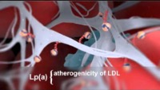

Slide 7
Lipoprotein(a)
Lipoprotein(a): A Genetically Determined, Causal, and Prevalent Risk Factor for Atherosclerotic Cardiovascular Disease
American Heart Association
Reyes-Soffer G, Ginsberg HN, Berglund L, et al. American Heart Association Council on Arteriosclerosis, Thrombosis and Vascular Biology; Council on Cardiovascular Radiology and Intervention; and Council on Peripheral Vascular Disease. Lipoprotein(a): A Genetically Determined, Causal, and Prevalent Risk Factor for Atherosclerotic Cardiovascular Disease: A Scientific Statement From the American Heart Association. Arterioscler Thromb Vasc Biol. 2021 Oct 14

Slide 8
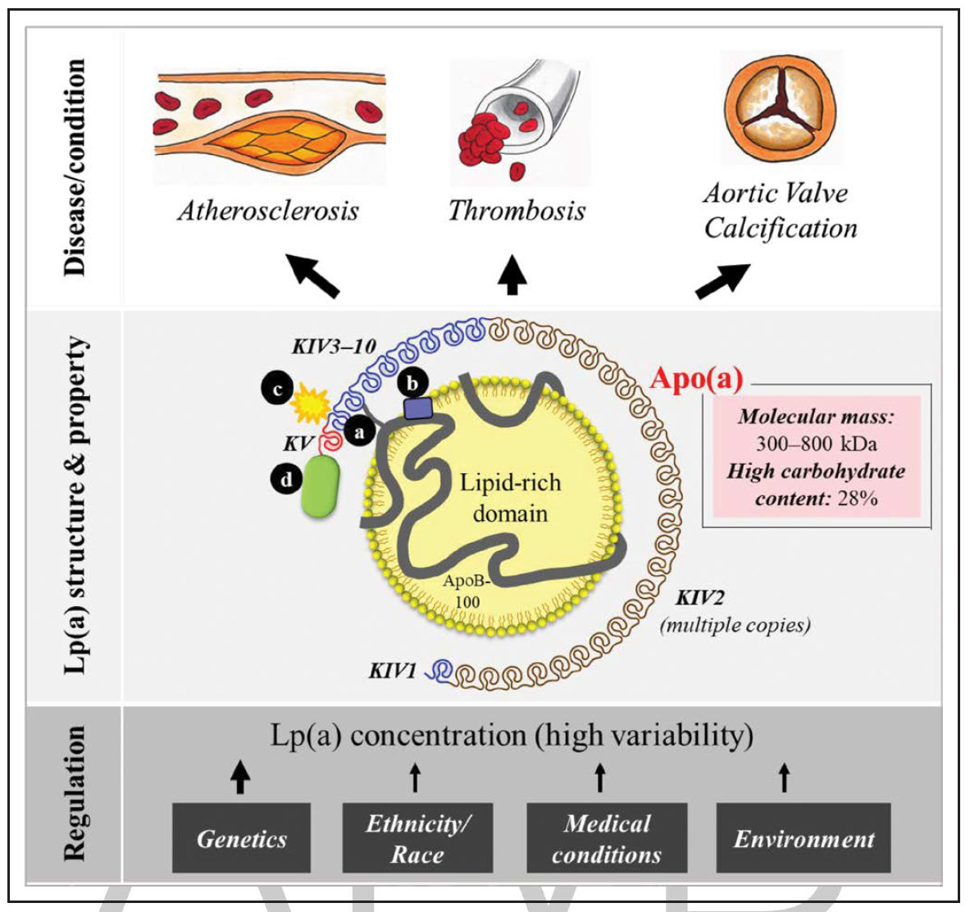
Lp(a) consists of a lipid-rich domain, primarily cholesteryl esters, and apolipoprotein(a). Apo(a) binds to Apo B via a single disulfide bond at a location close to the LDL receptor binding site of apoB .
Lp(a) contains repeated kringle structures comparable with those in plasminogen. There are 10 different subtypes of Lp(a).
Lp(a) is unique with a high carbohydrate content (≈28%).
Reyes-Soffer G, Ginsberg HN, Berglund L, et al. American Heart Association Council on Arteriosclerosis, Thrombosis and Vascular Biology; Council on Cardiovascular Radiology and Intervention; and Council on Peripheral Vascular Disease. Lipoprotein(a): A Genetically Determined, Causal, and Prevalent Risk Factor for Atherosclerotic Cardiovascular Disease: A Scientific Statement From the American Heart Association. Arterioscler Thromb Vasc Biol. 2021 Oct 14

Slide 9
Proinflammatory and proatherogenic oxidized phospholipids bind to Lp(a) KIV type 10
The Lp(a) concentration is heterogeneous and, to a major extent, controlled by genetics, and inversely related to the copy number variation in the LPA gene.
Other factors such as ethnicity and race and medical and environmental conditions also play roles in Lp(a) regulation.
Lp(a) has been associated with increased risks of atherosclerosis, thrombosis, and aortic valve calcification.
Reyes-Soffer G, Ginsberg HN, Berglund L, et al. American Heart Association Council on Arteriosclerosis, Thrombosis and Vascular Biology; Council on Cardiovascular Radiology and Intervention; and Council on Peripheral Vascular Disease. Lipoprotein(a): A Genetically Determined, Causal, and Prevalent Risk Factor for Atherosclerotic Cardiovascular Disease: A Scientific Statement From the American Heart Association. Arterioscler Thromb Vasc Biol. 2021 Oct 14

Slide 10
Lipoprotein(a)
Epidemiological, genome-wide association, and Mendelian randomization data provide clear support for a causal role for elevated Lp(a) in the development of atherosclerotic cardiovascular disease (ASCVD).
The definition of “high” Lp(a) levels can differ, depending on the units of measurement (mg/dL vs nmol/L), the population ancestry; and the underlying disease and clinical characteristics of the cohort. These factors have made it difficult to establish universal thresholds for clinical use.
Reyes-Soffer G, Ginsberg HN, Berglund L, et al. American Heart Association Council on Arteriosclerosis, Thrombosis and Vascular Biology; Council on Cardiovascular Radiology and Intervention; and Council on Peripheral Vascular Disease. Lipoprotein(a): A Genetically Determined, Causal, and Prevalent Risk Factor for Atherosclerotic Cardiovascular Disease: A Scientific Statement From the American Heart Association. Arterioscler Thromb Vasc Biol. 2021 Oct 14

Slide 11
Lipoprotein(a)
1963 - geneticist Kåre Berg identified a unique antigen in the LDL fraction of human serum that he called apolipoprotein(a). He studied families and found the strong genetic component and by 1974, he had linked the presence of Lp(a) to coronary heart disease (CHD).
Confirmation of the association of Lp(a) with CHD required improvements in the assays to measure Lp(a), by the mid-1980s, Berg’s observation was supported through retrospective and cross-sectional studies.
Strong genetic evidence supporting Lp(a) as an independent and potentially causal risk factor for ASCVD was reported in large studies published in 2009 in support of earlier smaller studies demonstrating associations of Lp(a) phenotypes/genotypes with CVD.
Reyes-Soffer G, Ginsberg HN, Berglund L, et al. American Heart Association Council on Arteriosclerosis, Thrombosis and Vascular Biology; Council on Cardiovascular Radiology and Intervention; and Council on Peripheral Vascular Disease. Lipoprotein(a): A Genetically Determined, Causal, and Prevalent Risk Factor for Atherosclerotic Cardiovascular Disease: A Scientific Statement From the American Heart Association. Arterioscler Thromb Vasc Biol. 2021 Oct 14

Slide 12
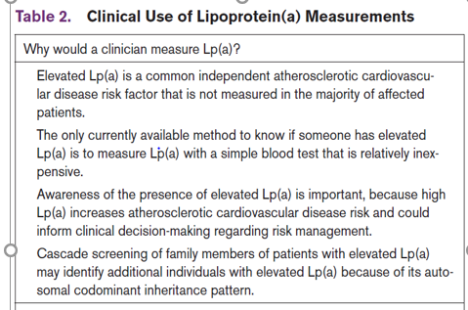
Strongest acknowledgement from AHA of the importance of measuring lipo(a)
BD Method
BD Method
BD Method
BD Method
Reyes-Soffer G, Ginsberg HN, Berglund L, et al. American Heart Association Council on Arteriosclerosis, Thrombosis and Vascular Biology; Council on Cardiovascular Radiology and Intervention; and Council on Peripheral Vascular Disease. Lipoprotein(a): A Genetically Determined, Causal, and Prevalent Risk Factor for Atherosclerotic Cardiovascular Disease: A Scientific Statement From the American Heart Association. Arterioscler Thromb Vasc Biol. 2021 Oct 14

Slide 13
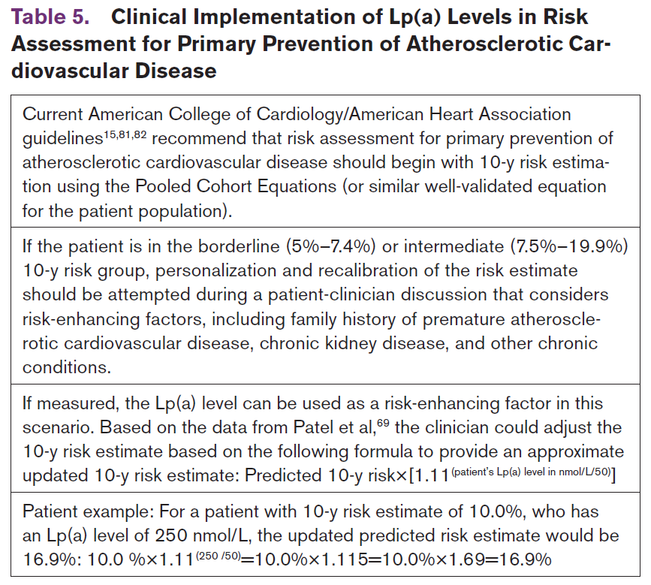
Unfortunately, still using a risk factor model on who should get lipo(a) tested.
? Disease
? Disease
? Disease
? Disease ?Inflammation
?lipo(a) >75nmol/L
Reyes-Soffer G, Ginsberg HN, Berglund L, et al. American Heart Association Council on Arteriosclerosis, Thrombosis and Vascular Biology; Council on Cardiovascular Radiology and Intervention; and Council on Peripheral Vascular Disease. Lipoprotein(a): A Genetically Determined, Causal, and Prevalent Risk Factor for Atherosclerotic Cardiovascular Disease: A Scientific Statement From the American Heart Association. Arterioscler Thromb Vasc Biol. 2021 Oct 14

Slide 14
Lipoprotein(a)
BaleDoneen Take-Away:
Genetically based studies demonstrated a consistent increase in MI risk with higher lipo (a) levels (Kamstrup, P.R., et al. 2009, JAMA, 301(22) and Clarke R., et al. 2009) N Engl J Med, 361, 2518-2528).
Enhances Risk Prediction by 40% in intermediate risk patients. (Willeit, P. 2014, J Am Coll Cardiol, 64(9), 851-860)
Elevated lipo(a) Increases Recidivistic stroke risk by 2.6-fold (p=0.016). (Lang, K.S., et al (2016). Stroke AHA. 116.014436)
In Post MI Pts - an increase >13% relative to a decrease of >13% generated a significant 21% increased risk of CV events. (Nestel, P.J., et al. (2013) ATVB.)
Lipo(a) is common in the US - >30 mg/dL- 35%-39.5%, >50 mg/dL -24%- 29.2% (Varvel, S., (2016). Prevalence of Elevated et al. ATVB, 36(11), 2239-2245)

Slide 15
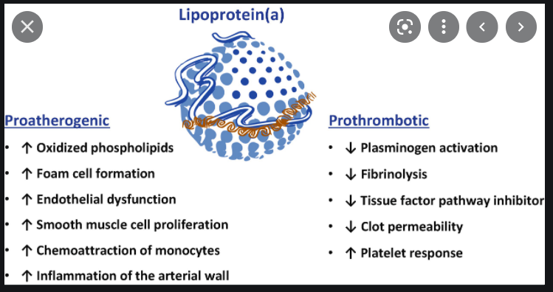

Slide 16
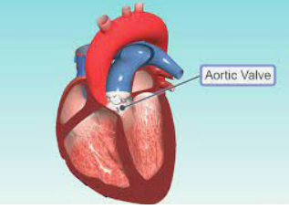
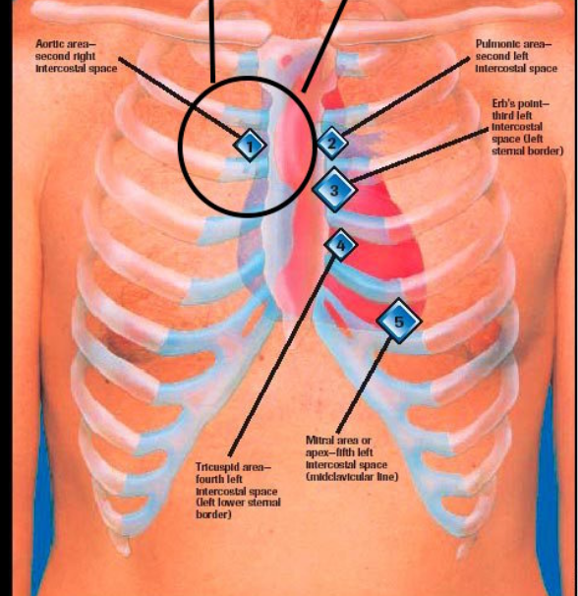
Aortic Valve Disease & Lipoprotein(a)

Slide 17
Lipo(a) and aortic valve disease
Elevated levels of lipoprotein(a) [Lp(a)] has been identified as an independent and causal risk factor for calcific aortic valve disease (CAVD).
CAVD is a slow, progressive disorder presenting as severe trileaflet calcification known as aortic valve stenosis (AS) that impairs valve motion and restricts ventricular outflow.
AS tends to be quite advanced by the time it presents clinical symptoms of exertional angina, syncope, or heart failure.
Youssef A, Clark JR, Koschinsky ML, Boffa MB. Lipoprotein(a): Expanding our knowledge of aortic valve narrowing. Trends Cardiovasc Med. 2021 Jul;31(5):305-311. doi: 10.1016/j.tcm.2020.06.001. Epub 2020 Jun 7.

Slide 18
Lipo(a) and aortic valve disease
Evidence is accumulating that Lp(a) can exacerbate pathophysiological processes in CAVD, specifically, endothelial dysfunction, formation of foam cells, and promotion of a pro-inflammatory state.
In the valve milieu, the pro-inflammatory effects of Lp(a) are manifested in valve thickening and mineralization through pro-osteogenic signaling and changes in gene expression in valve interstitial cells that is primarily facilitated by the oxidized phospholipid content of Lp(a).
The advent of effective therapies that dramatically lower Lp(a) provides the possibility of the first medical treatment to halt AS progression.
Youssef A, Clark JR, Koschinsky ML, Boffa MB. Lipoprotein(a): Expanding our knowledge of aortic valve narrowing. Trends Cardiovasc Med. 2021 Jul;31(5):305-311. doi: 10.1016/j.tcm.2020.06.001. Epub 2020 Jun 7.

Slide 19
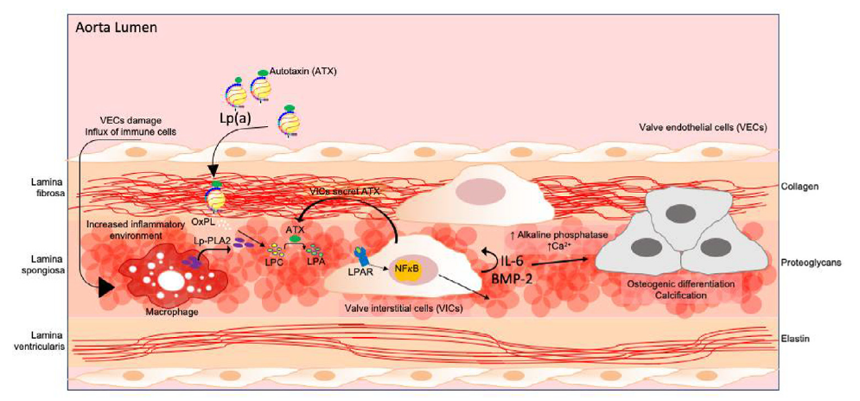
Lipo(a) and aortic valve disease
A schematic representation of the consequences in the aortic valve microenvironment upon insult of valve endothelial cells (VECs), leading to inflammation and infiltration of immune cells and lipids.
Youssef A, Clark JR, Koschinsky ML, Boffa MB. Lipoprotein(a): Expanding our knowledge of aortic valve narrowing. Trends Cardiovasc Med. 2021 Jul;31(5):305-311. doi: 10.1016/j.tcm.2020.06.001. Epub 2020 Jun 7.

Slide 20
Lipo(a) and aortic valve disease
Osteogenic differentiation and mineralization of valve interstitial cells (VICs) and hardening of valve tissue leads to aortic valve stenosis.
Lp(a) can infiltrate through the damaged endothelium, accumulate in the valve, and deliver its content of oxidized phospholipids (OxPL) along with autotaxin (ATX).
In turn, lipoprotein-associated phospholipase A2 (Lp-PLA2), secreted by macrophages, uses OxPLs to produce lysophosphatidylcholine (LPC).
Youssef A, Clark JR, Koschinsky ML, Boffa MB. Lipoprotein(a): Expanding our knowledge of aortic valve narrowing. Trends Cardiovasc Med. 2021 Jul;31(5):305-311. doi: 10.1016/j.tcm.2020.06.001. Epub 2020 Jun 7.

Slide 21
Lipo(a) and aortic valve disease
Autotaxin (ATX) converts LPC into lysophosphatidic acid (LPA), a substrate that binds and activates the LPA receptor (LPAR) leading to activation of NF- κB.
This activates a transcriptional response leading to increased inflammation (secretion of interlukin-6 (IL-6)) and induction of a strong osteogenic response through upregulation of bone-morphogenic protein-2 (BMP-2) in VICs.
This series of events promotes osteogenic differentiation and calcification of VICs leading to hardening of the valve leaflet and, ultimately, aortic stenosis.
Youssef A, Clark JR, Koschinsky ML, Boffa MB. Lipoprotein(a): Expanding our knowledge of aortic valve narrowing. Trends Cardiovasc Med. 2021 Jul;31(5):305-311. doi: 10.1016/j.tcm.2020.06.001. Epub 2020 Jun 7.

Slide 22
Can any current therapy for Lipo(a) also improve risk associated with aortic valve disease?
Niacin Data
PCSK-9 Data

Slide 23
Lipo(a) and aortic valve disease
Niacin therapy lowers Lp(a) by approximately 30%, along with favorable changes in LDL-C and HDL-C. The EAS and National Lipid Association (NLA) formerly recommended niacin for lowering Lp(a).
Early Aortic Valve Lipoprotein(a) Lowering (EAVaLL) ongoing randomized trial, is using extended-release niacin in individuals with early valve disease and high Lp(a) ( ≥50 mg/dL).
EAVaLL will provide both a preliminary test of the Lp(a) lowering hypothesis in aortic valve disease and further assessment of the effectiveness of niacin in the lowering of plasma Lp(a).
Thanassoulis G . Lipoprotein (a) in calcific aortic valve disease: from genomics to novel drug target for aortic stenosis. J Lipid Res 2016;57(6):917–24 .
Youssef A, Clark JR, Koschinsky ML, Boffa MB. Lipoprotein(a): Expanding our knowledge of aortic valve narrowing. Trends Cardiovasc Med. 2021 Jul;31(5):305-311. doi: 10.1016/j.tcm.2020.06.001. Epub 2020 Jun 7.

Slide 24
Lipo(a) and aortic valve disease
Potent second-generation antisense oligonucleotide targeting LPA mRNA has recently entered Phase 3 cardiovascular outcome trials. Based on recently-published Phase 2 data, this agent (originally named AKCEA-APO(a)-L Rx lowers Lp(a) by as much as 80%.
The Lp(a)HORIZON trial does not have pre-specified CAVD endpoints
Positive results from this trial may lead to additional studies evaluating the efficacy of Lp(a) lowering in other types of CVD including CAVD.
Youssef A, Clark JR, Koschinsky ML, Boffa MB. Lipoprotein(a): Expanding our knowledge of aortic valve narrowing. Trends Cardiovasc Med. 2021 Jul;31(5):305-311. doi: 10.1016/j.tcm.2020.06.001. Epub 2020 Jun 7.

Slide 25
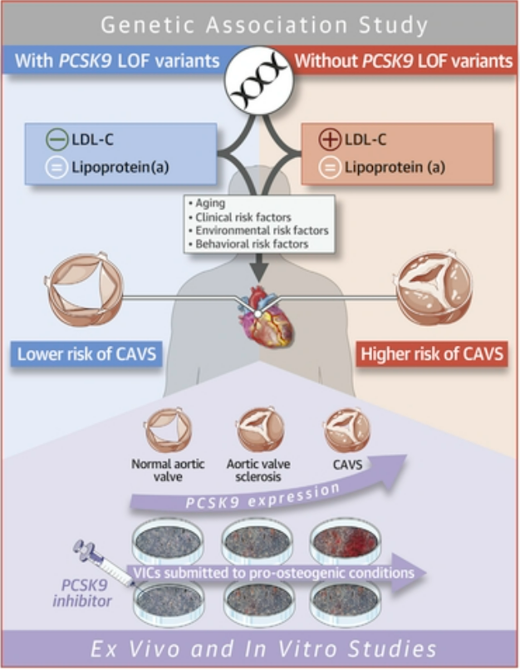
What about PCSK-9 and aortic valve disease?

Slide 26
PCSK9 and Calcific Aortic Valve Stenosis
Meta-analysis of 10 studies was performed to determine the impact of the PCSK9 R46L variant on CAVS
CAVS was less prevalent in carriers of this variant compared with noncarriers
OR: 0.80 [0.70 to 0.91]; p < 0.0011
PCSK9 expression was higher in the aortic valves of patients CAVS compared with control patients.
In human valve interstitial cells submitted to a pro-osteogenic medium, PCSK9 levels increased and a PCSK9 neutralizing antibody significantly reduced calcium accumulation.
Perrot, N., Valerio, V., Moschetta, D., Genetic and In Vitro Inhibition of PCSK9 and Calcific Aortic Valve Stenosis. JACCC: Basic to translational Science Vol. 5, NO. 7. 2020

Slide 27
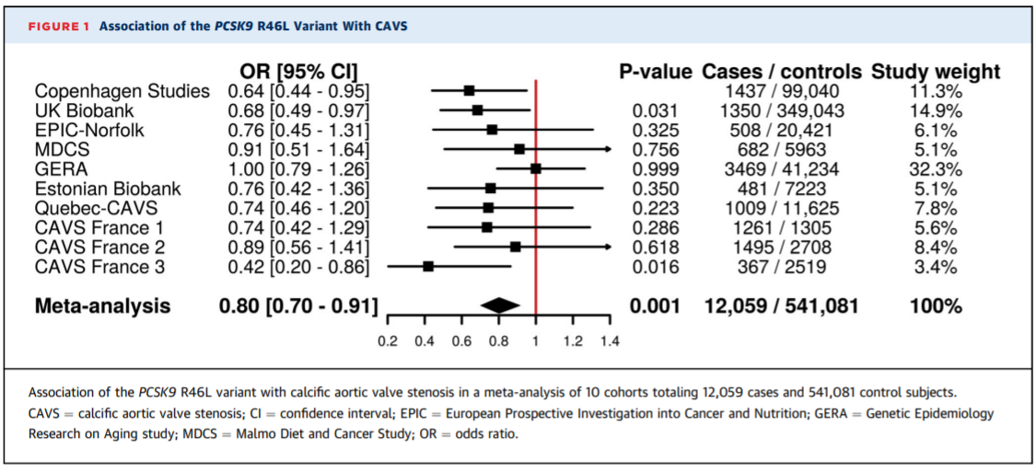
PCSK9 and Calcific Aortic Valve Stenosis
Perrot, N., Valerio, V., Moschetta, D., Genetic and In Vitro Inhibition of PCSK9 and Calcific Aortic Valve Stenosis. JACCC: Basic to translational Science Vol. 5, NO. 7. 2020

Slide 28
PCSK9 and Calcific Aortic Valve Stenosis
This large genetic association study as well as a series of experiments showing that variation in PCSK9 is linked with low cholesterol levels and protection against CAVS and that PCSK9 expression was higher in explanted aortic valves from patients with versus without CAVS.
PCSK9 expression and secretion were induced by an exposure to a pro-osteogenic milieu and a PCSK9 neutralizing antibody reduced valve interstitial cell (VIC) calcium levels by more than 50%, thereby providing experimental support to findings.
Perrot, N., Valerio, V., Moschetta, D., Genetic and In Vitro Inhibition of PCSK9 and Calcific Aortic Valve Stenosis. JACCC: Basic to translational Science Vol. 5, NO. 7. 2020

Slide 29
PCSK9 and Calcific Aortic Valve Stenosis
Results highlight the potential role of PCSK9 in the etiology of CAVS, the ultimate proof of causality and clinical benefit would be a clinical trial showing that PCSK9 inhibition is linked with a reduction in valvular outcomes.
PCSK9 Inhibitors in the Progression of Aortic Stenosis
An ongoing trial is currently testing the hypothesis that PCSK9 inhibition will reduce aortic valve macrocalcification (CT) and microcalcification (PET) in patients with mild-to-moderate CAVS
Perrot, N., Valerio, V., Moschetta, D., Genetic and In Vitro Inhibition of PCSK9 and Calcific Aortic Valve Stenosis. JACCC: Basic to translational Science Vol. 5, NO. 7. 2020

Slide 30
PCSK9 and Calcific Aortic Valve Stenosis
BaleDoneen Take-Away:
Calcific Aortic Valve Stenosis is strongly associated with lipo(a)
Do a thorough cardiac murmur exam and getting a baseline echocardiogram for evaluation is ideal.
Utilize our tools to “watch” the health of the heart – NT-ProBNP, HsTn, Galectin-3, ST2.
Niacin remains the only treatment formally indicated for lipo(a) reduction and is being studied regarding CAVS.
There is an association with genetic variant of PCSK9 and CAVS – data is being evaluated to determine if the inhibition of PCSK9 yields improvement.
Family history and physical exam are extremely important in Lipo(a) pts.
Perrot, N., Valerio, V., Moschetta, D., Genetic and In Vitro Inhibition of PCSK9 and Calcific Aortic Valve Stenosis. JACCC: Basic to translational Science Vol. 5, NO. 7. 2020

Slide 31
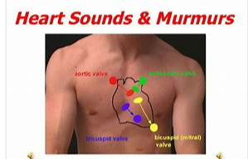
Considering the data with lipo(a) and Aortic valve calcification – what about the physical exam?
Is the hands-on exam a thing of the past?
Aortic regurgitation is a soft, high-pitched, early diastolic decrescendo murmur heard best at the 3rd intercostal space on the left on end expiration, with the patient sitting up and leaning forward.

Slide 32
The Disappearance of the Primary Care Physical Exam- Losing Touch
Dr. Hyman, a primary care physician of 15 years, states that he laments over the following:
The fact that accountable care organizations emphasize on increasing volume and
Medicare annual wellness visits do not require a physical examination
Some groups recommend against routine physical examinations in asymptomatic patients
Hyman, P. (2020). The disappearance of the primary care physical examination- losing touch. JAMA Intern Med. 2020;180(11):1417-1418

Slide 33
The Disappearance of the Primary Care Physical Exam- Losing Touch
Hyman eloquently reflects upon the physical exam:
“The physical examination remains one of the few domains where I maintain a sense of professional skill and authority. The mainstay of what I offer to patients is the ability to listen to them, to use critical thinking skills, and to offer my knowledge and experience. But those skills are sometimes challenged in a world where patients research their own health and develop their own medical narratives. The physical examination remains a place where I offer something of distinct value that is appreciated.”
Hyman, P. (2020). The disappearance of the primary care physical examination- losing touch. JAMA Intern Med. 2020;180(11):1417-1418

Slide 34
The Disappearance of the Primary Care Physical Exam- Losing Touch
Virtual visits do have their own value:
It can allow the clinician and the patient the opportunity to connect more frequently and with more ease.
Seeing patients in their home environment has its own element of value – such as providing information about their surroundings and how their environment may influence health behaviors
Wearable technology and guiding patients through physical exams will demand creative approaches to gain depth into virtual medicine.
,
Hyman, P. (2020). The disappearance of the primary care physical examination- losing touch. JAMA Intern Med. 2020;180(11):1417-1418

Slide 35
The Disappearance of the Primary Care Physical Exam- Losing Touch
BaleDoneen Take-Away:
The physical exam and actual “hands-on touch” of a patient is critical to an optimal level of care.
While we do not discuss this often in our courses and update sessions, I felt the discussion about the aortic stenosis was a nice reminder on how important it is to do a proper physical exam.
Coupled with the increase in telemedicine and the fact that we get caught up in technology such as labs, biometrics, genetics, imaging, and various tests, we sometimes fail to emphasize the importance of a good, thorough, physical exam.
If a stethoscope isn’t placed on the patient’s chest, there is a 100% chance of missing any murmur ☺
Hyman, P. (2020). The disappearance of the primary care physical examination- losing touch. JAMA Intern Med. 2020;180(11):1417-1418

Slide 36
Let’s Discuss the RNA Therapeutic Agents to lower blood levels of Lp(a).

Slide 37
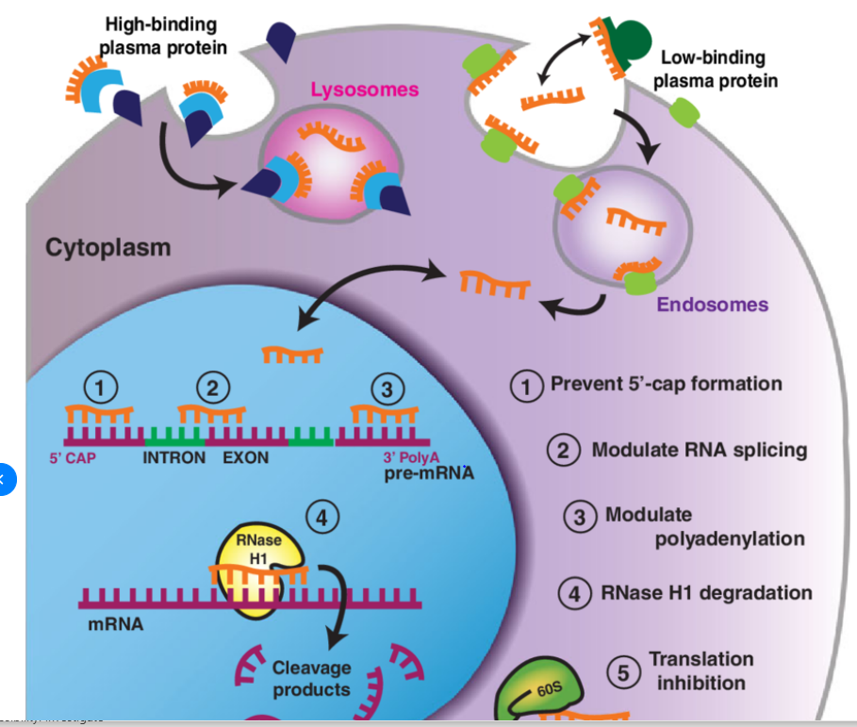
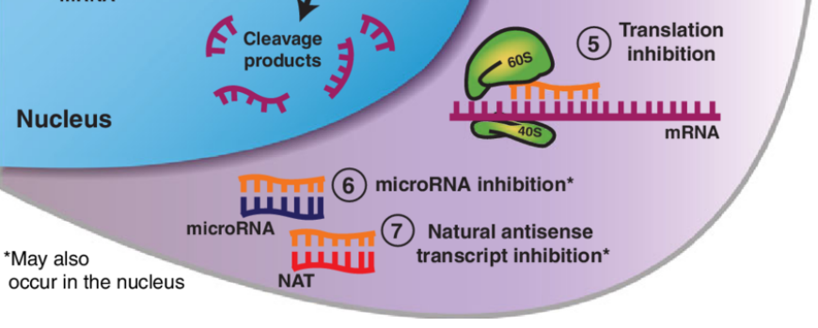
Antisense Gene Therapy
Single-stranded pieces of chemically modified nucleotides, known as oligonucleotides are inserted into cells.
They are chemically engineered to be complimentary to specific mRNA in the cell.
www://hopes.Stanford.edu

Slide 38
Antisense and lipo(a)
Ten RNA-targeted drugs including eight single-strand antisense drugs (ASOs) and two double strand ASOs (siRNAs) have now been approved for commercial use. They are administered by multiple routes on both rare and common diseases.
Synthetic DNA oligomers hybridize to a target RNA in a sequence-specific manner. They have successfully been employed to inhibit gene expression, modulate splicing of a precursor messenger RNA, or inactivate microRNAs.
No trials address the potential of antisense/lipo(a)/aortic valve stenosis at this time.
Crooke, S., Liang, Xue-Hai, Baker, B., Crooke, R., (2021). Antisense technology: A review. J. Biol. Chem. (2021) 296 100416

Slide 39
Pelacarsen to reduce lipo(a)

Slide 40
RNA Therapeutics to Lower Blood Levels of Lp(a)
Elevated blood levels of Lp(a) are a risk factor for atherosclerotic CVD and aortic stenosis, but currently there is no approved therapy.
  RNA therapeutics targeting hepatic synthesis of apolipoprotein(a) are under development.
  Multiple trials, including the phase 3 Lp(a)-HORIZON trial, are in progress to test the hypothesis that lowering Lp(a) could reduce cardiovascular risk.
Tsimikas S, Moriarty PM, Stroes ES. Emerging RNA Therapeutics to Lower Blood Levels of Lp(a): JACC Focus Seminar 2/4. J Am Coll Cardiol. 2021 Mar 30;77(12):1576-1589..

Slide 41
RNA Therapeutics to Lower Blood Levels of Lp(a)
Inhibiting apolipoprotein(a) production in the hepatocyte with ribonucleic acid therapeutics has emerged as an elegant and effective solution to reduce plasma Lp(a) levels.
Phase 2 clinical trials have shown that the antisense oligonucleotide Pelacarsen reduces mean Lp(a) levels by 80%, allowing 98% of subjects to reach on-treatment levels of <125 nmol/l (∼50 mg/dl).
Tsimikas S, Moriarty PM, Stroes ES. Emerging RNA Therapeutics to Lower Blood Levels of Lp(a): JACC Focus Seminar 2/4. J Am Coll Cardiol. 2021 Mar 30;77(12):1576-1589..

Slide 42
RNA Therapeutics to Lower Blood Levels of Lp(a)
The phase 3 Lp(a) HORIZON
(Assessing the Impact of Lipoprotein(a) Lowering With TQJ230 on Major Cardiovascular Events in Patients With CVD)
Outcome trial is currently enrolling approximately 7,680 patients with history of MI, ischemic stroke, and symptomatic and PAD controlled LDL to Pelacarsen versus placebo.
Additional ribonucleic acid–targeted therapies to lower Lp(a) are in preclinical and clinical development. The testing of the Lp(a) hypothesis will provide proof whether Lp(a)-mediated risk can be abolished by potent Lp(a) lowering.
Tsimikas S, Moriarty PM, Stroes ES. Emerging RNA Therapeutics to Lower Blood Levels of Lp(a): JACC Focus Seminar 2/4. J Am Coll Cardiol. 2021 Mar 30;77(12):1576-1589..

Slide 43
RNA Therapeutics to Lower Blood Levels of Lp(a)
BaleDoneen Take-Away:
Mipomersen is an injectable and is indicated as a conjunctive therapy for HoFH – Homozygous Familial Hypercholesterolemia
Pelacarsen may be a treatment in the future indicated specifically for lipo(a) reduction.
The BaleDoneen Method has used combination of statin/niacin for arterial disease with the root cause of lipo(a) for decades with tremendous success. Niacin remains only indicated tx for Lp(a) - EAS
Both Niacin and PCSK9 Inhibitors are being studied independently to determine their impact on Calcific Aortic Valve Disease.
Tsimikas S, Moriarty PM, Stroes ES. Emerging RNA Therapeutics to Lower Blood Levels of Lp(a): JACC Focus Seminar 2/4. J Am Coll Cardiol. 2021 Mar 30;77(12):1576-1589..

Slide 44

Let’s shift gears and talk about the very important root cause: Psychosocial Health

Slide 45
Mental health is of increased concern during the Covid-19 Pandemic
The purpose of this study was to conduct a comprehensive and systematic national assessment of the prevalence of depression and anxiety in the adult US population during the Covid Pandemic.
Multi-item, valid and reliable questionnaire was deployed online and social media sites to recruit adult US participants in the general population across the USA.
A total of 1978 individuals participated in the study, where the majority were: females (51%), whites (74%), non-Hispanic (81%), married (56%), employed full time (68%) and with a bachelor’s degree or higher (78%).
Khubchandani J, Sharma S, Webb FJ, Wiblishauser MJ, Bowman SL. Post-lockdown depression and anxiety in the USA during the COVID-19 pandemic. J Public Health (Oxf). 2021 Jun 7;43(2):246-253.

Slide 46
Mental health is of increased concern during the Covid-19 Pandemic
The prevalence of depression (39%), anxiety (42%) and psychological distress (39%) were computed from the PHQ-4 scale.
Depression, anxiety and psychological distress burden (assessed by PHQ-4 scale) was predicted significantly based on race, ethnicity, age, having children at home, employment as a healthcare worker, annual household income and area of residence.
Males were more likely to have depression, and females were more likely to have anxiety symptoms.
Khubchandani J, Sharma S, Webb FJ, Wiblishauser MJ, Bowman SL. Post-lockdown depression and anxiety in the USA during the COVID-19 pandemic. J Public Health (Oxf). 2021 Jun 7;43(2):246-253.

Slide 47
Mental health is of increased concern during the Covid-19 Pandemic
Given the high prevalence of depression and anxiety, interdisciplinary and multisectoral approaches are recommended in the USA along with population-based interventions on mental health improvement.
Khubchandani J, Sharma S, Webb FJ, Wiblishauser MJ, Bowman SL. Post-lockdown depression and anxiety in the USA during the COVID-19 pandemic. J Public Health (Oxf). 2021 Jun 7;43(2):246-253.

Slide 48


Fishing with a pole or a net?
What is best way to screen for a mental health issue?

Slide 49
What is Connected Mind Fast Check? (CMFC)
“Simple screening compared to a cross cutting tool (Connected Mind) is like fishing with a fishing pole vs fishing with a net.
When providers think depression may be a concern, they often fish with a PHQ-9 or for anxiety, they fish with a GAD-7.
The issue is that mental health is a spectrum, and it is almost impossible to know what someone is dealing with in a brief conversation or just by looking at the patient. That is why Connected Mind (CM) was designed to fish with a net.
CMFC evaluates for the 6 most common connected mental health conditions that are affecting patients, often at the same time. This makes it much more likely that we catch what is going on with the patient.”
Christian Lehinger – developer of Connected Mind Fast Check.

Slide 50
Mental Health: Connected Mind Fast Check
Globally, mental disorders continue to increase with an estimated 264 million people functionally impaired by depression alone (James et al., 2018).
According to World Health Organization (WHO), most persons with mental disorders, including those in the USA, remain untreated in medical and psychiatric settings.
The National Institute of Mental Health (NIMH, 2020) identified over 46 million adults that were diagnosed with at least one serious mental disorder.
Rogers R, Hartigan SE, Sanders CE. Identifying Mental Disorders in Primary Care: Diagnostic Accuracy of the Connected Mind Fast Check (CMFC) Electronic Screen. J Clin Psychol Med Settings. 2021 Oct 5:1–15.

Slide 51
Mental Health: Connected Mind Fast Check
Diagnostic severity with its functional impairment must also be considered. 82.9% of persons with bipolar disorders were classified at the highest level of severity.
Lifetime prevalence for four diagnostic categories:
28.8% for anxiety disorders
24.8% for impulse control disorders
20.8% for mood disorders
14.6% for substance use disorders
Rogers R, Hartigan SE, Sanders CE. Identifying Mental Disorders in Primary Care: Diagnostic Accuracy of the Connected Mind Fast Check (CMFC) Electronic Screen. J Clin Psychol Med Settings. 2021 Oct 5:1–15.

Slide 52
Health: Connected Mind Fast Check
Lehinger and his multidisciplinary team of psychologists, developed a mental health screen in 2017 (https://connectedmind. me)
The CMFC assesses six common mental disorders frequently found in primary care:
________________________________________________________________________
1. Major Depressive Disorders (MDD)
2. Anxiety Disorders - focus on Generalized Anxiety Disorder (GAD)
3. Bipolar Disorders
4. Attention-Deficit/Hyperactivity Disorders (ADHD)
5. Somatic Symptom Disorders
6. Substance and Alcohol Use Disorders
Rogers R, Hartigan SE, Sanders CE. Identifying Mental Disorders in Primary Care: Diagnostic Accuracy of the Connected Mind Fast Check (CMFC) Electronic Screen. J Clin Psychol Med Settings. 2021 Oct 5:1–15.

Slide 53
Mental Health: Connected Mind Fast Check
The cross-sectional, prospective design evaluated diagnostic accuracy and comorbidity at five PCP settings.
As the index test, the effectiveness of the CMFC Initial Screen and standard assessment modules (SAMs) in identifying common mental disorders was tested using SCID-RV diagnoses as the diagnostic reference standard.
Rogers R, Hartigan SE, Sanders CE. Identifying Mental Disorders in Primary Care: Diagnostic Accuracy of the Connected Mind Fast Check (CMFC) Electronic Screen. J Clin Psychol Med Settings. 2021 Oct 5:1–15.

Slide 54
Mental Health: Connected Mind Fast Check
The final sample consisted of 149 female and 85 male patients
(average age 47 (18-82 years)
European American (74.7%), African American (11.0%), Hispanic American (9.4%), and Multiracial (4.9%).
48.1% married, 30.9% never married, 16.3% divorced, and 4.7% other/unreported.
42.3% had been treated for a specific mental disorder with a much smaller but appreciable percent (15.8%) being psychiatrically hospitalized.
Rogers R, Hartigan SE, Sanders CE. Identifying Mental Disorders in Primary Care: Diagnostic Accuracy of the Connected Mind Fast Check (CMFC) Electronic Screen. J Clin Psychol Med Settings. 2021 Oct 5:1–15.

Slide 55
Mental Health: Connected Mind Fast Check
The CMFC Initial Screen worked exceptionally well in accurately identifying patients with specific mental disorders while missing very few false negatives.
In the current study, the CMFC Initial Screen performed comparably to and sometimes stronger than traditional screens (e.g., PHQ-9) used in primary care settings.
Rogers R, Hartigan SE, Sanders CE. Identifying Mental Disorders in Primary Care: Diagnostic Accuracy of the Connected Mind Fast Check (CMFC) Electronic Screen. J Clin Psychol Med Settings. 2021 Oct 5:1–15.

Slide 56
Mental Health: Connected Mind Fast Check
The assessments performed strongly, regarding specificity with substantially improved PPP, meaning the diagnostic accuracy of identifying patients with a particular disorder increased.
Excellent specificities and NPPs indicate the SAMs correctly ruled-out most patients without these mental disorders.
The CMFC suicide screen proved effective at identifying patients with varying degrees of suicidal ideation. The inclusion of suicide risk assessment can be critically important to early and effective management.
Rogers R, Hartigan SE, Sanders CE. Identifying Mental Disorders in Primary Care: Diagnostic Accuracy of the Connected Mind Fast Check (CMFC) Electronic Screen. J Clin Psychol Med Settings. 2021 Oct 5:1–15.

Slide 57
Case Illustration:
I have been using the Connected Mind Screening tool for several years on all new patients to evaluate for the root of psychosocial health.
Last week, considering the previous data discussed, I decided to begin using it on all patients starting 11/2/2021.

Slide 58
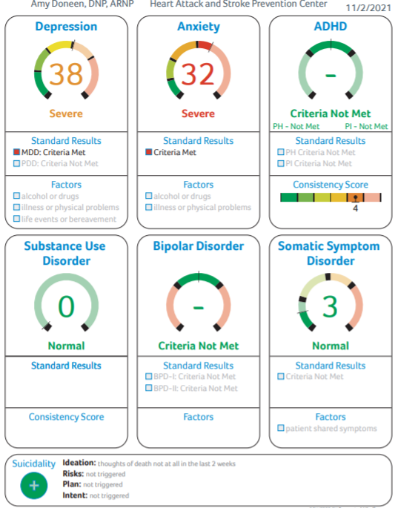
67-year-old female – in for her quarterly visit at 8 am on 11/2/21. Nancy has children and grandchildren in Europe that she has not been able to see for almost 2 years due to the Pandemic. I have worked with Nancy for approximately 15 years, and she usually visits them every 6 months.
Nancy had more of a flat affect the day she came in (which isn’t like her). I asked her how she was feeling, and she said, “I don’t know”…..”I’m tired”…..”I really miss the kids”.
I had her do a Connected Mind Quick Screen letting her know that my intent was to run this screen annually (or sooner as necessary). Nancy has NO history of depression or anxiety.

Slide 59
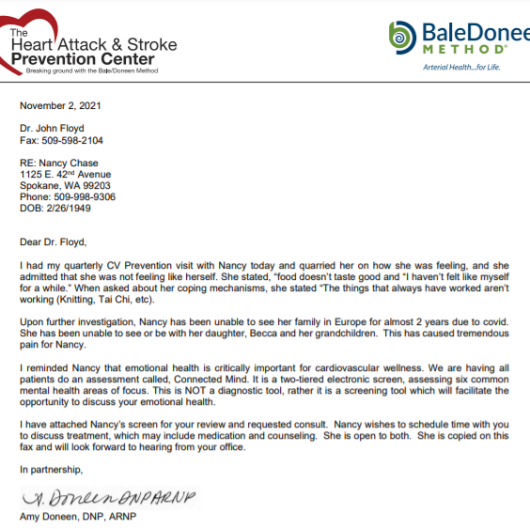
Nancy saw her PCP the next day and she has been referred to a counselor with a f/u appointment in 2 weeks to re-evaluate.

Slide 60
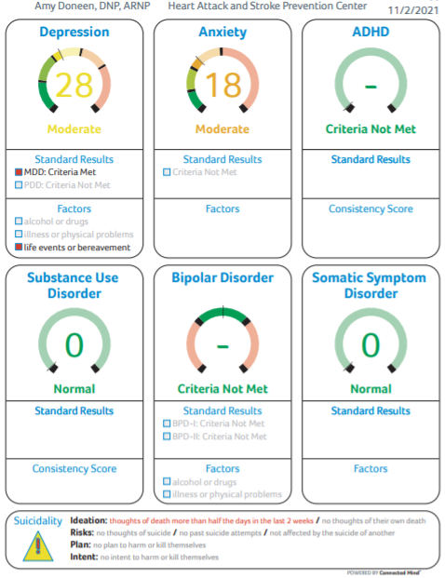
My next patient the same day – 9 am on 11/2/21:
56 y.o. female. She was a zoom along with her husband. I had them both do screens via telemedicine and had them prior to their visit.
Our focus of the meeting became her emotional health and upon further investigation, I learned that she had lost her mom in August and her best friend last week.
The screen picked up that her depression might be triggered by “life events or bereavement” which fit perfectly into her current situation.
Again – discussed the importance of recognizing her current state of mind and called her PCP and Bereavement counseling was started immediately with close follow-up.

Slide 61

Fortunately, the Connected Mind Screens did not show any areas of concern for the rest of the day!

Slide 62
Mental Health: Connected Mind Fast Check
BaleDoneen Take-Away:
Go to www.connectedmind.me and request a demo.
Psychosocial health is a root cause of CVD.
This test is reimbursable with insurance companies if your office is contracted with insurance companies.
Reliable, effective screening tools to use in all settings is important
While interviewing and discussion is always the best, objectifying the situation so that follow-up evaluation can be performed is helpful (both for the patient and the clinician).
Fish with a net when screening for mental health
Rogers R, Hartigan SE, Sanders CE. Identifying Mental Disorders in Primary Care: Diagnostic Accuracy of the Connected Mind Fast Check (CMFC) Electronic Screen. J Clin Psychol Med Settings. 2021 Oct 5:1–15.

Slide 63

Identifying depression/anxiety in the dental office

Slide 64
Oral Behavior and Anxiety & Depression
The aim of this study was to investigate the association of oral behaviors (OBs) with anxiety, depression, and jaw function in patients with temporomandibular disorders (TMDs).
This cross-sectional study examined the OB characteristics of patients with TMDs in China and further evaluate their correlation with jaw function, pain, mouth opening, depression, and anxiety
Xu L, Cai B, Fan S, Lu S, Dai K. Association of Oral Behaviors with Anxiety, Depression, and Jaw Function in Patients with Temporomandibular Disorders in China: A Cross-Sectional Study. Med Sci Monit. 2021 May 17;27:e929985.

Slide 65
Oral Behavior and Anxiety & Depression
Temporomandibular disorders (TMDs) are a group of diseases with complex pathogenic factors, including malocclusion, craniofacial trauma, neurological and psychological factors, and oral behaviors (OBs).
Oral parafunctions, mainly refer to activities other than normal oral physiological functions - chewing gum, clenching teeth, biting nails, and leaning the jaw on the hand, which may lead to TMDs.
Xu L, Cai B, Fan S, Lu S, Dai K. Association of Oral Behaviors with Anxiety, Depression, and Jaw Function in Patients with Temporomandibular Disorders in China: A Cross-Sectional Study. Med Sci Monit. 2021 May 17;27:e929985.

Slide 66
Oral Behavior and Anxiety & Depression
A total of 537 patients diagnosed with TMD were included in this study (average age, 32±12 years; 86 men [16.0%] and 451 women [84.0%]).
There were 31 cases of masticatory muscle pain, 459 cases of disc displacement, and 13 cases of arthralgia/arthrosis, and 34 cases were uncategorized.
Patients were assessed using the Oral Behaviors Checklist (OBC), Jaw Functional Limitation Scale (JFLS), Generalized Anxiety Disorder-7 (GAD-7) scale, and Patient Health Questionnaire-9 (PHQ-9).
Xu L, Cai B, Fan S, Lu S, Dai K. Association of Oral Behaviors with Anxiety, Depression, and Jaw Function in Patients with Temporomandibular Disorders in China: A Cross-Sectional Study. Med Sci Monit. 2021 May 17;27:e929985.

Slide 67
Oral Behavior and Anxiety & Depression
The total GAD-7 score ranges from 0 to 21, and the total PHQ-9 score ranges from 0 to 27.
Anxiety defined as GAD-7 score >10.
Depression defined as PHD-9 score >10.
Depression and anxiety symptoms were observed in 14.5% and 10.2% of patients with TMDs, respectively.
Xu L, Cai B, Fan S, Lu S, Dai K. Association of Oral Behaviors with Anxiety, Depression, and Jaw Function in Patients with Temporomandibular Disorders in China: A Cross-Sectional Study. Med Sci Monit. 2021 May 17;27:e929985.

Slide 68
Oral Behavior and Anxiety & Depression
Common Oral Behaviors in patients with TMDs:
Putting pressure on the jaw (52.9%)
Chewing food on 1 side (47.5%)
Holding teeth together during activities other than eating (33.3%)
The OBC scores were significantly correlated with the PHQ-9, and GAD-7 scores (P<0.01).
Patients with TMDs exhibit specific OBs, which are associated with depression, anxiety, and jaw function.
Xu L, Cai B, Fan S, Lu S, Dai K. Association of Oral Behaviors with Anxiety, Depression, and Jaw Function in Patients with Temporomandibular Disorders in China: A Cross-Sectional Study. Med Sci Monit. 2021 May 17;27:e929985.

Slide 69
Oral Behavior and Anxiety & Depression
BaleDoneen Take-Away:
The Connected Mind Quick Screen is a tool that could also be used in the dental office.
The physical exam obtained in the dental office can provide important clues into the mental health of the patient.
This is one more element to the depth of collaboration into the oral/systemic connection.
It would be wonderful for a BaleDoneen Oral Health Provider to offer a short course for our medical providers on how to evaluate and properly exam the oral cavity for TMD.
Consider the CMFS – www.connectedmind.me
Xu L, Cai B, Fan S, Lu S, Dai K. Association of Oral Behaviors with Anxiety, Depression, and Jaw Function in Patients with Temporomandibular Disorders in China: A Cross-Sectional Study. Med Sci Monit. 2021 May 17;27:e929985.

Slide 70

Upcoming Talks and Exciting Activities
Brad and Amy speaking at the Pacific Dental Meeting in Phoenix Arizona this weekend – Saturday November 14, 2021
Book is on schedule! Pre-sale Orders on Amazon help drive it to the NY Best Seller List. Little Brown, Spark is excited about the early attention! Amazon.com!
The Heart Attack & Stroke Prevention Center and the BaleDoneen Academy are on track to be in our new building in February – look for an invite to an open house and book signing!

Slide 71
Praise for Healthy Heart, Healthy Brain:
“I’ve not only used the BaleDoneen method, but I’ve seen it work with my former patients. A comprehensive yet personalized approach to identifying and eliminating inflammation, Healthy Heart, Healthy Brain is a roadmap to the future of cardiovascular disease management. A true practice changer, this is sure to be one of the most compelling books you’ve read in years!”
–– Sean Conley, DO, FACEP, CDR, MC, USN, White House Physician, ‘2016-21’, Physician to the President, ‘2018-21’
"Healthy Heart, Healthy Brain summons us to reclaim our health. With simple screening tests and diagnostics, it revolutionizes our idea of preventative medicine as well our concepts about holistic health. No longer do you need to go to a different specialist for every body part when you take Drs. Bale and Doneen’s approach. If you care about your health and longevity, you’re going to want to read this book.”
–– Edward Mylett, author of #MaxOut Your Life
"Healthy Heart, Healthy Brain is a life-saving book! I would know –– I am alive today because of Bale and Doneen’s extraordinary work. Providing me with top-notch medical advice and treatments for over a decade, they continue to open our eyes to the insidious ways cardiovascular disease can creep into our lives by examining everything from oral health, diets, and sleep patterns to provide precise, extensive, and approachable advice for anyone who picks this book up.”
–– Dr. Jeff Life, author of The Life Plan Diet

Slide 72
Praise for Healthy Heart, Healthy Brain:
“Based in the most cutting-edge and formative science, Healthy Heart, Healthy Brain unravels cardiovascular disease in a holistic and personalized manner. [It has] practical advice and simple tricks based upon their revolutionary BaleDoneen Method, which has been meticulously developed over the past two decades–– you won’t regret getting your hands on this book!”
–– Robert G. Darling, MD, FACEP, FFSEM, White House Physician, ‘96-’99, Founder & Chief Medical Officer of Patronus Medical
“Healthy Heart, Healthy Brain will help you change your body, heart and mind. I can’t recommend this groundbreaking book from Bale and Doneen enough. Fascinating and filled with so much actionable information, you’ll want to read every page.”
–– Daniel G. Amen, MD, author of Change Your Brain, Change Your Life and You, Happier

