Slide 1
Scientific Update Session
November 2019
Amy Doneen DNP

Slide 2
I want to welcome those who are new to our monthly scientific update sessions. Remember – you can go back and view at anytime.

Slide 3
Outline for November 2019 Scientific Update session – Study Club ☺
Red Flags - Bulimia Nervosa
Red Flag for IR and CAD risk - Acanthosis Nigricans
Influenza worsens prognosis of MI
Tith, R., Paradis, G., Potter, B., et al. (2019). Association of bulimia nervosa with long-term risk
of cardiovascular disease and mortality among young women. JAMA Psychiatry.
Published online October 16, 2019.
Marchand, L, Gaimard, M., Luyton, C. (2019). All about skin manifestations of insulin resistance and type 2 diabetes: acanthosis nigricans and acrochordons. Postgraduate Medical Journal10.1136.
Vejpongsa, P., Kitkungvan, D., Madjid, M., et al. (2019). Outcomes of Acute Myocardial Infarction in
Patients with Influenza and Other Viral Respiratory Infections. The American Journal of Medicine,
Vol 132, No 10, October 2019

Slide 4
ARBS and Suicide Risk
Fibrates – A rebirth?
Hs-Troponin – This is in our wheelhouse!
Mamdani, M., Gomes, T., Greaves, S., et al. (2019). Association Between Angiotensin-Converting Enzyme Inhibitors, Angiotensin Receptor Blockers, and Suicide. JAMA Network Open. 2019;2(10). October 19, 2019 online.
Phillips, M.I. & de Oliveira, E.M. J Mol Med (2008) 86: 715
Vian J, Pereira C, Chavarria V, et al. The renin-angiotensin system: a possible new target for depression. BMC Med. 2017;15(1):144. Published 2017 Aug 1. doi:10.1186/s12916-017-0916-3
Berk M, Williams LJ, Jacka FN, et al. So depression is an inflammatory disease, but where does the inflammation come from?. BMC Med. 2013;11:200. Published 2013 Sep 12. doi:10.1186/1741-7015-11-200
Kim, N., Hoon, K., Choi, J., et al. (2019). Use of fenofibrate on cardiovascular outcomes in statin users with metabolic syndrome: propensity matched cohort study. BMJ 2019;366:l5125
McCarthy, C., Raber, I., Chapman, A., et al. (2019). Myocardial Injury in the Era of High-Sensitivity Cardiac Troponin Assays. JAMA Cardiology October 2019 Vol 4, No10. 1034-1041.

Slide 5
Low Vitamin D associated with Low T –
Clopidogrel and PCY2C19
Leisure Time Running Prevents T2DM
20year follow-up with statins in children with FH
Chen, C., Zhai, H., Cheng, J., et al. (2019). Causal link between vitamin D and total testosterone in men: a mendelian randomization analysis. J Clin Endocrinol Metab, 104(8):3148–3156
Roden, D. (2019). Editorial. Clopidogrel pharmacogenetics – why the wait? n engl j med 381;17 nejm.org October 24, 2019
Wang, Y., Lee, D., Brellenthin, A., et al. (2019). Leisure-time running reduces risk of incident Type 2 DM. The Am J Med. 132:1225-1232
Luirink, I., Wiegman, A., Kusters, D., et al (2019). 20-year follow-up of statins in children with familiar hypercholesterolemia. New Eng J. Med 381;1547-56.

Slide 6
What I couldn’t cover today due to time constraints - ☹ Never enough time!
MR of the Carotid
Sex Differences in MI Symptoms and Treatment
Mental Stress increases MI risk
Subclinical Thyroid Management
Heart Failure meds in women vs men
Uric Acid and ACS risk – a Chinese population.

Slide 7
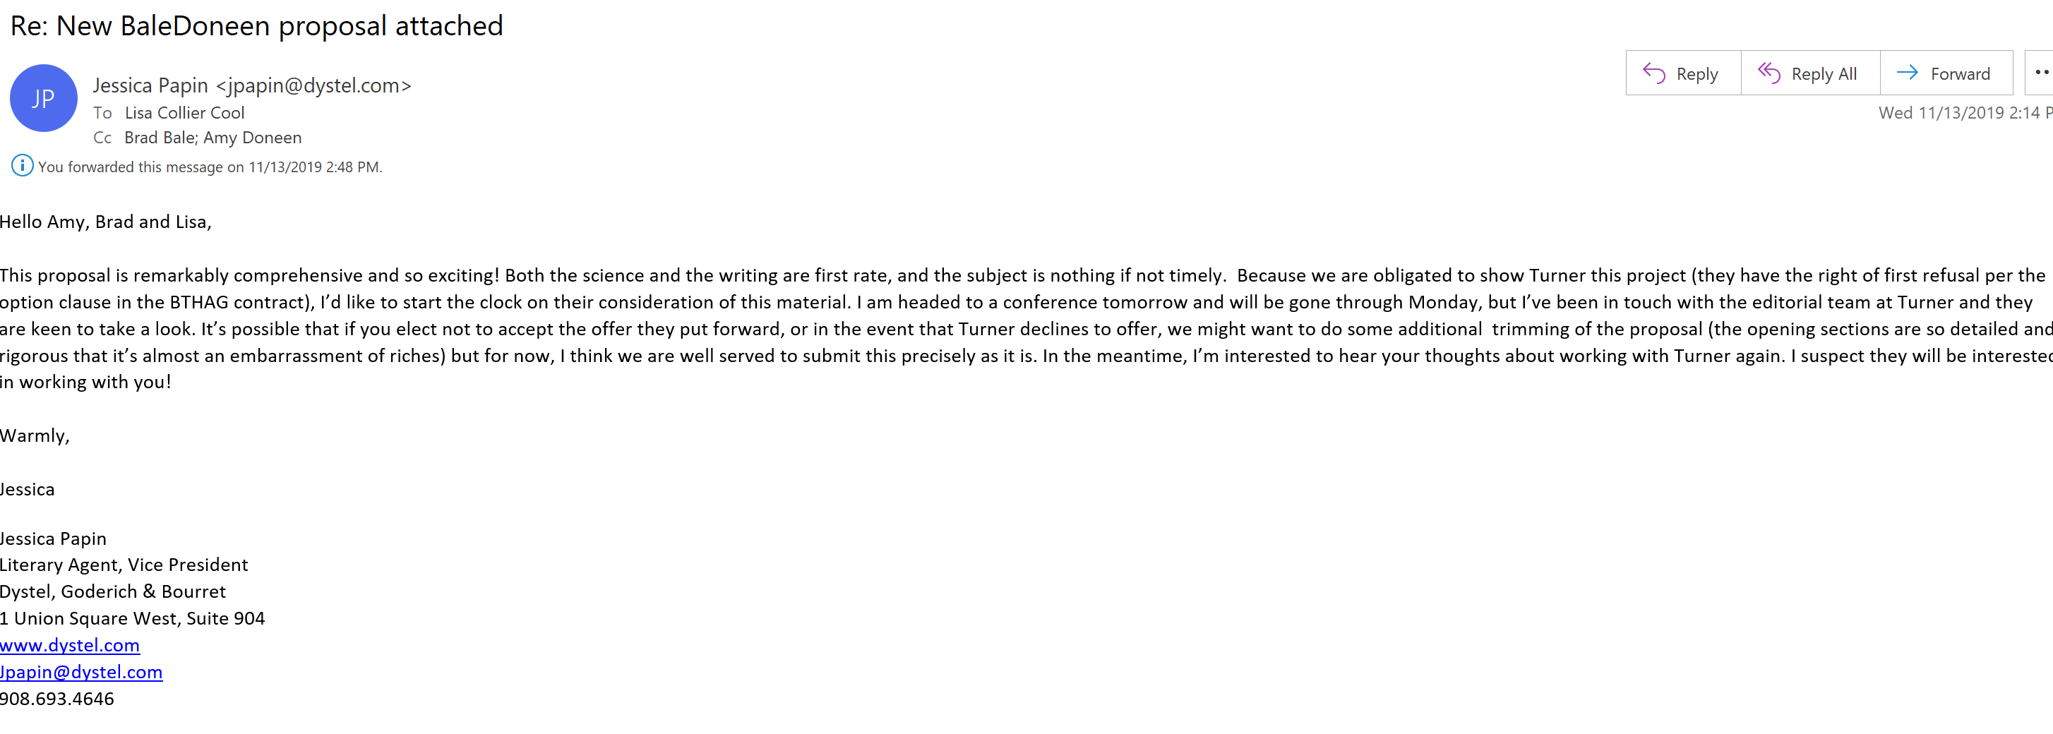
We are so excited to share some news that I don’t want to wait until the end of the program!

Slide 9
Red Flag – Bulimia Nervosa
The registry includes discharge abstracts of all hospitalizations in Quebec and contains up to 41 diagnostic codes and 35 procedure codes for each admission.
Identified women who were hospitalized for bulimia nervosa between 2006 and 2016 in Quebec. Mean age 28.3 + 13 years for both groups. Comparison group comprising women who were hospitalized for a pregnancy-related event.
We began following up the women at their first (index) admission and ended follow-up at the first incidence of cardiovascular disease, death, or the end of the study on March 31, 2018, which ever occurred first.
Prospective 12-year review
Tith, R., Paradis, G., Potter, B., et al. (2019). Association of bulimia nervosa with long-term risk
of cardiovascular disease and mortality among young women. JAMA Psychiatry.
Published online October 16, 2019.

Slide 10
Red Flag – Bulimia Nervosa
Tith, R., Paradis, G., Potter, B., et al. (2019). Association of bulimia nervosa with long-term risk
of cardiovascular disease and mortality among young women. JAMA Psychiatry.
Published online October 16, 2019.

Slide 11
Red Flag – Bulimia Nervosa
Women hospitalized for Bulimia Nervosa have a 5-fold increase risk of CV death over 12-years.
Tith, R., Paradis, G., Potter, B., et al. (2019). Association of bulimia nervosa with long-term risk
of cardiovascular disease and mortality among young women. JAMA Psychiatry.
Published online October 16, 2019.

Slide 12
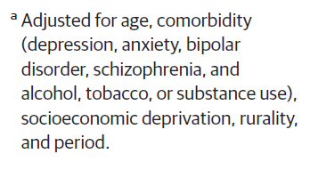
Red Flag – Bulimia Nervosa
Tith, R., Paradis, G., Potter, B., et al. (2019). Association of bulimia nervosa with long-term risk
of cardiovascular disease and mortality among young women. JAMA Psychiatry.
Published online October 16, 2019.

Slide 13
Red Flag – Bulimia Nervosa
BaleDoneen Take-Away:
Bulimia Nervosa is associated with increased adverse CV outcomes, including myocardial infarction, other ischemic heart disease, atherosclerosis, and conduction disorders.
Patients with history of Bulimia Nervosa should receive a full BaleDoneen CV Screening as soon as possible and be under the care of a BDM CV preventative provider throughout their lifetime.
Concerned that men were not included in the trial – this condition affects both men and women.
Bulimia Nervosa should be added to the health and history form in both medical and dental practices.
Bulimia Nervosa can create devastating dental issues due to the chronic binge/purge cycle – leading to dental caries and overall poor oral health. This was not examined in this trial. Refer all bulimia patients to a BDM Oral health Provider for full 3D and Pathogen testing.
Tith, R., Paradis, G., Potter, B., et al. (2019). Association of bulimia nervosa with long-term risk
of cardiovascular disease and mortality among young women. JAMA Psychiatry.
Published online October 16, 2019.

Slide 14
Red Flags for Possible IR: History and Physical
Acanthosis Nigricans
Central adiposity
Erectile dysfunction
Ethnicity
Family history for: DM or premature CV death
Gestational diabetes
Gout
History of CVD
HR >73
BP > 110/70
Idiopathic peripheral neuropathy
Inactive lifestyle
Low weight at birth with rapid BMI increase btw 2 and 11 yo
Obesity- or brother of
Periodontal disease
Pre-eclampsia
Sleep deficiency

Slide 15
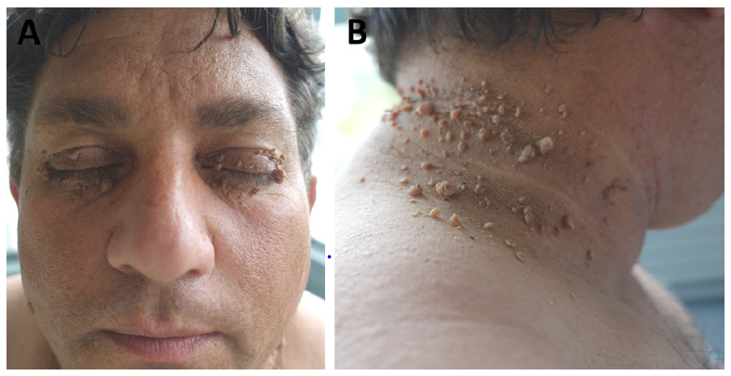
Acanthosis Nigricans – Skin manifestations of Insulin Resistance and T2DM
47-year-old Romanian man with severe hyperglycemia (HbA1c at 10.1%), leading to the diagnosis of type 2 diabetes in a context of android obesity with a BMI of 49.5 kg/m², hepatic steatosis and hypertriglyceridemia.
The patient also presented multiple acrochordons on the eyelids, neck, axillae, and groin.
Marchand, L, Gaimard, M., Luyton, C. (2019). All about skin manifestations of insulin resistance and type 2
diabetes: acanthosis nigricans and acrochordons. Postgraduate Medical Journal10.1136.

Slide 16
Acanthosis Nigricans – Skin manifestations of Insulin Resistance and T2DM
Acanthosis nigricans (B)(hyperpigmented velvety thickening of skin folds) is the most familiar cutaneous manifestation associated with insulin resistance, while acrochordon is less known.
Acrochordon (A) also called fibroepithelial polyp, molluscum pendulum or skin tag, is a pedunculated outgrowth of normal skin on a narrow stalk. Most often found on the neck and axilla, are also associated with hyperinsulinemia.
Clinicians should be aware of these cutaneous lesions, as their recognition can lead to diagnose metabolic diseases at an early stage.
Marchand, L, Gaimard, M., Luyton, C. (2019). All about skin manifestations of insulin resistance and type 2
diabetes: acanthosis nigricans and acrochordons. Postgraduate Medical Journal10.1136.

Slide 17
Acanthosis Nigricans – Skin manifestations of Insulin Resistance and T2DM
BaleDoneen Take-Away:
Advertise these in your clinic – all visual ‘red flags’ are opportunities to educate patients.
If you see this in the dental arena – refer to a medical side for proper assessment for metabolic disorders – particularly Insulin Resistance and T2DM – before doing dental surgical work – make sure you know their blood sugars.
These patients NEED an OGTT immediately (if not already diabetic).
Marchand, L, Gaimard, M., Luyton, C. (2019). All about skin manifestations of insulin resistance and type 2
diabetes: acanthosis nigricans and acrochordons. Postgraduate Medical Journal10.1136.

Slide 18
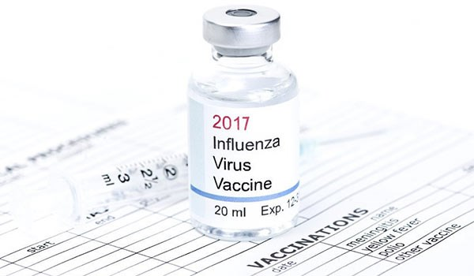

Slide 20
Influenza worsens prognosis with MI
Patients ≥18 years old with ST-elevation and non-ST-elevation myocardial infarction during January 2013-December 2014 were identified using the National Inpatient Sample.
The clinical outcomes were compared among patients who had no respiratory infection to the ones with influenza and other viral respiratory infections using propensity score-matched analysis.
Vejpongsa, P., Kitkungvan, D., Madjid, M., et al. (2019). Outcomes of Acute Myocardial Infarction in
Patients with Influenza and Other Viral Respiratory Infections. The American Journal of Medicine,
Vol 132, No 10, October 2019

Slide 21
Influenza worsens prognosis with MI
3 main outcomes –
Acute MI patients with concomitant influenza infection had a worse outcome than those with acute MI alone (in-hospital case fatality rate, development of shock, acute respiratory failure, acute kidney injury, and higher rate of blood transfusion after propensity scores).
The length of stay was significantly longer in influenza patients with acute MI.
Despite presenting with acute MI, <1/4 of patients with concomitant influenza infection underwent coronary angiography, but more than half (51.4%) required revascularization.
Vejpongsa, P., Kitkungvan, D., Madjid, M., et al. (2019). Outcomes of Acute Myocardial Infarction in
Patients with Influenza and Other Viral Respiratory Infections. The American Journal of Medicine,
Vol 132, No 10, October 2019

Slide 22
Influenza worsens prognosis with MI
Laboratory-confirmed influenza-associated hospitalization during the 2017-2018 influenza season was more than double that of the previous year, with the highest rate in adults aged ≥65 years.
Influenza infections result in substantial morbidity and mortality, particularly in elderly patients with multiple comorbidities.
An acute systemic inflammatory process during influenza infection might transiently increase the risk of cardiovascular events, including acute myocardial infarction and stroke.
It has been suggested that influenza virus itself can exert thrombotic effect and inflammatory process on atherosclerotic plaques.
Stress from acute illness might also contribute to ischemia in patients with preexisting cardiovascular disease.
Vejpongsa, P., Kitkungvan, D., Madjid, M., et al. (2019). Outcomes of Acute Myocardial Infarction in
Patients with Influenza and Other Viral Respiratory Infections. The American Journal of Medicine,
Vol 132, No 10, October 2019

Slide 23
Influenza worsens prognosis with MI
Vejpongsa, P., Kitkungvan, D., Madjid, M., et al. (2019). Outcomes of Acute Myocardial Infarction in
Patients with Influenza and Other Viral Respiratory Infections. The American Journal of Medicine,
Vol 132, No 10, October 2019

Slide 24
Influenza worsens prognosis with MI
Vejpongsa, P., Kitkungvan, D., Madjid, M., et al. (2019). Outcomes of Acute Myocardial Infarction in
Patients with Influenza and Other Viral Respiratory Infections. The American Journal of Medicine,
Vol 132, No 10, October 2019

Slide 25
Influenza worsens prognosis with MI
Despite being admitted with acute MI, only a fifth of patients with influenza infection underwent cardiac catheterization.
Why?
Often, these patients are regarded as having a type II acute MI, and are not referred for catheterization during the acute phase of an infection. However, more than half of acute MI patients with concomitant influenza infection required revascularization.
Concerns for contrast nephropathy could potentially be the reason that catheterization was deferred, as researchers found a higher incidence of acute kidney injury in acute MI patients with influenza.
Despite inherent selection bias in the patients who are referred for catheterization, it appears that coronary angiography may be underutilized in acute MI patients with influenza.
Vejpongsa, P., Kitkungvan, D., Madjid, M., et al. (2019). Outcomes of Acute Myocardial Infarction in
Patients with Influenza and Other Viral Respiratory Infections. The American Journal of Medicine,
Vol 132, No 10, October 2019

Slide 26
Influenza worsens prognosis with MI
One CV event would be prevented for every 58 patients vaccinated with influenza vaccine.
The risk of major CV events was reduced from 4.7% to 2.9% in patients with high CV risk factor burdens after influenza vaccination.
Influenza vaccine effectiveness against acute myocardial infarction to be 29% (95%CI), which is equal to or better than other preventive strategies, including statin treatment (36%), antihypertensive therapy (15%-18%), or smoking cessation intervention (26%).
Treating patients with acute influenza infection using antiviral medication was associated with significant reduction in cardiovascular events including myocardial infarction, heart failure, and cerebrovascular accident.
Vejpongsa, P., Kitkungvan, D., Madjid, M., et al. (2019). Outcomes of Acute Myocardial Infarction in
Patients with Influenza and Other Viral Respiratory Infections. The American Journal of Medicine,
Vol 132, No 10, October 2019

Slide 27
Influenza worsens prognosis with MI
BaleDoneen Take-Away:
GET yourself and your entire office vaccinated!
For patients with known CVD – GET vaccinated!
Appreciating the inflammatory burden of influenza on arterial wall health – Watch inflammatory markers diligently for ANYONE with known CVD, especially during flu season.
For patients that require intervention for CVD – monitor inflammation increase anti-inflammatory vascular therapy prior to procedure.
Appropriate diagnosis for influenza critical, as antiviral agents show improved CVD outcomes.
Remember – tell patients with ASVD – we don’t want your ARTERIES to get the flu!
Vejpongsa, P., Kitkungvan, D., Madjid, M., et al. (2019). Outcomes of Acute Myocardial Infarction in
Patients with Influenza and Other Viral Respiratory Infections. The American Journal of Medicine,
Vol 132, No 10, October 2019

Slide 29
ARBs and Suicide Risk
Angiotensin-converting enzyme inhibitors (ACEIs) and angiotensin receptor blockers (ARBs) are widely used for the management of hypertension, chronic kidney disease, heart failure, and diabetes.
These drugs lower blood pressure by modulating the renin-angiotensin aldosterone system in distinct ways.
ACE-I inhibit the conversion of angiotensin I to angiotensin II (AII)
ARBs block the binding of AII to its AII type 1 receptor, resulting in up regulation of AII and unopposed stimulation of the AII type 2 receptor.
Mamdani, M., Gomes, T., Greaves, S., et al. (2019). Association Between Angiotensin-Converting Enzyme Inhibitors, Angiotensin Receptor Blockers, and Suicide. JAMA Network Open. 2019;2(10). October 19, 2019 online.

Slide 30
ARBs and Suicide Risk
Angiotensin II (AII) does not cross the blood-brain barrier. It is generated in the central nervous system.
Its central effects include modulation of neurotransmitter release and activation of proinflammatory pathways that may influence mental health.
Because ACEI and ARBs can cross the blood-brain barrier to various degrees, these drugs may interfere with central AII activity.
The effect of these drugs on mental health outcomes, particularly suicide, is of increasing interest because of the bi-directional association between depression and cardiovascular disease.
Mamdani, M., Gomes, T., Greaves, S., et al. (2019). Association Between Angiotensin-Converting Enzyme Inhibitors, Angiotensin Receptor Blockers, and Suicide. JAMA Network Open. 2019;2(10). October 19, 2019 online.

Slide 31
ARBs and Suicide Risk
This assertion is supported by an increased risk of suicide in patients with ACE gene polymorphisms associated with higher levels of this peptide.
The mechanisms by which AII may be associated with a higher risk of suicide remain largely unclear.
Possible explanations include AII-mediated increases in substance P activity and heightened hypothalamic-pituitary-adrenal axis activity, provoking stress and anxiety.
Mamdani, M., Gomes, T., Greaves, S., et al. (2019). Association Between Angiotensin-Converting Enzyme Inhibitors, Angiotensin Receptor Blockers, and Suicide. JAMA Network Open. 2019;2(10). October 19, 2019 online.

Slide 32
ARBs and Suicide Risk
Polymorphisms associated with higher levels of AII have been associated with other mental health conditions, including major depression, bipolar disorder, panic disorder, and anxiety disorder.
Recent data suggest that users of ARBs, but not ACEIs, may have an increased risk of suicide compared with nonusers.
Study objective was to examine the association between suicide and exposure to ARBs compared with ACEIs.
Mamdani, M., Gomes, T., Greaves, S., et al. (2019). Association Between Angiotensin-Converting Enzyme Inhibitors, Angiotensin Receptor Blockers, and Suicide. JAMA Network Open. 2019;2(10). October 19, 2019 online.

Slide 33
ARBs and Suicide Risk
Population-based case-control study of individuals aged 66 years and older used administrative claims databases in Ontario, Canada, from January 1, 1995, to December 31, 2015.
Data analysis was performed from January to April 2019.
Cases were individuals who died by suicide within 100 days of receiving an ACEI or ARB.
Mamdani, M., Gomes, T., Greaves, S., et al. (2019). Association Between Angiotensin-Converting Enzyme Inhibitors, Angiotensin Receptor Blockers, and Suicide. JAMA Network Open. 2019;2(10). October 19, 2019 online.

Slide 34
ARBs and Suicide Risk
Findings suggest a possible increased risk of suicide associated with the use of ARBs compared with ACEIs among adults aged 66 years and older
Mamdani, M., Gomes, T., Greaves, S., et al. (2019). Association Between Angiotensin-Converting Enzyme Inhibitors, Angiotensin Receptor Blockers, and Suicide. JAMA Network Open. 2019;2(10). October 19, 2019 online.

Slide 35
ARBs and Suicide Risk
Why? Is it all about the possible increased levels of substance P thus promoting stress and anxiety?
Animal studies have found that AII induces panic and stress when injected into stress-sensitive brain structures such as the dorsomedial hypothalamus and amygdala.
However, because these effects were reversible after AII type 1 receptor blockade with an ARB, it is unlikely that this is the mechanism associating these drugs with suicide.
Mamdani, M., Gomes, T., Greaves, S., et al. (2019). Association Between Angiotensin-Converting Enzyme Inhibitors, Angiotensin Receptor Blockers, and Suicide. JAMA Network Open. 2019;2(10). October 19, 2019 online.

Slide 36
ARBs and Suicide Risk
Or could it be the inflammatory response through the pathway of NF-kB?
Another possible explanation for a higher risk of suicide among users of ARBs is associated with the upregulation of AII and resulting unopposed stimulation of AII type 2 receptors.
These effects have been associated with nuclear factor–κB pathway activation, a process increasingly recognized as being involved in the pathophysiology of mood disorders.
The mechanisms linking ARBs to mental health conditions and whether these effects are common to all members of this class are areas where further research is required.
Mamdani, M., Gomes, T., Greaves, S., et al. (2019). Association Between Angiotensin-Converting Enzyme Inhibitors, Angiotensin Receptor Blockers, and Suicide. JAMA Network Open. 2019;2(10). October 19, 2019 online.

Slide 37
ARBs and Suicide Risk
BaleDoneen Take-Away:
Several limitations to this study –
unable to assess clinically important comorbidities and behaviors such as substance use.
No reliable data on mental health–related hospital admissions and emergency department visits.
Studied an elderly population - generalizability of findings to younger populations is not known.
Most cases were men, these findings may not be generalizable to women.
Suicide may be misclassified, particularly among elderly individuals,
Study had insufficient power to explore potential intraclass differences in suicide risk.
Systemic health understanding was not identified – PD? Gut Health? Auto-immune issues? Concomminent drug use – pain, NSAIDs, ETOH, genetics?
Mamdani, M., Gomes, T., Greaves, S., et al. (2019). Association Between Angiotensin-Converting Enzyme Inhibitors, Angiotensin Receptor Blockers, and Suicide. JAMA Network Open. 2019;2(10). October 19, 2019 online.

Slide 38
ARBs and Suicide Risk
So – appreciating that this study showed a 63% increased risk of suicide in an elderly population with ARBs vs ACE-1……..we have a couple of options with this data –
Ignore it?
Suggest it is one more reason to use ACE-1 over ARBs?
Appreciate the complexity of inhibiting various systems in body.
Try to learn and appreciate the impact of AII with the brain related to inflammation, NK-fB, Substance P and others….
Also – appreciating the intricate relationship between infection (Periodontal pathogens and Gut Dysbiosis) and genetics and how it all works?
Mamdani, M., Gomes, T., Greaves, S., et al. (2019). Association Between Angiotensin-Converting Enzyme Inhibitors, Angiotensin Receptor Blockers, and Suicide. JAMA Network Open. 2019;2(10). October 19, 2019 online.

Slide 39
ARBs and Suicide Risk
We need to understand more……..
Let’s take an examination of a few other studies that may provide a deeper understanding of the inter-workings of the brain and the angiotensin-renin system…..
Mamdani, M., Gomes, T., Greaves, S., et al. (2019). Association Between Angiotensin-Converting Enzyme Inhibitors, Angiotensin Receptor Blockers, and Suicide. JAMA Network Open. 2019;2(10). October 19, 2019 online.

Slide 40
Angiotensin II receptors in the brain as related to brain RAS and neurological diseases
Data from 2017 – showing angiotensin and depression benefit.
Angiotensin II (ANG II) has many neural effects.
It activates behavioral effects by selective activation of ANG II receptor subtypes in different locations.
It regulates sympathetic activity and contributes to neurogenic hypertension.
Phillips work reviewed brain RAS involvement in Alzheimer’s disease, stroke memory, and learning alcoholism stress depression.
There is growing evidence to consider developing treatment strategies for a variety of neurological disease states based on brain RAS.
Phillips, M.I. & de Oliveira, E.M. J Mol Med (2008) 86: 715

Slide 41
The Renin-Angiotensin System: a possible new target for depression.
In the central nervous system, angiotensin II may be important in
multiple pathways related to neurodevelopment
and regulation of the stress response.
Vian J, Pereira C, Chavarria V, et al. The renin-angiotensin system: a possible new target for depression. BMC Med. 2017;15(1):144. Published 2017 Aug 1. doi:10.1186/s12916-017-0916-3

Slide 42
The Renin-Angiotensin System: a possible new target for depression.
Data from 2017 (Vian et al) demonstrated case reports and observational studies showed that angiotensin-converting enzyme inhibitors or angiotensin receptor blockers had positive effects on depression, whereas other antihypertensive agents did not.
Drugs targeting the renin–angiotensin system act on inflammatory pathways implicated in depression.
Both preclinical and clinical data suggest that these drugs possess antidepressant properties.
(This is in direct contradiction to the most recent data – why?)
Vian J, Pereira C, Chavarria V, et al. The renin-angiotensin system: a possible new target for depression. BMC Med. 2017;15(1):144. Published 2017 Aug 1. doi:10.1186/s12916-017-0916-3

Slide 43
The Renin-Angiotensin System: a possible new target for depression.
Vain’s focus was on the inflammatory pathway – stating that the pathophysiology of depression remains elusive and current treatments, which focus on traditional pathways (monoamine alterations), are only partially effective.
Remission rates in the treatment of depression are only about 30% for those treated with traditional pharmacotherapy, and multiple agents are often required to achieve an adequate level of recovery.
Evidence points to the involvement of neuroinflammation, oxidative and stress pathways, mitochondrial dysfunction and neurotrophic signaling in depression.
Recently, the renin–angiotensin system (RAS) was proposed to be implicated in depression, and that blocking this system, either with angiotensin-converting enzyme inhibitors (ACEIs) or with angiotensin II type 1 receptor (AT1R) blockers, would translate into clinical benefits for the depression treatment.
?????? Why a contradiction? Makes me wonder about the patient’s baseline inflammatory/infectious and genetic situation????
Vian J, Pereira C, Chavarria V, et al. The renin-angiotensin system: a possible new target for depression. BMC Med. 2017;15(1):144. Published 2017 Aug 1. doi:10.1186/s12916-017-0916-3

Slide 44
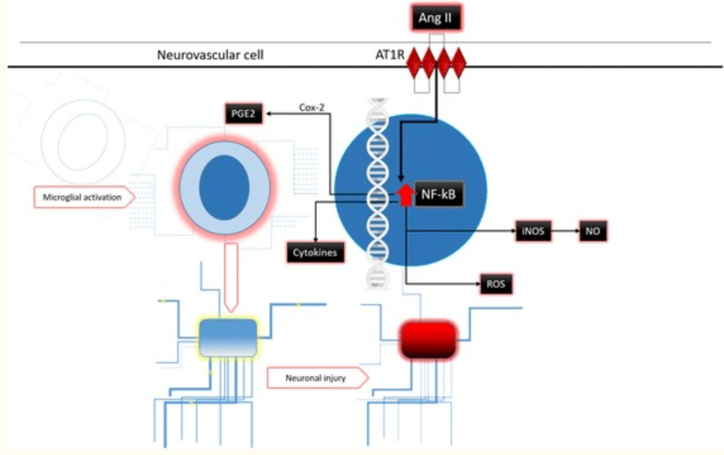
The Renin-Angiotensin System: a possible new target for depression.
Vian J, Pereira C, Chavarria V, et al. The renin-angiotensin system: a possible new target for depression. BMC Med. 2017;15(1):144. Published 2017 Aug 1. doi:10.1186/s12916-017-0916-3

Slide 45
The Renin-Angiotensin System: a possible new target for depression.
Vian J, Pereira C, Chavarria V, et al. The renin-angiotensin system: a possible new target for depression. BMC Med. 2017;15(1):144. Published 2017 Aug 1. doi:10.1186/s12916-017-0916-3

Slide 46
The Renin-Angiotensin System: a possible new target for depression.
Researchers are puzzled because while Ang II is too hydrophilic to cross the blood–brain barrier, expression of renin in the brain is too low to account for its local synthesis.
Among the hypotheses advanced to solve this apparent paradox are renin-independent synthesis of angiotensin peptides; impaired blood–brain barrier in hypertension leading to Ang II leaking into the cerebrospinal fluid (Haptoglobin 2-2?)
Although uncertainties persist, targeting the brain RAS or the peripheral RAS cannot be equal because ACEIs that penetrate the blood–brain barrier are superior to non-centrally acting ones in preventing cognitive decline
Vian J, Pereira C, Chavarria V, et al. The renin-angiotensin system: a possible new target for depression. BMC Med. 2017;15(1):144. Published 2017 Aug 1. doi:10.1186/s12916-017-0916-3

Slide 47
The Renin-Angiotensin System: a possible new target for depression.
Inflammation is essential for restoring homeostasis in stress, infection and injury. (Gut dysbiosis, Periodontal pathogens?)
Hormones and circulating pro-inflammatory cytokines, products of neuronal injury and bacterial endotoxins (PD pathogens?), activate transcription factors.
Activated inflammatory cascades allows infiltrating macrophages also participate.
A well-regulated central inflammatory chain is fundamental to restore homeostasis, but an exaggerated response can be responsible for chronic inflammation, neuronal damage and a decrease in brain-derived neurotrophic factor. (Again – PD is a chronic infection, as is gut dysbiosis particularly in Hp2 individuals)
Thus, excess or sustained activation of immune responses augments the risk of disease in vulnerable individuals, and can be important in the pathophysiology of many neurological and psychiatric disorders (Again chronic infections – PD, also chronic barrier permeability with Hp 2-2)
Vian J, Pereira C, Chavarria V, et al. The renin-angiotensin system: a possible new target for depression. BMC Med. 2017;15(1):144. Published 2017 Aug 1. doi:10.1186/s12916-017-0916-3

Slide 48
The Renin-Angiotensin System: a possible new target for depression.
Seven single nucleotide polymorphisms were significantly tied to late-life depression and cortisol levels under stressful circumstances.
The AT1R genotype (A1166C) CC is also associated with depression and increased responsiveness to Ang II, as well as clinical response.
Epigenetic mechanisms also appear to be important, as altered methylation of the regulatory region of the ACE gene has been associated with depression.
ACE polymorphisms even seem able to influence antidepressant response, cognitive function after a depression episode in the elderly, or suicide behavior (none of these pts in the Mamdani study presented were genetically tested)
Vian J, Pereira C, Chavarria V, et al. The renin-angiotensin system: a possible new target for depression. BMC Med. 2017;15(1):144. Published 2017 Aug 1. doi:10.1186/s12916-017-0916-3

Slide 49
Depression is an inflammatory disease?
Berk and colleagues (2013) state that depression is associated with a chronic, low-grade inflammatory response and activation of cell-mediated immunity, as well as activation of the compensatory anti-inflammatory reflex system.
It is similarly accompanied by increased oxidative and nitrosative stress (O&NS), which contribute to neuro-progression in the disorder.
The obvious question this poses is ‘what is the source of this chronic low-grade inflammation?’ BDM must look at all sources!
Berk M, Williams LJ, Jacka FN, et al. So depression is an inflammatory disease, but where does the inflammation come from?. BMC Med. 2013;11:200. Published 2013 Sep 12. doi:10.1186/1741-7015-11-200

Slide 50
Depression is an inflammatory disease?
Berk review explores the role of inflammation and oxidative and nitrosative stress as possible mediators of known environmental risk factors in depression.
A range of factors appear to increase the risk for the development of depression and seem to be associated with systemic inflammation; these include psychosocial stressors, poor diet, physical inactivity, obesity, smoking, altered gut permeability, atopy, dental cares, sleep and vitamin D deficiency.
BDM – We LOOK AT ALL! Good for Berk to recognize the association to PD in this inflammatory story!
Berk M, Williams LJ, Jacka FN, et al. So depression is an inflammatory disease, but where does the inflammation come from?. BMC Med. 2013;11:200. Published 2013 Sep 12. doi:10.1186/1741-7015-11-200

Slide 51
ARBs and Suicide Risk
So – appreciating that this study showed a 63% increased risk of suicide in an elderly population with ARBs vs ACE-1……..we have a couple of options with this data –
1. Ignore it?
No I won’t ignore it but certainly appreciate the limitations in the study
2. Suggest it is one more reason to use ACE-1 over ARBs?
Not really – I still prefer ACE-1 and this study doesn’t change that – also suicide w/in 100 days? (3mo)?
3. Appreciate the complexity of inhibiting various systems in body.
Absolutely! Each patient needs a full BDM inflammatory and genetic work-up!
4. Try to learn and appreciate the impact of AII with the brain related to inflammation, NK-fB, Substance P and others….
Absolutely! Appreciating the role of genetics, epigenetics, chronic infection, underlying pathogy of brain health regarding depression and anxiety
This supports BDM approach to treat each patient as the n of 1
5. Also – appreciating the intricate relationship between infection (Periodontal pathogens and Gut Dysbiosis) and genetics and how it all works?
ALL patients need Hp testing, PD pathogen testing along with CYP 450 isoenzyme testing and full assessment of depression, anxiety, PTSD and ADD/ADHD risk assessment, and ETOH eval.
Mamdani, M., Gomes, T., Greaves, S., et al. (2019). Association Between Angiotensin-Converting Enzyme Inhibitors, Angiotensin Receptor Blockers, and Suicide. JAMA Network Open. 2019;2(10). October 19, 2019 online.

Slide 52
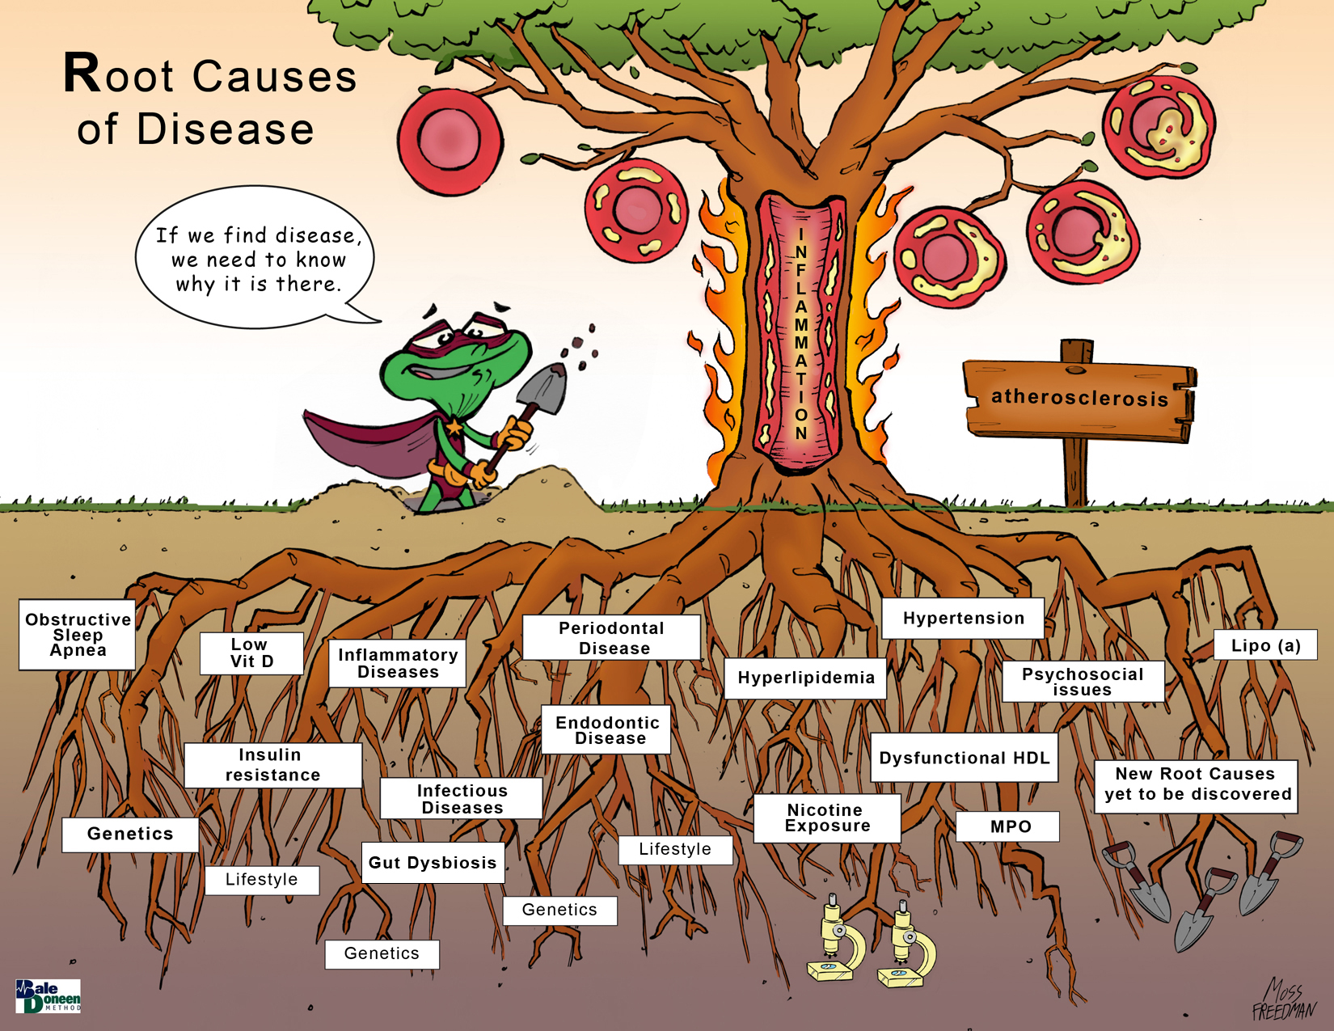
Follow EDFROG and do our part to prevent suicide in our patients!

Slide 53
I thought we were done with the fibrate story? New research? Not really….

Slide 54
Use of fenofibrate improved CV outcomes in statin users with metabolic syndrome
Fenofibrate, a peroxisome proliferator activated receptor-α agonist, has been a treatment option in the management of dyslipidemia (mainly TG reduction and HDL improvement).
FIELD and ACCORD Trials are most often cited – showing a failure to show a reduction in the primary outcome of MACE in populations with diabetes, but a statistically significant CV risk reduction was observed in subgroups with atherogenic dyslipidemia.
Kim, N., Hoon, K., Choi, J., et al. (2019). Use of fenofibrate on cardiovascular outcomes in statin users
with metabolic syndrome: propensity matched cohort study. BMJ 2019;366:l5125

Slide 55
Use of fenofibrate improved CV outcomes in statin users with metabolic syndrome
Two meta-analyses of fibrates also indicated that the associated reduction of cardiovascular events would benefit people with atherogenic dyslipidemia
Jun M, Foote C, Lv J, et al. Effects of fibrates on cardiovascular outcomes: a systematic review and meta-analysis. Lancet 2010;375:1875-84. doi:10.1016/S0140-6736(10)60656-3
Bruckert E, Labreuche J, Deplanque D, Touboul PJ, Amarenco P. Fibrates effect on cardiovascular risk is greater in patients with high triglyceride levels or atherogenic dyslipidemia profile: a systematic review and meta-analysis. J Cardiovasc Pharmacol 2011;57:267-72. doi:10.1097/FJC.0b013e318202709f
Kim, N., Hoon, K., Choi, J., et al. (2019). Use of fenofibrate on cardiovascular outcomes in statin users
with metabolic syndrome: propensity matched cohort study. BMJ 2019;366:l5125

Slide 56
Fibrates used to be part of our BDM preceptorship program and I would highlight the 3 pieces of data….

Slide 59
Elevated Remnant Cholesterol Causes Arterial Inflammation and CHD: Elevated LDL-C Does Not Cause Inflammation
Every 39 mg/dL increase in remnant cholesterol increased the risk of CHD 3.3X (95%CI: 2.1-5.2)
Every 39 mg/dL increase in LDL increased the risk of CHD 1.8X (95%CI: 1.5-2.2).
mg/dL to mg/dL remnants (TG) virtually twice as dangerous as LDL!!
Varbo, A., et. al. (2013). Circulation. doi: 10.1161/CIRCULATIONAHA.113.003008
Notes:
The association between elevated levels of nonfasting remnant cholesterol and low-grade nflammation was robust even after stratifying by sex, hormone replacement therapy, diabetes mellitus, and obesity.
LDL not being assoc. with inflammation should not be surprising as studies of patients with heterozygous familial hypercholesterolemia, which is an inherited condition with very high levels of LDL cholesterol as a result of a defect in the LDL receptor, found either no difference in CRP levels between patients and controls18-21 or only slightly higher levels of CRP in patients compared to controls22

Slide 60
TG Lowering Independent of LDL Lowering Reduces CV Risk
374,858 pts; average age 63 yrs; mean TG 163 mg/dL; median follow-up 4.8 yrs.; 46,080 MACE.
TG lowering reduced MACE, after adjusting for the degree of LDL-C lowering.
Marston, N. A., et al. (2019). "Association Between Triglyceride Lowering and Reduction of Cardiovascular Risk Across Multiple Lipid-Lowering Therapeutic Classes: A Systematic Review and Meta-Regression Analysis of Randomized Controlled Trials." Circulation.

Slide 61
Use of fenofibrate improved CV outcomes in statin users with metabolic syndrome
DESIGN:
Propensity matched cohort study.
SETTING:
Population based cohort in Korea.
PARTICIPANTS:
29,771 adults with metabolic syndrome (≥40 years) receiving statin treatment. 2156 participants receiving combined treatment (statin plus fenofibrate) were weighted based on propensity score in a 1:5 ratio with 8549 participants using statin only treatment.
MAIN OUTCOME MEASURE:
Primary outcome was composite cardiovascular events including incident coronary heart disease, ischemic stroke, and death from cardiovascular causes.
Kim, N., Hoon, K., Choi, J., et al. (2019). Use of fenofibrate on cardiovascular outcomes in statin users
with metabolic syndrome: propensity matched cohort study. BMJ 2019;366:l5125

Slide 62
Use of fenofibrate improved CV outcomes in statin users with metabolic syndrome
This cohort of 514,866 (>40 y.o.) Koreans represents 10% of a random selection of screened participants aged 40 to 79 in the index years 2002 or 2003 and followed-up to 2015.
All had used statins for at least three months. Excluded those without lipid profiles before initiation of statin treatment
Potentially eligible participants were then selected who met the metabolic syndrome criteria, as defined by the Adult Treatment Panel III guidelines, before the index date.
Kim, N., Hoon, K., Choi, J., et al. (2019). Use of fenofibrate on cardiovascular outcomes in statin users
with metabolic syndrome: propensity matched cohort study. BMJ 2019;366:l5125

Slide 63
Use of fenofibrate improved CV outcomes in statin users with metabolic syndrome
Kim, N., Hoon, K., Choi, J., et al. (2019). Use of fenofibrate on cardiovascular outcomes in statin users
with metabolic syndrome: propensity matched cohort study. BMJ 2019;366:l5125

Slide 64
Use of fenofibrate improved CV outcomes in statin users with metabolic syndrome
Kaplan-Meier survival curves for composite cardiovascular outcomes between
treatment groups.
All participants
High triglyceride and low HDL concentrations
Low triglyceride and high HDL concentrations
Kim, N., Hoon, K., Choi, J., et al. (2019). Use of fenofibrate on cardiovascular outcomes in statin users
with metabolic syndrome: propensity matched cohort study. BMJ 2019;366:l5125

Slide 65
Use of fenofibrate improved CV outcomes in statin users with metabolic syndrome
Who received the significant benefit?
Again – I believe the use of any adjunctive agent has everything to do with proper patient selection –
High TG/HDL ratio, increased waistline, HTN, low HDL = IR population
What I find particularly interesting…..
Who didn’t do better?
Those with underlying CVD and DM was neutral……Why? Caught later?
Kim, N., Hoon, K., Choi, J., et al. (2019). Use of fenofibrate on cardiovascular outcomes in statin users
with metabolic syndrome: propensity matched cohort study. BMJ 2019;366:l5125

Slide 66
Use of fenofibrate improved CV outcomes in statin users with metabolic syndrome
BaleDoneen Take-Away:
This study confirms what we have long known with fibrate therapy – proper patient selection is CRITICAL for any successful benefit of CV risk reduction.
Remember – Patients with Metabolic Syndrome are insulin resistant – don’t forget to assess OGTT with all of these patients.
The ACCORD Eye Trial was an exciting opportunity to witness the microvascular benefit of fibrates in type 2 DM.
Current trial is not that impressive but does illustrate the importance of choosing this med in the proper population. Remember – hypertriglyceridemia is a representation of increased remnant-like particle cholesterol which is inflammatory.
Not entirely sure why this study was financially supported however – it does not suggest replacing fibrates with Vitamin B3 or the importance of treating the proper IR patient with lifestyle and pioglitazone if necessary.
Kim, N., Hoon, K., Choi, J., et al. (2019). Use of fenofibrate on cardiovascular outcomes in statin users
with metabolic syndrome: propensity matched cohort study. BMJ 2019;366:l5125

Slide 67
high-sensitive Troponin Assays – it is a critical assessment tool.
In a way, I feel that hsTn helps highlight an arteriologist’s value in a standard medical model. This test may propose to be a bit daunting to a traditional, surgical model of cardiology as it is telling us about a very serious condition that is rarely best handled by surgery – the treatment of hsTn requires the BDM approach to arteriology.

Slide 68
High-Sensitivity Cardiac Troponin Assays are valuable clinical tools to assess myocardial injury
Current epidemiological evidence suggests that myocardial injury without overt ischemia represents about 60% of cases of abnormal troponin concentrations when obtained for clinical indications.
1 in 8 pts present to the hospital have evidence of myocardial injury.
Myocardial injury is a concerning prognosis; the 5-year mortality rate is approximately 70%, with a major adverse CV 5-year event rate of 30%.
McCarthy, C., Raber, I., Chapman, A., et al. (2019). Myocardial Injury in the Era of High-Sensitivity
Cardiac Troponin Assays. JAMA Cardiology October 2019 Vol 4, No10. 1034-1041.

Slide 69
High-Sensitivity Cardiac Troponin Assays are valuable clinical tools to assess myocardial injury
The differential diagnosis is broad and can be divided into acute and chronic precipitants. The initial workup involves an assessment for myocardial ischemia.
If infarction is ruled out, further evaluation includes a detailed history, physical examination, laboratory testing, a 12-lead EKG, and (if there is no known history of structural or valvular heart disease) an echocardiogram.
Unfortunately, no consensus exists on routine management of patients with myocardial injury.
Identifying and treating the underlying precipitant is the most practical approach. (ie: The BaleDoneen Method – treating the n of 1 = the patient)
McCarthy, C., Raber, I., Chapman, A., et al. (2019). Myocardial Injury in the Era of High-Sensitivity
Cardiac Troponin Assays. JAMA Cardiology October 2019 Vol 4, No10. 1034-1041.

Slide 70
High-Sensitivity Cardiac Troponin Assays are valuable clinical tools to assess myocardial injury
Most cTn in the cardiac myocyte is bound within the sarcomere, while approximately 5% remains free in the cytoplasm.
Under ischemic conditions, when MI occurs, free cytoplasmic cTn is released first, causing an initial rapid change in cTn concentration, while myofibrils are subsequently degraded over several days, resulting in a more stable and continuous cTn release.
McCarthy, C., Raber, I., Chapman, A., et al. (2019). Myocardial Injury in the Era of High-Sensitivity
Cardiac Troponin Assays. JAMA Cardiology October 2019 Vol 4, No10. 1034-1041.

Slide 71
High-Sensitivity Cardiac Troponin Assays are valuable clinical tools to assess myocardial injury
With improvements in technology, cTn can now be quantified at levels greater than the limit of detection in 50% of healthy individuals or more by using high-sensitivity (hs) cTn assays
some preclinical assays may reliably detect concentration of cTn in all normal individuals. The mechanism of cTn detection in healthy individuals is not fully understood but is hypothesized to be associated with myocyte turnover.
These advancements in analytical sensitivity have facilitated the early, rapid rule-in and rule-out of MI, with the ensuing potential to improve patient outcomes and decrease health care costs.
McCarthy, C., Raber, I., Chapman, A., et al. (2019). Myocardial Injury in the Era of High-Sensitivity
Cardiac Troponin Assays. JAMA Cardiology October 2019 Vol 4, No10. 1034-1041.

Slide 72
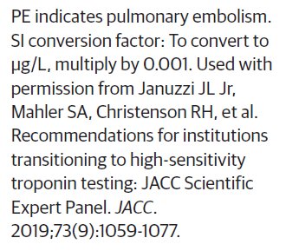
High-Sensitivity Cardiac Troponin Assays are valuable clinical tools to assess myocardial injury
McCarthy, C., Raber, I., Chapman, A., et al. (2019). Myocardial Injury in the Era of High-Sensitivity
Cardiac Troponin Assays. JAMA Cardiology October 2019 Vol 4, No10. 1034-1041.

Slide 73
High-Sensitivity Cardiac Troponin Assays are valuable clinical tools to assess myocardial injury
McCarthy, C., Raber, I., Chapman, A., et al. (2019). Myocardial Injury in the Era of High-Sensitivity
Cardiac Troponin Assays. JAMA Cardiology October 2019 Vol 4, No10. 1034-1041.

Slide 74
High-Sensitivity Cardiac Troponin Assays are valuable clinical tools to assess myocardial injury
McCarthy, C., Raber, I., Chapman, A., et al. (2019). Myocardial Injury in the Era of High-Sensitivity
Cardiac Troponin Assays. JAMA Cardiology October 2019 Vol 4, No10. 1034-1041.

Slide 75
High-Sensitivity Cardiac Troponin Assays are valuable clinical tools to assess myocardial injury
Several studies indicate that, when using contemporary and high sensitivity assays, myocardial injury in the absence of ischemia is the most common cause of an increased cTn concentration
McCarthy, C., Raber, I., Chapman, A., et al. (2019). Myocardial Injury in the Era of High-Sensitivity
Cardiac Troponin Assays. JAMA Cardiology October 2019 Vol 4, No10. 1034-1041.

Slide 76
High-Sensitivity Cardiac Troponin Assays are valuable clinical tools to assess myocardial injury
No standard exists for how much rise and/or fall of hs-cTn concentration identifies an acute injury.
Typically, an increase in the cTn concentration greater than the reference change value (the biological variation of an assay) is considered acute for both cTnT and cTnI assays if the initial cTn value is less than the 99th-percentile value.
McCarthy, C., Raber, I., Chapman, A., et al. (2019). Myocardial Injury in the Era of High-Sensitivity
Cardiac Troponin Assays. JAMA Cardiology October 2019 Vol 4, No10. 1034-1041.

Slide 77
High-Sensitivity Cardiac Troponin Assays are valuable clinical tools to assess myocardial injury
If the first cTn level is greater than the 99th-percentile value, then an increase of at least 50% of the 99th-percentile value or a change greater than 20% relative to the baseline value may be considered acute.
While small changes in cTn concentration have poor specificity, a large rise and/or fall is much more specific for acute myocardial injury, with the largest increases typically occurring in acute MI; the larger the rise and/or fall of cTn concentrations, the higher the positive predictive value for MI.
McCarthy, C., Raber, I., Chapman, A., et al. (2019). Myocardial Injury in the Era of High-Sensitivity
Cardiac Troponin Assays. JAMA Cardiology October 2019 Vol 4, No10. 1034-1041.

Slide 78
High-Sensitivity Cardiac Troponin Assays are valuable clinical tools to assess myocardial injury
BaleDoneen Take-Away:
hs-cTn is an extremely valuable test for preventative clinical use.
Important to establish baseline and monitor level over time.
Always correlate hs-cTn with symptoms – be specific in chart and record exercise tolerance, HR variability, CV symptoms – be as objective as possible.
This test is readily available at most labs.
Utilize in ALL patients – especially with those in secondary or tertiary prevention status. We recommend obtaining a baseline and measuring every 3-6 months. Take note of all – AF, Microvascular, IR, HTN, OSA, etc.
McCarthy, C., Raber, I., Chapman, A., et al. (2019). Myocardial Injury in the Era of High-Sensitivity
Cardiac Troponin Assays. JAMA Cardiology October 2019 Vol 4, No10. 1034-1041.

Slide 79
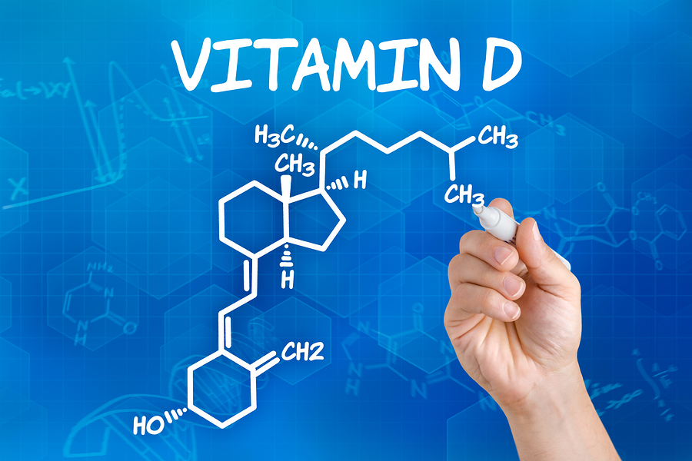
Are these related to one another?

Slide 80
Causal Link Between Vitamin D and Total Testosterone in Men: A Mendelian Randomization Analysis
Tested whether genetically lowered vitamin D levels were associated with lower total testosterone (T), using Mendelian randomization (MR) methodology.
4254 men were enrolled from the Survey on Prevalence in East China for Metabolic Diseases and Risk Factors (SPECT-China) study in 23 sites in eastern China during 2014 to 2016.
Chen, C., Zhai, H., Cheng, J., et al. (2019). Causal link between vitamin D and total testosterone in men: a mendelian randomization analysis. J Clin Endocrinol Metab, 104(8):3148–3156

Slide 81
Causal Link Between Vitamin D and Total Testosterone in Men: A Mendelian Randomization Analysis
Used this MR design to examine the causal link between 25(OH)D and total T levels.
Study demonstrated that a genetic decrease in 25(OH)D was associated with lower T level, providing evidence in support of a causal role of vitamin D in raising T levels.
Vitamin D receptor has been observed in the male reproductive system.
Vitamin D receptor knockout mice have gonadal insufficiency, both of which suggest a potential role of vitamin D in the production of male reproductive hormones.
This notion is supported by an association of vitamin D and androgen levels in men, suggested by observational studies.
Chen, C., Zhai, H., Cheng, J., et al. (2019). Causal link between vitamin D and total testosterone in men: a mendelian randomization analysis. J Clin Endocrinol Metab, 104(8):3148–3156

Slide 82
Causal Link Between Vitamin D and Total Testosterone in Men: A Mendelian Randomization Analysis
Lower 25(OH)D levels were associated with lower total T by 0.40
(95% CI, 0.23 to 0.58)
after multivariable adjustment.
Using VD_GRS as the instrumental variable in the MR analysis, the causal regression coefficient of genetically determined
per-SD increase for 25(OH)D on total T was 0.12
(95% CI, 0.02 to 0.22)
Chen, C., Zhai, H., Cheng, J., et al. (2019). Causal link between vitamin D and total testosterone in men: a mendelian randomization analysis. J Clin Endocrinol Metab, 104(8):3148–3156

Slide 83
Causal Link Between Vitamin D and Total Testosterone in Men: A Mendelian Randomization Analysis
Research provides evidence for the biologically plausible causal effects of 25(OH)D on total T using MR analysis.
Whether vitamin D supplementation can raise androgen levels merits further investigation in long-term, randomized controlled trials.
Chen, C., Zhai, H., Cheng, J., et al. (2019). Causal link between vitamin D and total testosterone in men: a mendelian randomization analysis. J Clin Endocrinol Metab, 104(8):3148–3156

Slide 84
Causal Link Between Vitamin D and Total Testosterone in Men: A Mendelian Randomization Analysis
BaleDoneen Take-Away:
This MR analysis does demonstrate that genetically lowered 25(OH)D level is associated with lower total T level and does speak to the therapeutic benefits of vitamin D supplementation in increasing androgen levels.
This data supports the importance of looking at total T levels in men with low levels of Vitamin D.
The data I showed in the September chat session demonstrated that testosterone levels of 450-550 lowered DM risk in men.
Optimization of hormone levels must include the recognition of the connection between the entire endocrine system, including TSH, estrogen/testosterone and vitamin D levels.
Chen, C., Zhai, H., Cheng, J., et al. (2019). Causal link between vitamin D and total testosterone in men: a mendelian randomization analysis. J Clin Endocrinol Metab, 104(8):3148–3156

Slide 85
Editorial – ‘Read all about it’ ☺

Slide 86
Editorial – Clopidogrel Pharmacogenetics – Why the wait? - Dan M Roden, MD
More than 3 million people annually in the United States receive prescriptions for the antiplatelet drug clopidogrel after stenting for acute coronary syndrome.
Clopidogrel was approved by the Food and Drug Administration (FDA) in 1997 for the reduction of atherosclerotic events. It was known to be a prodrug, but it was not until 2006 that CYP2C19 was identified as the bioactivating enzyme. It went generic in 2012.
Claassens DMF, Vos GJA, Bergmeijer TO, et al. A genotype guided
strategy for oral P2Y12 inhibitors in primary PCI.
N Engl J Med 2019; 381: 1621-31.
Roden, D. (2019). Editorial. Clopidogrel pharmacogenetics – why the wait? n engl j med 381;17 nejm.org October 24, 2019

Slide 87
Editorial – Clopidogrel Pharmacogenetics – Why the wait? - Dan M Roden, MD
Common genetic variants in CYP2C19 affect enzyme function:
NORMAL CYP2C19 activity (clopidogrel 75mg/day for 7 d - mean (±SD) 48.9±14.9% reduction in platelet activity (measured as aggregation induced by adenosine diphosphate)
HETEROZYGOUS for loss-of-function” variants (24 to 47% of the population, depending on ancestry) had no change in platelet activity with the same dose. Higher doses of clopidogrel can overcome this enzyme inhibition.
POOR METABOLIZERS persons who carry two loss-of-function alleles. Frequency of this phenotype varies from 2.5% in populations of European ancestry to 14.5% in East Asians and 46.4% in Pacific Islanders
Roden, D. (2019). Editorial. Clopidogrel pharmacogenetics – why the wait? n engl j med 381;17 nejm.org October 24, 2019

Slide 88
Editorial – Clopidogrel Pharmacogenetics – Why the wait? - Dan M Roden, MD
FDA added a black-box warning in 2010, recommending that practitioners “consider alternative treatment or treatment strategies” in patients with loss-of-function variants, but stopped short of recommending genotype testing.
Response from the cardiology community was almost hostile –focusing on the limitations of the data, unknown patient adherence, uncertainty around defining high-risk persons, and lack of data from patients with cerebrovascular and PAD
Currently recommending “careful clinical judgment” rather than pharmacogenetic testing
Roden, D. (2019). Editorial. Clopidogrel pharmacogenetics – why the wait? n engl j med 381;17 nejm.org October 24, 2019

Slide 89
Editorial – Clopidogrel Pharmacogenetics – Why the wait? - Dan M Roden, MD
There are options beyond clopidogrel – however, cost and side effect profiles can be challenging – latest recommendation is that genotype testing will improve outcomes of antiplatelet therapy.
Prescribing prasugrel or ticagrelor to all patients exposes many to increased bleeding risk and, for the time being, increased cost. Prescribing clopidogrel without genotyping exposes variant carriers to blunted responses or lack of response
Roden, D. (2019). Editorial. Clopidogrel pharmacogenetics – why the wait? n engl j med 381;17 nejm.org October 24, 2019

Slide 90
Editorial – Clopidogrel Pharmacogenetics – Why the wait? - Dan M Roden, MD
BaleDoneen Take-Away:
Clopidogrel remains a first line DAPT medication.
CYP2C19 is a simple test to order - available at all labs and is covered by major insurers, including Medicare/Medicaid.
Remember the Post-Charisma data indicating the utility of DAPT with Clopidogrel and baby aspirin in PAD, CVA/TIA.
The length of time to remain on DAPT for post PCI remains somewhat loosely defined. At minimum, allow adequate time to insure all root causes are evaluated and optimally treated so that the inflammatory burden is eradicated.
Roden, D. (2019). Editorial. Clopidogrel pharmacogenetics – why the wait? n engl j med 381;17 nejm.org October 24, 2019

Slide 91
Running!

Slide 92
Leisure-Time Running reduces risk of T2DM
Examined the overall association as well as the dose−response relationship between leisure-time running and incident type 2 diabetes.
Participants were 19,347 adults aged 18-100 years who were free of CVD, cancer, and diabetes at baseline, and who received at least 2 extensive preventive medical examinations between 1974 and 2006.
Running and other types of aerobic physical activity were assessed by self reported leisure-time activities.
Type 2 diabetes was defined as fasting glucose ≥126 mg/dL (7.0 mmol/L), physician diagnosis, or insulin use.
Wang, Y., Lee, D., Brellenthin, A., et al. (2019). Leisure-time running reduces risk of incident Type 2 DM. The Am J Med. 132:1225-1232

Slide 93
Leisure-Time Running reduces risk of T2DM
During an average follow-up of 6.5 years, 1015 adults developed type 2 diabetes.
Approximately 29.5% of adults participated in leisure-time running at baseline.
Runners had a 28% ([HR] 0.72; 95 CI, 0.62-0.84) lower risk of developing type 2 diabetes compared with nonrunners during follow-up.
Consistent linear dose−response relationships were observed between various running parameters and incident type 2 diabetes, supporting the prescription of running to prevent type 2 diabetes.
Wang, Y., Lee, D., Brellenthin, A., et al. (2019). Leisure-time running reduces risk of incident Type 2 DM. The Am J Med. 132:1225-1232

Slide 94
Leisure-Time Running reduces risk of T2DM
The benefits of moderate-intensity physical activity (defined as any physical activity requiring an energy expenditure of ≥3-6 metabolic equivalent [MET]) on the primary prevention of type 2 diabetes is well established.
Moreover, vigorous-intensity physical activity has been shown to attenuate weight gain more adequately than moderate-intensity physical activity which is related to a higher risk of type 2 diabetes.
Therefore, vigorous-intensity physical activity, such as running, may confer superior benefits over other types of physical activity on preventing type 2 diabetes.
Wang, Y., Lee, D., Brellenthin, A., et al. (2019). Leisure-time running reduces risk of incident Type 2 DM. The Am J Med. 132:1225-1232.

Slide 95
Leisure-Time Running reduces risk of T2DM
Of the different types of exercise, running is the most popular among individuals who do participate in vigorous intensity physical activity.
Running is convenient and easily accessible, because it does not require specialized equipment or locations.
Running is usually well above the MET level of 6 and even slow jogging is considered as vigorous-intensity physical activity
Wang, Y., Lee, D., Brellenthin, A., et al. (2019). Leisure-time running reduces risk of incident Type 2 DM. The Am J Med. 132:1225-1232.

Slide 96
Leisure-Time Running reduces risk of T2DM
Current public health physical activity guidelines recommend that individuals should perform at least 500 MET-min/week of physical activity (equivalent to at least 75 minutes/week of vigorous-intensity physical activity) to obtain general health benefits, including type 2 diabetes prevention (that is roughly only 12 minutes per day!)
The objective of this study was to examine the association of leisure-time running and type 2 diabetes incidence after adjusting for potential confounders, including other types of aerobic physical activity.
Wang, Y., Lee, D., Brellenthin, A., et al. (2019). Leisure-time running reduces risk of incident Type 2 DM. The Am J Med. 132:1225-1232.

Slide 97
Leisure-Time Running reduces risk of T2DM
Runners were more likely to be younger, male, leaner, nonsmokers, heavy alcohol drinkers, less active in other types of aerobic physical activity, had lower prevalence of chronic diseases (HTN, hypercholesterolemia, and abnormal EKG), had less parental history of DM, and lower baseline FBS (all P < .05).
Runners had higher cardiorespiratory fitness levels (P < .001).
Runners had a 28% (HR 0.72; 95% CI, 0.62-0.84) reduced risk of T2DM compared with nonrunners after adjustment for potential confounders
Wang, Y., Lee, D., Brellenthin, A., et al. (2019). Leisure-time running reduces risk of incident Type 2 DM. The Am J Med. 132:1225-1232.

Slide 98
Leisure-Time Running reduces risk of T2DM
Wang, Y., Lee, D., Brellenthin, A., et al. (2019). Leisure-time running reduces risk of incident Type 2 DM. The Am J Med. 132:1225-1232.

Slide 99
Leisure-Time Running reduces risk of T2DM
What speed and distance are we talking about here to be considered as ‘effective’ for the prevention of T2DM –
Median running speed was 6.7 mph (9 min 14 sec per mile)
Medan distance was 10 miles per week.
Most effective for T2DM prevention compared to nonrunners was running at a speed >6.7 mph and running for a distance of >10 miles per week.
Wang, Y., Lee, D., Brellenthin, A., et al. (2019). Leisure-time running reduces risk of incident Type 2 DM. The Am J Med. 132:1225-1232.

Slide 100
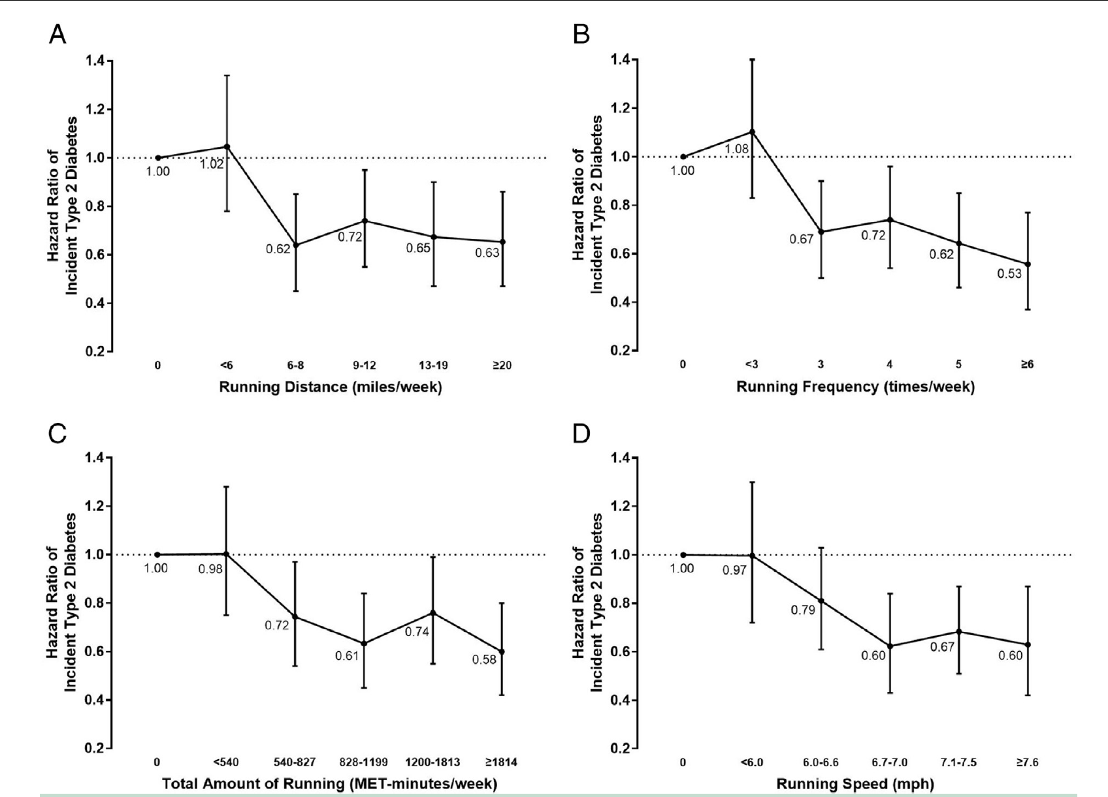
Leisure-Time Running reduces risk of T2DM
Wang, Y., Lee, D., Brellenthin, A., et al. (2019). Leisure-time running reduces risk of incident Type 2 DM. The Am J Med. 132:1225-1232.

Slide 101
Leisure-Time Running reduces risk of T2DM
BaleDoneen Take-Away:
Running at these levels (speed, distance, time) is a very attainable commitment for many people.
Additionally, this study reflects the importance of consistency and allows the ability to project these findings to other areas of exercise that might be more favorable.
This is great information for EVERYONE and….you don’t have to run either – you can do an equivalent exercise!
Yeah for runners….and walkers…..and wogers ☺
Wang, Y., Lee, D., Brellenthin, A., et al. (2019). Leisure-time running reduces risk of incident Type 2 DM. The Am J Med. 132:1225-1232.

Slide 102
Statins in children? What are the long-term implications?

Slide 103
20-Year Follow-up of Statins in Children with Familial Hypercholesterolemia
20-year follow-up study of statin therapy in children.
A total of 214 patients with familial hypercholesterolemia (genetically confirmed in 98% of the patients), who were previously participants in a placebo-controlled trial evaluating the 2-year efficacy and safety of pravastatin, were invited for follow-up together with their 95 unaffected siblings.
Participants completed a questionnaire, provided blood samples, and underwent measurements of carotid intima–media thickness.
The incidence of cardiovascular disease among the patients with familial hypercholesterolemia was compared with that among their 156 affected parents.
Luirink, I., Wiegman, A., Kusters, D., et al (2019). 20-year follow-up of statins in children with familiar hypercholesterolemia. New Eng J. Med 381;1547-56.

Slide 104
20-Year Follow-up of Statins in Children with Familial Hypercholesterolemia
Familial hypercholesterolemia is a common autosomal dominant disorder of lipoprotein metabolism. It is caused by mutations in genes encoding key proteins involved in the low-density lipoprotein (LDL) receptor endocytic and recycling pathways that lead to decreased cellular uptake of LDL cholesterol.
Consequently, severely elevated plasma levels of LDL cholesterol develop from birth onward in patients with familial hypercholesterolemia, and these patients are at high risk for premature cardiovascular disease
Go to BaleDoneen.com and watch Genetic talk on FH
Luirink, I., Wiegman, A., Kusters, D., et al (2019). 20-year follow-up of statins in children with familiar hypercholesterolemia. New Eng J. Med 381;1547-56.

Slide 105
20-Year Follow-up of Statins in Children with Familial Hypercholesterolemia
Although the lipid-lowering effect of statin therapy is well established in children,6 proper follow-up data on outcomes in treated children into adulthood to evaluate the risk of cardiovascular disease are lacking.
Avis HJ, Vissers MN, Stein EA, et al. A systematic review and meta-analysis of statin therapy in children with familial hypercholesterolemia. Arterioscler Thromb Vasc Biol 2007; 27: 1803-10
Luirink, I., Wiegman, A., Kusters, D., et al (2019). 20-year follow-up of statins in children with familiar hypercholesterolemia. New Eng J. Med 381;1547-56.

Slide 106
20-Year Follow-up of Statins in Children with Familial Hypercholesterolemia
The European Atherosclerosis Society (EAS) consensus panel and the current American College of Cardiology–American Heart Association guidelines for familial hypercholesterolemia advocate initiation of statins from as Young as 8 years or 10 years of age.
Wiegman A, Gidding SS, Watts GF, et al. Familial hypercholesterolaemia in children and adolescents: gaining decades of life by optimizing detection and treatment. Eur Heart J 2015; 36: 2425-37.
Grundy SM, Stone NJ, Bailey AL, et al. 2018 AHA/ACC/AACVPR/AAPA/ABC/ACPM/ ADA/AGS/APhA/ASPC/NLA/PCNA guideline on the management of blood cholesterol: a report of the American College of Cardiology/American Heart Association Task Force on Clinical Practice Guidelines. Circulation 2019; 139(25): e1082- e1143.
Luirink, I., Wiegman, A., Kusters, D., et al (2019). 20-year follow-up of statins in children with familiar hypercholesterolemia. New Eng J. Med 381;1547-56.

Slide 107
20-Year Follow-up of Statins in Children with Familial Hypercholesterolemia
All 214 children with familial hypercholesterolemia who had undergone randomization from 1997 through 1999 in a single-center, double blind,placebo-controlled trial, which evaluated the 2-year efficacy and safety of pravastatin, were eligible for the current study.
All the children were genetically tested; 210 (98%) had a documented pathogenic mutation in the genes encoding LDL receptor or apolipoprotein B.
Luirink, I., Wiegman, A., Kusters, D., et al (2019). 20-year follow-up of statins in children with familiar hypercholesterolemia. New Eng J. Med 381;1547-56.

Slide 108
20-Year Follow-up of Statins in Children with Familial Hypercholesterolemia
95 unaffected siblings were enrolled at baseline as a control group. These siblings had all been genetically tested, and familial hypercholesterolemia was excluded.
We contacted all eligible patients and their unaffected siblings approximately 20 years after the trial was initiated. Those who agreed to participate were invited for a single hospital visit. questionnaire was sent to document medical history, lifestyle habits, medication use, and family history. During the visit, participants underwent a physical examination, a fasting blood sample was obtained, and the carotid intima–media thickness was measured
Prespecified outcomes were cardiovascular disease and death from cardiovascular causes. Cardiovascular disease was defined as the presence of a myocardial infarction, angina pectoris, peripheral artery disease, or stroke (all diagnosed by medical professionals) or a coronary revascularization procedure (percutaneous transluminal coronary angioplasty or coronary-artery bypass grafting)
Luirink, I., Wiegman, A., Kusters, D., et al (2019). 20-year follow-up of statins in children with familiar hypercholesterolemia. New Eng J. Med 381;1547-56.

Slide 109
20-Year Follow-up of Statins in Children with Familial Hypercholesterolemia
Luirink, I., Wiegman, A., Kusters, D., et al (2019). 20-year follow-up of statins in children with familiar hypercholesterolemia. New Eng J. Med 381;1547-56.

Slide 110
20-Year Follow-up of Statins in Children with Familial Hypercholesterolemia
Luirink, I., Wiegman, A., Kusters, D., et al (2019). 20-year follow-up of statins in children with familiar hypercholesterolemia. New Eng J. Med 381;1547-56.

Slide 111
20-Year Follow-up of Statins in Children with Familial Hypercholesterolemia
Findings suggest that statin therapy in these patients with
familial hypercholesterolemia reduced the progression
of carotid intima–media thickness to a
level similar to that of their siblings; this appears
to constitute an important step toward
future cardiovascular risk reduction, since carotid
intima–media thickness is a well-validated surrogate
marker for future cardiovascular risk.2
Luirink, I., Wiegman, A., Kusters, D., et al (2019). 20-year follow-up of statins in children with familiar hypercholesterolemia. New Eng J. Med 381;1547-56.

Slide 112
20-Year Follow-up of Statins in Children with Familial Hypercholesterolemia
Of the FH parents, 11 of 156 (7%) died before 40 years of age, all from myocardial infarction. One parent died at 23 years of age.
In the whole cohort, the cumulative percentage of persons who were free from death from cardiovascular causes at 39 years of age was 100% among patients with familial hypercholesterolemia who had received treatment since childhood.
Four patients had discontinued statin therapy because of side effects. No episodes of noted rhabdomyolysis or other serious adverse events were reported. There were no significant differences in the results of liver-function tests or creatine kinase levels.
Luirink, I., Wiegman, A., Kusters, D., et al (2019). 20-year follow-up of statins in children with familiar hypercholesterolemia. New Eng J. Med 381;1547-56.

Slide 113
20-Year Follow-up of Statins in Children with Familial Hypercholesterolemia
In the group of 156 parents with familial hypercholesterolemia, 41 (26%) had had a cardiovascular event before 40 years of age. The majority had a myocardial infarction (27 parents; 66%) or angina pectoris (7 parents; 17%). The youngest affected parent had a myocardial infarction at 20 years of age
Luirink, I., Wiegman, A., Kusters, D., et al (2019). 20-year follow-up of statins in children with familiar hypercholesterolemia. New Eng J. Med 381;1547-56.

Slide 114
20-Year Follow-up of Statins in Children with Familial Hypercholesterolemia
At baseline in the original trial, patients with FH had a greater cIMT than their unaffected siblings:
(mean, 0.446 mm [95% CI, 0.439 to 0.453] vs. 0.439 mm
[95% CI, 0.430 to 0.449];
mean difference adjusted for age and sex, 0.012 mm
Mean progression of cIMT over the entire follow-up period was 0.0056 mm per year in patients with FH and 0.0057 mm per year in siblings (mean difference adjusted for sex, −0.0001 mm per year; 95% confidence interval, −0.0010 to 0.0008).
Luirink, I., Wiegman, A., Kusters, D., et al (2019). 20-year follow-up of statins in children with familiar hypercholesterolemia. New Eng J. Med 381;1547-56.

Slide 115
20-Year Follow-up of Statins in Children with Familial Hypercholesterolemia
BaleDoneen Take Away:
Starting statin therapy early with FH is a critical step in preventing the trapping of lipoproteins within the intima of the artery.
Statin therapy through puberty appears to be safe in this vulnerable population.
Treatment was well-tolerated.
For patients with FH…..the reality of living past age 40 without this treatment is challenged.
This is a good example of using statin therapy in a primary prevention situation with the aim of keeping them there.
BDM providers are being referred these complicated FH patients – keep everything else in mind – including Pg!
Luirink, I., Wiegman, A., Kusters, D., et al (2019). 20-year follow-up of statins in children with familiar hypercholesterolemia. New Eng J. Med 381;1547-56.

Slide 116
We wish our entire BaleDoneen Community a very blessed Thanksgiving.

