Slide 1
SCIENCE UPDATE
David B Wright MD
Clinical Coach BDM
9 March 2022

Slide 3
TOPICS
Bentracimab for Ticagrelor Reversal in Patients Undergoing Urgent Surgery. Bhatt et al. NEMJ Evid 2021;1(3) doi.org/10.1056/EVIDoa2100047
Time to Retire the Concept of a Transient Ischemic Attack. Eaton and Johnston JAMA 2022; 327(9):813-4
Intra-arterial Thrombolysis to Target Occlusions in Distal Arteries and the Microcirculation. Kharti JAMA 2022;327(9):821-2
Epidemiology and Mechanisms of De Novo and Persistent Hypertension in the Postpartum Period. Goel et al. Circulation 2015;132:1726-1733
Carotid Intima-Media Thickness Progression as a Surrogate Marker for CV Risk: Metanalysis of 119 clinical trials involving 100667 patients. Willeit et al. Circ 2020;142(7):621-642.
Carotid Atherosclerosis in Predicting Coronary Artery Disease Metanalysis. ATVB 2021;41(4):e224-e237.
Screening for Atrial Fibrillation: USPTF Recommendtion Statement. JAMA 2022;327(4):360-67

Slide 4
ANTI-PLATELET THERAPY
“All drugs (and supplements) are poisons!”
Brad Bale MD
At EVERY Preceptorship

Slide 5
REVERSAL OF ANTI-PLATELET AGENTS
Clopidogrel
Stop 5 days before
Consider loading dose when resuming
Platelet transfusion based on risk of bleeding
Prasugrel
Stop 7 days before
Platelet transfusion based on risk of bleeding
Aspirin
Stop 5-7 days before
Platelet transfusion based on risk of bleeding
Ticagrelor
Stop 5 days before
Platelet transfusions are ineffective
No guidelines published in US since 2011, Europe 2017

Slide 6
TICAGRELOR REVERSAL
Ticagrelor (Brilinta) reversible P2Y₁₂ inhibitor (unlike ASA, Clopidogrel, Prasugrel)
Preferred for Brain-related events
Also used for Coronary-related events
Platelet transfusions ineffective due to reversible binding
Bentracimab is a recombinant IgG1 monoclonal Ab that binds to both Ticagrelor and its active metabolite
Healthy volunteer study in 2019 proved its safety

Slide 7
REVERSE-IT Trial
Active enrollment ongoing, goal of 200
This interim report is on 154 consented patients
18 yo and above
On Ticagrelor within 72 hours
Urgent surgery/invasive procedures OR major bleeding post-procedure
Endpoints:
VerifyNow P2Y₁₂ Assay
Effective hemostasis
Prothrombotic effect on platelets also assessed

Slide 8
REVERSE-IT Trial
150 patients entered trial
Average age 65, 77% male, 83% Caucasian
Coronary Artery Disease was main co-morbidity
97.3% were on DAPT
81% prior AMI
91% undergoing Emergent or Urgent CABG
122 surgical patients and 9 bleeding patients evaluated
4 of 9 bleeds were intracranial

Slide 9
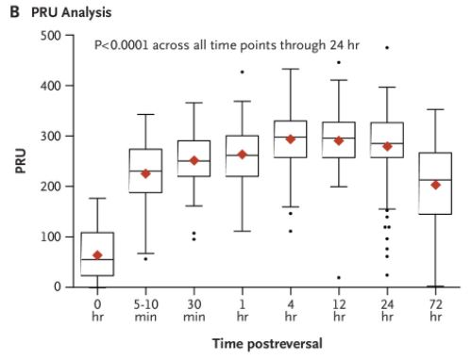
IN VITRO EFFICACY

Slide 10
IN VIVO EFFICACY
Expected bleeding events in non-treated: 50%!!!
Adequate hemostasis: 98.4%
78% in those entered with active bleeding
Urgent CABG bleeding compared to PLATO trial¹:
Severe: 0% vs 10.6%
Transfusion needed: 7% vs. 16.2%
Allogeneic blood products required in 10%
No infusion-related, allergic or anaphylactic reactions
Anti-drug antibody
22.6% had preexisting
24.3% developed
53% had none
Did not affect
platelet reactivity
2011 PLATO trial showed Ticagrelor 16% fewer events than Clopidogrel in ACS

Slide 11
ADVERSE EVENTS
8 (5%) Atherothrombotic events
6 were within 7 days
3 had already resumed DAPT
???How many were “on fire” at the time of surgery???

Slide 12
SUMMARY
Safety and efficacy appear excellent
Nearly all patients were undergoing CABG
Not enough patients with spontaneous bleeding on Ticagrelor enrolled to draw conclusions
Thrombotic event rate of 5% post-treatment is a reason for caution

Slide 13
BALE DONEEN TAKEAWAY
Put out the FIRE in ALL our patients so that
Stents and CABG aren’t needed
Safer to withdraw anti-platelets should major surgery be needed

Slide 14
TIA DEFINITION
Definition evolution
1975: time-based definition “temporary and focal cerebral dysfunction of vascular origin, rapid in onset (less than 1 up to 5 minutes), commonly lasting 2-15 minutes but occasionally as long as 24 hours without infarction”
1990s: MRI challenged the concept of “no damage”--time course of symptoms had no bearing on prognosis
2002: tissue-based definition “brief episode of neurologic dysfunction caused by focal brain or retinal ischemia, with clinical symptoms typically lasting less than one hour and without evidence of acute infarction” (time still an element)
2009: “transient dysfunction caused by focal brain, spinal cord, or retinal ischemia, without infarction”

Slide 15
TIA SHOULD NO LONGER BE USED 2022
MRI using 7 T and 11 T magnets and/or blood tests reveal neuronal damage in most TIA’s
Histopathology shows neuronal dropout even if no infarction!
2006 article showed “2,000,000 neurons for every 60 second delay in starting TPA treatment! (We have approx. 86 Billion neurons)
“ALL symptomatic focal cerebral ischemic events should be considered to be cerebral infarctions.” They really ARE ‘min-strokes’ after all!!
Remember to consider focal seizure, migraine aura, syncope, metabolic disturbances in your differential!

Slide 16
ISCHEMIA = INFARCTION IN BRAIN AND HEART!
Unstable angina ➔ Acute Coronary Syndrome
TIA ➔ Acute Ischemic Cerebrovascular Syndrome (first suggested in 2003!!)
Yes Virginia, it really does take 20+ years for the practice of medicine to catch up with the science of medicine….

Slide 17
MICROCIRCULATORY STROKE EVENTS
Advances in stroke treatment beyond TPA
Mechanical thrombectomy possible in 71% of large vessel occlusions, but only 20-27% become disability free
54% with severe strokes lose independence or die
72% of survivors have residual disability
“Technically successful but futile angiographic reperfusion is more common in patients with advanced age, diabetes, and hypertension and associated small vessel disease”
Tissue edema
Endothelial swelling
Micro-thrombi and fibrin-platelet deposits
Vasoconstriction
Inflammation

Slide 18
CHOICE TRIAL
Chemical Optimization of Cerebral Embolectomy
Adjunct intra-arterial alteplase vs placebo in patients with large vessel occlusion acute ischemic stroke treated with thrombectomy resulting in “successful reperfusion”
Rationale:
Nearly every neuron has its own capillary
90% of vascular volume in brain is capillary (slightly more than other organs)
Up to 40% of successful reperfusion have areas of hypoperfusion
Population:
1825 thrombectomy-treated candidates, 748 met criteria, 113 entered study, 47% women
Thrombectomy within 24 hours of “last seen well”
“Time is Brain!!! 2,000,000/minute!!!”

Slide 19
CHOICE TRIAL OUTCOMES
Stopped early due to slow recruitment during COVID19 AND lack of placebo supply!
121 randomized, 113 treated
Only 23% had complete angiographic reperfusion prior to IA-atelplase
The rest had at least 50% reperfusion
No symptomatic intracranial hemorrhage at 24 hours
18.4% absolute increase in excellent outcomes on Modified Rankin Scale, e.g. disability-free; NNT = 5.4
Confidence interval 0.3-36.4% due to small sample size…)
Small study, so more trials needed
MOST trial just begun will study microcirculation better

Slide 20
BALE DONEEN TAKEAWAY
Once again, amazing efforts to treat end stage disease provide benefit beyond current measures—BUT with limitations to the amount of improvement possible!
Once again, prevention outperforms disease rescue!

Slide 21
HYPERTENSION AND PREGNANCY
Normal pregnancy is characterized by decreased vascular resistance due to “resistance” to Angiotensin II
Normotension in pregnancy and postpartum is defined as
<140 mm SBP and < 90 mm DBP
50% of hypertensive pregnancies remain hypertensive after delivery
Gestational diabetes and High BMI are more common
Prevalence of Postpartum Hypertension only recognized 2015

Slide 22
HYPERTENSION AND PREGNANCY
Hypertensive disorders of pregnancy account for 18% of maternal deaths
Association with future stroke, ischemic heart disease and venous thromboembolism has been known since 2007

Slide 23
PREECLAMPSIA
Preeclampsia = HBP and Proteinuria, organ dysfunction or placental dysfunction
3-5% of first pregnancies
Endothelial dysfunction is widespread
Late onset PE after 34 weeks has a heightened maternal response to the “normal inflammatory state of pregnancy”

Slide 24
Primordial Unifier
Oxidative
Stress
Air Polution

Slide 25
PREECLAMPSIA
Diffuse endothelial dysfunction and activation
Increased levels of
Oxidative stress—superoxides, oxidized lipoproteins
Thrombomodulin
VonWillebrand factor
Inflammatory cytokines including tumor necrosis factor-alpha
Deficiency of vasodilators
Prostacyclin
Nitric oxide
Endothelial dysfunction endures at least 3 years and biomarkers of endothelial adhesion molecules at least 15 years postpartum!!
Loss of “resistance” to Ang II—mechanism uncertain

Slide 26
PREECLAMPSIA
Biomarkers:
sFLT-1, soluble fms-like tyrosine kinase, an anti-angiogenic factor, rises last 10 weeks of gestation, more so in PE
Inhibits Vascular Endothelial Growth Factor, VGEF and PlGF, causing endothelial dysfunction!
Proteinuria due to glomerular endothelial swelling and albumin leak
Liver has fibrin deposition diffusely, can lead to DIC
Brain pathology similar to hypertensive encephalopathy with edema
PlGF, Placental Growth Factor, an angiogenic factor, starts to fall last 10 weeks of gestation, decreases sooner in PE

Slide 27
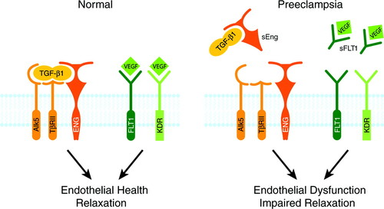
VEGF is essential for normal endothelial health throughout the mother
sFLT1 blocks its action
*Renal podocytes
*Hepatic sinusoids
*Choroid plexus
*Coronary arteries
© 2011 American Heart Association, Inc.
Camille E. Powe. Circulation. Preeclampsia, a Disease of the Maternal Endothelium, Volume: 123, Issue: 24, Pages: 2856-2869, DOI: (10.1161/CIRCULATIONAHA.109.853127)

Slide 28
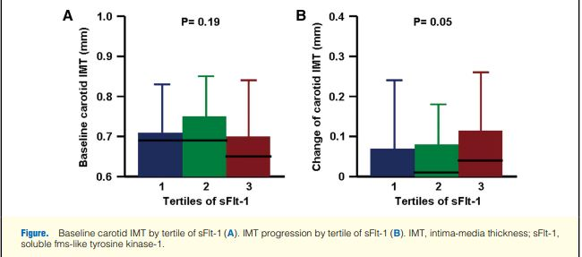
sFLT-1 INCREASES CIMT
10-fold faster increase in IMT over 24 months
0.006 vs 0.06 mm
Circulation Journal 2010:1007290834

Slide 29
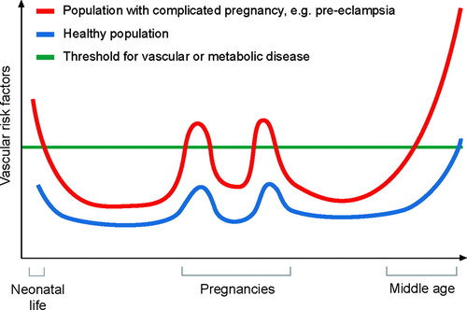
THE FOURTH TRIMESTER:
PREGNANCY AS A PREDICTOR OF CVD¹
CVD Risk Factors account for more than 50% of the risk for pregnancy-associated
blood pressure and
blood sugar disorders
© 2011 American Heart Association, Inc.
Camille E. Powe. Circulation. Preeclampsia, a Disease of the Maternal Endothelium, Volume: 123, Issue: 24, Pages: 2856-2869, DOI: (10.1161/CIRCULATIONAHA.109.853127)
1. Eur Cardiol 2021 Feb 16:e31

Slide 30
POSTPARTUM HYPERTENSION

Slide 31
POSTPARTUM HYPERTENSION
Post-partum HBP begins in first 6 weeks after delivery
Can be de novo in 60+%, or follow a pregnancy complicated by preeclampsia
Can herald seizures (postpartum eclampsia)
Increases risk of intracerebral hemorrhage

Slide 32
POSTPARTUM HYPERTENSION
NOTE: first postpartum visit is usually at 6 weeks!!!
BP peaks 3-6 days postpartum
Hypertension develops in 20% within 6 weeks, and 60% of those within 72 hours¹
60% are de novo, rest had antepartum HBP disorders
20% have stage 2 HBP and are above 160 SBP or 110 DBP
Associated features:
High BMI and DM more common
90% were given NSAIDs postpartum—possible contributor?
Ibuprofen and ketorolac most commonly
Circulation 2015;132:1726-1733

Slide 33
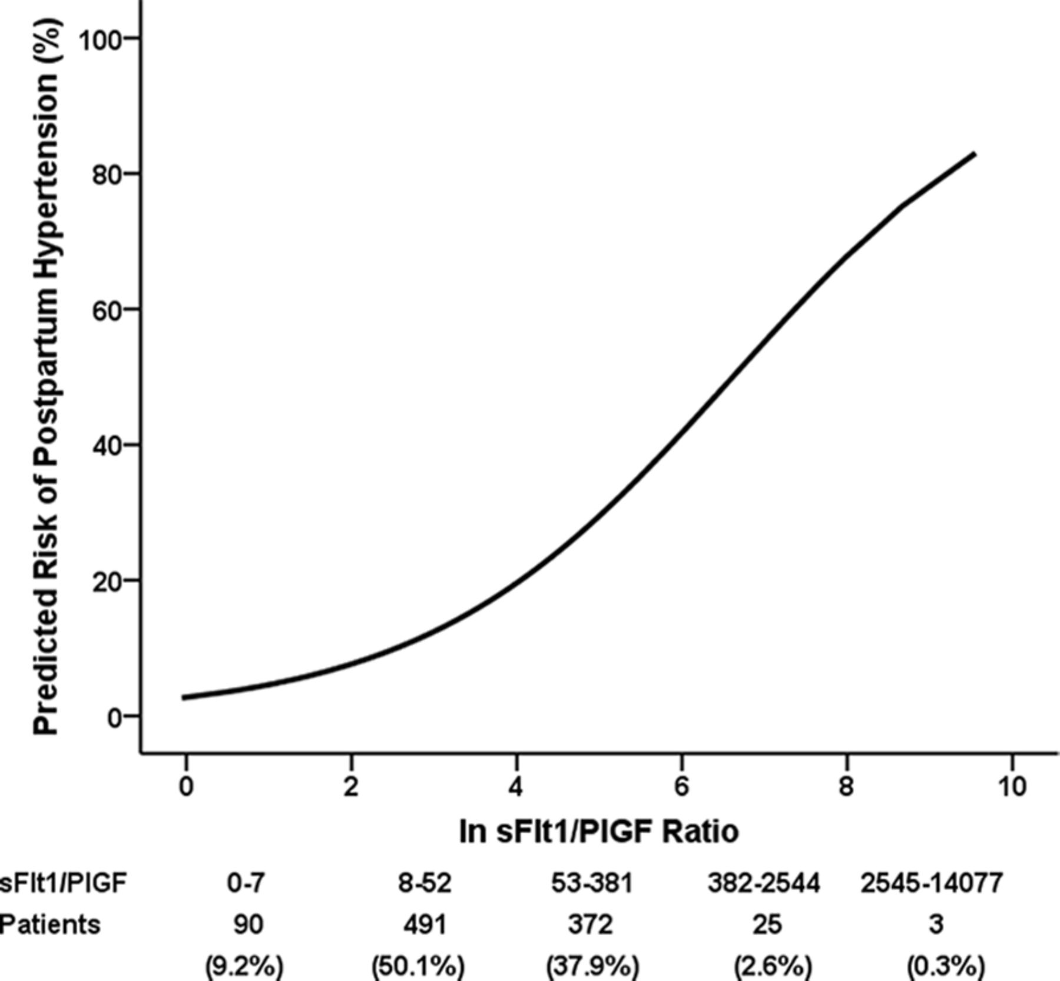
POSTPARTUM HYPERTENSION
Biomarkers
Antepartum fms-like tyrosine kinase 1: placental growth factor ratios are elevated similar to pre-eclampsia
No abnormal urine, liver,
platelet counts to suggest HELLP
?subclinical preeclampsia

Slide 34
POSTPARTUM STROKE
Pregnancy is a hypercoagulable state
Highest risk is within 6 weeks postpartum, extends to 12 weeks
Most postpartum strokes are in first 48 hours
50+% have a history of hypertension

Slide 35
BALE DONEEN TAKEAWAYS
ASK about pregnancy-related CV risks
EDUCATE patients/family members you are seeing about risks to their loved ones who become pregnant
PARTNER with OB-GYN colleagues in managing these high-risk patients
CREATE arterial wellness in your child-bearing patients!
BTW…NO ACE Inhibitors in pregnancy!!!

Slide 36
CIMT PROGRESSION
Mean IMT values range between 0.65-0.9 mm
Annual progression averages 0-0.04 mm/year
Accelerated arterial aging is indicated by higher rates of progression

Slide 37
CIMT AS A SURROGATE FOR CV RISK
119 randomized controlled studies using cIMT
Primary outcome: Combined MI, CVA, Revascularization or fatal CVD
100,667 patients, 62 yo, 42% female
Average 3.7 years follow up
12,038 patients (12%) had a CV event, or 3.2%/year
90% had repeat studies
Trials studied
Antidiabetics
Antihypertensives
Diet/vitamins
Lipid lowering
CIMT Metanalysis of 119 clinical trials involving 100667 patients. Willeit et al. Circ 2020;142(7):621-642.

Slide 38
CIMT PROGRESSION

Slide 39
CIMT AS A SURROGATE FOR CV RISK
Findings:
Mean progression
Contol arms +0.009mm/year
Treatment arms +0.001mm/year
Every 0.01 mm reduction in cIMT progression decreased CVD risk by 9%
“a small but significant proportion of the intervention effect acted independently of cIMT progression”
This is the first paper to definitively show that a change in cIMT progression is related to the change in risk of CVD events
CIMT Metanalysis of 119 clinical trials involving 100667 patients. Willeit et al. Circ 2020;142(7):621-642.

Slide 40
BALE DONEEN TAKEAWAYS
CIMT independent of plaque quality, is an independent predictor of MACE
Not all the benefit can be captured by IMT measurements—no surprise, as many factors conspire to cause EVENT REALITY!
Lipid-richness of the plaque has been shown in many other studies to be highly predictive of MACE—and is the most important CIMT metric to track
BDM principles improve all components of MACE etiology

Slide 41
CAROTID PLAQUE AND PREDICTION OF CAD
89 papers
22,683 patients
CIMT 1 mm or higher
77% Sensitivity, 58% Specificity
82% PPV, 66% NPV
Carotid Plaque
80% Sensitivity, 67% Specificity
78% PPV, 65% NPV

Slide 42
BALE DONEEN TAKEAWAYS
Nice to see others acknowledge the value CIMT—you are applying science which has been known for years, but not “endorsed by the guidelines”
Abnormal CIMT without plaque ➔ keep looking!
Carotid plaque present ➔ start treating!
Monitor response to therapy with annual CIMT follow up

Slide 43
ATRIAL FIBRILLATION
Prevalence—men > women
<0.2% under age 55
4% after age 60
10% after age 85
>20% after age 90
20% are diagnosed at the time of their stroke
“It’s silent until it isn’t”

Slide 44
ATRIAL FIBRILLATION RISK FACTORS
ALL BDM ROOT CAUSES
Age—due to length of time exposed to risk factors
Obesity
Diabetes and Metabolic Syndrome
Hypertension
Heart Disease: Ischemic, Valvular, Myocardial, Electrical, Pericardial
Cardiac surgery
Sleep Apnea—21-74% prevalence!
Venous Thromboembolism
Hyperthyroidism
Hypomagnesemia below 2.0 mg/dL
Chronic Kidney Disease

Slide 45
ATRIAL FIBRILLATION RISK FACTORS
Alcohol
Genetic, including 4q25
Night shift workers
Influenza—18% higher incidence in non-vaccinated in one study
Your Prescription Pad
Theophylline
Digoxin
Adrenergic stimulants, especially if underlying disease
Vagotonic agents, especially in younger

Slide 46
CLINICAL VS. SUBCLINICAL A FIB
Clinical a fib: present with symptoms or events
Subclinical a fib: detected by monitoring
Does screening for subclinical atrial fibrillation
improve outcomes?

Slide 47
STROKESTOP STUDY
28,000+ invited to participate, 7165 entered study
Twice daily EKG for 14 days
6.9 years follow up
1.1% absolute improvement in stoke, embolism, bleeding and all cause mortality (NNT 90)
31.9% vs 33%
“small benefit of screening”
Methodological issues limit validity
Lancet 2021;298(10310):1498-1506

Slide 48
LOOP TRIAL
Ages 70-90
At least one risk factor—which did NOT include sleep apnea!
Hypertension
Type 2 Diabetes
Prior CVA
Heart Failure
6004 patients, 1 in 4 had LOOP recorder implanted
A fib of at least 6 minutes detected over 64.5 months
31.8% vs. 12.2%
Lancet 2021;398(10310):1507-1516

Slide 49
LOOP TRIAL
No reduction is stroke or systemic embolism in those treated with anticoagulation
Subclinical atrial fibrillation may not carry the same risk as clinical atrial fibrillation??

Slide 50
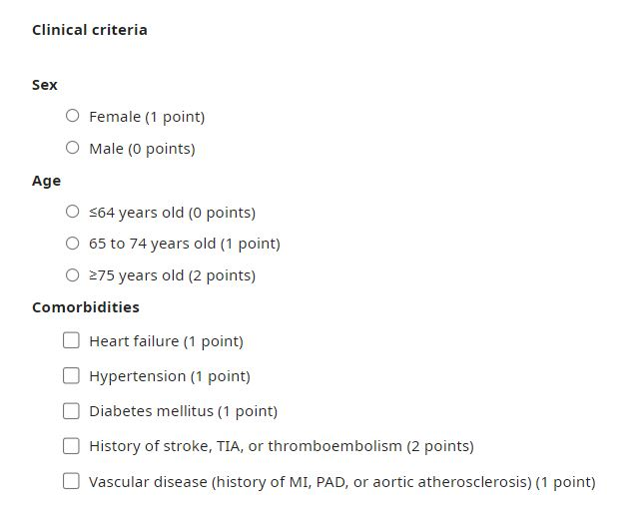
SUBCLINICAL ATRIAL FIBRILLATION
Can we discriminate those more likely to benefit?
21,768 with implanted cardiac devices, not anticoagulated, and low risk for a fib
Looked at duration of
AF
and
CHA₂DS₂-VASc Score
Circulation 2019;140(20):1639-1646.

Slide 51
SUBCLINICAL ATRIAL FIBRILLATION
Stroke risk exceeded 1%/year when Mean age greater than 68.6 years AND
2 points: >65 and either HBP, DM, HF, AMI, PAD or Aortic plaque
3 or 4: >75 and the above OR history of CVA/Embolic event
AF duration | 23.5 hours or longer | 6 minutes or longer
CHA₂DS₂-VASc Score | 2 | 3 or 4
Circulation 2019;140(20):1639-1646.

Slide 52
USPTF AND ATRIAL FIBRILLATION
26 RCT studies included
1 showed 1.1% absolute difference in outcomes with screening/treatment but had limitations
4 showed improvement in outcomes in populations with clinical, and mostly persistent AF
Wearable studies didn’t look at treatment, only detection
“…current evidence is insufficient to assess the balance of benefits and harms of screening for AF”
Screening for Atrial Fibrillation: USPTF Recommendtion Statement. JAMA 2022;327(4):360-67

Slide 53
BALE DONEEN TAKEAWAYS
The VAST majority of atrial fibrillation is preventable by applying the BDM principles!
Consider evaluating for atrial fibrillation your high risk patients with
Sleep Apnea 2-3 x risk
HBP 1.4 x risk
Valvular heart diseases—severe MVP, Rheumatic
CKD 1.3-3.2 x risk

Slide 54
QUESTIONS & ANSWERS

