Slide 1
Bale/Doneen Live Scientific Update Session
Amy Doneen DNP, ARNP
September 11, 2019
5:30-6:30 pm PST

Slide 2
Let us never forget to honor this day September 11, 2001

Slide 3
Today’s Agenda:
Coffee and Atrial Fibrillation
Midlife HTN and cognition impairment in later life
Review of the SPRINT-MIND
The Polypill – a cost effective analysis
E-Cigarettes
Smoking Cessation and health benefits
GETTING IN THE WEEDS -
Marijuana & CVD – a systemic review
Cannabis Use in Patients with CVD
Cannabinoid and THC – understanding the difference
CBD oil – what is it exactly?
CBD related to Anxiety and Sleep
CBD related to PTSD
Resources to learn more.
Reminder about the BaleDoneen Reunion! Can’t wait!

Slide 4
Coffee and Atrial Fibrillation

Slide 5
Coffee Consumption lowers AF risk in men
Prospective studies on the relation of coffee consumption with AF risk have been inconsistent. Sought to assess the association between coffee consumption and risk of AF in men.
Prospectively studied men who participated in the Physicians’ Health Study (N=18 960). Coffee consumption was assessed through self-reported food frequency questionnaires. Ave age 66 years.
The incidence of AF was assessed through annual questionnaires and validated through review of medical records.
Bodar, V., Chen, J., Gaziano, M., et al. (2019). Coffee consumption and risk of atrial fibrillation in the physicians’ health study. J. Am Heart Association. 2019;8:e011346.

Slide 6
Coffee Consumption lowers AF risk in men
Incidence rate, cases/1000 person-years
Model 1: Adjusted for age.
Model 2: Adjusted for age, smoking, alcohol intake (never, rarely, monthly, weekly, daily, >2 cups/d), and exercise (none, <1 d/wk, 1-2 d/wk, 3-4 d/wk, 5-7 d/wk).
Model 3: Adjusted for variables in Model 2 plus BMI, SBP, taking BP meds, DM, lipids, HF, CAD.
Bodar, V., Chen, J., Gaziano, M., et al. (2019). Coffee consumption and risk of atrial fibrillation in the physicians’ health study. J. Am Heart Association. 2019;8:e011346.

Slide 7
Coffee Consumption lowers AF risk in men
Spline curve assessing the relationship between coffee consumption and AF risk.
Dashed curves indicate 95% CI band.
Adjusted for age, smoking, alcohol, and exercise (P trend=0.01)
Bodar, V., Chen, J., Gaziano, M., et al. (2019). Coffee consumption and risk of atrial fibrillation in the physicians’ health study. J. Am Heart Association. 2019;8:e011346.

Slide 8
Coffee Consumption lowers AF risk in men
In this cohort of US male physicians we found a lower risk of AF only among participants drinking 1 to 3 cups of coffee per day; consumption below 1 cup/day or above 3 cups/day was not associated with AF risk reduction.
Authors hypothesize that coffee has other components of potential benefits.
Coffee contains a high number of antioxidants including polyphenol, cafestol, polyphenol, trigonelline, chlorogenic acid, and quinine, which could reduce CV events through anti-inflammatory effects.
Bodar, V., Chen, J., Gaziano, M., et al. (2019). Coffee consumption and risk of atrial fibrillation in the physicians’ health study. J. Am Heart Association. 2019;8:e011346.

Slide 9
Coffee Consumption lowers AF risk in men
BaleDoneen Take-Away:
No genetic testing – CYP1A2
Did not review coffee prep or decaf/caf or coffee prep
Physicians’ health study provides excellent long-term data on several factors – now including coffee and AF risk.
Based on this data and previous data – coffee intake of 1-3 cups/d reduces risk of atrial fibrillation in men.
Bodar, V., Chen, J., Gaziano, M., et al. (2019). Coffee consumption and risk of atrial fibrillation in the physicians’ health study. J. Am Heart Association. 2019;8:e011346.

Slide 10
Midlife Hypertension and cognitive impairment later in life

Slide 11
Midlife hypertension confers increased risk for cognitive impairment in late life
Midlife HTN is associated with late-life dementia risk and with risk of clinically diagnosed Alzheimer’s disease.
Previous work on BP and brain health focused on white matter hyperintensities, brain volumes, and amyloid pathology.
Extensive published literature describes the positive association between HTN and cerebral small vessel disease.
HTN has also been associated with smaller brain volumes, with more consistent associations seen with midlife, rather than late life.
The association between blood pressure and amyloid burden is less clear.
Lane, C., Barnes, J., Nicholas, J. et al. 2019. Associations between blood pressure across adulthood and late-life brain structure and pathology in the neuroscience substudy of the 1946 British birth cohort: an epidemiological study. Lancet neuro. August 20, 2019(19)30228-5

Slide 12
Midlife hypertension confers increased risk for cognitive impairment in late life
The sensitive period for risk exposure and extent that risk is mediated through amyloid or vascular-related mechanisms are poorly understood.
Aimed to identify if, and when, BP or change in BP during adulthood were associated with late-life brain structure, pathology, and cognition.
Participants were from Insight 46, a neuroscience sub-study of the ongoing longitudinal Medical Research Council National Survey of Health and Development, a birth cohort that initially comprised 5362 individuals born throughout mainland Britain in one week in 1946.
Participants aged 69–71 years received T1 and FLAIR volumetric MRI, amyloid-PET imaging, and cognitive assessment; all participants were dementia-free.
Lane, C., Barnes, J., Nicholas, J. et al. 2019. Associations between blood pressure across adulthood and late-life brain structure and pathology in the neuroscience substudy of the 1946 British birth cohort: an epidemiological study. Lancet neuro. August 20, 2019(19)30228-5

Slide 13
Midlife hypertension confers increased risk for cognitive impairment in late life
BP’s collected at ages 36, 43, 53, 60–64, and 69 years.
Also calculated BP change variables between ages
Primary outcome measures were:
1. White matter hyperintensity volume (WMHV) - MRI
2. Amyloid-β positivity or negativity: standardized uptake value ratio-PET
3. Whole-brain and hippocampal volumes quantified from 3D MRI
4. Composite cognitive score—the Preclinical Alzheimer Cognitive Composite (PACC).
Lane, C., Barnes, J., Nicholas, J. et al. 2019. Associations between blood pressure across adulthood and late-life brain structure and pathology in the neuroscience substudy of the 1946 British birth cohort: an epidemiological study. Lancet neuro. August 20, 2019(19)30228-5

Slide 14
Midlife hypertension confers increased risk for cognitive impairment in late life
Researchers investigated associations between BP and BP changes at and between 36, 43, 53, 60–64, and 69 years of age with white matter changes, amyloid-β status using logistic regression, whole-brain volume and hippocampal volumes using linear regression, and PACC score using linear regression, with adjustment for potential confounders.
Lane, C., Barnes, J., Nicholas, J. et al. 2019. Associations between blood pressure across adulthood and late-life brain structure and pathology in the neuroscience substudy of the 1946 British birth cohort: an epidemiological study. Lancet neuro. August 20, 2019(19)30228-5

Slide 15
Midlife hypertension confers increased risk for cognitive impairment in late life
At 53 years of age, there was evidence of a association between SBP and whole-brain volume (quadratic p=0·011) and between SBP and hippocampal volume (quadratic p=0·044).
A negative association did exist between greater SBP and whole-brain volume at blood pressures greater than 140 mm Hg (p=0·0008), suggesting that 140 mm Hg is a crucial threshold above which SBP at 53 years of age adversely affects whole-brain volume in late life.
A similar pattern was observed for hippocampal volume (SBP >140 p=0·0063).
Greater increases between 43 and 53 years of age showed a significant linear association with smaller whole-brain volume later in life.
Lane, C., Barnes, J., Nicholas, J. et al. 2019. Associations between blood pressure across adulthood and late-life brain structure and pathology in the neuroscience substudy of the 1946 British birth cohort: an epidemiological study. Lancet neuro. August 20, 2019(19)30228-5

Slide 16
Midlife hypertension confers increased risk for cognitive impairment in late life
Even accounting for BP in late life, higher BP in midlife is associated with greater cerebral small vessel disease burden and smaller whole-brain and hippocampal volumes at age 70.
Found no evidence that blood pressure or blood pressure changes affect amyloid status.
Observations are in agreement with previous work showing a particularly strong association between midlife blood pressure and late-life cerebral small vessel disease.
Both SBP and DBP at 53 years of age were associated with late-life cerebral small vessel disease
Lane, C., Barnes, J., Nicholas, J. et al. 2019. Associations between blood pressure across adulthood and late-life brain structure and pathology in the neuroscience substudy of the 1946 British birth cohort: an epidemiological study. Lancet neuro. August 20, 2019(19)30228-5

Slide 17
Midlife hypertension confers increased risk for cognitive impairment in late life
BaleDoneen Take-Away:
1. This work shows that the fourth to sixth decade, from early adulthood into midlife, is a sensitive period when greater BP affects brain pathologies later in life.
2. Routine serial BP measurements should start early (at least by age 40) and decisions to start tx should account for longitudinal BP change.
3. BP is an accessible tool to assess risk of generalized vascular health and can be achieved in so many clinical and outpatient settings – schools, dental, medical, office, home. GET PEOPLE EDUCATED!
4. Give Blood Pressure cuffs away during the holidays! Be a change agent within your community!
Lane, C., Barnes, J., Nicholas, J. et al. 2019. Associations between blood pressure across adulthood and late-life brain structure and pathology in the neuroscience substudy of the 1946 British birth cohort: an epidemiological study. Lancet neuro. August 20, 2019(19)30228-5

Slide 18
So – let’s examine the SPRINT-MIND trial – asking the question of whether aggressive treatment of BP affects dementia risk

Slide 19
Intensive vs Standard Blood Pressure control and dementia risk (SPRINT-MIND)
There are currently no proven treatments to reduce the risk of mild cognitive impairment and dementia.
To evaluate the effect of intensive blood pressure control on risk of dementia.
Randomized clinical trial conducted at 102 sites in the United States and Puerto Rico among adults aged 50 years or older with hypertension but without diabetes or history of stroke.
Randomization began on November 8, 2010. The trial was stopped early for benefit on its primary outcome (a composite of cardiovascular events) and all-cause mortality on August 20, 2015.
The final date for follow-up of cognitive outcomes was July 22, 2018.
Williamson, J., Pajewski, N., Auchus, A., et al. 2019. Effect of intensive vs standard blood pressure control on probably dementia. JAMA February 12, 2019 Vol 321,6

Slide 20
Intensive vs Standard Blood Pressure control and dementia risk (SPRINT-MIND)
Participants were randomized to a systolic blood pressure goal of either less than 120mmHg or less than 140mmHg
The primary cognitive outcome was occurrence of adjudicated probable dementia.
Secondary cognitive outcomes included adjudicated mild cognitive impairment and a composite outcome of mild cognitive impairment or probable dementia.
Williamson, J., Pajewski, N., Auchus, A., et al. 2019. Effect of intensive vs standard blood pressure control on probably dementia. JAMA February 12, 2019 Vol 321,6

Slide 21
Intensive vs Standard Blood Pressure control and dementia risk (SPRINT-MIND)
Among 9361 randomized participants
Mean age, 67.9 years; 3332 women (35.6%)
8563 (91.5%) completed at least 1 follow-up cognitive assessment.
Median intervention period was 3.34 years.
Williamson, J., Pajewski, N., Auchus, A., et al. 2019. Effect of intensive vs standard blood pressure control on probably dementia. JAMA February 12, 2019 Vol 321,6

Slide 22
Intensive vs Standard Blood Pressure control and dementia risk (SPRINT-MIND)
During a total median follow-up of 5.11 years:
Probable dementia
7.2 vs 8.6 cases per 1000 person-years
HR, 0.83; 95%CI, 0.67-1.04 - NS
Mild cognitive impairment
14.6 vs 18.3 cases per 1000 person-years
HR, 0.81; 95%CI, 0.69-0.95 (19% reduction)
Combined rate of mild cognitive impairment or probable dementia
20.2 vs 24.1 cases per 1000 person-years;
HR, 0.85; 95%CI, 0.74-0.97 (15% reduction)
Williamson, J., Pajewski, N., Auchus, A., et al. 2019. Effect of intensive vs standard blood pressure control on probably dementia. JAMA February 12, 2019 Vol 321,6

Slide 23
Intensive vs Standard Blood Pressure control and dementia risk (SPRINT-MIND)
BaleDoneen Take-Away:
1.
JAMA Published online January 28, 2019 – by Kristine Yaffe, MD
2. Alzheimer Disease and related dementia is expected to triple over the next 30 years in the United States and Worldwide.
3. Blood pressure is an identifiable and accessible root cause to modify.
4. The early termination of the trial and the extended follow-up as a cohort blurs
what the effect size might have been if the intervention had
continued as planned. The magnitude of the effect of intensive SBP lowering might have been greater.
5. The SPRINT-MIND trial adds insight into the importance of optimally controlled Blood pressure for brain health long term.
Williamson, J., Pajewski, N., Auchus, A., et al. 2019. Effect of intensive vs standard blood pressure control on probably dementia. JAMA February 12, 2019 Vol 321,6

Slide 24
THE polypill is on the horizon.

Slide 25
Cost-effectiveness of a fixed-dose combination pill for secondary prevention
Assess the cost-effectiveness of a polypill
(aspirin, lisinopril, atenolol, and simvastatin)
for secondary prevention of atherosclerotic CV disease compared with current care in China, India, Mexico, Nigeria, and South Africa.
In the intervention arm, we assumed that patients currently prescribed any prevention drug for atherosclerotic cardiovascular disease would receive the polypill instead, which would improve adherence by 32%
(from previous data predictions)
Assessed the cost-effectiveness of the polypill at prices in the public sector and on the retail market.
Lin, J., Moran, A., Bibbins-Domingo, K. et al. 2019. Cost-effectiveness of a fixed-dose combination pill for secondary prevention of cardiovascular disease: a modelling study. The Lancet. Http://dx.doi.org/10.1016.
Notes:
Previous studies have shown cost-effectiveness in higher income countries such as the US, Australia and UK

Slide 26
Cost-effectiveness of a fixed-dose combination pill for secondary prevention
Key outcomes were major adverse CV events
(CV death, non-fatal MI, or non-fatal stroke)
over a 5-year period and the incremental cost-effectiveness ratio (ICER) from the perspective of the health-care sector and a lifetime analytical horizon.
A cost-effectiveness threshold equal to each country’s per capita gross domestic product (GDP) per disability-adjusted life-year (DALY) averted.
Lin, J., Moran, A., Bibbins-Domingo, K. et al. 2019. Cost-effectiveness of a fixed-dose combination pill for secondary prevention of cardiovascular disease: a modelling study. The Lancet. Http://dx.doi.org/10.1016.

Slide 27
Cost-effectiveness of a fixed-dose combination pill for secondary prevention
What exactly is IN this polypill?
Aspirin 75 mg
Lisinopril10 mg
Atenolol 50 mg
Simvastatin 40 mg
The combination of drugs was chosen to reflect the fixed-dose combination pill investigated in the Use of Multidrug Pill In Reducing cardiovascular Events (UMPIRE) study.
Lin, J., Moran, A., Bibbins-Domingo, K. et al. 2019. Cost-effectiveness of a fixed-dose combination pill for secondary prevention of cardiovascular disease: a modelling study. The Lancet. Http://dx.doi.org/10.1016.

Slide 28
Cost-effectiveness of a fixed-dose combination pill for secondary prevention
Among adults aged 30–84 years with established CVD, the polypill for secondary prevention compared with current care was projected to avert 40–54 major adverse cardiovascular events for every 1000 patients treated for 5 years
Lin, J., Moran, A., Bibbins-Domingo, K. et al. 2019. Cost-effectiveness of a fixed-dose combination pill for secondary prevention of cardiovascular disease: a modelling study. The Lancet. Http://dx.doi.org/10.1016.

Slide 29
Cost-effectiveness of a fixed-dose combination pill for secondary prevention
DALYs - disability-adjusted life-year
Lin, J., Moran, A., Bibbins-Domingo, K. et al. 2019. Cost-effectiveness of a fixed-dose combination pill for secondary prevention of cardiovascular disease: a modelling study. The Lancet. Http://dx.doi.org/10.1016.

Slide 30
Cost-effectiveness of a fixed-dose combination pill for secondary prevention
BaleDoneen Take-Away:
The BaleDoneen Method has long discussed the dream of having the ‘perfect’ polypill that included the cornerstones to therapy. The challenge: precision-based healthcare limits this possibility.
At the same time – this article was interesting because it demonstrated in a financially challenged environment, this adds definite improvement in outcomes.
The authors state, and we concur, that infrastructure for lifestyle counseling must be in place to truly reduce CVD long term.
Lin, J., Moran, A., Bibbins-Domingo, K. et al. 2019. Cost-effectiveness of a fixed-dose combination pill for secondary prevention of cardiovascular disease: a modelling study. The Lancet. Http://dx.doi.org/10.1016.

Slide 31
Shifting gears – Let’s talk e-cigarettes and nicotine!

Slide 32
Really? What were they thinking?

Slide 33
9/11/2019

Slide 34
Source: www.msn.com 9-11-2019

Slide 35
E-cigarettes damage arteries
Previous studies showed that nicotinized electronic cigarettes (e-cigarettes) elicit systemic oxidative stress & inflammation.
However, the effect of the aerosol alone on endothelial function is not fully understood.
Purpose:
To quantify surrogate markers of endothelial function in nonsmokers after inhalation of aerosol
from nicotine-free e-cigarettes.
Caporale, A., Langham, M., Guo, W., et al. 2019. Acute effects of electronic cigarette aerosol inhalation on vascular function detected at quantitative MRI. Radiology 2019; 00:1–10

Slide 36
E-cigarettes damage arteries
Caporale, A., Langham, M., Guo, W., et al. 2019. Acute effects of electronic cigarette aerosol inhalation on vascular function detected at quantitative MRI. Radiology 2019; 00:1–10

Slide 37
E-cigarettes damage arteries
E-cigarette Vaping Challenge:
The supervised e-cigarette vaping challenge consisted of 16
3-second inhalations.
The research coordinator monitored the challenge, considered successful in the absence of coughing or swallowing of the vapor. 15% flavor dilution ratio and 0 mg of nicotine.
Caporale, A., Langham, M., Guo, W., et al. 2019. Acute effects of electronic cigarette aerosol inhalation on vascular function detected at quantitative MRI. Radiology 2019; 00:1–10

Slide 38
E-cigarettes damage arteries
Multivascular Quantitative MRI:
(a)peripheral vascular reactivity in the superficial femoral artery and vein,
(b) cerebrovascular reactivity in the superior sagittal sinus
(c) Aortic arch pulse wave velocity
Peripheral vascular reactivity assessment:
5 min occlusion and 5 min recovery to quantify femoral artery luminal flow-mediated dilation.
Cerebrovascular reactivity assessment:
The superior sagittal sinus was imaged during apnea challenge consisting of three successive 30-second postexpiratory breath holds interspersed by 2 min of normal breathing. Blood flow velocity in the superior sagittal sinus was quantified by phase-contrast MRI.
Aortic pulse wave velocity assessment:
The pulse wave path length was traced on a sagittal image of the aortic arch.
Caporale, A., Langham, M., Guo, W., et al. 2019. Acute effects of electronic cigarette aerosol inhalation on vascular function detected at quantitative MRI. Radiology 2019; 00:1–10

Slide 39
E-cigarettes damage arteries
Caporale, A., Langham, M., Guo, W., et al. 2019. Acute effects of electronic cigarette aerosol inhalation on vascular function detected at quantitative MRI. Radiology 2019; 00:1–10

Slide 40
E-cigarettes damage arteries
Summary:
Nicotine-free electronic cigarette aerosol inhalation in young, healthy nonsmokers resulted in transient impairment of vascular reactivity and endothelial function by using quantitative MRI metrics across multiple vascular beds.
Caporale, A., Langham, M., Guo, W., et al. 2019. Acute effects of electronic cigarette aerosol inhalation on vascular function detected at quantitative MRI. Radiology 2019; 00:1–10

Slide 41
E-cigarettes damage arteries
Key Results:
After inhalation of nicotine-free electronic cigarette aerosol, femoral artery flow-mediated dilation and reactive hyperemia acceleration were reduced (234%, P , .001; 225.8%, P , .001, respectively), indicating acute endothelial dysfunction.
Inhalation of nicotine-free electronic cigarette aerosol was associated with hemoglobin saturation reduction (220%; P , .001) in the superficial femoral vein, suggesting impaired microvascular function.
Inhalation of nicotine-free electronic cigarette aerosol was also associated with increase in aortic pulse wave velocity (3%; P = .05), suggesting acute aortic stiffening
Caporale, A., Langham, M., Guo, W., et al. 2019. Acute effects of electronic cigarette aerosol inhalation on vascular function detected at quantitative MRI. Radiology 2019; 00:1–10

Slide 42
E-cigarettes damage arteries
BaleDoneen Take-Away:
This study looks at the mechanism of e-cigarettes (not nicotine) and showed negative effects on:
1. Peripheral hyperemia in response to cuff-induced ischemia
2. Cerebrovascular reactivity in response to breath hold
3. Aortic pulse wave velocity, and an indicator of aortic stiffness
Appreciating the contributory effects of nicotine to this milieu of risk, we must appreciate the negative effects of vaping in general.
Previous work also showed that nicotine-free e-cigarette vaping caused a transient increase in serum markers of inflammation (c-reactive protein) and oxidative stress, and the changes peaked at 1–2 hours after vaping and recovery occurred within 6 hours. (Chatterjee S. J Physiol Lung Cell Mol Physiol 2019)
Caporale, A., Langham, M., Guo, W., et al. 2019. Acute effects of electronic cigarette aerosol inhalation on vascular function detected at quantitative MRI. Radiology 2019; 00:1–10

Slide 44
Smoking cessation continues to show CV risk even after 5 years.
The time course of cardiovascular disease (CVD) risk after smoking cessation is unclear.
Risk calculators consider former smokers to be at risk for only 5 years.
OBJECTIVE To evaluate the association between years since quitting smoking and incident CVD.
Duncan, M., Freiberg, M., et al. 2019. Association of smoking cessation with subsequent risk of CVD. JAMA. 2019;322(7):642-650

Slide 45
Smoking cessation continues to show CV risk even after 5 years.
Retrospective analysis of prospectively collected data from Framingham Heart Study participants without baseline CVD (original cohort: attending their fourth examination in 1954-1958; offspring cohort: attending their first examination in 1971-1975) followed up through December 2015.
Time-updated self-reported smoking status, years since quitting, and cumulative pack-years.
Duncan, M., Freiberg, M., et al. 2019. Association of smoking cessation with subsequent risk of CVD. JAMA. 2019;322(7):642-650

Slide 46
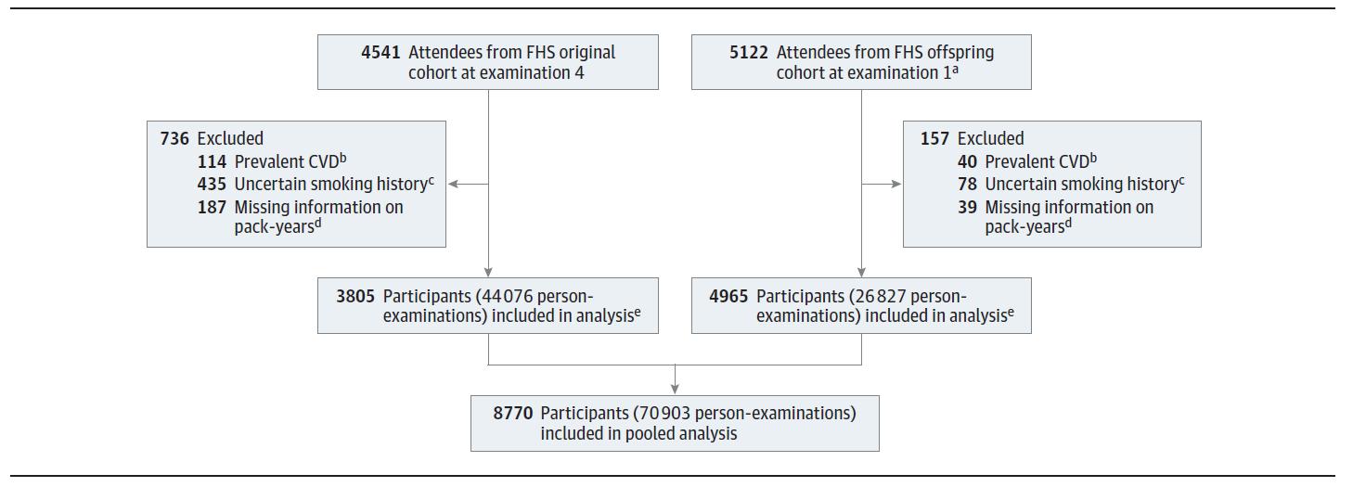
Smoking cessation continues to show CV risk even after 5 years.
Duncan, M., Freiberg, M., et al. 2019. Association of smoking cessation with subsequent risk of CVD. JAMA. 2019;322(7):642-650

Slide 47
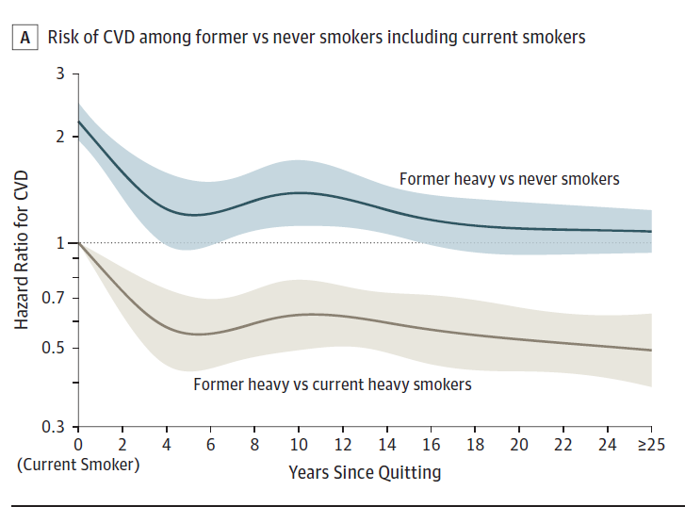
Smoking cessation continues to show CV risk even after 5 years.
Duncan, M., Freiberg, M., et al. 2019. Association of smoking cessation with subsequent risk of CVD. JAMA. 2019;322(7):642-650

Slide 48
Smoking cessation continues to show CV risk even after 5 years.
What is the question and necessity of this new research?
Among heavy smokers (ie,20 pack-years), what is the association between time since smoking cessation and subsequent reduced risk of cardiovascular disease?
Duncan, M., Freiberg, M., et al. 2019. Association of smoking cessation with subsequent risk of CVD. JAMA. 2019;322(7):642-650

Slide 49
Smoking cessation continues to show CV risk even after 5 years.
In this observational cohort study of 8770 participants, former heavy smokers’ risk of CVD was significantly lower within 5 years of smoking cessation relative to current smokers but remained significantly elevated for at least 5 to 10 years and possibly for 25 years after cessation relative to never smokers.
Duncan, M., Freiberg, M., et al. 2019. Association of smoking cessation with subsequent risk of CVD. JAMA. 2019;322(7):642-650

Slide 50
Smoking cessation continues to show CV risk even after 5 years.
Among heavy smokers, smoking cessation was associated with significantly lower CVD risk within 5 years relative to current smokers.
However, relative to never smokers, former smokers’ risk remained significantly elevated beyond 5 years after smoking cessation.
Duncan, M., Freiberg, M., et al. 2019. Association of smoking cessation with subsequent risk of CVD. JAMA. 2019;322(7):642-650

Slide 51
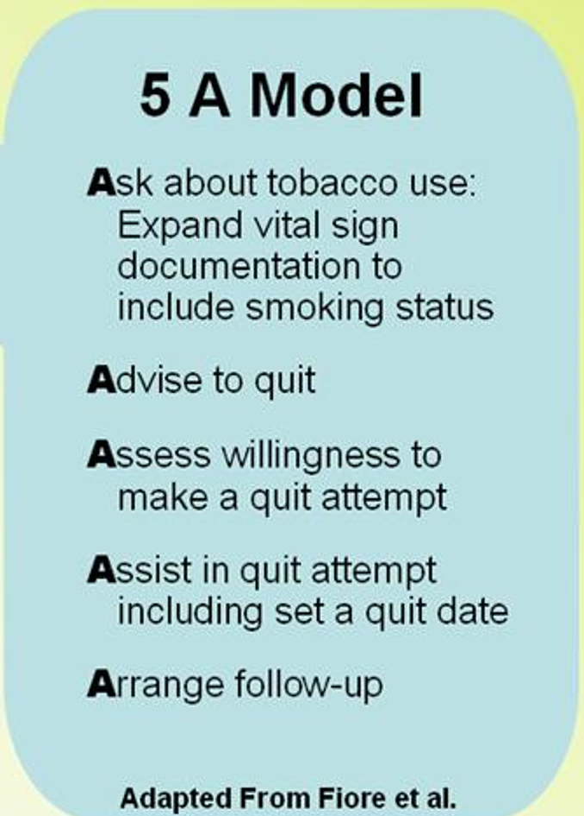
Smoking cessation continues to show CV risk even after 5 years.
BaleDoneen Take-Away:
Smoking has long term complications.
Best education is to discuss the long term impact and encourage never starting and if currently smoking – cessation is a must.
The current ‘acceptance’ of nicotine use without smoking is of high concern based on this study.
5-A’s – Always!
Duncan, M., Freiberg, M., et al. 2019. Association of smoking cessation with subsequent risk of CVD. JAMA. 2019;322(7):642-650

Slide 52
Let’s get in the weeds of the issue ☺

Slide 53
Marijuana use and CVD: Systemic Review
Marijuana use is increasing in the United States, and its effect on cardiovascular health is unknown.
Review harms and benefits of marijuana use in relation to cardiovascular risk factors and clinical outcomes.
PubMed, MEDLINE, EMBASE, PsycINFO, and the Cochrane Library between 1 January 1975 and 30 September 2017.
Adults using any form of marijuana, and reported on vascular risk factors (hyperglycemia, diabetes, dyslipidemia, and obesity) or on outcomes (stroke, myocardial infarction, cardiovascular mortality, and all-cause mortality in cardiovascular cohorts).
Ravi, D., Ghasemiesfe, M. et al. 2018. Marijuana use and cardiovascular disease: a systemic review. Ann Intern Med. 2018;168:187-194.

Slide 54
Marijuana use and CVD: Systemic Review
Lots of limitations with this systemic review:
Evidence examining the effect of marijuana on diabetes, dyslipidemia, acute MI, CVA, or CV mortality and all-cause mortality was insufficient.
Current literature includes several long-term prospective studies, they are limited by recall bias, inadequate exposure assessment, minimal marijuana exposure, and a predominance of low-risk cohorts.
Poor- or moderate-quality data, inadequate assessment of marijuana exposure and minimal exposure in the populations studied, and variation in study design.
Ravi, D., Ghasemiesfe, M. et al. 2018. Marijuana use and cardiovascular disease: a systemic review. Ann Intern Med. 2018;168:187-194.

Slide 55
Marijuana use and CVD: Systemic Review
Literature Search
Search yielded 3006 abstracts, 1669 of which were selected for further evaluation.
Among these, 140 were selected for full-text review.
Another 7 articles were added via author and reference tracking. Of these 147 papers, 24 met inclusion criteria
Ravi, D., Ghasemiesfe, M. et al. 2018. Marijuana use and cardiovascular disease: a systemic review. Ann Intern Med. 2018;168:187-194.

Slide 56
Marijuana use and CVD: Systemic Review
Ravi, D., Ghasemiesfe, M. et al. 2018. Marijuana use and cardiovascular disease: a systemic review. Ann Intern Med. 2018;168:187-194.

Slide 57
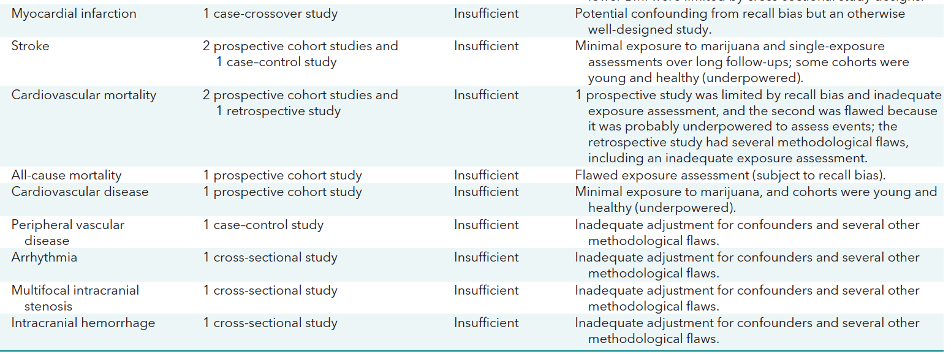
Marijuana use and CVD: Systemic Review
Ravi, D., Ghasemiesfe, M. et al. 2018. Marijuana use and cardiovascular disease: a systemic review. Ann Intern Med. 2018;168:187-194.

Slide 58
Marijuana use and CVD: Systemic Review
Although several studies suggested a metabolic benefit from marijuana use, they were based on cross sectional designs and not supported by prospective studies.
Evidence examining the effect of marijuana
on diabetes, hyperlipidemia, acute myocardial
infarction, stroke, and cardiovascular mortality was insufficient.
Adequately powered prospective studies are
needed to determine the effect of chronic marijuana
use on cardiovascular health
Ravi, D., Ghasemiesfe, M. et al. 2018. Marijuana use and cardiovascular disease: a systemic review. Ann Intern Med. 2018;168:187-194.

Slide 59
Marijuana use and CVD: Systemic Review
BaleDoneen Take Away:
More prospective evidence is needed regarding the safety and risk profile of marijuana use and CVD risk.
This data does not support proactively supporting the use of marijuana – so much more to data is needed.
This meta analysis proposes that prospective data is necessary to make a decision.
This meta-analysis did not look at CBD or THC individually – used word search of “marijuana” which includes both.
Ravi, D., Ghasemiesfe, M. et al. 2018. Marijuana use and cardiovascular disease: a systemic review. Ann Intern Med. 2018;168:187-194.

Slide 60
Case review of Cannabis use in man with established CVD

Slide 61
Cannabis Use in Patients with Cardiovascular Disease
In the context of widespread legalization of cannabis use for both medical and recreational purposes, health care providers need to understand and manage cannabis use and its complications in older patients, particularly in those with cardiovascular disease (CVD).
Benowitz, N. (2019). Cannabis use in patients with cardiovascular disease. Canadian Journal of Cardiology. Volume 35 2019

Slide 62
Cannabis Use in Patients with Cardiovascular Disease
Older man with stable coronary artery disease (CAD), taking appropriate cardiac medications, who consumed a large dose of delta-9-tetrahydrocannabinol (THC) orally for the treatment of pain and to aid sleep. Resulted in extreme discomfort (anxiety & fearful hallucinations), associated with intense sympathetic neural stimulation and a non ST-segment elevation myocardial infarction.
Initial vital signs included tachycardia and hypertension, despite taking substantial doses of metoprolol and a calcium channel blocker.
After resolution of the hallucinations, the chest pain resolved. Prior case reports, as well as epidemiologic studies, have described the association between cannabis use and acute CV adverse events, including myocardial infarction, stroke, arrhythmias, and sudden death
Benowitz, N. (2019). Cannabis use in patients with cardiovascular disease. Canadian Journal of Cardiology. Volume 35 2019

Slide 63
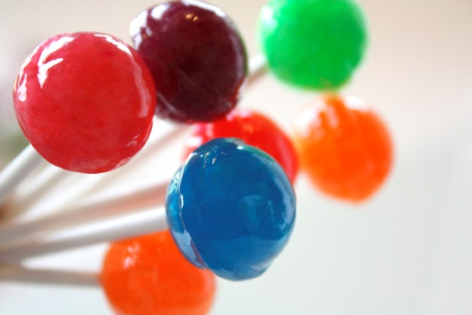
Cannabis Use in Patients with Cardiovascular Disease
Some edible products, such as brownies for example, may contain several “servings” of THC, but the patient may not know that.
In the case of a 90 mg THC lollipop, such as was purchased by the patient in this case report, an appropriate starting dose might be a few licks or a small piece.
Benowitz, N. (2019). Cannabis use in patients with cardiovascular disease. Canadian Journal of Cardiology. Volume 35 2019

Slide 64
Cannabis Use in Patients with Cardiovascular Disease
CV toxicity of marijuana can be viewed as a consequence of
1 or more of the following:
(1) inhalation of combustion products of marijuana
(2) direct CV effects of THC
(3) indirect effects of THC related to acute anxiety, hallucination, and/or psychosis.
Benowitz, N. (2019). Cannabis use in patients with cardiovascular disease. Canadian Journal of Cardiology. Volume 35 2019

Slide 65
Cannabis Use in Patients with Cardiovascular Disease
What about Marijuana smoke?
Marijuana smoke exposes the smoker to high levels of oxidants, particulates, numerous toxic volatile organic chemicals, and carbon monoxide.
Adverse CV effects of smoke include oxidant damage, inflammation, endothelial dysfunction, induction of a prothrombotic state, and reduction of oxygen-carrying capacity of red blood cells.
These toxic effects can translate into plaque rupture, acute thrombosis, and/or vasoconstriction with reduced coronary blood flow, resulting in an increased risk of acute coronary syndrome, stroke, and sudden cardiac death
Benowitz, N. (2019). Cannabis use in patients with cardiovascular disease. Canadian Journal of Cardiology. Volume 35 2019

Slide 66
Cannabis Use in Patients with Cardiovascular Disease
Benowitz, N. (2019). Cannabis use in patients with cardiovascular disease. Canadian Journal of Cardiology. Volume 35 2019

Slide 67
Cannabis Use in Patients with Cardiovascular Disease
How should health care providers manage patients with CVD who are using or would like to use cannabis products?
Many patients would like to use or are using cannabis to manage anxiety, chronic pain, and/or to aid sleep.
Particularly vulnerable to the adverse effects of cannabis are patients with coronary artery or cerebrovascular disease, heart failure, and arrhythmias, including atrial fibrillation, paroxysmal supraventricular arrhythmias, and ventricular tachycardia.
No empirical evidence is available to guide management of cannabis use in older patients and/or patients with cardiovascular disease.
Benowitz, N. (2019). Cannabis use in patients with cardiovascular disease. Canadian Journal of Cardiology. Volume 35 2019

Slide 68
Cannabis Use in Patients with Cardiovascular Disease
BalenDoneen Take Away:
Despite claims of cannabis having benefits on sleep, anxiety and pain – at this point, we cannot consider it to be safe from a cardiovascular standpoint. Cannabis is the entire plant – not just the cannabinoid
Due to the legalization of cannabis – this must be brought up with all interviews with patients regardless of age and background.
Most importantly, education is important – people want to fell less anxiety, sleep better and be in less pain – now that cannabis is legal in many states – at this point we cannot offer a blanket offering as ‘safety’ with this substance.
Author does state – if one wants to use Cannabis, consider the alternative of CBD instead. However – no data was cited.
Benowitz, N. (2019). Cannabis use in patients with cardiovascular disease. Canadian Journal of Cardiology. Volume 35 2019

Slide 70
Cannabinoids and THC – Two different animals from the same plant.
Freeman, T., Hindocha, C., 2019. Medicinal use of cannabis based product and cannabinoids. BMJ 2019;365:l1141 doi: 10.1136/bmj.l1141 (Published 4 April 2019)

Slide 71
Cannabinoids and THC – Two different animals from the same plant.
Cannabis is available for medicinal use in 33 US states and for non-medicinal use in 10 US states, although both remain illegal under federal law.
Other recent developments include the legalization of cannabis for non-medicinal use in Canada on 17 October 2018.
The World Health Organization has proposed that cannabis should be rescheduled within international law because of growing evidence of its medicinal applications
Freeman, T., Hindocha, C., 2019. Medicinal use of cannabis based product and cannabinoids. BMJ 2019;365:l1141 doi: 10.1136/bmj.l1141 (Published 4 April 2019)

Slide 72
Cannabinoids and THC – Two different animals from the same plant.
The cannabis plant can produce at least 144 naturally occurring compounds known as cannabinoids.
The most widely researched cannabinoids are
Δ9-tetrahydrocannabinol (THC) and CBD.
THC is the primary constituent of cannabis that causes the “high” whereas CBD is not intoxicating at typical doses.
Freeman, T., Hindocha, C., 2019. Medicinal use of cannabis based product and cannabinoids. BMJ 2019;365:l1141 doi: 10.1136/bmj.l1141 (Published 4 April 2019)

Slide 73
Cannabinoids and THC – Two different animals from the same plant.
Freeman, T., Hindocha, C., 2019. Medicinal use of cannabis based product and cannabinoids. BMJ 2019;365:l1141 doi: 10.1136/bmj.l1141 (Published 4 April 2019)

Slide 74
Cannabinoids and THC – Two different animals from the same plant.
THC and CBD have contrasting mechanisms of action on the endocannabinoid system, which is widely expressed in the central and peripheral nervous systems.
These actions may account for their therapeutic effects. CBD increased plasma endocannabinoid levels in a clinical trial in schizophrenia, which correlated with the degree of symptom improvement.
When taken together with THC, CBD may offset some of the adverse effects of THC, such as memory impairment and paranoia.
Freeman, T., Hindocha, C., 2019. Medicinal use of cannabis based product and cannabinoids. BMJ 2019;365:l1141 doi: 10.1136/bmj.l1141 (Published 4 April 2019)

Slide 75
Cannabinoids and THC – Two different animals from the same plant.
The balance of THC and CBD may contribute to safety as well as therapeutic effects. CBD has an excellent safety profile and is well tolerated, even at high doses.
THC carries an increased risk of adverse events
(including potentially serious adverse CV events)
In a systematic review and meta-analysis, cannabinoids (primarily THC) were associated with a five-fold increase in rates of disorientation and dizziness, compared with placebo or active comparators.
Freeman, T., Hindocha, C., 2019. Medicinal use of cannabis based product and cannabinoids. BMJ 2019;365:l1141 doi: 10.1136/bmj.l1141 (Published 4 April 2019)

Slide 76
Freeman, T., Hindocha, C., 2019. Medicinal use of cannabis based product and cannabinoids. BMJ 2019;365:l1141 doi: 10.1136/bmj.l1141 (Published 4 April 2019)

Slide 77
Cannabinoids and THC – Two different animals from the same plant.
BaleDoneen Take-Away:
Most importantly – understand the difference and the definitions – Ask the appropriate questions - *BDM intake forms are being improved to include the right questions.
With legality of Cannabis – patients sometimes do not know the difference between Cannabis, THC, Cannabinoid, and Hemp?
The various forms of ingestion also compound the question of exactly what people are taking.
Anecdotally – I will share that my patient population (HASPC of Spokane – my elderly patients are using CBD for pain and sleep on a very regular basis – I needed to get educated!
Freeman, T., Hindocha, C., 2019. Medicinal use of cannabis based product and cannabinoids. BMJ 2019;365:l1141 doi: 10.1136/bmj.l1141 (Published 4 April 2019)

Slide 78
The most common delivery module for Cannabidiol is in an oil form

Slide 79
CBD Oil – what is it exactly?
The cannabinoid CBD, a non-psychoactive isomer of the more infamous tetrahydrocannabinol (THC), is available in a growing number of administration modes, but the most commonly known is CBD oil.
There are currently dozens, if not hundreds, of producers and sellers of CBD oils active in the market, and their number is increasing rapidly.
Despite the growing availability of CBD, many uncertainties remain about the legality, quality, and safety of this new “miracle cure.”
Hazekamp, A. 2018. The trouble with CBD oil. Med Cannabis Cannabinoids 2018;1:65–72

Slide 80
CBD Oil - what is it exactly?
As a result, CBD is under scrutiny on many levels, ranging from national health organizations and agricultural lobbyists to the WHO and FDA.
The central question is whether CBD is simply a food supplement, an investigational new medicine, or even a narcotic.
The intention of this paper is to create a better understanding of the benefits versus the risks of the current way CBD products are produced, used, and advertised
Hazekamp, A. 2018. The trouble with CBD oil. Med Cannabis Cannabinoids 2018;1:65–72

Slide 81
CBD Oil - what is it exactly?
Cannabidiol (CBD) oil is essentially a concentrated solvent extract made from cannabis flowers or leaves that is dissolved in an edible oil such as sunflower, hemp, or olive oil.
Solvents used can vary from relatively innocuous organic solvents (ethanol, isopropyl alcohol) to more harmful ones (petroleum-ether, naphtha), or supercritical fluids (butane, CO2).
Cannabis oils may contain various concentrations of CBD, tetrahydrocannabinol (THC), and minor cannabinoids, mainly depending on the cannabis variety used for extraction.
Hazekamp, A. 2018. The trouble with CBD oil. Med Cannabis Cannabinoids 2018;1:65–72

Slide 82
CBD Oil - what is it exactly?
Oil has become a favorite mode of administration for many medical users of cannabis and cannabinoids for multiple reasons:
1. Concentrated extracts allow the consumption of a large dose of cannabinoids in an easily ingestible form.
2. With CBD oil, there is no risk of intoxication (getting high), so much larger doses can be consumed than would be possible for THC-rich products.
3. Cannabis oil has no smell
Hazekamp, A. 2018. The trouble with CBD oil. Med Cannabis Cannabinoids 2018;1:65–72

Slide 83
CBD Oil - what is it exactly?
CBD is used for the treatment of a wide range of medical conditions. Started with discovery (by parents experimenting with self-medication for their children) that CBD had a therapeutic effect on a serious form of epilepsy in children, called Dravet syndrome. (Epidiolex)
Other medical indications that are treated with CBD (with clinical evidence) include Parkinson’s disease, schizophrenia, and anxiety disorders.
Used commonly using for pain, sleep, and anxiety.
However, although research into the therapeutic effects of CBD is rapidly increasing, most current uses of CBD are not supported by clinical data
Hazekamp, A. 2018. The trouble with CBD oil. Med Cannabis Cannabinoids 2018;1:65–72

Slide 84
CBD Oil - what is it exactly?
BaleDoneen Take-Away:
CBD is easily attainable online and at supplement stores.
Be aware of ALL meds and supplements that patients are taking. Despite the apparent global use of CBD, it remains a foreign substance that has systemic impact. Nothing is benign.
CBD is metabolized via the CYP3A4 enzyme and is consider an ‘inhibitor’. - common meds that share this pathway include: Fluvastatin, Atorvastatin, Simvastatin, Clarithromycin, Cyclosporin, Diltiazem, Erythromycin, Verapamil, Grapefruit Juice, Amiodarone.
Hazekamp, A. 2018. The trouble with CBD oil. Med Cannabis Cannabinoids 2018;1:65–72

Slide 85
Example of my patient’s “MyPGT report
CYP3A4
Extensive metabolizer

Slide 86
So many people feel….. And….they WANT to feel better!

Slide 87
Cannabidiol (CBD) helps with anxiety and sleep
Objective: To determine whether CBD helps improve sleep and/ or anxiety in a clinical population.
Design: A large retrospective case series at a psychiatric clinic involving clinical application of CBD for anxiety and sleep complaints as an adjunct to usual treatment.
The retrospective chart review included monthly documentation of anxiety and sleep quality in 103 adult patients.
Main Outcome: Sleep and anxiety scores, using validated instruments, at baseline and after CBD treatment.
Shannon, S., Lewis, N., et al. 2019. Cannabidiol in anxiety and sleep: a large case series. Perm J 2019;23:18-041.

Slide 88
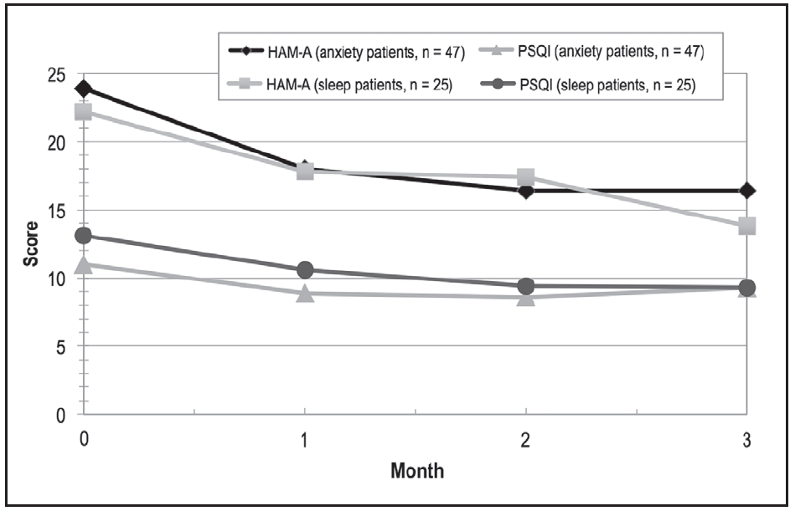
Cannabidiol (CBD) helps with anxiety and sleep
The final sample consisted of 72 adults presenting with primary concerns of anxiety (n = 47) or poor sleep (n = 25).
Anxiety scores decreased within the first month in 57 patients (79.2%) and remained decreased during the study duration.
Sleep scores improved within the first month in 48 patients (66.7%) but fluctuated over time
Shannon, S., Lewis, N., et al. 2019. Cannabidiol in anxiety and sleep: a large case series. Perm J 2019;23:18-041.

Slide 89
Cannabidiol (CBD) helps with anxiety and sleep
BaleDoneen Take Away:
Only side effect of mention was fatigue – no CV side effects reported but poorly followed and average age was 34 years.
Study has limitations as it was retrospective with chart review. No placebo group. CBD given in capsule form.
Despite the limitations – CBD shows promise with sleep and anxiety.
No CV negative outcomes reported.
Shannon, S., Lewis, N., et al. 2019. Cannabidiol in anxiety and sleep: a large case series. Perm J 2019;23:18-041.

Slide 90
Examined trauma exposure and PTSD symptoms in relation to incident CVD over a 20-year period in 49,978 women in the Nurses Health Study II.
Compared to no trauma, 4 or more PTSD symptoms was associated with increased CVD risk after adjusting for age, family history and childhood factors.
HR 1.60 [95% CI. 1.20-2.13].
Sumner, J., Kubzansky L, Elkind, M. et al. PTSD and cardiovascular events in women. June 19, 2015. Circulation, AHA.

Slide 91
Cannabidiol (CBD) helps with PTSD
This retrospective case series examines the effect of oral CBD administration on symptoms of PTSD in a series of 11 adult patients at an outpatient psychiatry clinic. Mean age 39 years
CBD was given on an open-label, flexible dosing regimen to patients diagnosed with PTSD by a mental health professional.
Patients also received routine psychiatric care, including concurrent treatment with psychiatric medications and psychotherapy.
The length of the study was 8 weeks.
PTSD symptom severity was assessed every 4 weeks by patient-completed PTSD Checklist for the DSM-5 (PCL-5) questionnaires.
Elms, L., Shannon, S., Hughes, S., Lewis, N. (2019) The Journal of Alternative and Complementary Medicine; 25: 4. pp. 392-397.

Slide 92
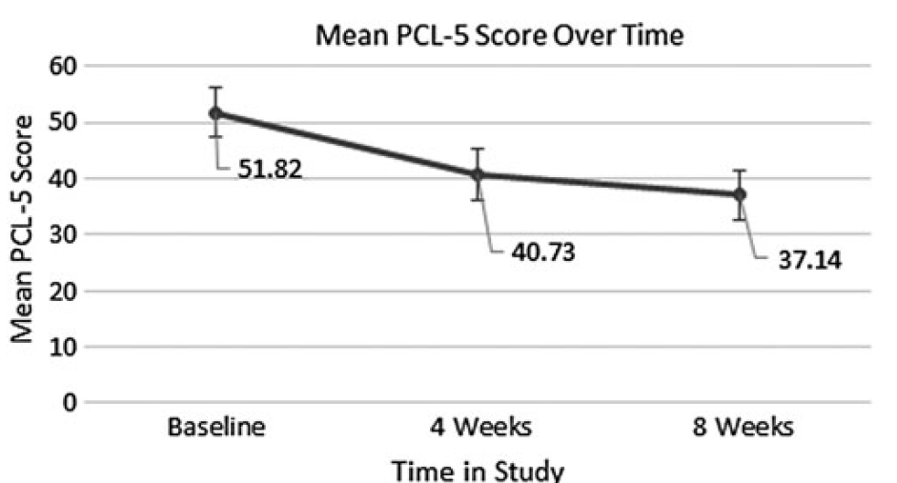
Cannabidiol (CBD) helps with PTSD
From the total sample of 11 patients, 91% (n = 10) experienced a decrease in PTSD symptom severity, as evidenced by a lower PCL-5 score at 8 weeks than at their initial baseline.
The mean total PCL-5 score decreased 28%, from a mean baseline score of 51.82 down to 37.14, after eight consecutive weeks of treatment with CBD.
CBD was generally well tolerated, and no patients discontinued treatment due to side effects. No CV side effects reported.
Elms, L., Shannon, S., Hughes, S., Lewis, N. (2019) The Journal of Alternative and Complementary Medicine; 25: 4. pp. 392-397.

Slide 93
Cannabidiol (CBD) helps with PTSD
BaleDoneen Take Away:
Again – this article supports the use of CBD for patients with PTSD to help reduce symptoms.
It is well published that anxiety and PTSD are root causes of vascular inflammation under the ‘root’ of psychosocial issues
Along with mindfulness and counseling – could CBD a good addition to anxiety and PTSD management in cardiac patients? No studies have been powered to look at CV safety and vascular inflammation.
Always follow patient with inflammatory testing to ensure safety with any and all treatments – including CBD.
Tawakol, A., et., al. Relation between resting amygdalar activity and cardiovascular events: a longitudinal and cohort study. The Lancet. (16)31714-7
Elms, L., Shannon, S., Hughes, S., Lewis, N. (2019) The Journal of Alternative and Complementary Medicine; 25: 4. pp. 392-397.

Slide 94
Resources provided by our BaleDoneen Affiliate member Patti DeMatteis, RDH
Dr. Michelle Weiner about CBD oil
https://www.cinyour.facebook.com/NBC6SouthFlorida/videos/2007146429393431/
https://www.youtube.com/watch?v=dxDONO8B4LY
Calm Effects , Pure Kentucky CBD, 750 Mg, 1 oz (30 ml) bottle
https://gencanna.com/

Slide 95
We are one week away from our annual BaleDoneen Reunion!

Slide 96
Thank you all for your time this evening – here is a summary of our discussion
Coffee and Atrial Fibrillation
Midlife HTN and cognition impairment in later life
Review of the SPRINT-MIND
The Polypill – a cost effective analysis
E-Cigarettes
Smoking Cessation and health benefits
GETTING IN THE WEEDS -
Marijuana & CVD – a systemic review
Cannabis Use in Patients with CVD
Cannabinoid and THC – understanding the difference
CBD oil – what is it exactly?
CBD related to Anxiety and Sleep
CBD related to PTSD
Resources to learn more.
Reminder about the reunion! Can’t wait!

